Slide 1
FINANCE
PRESENTED BY
Jim Purgerson, CCIM – Citizens Bank & Trust
Jamie Taylor – Assurance Financial

Slide 2
FINANCE COMMITTEE MEMBERS
Jim Purgerson, CCIM
Trends Speaker
Citizens Bank & Trust
Jamie Taylor
Trends Speaker
Assurance Financial
Brian S. Andrews, CMB
TRENDS Magazine Research
The Real Estate Research Institute
At LSU’s E. J. Ourso College of Business
Holly Hidalgo-DeKeyzer
Investar Bank
C. Brett Blanchard
Bancorp South
Claiborne Duval
South Louisiana Bank
T. Jefferson Fair
American Planning Corporation

Slide 3
TEAM FINANCE
Home mortgage rates
Survey of Local Bankers
Appetite for loans based on property type
Interest rate trends by certain property types (and owner occupied / non-owner occupied)
Amortizations and down payment requirements
Debt Service Coverage requirements
PPP Loans
COVID Loan Deferrals
Residential Mortgage Trends
How do you make your buyer’s offer stand out in this seller’s market?
Underwriting challenges due to Covid
(jumbo loans, self-employed borrowers)
Fannie Mae’s 7% limit on 2nd homes and investment properties

Slide 4
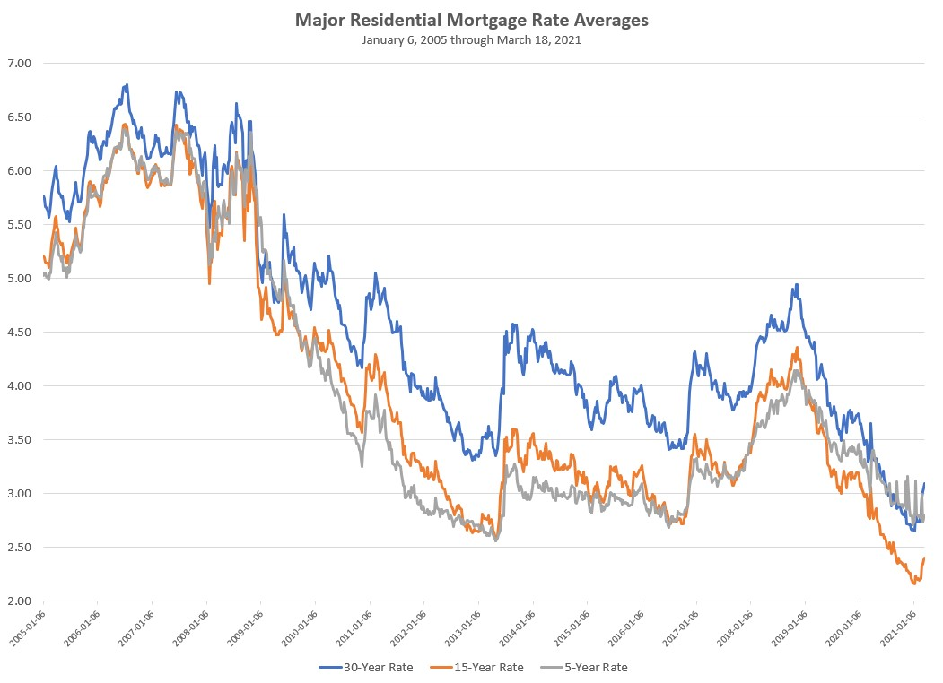
2008
2019
2013
2021
SOURCE: BLOOMBERG MARKETS

Slide 5
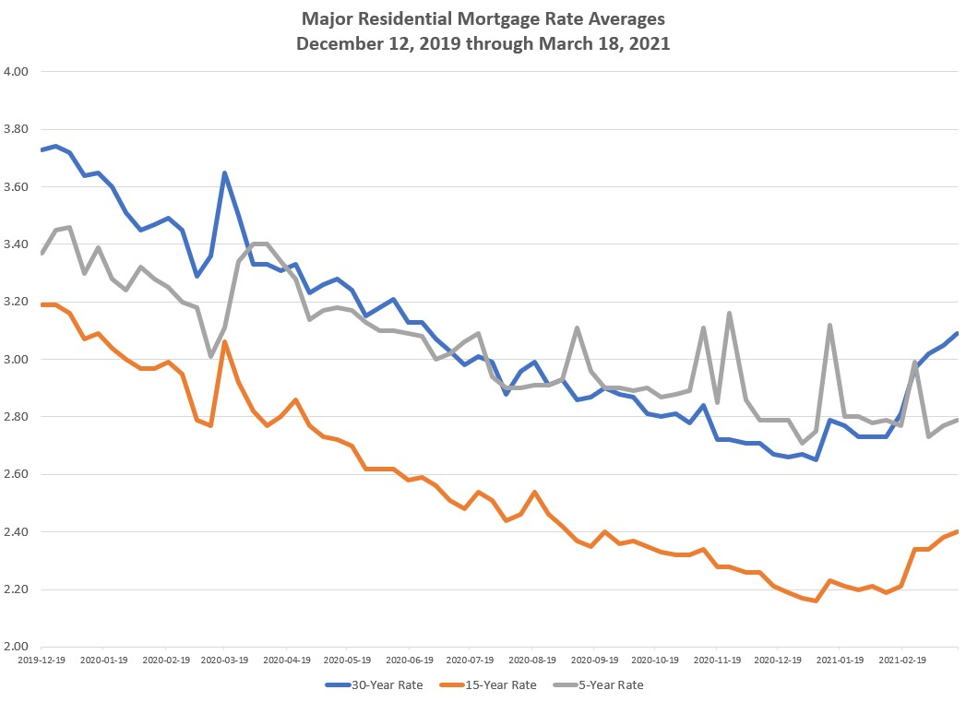
December
2019
March
2020
February
2021
SOURCE: BLOOMBERG MARKETS

Slide 6
BANKER SURVEY
Survey of Local Financial Institutions
Rates
Bank of St Francisville | Carter Leak
BancorpSouth | Brett Blanchard
Bank of Zachary | Josh Prejean
BankPlus | Andy Adler
B1 Bank | Mike Nizzo
Campus Federal | Jay Noel
Citizens Bank | Jim Purgerson
Concordia Bank | Scott Singletary
Essential FCU | Rick Williams
First Bank and Trust | Dennis Shill
Guaranty Bank | Wade O'Neal
Gulf Coast Bank & Trust | Gary Littlefield
HancockWhitney | Jerry Denicola
Home Bank | Chris Harrell
Investar Bank | Holly Hidalgo
Plaquemine Bank & Trust | Janet Campo
Red River Bank | David Thompson
Resource Bank | Kirk Maynard
South Louisiana Bank | Claiborne Duval
The Cottonport Bank | Keith Miller
The First | Kevin Schexnayder
Amortizations
Cash Requirements
Appetite for
Property Types
PPP Loans
Loan Payment Deferrals

Slide 8
Fixed Interest Rates – average interest rates offered on the following loan types
(assuming moderate to high credit quality)
Owner Occupied - Five (5) Year fixed
3.87%
Owner Occupied - Seven (7) Year fixed
4.13%
Owner Occupied - Ten (10) Year fixed
4.34%
Non-Owner Occupied - Five (5) Year Fixed
4.40%
Non-Owner Occupied - Seven (7) Year Fixed
4.69%
Non-Owner Occupied - Ten (10) Year Fixed
One Bank 4.25% Two Banks > 5.25%

Slide 9
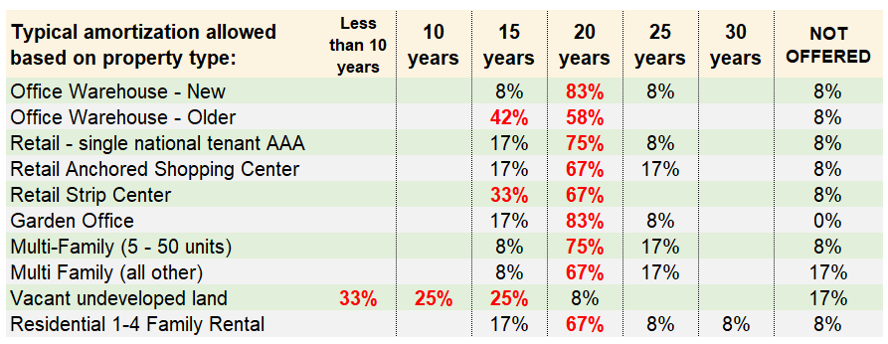
AMORTIZATIONS
Typical amortization offered based on property type

Slide 10
DEBT COVERAGE RATIOS
Minimum Debt Service Coverage Ratio
Commercial Investment Property (includes multi-family residential)
1.25 (69% of respondents)
1.29 (average of all)
Residential Investment Property
1.25 (92% of respondents)

Slide 11
A BANKERS LIFE IN 2020
Paycheck Protection Loans
3,879 PPP Loans to
Baton Rouge Area Businesses
$484,491,000 loan volume
COVID Loan Deferrals
78% of banks offered deferrals

Slide 12
Hot Topics for Bank Regulators
Global cashflow
Construction & land development Speculative deals get a closer look
Cash flow and stress level due to effects of pandemic on specific industries.
Cost overruns on construction
Portfolio concentrations

Slide 13
Residential Mortgage Trends
Jamie Taylor, Assurance Financial

Slide 14
How do you make your buyer’s offer stand out in this seller’s market?
Preapproval with a local, reputable mortgage lender
Solid preapproval
Very specific letter
Lender reviews
Reduce concessions needed
Lender credit via rate
Property Inspection Waivers
20% down payment, Waive appraisal contingency

Slide 15
Underwriting challenges due to Covid
Jumbo loans
Not purchased by Fannie and Freddie; few outlets for these loans
Economic uncertainty has increased risk for jumbo loan investors
Mainly self-employed borrowers
Self-employed borrowers
2019 and possibly 2018 Tax Returns – Personal and Business
2020 Profit & Loss (if not filed 2020 return)
2021 YTD Profit & Loss
Most recent 3 months business bank statements
Forbearance
Additional underwriting requirements
Could increase inventory when moratorium ends on June 30th

Slide 16
Fannie Mae’s 7% limit on 2nd homes and investment properties
Why?
Encourage homeownership
Focus portfolio on primary residences
Traditionally equals around 15% of Fannie & Freddie portfolio
What could this mean?
Uncertainty
Tighter underwriting requirements
Higher interest rate/cost
Private investors

Slide 17
Jamie Taylor
Assurance Financial
jtaylor@assurancemortgage.com
225-921-4003
-

Slide 18
THANK YOU

