Slide 1
BATON ROUGE
INDUSTRIAL MARKET
PRESENTED BY
Ryan Greene, CCIM, SIOR
NAI Latter and Blum

Slide 2
INDUSTRIAL COMMITTEE MEMBERS
Ryan Greene, CCIM, SIOR
NAI Latter & Blum
Evan Scroggs, CCIM
NAI Latter & Blum
Scot Guidry, CCIM
Mike Falgoust & Associates
Todd Pevey, MPA
St. John Properties
Brent Garrett, CCIM, SIOR
Beau Box Commercial Real Estate
David Lakvold, MAI, SRA
The Lakvold Group
Dex Shill
NAI Latter & Blum

Slide 3
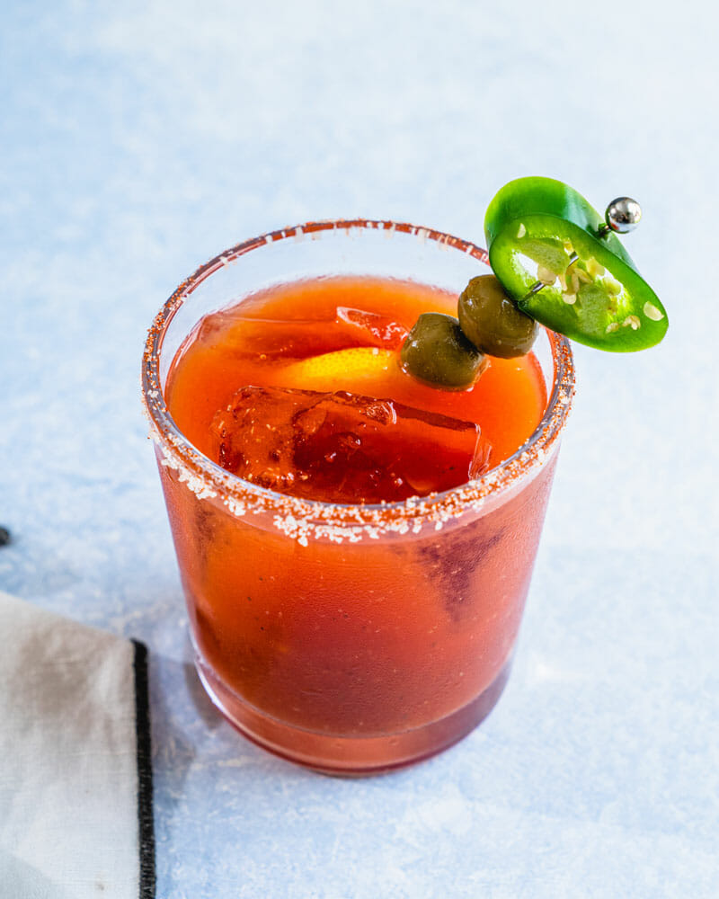
2020

Slide 4
2021 Report
Industrial’s New Look
Renewables’ Impact
Trends and Outlook

Slide 5
Industrial is Sexy?
Pre-Covid
Post-Covid

Slide 6
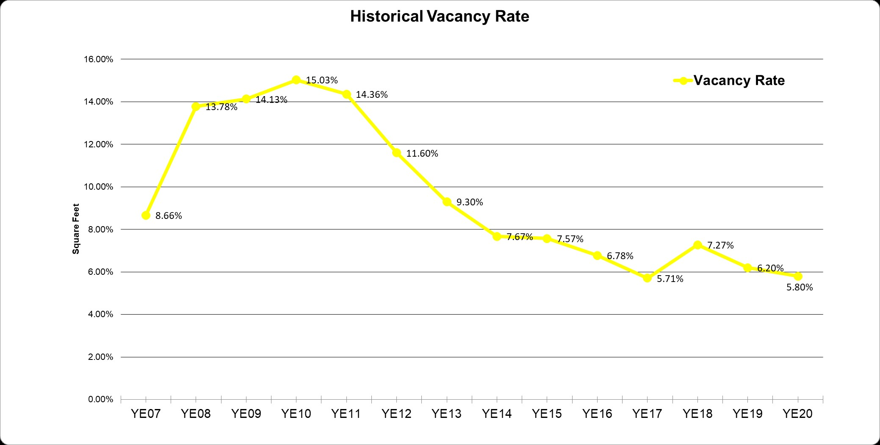
Low Vacancy = Landlord Friendly
Low Vacancy = Landlord Friendly Market

Slide 7
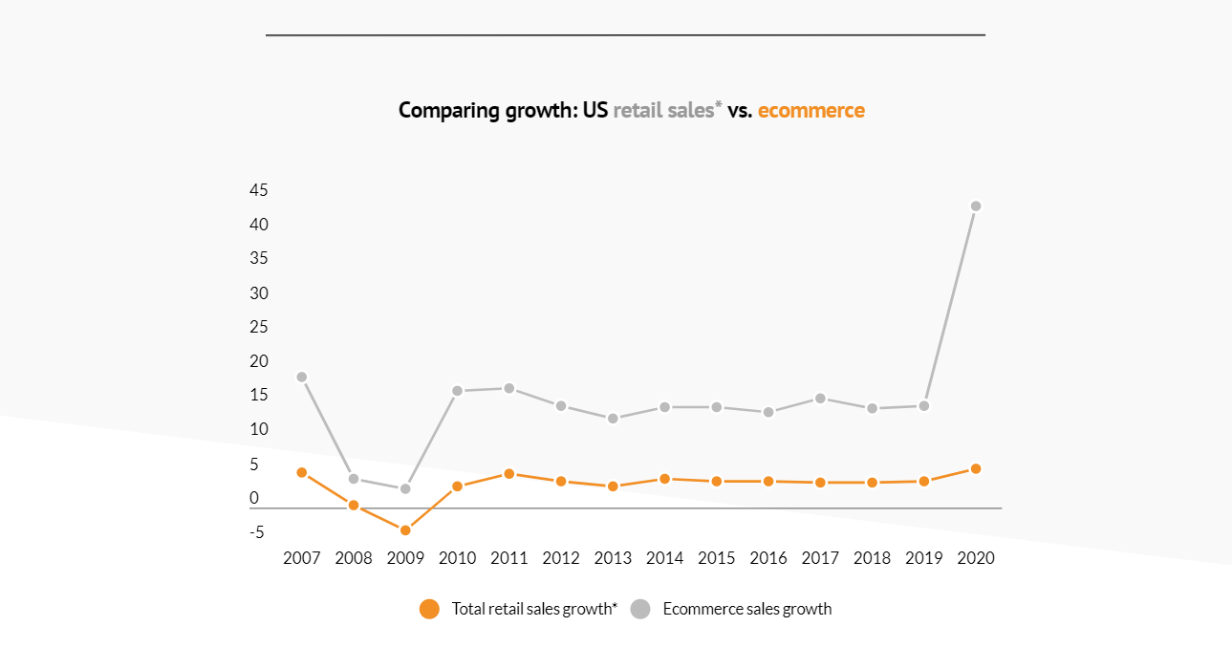

Slide 8
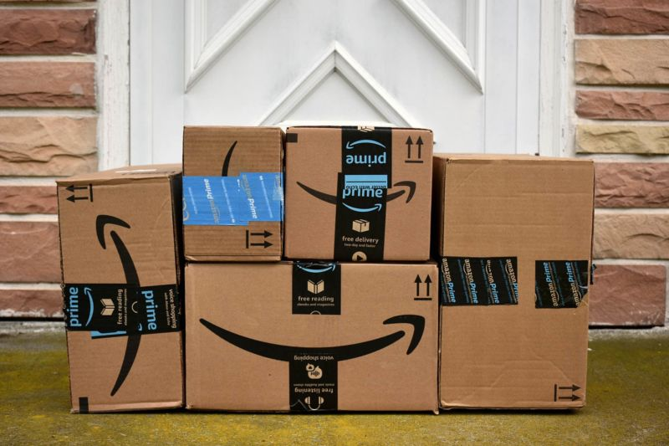

Slide 9
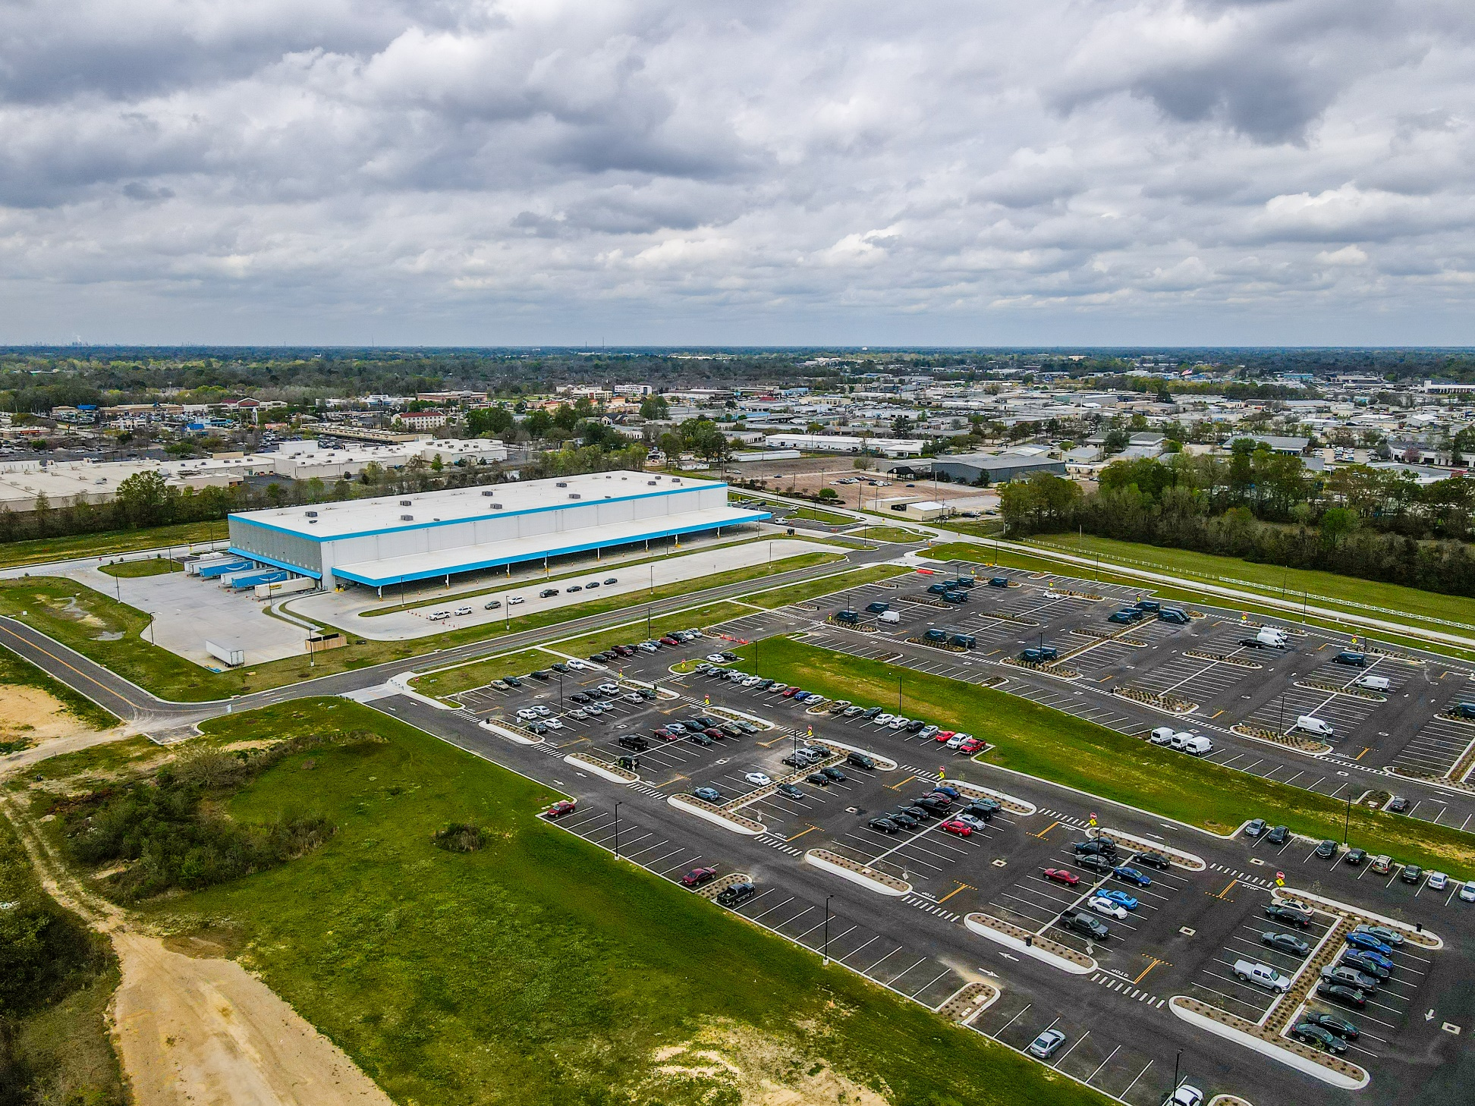
Siegen Lane Amazon Fulfillment Center

Slide 10
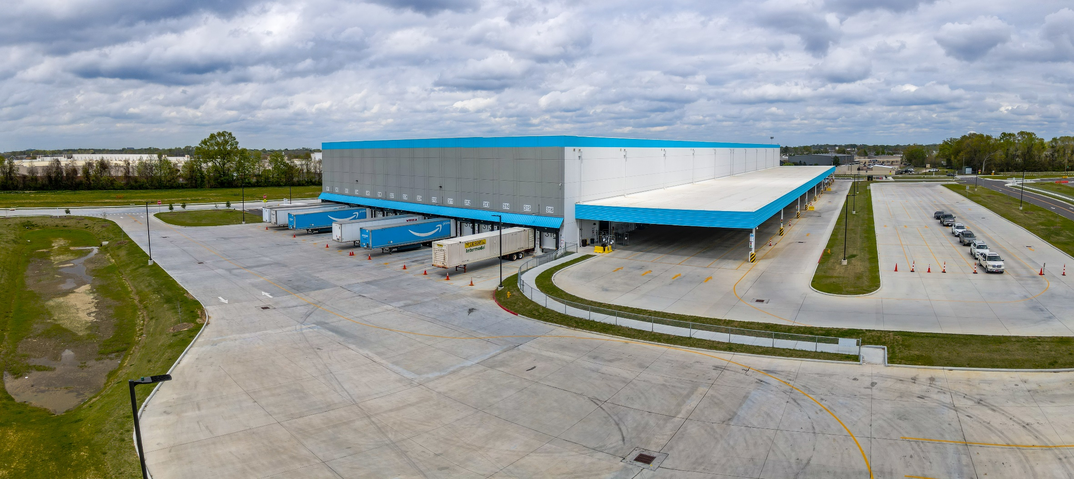
Siegen Lane Amazon Fulfillment Center

Slide 11
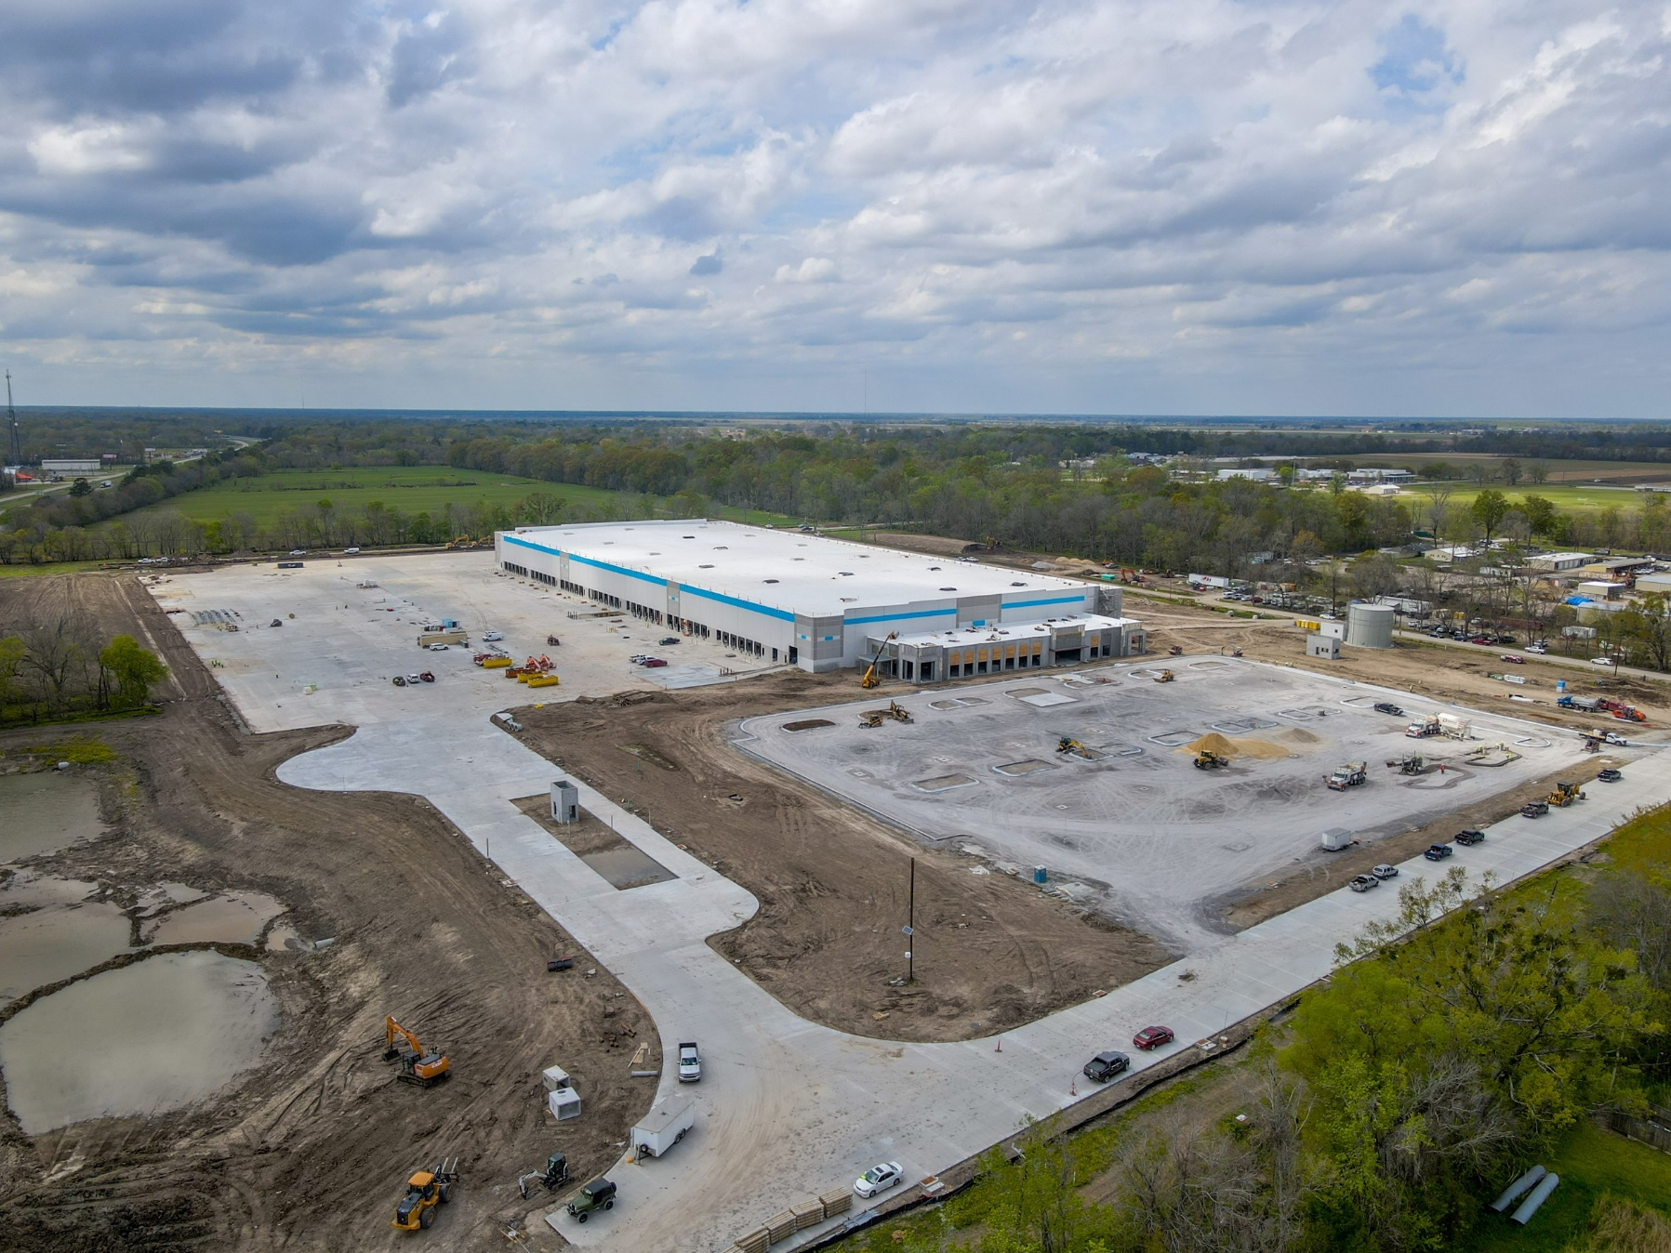
West Baton Rouge Distribution Center

Slide 12
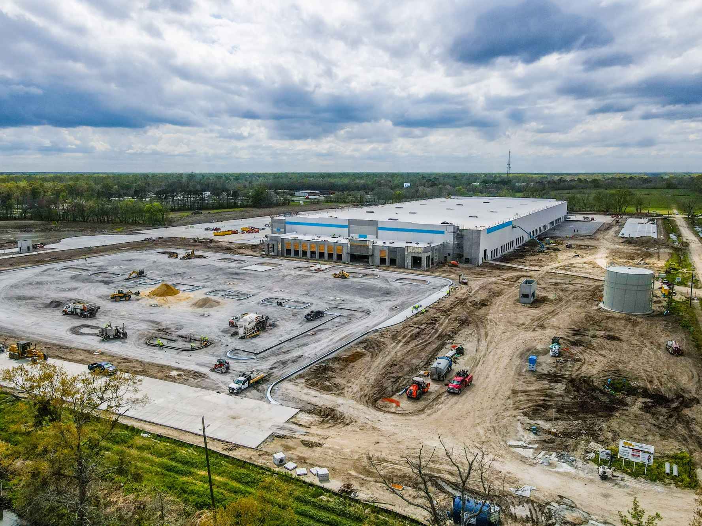
West Baton Rouge Distribution Center

Slide 13
Pre-Covid
Post-Covid

Slide 14
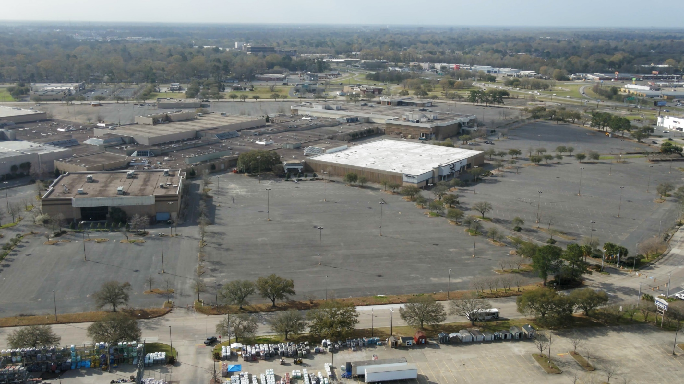
Cortana Mall

Slide 15
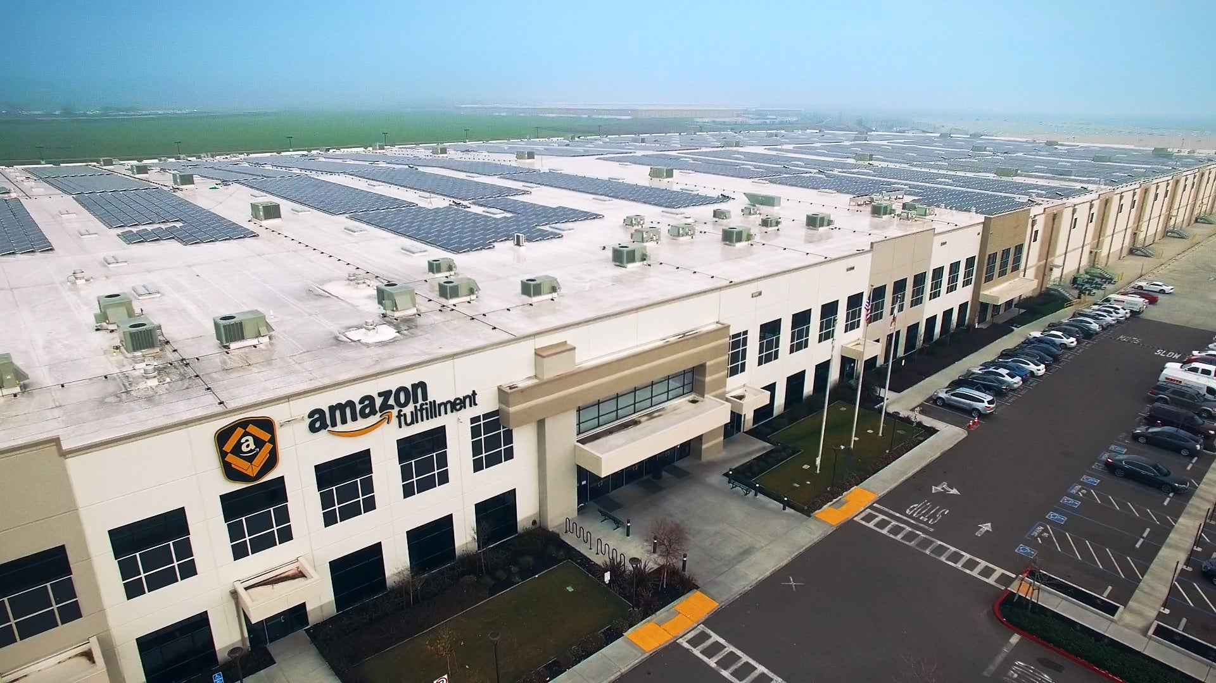
New Cortana Mall

Slide 16
Transportation Hub
Rail
Interstate
Port

Slide 17
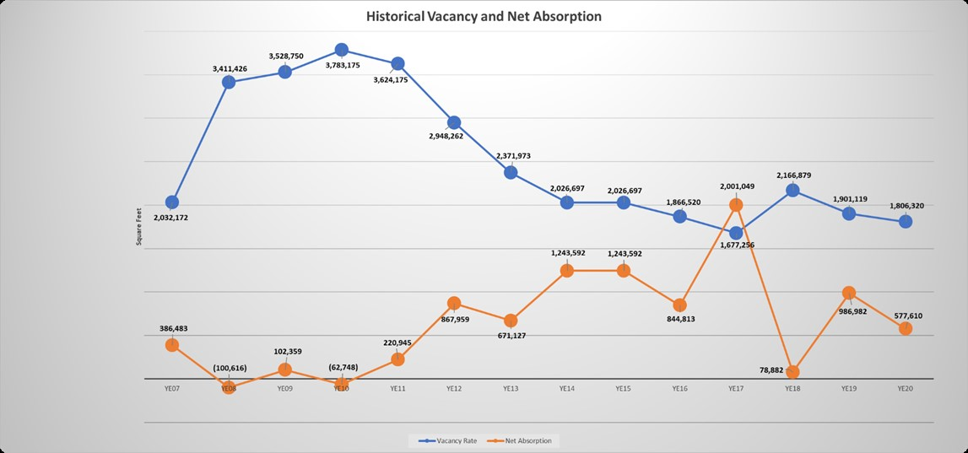
High Absorption

Slide 18
Will Distribution/3PL Replace Petro-Chemical in Baton Rouge as a the major player?

Slide 19
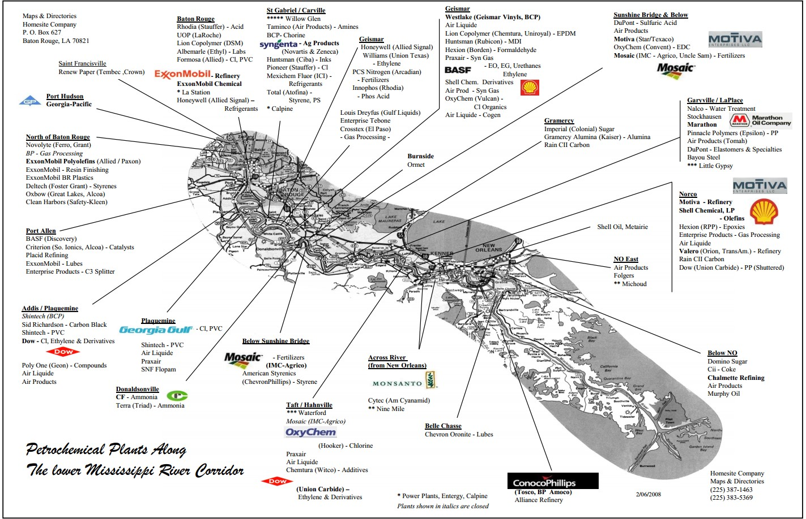

Slide 20
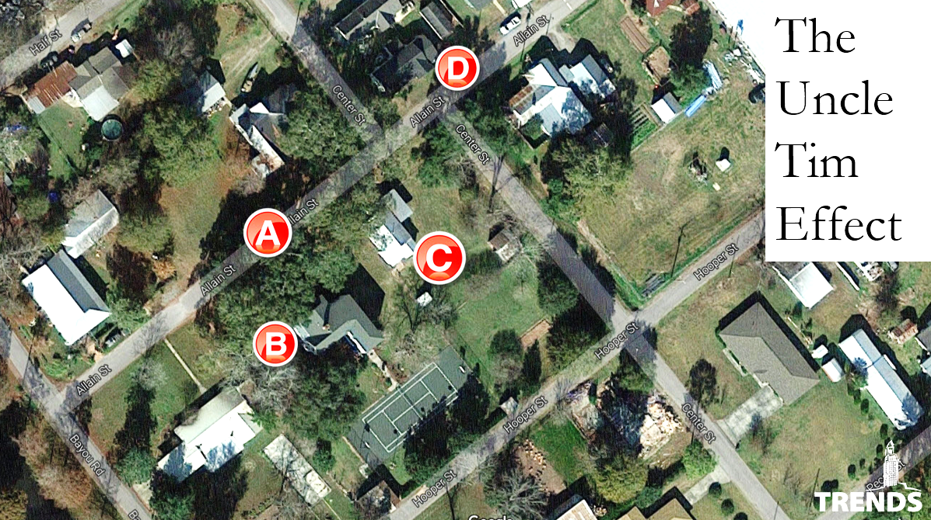
Uncle Tim has more money than me!

Slide 21
Renewables

Slide 23
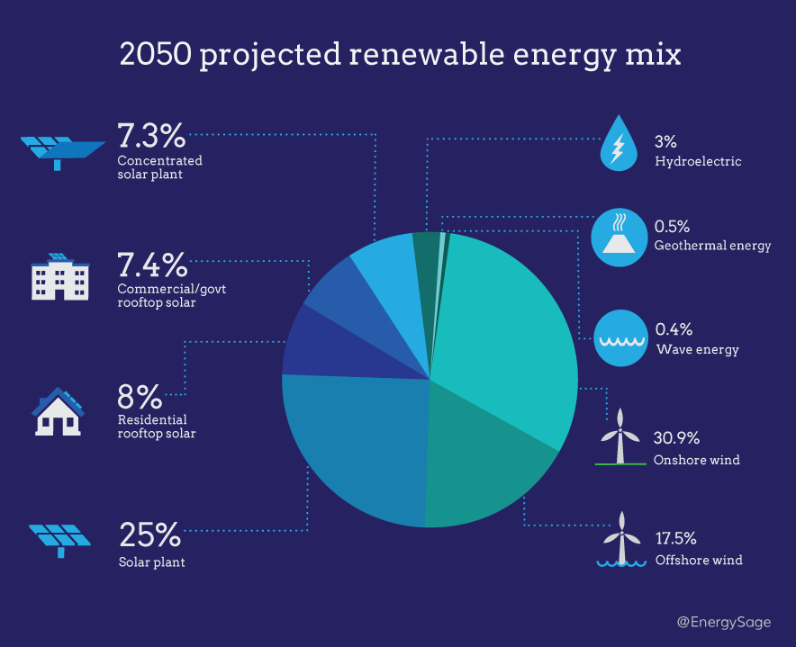

Slide 24
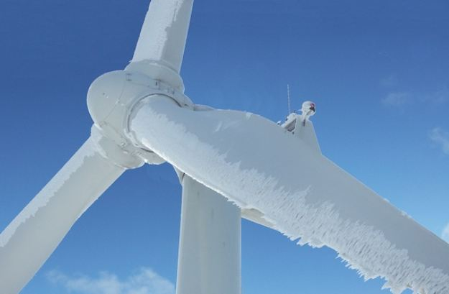

Slide 25
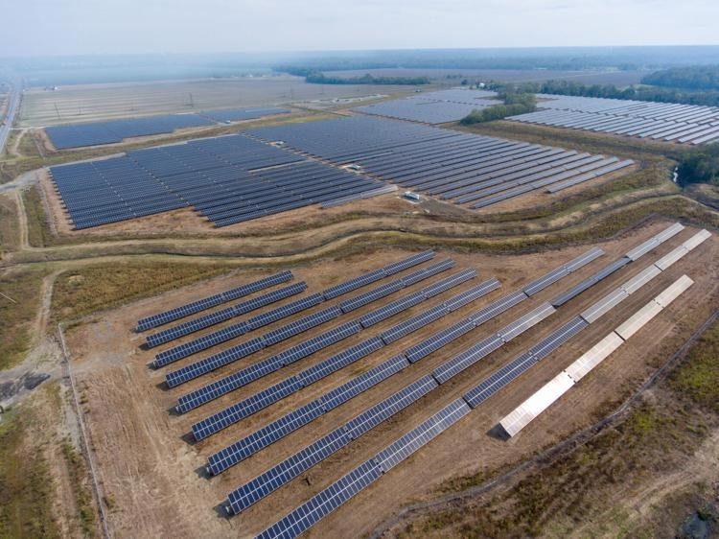
West Baton Rouge Solar Farm

Slide 27
What to watch for:
3PL Growth and Fast Followers to Amazon
National Political Policies and Local Impact
State Political Race and Industrial Impact
Local Increased Rental Rates
Increased Supply to meet demand

Slide 28
THANK YOU

