Slide 1
BATON ROUGE
OFFICE MARKET
PRESENTED BY
Ty Gose, CCIM, SIOR
NAI Latter and Blum, Inc.

Slide 2
OFFICE COMMITTEE MEMBERS
Ty Gose, CCIM, SIOR
NAI Latter & Blum
Jonann Stutzman
NAI Latter & Blum
Gary Black
Wampold Companies
Michael Cashio, CCIM
NAI Latter & Blum
Jake Loach
NAI Latter & Blum
George Bonvillain, J.D.
Elifin Realty

Slide 3
2020
Year End Review
Commercial Office Space
Covid-19
A market on pause
Acceleration of an existing problem
Uncertainty for the future of office

Slide 4
BATON ROUGE MSA OFFICE MARKET 2020 4.3 MILLION SQUARE FEET 2.09 MILLION SQUARE FT.
Class B/C
OCCUPIED
VACANT
Class A
Condo A/B
1.64 MILLION SQUARE FT. CONDO

Slide 5
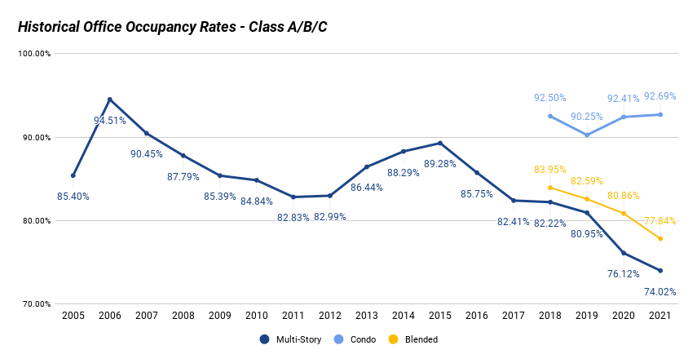

Slide 6
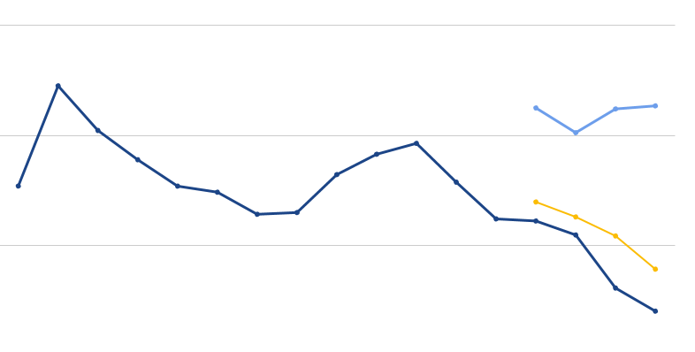
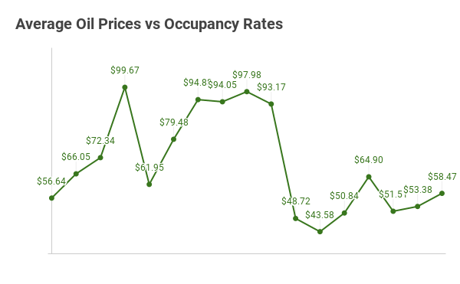
Avg Oil Prices vs Occupancy Rates
2005
2010
2015
2020
SOURCE: https://www.macrotrends.net/1369/crude-oil-price-history-chart

Slide 7
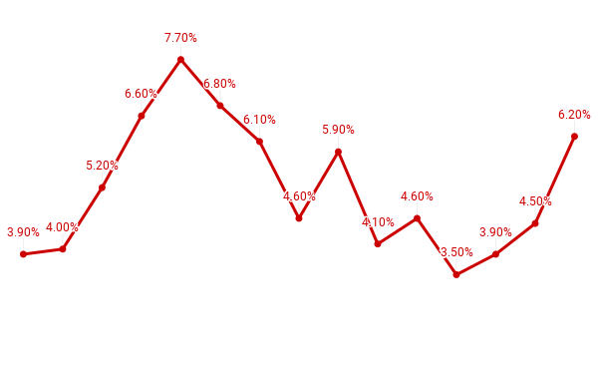
Unemployment vs Occupancy Rates
2005
2010
2015
2020
SOURCE: https://www.bls.gov/eag/eag.la_batonrouge_msa.htm

Slide 8
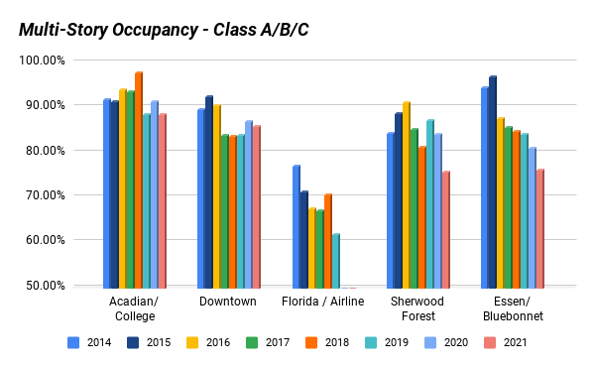
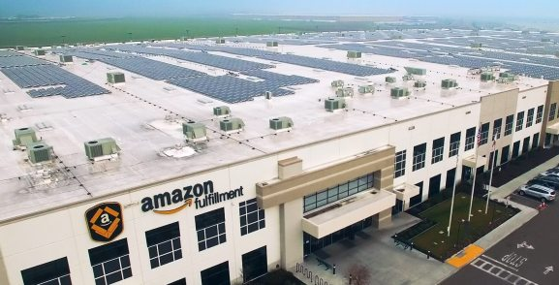

Slide 9
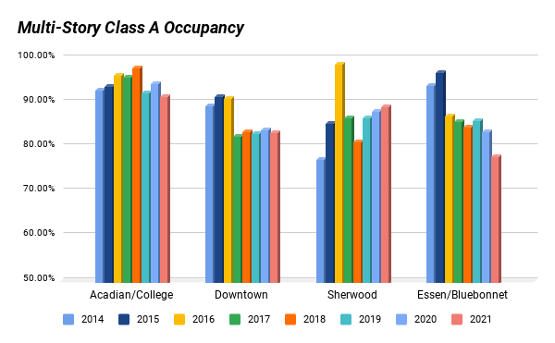

Slide 10
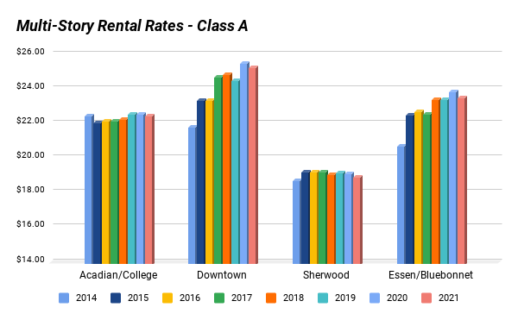

Slide 11
Pulse of the Office Market
What Brokers are Reporting in 2021
Historic Pandemic threw the rulebook out
Multistory office decline accelerated
Few large lease deals – transactions were primarily renewals and downsizes
Acadian/College and Essen/Bluebonnet occupancy dropped
Downtown and Sherwood occupancy remained steady
Almost 1MM SF of Class A office space being marketed when sublease included
A handful of owner-occupant sales in Class B markets
General trend of tenants and buyers looking for value deals
Continued trend towards Garden Office Condos and away from multistory

Slide 12
2020
Notable Sales
Bon Carre

Slide 13
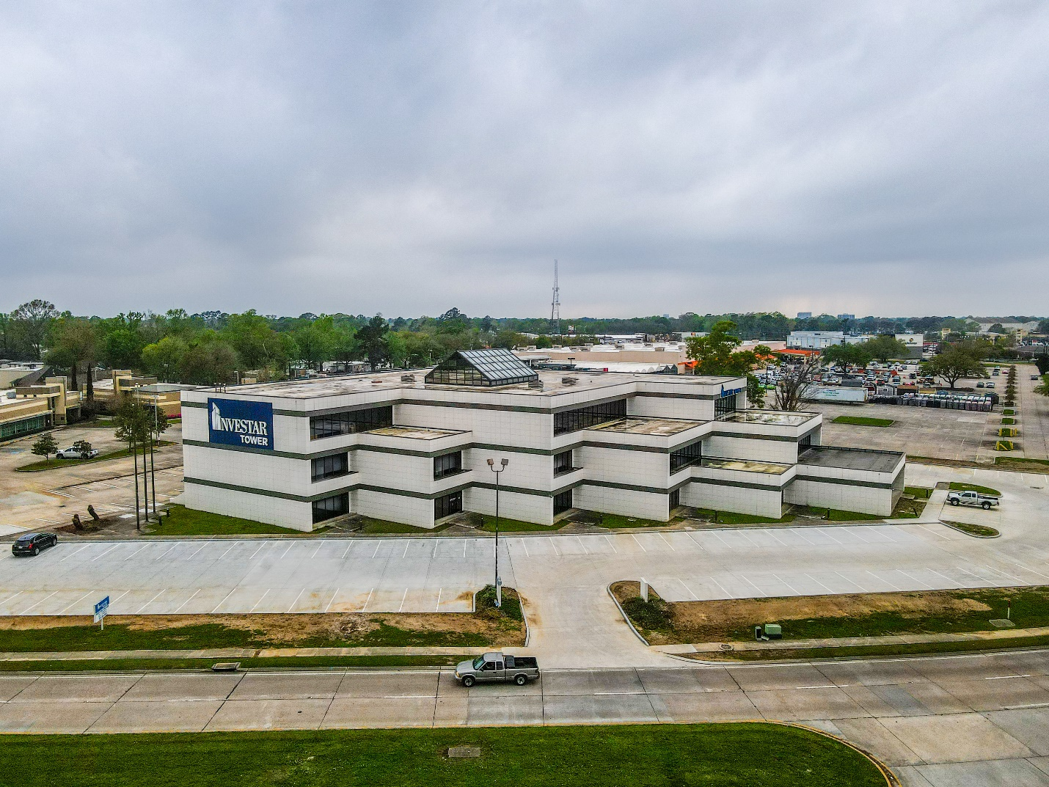
2020
Notable Sales
Investar Tower

Slide 14
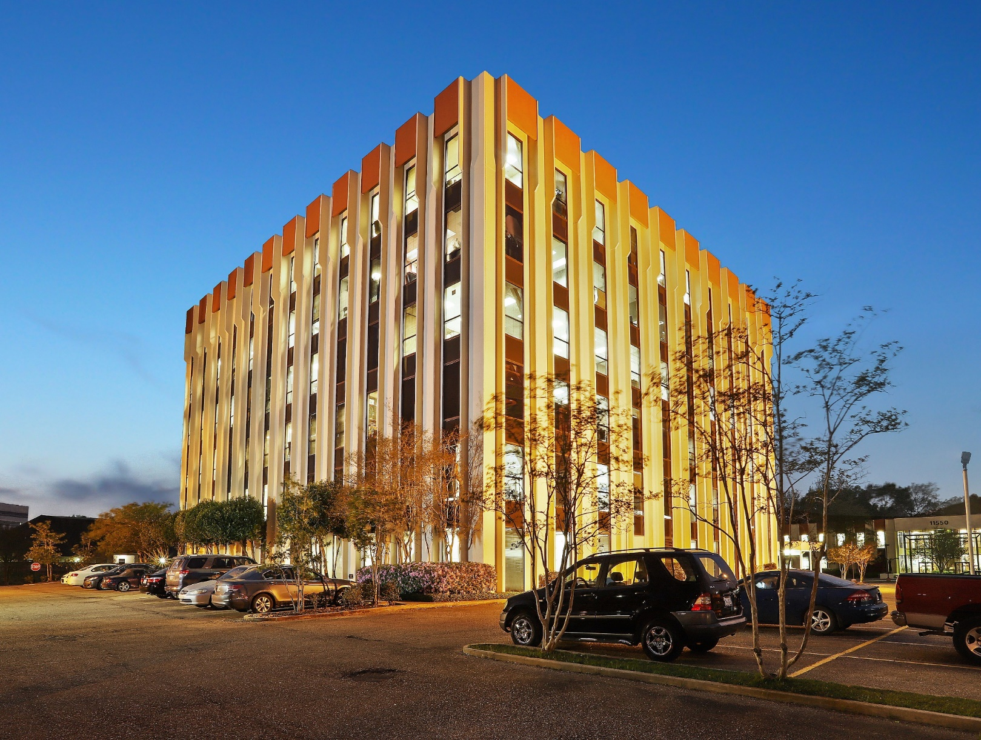
2020
Notable Sales
Sherwood Tower

Slide 15
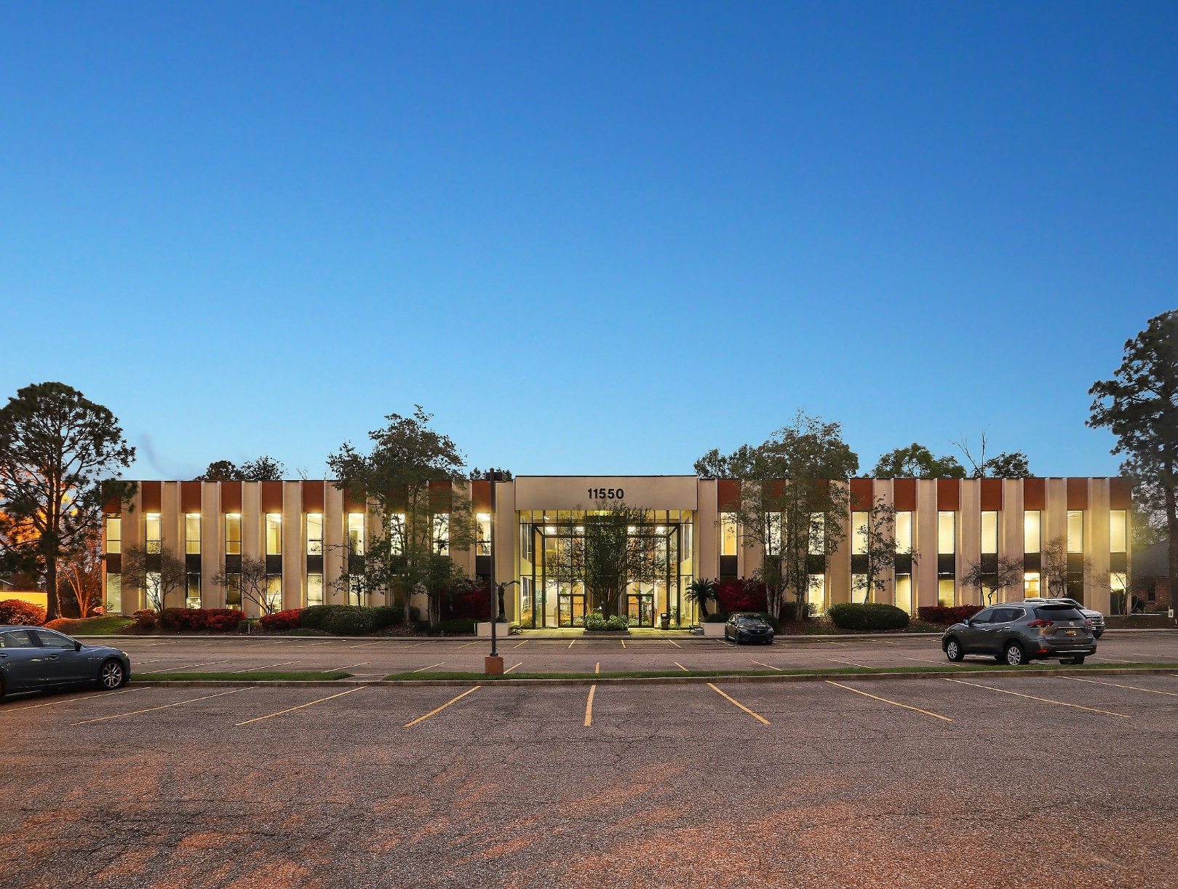
2020
Notable Sales
Sherwood II
(Part of Sherwood Tower Sale)

Slide 16
New Developments
In 2020
Very few new developments this year:
River Mark Centre– formerly Chase South Tower
1200 Brickyard – Water Campus
The Exchange – Office Condos
861 Main St

Slide 17
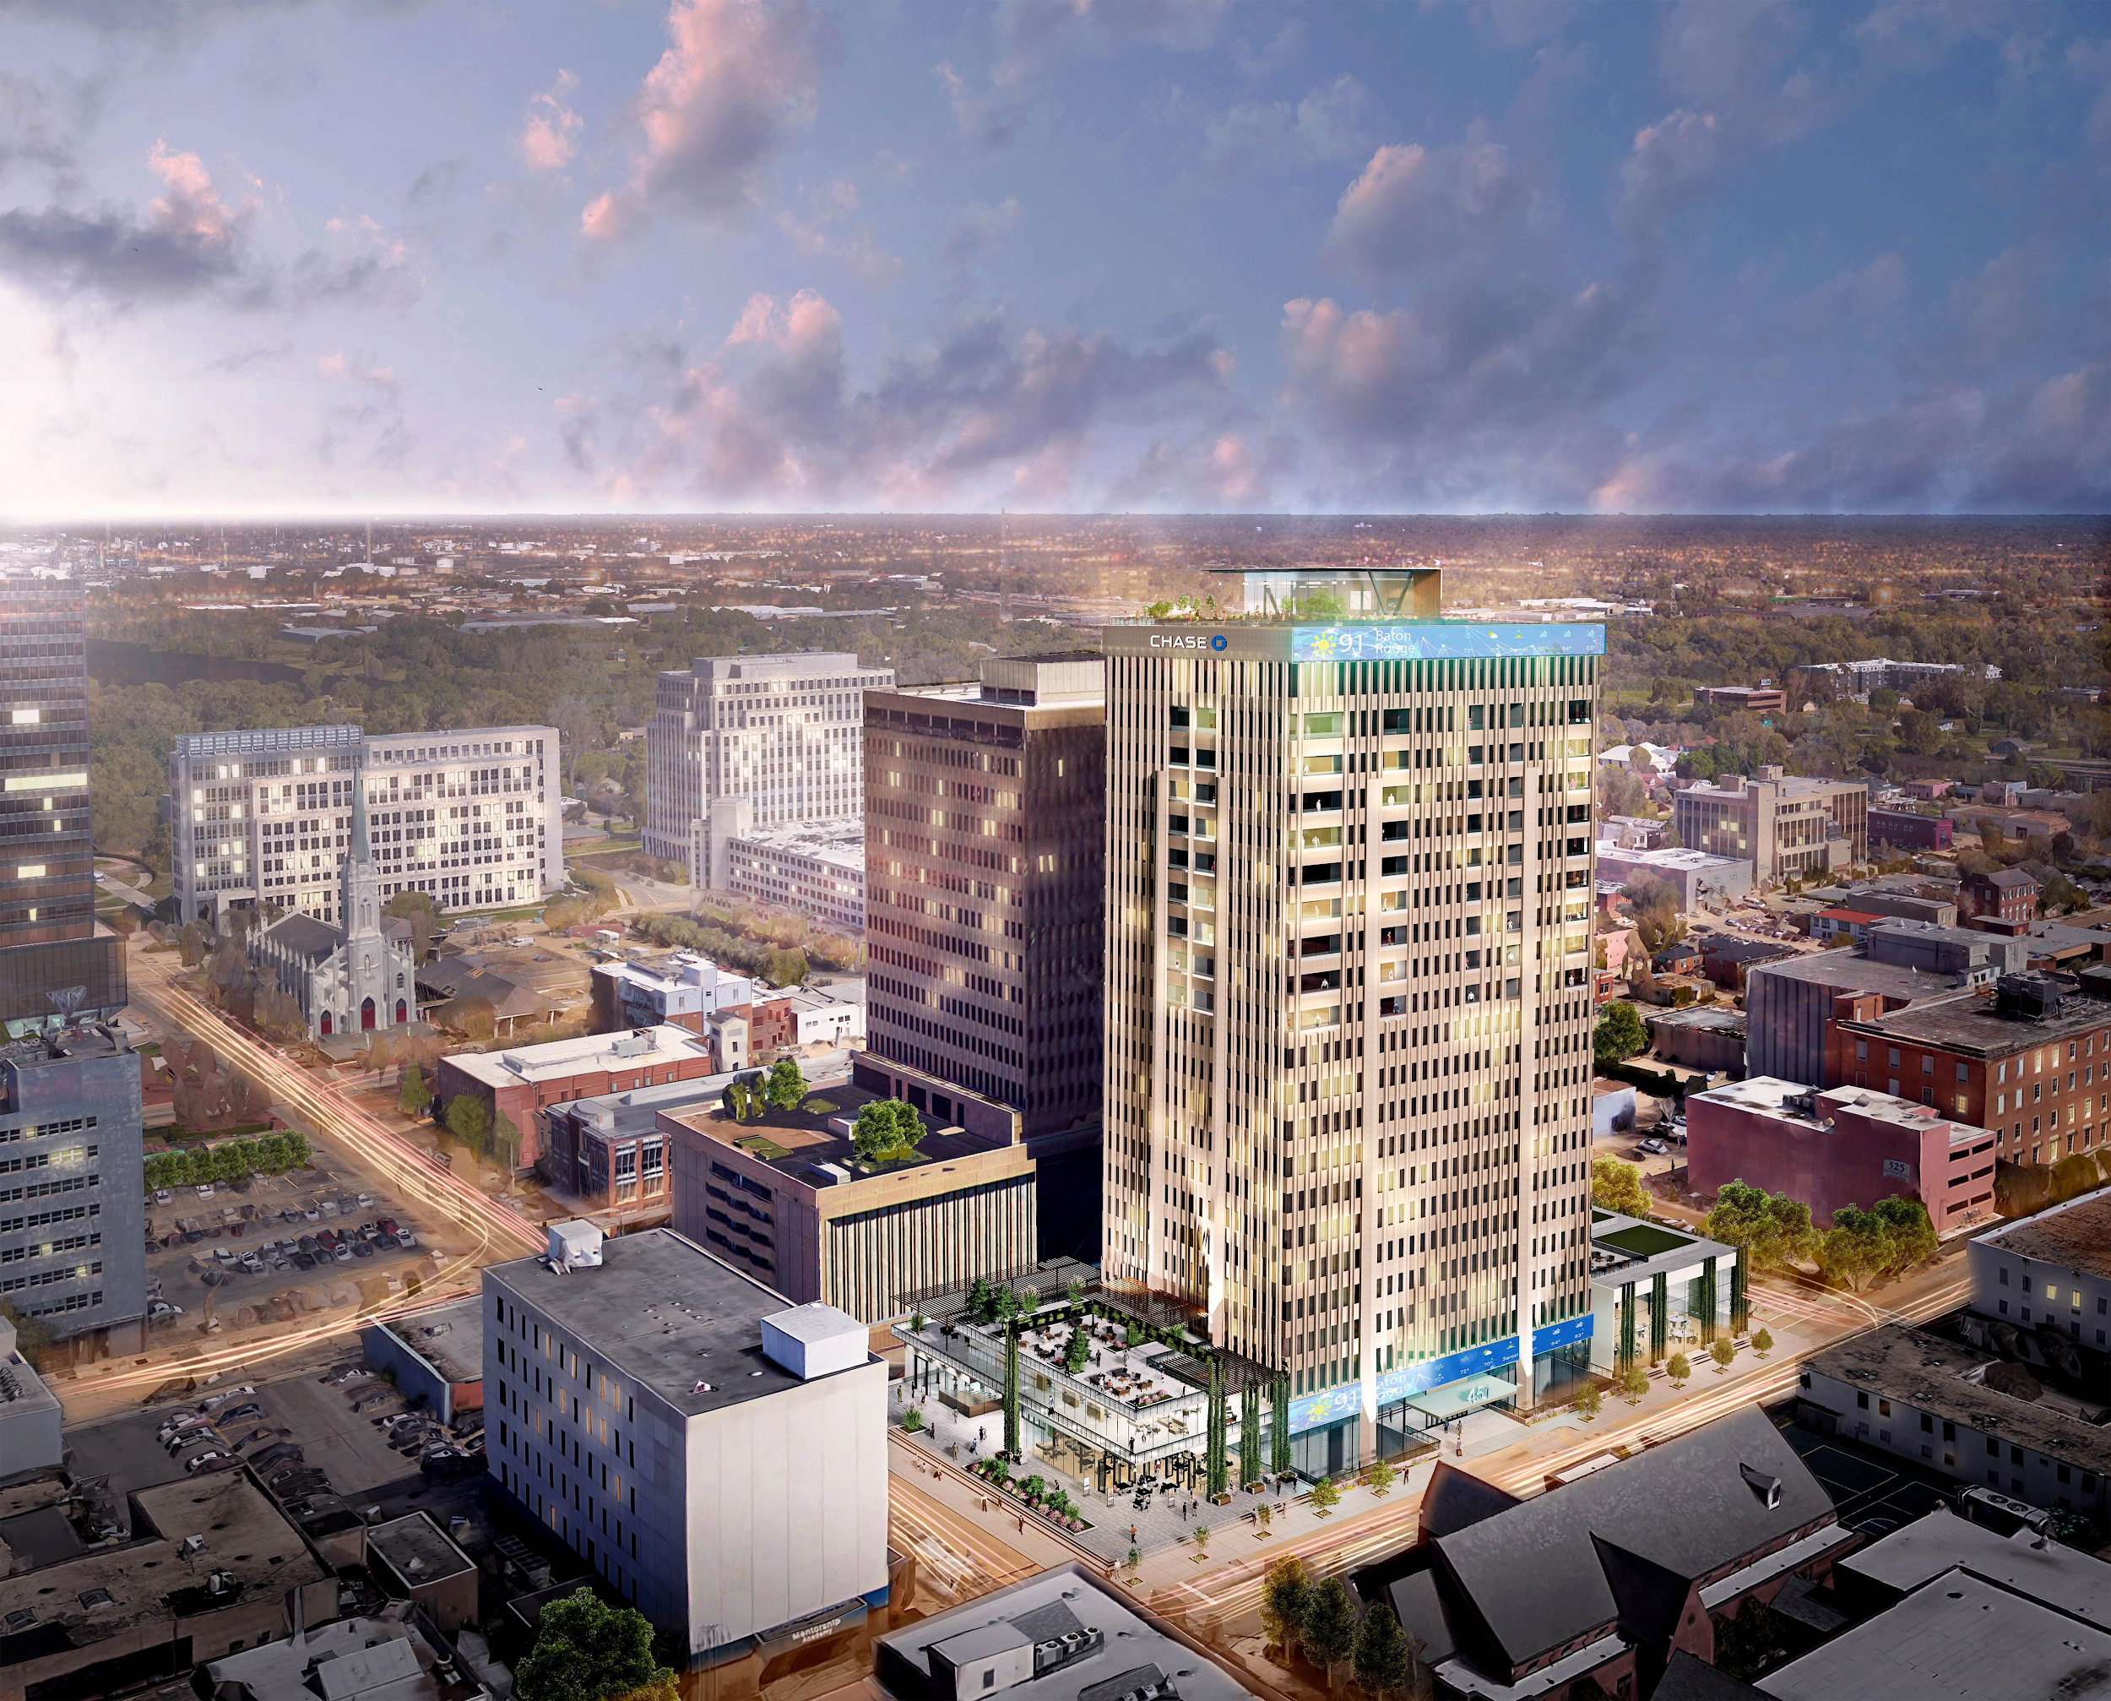
2020
New Development
River Mark
Centre

Slide 18
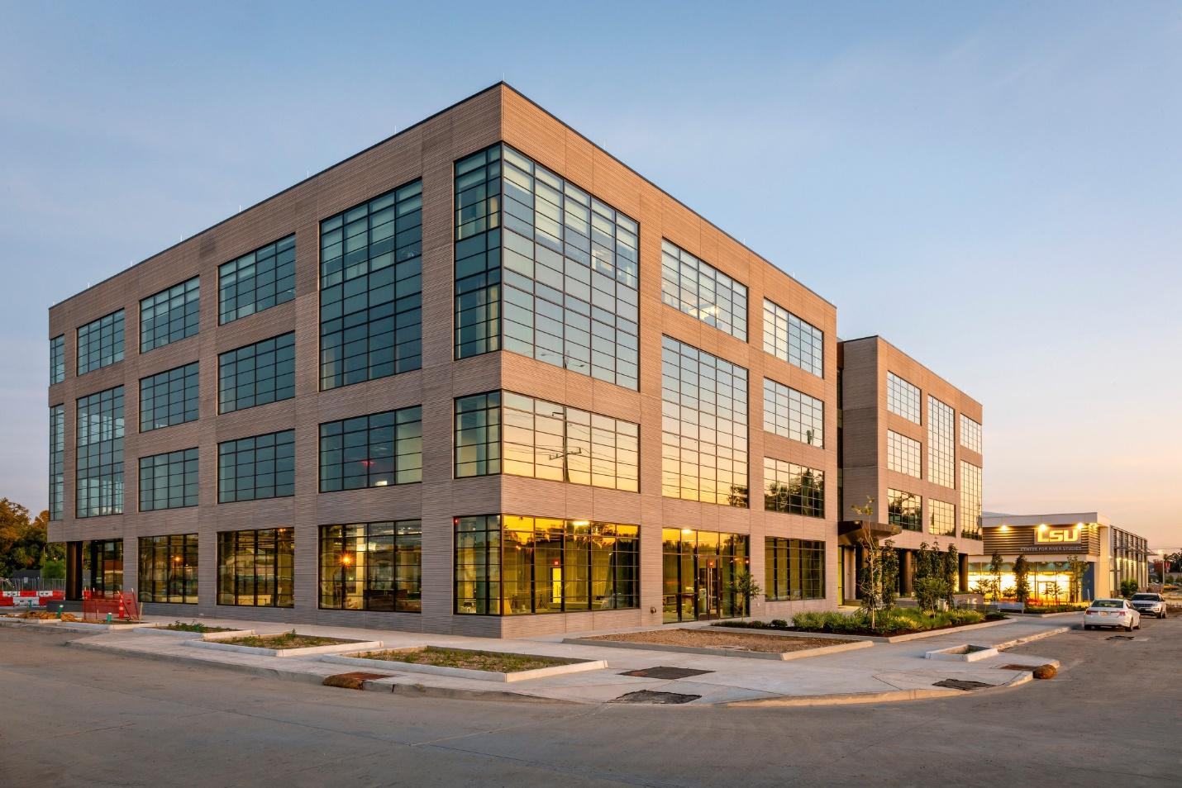
2020
New Development
1200 Brickyard

Slide 19
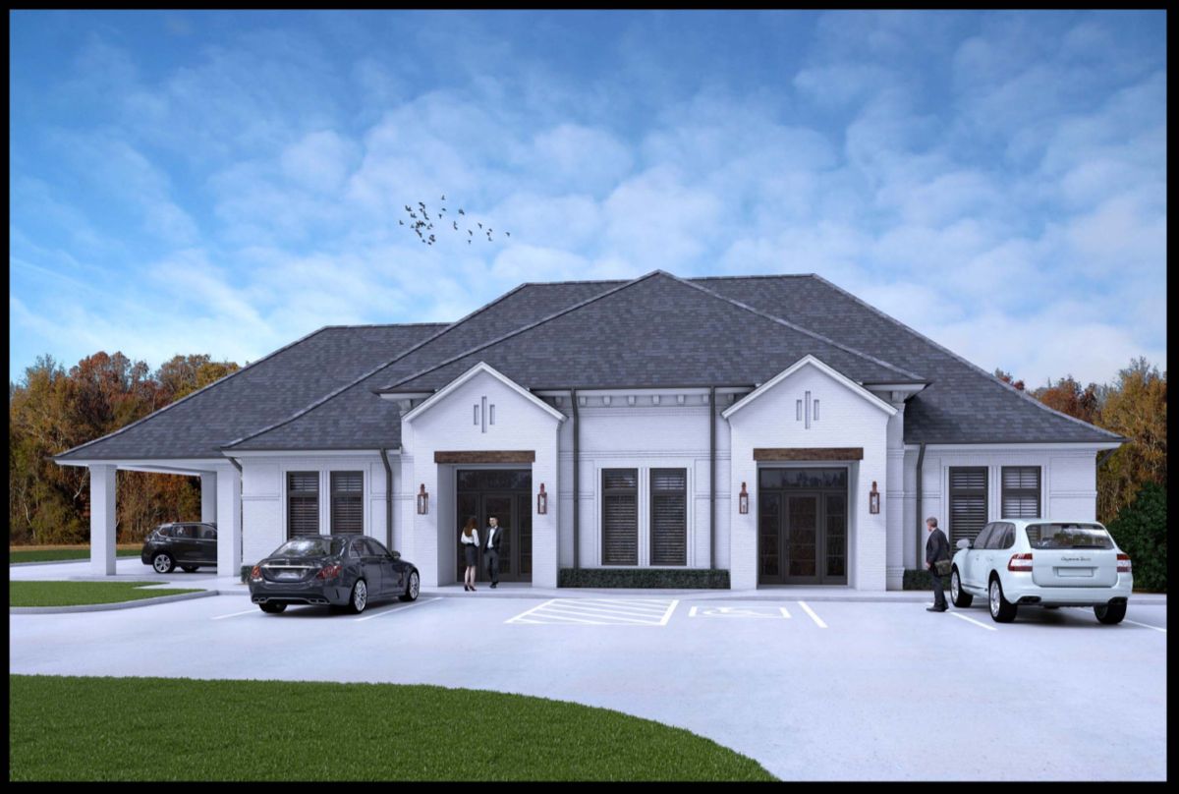
2020
New Development
The Exchange

Slide 20
2020
New Development
861 Main St

Slide 21
Baton Rouge Class A Market
Compared to Other Cities
Baton Rouge, LA – 82.11 % Occupancy at $22.46 / SF Average
Austin, Texas – 82.9% Occupancy at $49.27 / SF Average
Oklahoma City, Oklahoma – 86.4% Occupancy at $22.06 / SF Average
Louisville, Kentucky – 82.1% Occupancy at $20.51 / SF Average
Nashville, Tennessee – 85.7% Occupancy at $33.01 / SF Average
Birmingham, Alabama – 83.2% Occupancy at $22.33/ SF Average

Slide 22
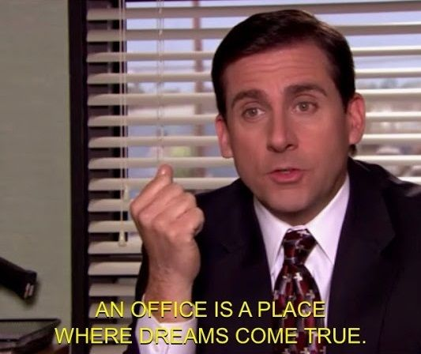
The Future of Office
Commercial Office Space

Slide 23
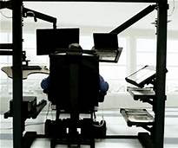
The Future of Office Nationwide
Commercial Office Space
Initially Work from Home was here to stay
Possibility The Home Working Honeymoon is over?
Responses are Industry Specific and Vary
Gen Z is Struggling to Gain Traction
Human Element
Designed for Connection and Comradery
Office Necessary for Competition

Slide 24
The Future of Office Baton Rouge
Commercial Office Space
Our Growth in GDP has been Lopsided
Masking the decrease in office or white collar jobs
Road Map for Growth
Community Schools
Overhaul State Taxes
Improve Livability – Community, Well-Being, Public Investment
Utilize the existing GBTR Industrial Structure
Uniquely Louisiana

Slide 25
THANK YOU

