Slide 1


BATON ROUGE
RETAIL MARKET
PRESENTED BY
Charlie Colvin, CCIM, Momentum Commercial Real Estate

Slide 2


RETAIL COMMITTEE MEMBERS
Charlie Colvin, CCIM
Momentum Commercial Real Estate
Jonathan Walker, CCIM
Maestri Murrell, Inc.
Dottie Tarleton, CCIM
Stirling Properties
Clay Furr
Momentum Commercial Real Estate
Colin Smith
Kurz & Hebert Commercial Real Estate
Andrew D’Ostilio
NAI Latter & Blum
Matthew Shirley, CCIM
Saurage Rotenberg Commercial Real Estate
Ransom Pipes, CCIM
Maestri Murrell, Inc.
Ben Graham, CCIM
Stirling Properties
Will Chadwick, MBA
Elifin Realty
Drew Whitaker
Cook Moore Davenport & Associates
Andrew Kimble
Beau Box Commercial Real Estate

Slide 3

COVID 19
IMPACT

Slide 4
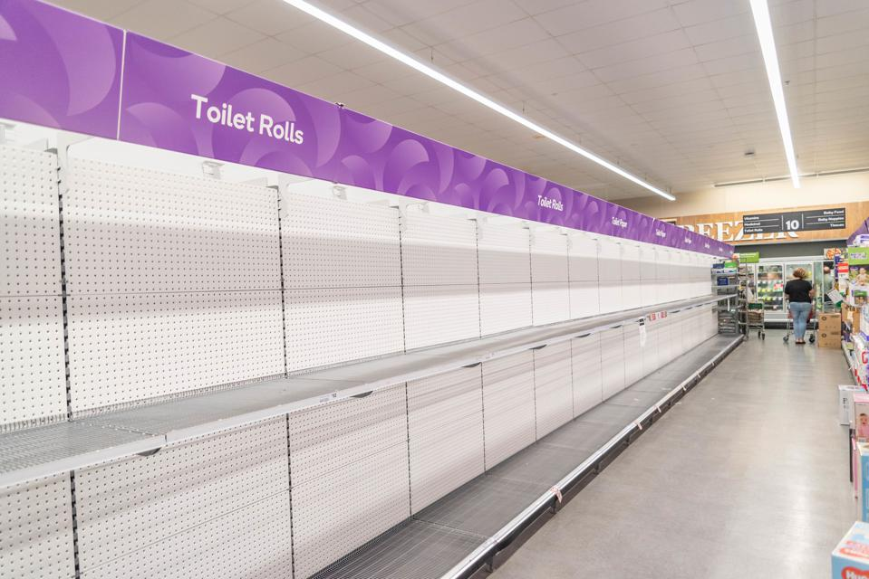
COVID 19
IMPACT

Slide 5

2021 Shopping Center Survey
2020 2021
Total Area Surveyed: 8,403,893 SF 8,382,526 SF
Number of Centers: 121 120
Average Rent: $19.60 PSF $19.78 PSF
Area Vacancy Rate: 9.00% 10.50%

Slide 6
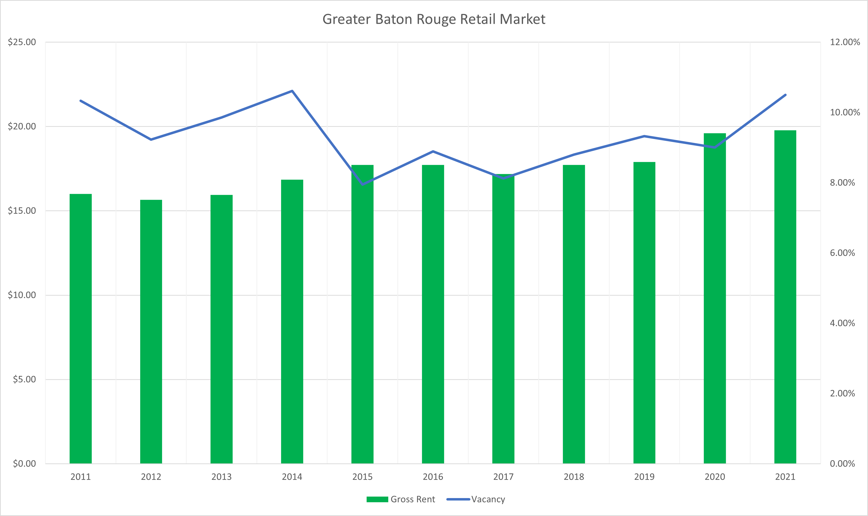

Gross Rents & Vacancy Rates

Slide 7

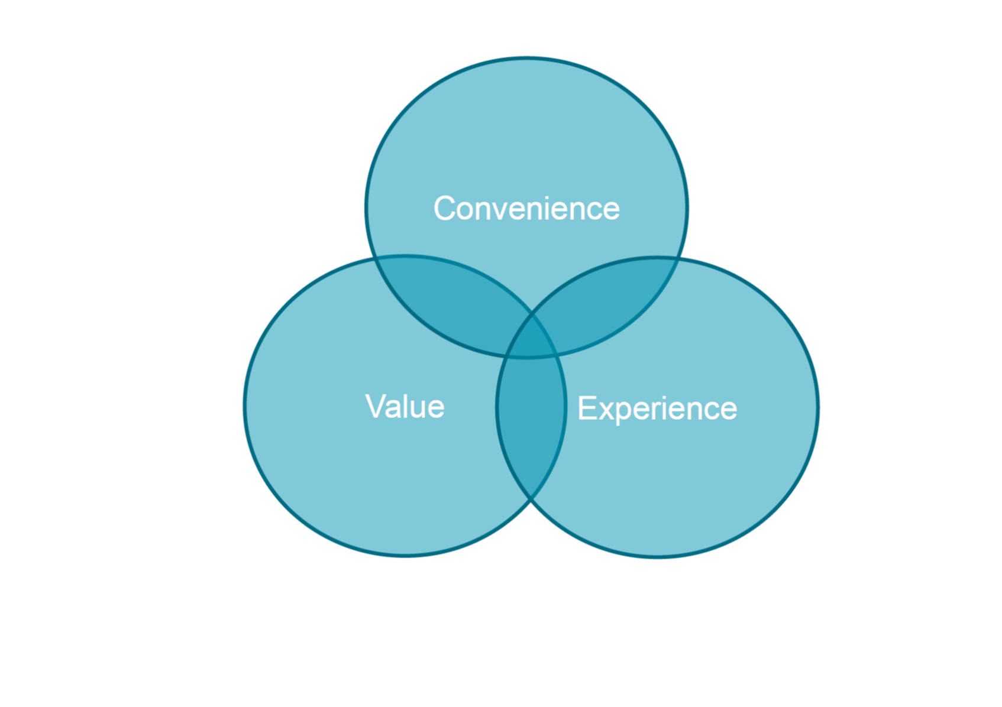
Driving Force Behind Brick & Motor

Slide 8
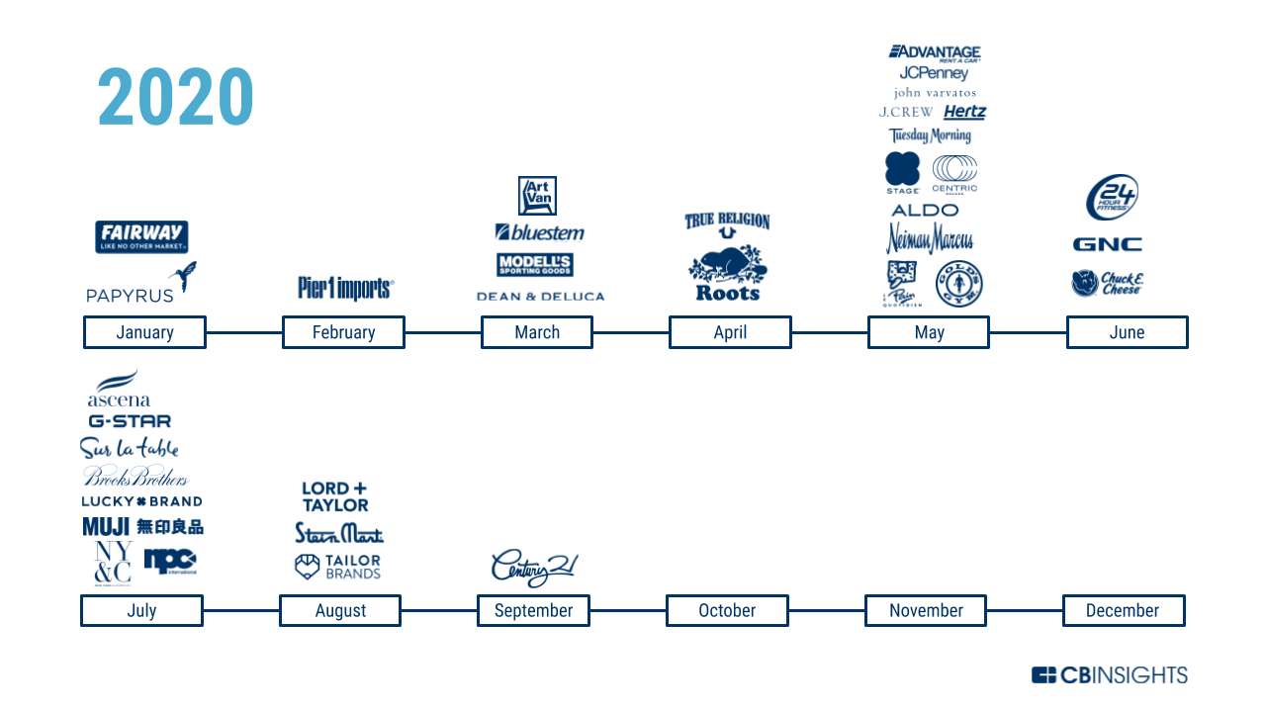
Retail Bankruptcies

Slide 9
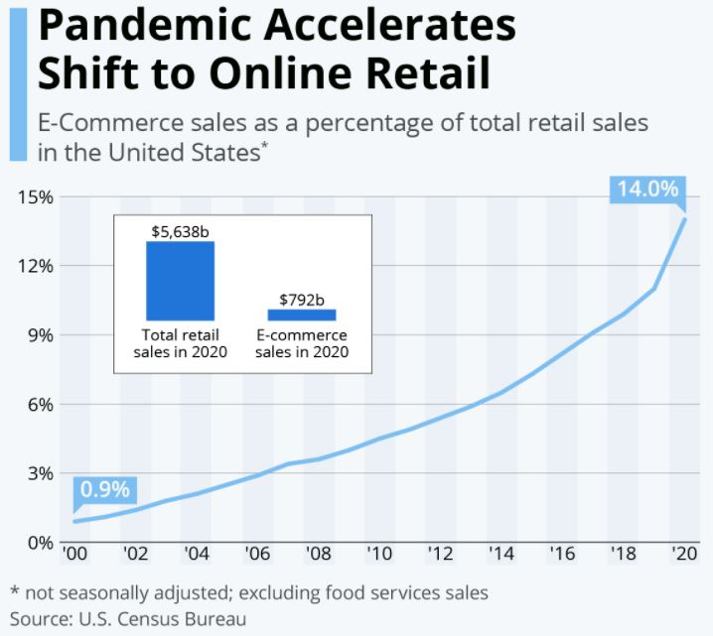

Slide 10
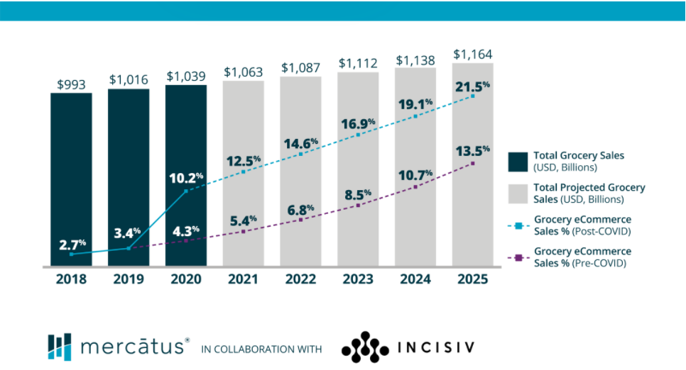
Grocery eCommerce Shift

Slide 11
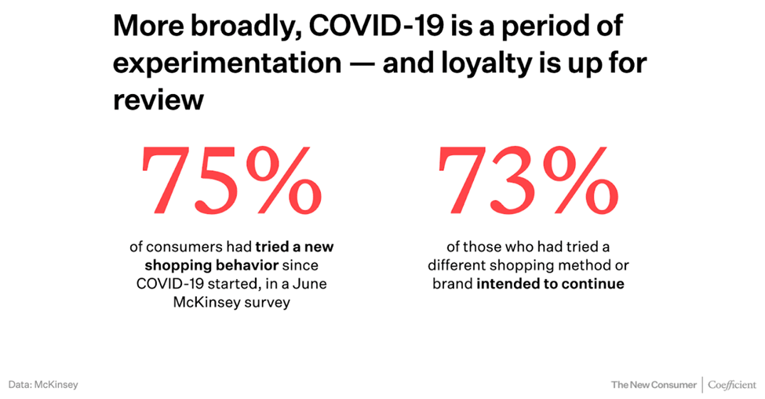

Slide 12
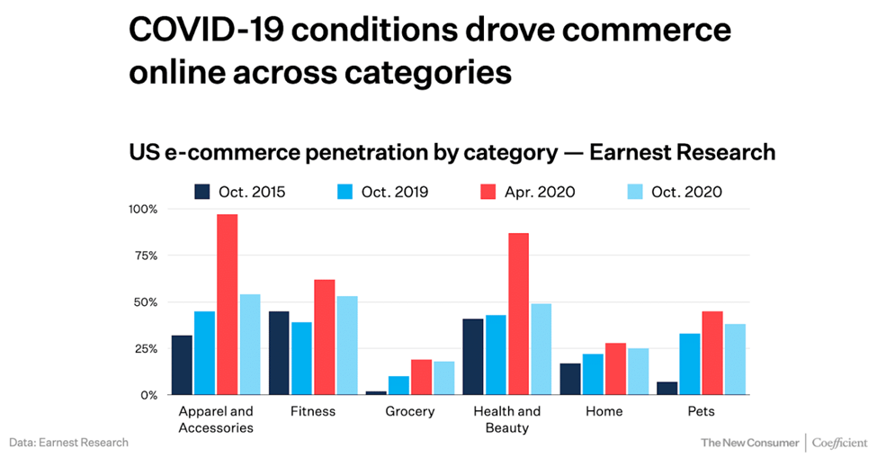

Slide 13
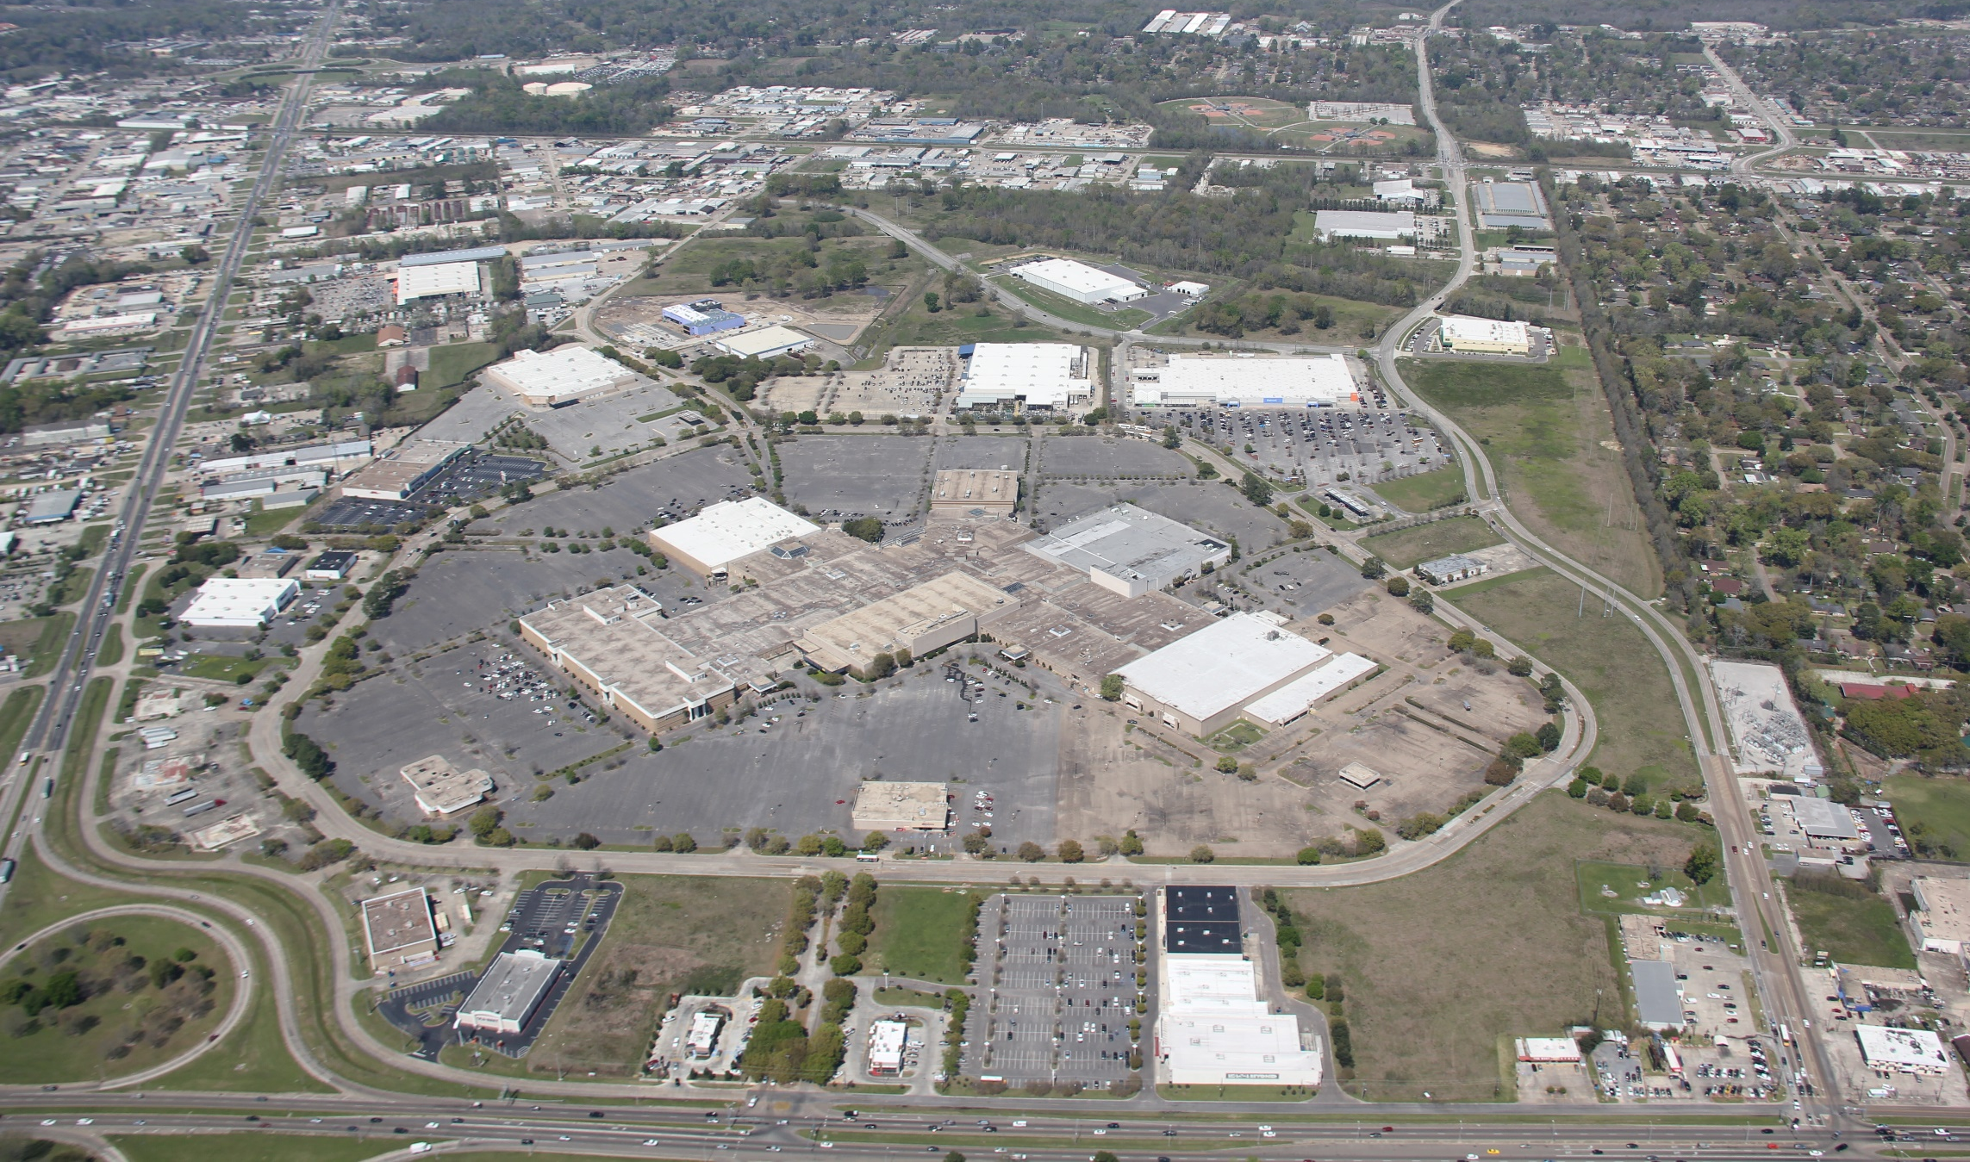
Cortana Mall - 2018

Slide 14
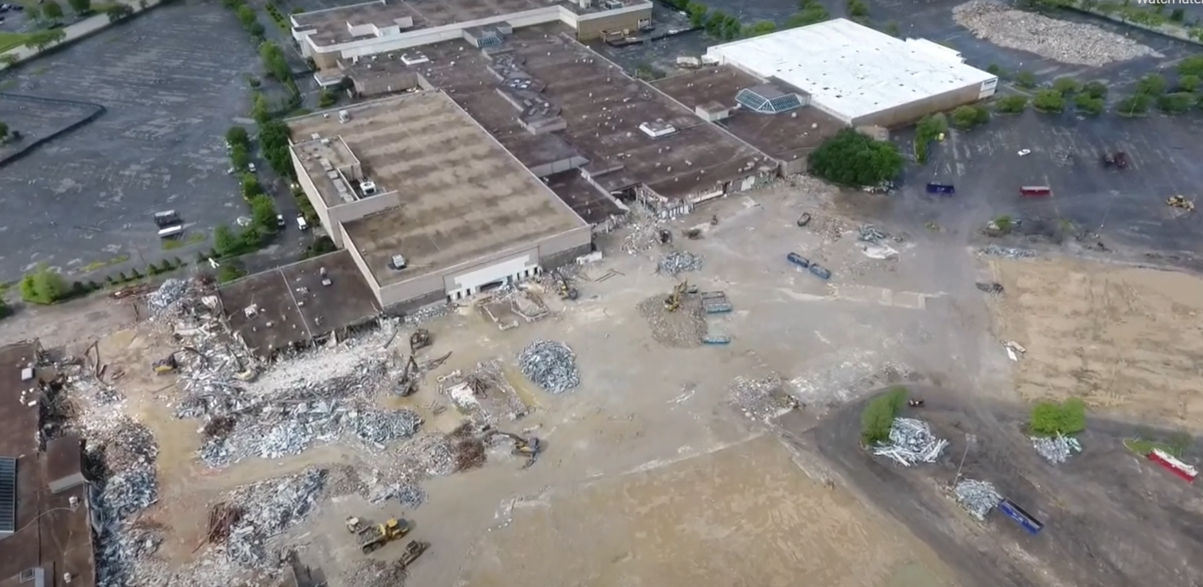
Cortana Mall - 2021

Slide 15
Cortana Mall - 2021

Slide 16
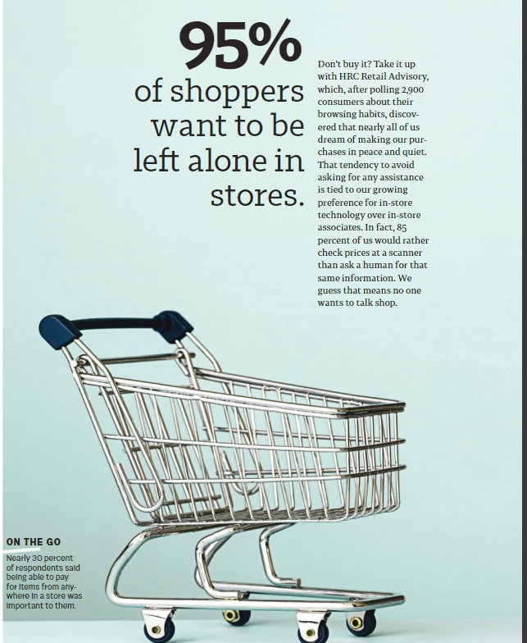

Slide 17

Millennial Shopping Habits During Pandemic

Slide 18

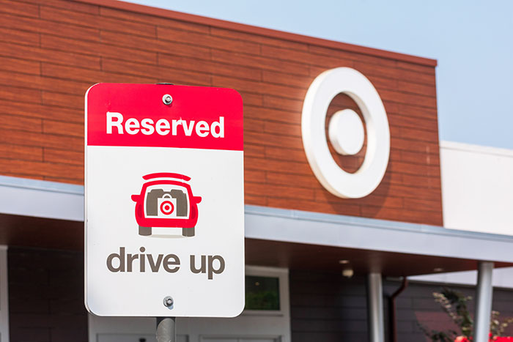
How Retailers Are Reacting
-Target Investing $4 Billion per year
- Speed up store restocking
- 30-40 new stores, many of them “small-format”

Slide 19

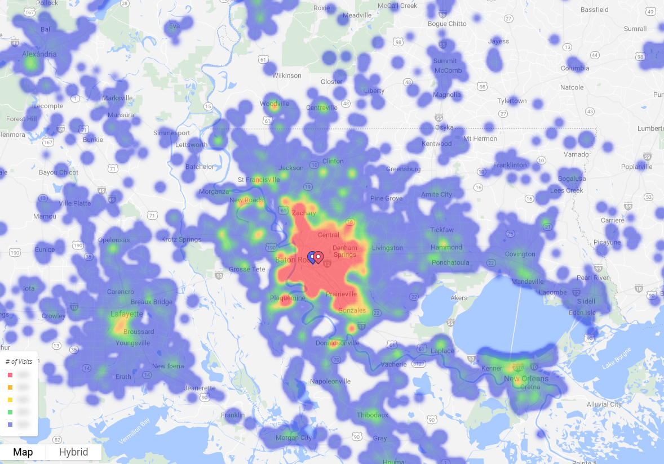
How Retailers are Reacting

Slide 20
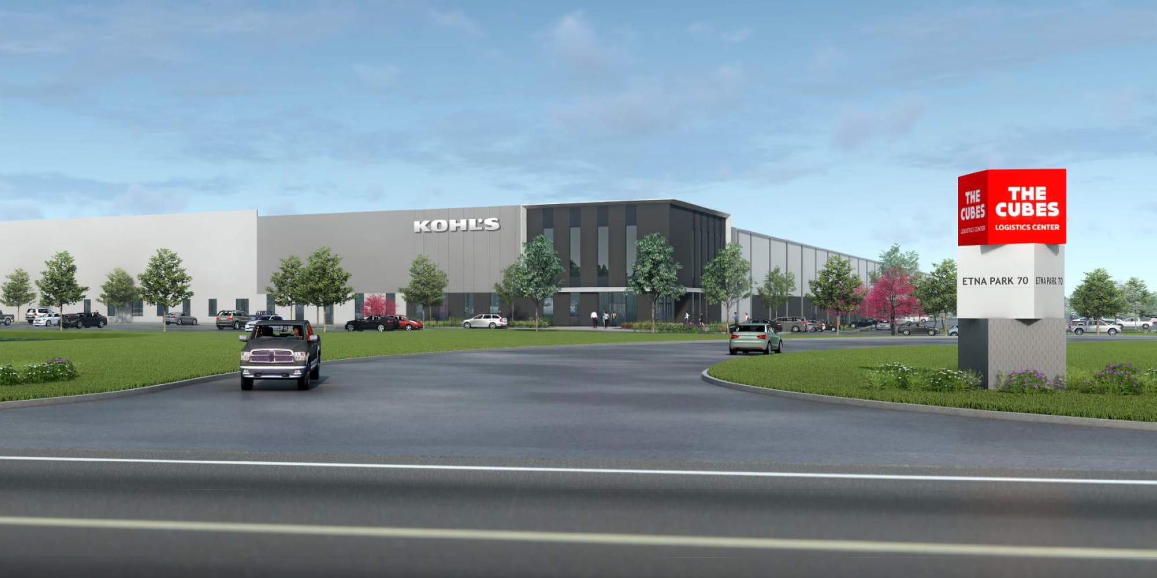
How Retailers are Reacting
Kohl's Opens New1.2 Million SF Fulfillment Centre to Boost E-commerce
.

Slide 21








New to Market Retailers

Slide 22
















Expanding Retailers / Restaurants

Slide 23
Infill Development / Adaptive Reuse

Slide 24
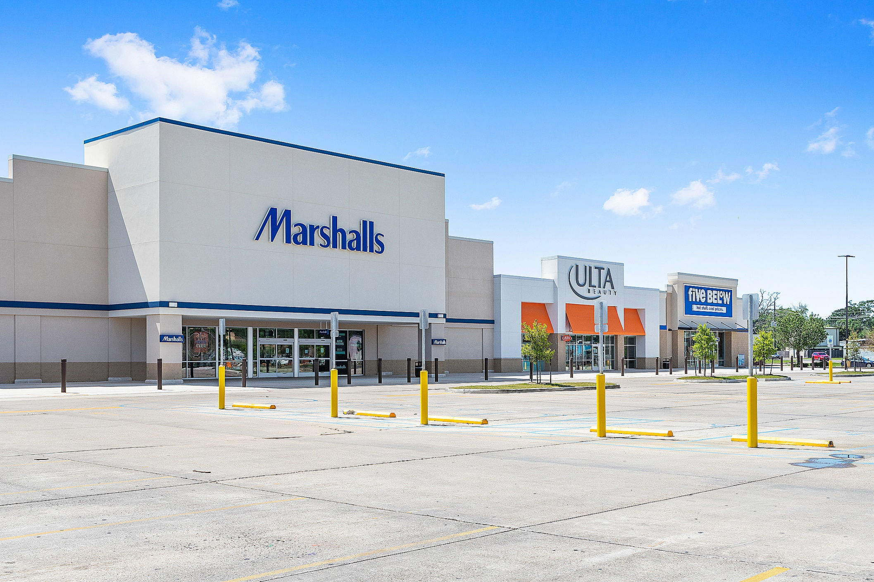
K-Mart Redevelopment Gonzales

Slide 25
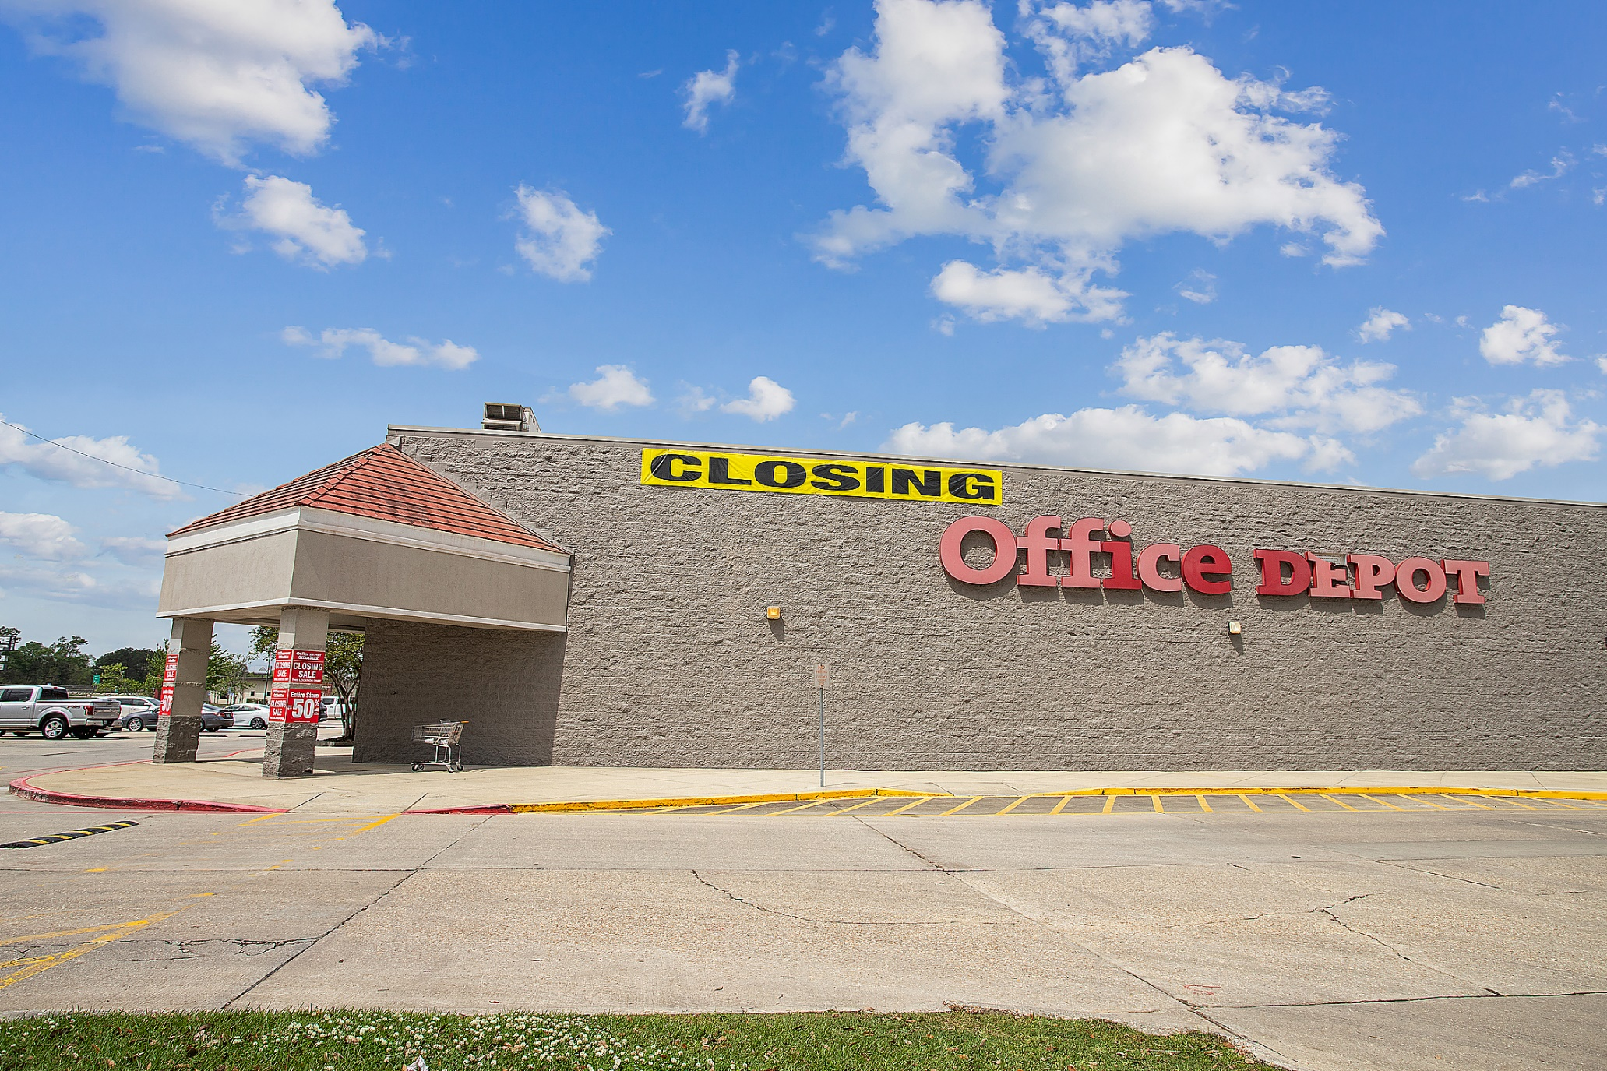
Siegen Lane

Slide 26
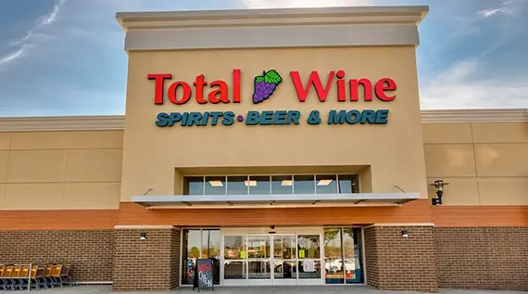
Siegen Lane

Slide 27
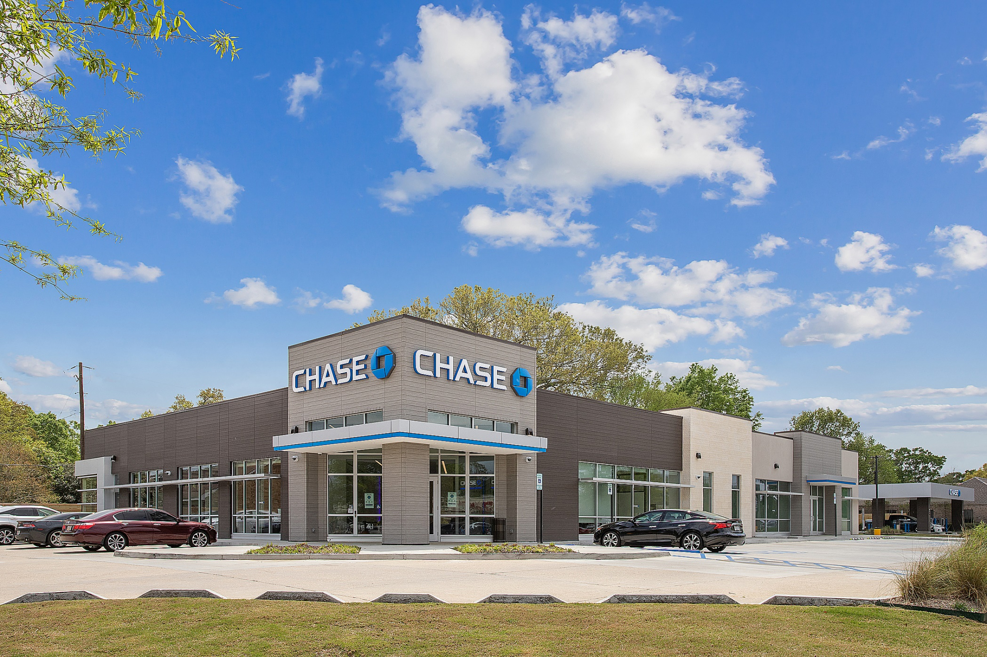
Siegen Lane

Slide 28
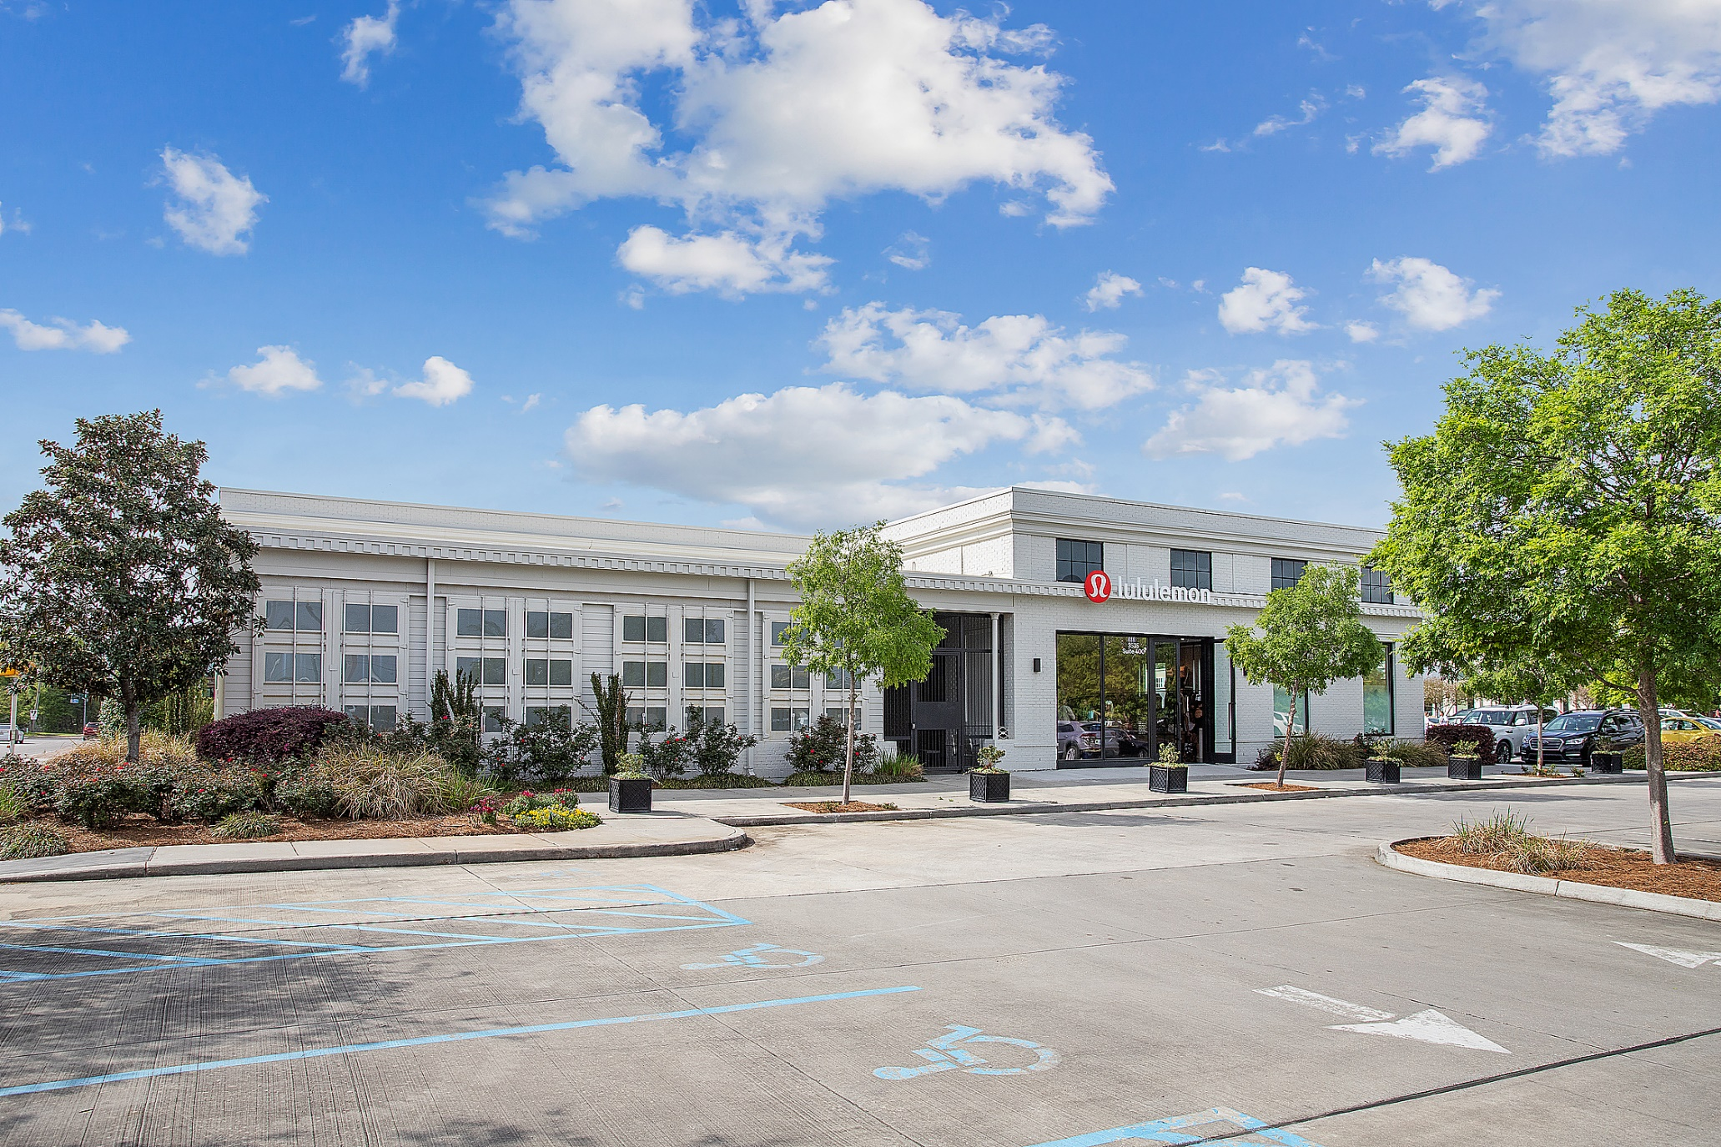
Acadian Village

Slide 29
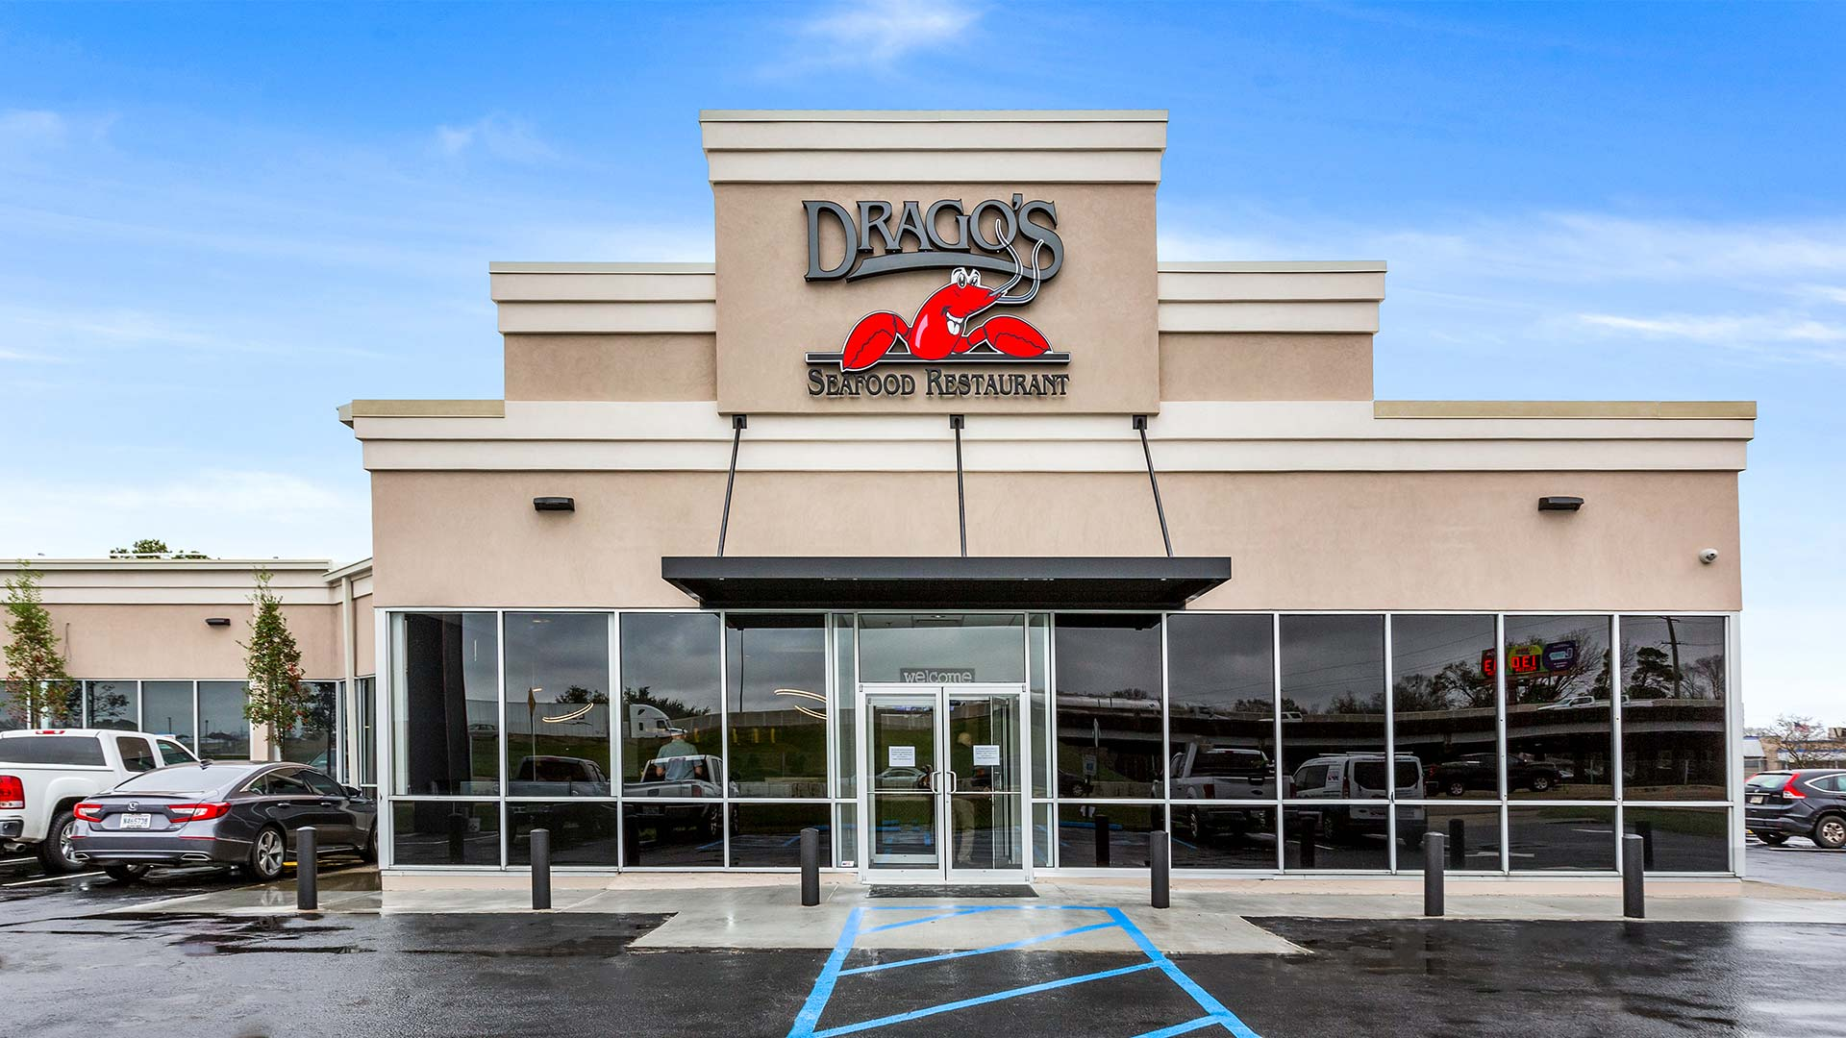
College Drive

Slide 30
New Development

Slide 31
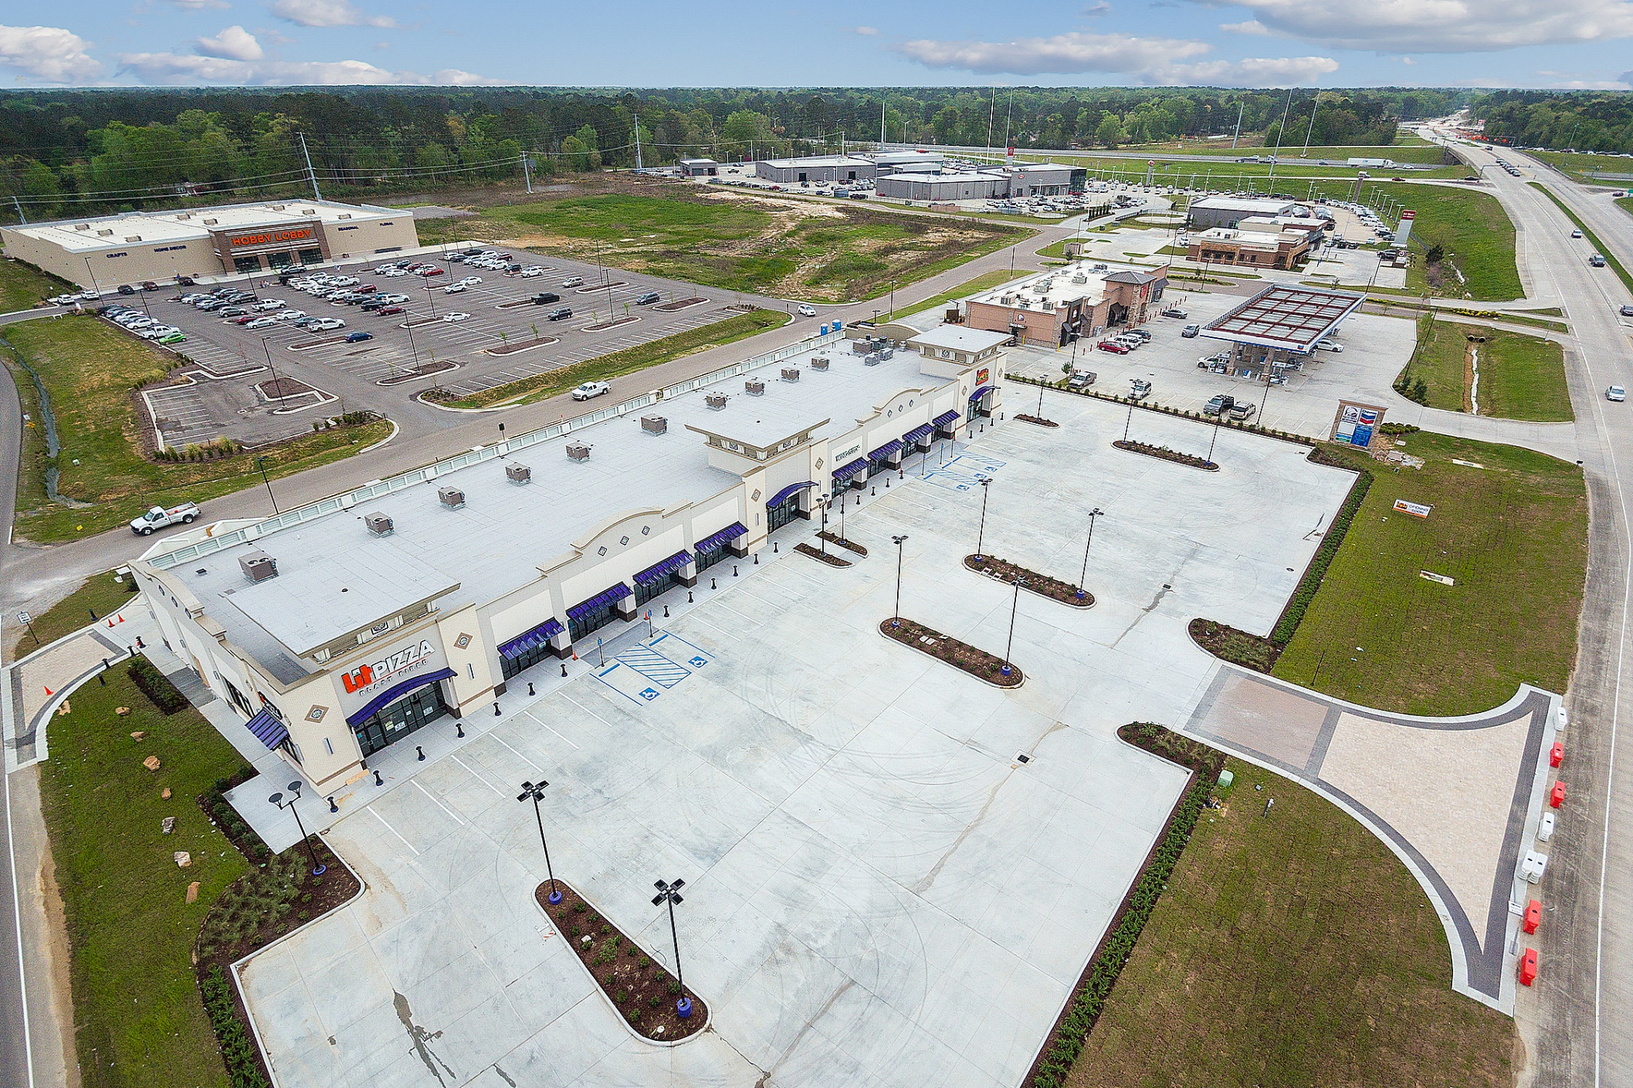
Juban Square – Denham Springs

Slide 32
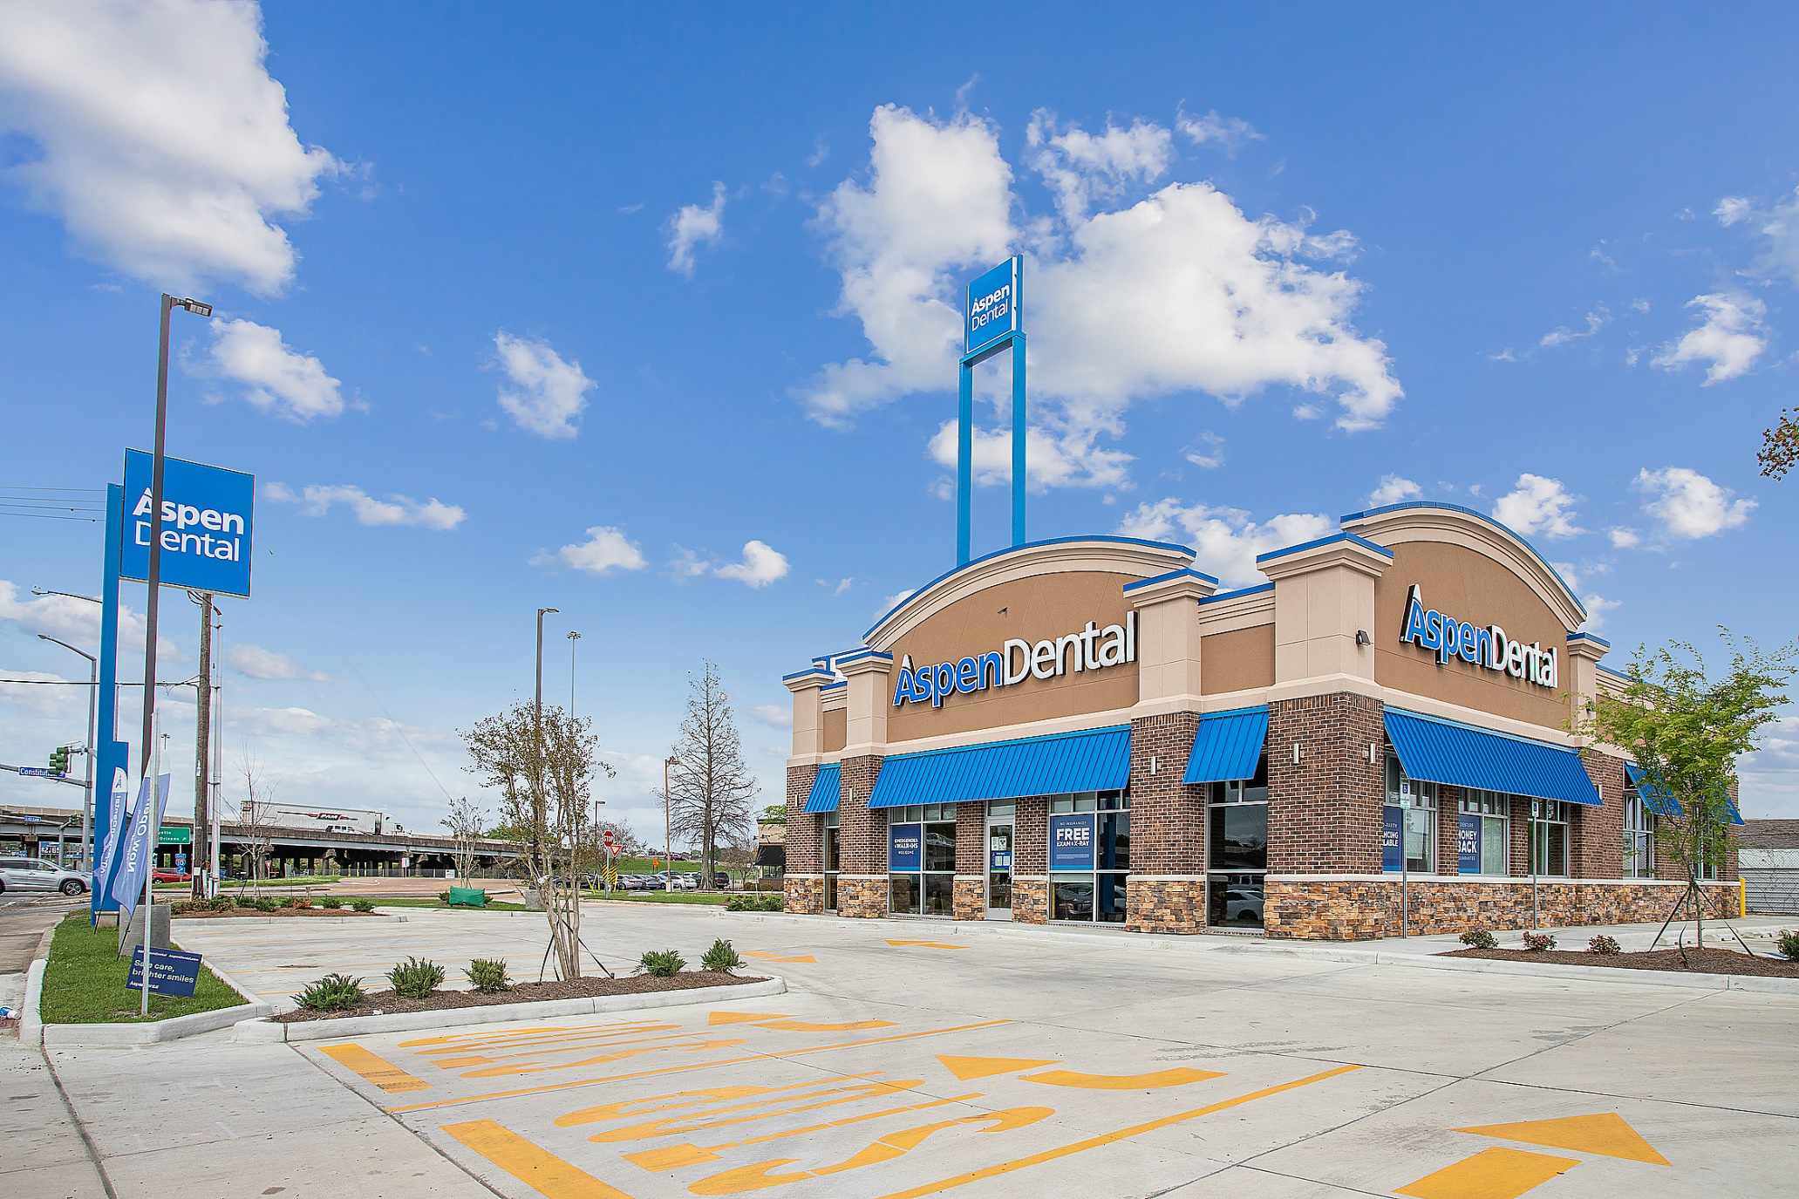
College Drive

Slide 33
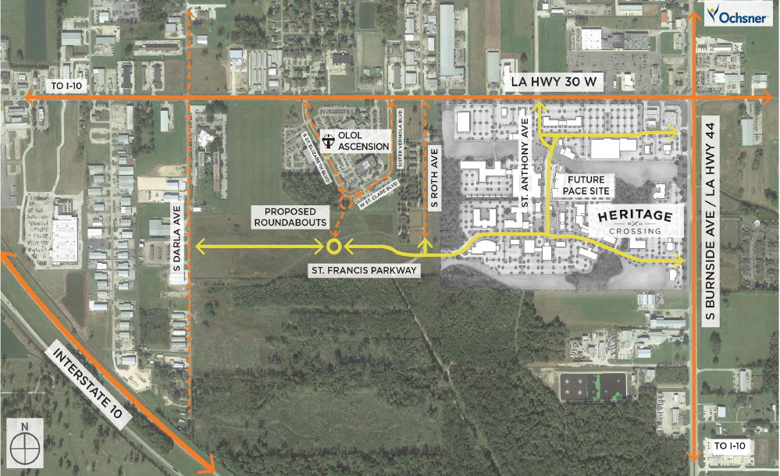
Heritage Crossing - Gonzales

Slide 34
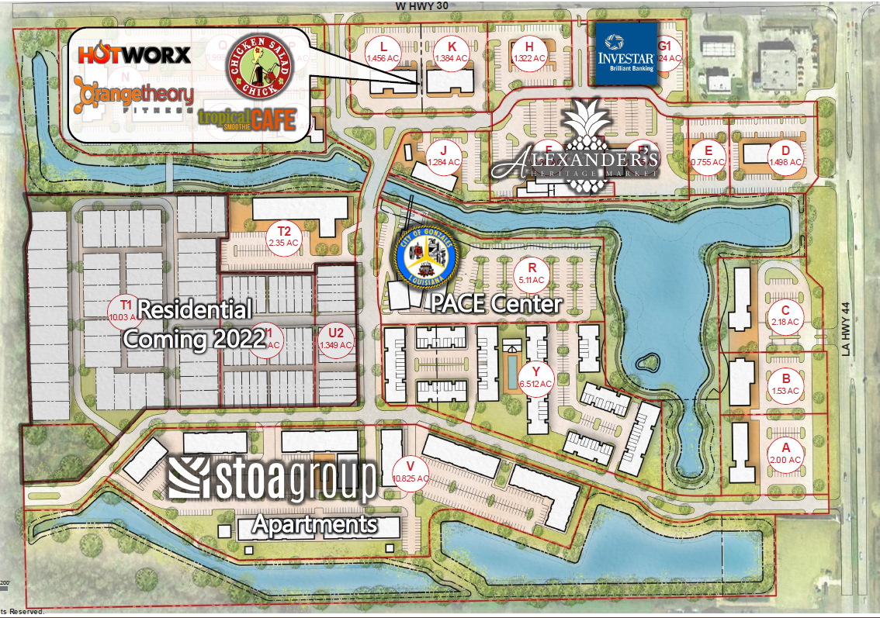
Heritage Crossing - Gonzales

Slide 35
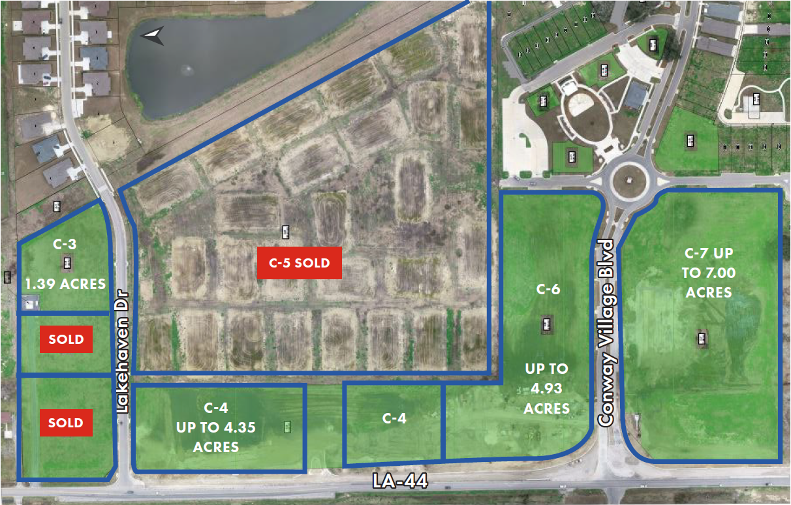
Conway Plantation - Gonzales

Slide 36
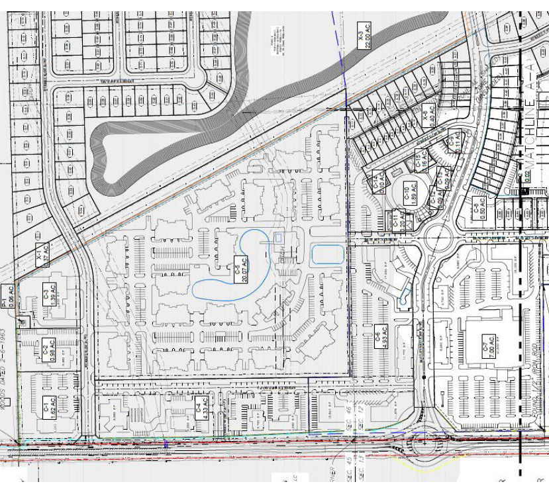
Conway Plantation - Gonzales

Slide 37
Shoe Creek - Central

Slide 38
Shoe Creek - Central

Slide 39
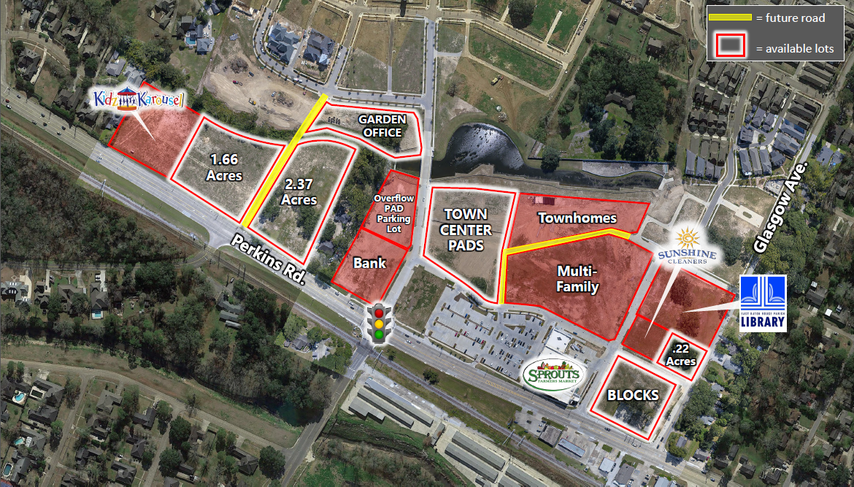
Rouzan

Slide 40
Rouzan

Slide 41

Other Development to Watch in 2021
- Harveston
- Long Farm
- Arlington Marketplace
- Juban Crossing
- City Square

Slide 42


Overview / Predictions
- Vacancy rates will remain flat in 2021
- Modest increases in total rent
- Expansion of existing projects
- Continued acceleration of E-Commerce

Slide 43

THANK YOU!
Special Thanks To: Jill Sylvest, Ken Damann, Stephen Eisenbraun – Fotosold
& Trends Steering Committee

