Slide 1


BATON ROUGE
Residential Market
PRESENTED BY
Tom W. Cook MAI
Cook Moore Davenport And Associates

Slide 2


RESIDNETIAL COMMITTEE MEMBERS
Tom W. Cook MAI
Cook Moore Davenport and Associates
Brython Cox
GBRAR
Jill Sylvest
GBRAR
Rich Rachael, MAI
Cook Moore Davenport and Associates
Robert Beaman
Cook Moore Davenport and Associates

Slide 3

Executive Summary:
Residential markets in most sectors have been healthy.
Dollar Volume was up
Median Home Price was up
Inventory of homes, as exhibited by months of supply rose
Because the data set ends on December 31, 2019, it is not impacted by the COVID 19 pandemic or the 2 trillion-dollar stimulus package, nor does it take into consideration the drop in the price of crude oil to below $30.00 per barrel, all of which is likely to have an impact on the market moving forward.
2019 Report

Slide 4

2019 Report

Slide 5
Dollar Volume Entire MLS |  |  | Change | Change
 | 2019 | 2020 | 2019 to 2020 | 2015 to 2019
All Sales All Price Ranges | $2,566,063,304 | $3,129,363,927 | 21.95% | 4.99%
Sale Price $93,999 or Less | $54,865,652 | $47,828,787 | -12.83% | -0.92%
Sale Price $94,000 to $177,999 | $421,313,669 | $430,741,572 | 2.24% | -3.33%
Sale Price $178,000 to $261,999 | $831,918,931 | $1,003,378,762 | 20.61% | 6.30%
$262,000 or More | $1,257,965,052 | $1,647,414,806 | 30.96% | 8.29%

Slide 6
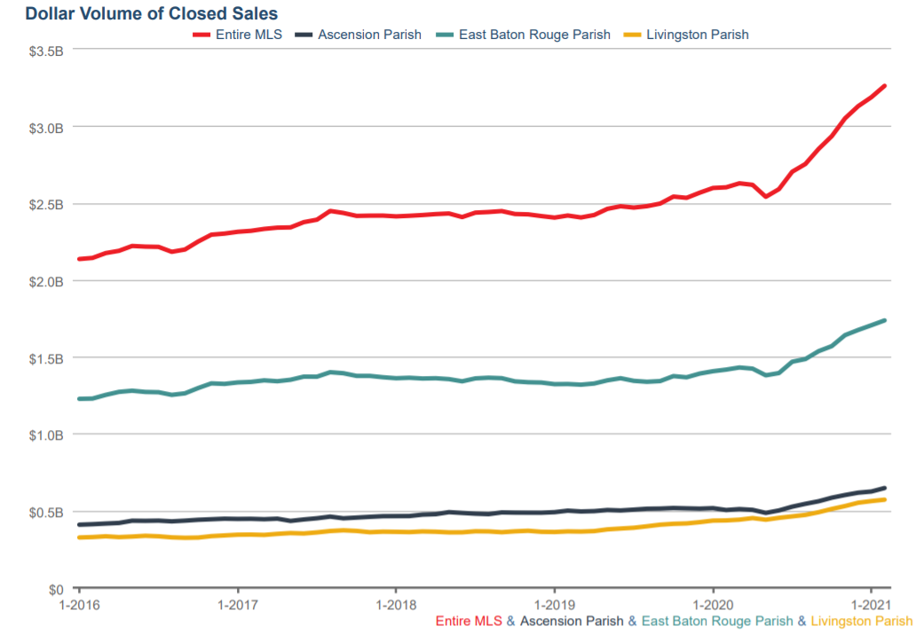

Slide 7
Dollar Volume New Homes Entire MLS |  |  | Change | Change
 | 2019 | 2020 | 2019 to 2020 | 2015 to 2019
All Sales All Price Ranges | $575,102,897 | $712,088,512 | 23.82% | 5.00%
Sale Price $93,999 or Less | $89,000 | $92,000 | 3.37% | NA
Sale Price $94,000 to $177,999 | $26,928,664 | $36,393,737 | 35.15% | -18.15%
Sale Price $178,000 to $261,999 | $232,879,577 | $273,867,599 | 17.60% | 3.45%
$262,000 or More | $315,205,656 | $402,144,274 | 27.58% | 13.02%

Slide 8
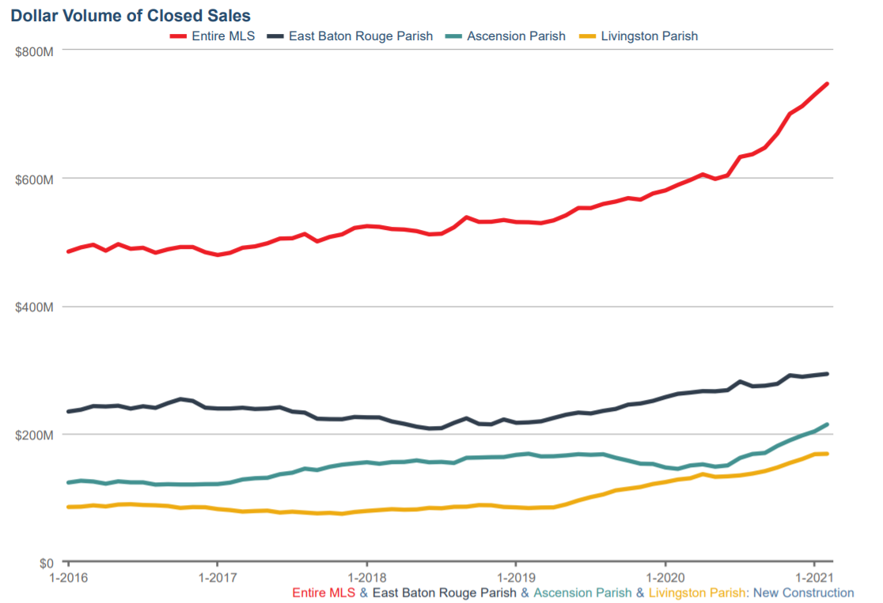

Slide 9

 |  |  | Change | Average
Median Sale Price | 2019 | 2020 | 2019 to 2020 | 2015 to 2019
Entire MLS | $207,000 | $220,000 | 6.28% | 2.59%
New Homes Entire MLS | $247,185 | $249,900 | 1.10% | 2.32%
EBR Parish All Homes | $209,000 | $225,000 | 7.66% | 1.04%
EBR New Home Sales | $272,133 | $269,900 | -0.82% | 1.12%
Ascension Parish All Homes | $234,900 | $248,000 | 5.58% | 2.46%
Ascension Parish New Homes Sales | $265,000 | $269,900 | 1.85% | 4.62%
Livingston Parish All Homes | $185,500 | $195,210 | 5.23% | 1.63%
Livingston Parish New Home Sales | $212,638 | $213,409 | 0.36% | 3.60%

Slide 10
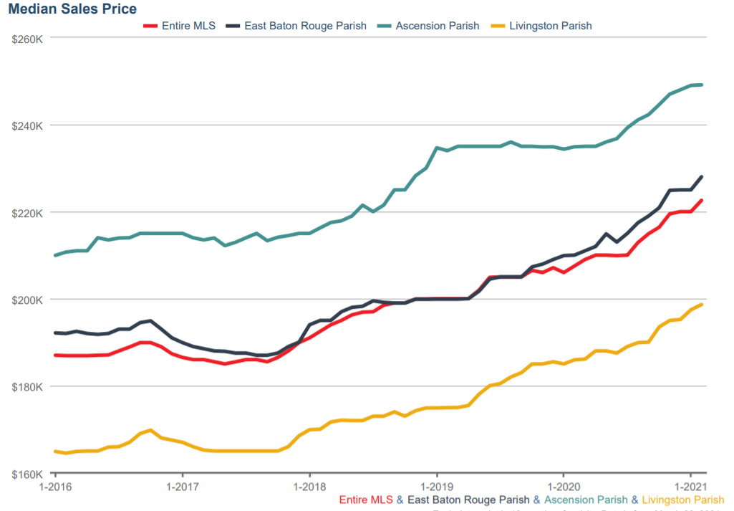

Slide 11
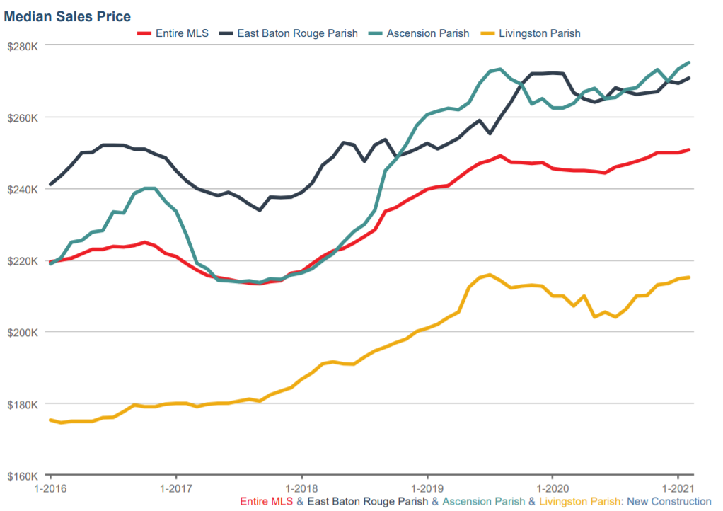

Slide 12
 |  |  | Change | Change
Months' Supply All Price Ranges | 2019 | 2020 | 2019 to 2020 | 2015 to 2019
Entire MLS | 4.9 | 3.5 | -28.57% | 2.40%
New Homes Entire MLS | 5.1 | 3.6 | -29.41% | 9.20%
EBR Parish All Homes | 4.9 | 3.8 | -22.45% | 2.64%
EBR New Home Sales | 5.4 | 4.1 | -24.07% | 5.82%
Ascension Parish All Homes | 3.7 | 2.6 | -29.73% | 5.33%
Ascension Parish New Homes Sales | 3.8 | 3.2 | -15.79% | 13.26%
Livingston Parish All Homes | 4.7 | 2.8 | -40.43% | 5.13%
Livingston Parish New Home Sales | 5.9 | 2.8 | -52.54% | 19.59%

Slide 13
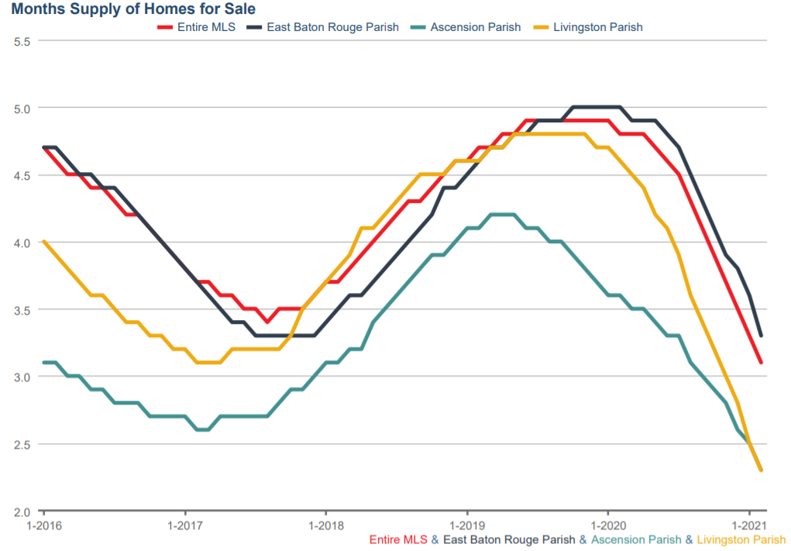

Slide 14
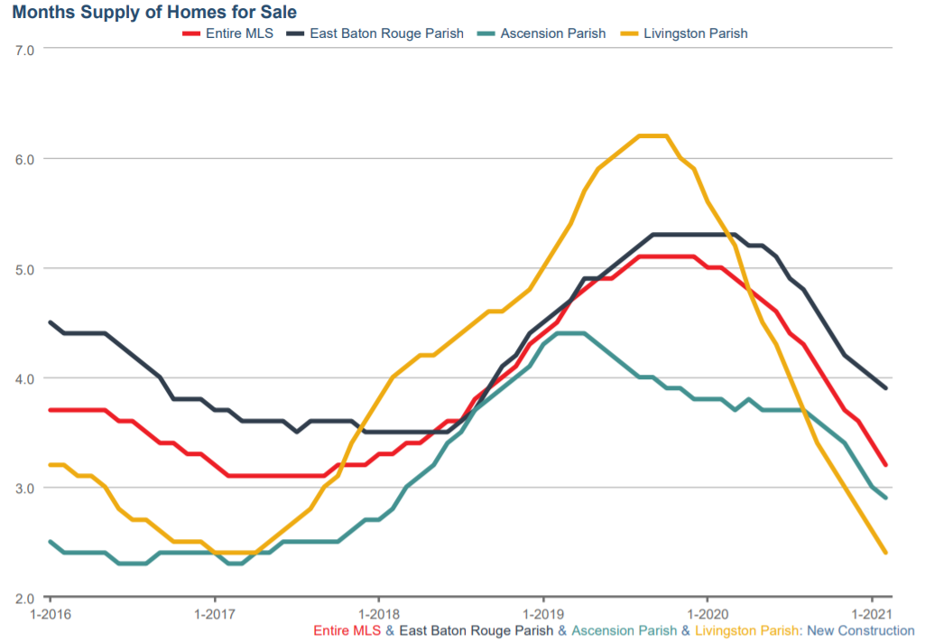

Slide 15
 |  |  | Change
Median Days on Market | 2019 | 2020 | 2019 to 2020
All Price Ranges
Entire MLS | 34 | 26 | -23.53%
New Homes Entire MLS | 29 | 28 | -3.45%
EBR Parish All Homes | 33 | 28 | -15.15%
EBR New Home Sales | 21 | 36 | 71.43%
Ascension Parish All Homes | 33 | 20 | -39.39%
Ascension Parish New Homes Sales | 23 | 14 | -39.13%
Livingston Parish All Homes | 36 | 25 | -30.56%
Livingston Parish New Home Sales | 55 | 38 | -30.91%

Slide 16
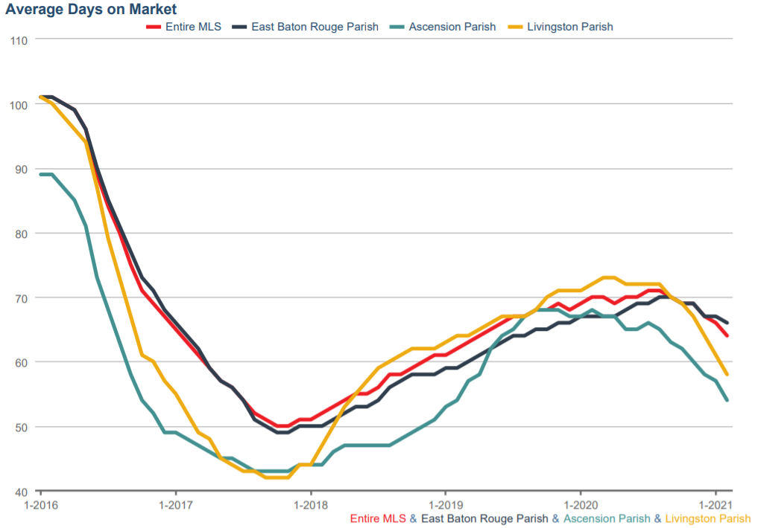

Slide 17
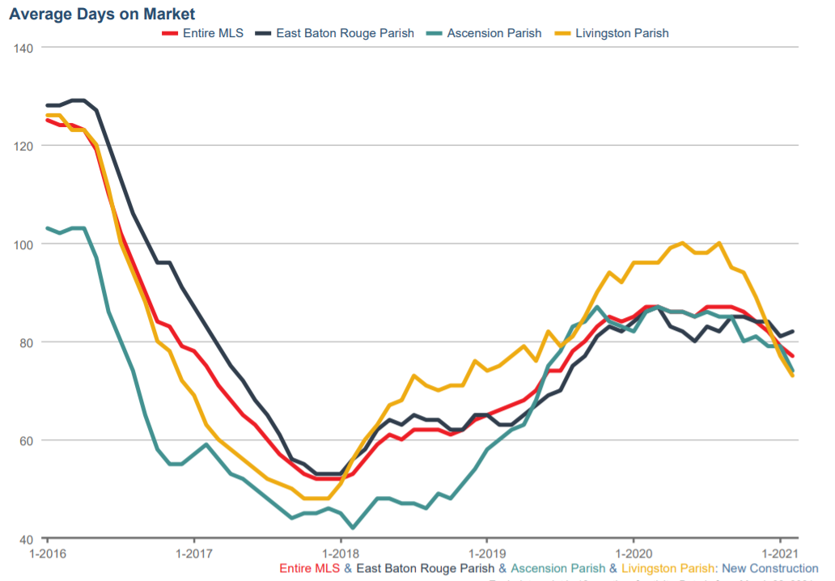

Slide 18
WHY ?
What is the Driving Force

Slide 19
Is it Job Growth?
Are Buyers Coming From The Apartment Rental Market ?

Slide 20
April Employment Data
By MSA
Sector April Loss %
Total -286,800 -14%
New Orleans -103,400 -18%
Baton Rouge -63,100 -15%
Shreveport-Bossier -24,300 -13%
Lafayette -24,200 -12%
Houma -9,200 -11%
Lake Charles -21,300 -18%
Monroe -10,300 -13%
Alexandria -6,000 -10%
Hammond -4,700 -10%

Slide 21

APARTMENT RENTAL DATA
MATCHED DATA SET (214 Complexes)
 | Avg Rent/SF | Trend |  | Vacancy
2015 Survey | $1.04 |  | 2.05% | 5.97%
2016 Survey | $1.04 | Flat | 0.00% | 6.21%
2017 Survey | $1.08 |  | 3.85% | 2.67%
2018 Survey | $1.05 |  | 2.78% | 8.01%
2019 Survey | $1.04 |  | 0.95% | 9.54%
2020 Survey | $1.04 | Flat | 0.00% | 10.26%
Flood
2021 Survey | $1.05 |  | 0.96% | 9.11%

Slide 22
Millennials Moving Out of Their Parent’s House
Older Folks Moving to be Closer to Children
Divorce
Reduced Number in Household (down from 2.53)
Pent up Demand
Poor Existing Housing Stock
Better Work From Home Environment
More Disposable Income Due to COVID
Lake Charles Relocation

Slide 23
THE PRIMARY DRIVING FORCE
LOW INTEREST RATES
INCREASING HOME PRICES

Slide 25
Dollar Volume Entire MLS |  |  | Change | Change
 | 2019 | 2020 | 2019 to 2020 | 2015 to 2019
All Sales All Price Ranges | $2,566,063,304 | $3,129,363,927 | 21.95% | 4.99%
Sale Price $93,999 or Less | $54,865,652 | $47,828,787 | -12.83% | -0.92%
Sale Price $94,000 to $177,999 | $421,313,669 | $430,741,572 | 2.24% | -3.33%
Sale Price $178,000 to $261,999 | $831,918,931 | $1,003,378,762 | 20.61% | 6.30%
$262,000 or More | $1,257,965,052 | $1,647,414,806 | 30.96% | 8.29%

Slide 26
 | Total Number of | Total Number of
 | Sale Transactions | Sales Transactions
Year | All Homes GBRAR | New Homes GBRAR
2019 | 9,922 | 1,943
2020 | 11,261 | 2,367
% Change | 13.50% | 21.82%

Slide 27
What to Expect

Slide 28
For well-organized and well-managed home building companies, this decade is going to be the greatest home building opportunity since the 1970s. Charles C. Shinn Ph.D. Shin Consulting the roaring 2020’s

Slide 29
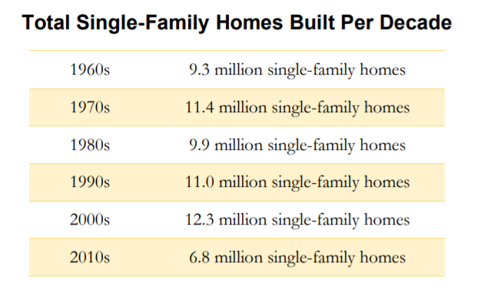

Slide 30
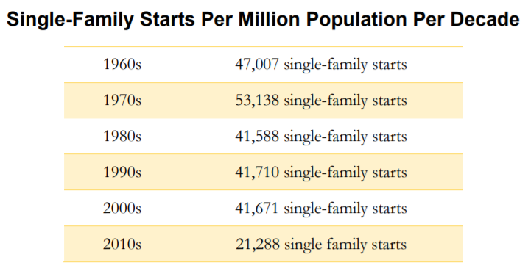

Slide 32
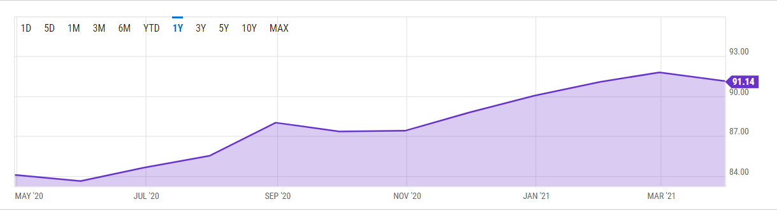
Timber Price Index
91.14 for Mar 2021

Slide 33
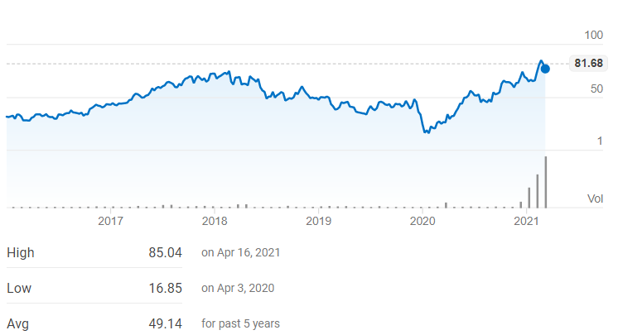
West Fraser Timber Co Ltd
NYSE: WFG

Slide 34
Increasing Prices
Lumber and Material Cost to Continue to Rise (cutting less)
Inventory to Stay Sparce
Above List Offers on Good Homes to Continue
Escalation Clauses / Bidding Wars
Agents Will Have to be More Educated

Slide 35
What if Interest Rates Go to 6%
Current Payment on $300K at 3% 30 year Am
$1,265
Payment on $300K at 6% 30 year AM
$1,800
Difference of $535
Borrowers Will Have to Make about $1500 More per month to qualify for the Same Mortgage

Slide 36
What is the Median Family Income BR MSA
$57,000
The required increase in Income to qualify for an additional $535 per month in payment $18,000/yr.
31.58% more than the Median Family Income

Slide 37
2020
2020 Report

Slide 39
 | Date of | Sale | Number | Sale Price
Subdivision / Location | Sale | Price | of Lots | Per Lot | Purchaser
Grays Creek/ Denham Springs | 12/29/2020 | $2,908,750 | 65 | $44,750 | DSLD
Oak Colony / Baton Rouge | 12/7/2020 | $10,235,000 | 89 | $115,000 | Alvarez
Clark's Ferry / Baton Rouge | 11/12/2020 | $2,150,000 | 25 | $86,000 | Bardwell
Retreat At Juban / Denham Springs | 11/3/2020 | $7,446,000 | 146 | $51,000 | DR Horton
Kenilworth Crossing / Baton Rouge | 10/28/2020 | $3,804,750 | 57 | $66,750 | DSLD

Slide 40
 | Date of | Sale | Number | Sale Price
Subdivision / Location | Sale | Price | of Lots | Per Lot | Purchaser
Villiage at Magnolia Square / Central | 10/7/2020 | $748,000 | 11 | $68,000 | Bardwell
Hunters Ridge / Denham Springs | 9/18/2020 | $2,471,000 | 70 | $35,300 | DSLD
Fields Creek / Baton Rouge | 9/4/2020 | $1,165,500 | 21 | $55,500 | Highlandia Trace
Settlement at Shoe Creek / Central | 8/10/2020 | $2,029,678 | 38 | $53,413 | Alvarez
Highland Trace / Prairieville | 7/1/2020 | $3,480,000 | 60 | $58,000 | DSLD
Preserve at Grays Creek / Denham Springs | 12/30/2020 | $6,360,000 | 106 | $60,000 | DSLD

Slide 41
 | Date of | Sale | Number | Sale Price
Parish / Location | Sale | Price | of Lots | Per Lot | Purchaser
EBR | Pending | $5,590,000 | 86 | $65,000 | Masked
Livingston | Pending | $3,942,000 | 73 | $54,000 | Masked
Iberville | Pending | $6,050,000 | 121 | $50,000 | Masked
EBR | Pending | $10,235,000 | 89 | $115,000 | Masked
Livingston | Pending | $7,446,000 | 146 | $51,000 | Masked
Ascension | Pending | $577,401 | 6 | $96,233 | Masked
Ascension | Pending | $913,400 | 8 | $114,175 | Masked
EBR | Pending | $4,346,000 | 53 | $82,000 | Masked
EBR | Pending | $15,522,493 | 161 | $96,413 | Masked
Livingston | Pending | $2,400,000 | 60 | $40,000 | Masked
EBR | Pending | $1,120,000 | 16 | $70,000 | Masked
Total |  | $58,142,294 | 819 | $70,992

Slide 42
New Development

Slide 43
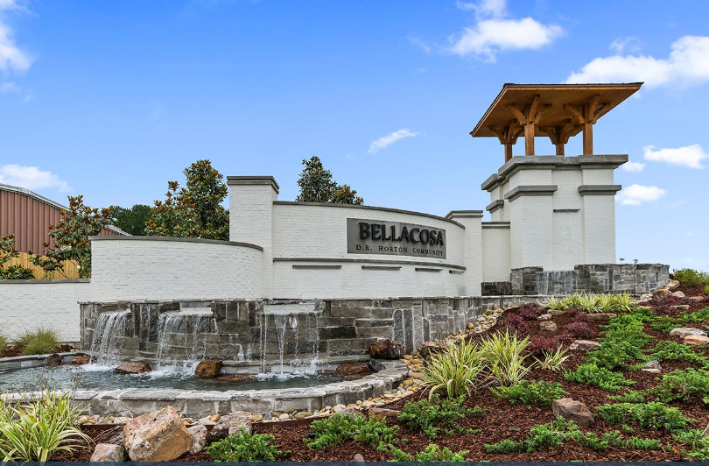
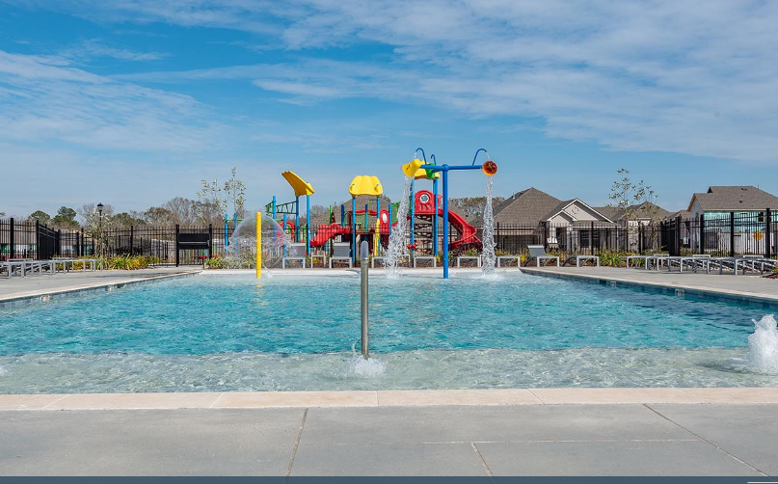
Bellacosa DR Horton
Location: Jones Creek Road between S. Harrell's Ferry Rd. and Coursey Blvd. in Baton Rouge
Total lots: 400
Lot Sizes: 50 x 120
Home Sizes: 1,613 - 3,309 sq. ft. living area
Home Price Range: Starting in the $260,000s
Features: Ponds, playground, pool and amenity center, sidewalks, curb and gutter, and community green spaces.

Slide 44

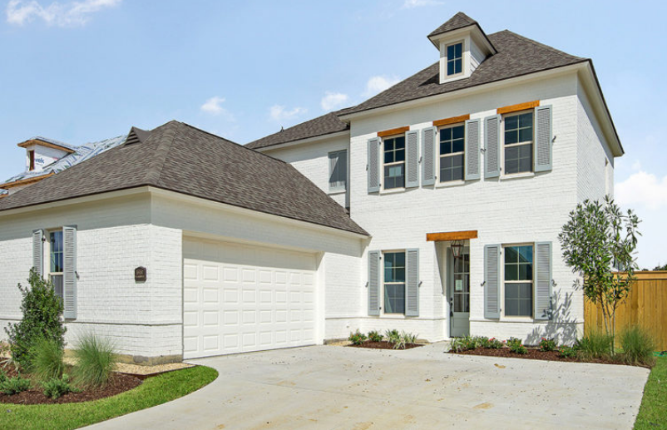
Bell Savanne Level Homes
Location: Geismar, Louisiana
Lot Count: 284
Home size: 1,600 SF to 3,000+ SF
Price Range: Starting at $300s+
Market Date: Now Selling
Additional Features/Amenities: The Community Pool and Cabana is NOW OPEN.
Phase 1 is SOLD OUT, and only 4 homes left in phase 2
3rd and Final Phase (96 lots) — Starting Q4 2021

Slide 45

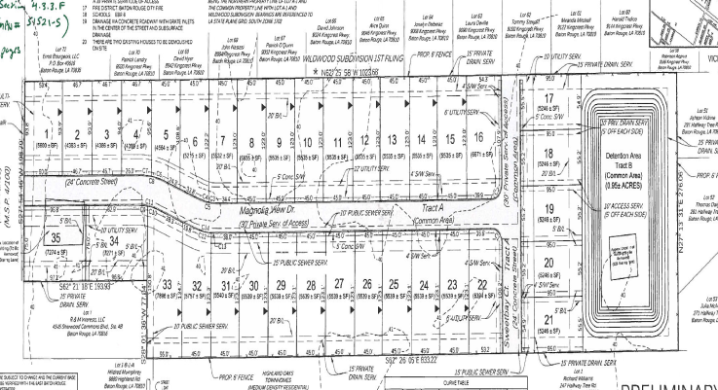
Magnolia Crossing Level Homes
NEW - Baton Rouge, on Staring Lane near Highland Road
Lot count: 32 lots
Starting price in: $300s+
Home Size: 1,700 to 2,400 SF
Starting in 3rd quarter 2021

Slide 46
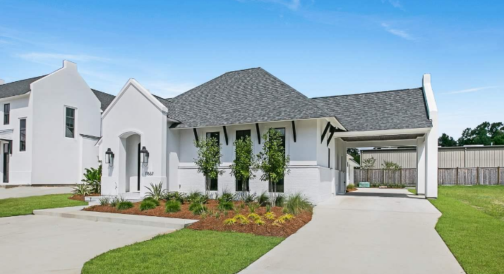
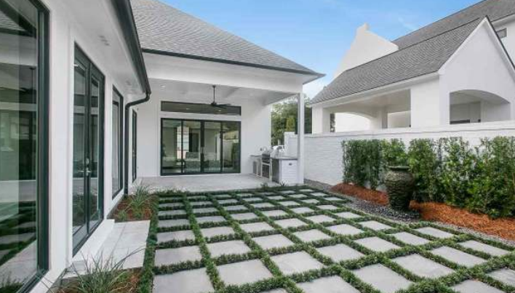
Bent Tree Court | Developer/ Builder, Kevin Nguyen/ Rusty Golden, LeJardin Development
Location: Parcel 21, The Country Club of Louisiana
Total Lots: 6
Price Range of Lots/ Home Prices: Lots are not for sale, $800,000+
Home Size/ Living Area: 2400+
Presold Lots: 2
New specs starting in June, 2020

Slide 47
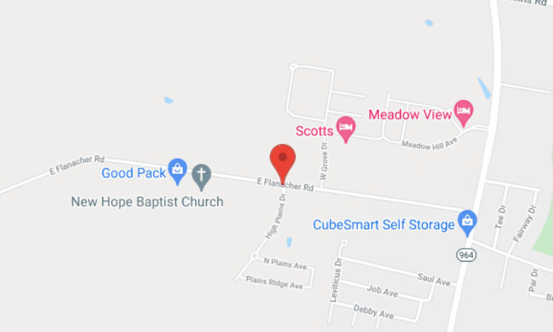
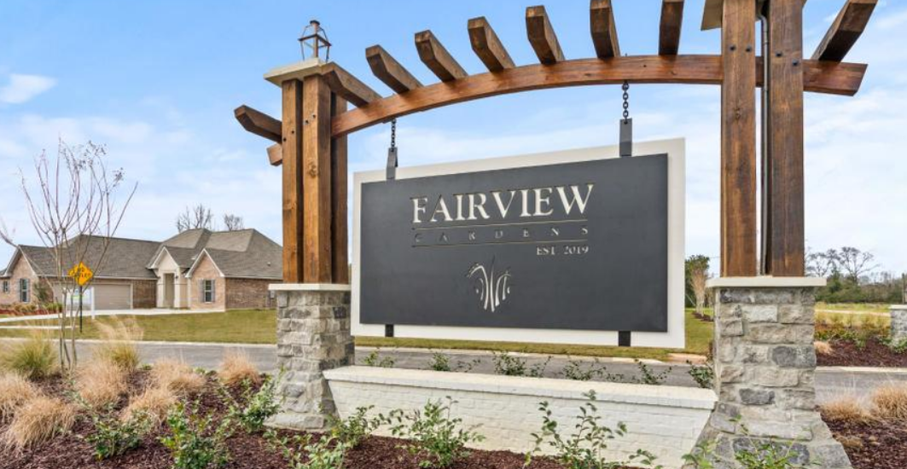
Fairview Gardens | DSLD Homes
Location: Zachary, LA
Total Lots:166
Price Range lots/home price: $230,990 - $312,990
Living Area: Living Area 1689 SF – 2471 SF
Additional Features/Amenities: Gorgeous Community Entrance and Neighborhood Lake. Located in the #1 School System in the State. Easy Access to a Vast Array of Outdoor Activities Including a Walking Trails, Biking Trails, Golf, and Other Sporting Activities

Slide 48
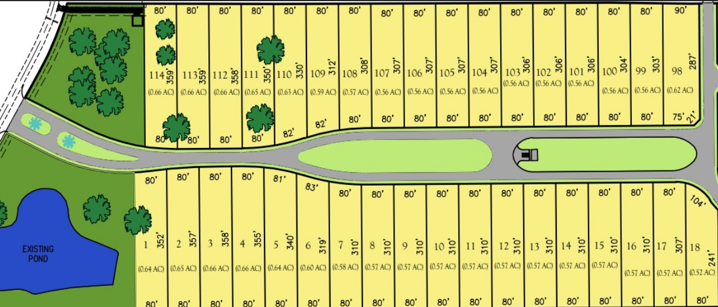
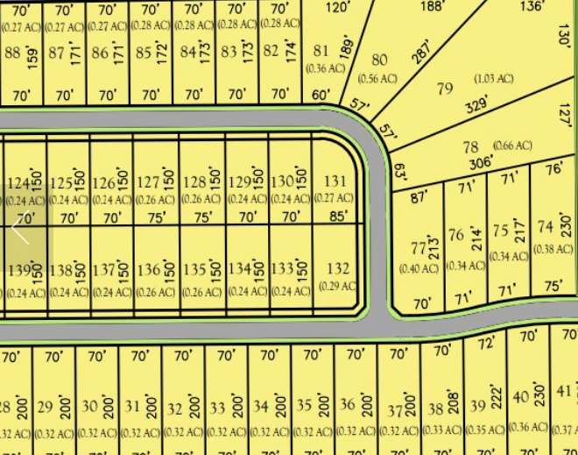
Oak Colony | Alvarez Construction
Project Type: Detached Single-Family
Location: Baton Rouge, Louisiana
Number of Lots: 114
Lot Sizes: 70x140, 70x200 with also estate lots of 80x300+
Current Status: Final Plat
Features: Community includes over 19 acres of green

Slide 49
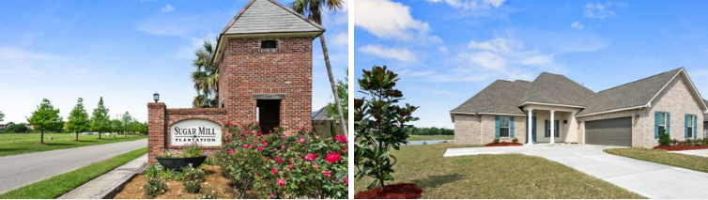
Sugar Mill | DSLD Homes
Location: West Baton Rouge, LA
Total Lots: 672
Price Range lots/home price: $234,990 - $308,990
Living Area 1,856 SF – 2,622 SF
Separate Ponds for Homeowners to Enjoy
Designated Greenspace Areas
Located in highly ranked West Baton Rouge School District

Slide 50

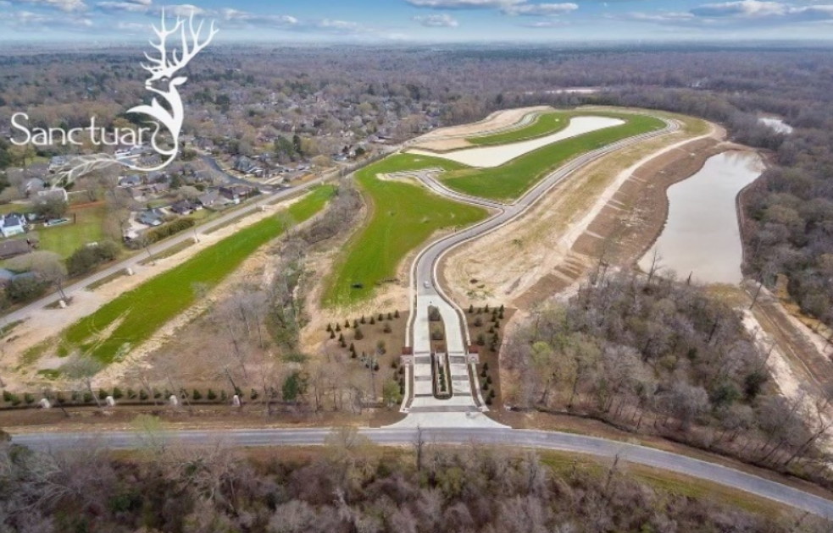
The Sanctuary | Corbin Ladner
Location: Off Tiger Bend in Baton Rouge, near Babin Rd.
Total Lots: 105 – Sold: 61
Lot size: 0.3 acres up to 1.4 acres with more than 40 lots being a half-acre and larger in size
Lot prices $130,000 - $250,000
Home size: Min living area is 2,400
Home prices starting in mid $500,000s
Lots available for purchase by Buyers and Home Builders.

Slide 51
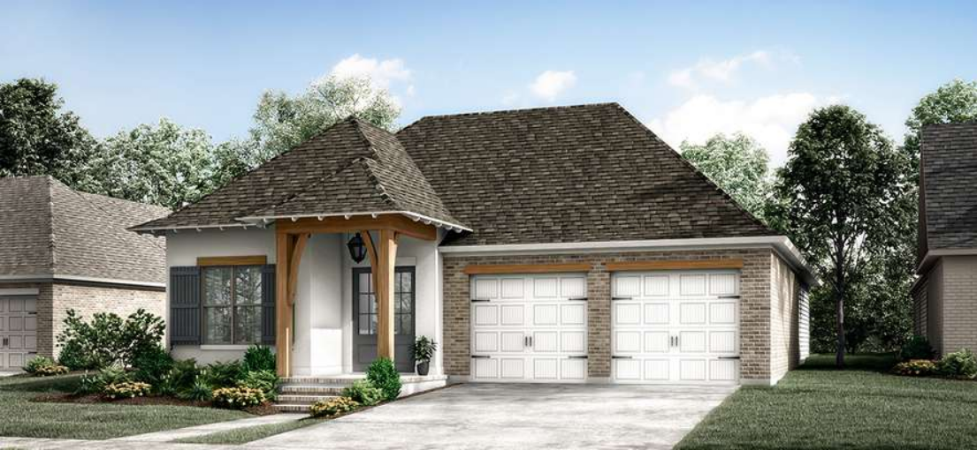
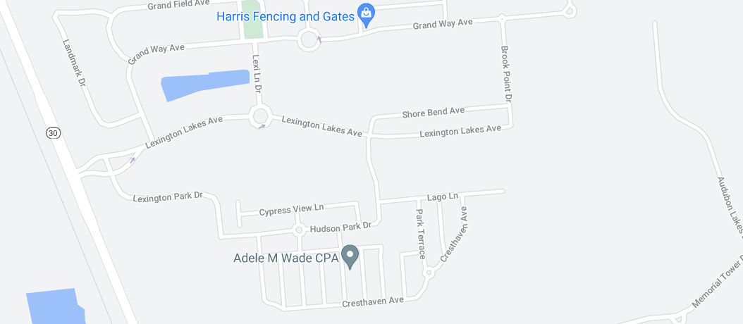
WATER’S EDGE | Level Homes
NEW - Baton Rouge, Lexington Estates
Lot Count: 168
Starting in $300s+
Home Size: 1,670 to 2,600 SF
Starting 4th quarter 2021

Slide 52
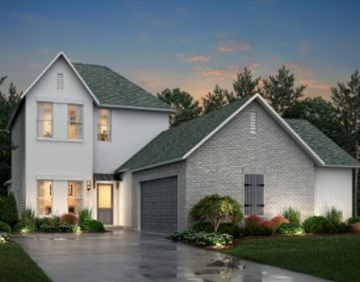
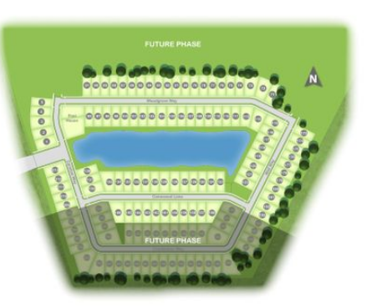
Woodstock | Alvarez Construction
Project Type: Detached Single-Family
Location: Baton Rouge, Louisiana
Home Sizes: 1861-2793 living area
Lot Sizes: 50x120
Home Price Range: starting in the $324,000’s
Number of Lots: 213 – 4 presold with 18 lot reservations as of 3/24/21
Current Status: site work. To begin home construction within 45 days
Features: Central lake setting, and community pool

Slide 53
Reserve at Eden Heights | Alvarez Construction
Project Type: Detached Single-Family
Location: Dunn Road and Lockhart Livingston Parish, Louisiana
Number of Lots: 72
Current Status: Subdivision under construction
Pending Lot Purchase $50,000 to $55,000

Slide 54
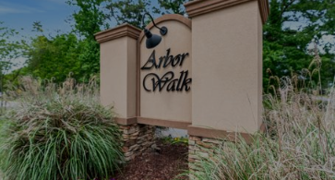
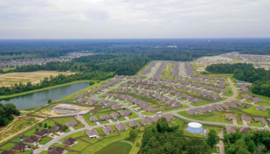
Arbor Walk | DSLD Homes
  Location: Denham Springs , LA
  Total Lots: 434
  Price Range lots/home price: $179,990 - $225,990
  Living Area 1,426 SF – 2,072 SF
Additional Features/Amenities: 3 ponds for homeowners to enjoy. A community playground with covered pavilion

Slide 55
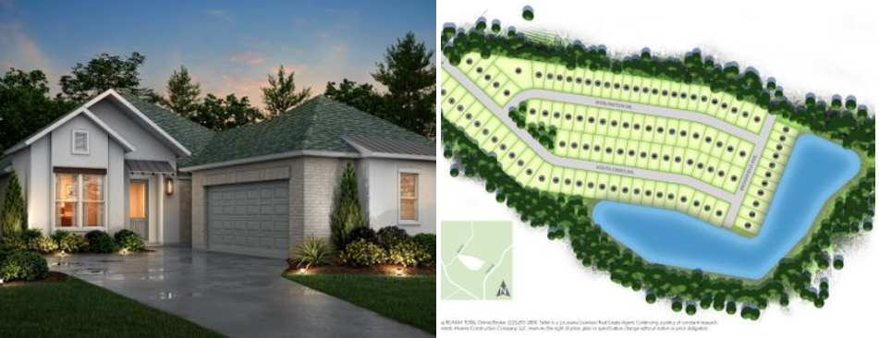
South Creek | Alvarez Construction
Project Type: Detached Single-Family
Location: Wax Rd. Denham Springs
Number of Lots: 103 – 7 Sold
Home Sizes: 1861-2069
Lot Sizes: 60x140 and 50x140
Home Price Range: starting in the $274,000’s

Slide 56
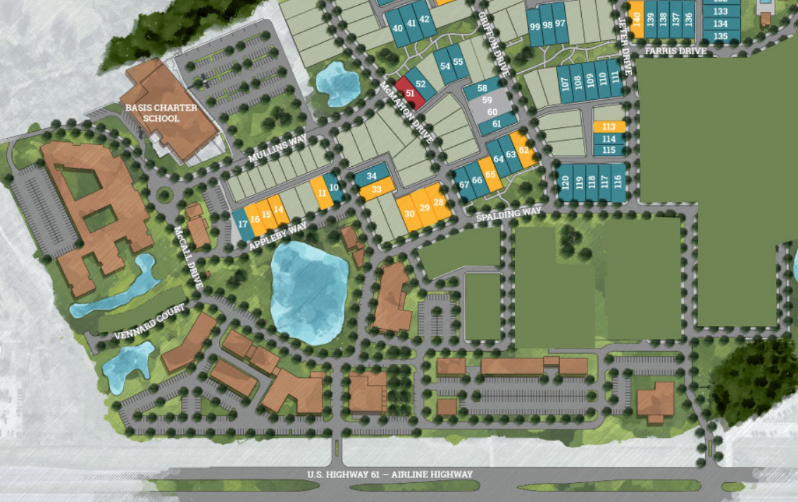
MATERRA | Level Homes
NEW - Location: Baton Rouge, near Woman’s Hospital
Lot Count Phase 1: 79
Home size: 1,470 SF to 3,000+ SF
Price Range: Starting in $334,900 – $600s
Market Date: Now selling, starting construction in April

Slide 57
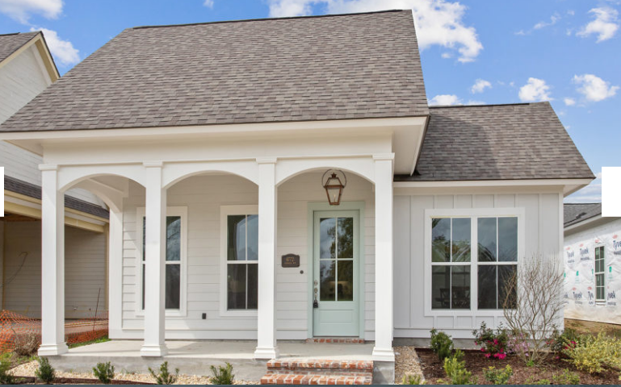
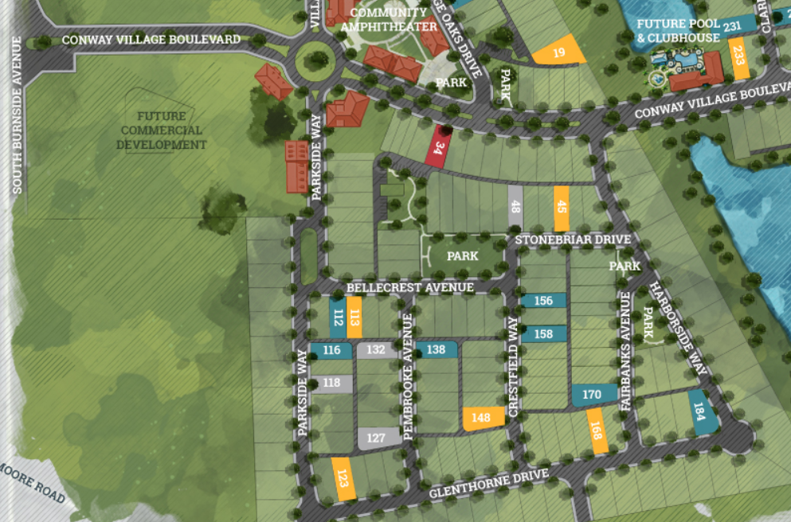
CONWAY | Level Homes
Gonzales, Louisiana
Lot Count: 27
Price Range: Starting in $290s
Home Size: 1,470 to 2,200+ SF
Currently Selling
Model Home NOW OPEN
Additional Features/Amenities: future community pool and clubhouse, lakes and walking trails

Slide 58
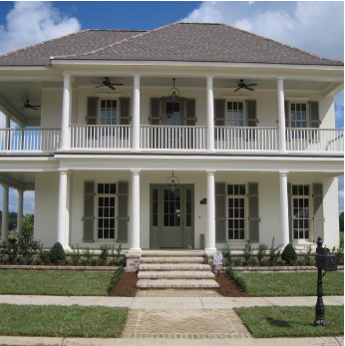
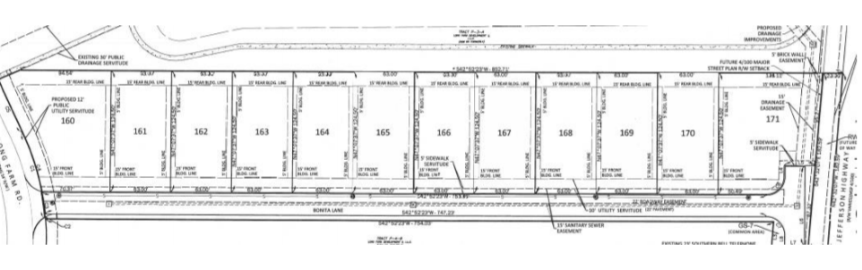
Long Farm Village | Developer: Russell Mosely
Location: Baton Rouge
A 237 acre master planned community with a mix of retail, office, multi-family, detached single family, senior living and more than 40 acres of parks/green space. 160 residential lots completed; Construction of the 4th Filing (12 lots) currently underway and scheduled to be complete in May, 2021. Lot prices average $171,000.
New home prices range from $500,000 to $900,000; Amenities: Pool/Clubhouse; Paved walks around residential

Slide 59
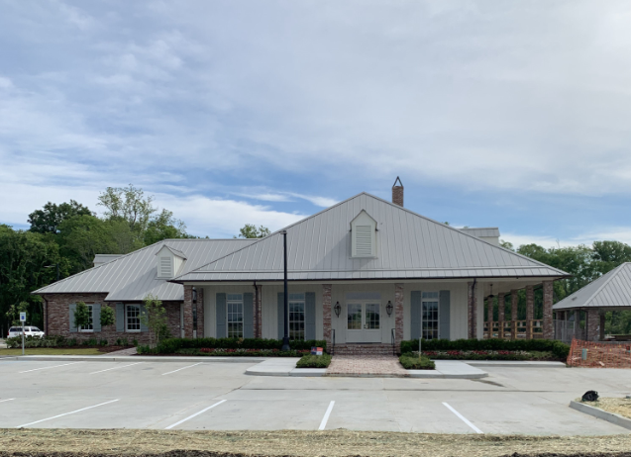
The Lakes at Harveston Phase 1 | John Fetzer and Mike Wampold
Number of Lots: 186
Homes sales to date: 30 lots Closed 24 Letters of Intent to purchase homes
Lot Price(s) from $108,000
Lot Size: 45 to 65 x 120’ to 140’
Home Size: 2,000 to 3,000 Sq.Ft.
Home Price Range: $550,000 to $750,000
Additional Features:
  Community Center overlooking the 50 acre Harveston Lake with fountains
    Community Building
    Fitness Center
    Cabana with Grill
    Pool and Splash Pad
    Mail Center
    Multi-Use Trails and Walks

Slide 60

THANK YOU

