Slide 1
FINANCE
PRESENTED BY
Jim Purgerson, CCIM – Citizens Bank & Trust
Jamie Taylor – The Mortgage Firm

Slide 2
FINANCE COMMITTEE MEMBERS
Jim Purgerson, CCIM
Trends Speaker
Citizens Bank & Trust
Jamie Taylor
Trends Speaker
The Mortgage Firm
Brian S. Andrews, CMB
TRENDS Magazine Research
The Real Estate Research Institute
At LSU’s E. J. Ourso College of Business
Scott Gaudin
Currency Bank
Holly Hidalgo-DeKeyzer
Investar Bank
C. Brett Blanchard
Bancorp South
Tommy Kehoe
Eustis Commercial Mortgage
Elise Walker
Assurance Financial
T. Jefferson Fair
American Planning Corporation

Slide 3
TEAM FINANCE
Home mortgage rates
Survey of Local Bankers
Appetite for loans based on property type
Interest rate trends by certain property types (and owner occupied / non-owner occupied)
Amortizations and down payment requirements
Debt Service Coverage requirements
Flood 2.0
Banker Concerns & Hot Topics for Regulators
Residential Mortgage Trends
Changes coming at credit reporting agencies
Tightening of Lending Standards & why the next recession will not mirror 2007/2008 foreclosure crisis
Property value surges and their affect on foreclosures

Slide 4
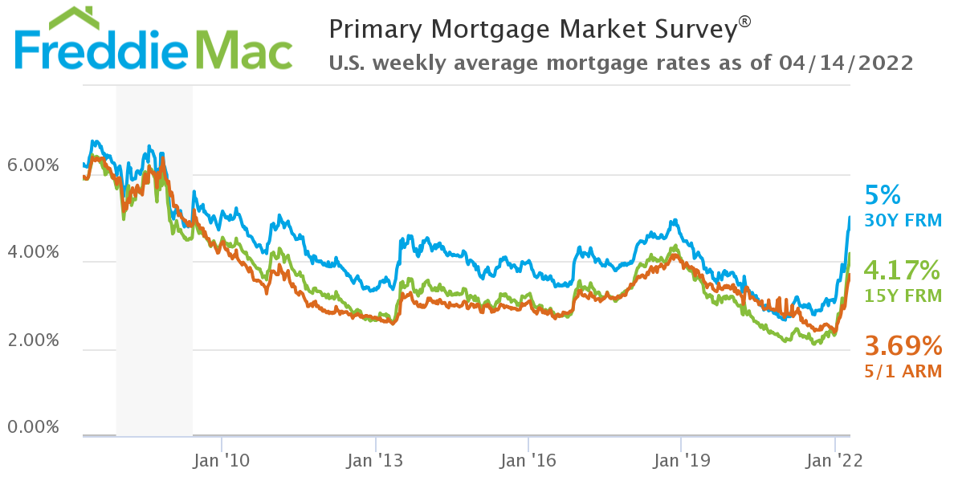
2008
2021
2019
2013
SOURCE: FREDDIE MAC

Slide 5
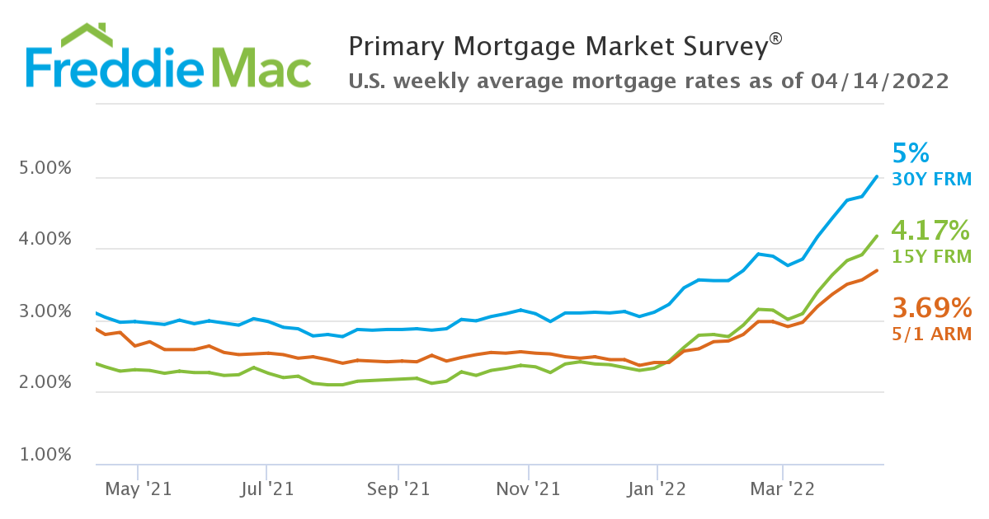
April
2022
April
2021
SOURCE: FREDDIE MAC

Slide 6
BANKER SURVEY
BancorpSouth | Brett Blanchard | Guaranty Bank | Wade O'Neal
Bank of St Francisville | Carter Leak | Gulf Coast Bank & Trust | Gary Littlefield
Bank of Zachary | Josh Prejean | HancockWhitney | Jerry Denicola
BankPlus | Andy Adler | Home Bank | Chris Harrell
B1 Bank | Mike Nizzo | Investar Bank | Holly Hidalgo
Campus Federal | Jay Noel | Louisiana National Bank | Alex Mahon
Capital One | David Mullins | Plaquemine Bank | Janet Campo
Citizens Bank & Trust | Ryan Elliott | Red River Bank | David Thompson
Concordia Bank | Scott Singletary | Resource Bank | Kirk Maynard
Currency Bank | Scott Gaudin | South Louisiana Bank | Steve Crispino
Essential FCU | Rick Williams | The Cottonport Bank | Keith Miller
First Bank and Trust | Dennis Shill | The First | Kevin Schexnayder
First Horizon | John Everett | United Community Bank | David Henry
Survey of Local Financial Institutions
Rates
Amortizations
Debt Coverage Ratios
Appetite for
Property Types
FLOOD 2.0
Regulator Concerns

Slide 7
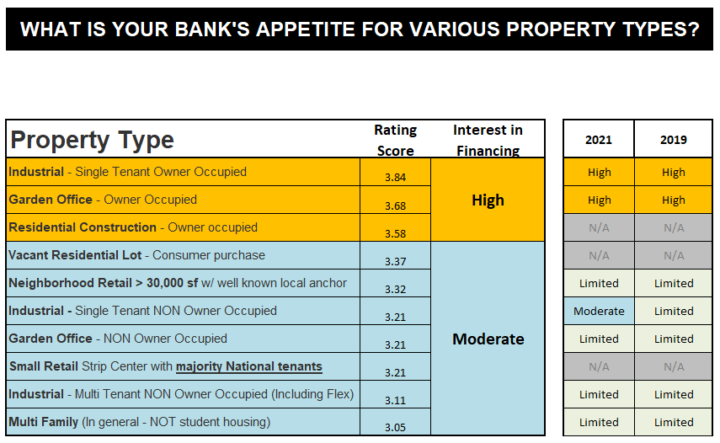

Slide 8
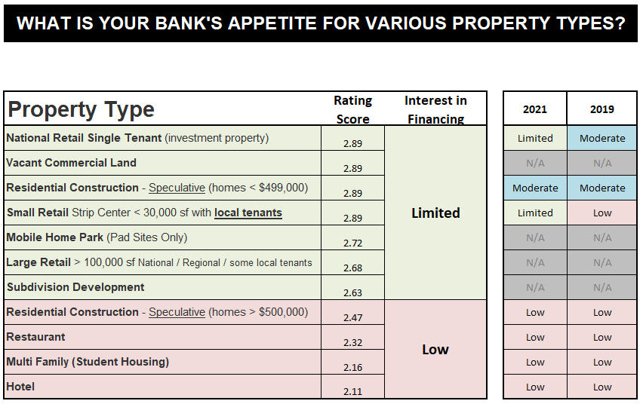

Slide 9
Fixed Interest Rates – average interest rates offered on the following loan types
(assuming moderate to high credit quality)
2022
2021
% Change
Owner Occupied - Three (3) Year fixed
4.37%
N/A
Owner Occupied - Five (5) Year fixed
4.61%
3.87%
+19%
Owner Occupied - Seven (7) Year fixed
4.81%
4.13%
+16%
Owner Occupied - Ten (10) Year fixed
5.02%
4.34%
+16%
Non-Owner Occupied - Three (3) Year fixed
4.65%
N/A
N/A
Non-Owner Occupied - Five (5) Year Fixed
4.95%
4.40%
+13%
Non-Owner Occupied - Seven (7) Year Fixed
5.07%
4.69%
+8%
Non-Owner Occupied - Ten (10) Year Fixed
Majority of banks not offered
Majority of banks not offered

Slide 10
AMORTIZATIONS
Typical amortization offered based on property type
Majority of property types – 20 year amortization
Mobile Home Parks and Restaurants – 15 year amortization

Slide 11
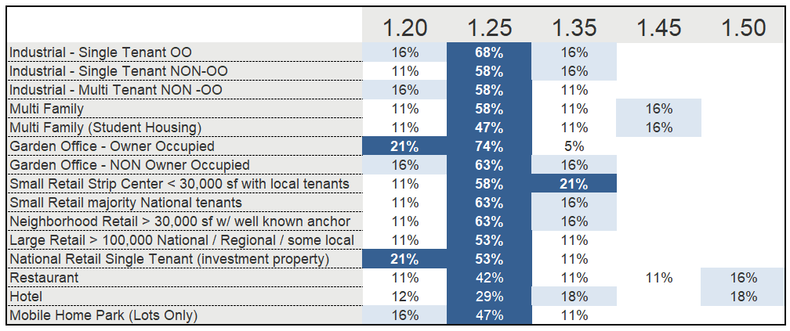
DEBT COVERAGE RATIOS
Typical debt coverage minimum based on property type

Slide 12
FLOOD INSURANCE (Risk Rating 2.0)
All policies renewing on or after April 1, 2022, will be subject to new rating methodology
Potential effect on:
Net Operating Income
Debt Coverage Ratios
Property values
Example: $10,000 flood premium – increase of 25% to $12,500
$2,500 Increase
8% Cap Rate
$31,250 Decrease in Property Value
84% of Banks polled say it will have an impact on underwriting

Slide 13
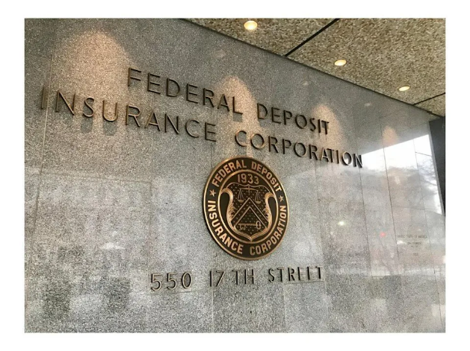
Hot Topics for Bank Regulators
Construction & land development (Speculative deals get a closer look, especially with rising construction costs and cost overruns)
Increased Flood & Hazard Insurance
Compression of Debt Coverage Ratios
Appraised Values
Concerns that the appraised values won’t keep up with the costs of properties
Covenant Compliance
Caused by depressed DSC & values
Lack of regulators(understaffed)
Exam teams from other states & remote exams
Lack of understanding of Louisiana markets
Young, new, inexperienced examiners

Slide 14
Residential Mortgage Trends
Jamie Taylor, The Mortgage Firm

Slide 16
Notes:
Affordability for move up buyer but majority of issues with 1st time homebuyers. Increasing rates you need to make sure your buyer’s preapprovals stay current
– fastest increase in rates in 20 years
- Second home rates increased to almost mirror investment property rates

Slide 17
What has caused the inventory issue?
Mortgage Crisis of 2007-2008
Supply Chain & Labor issues
Lack of lots available
Low rates
Millennials entering market
Notes:
The 2022 Home Buyer and Seller Generational Trends report from the National Association of Realtors® (NAR) says the Millennial bloc, now aged 23 to 41, are accounting for more transactions than any other age group, 43 percent of home sales, up from 37 percent a year earlier.

Slide 18
The bad news…
Potential recession on the horizon
Inflation
Rates are on the rise
Affordability becoming an issue

Slide 19
What’s the good news?
This is not the Mortgage Crisis of 2007-2008

Slide 20
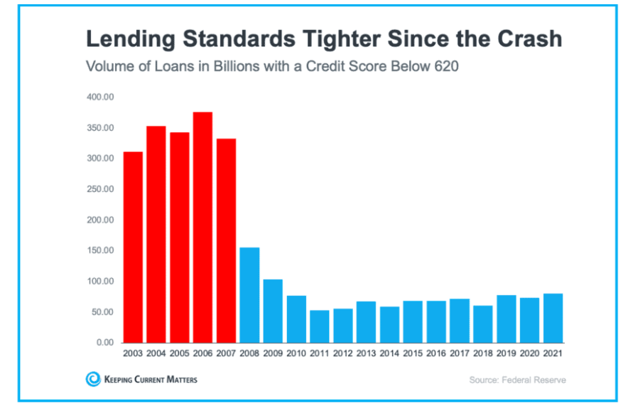

Slide 21
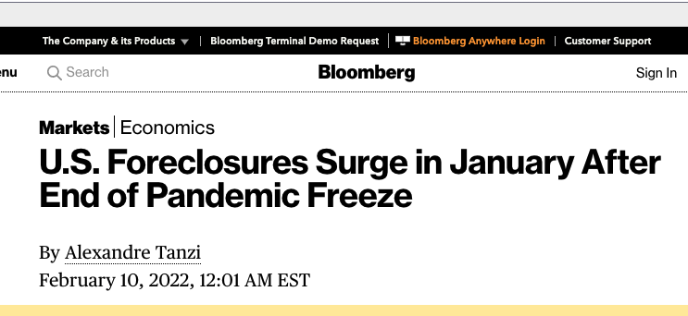
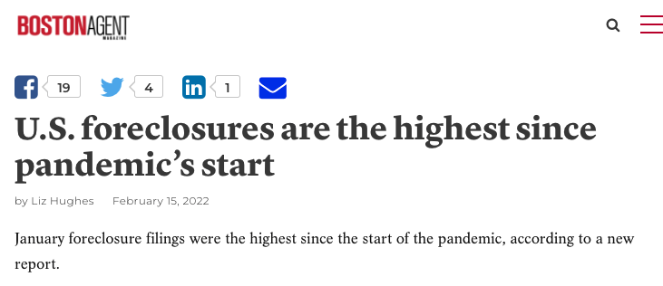
Notes:
https://bostonagentmagazine.com/2022/02/15/u-s-foreclosures-are-the-highest-since-pandemics-start/
https://www.bloomberg.com/news/articles/2022-02-10/u-s-foreclosures-rose-in-january-after-end-of-pandemic-freeze

Slide 22
Foreclosure Activity at an All-Time Low
Source: ATTOM Data Solutions

Slide 23
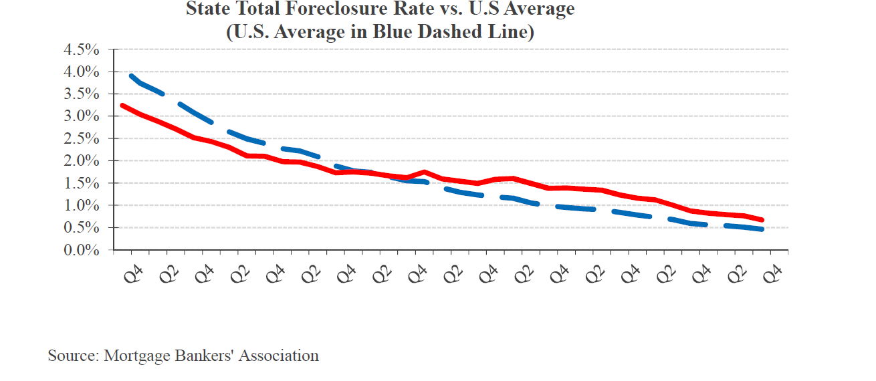

Slide 24
“A surge in foreclosures as the forbearance plan ends is unlikely. The very rapid home price appreciation in 2020 - 2021 has boosted home equity. Record levels of home equity will help limit the number of homeowners that experience foreclosure.”
- Archana Pradhan, Economist, CoreLogic
Notes:
house prices increased 18.05 percent, on average, between the third quarters of 2020 and 2021.

Slide 25
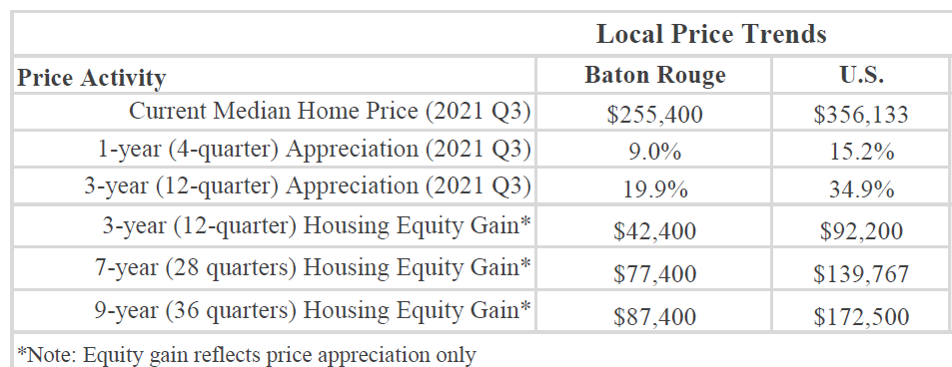
Equity has increased…

Slide 26
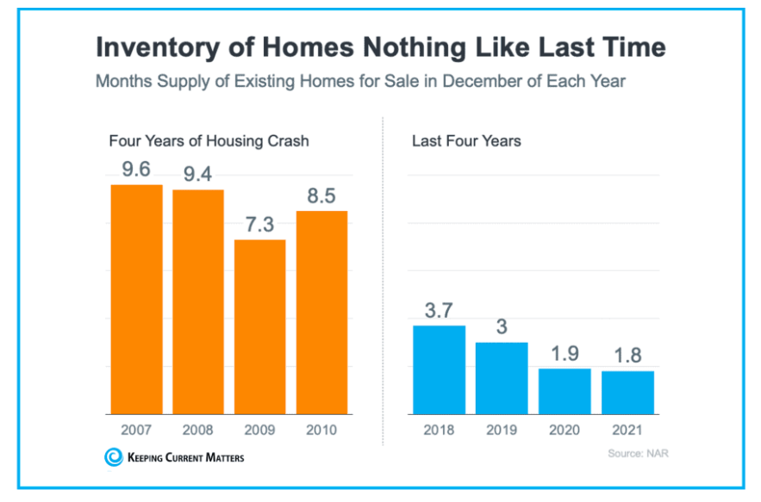

Slide 27
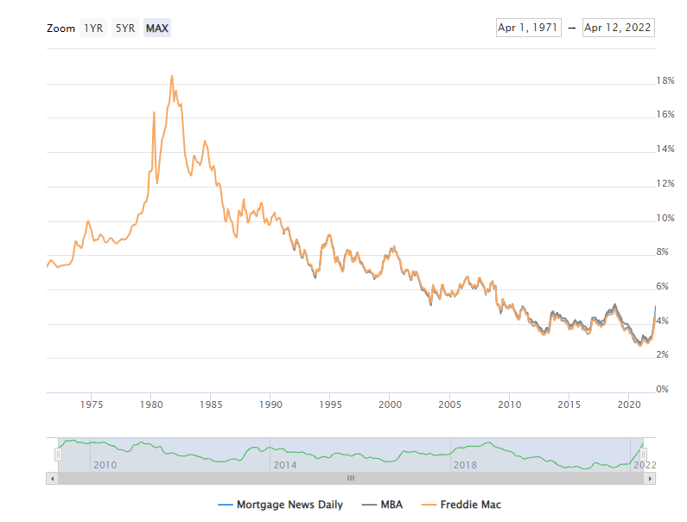
Rates are still historically low…

Slide 29
Medical Collections
Starting on July 1
Will eliminate up to 70 percent of the medical debt
Will not be reported until after a full year of being sent to collections — instead of the current six months
In 2023, the credit-reporting companies will exclude unpaid medical collection debts under $500
Help boost score and improve terms for borrowers/affordability

Slide 30
Underwriting Guidelines
Covid overlays removed for self-employed
Jumbo and Non-QM loans are back
Credit score requirements back to pre-covid standards
Loan limits increased from 2021 to 2022
Conventional
From $548,250 to $647,200
FHA
From $356,362 to $420,680
Notes:
Loan limit increases should help with affordability / avoid jumbo financing which has more strict requirements

Slide 31
Advice for homebuyers
Get preapproved
Work with a realtor
Focus on budget and monthly payment – not rate
Be flexible
Move up buyer - Use equity to pay down debt
Improve credit
Save money
Notes:
Loan limit increases should help with affordability / avoid jumbo financing which has more strict requirements

Slide 33
Jamie Taylor Branch Manager, Loan Originator 225-921-4003 Jamie.taylor@ tmf.mortgage

Slide 34
THANK YOU

