Slide 1
BATON ROUGE
INDUSTRIAL MARKET
PRESENTED BY
Evan Scroggs, CCIM
NAI Latter and Blum

Slide 2
INDUSTRIAL COMMITTEE MEMBERS
Evan Scroggs, CCIM
Chairman
NAI Latter & Blum
Scot Guidry, CCIM
Mike Falgoust & Associates
Todd Pevey, MPA
St. John Properties
Grey Mullins, CCIM
Grey Mullins Commercial Properties
Brent Garrett, CCIM, SIOR
Beau Box Commercial Real Estate
David Lakvold, MAI, SRA
The Lakvold Group
Dex Shill
NAI Latter & Blum
Alex McCollam
NAI Latter & Blum
Lance Ginn, CCIM
Beau Box Commercial Real Estate

Slide 3
Industrial is Sexy?
Pre-Covid
Post-Covid

Slide 4
Industrial Real Estate as:
A highly desirable asset type
An in-demand property type for users – both buyers and tenants
An underbuilt product type nationally and locally

Slide 5
2022 Industrial Trends
Defining the Dataset (Geography and Type)
National Trends
Local Trends
Evolving Demand Drivers
Outlook

Slide 6
The Dataset
(Geography and Type)

Slide 7
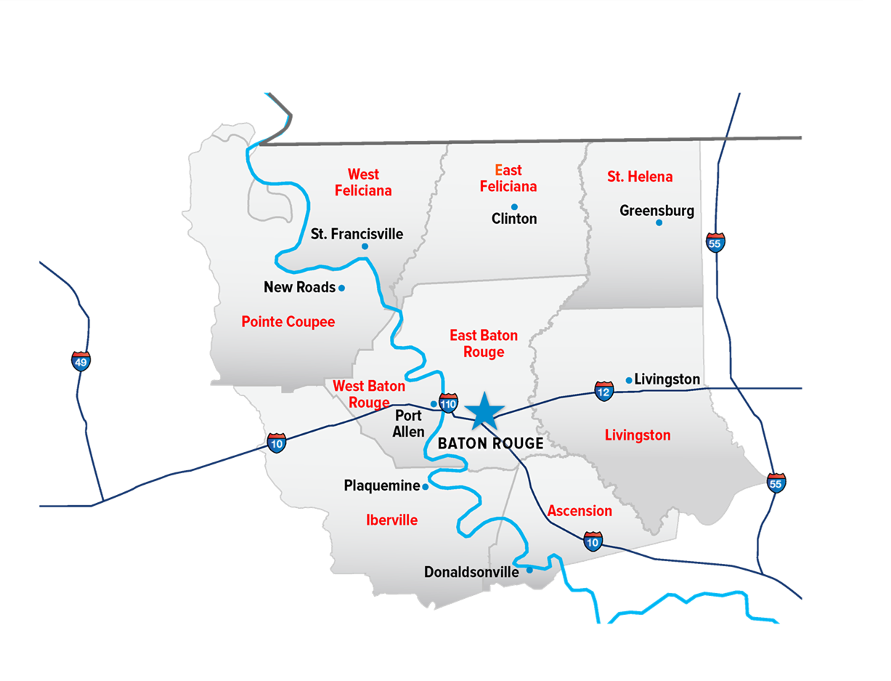
Baton Rouge MSA

Slide 8
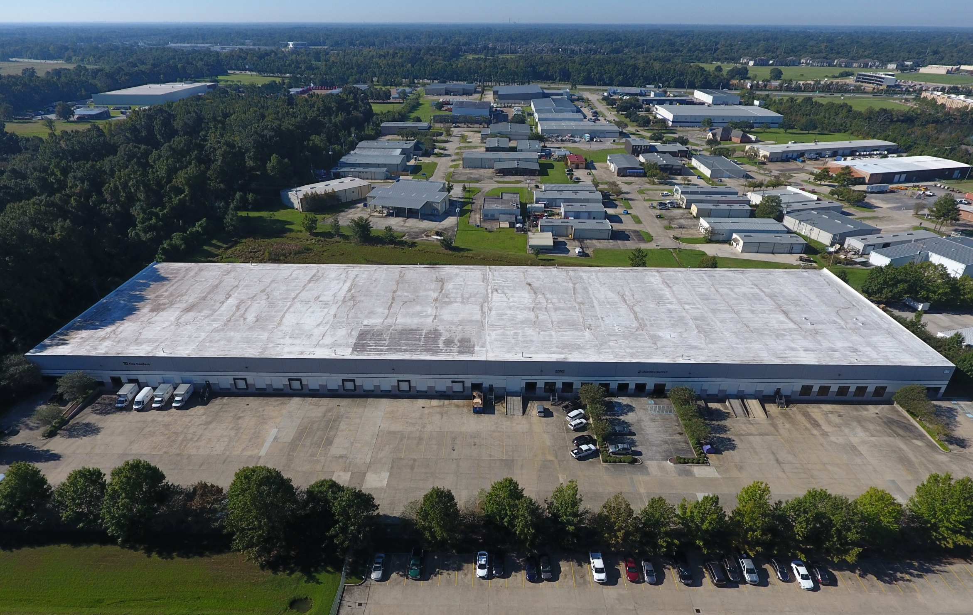
Bulk Warehouse/Distribution

Slide 9
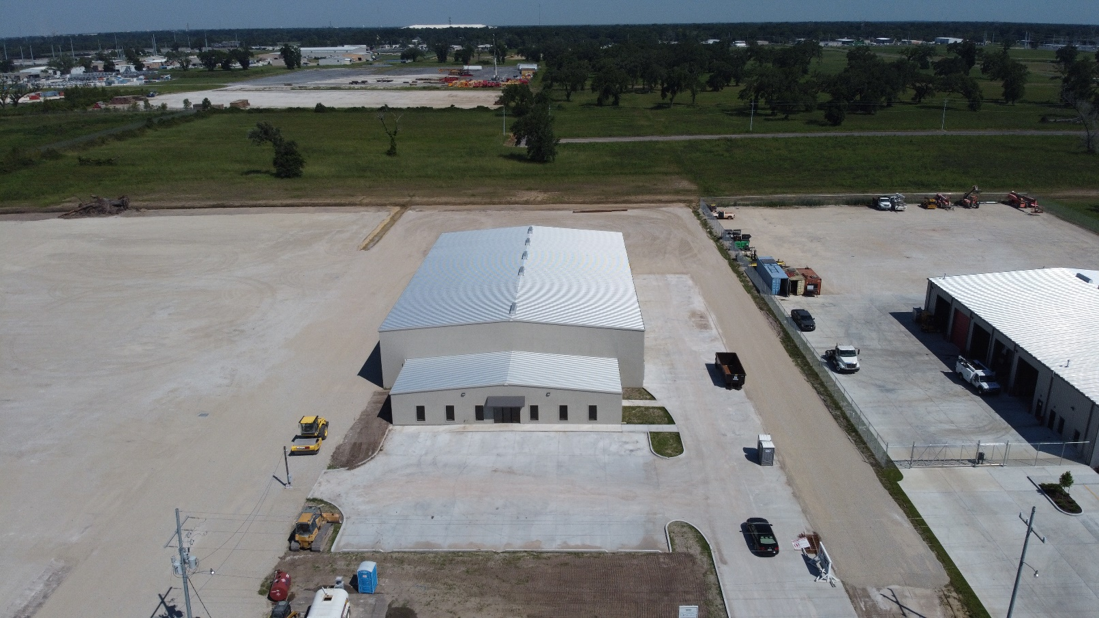
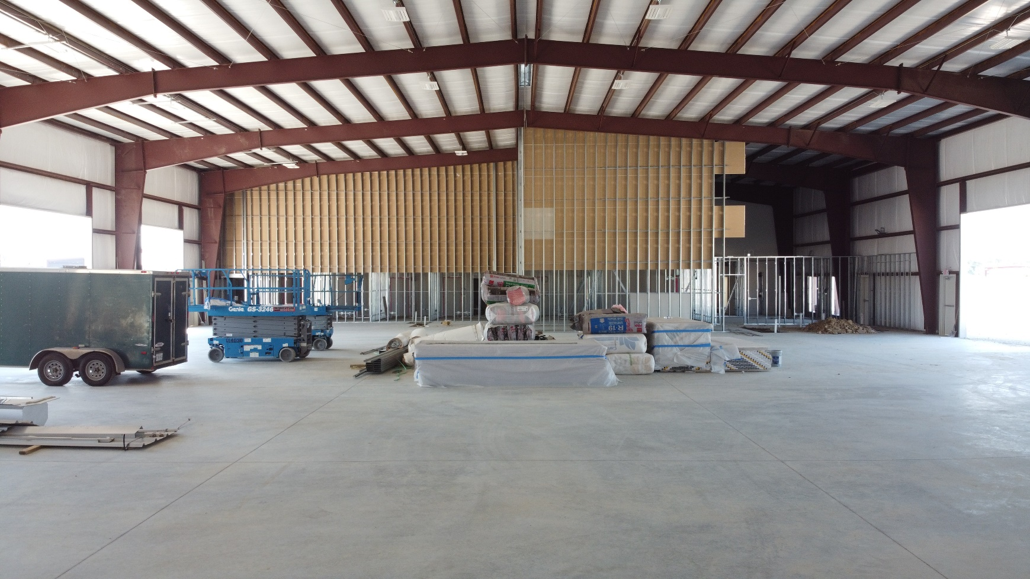
Office-Warehouse

Slide 10
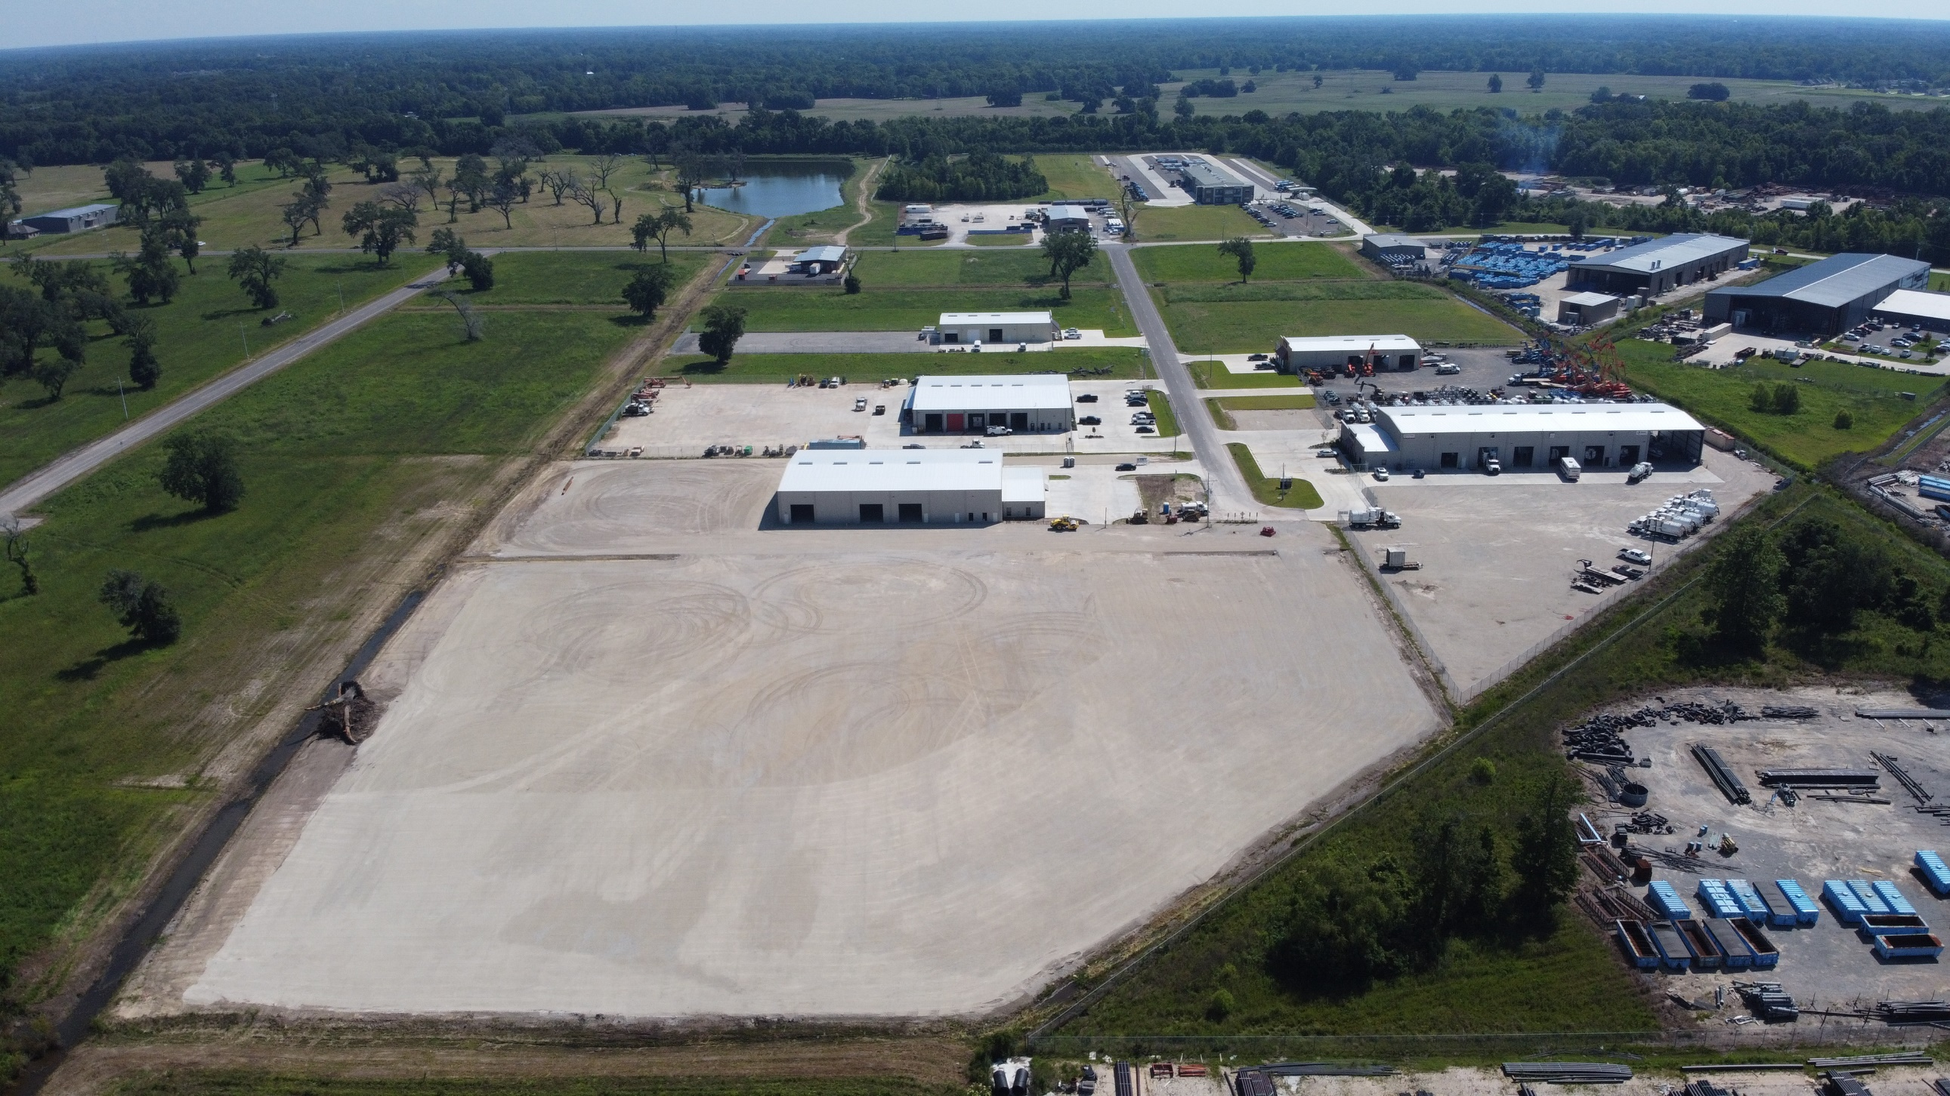
Office-Warehouse

Slide 11
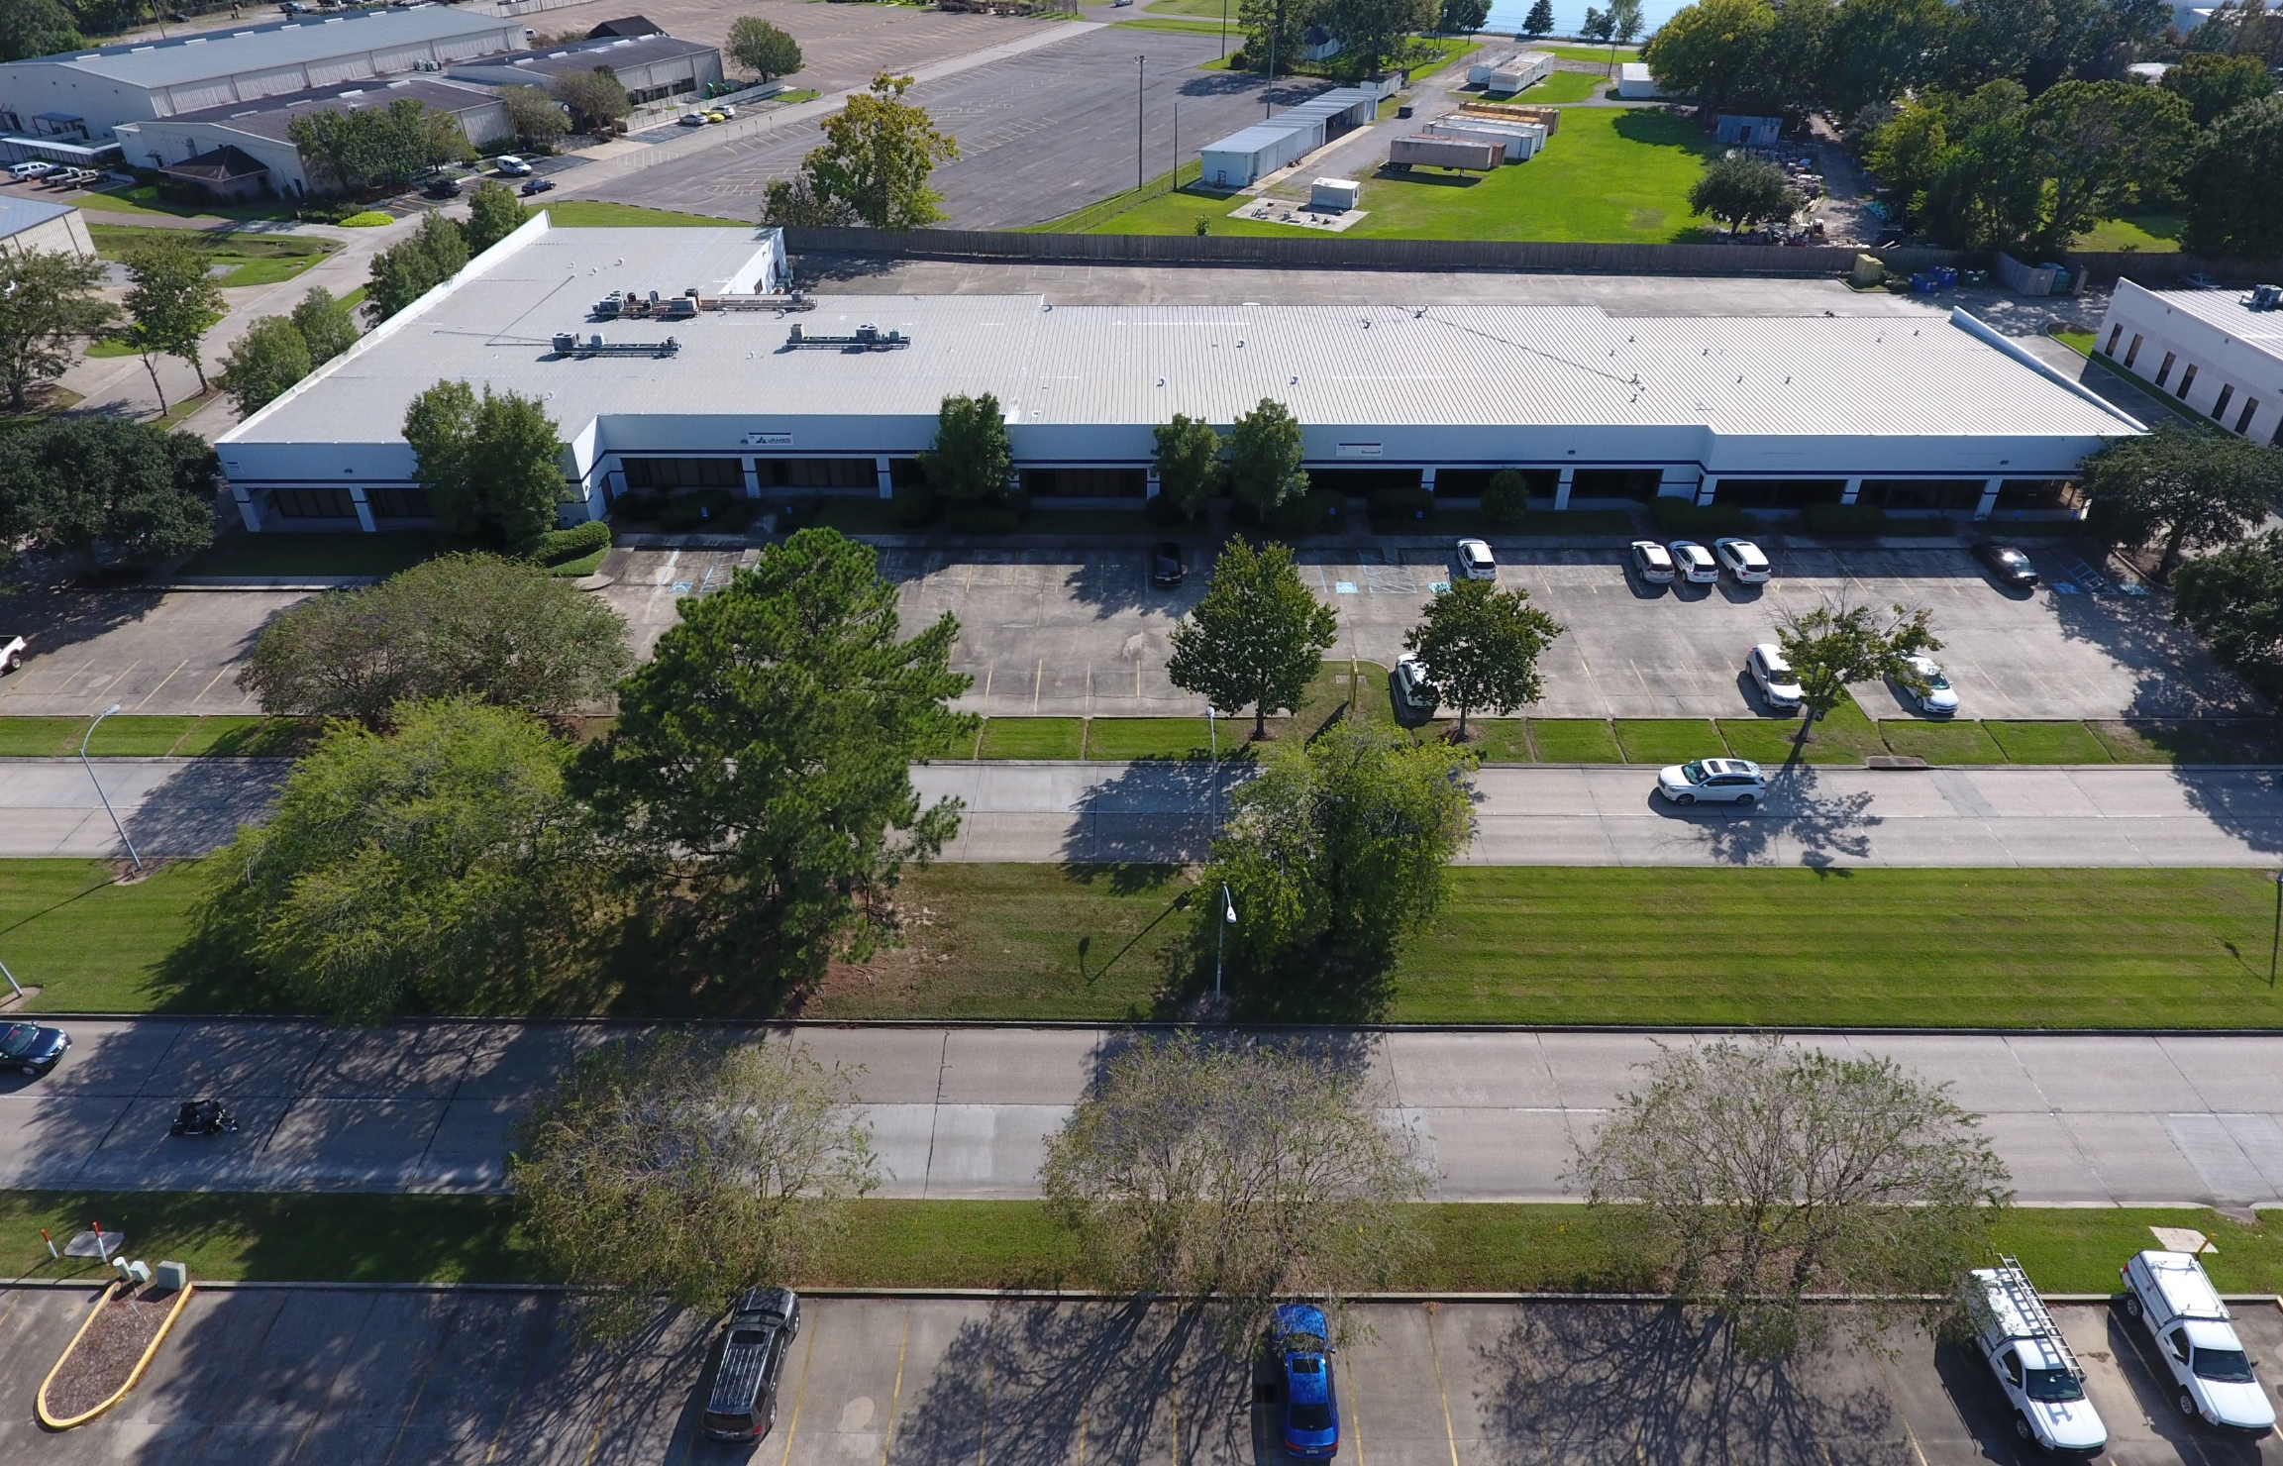
Flex Space

Slide 12
National Trends

Slide 13
Record Low Vacancy Rate (3.8%)
350M SF Built in 2021
Nearly 500M SF of net absorption
467M SF currently under construction
Cap Rates are at record lows in every market type
Highest annual and quarterly transaction volume occurred in 2021 and Q4 of 2021

Slide 14
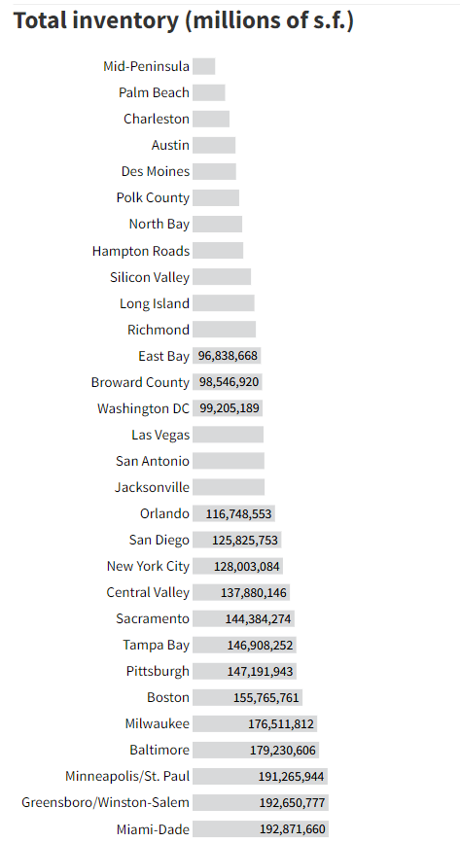
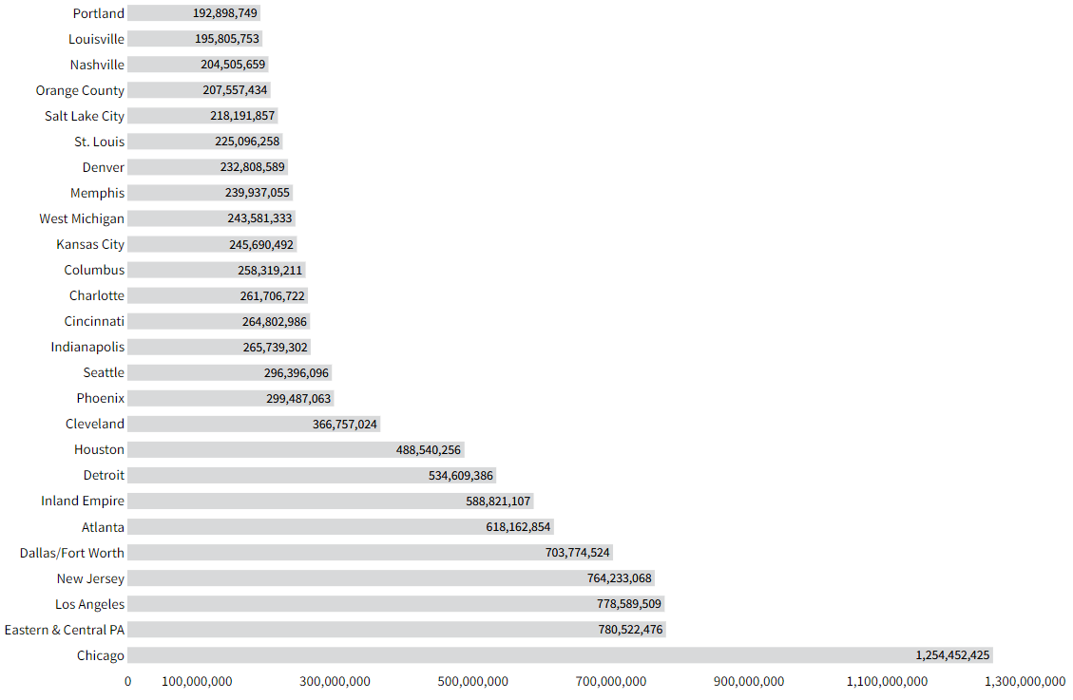
32M SF

Slide 15
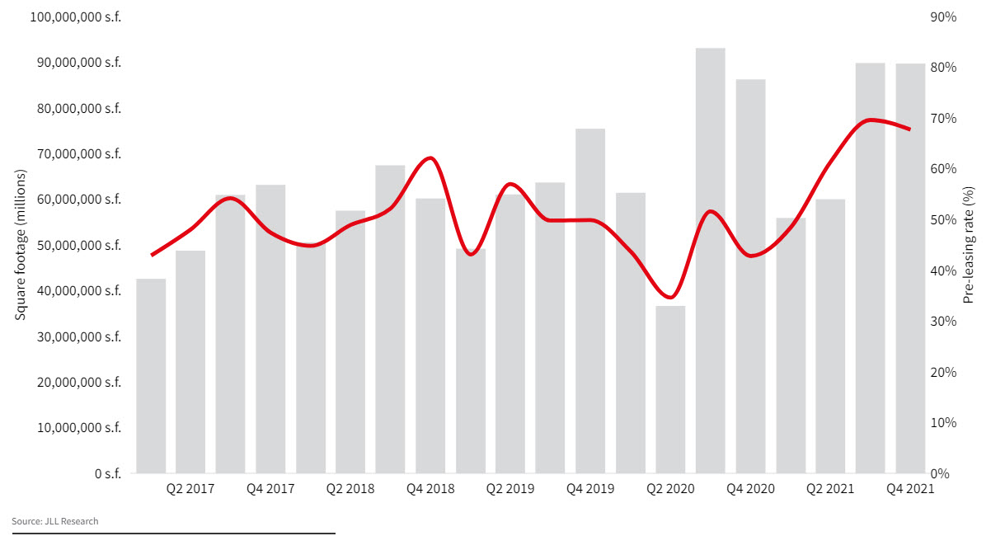
Pre-Leasing Activity Trends

Slide 16
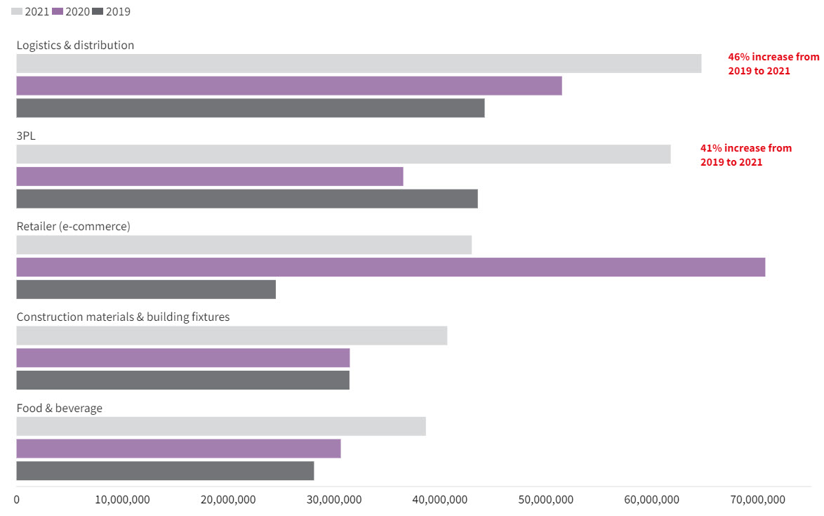
Leasing Activity Trend

Slide 17
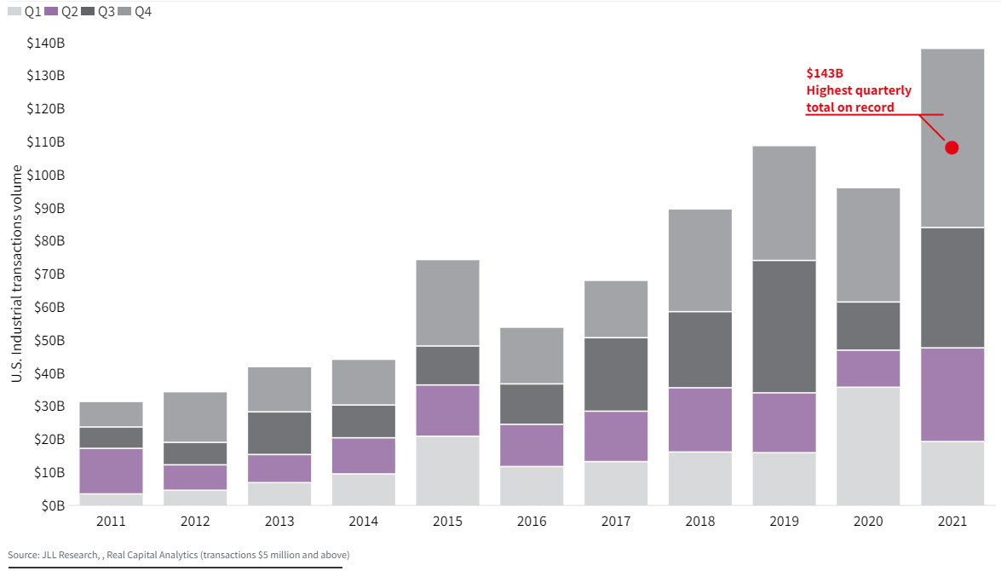
Industrial Transaction Volume

Slide 18
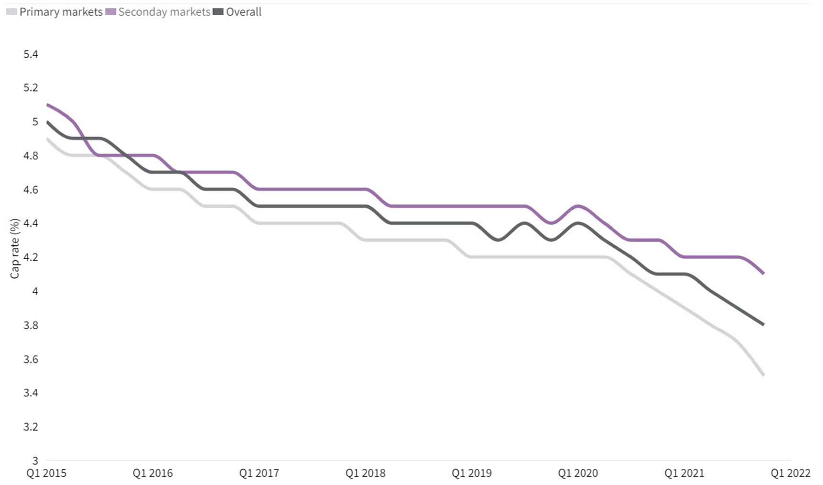
Cap Rate Trends
4.1%
3.8%
3.5%

Slide 19
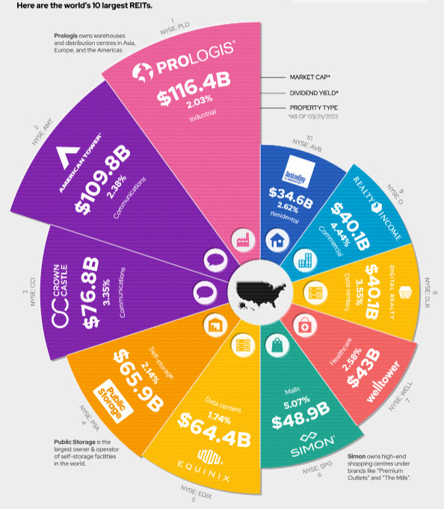

Slide 20
Local Trends

Slide 21
Record Low Vacancy Rate (3.08%)
4.25M SF under construction
Nearly 1.5M SF of net absorption
Cap Rates are compressed and good assets are hard to find
Chronically underbuilt
Rates increasing due to limited supply and rising construction costs

Slide 22
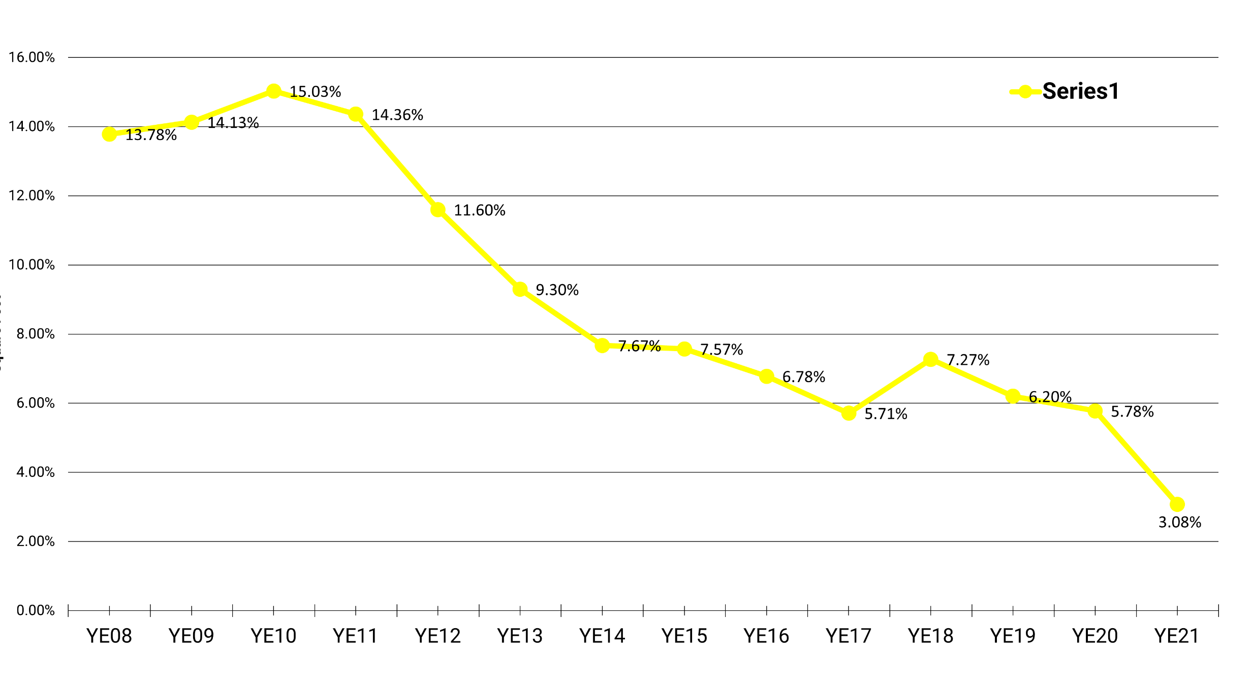
Vacancy Rate Trends

Slide 23
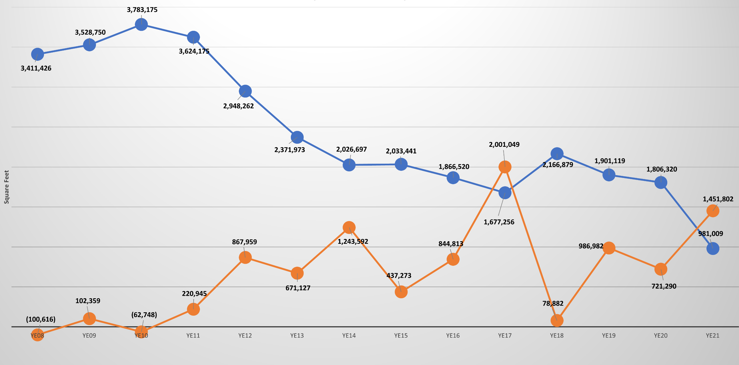
Historical Vacancy vs. Absorption
Vacancy
Absorption

Slide 24
Construction vs. Absorption
Year | Annual Construction | Annual Absorption | Surplus/Deficit
2013 | 738,459.00 | 671,127.00 | 67,332.00
2014 | 969,344.00 | 1,243,592.00 | (274,248.00)
2015 | 204,892.00 | 437,273.00 | (232,381.00)
2016 | 2,122,199.00 | 844,813.00 | 1,277,386.00
2017 | 533,752.00 | 2,001,049.00 | (1,467,297.00)
2018 | 478,433.00 | 78,882.00 | 399,551.00
2019 | 684,459.00 | 986,982.00 | (302,523.00)
2020 | 843,035.00 | 721,290.00 | 121,745.00
2021 | 4,248,962.00 | 1,451,802.00 | 2,797,160.00
Average | 1,202,615.00 | 937,423.33 | 265,191.67

Slide 25
Construction vs. Absorption Revisited
Year | Annual Construction | Annual Absorption | Surplus/Deficit
2013 | 738,459.00 | 671,127.00 | 67,332.00
2014 | 969,344.00 | 1,243,592.00 | (274,248.00)
2015 | 204,892.00 | 437,273.00 | (232,381.00)
2016 | 2,122,199.00 | 844,813.00 | 1,277,386.00
2017 | 533,752.00 | 2,001,049.00 | (1,467,297.00)
2018 | 478,433.00 | 78,882.00 | 399,551.00
2019 | 684,459.00 | 986,982.00 | (302,523.00)
2020 | 843,035.00 | 721,290.00 | 121,745.00
2021 | 117,089.00 | 1,451,802.00 | (1,334,713.00)
Average | 1,202,615.00 | 937,423.33 | (193,905.33)

Slide 26
Demand Drivers

Slide 27
What’s driving demand?
Bread and Butter – Petro Chem driving demand from service and supply companies
Petro Chem crossover into bulk warehouse
Amazon/e-commerce
Logistics and Distribution
Food and Beverage
Healthcare/Medical

Slide 28
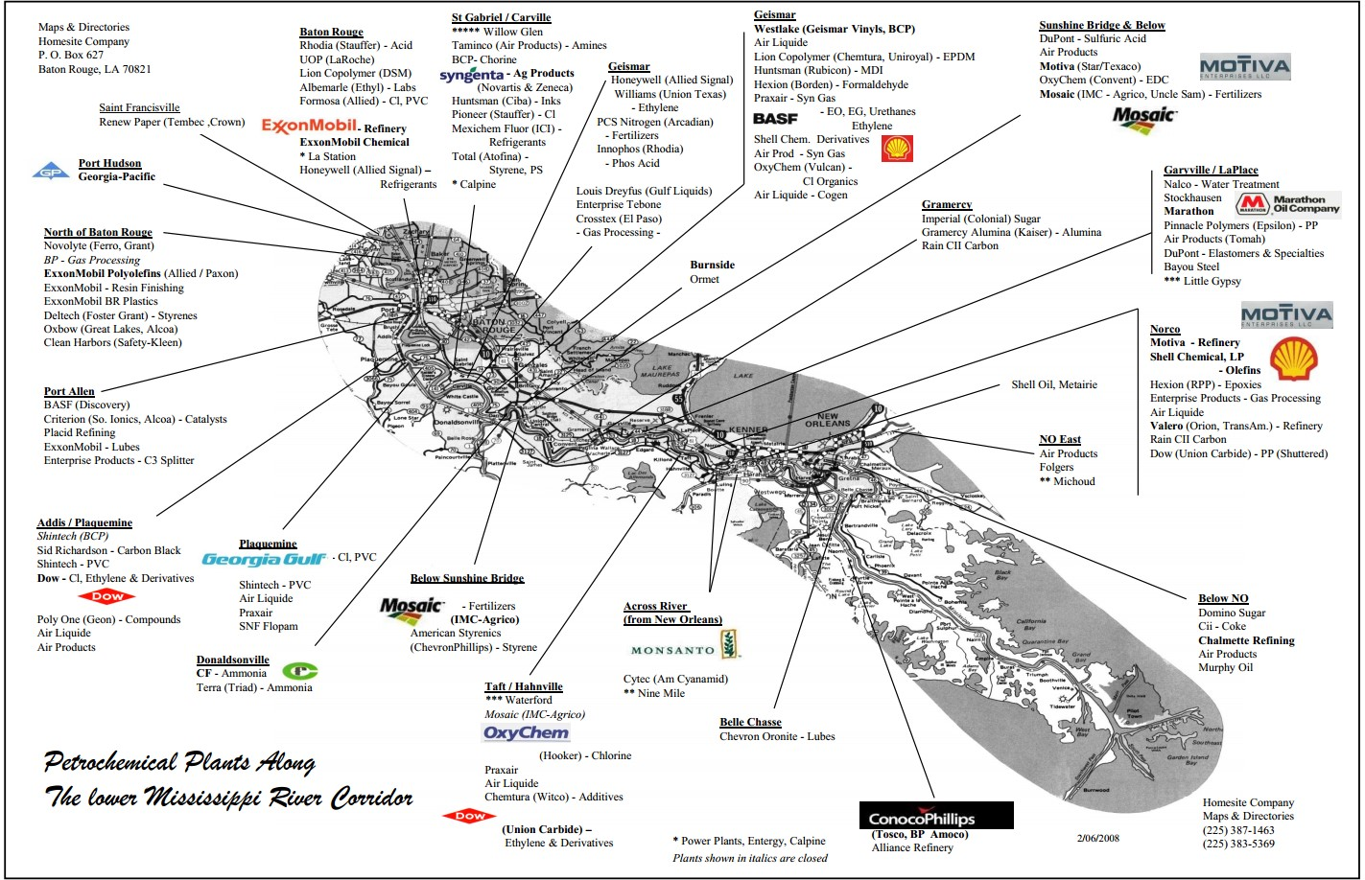

Slide 29
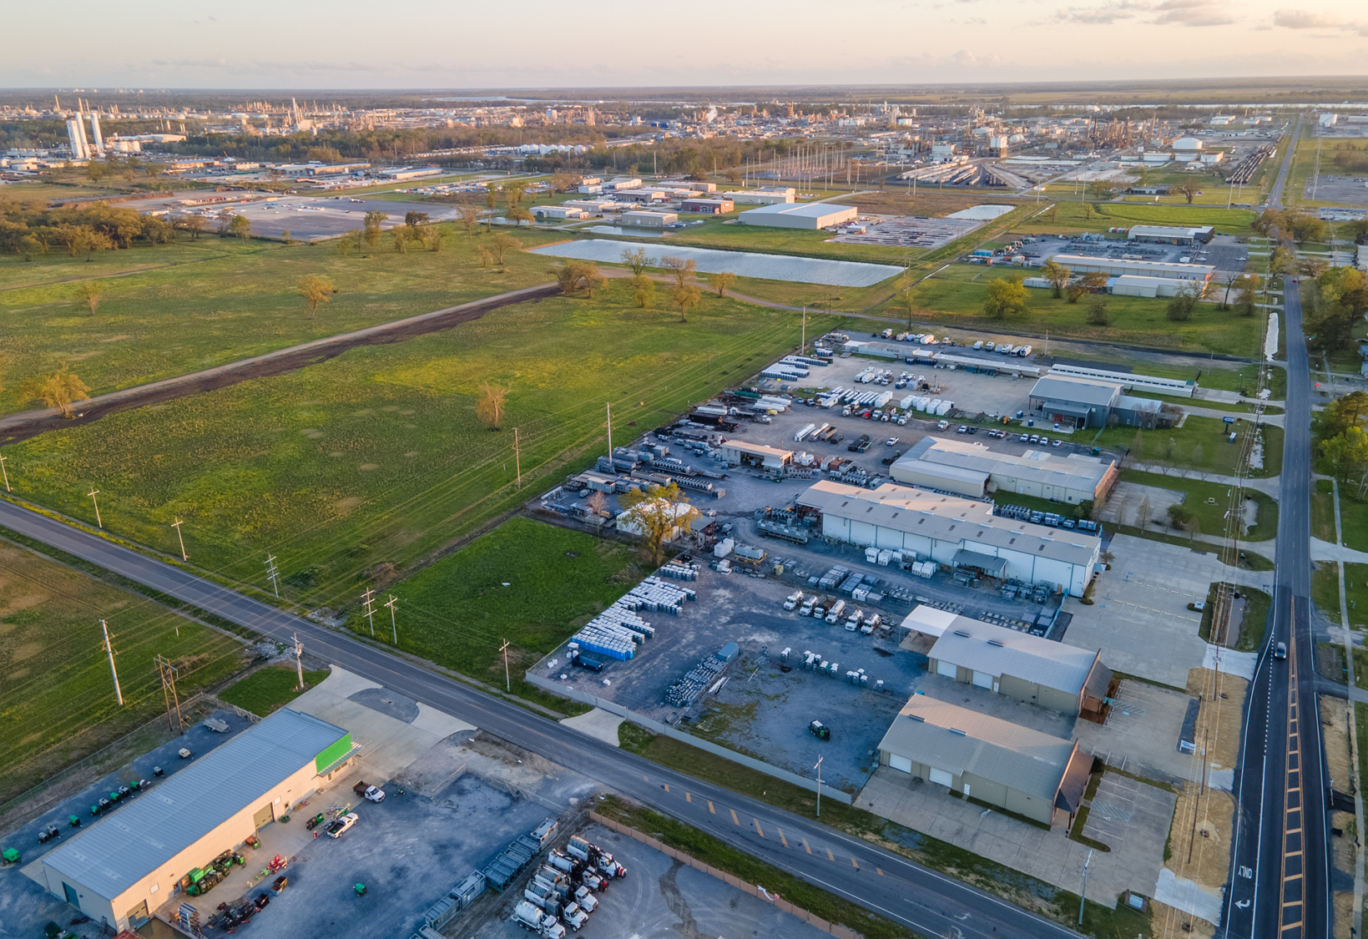

Slide 30
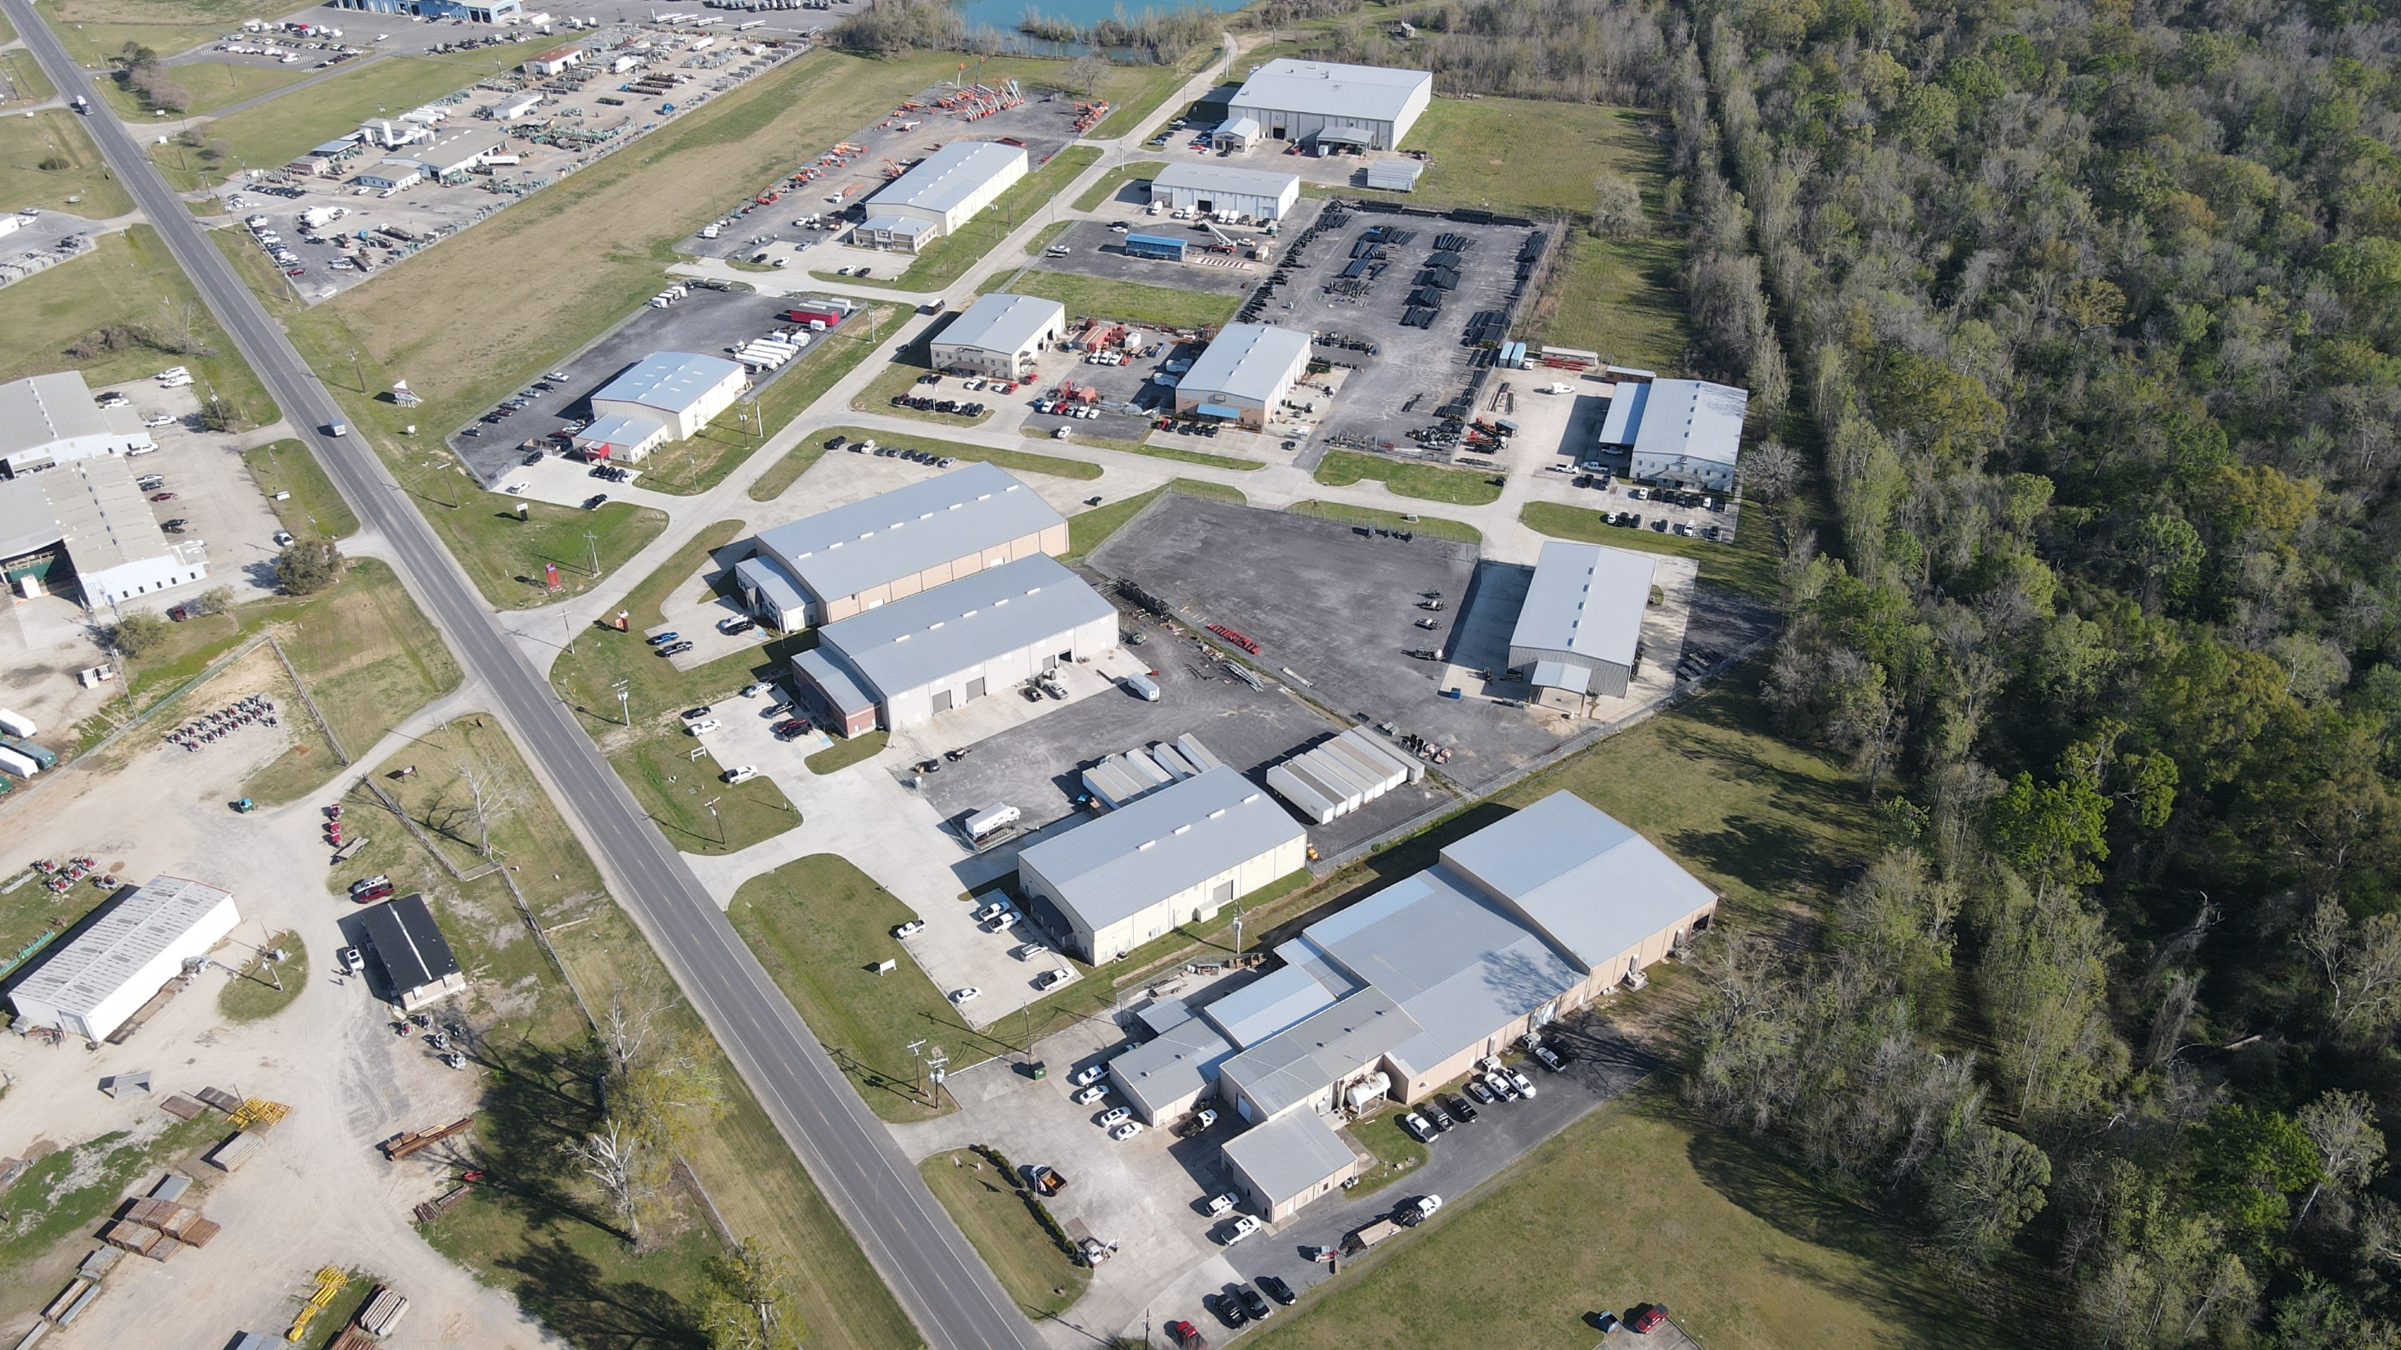

Slide 31
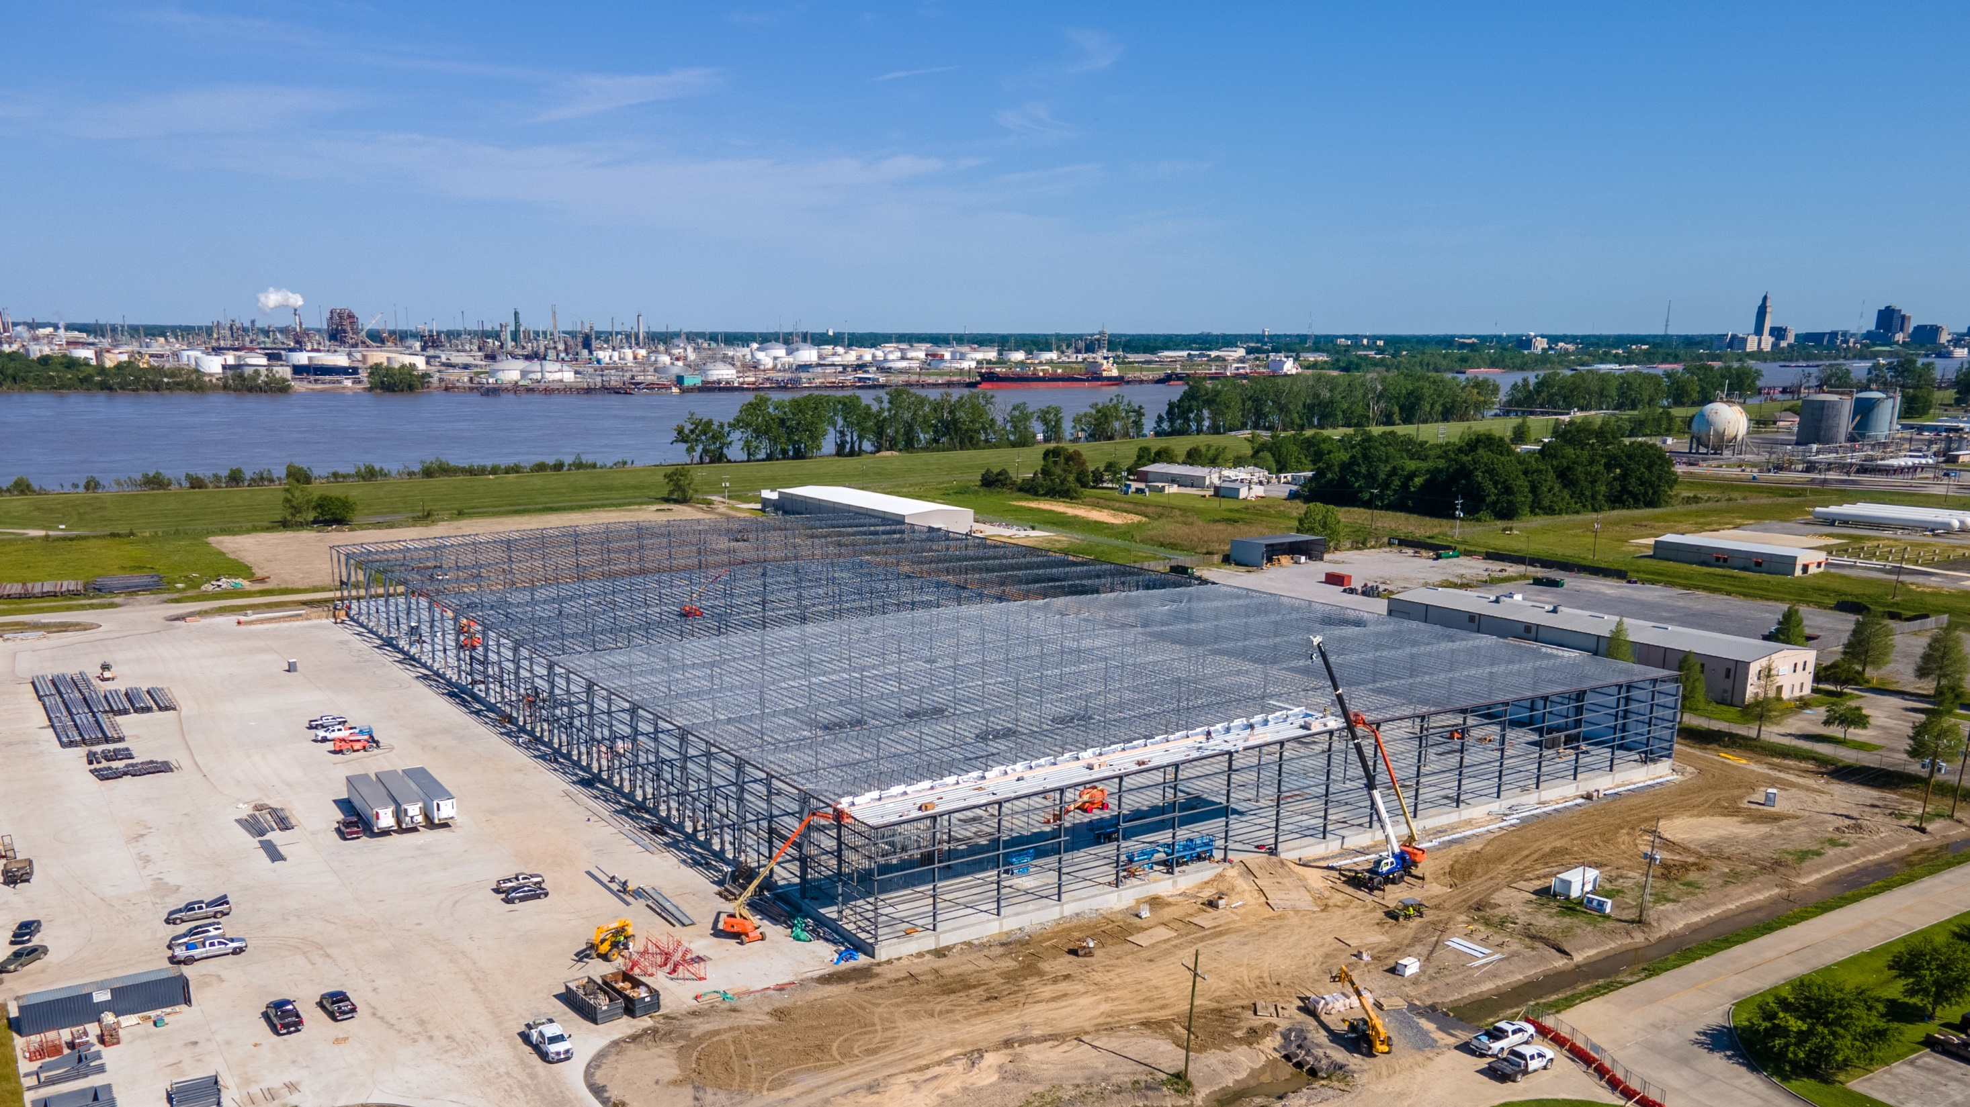
Poplar Grove – 300,000 SF
Occupied by BP
XPO is the 3PL

Slide 32
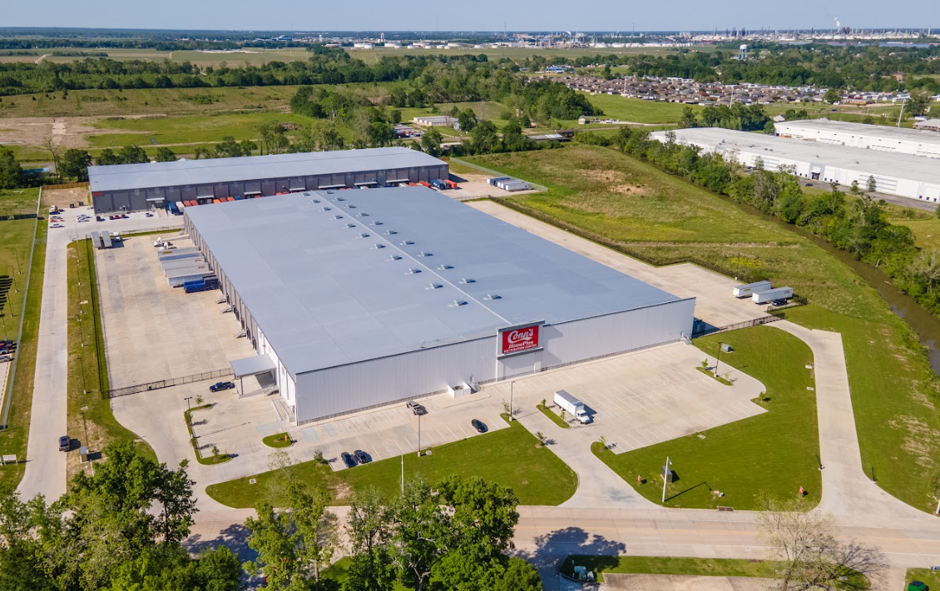
Dupont – 155,000 SF
Completed 9/21
Conn’s – 250,000 SF
Completed 2020

Slide 33
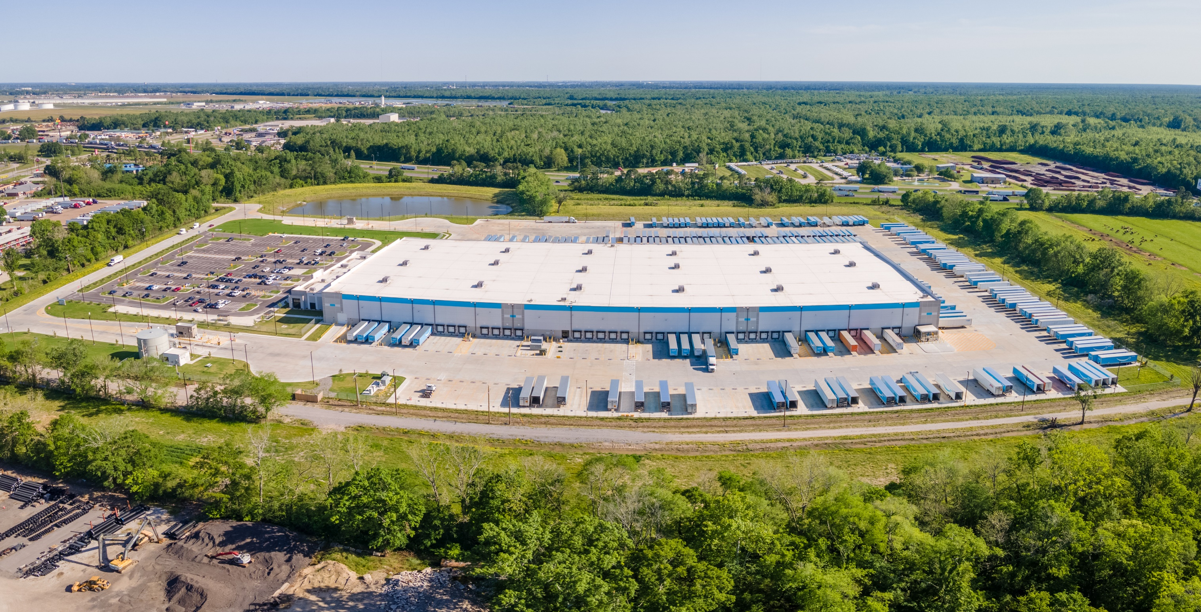
Amazon – 300,000 SF

Slide 34
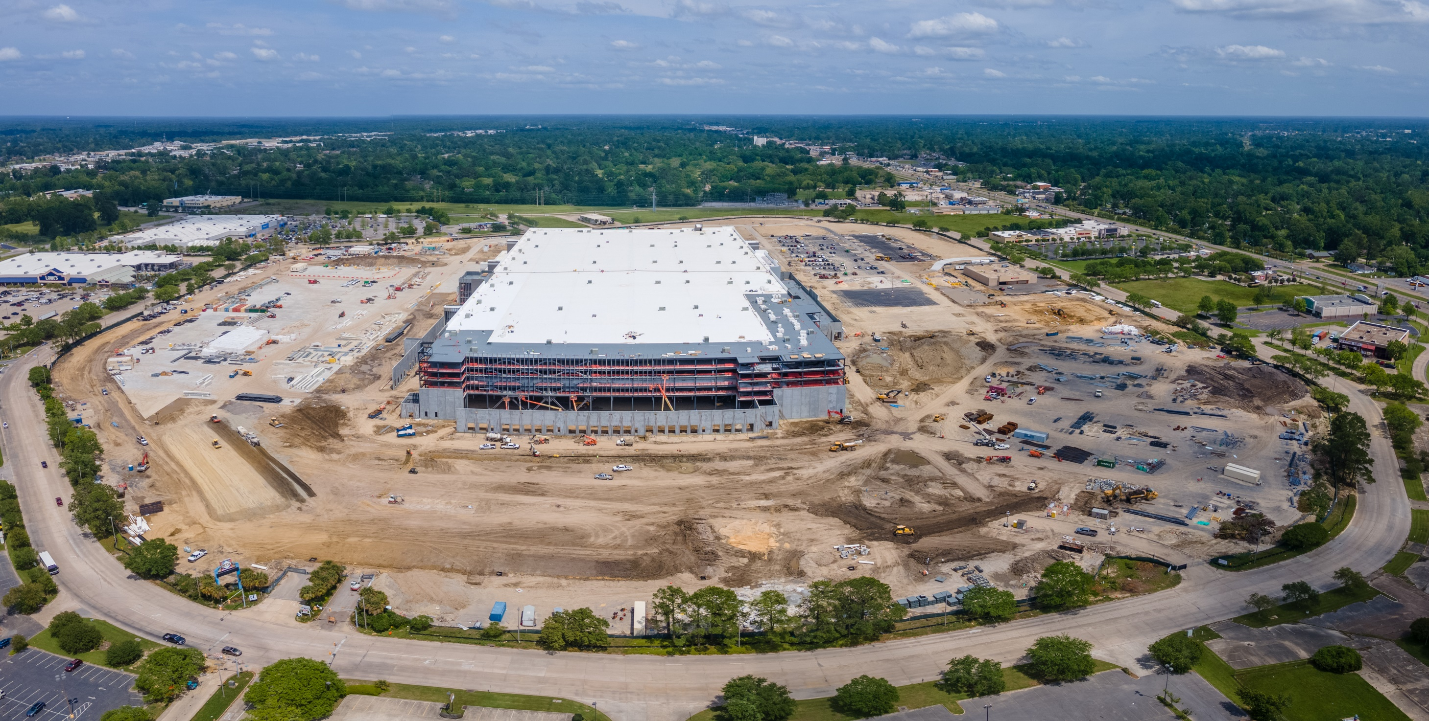
Amazon – 3,800,000 SF

Slide 35
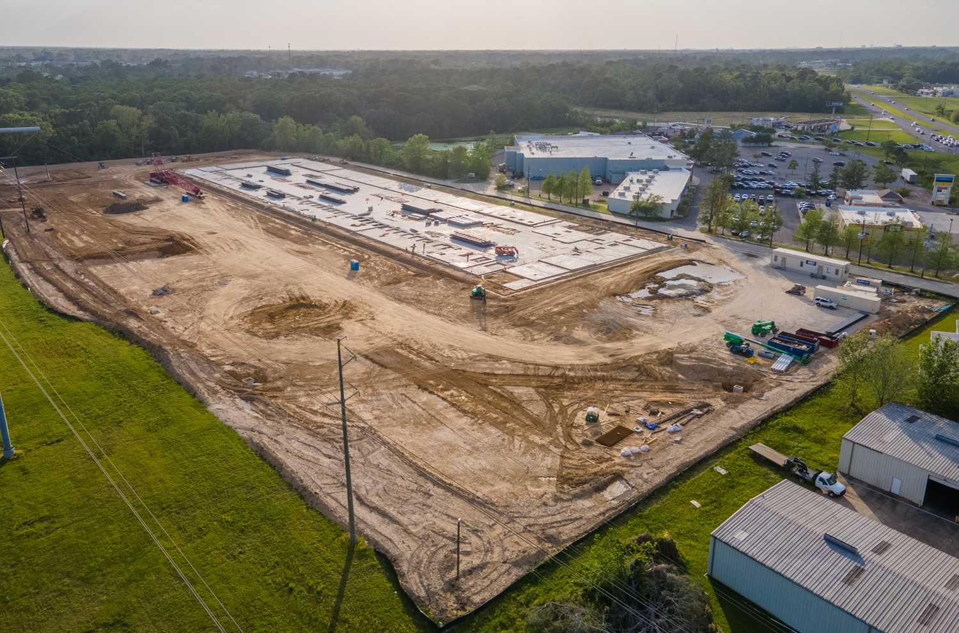
Frito-Lay – 150,000 SF
Completion: Q1 2023

Slide 36
But what about supply?
The Baton Rouge MSA has a supply problem
Primary deal structure on large new construction projects are build to suits
Spec builds are typically 10K – 25K SF
No large-scale speculative developments – 100k+SF
Primarily a local developer market appetite for risk and evaluation of risk is lower than national/institutional developers
Limited supply translates into missed opportunities for Baton Rouge

Slide 37
Outlook

Slide 38
Opportunity and Optimism
High Absorption

Slide 39
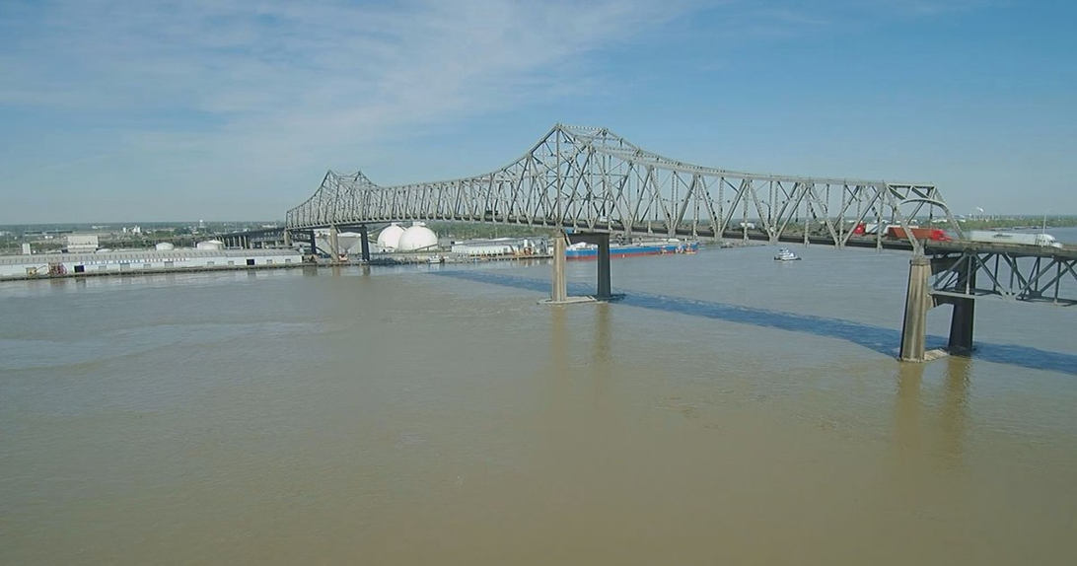
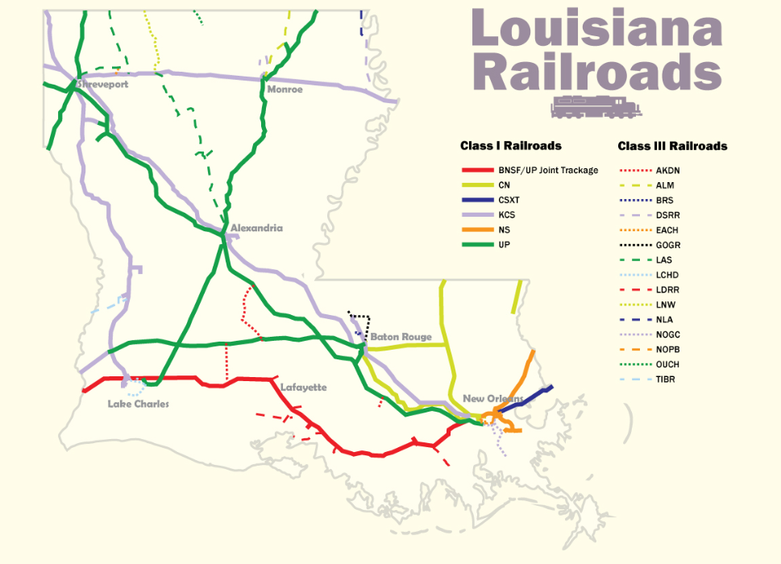
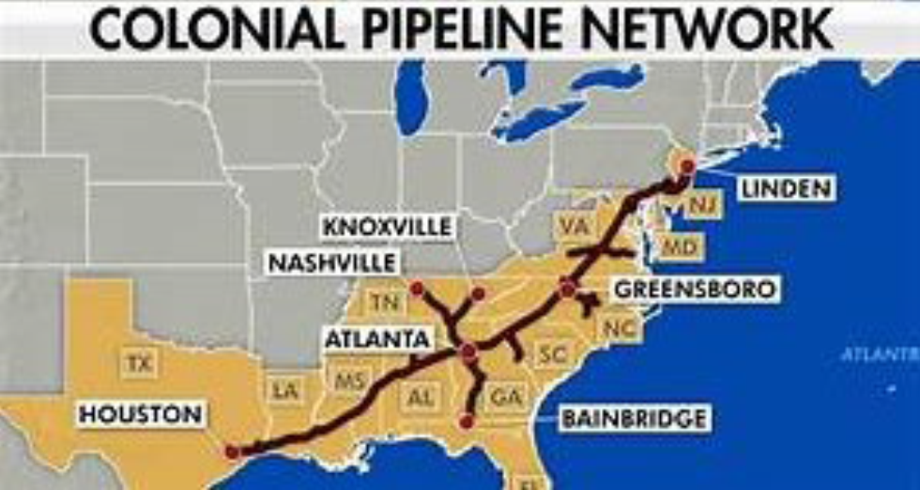
Transportation & Infrastructure Hub
Rail
Interstate
Port
Pipelines

Slide 40
What to watch for:
Vacancy will fall below 3% possibly lower
Rental rates will continue to increase
Sale Prices will remain high - $120 - $140/SF will become the norm
Cap Rates will remain low but rising interest rates could finally begin to move cap rates up
Headwinds - Construction costs both on new construction and for TI and rising interest rates

Slide 41
THANK YOU

