Slide 1
2022
BATON ROUGE
MULITFAMILY TRENDS
PRESENTED BY
Craig Davenport, MAI
Cook, Moore, Davenport & Associates
www.CookMoore.com
cdavenport@cookmoore.com

Slide 2
2018 - 2021
2021 - 2022

Slide 3
National Apartment Info
2021 – National Apartment Market
Record $335 billion in multifamily sales
Net absorption of units was up 238% over 2020 figures
Nationally, average rents rose 13.4%
Some markets reporting 25% to 30% increase in rents over 2020

Slide 4
2022 Rental Survey
FULL DATA SET
MATCHED SAMPLE
250+ Complexes
39,037+ Units
225+ Complexes
34,449+ Units

Slide 5
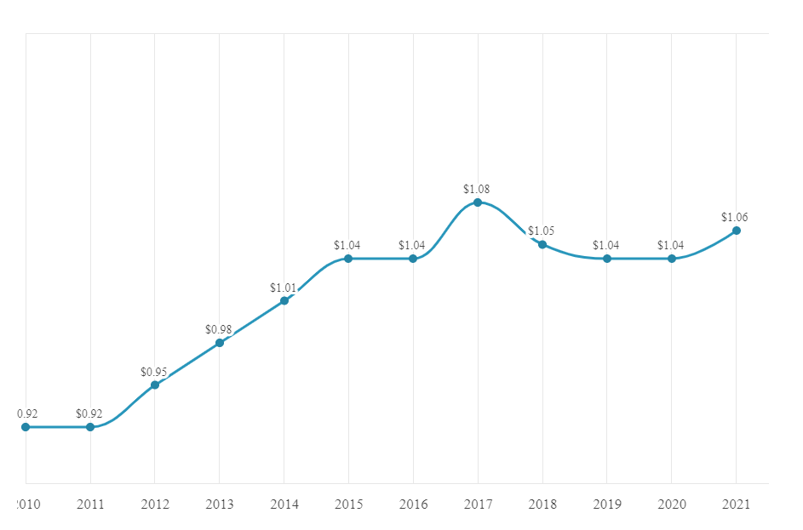
AVERAGE RENT PER SQUARE FOOT - OVERALL MARKET
4% INCREASE
10%
AFTER 2016 FLOOD
INCREASE AFTER KATRINA
4%
KATRINA
HANGOVER
INCREASE AFTER 2016 FLOOD
1% - 3%
ANNUAL GROWTH

Slide 6
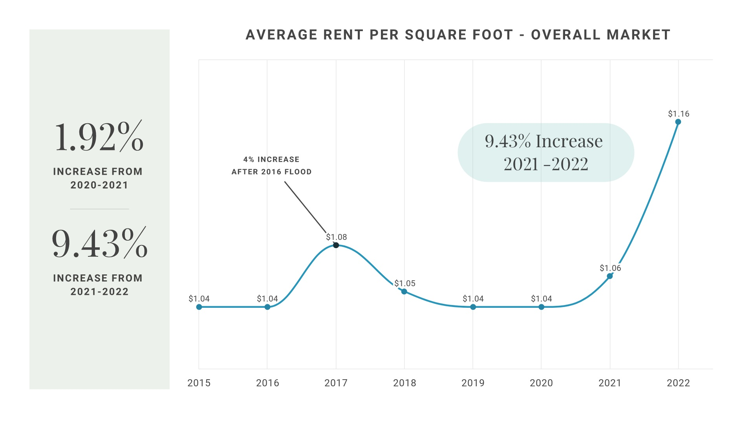
OCCUPIED
VACANT

Slide 7
HISTORICAL VACANCY RATES
(Matched Sample)
4.92% Vacancy Rate
in 2022

Slide 8
SUBMARKET ANALYSIS
(Matched Sample)
Submarket | Avg Rent/SF 2022 | Rent Change Since 2021 | Rent Change Since 2020
Baton Rouge – Class A | $1.52 | +21.6% | +24.6%
Central Business District (CBD) | $1.61 | +1.26% | +3.21%
LSU By-the-Bed | $1.47 | +2.08% | +0.07%
LSU Standard | $1.07 | +4.90% | +4.90%
Ascension – Class A | $1.24 | +12.73% | +14.81%
Livingston – Class A | $1.05 | +11.7% | +16.7%

Slide 9
SUBMARKET ANALYSIS
(Matched Sample)
Submarket | Vacancy 2022 | Vacancy 2021 | Vacancy 2020 | Vacancy 2019 | Vacancy 2018
Baton Rouge – Class A | 4.11% | 7.33% | 9.91% | 9.24% | 5.99%
Central Business District (CBD) | 10.00% | 9.81% | 8.75% | 8.88% | 8.17%
Ascension – Class A | 1.36% | 4.23% | 5.87% | 5.33% | 7.92%
Livingston – Class A | 3.66% | 5.89% | 8.83% | 9.90% | 6.24%
LSU By-the-Bed | 7.04% | 17.08% | 15.89% | 18.26% | 15.80%
LSU Standard | 5.30% | 13.90% | 12.78% | 11.23% | 12.01%
LSU Market Has Finally Stabilized

Slide 10
LSU STUDENT APARTMENT MARKET
FALL 2019 ENROLLMENT
FALL 2020 ENROLLMENT
FALL 2021 ENROLLMENT
30,634
32,390
33,519
On-Campus Enrollment
All-Time High Enrollment
2021 Largest Class in LSU History
LSU Students Back On Campus
Limited On-Campus Housing

Slide 11
CONSTRUCTION CLASS ANALYSIS
(Matched Sample)
 | Avg Rent/SF | Rent Change Since 2021 | Rent Change Since 2020
Class A | $1.45 | +11.54% | +12.4%
Class B | $1.12 | +8.74% | +13.13%
Class C/D | $0.95 | +7.95% | +9.20%
Vacancy 2022 | Vacancy 2021 | Vacancy 2020
4.82% | 10.60% | 11.90%
4.34% | 7.85% | 10.07%
5.31% | 8.76% | 9.28%
Average Class A Rent is $1,506/month
Average Class B Rent is $1,105/month
Average Class C/D Rent is $832/month

Slide 12
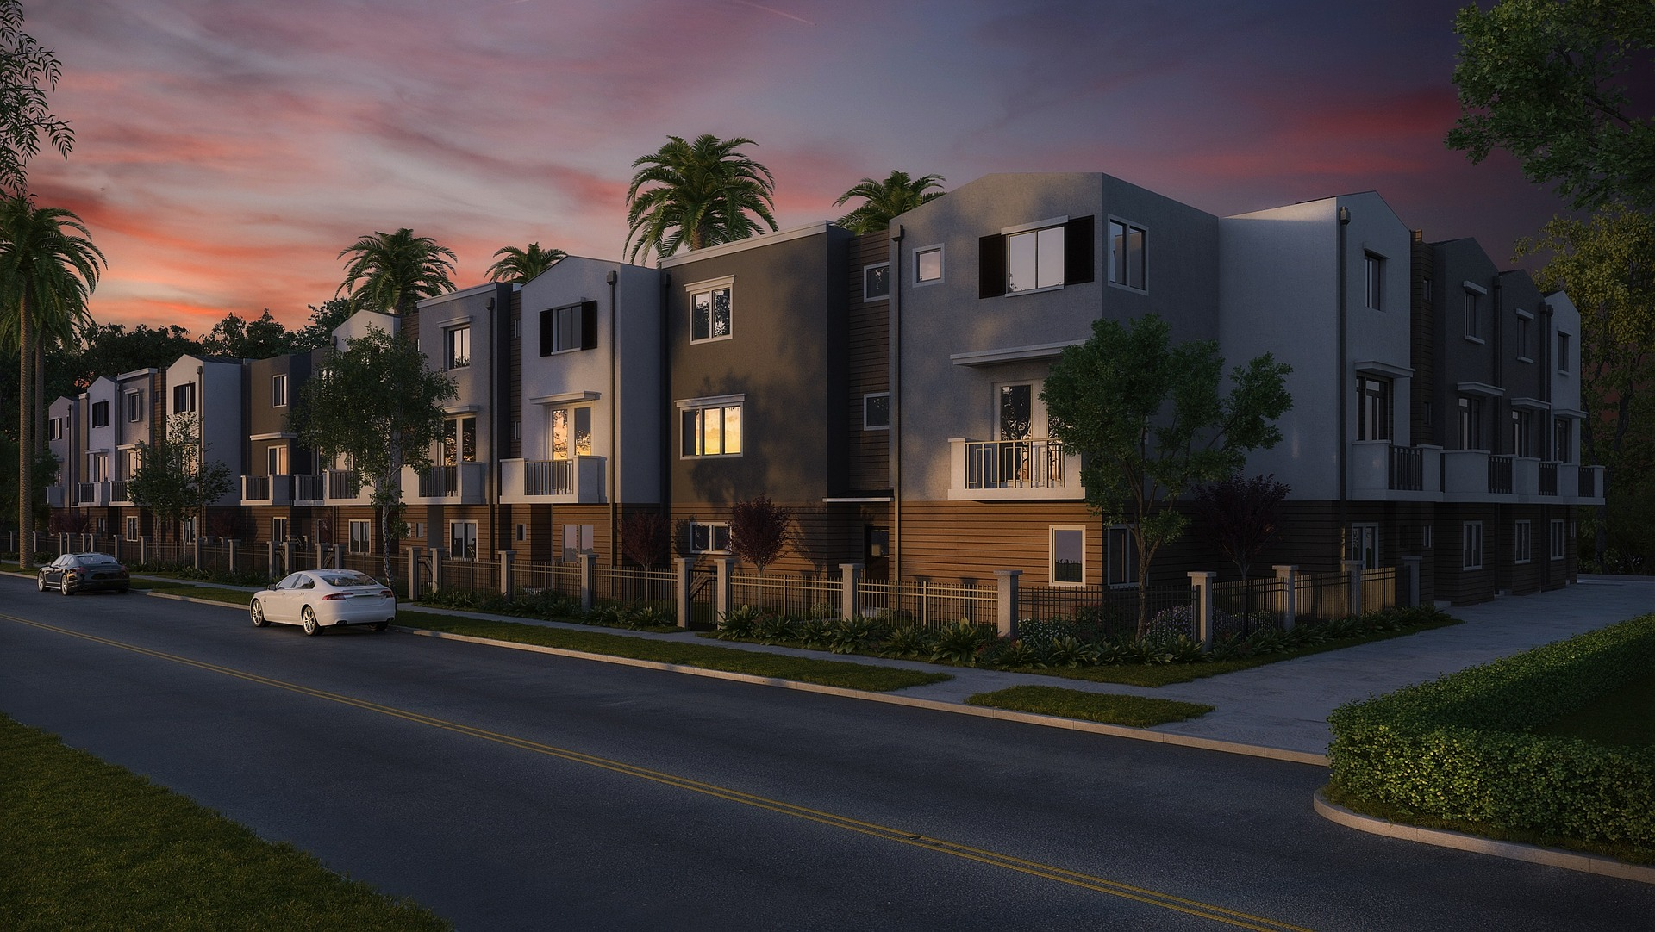
APARTMENT SALES FOR 2021

Slide 13
2021 – State and Regional
Prior to 2021, there were a total of 2 non-student apartment complexes (25+ units) in Louisiana that had sold for more than $190,000/unit (1 in Baton Rouge and 1 in New Orleans)
In 2021, there were a total of 8 complexes in Louisiana that sold for more than $190,000/unit
In the Baton Rouge area, 12 complexes sold for more than $24,000,000 each
9 out of the top 10 largest commercial sales this year in Baton Rouge were apartment complexes

Slide 14
APARTMENT SALES VOLUME
(25+ UNIT COMPLEXES)
Year | # Complexes | Total Volume
2017 | 38 | $367,350,000
2018 | 25 | $241,869,100
2019 | 27 | $194,616,850
2020 | 23 | $223,984,000
TOTAL SALES VOLUME 2017-2020 113 Complexes $1,027,819,950
in Total Sales
OCCUPIED
VACANT
2021 | 40 | $580,029,500
Jan – Mar 2022 | 13 | $128,582,500

Slide 15
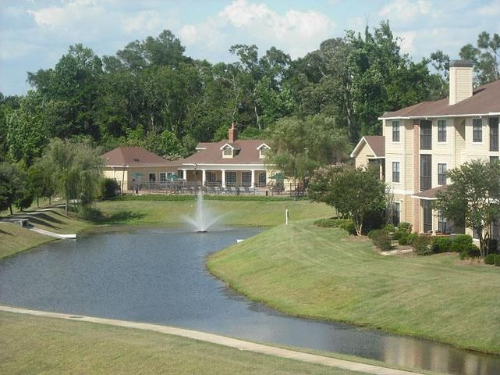
EVERGREEN AT COURSEY
13675 COURSEY BLVD
Date | June 29, 2021
Price | $49,751,000
Price /SF | $126.99
Price/Unit | $141,338

Slide 16
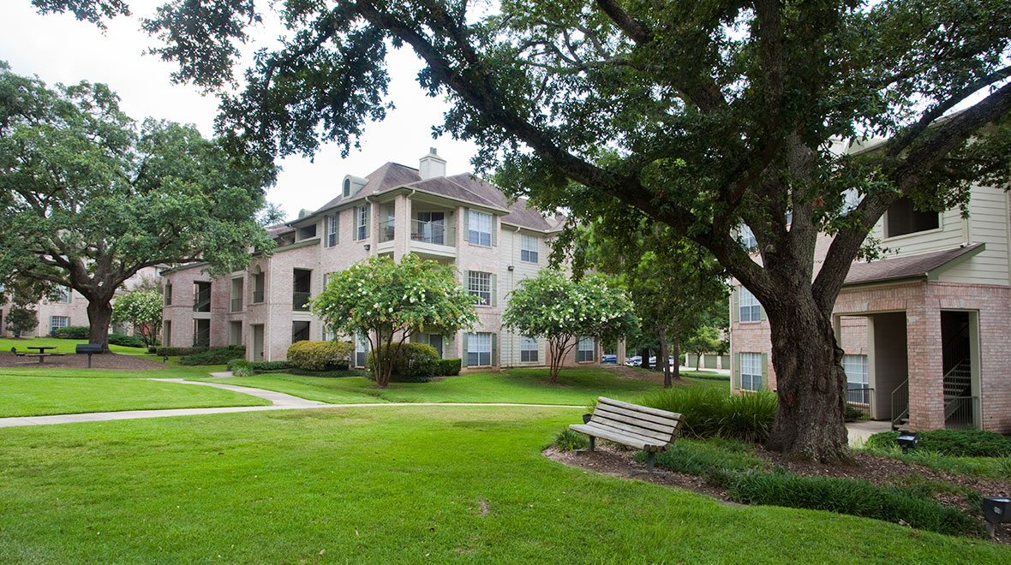
MANSIONS IN THE PARK
7250 PERKINS ROAD
Date | December 22, 2021
Price | $52,200,000
Price /SF | $233.23
Price/Unit | $197,727

Slide 17
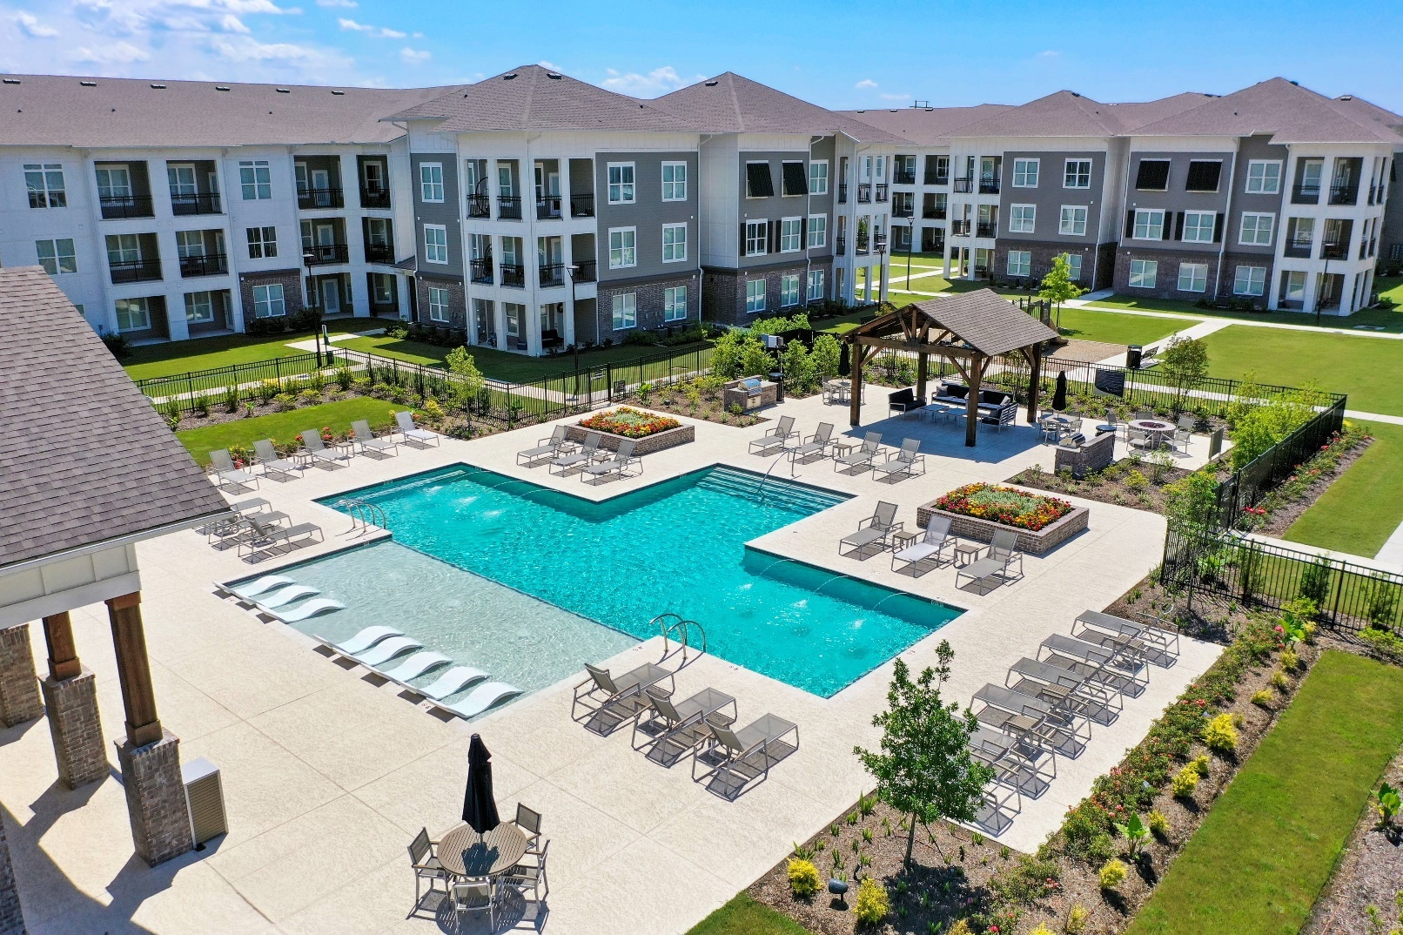
SWEETWATER APARTMENTS
3476 Sweetwater Blvd
Addis, LA
Date | November 17, 2021
Price | $57,000,000
Price /SF | $197.26
Price/Unit | $206,522

Slide 18
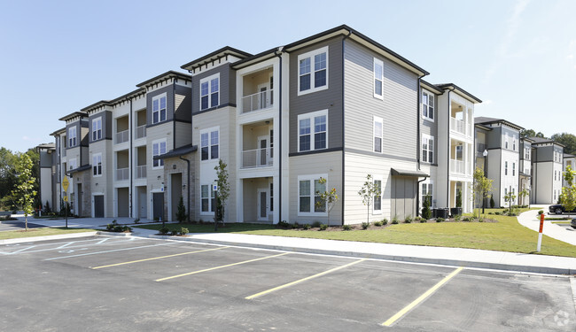
TAPESTRY LONG FARM
16333 COLUMNS WAY
Date | September 29, 2021
Price | $61,033,500
Price /SF | $210.30
Price/Unit | $221,136

Slide 19
OTHER SELECT PROPERTY SALES 2021
Name | Address | # of Units | Price/Unit
The Exchange (student) | 449 Ben Hur Road | 297 | $170,034
High Grove / The Addison | The Grove Boulevard | 331 | $195,166
Sable Chase / Pine Grove | Blvd de Province / Bard Ave | 411 | $40,000
Chestnut Creek | 8686 Coy Ave | 128 | $75,781
Boardwalk Place | 8275 Vincent Road (Denham) | 264 | $125,455
Legacy at Twenty 20 | 2020 Veterans Blvd (Gonzales) | 212 | $170,991
Rosenwald | 1188 Rosenwald Road | 36 | $26,400
Crestworth Place | 10032 Avenue I | 24 | $21,700
OCCUPIED
VACANT
Prices per Unit are Increasing and Cap Rates are Decreasing

Slide 20
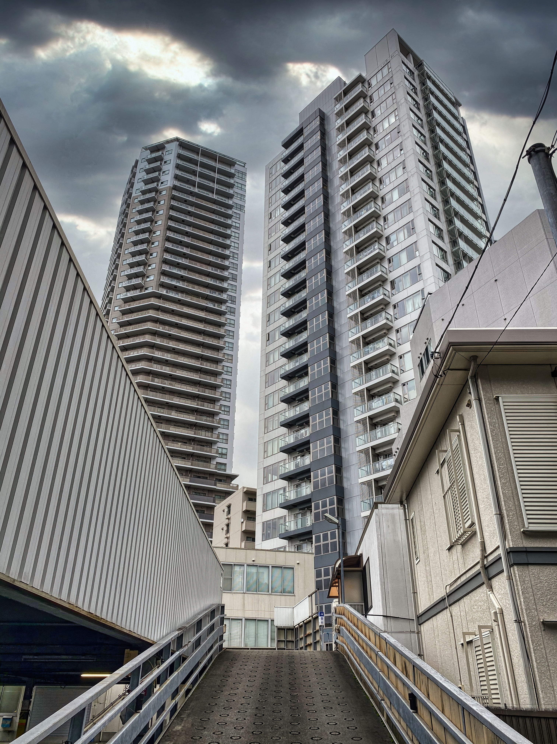
Baton Rouge and Overall Market
Other Factors in the Multifamily Sales Market
CAP RATES
OUT OF STATE INVESTORS
Cap Rates have been decreasing
Class A – 4.25% - 4.75%
Class B – 5.00% - 5.50%
Class C/D – 5.75% - 7.0%
Have been, and still are, showing a lot of interest in our apartment market
INTEREST RATES
PENDING TRANSACTIONS
10 Year Treasury Rates have increased by 100 bps over the past year (200bps over the past 2 years), and are expected to continue Increasing thru 2022
Several big apartment sales still looming
2021 ---
2022

Slide 21
COMPLETED
COMPLEXES 2021

Slide 22
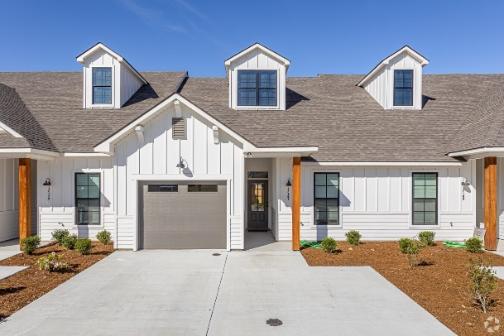
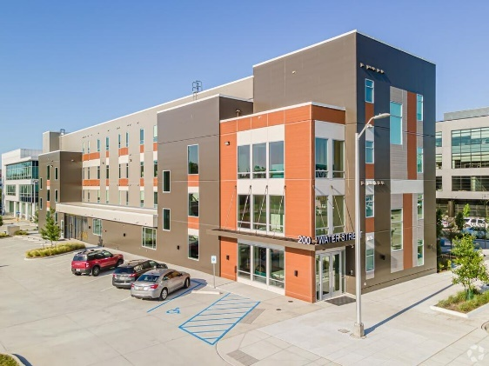
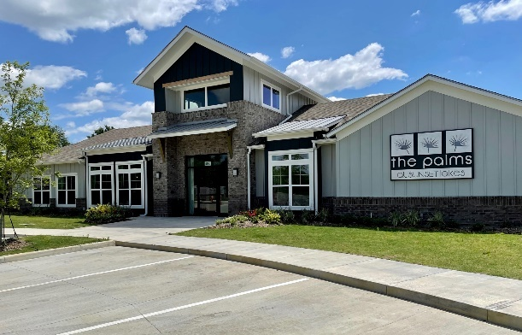
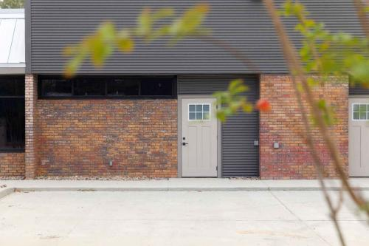
CONVENTIONAL COMPLEXES – COMPLETED IN 2021
581 Units
Fewest in Single Year
Since 2014
Oak Grove Townhomes (88 Units)
17172 Oak Lawn Blvd, Prairieville
200 Water Street (20 Units) (on Water Campus)
The Palms at Sunset Lake (144 Units) 4150 McHugh Road, Zachary
MidCity Flats (59 Units) 4501-4659 North Blvd.
Dawson Park and Royal Palms

Slide 23
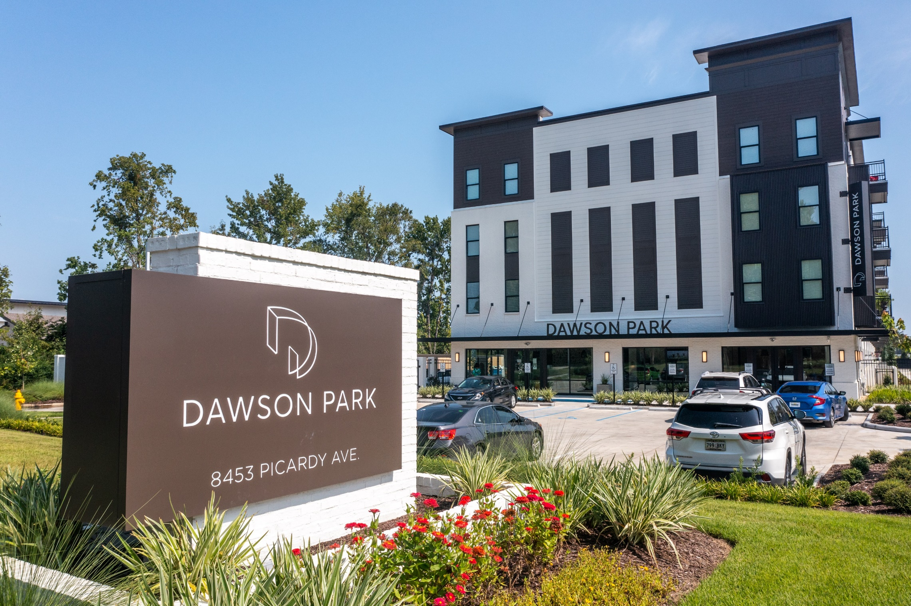
OCCUPIED
VACANT

Slide 24
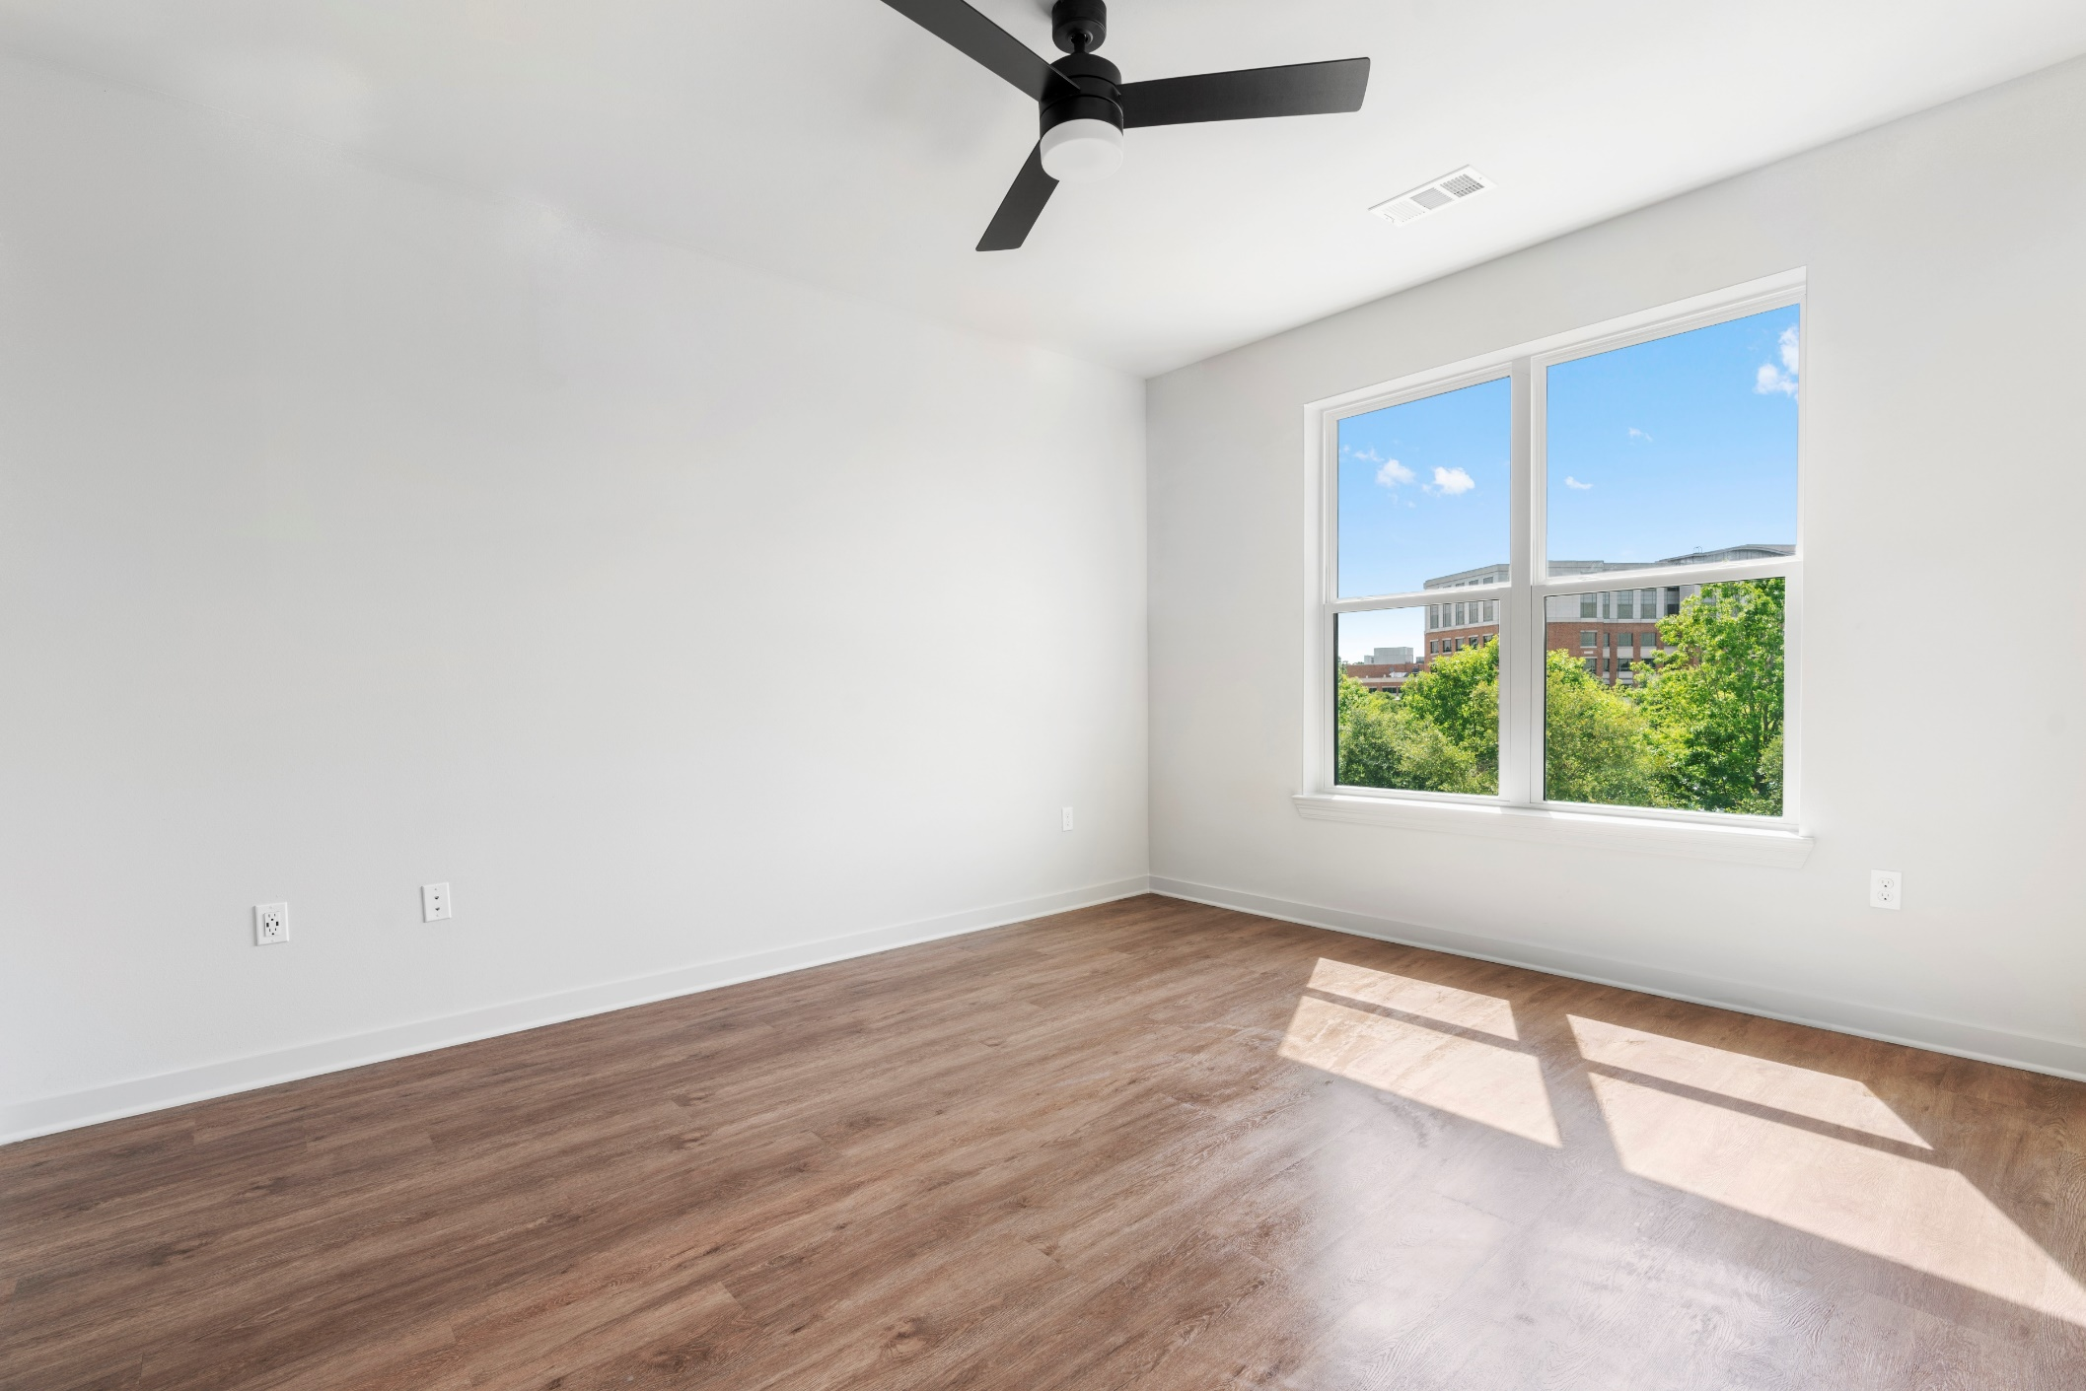
Living Room
OCCUPIED
VACANT

Slide 25
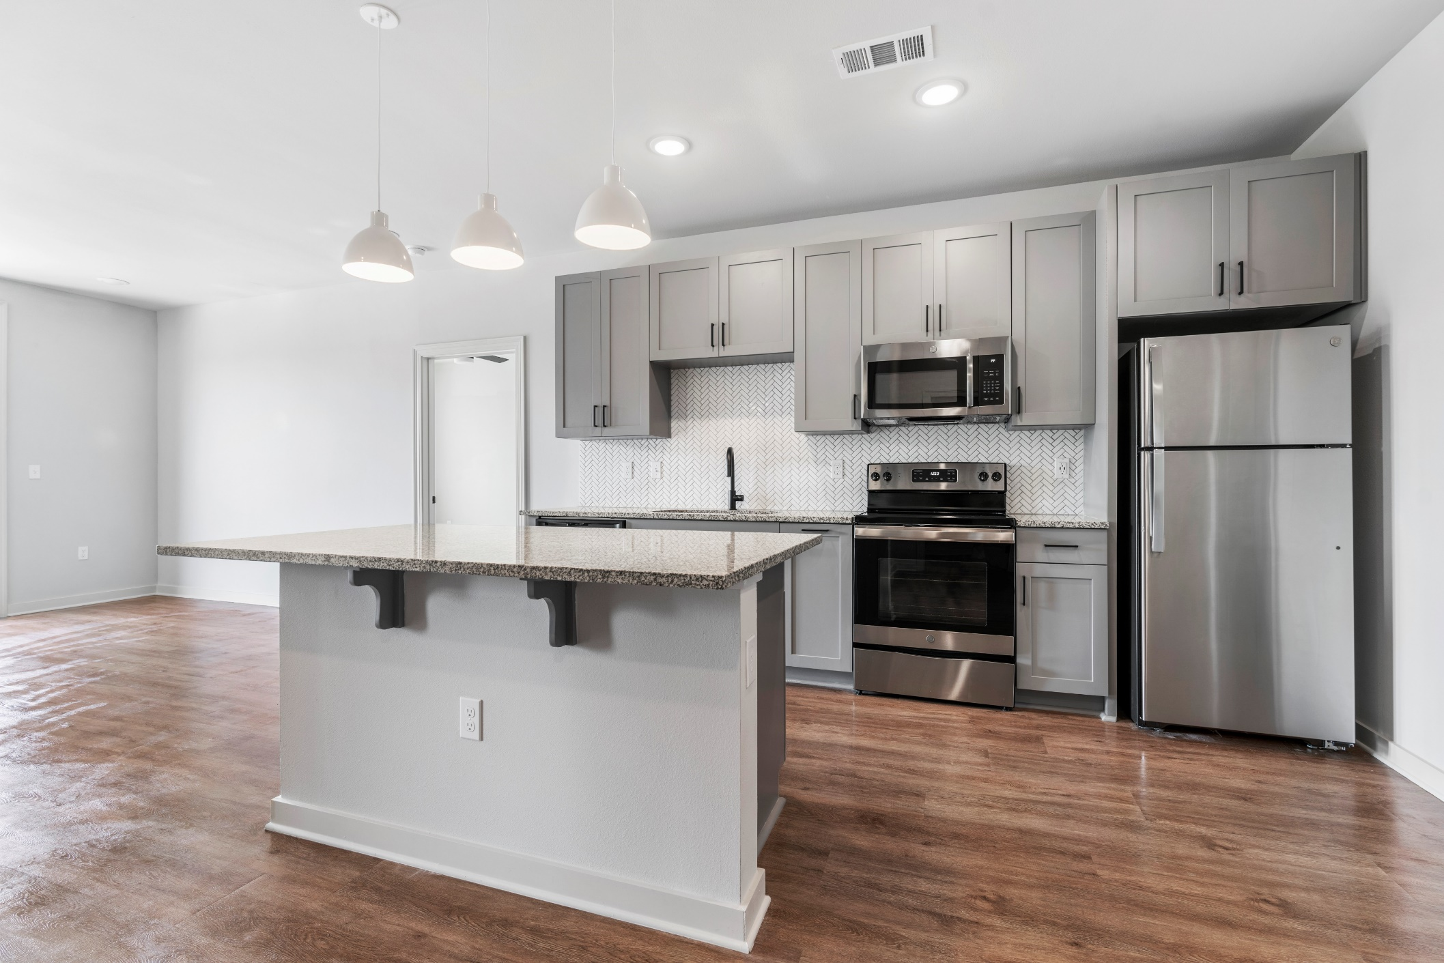
Kitchen
OCCUPIED
VACANT

Slide 26
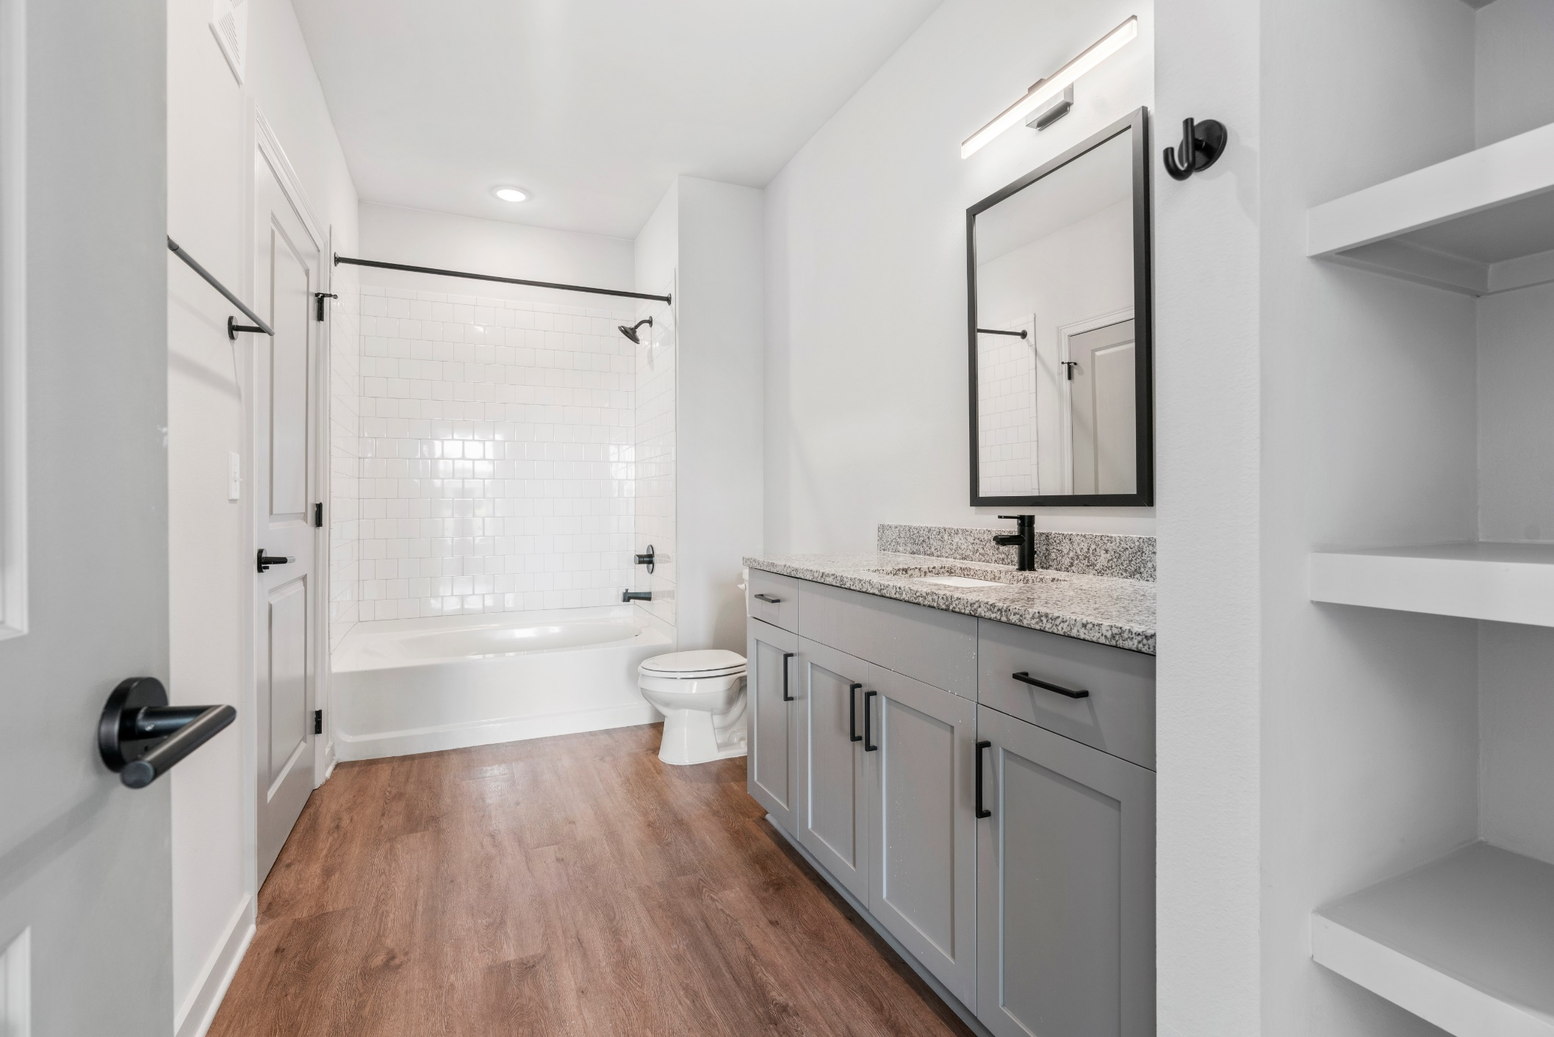
OCCUPIED
VACANT
Bathroom

Slide 27
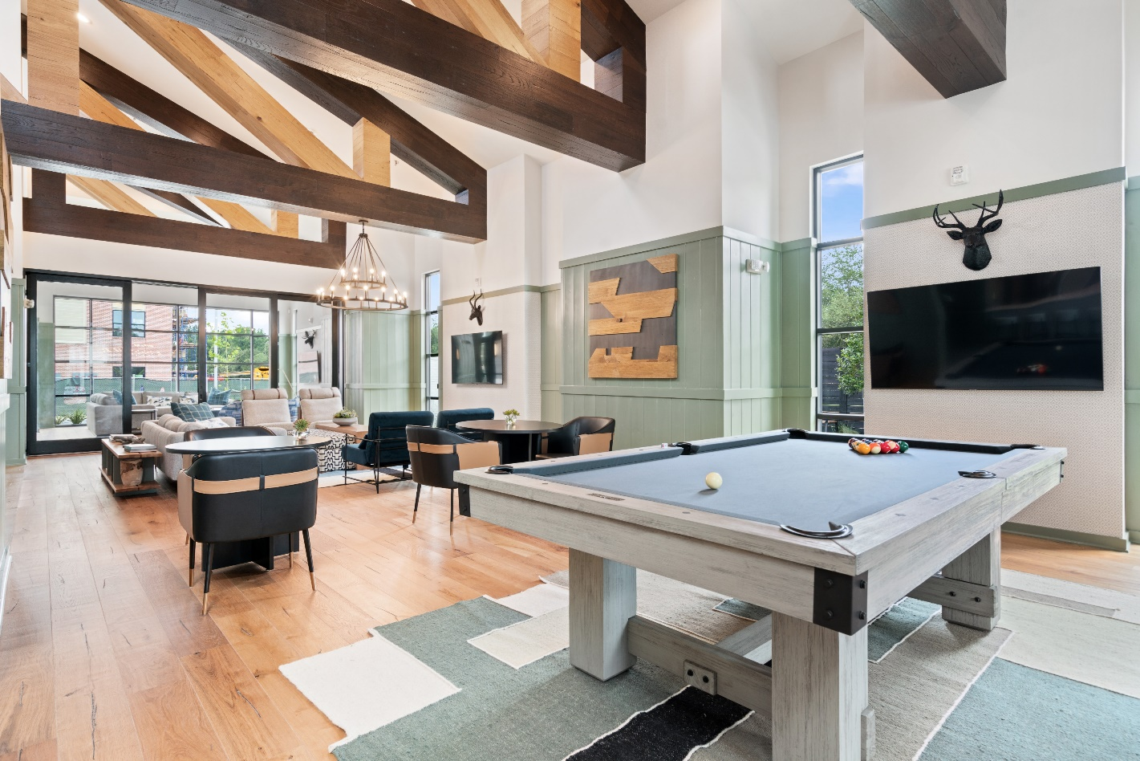
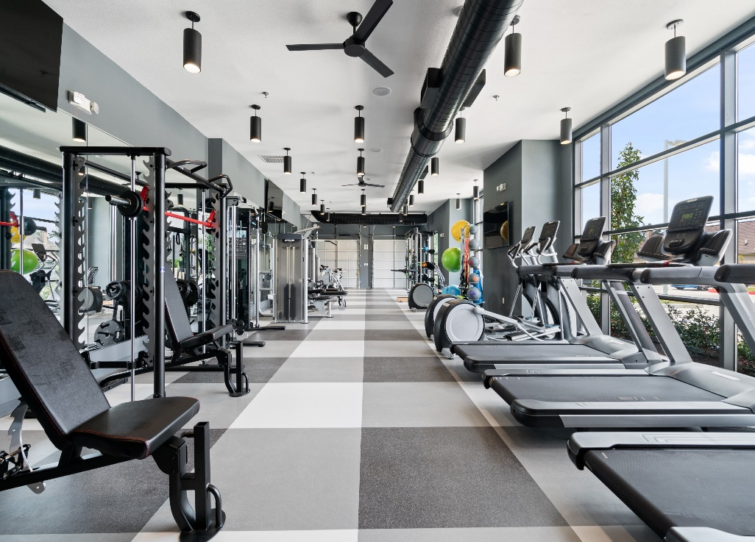
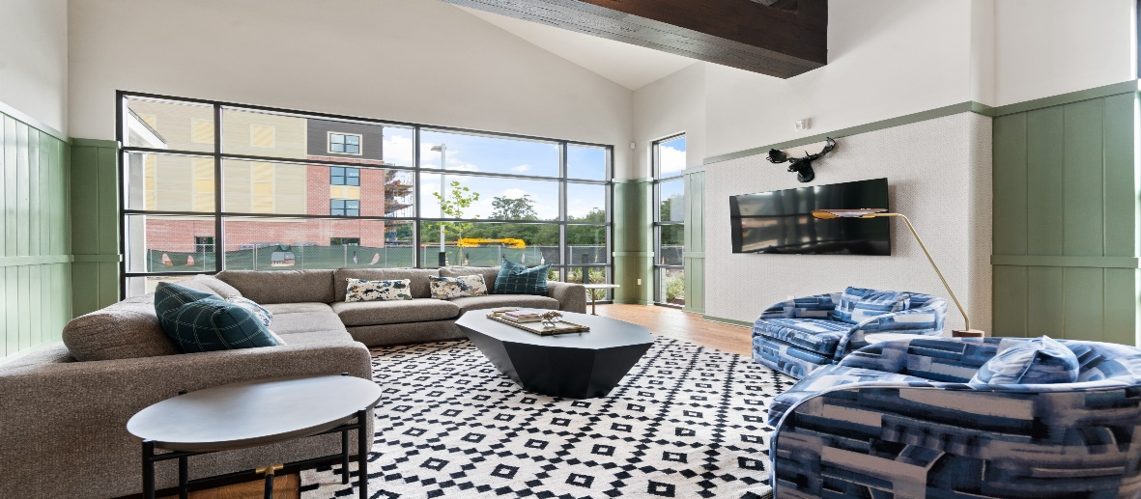
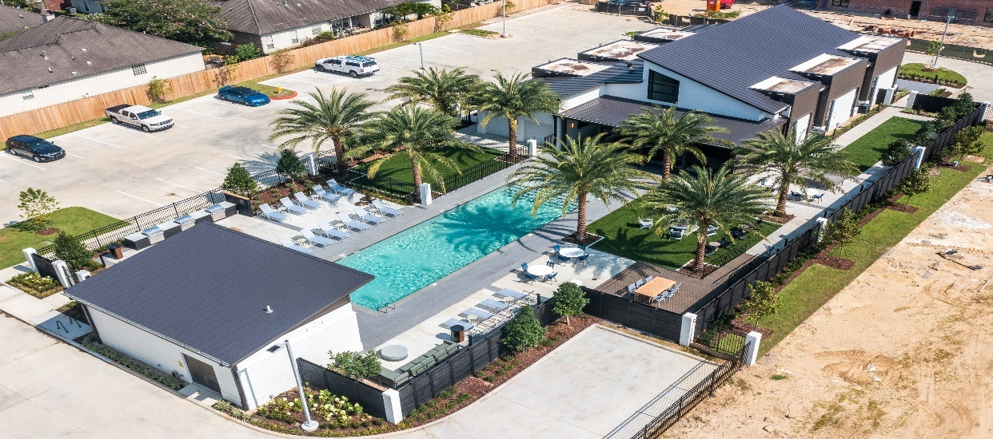

Slide 28
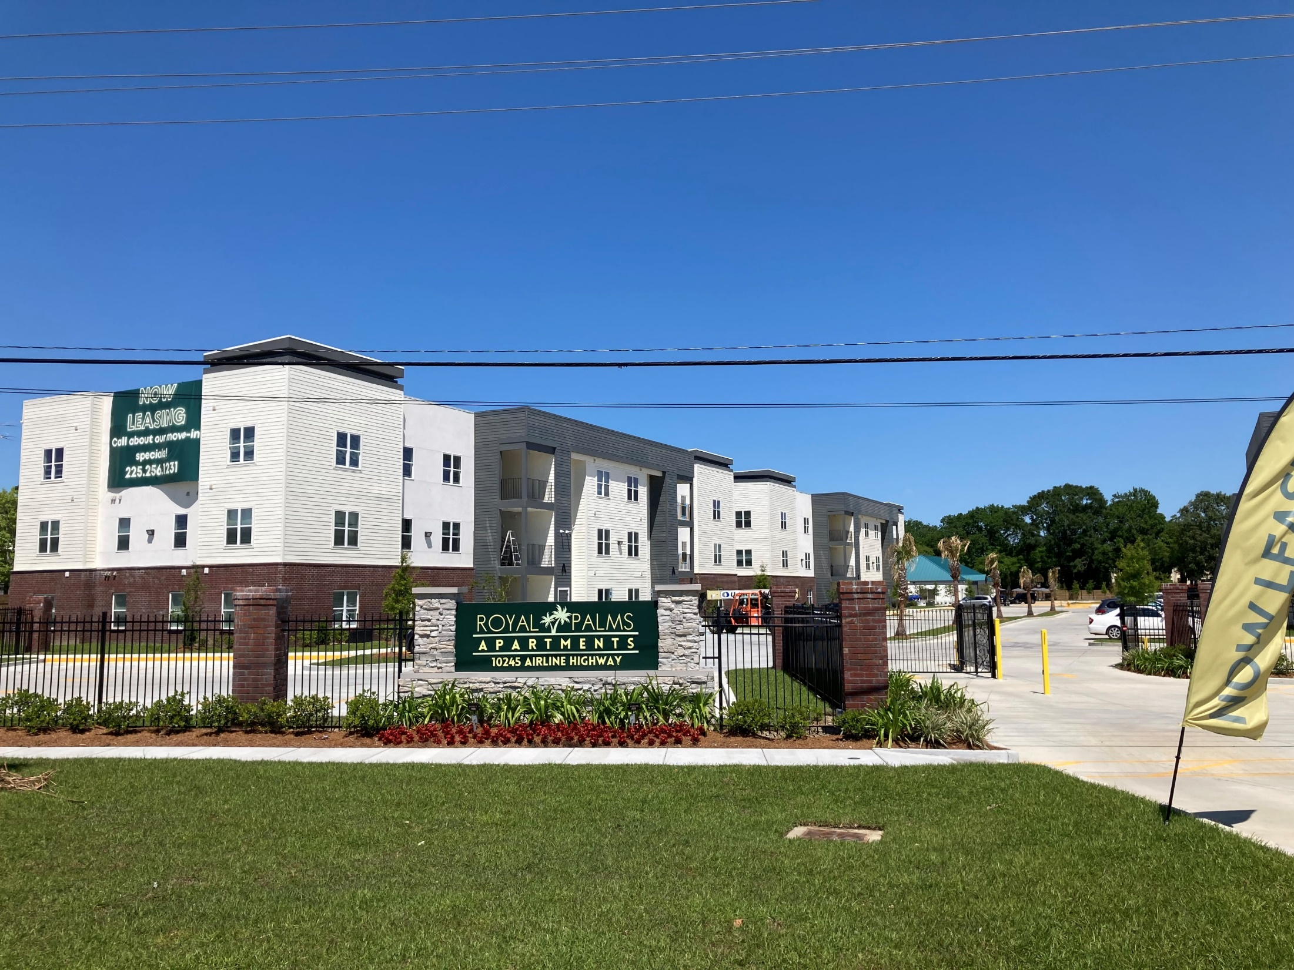
Airline Highway Across From Costco

Slide 29
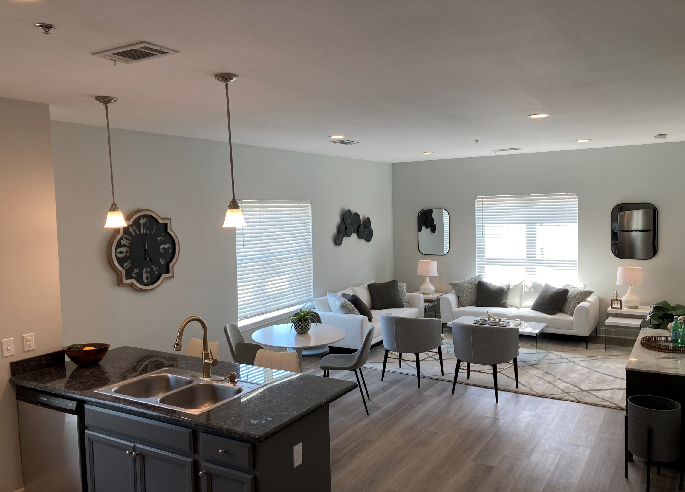
Living Room

Slide 30
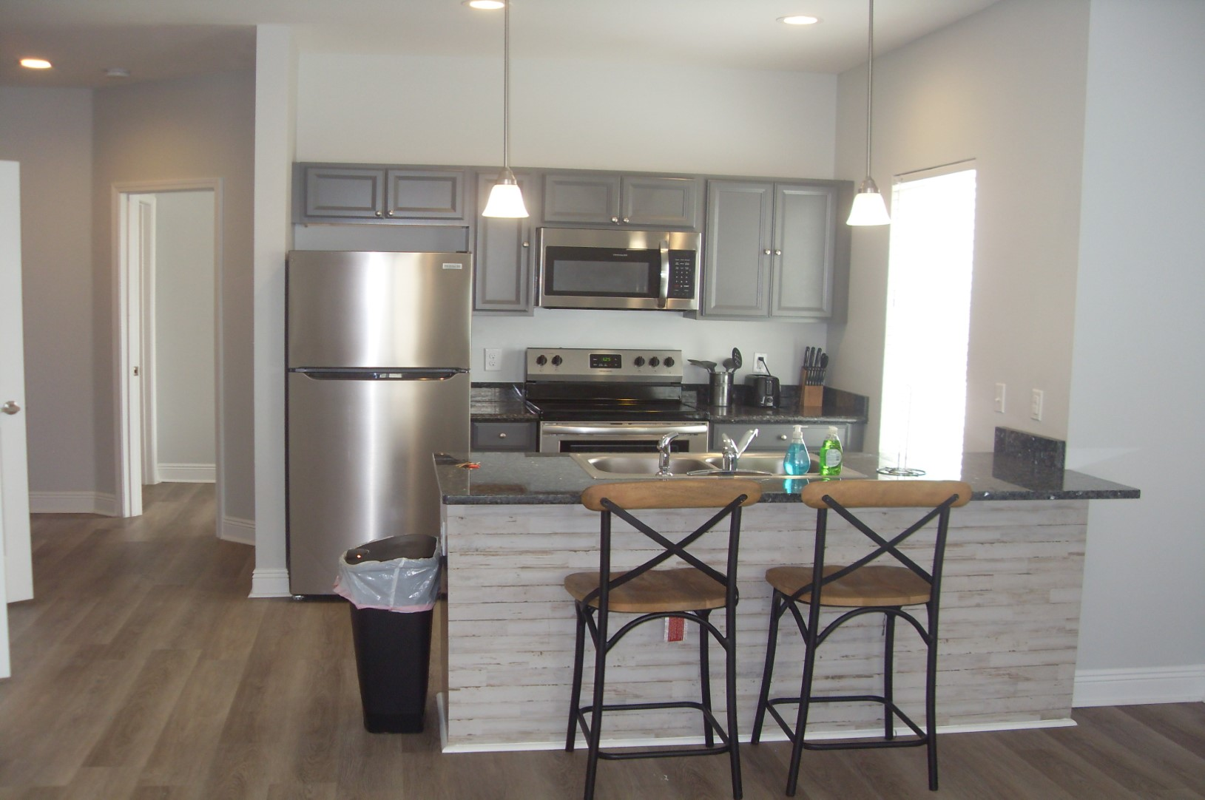
Kitchen

Slide 31
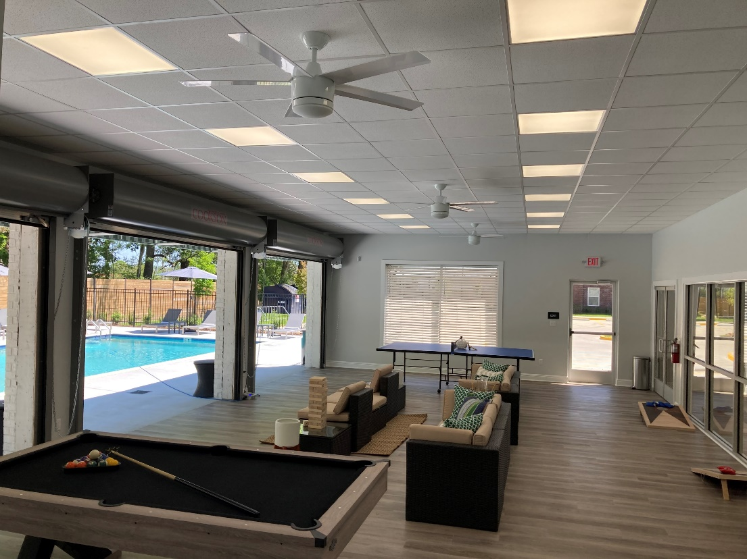
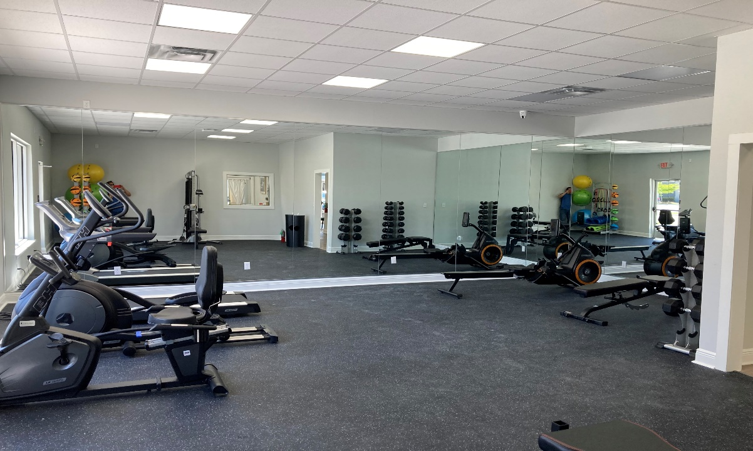
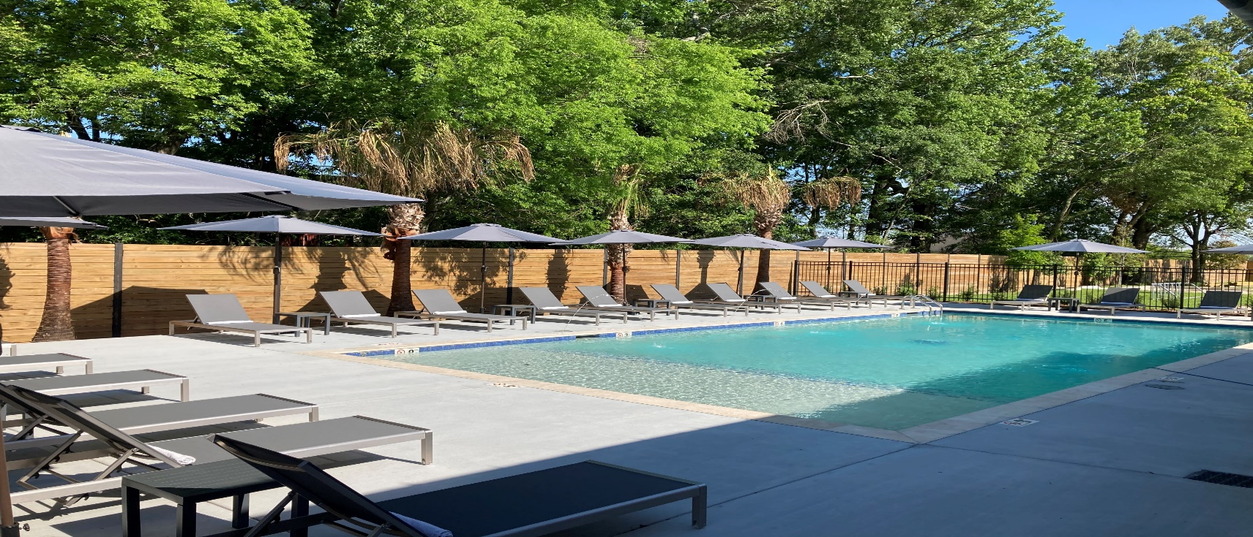
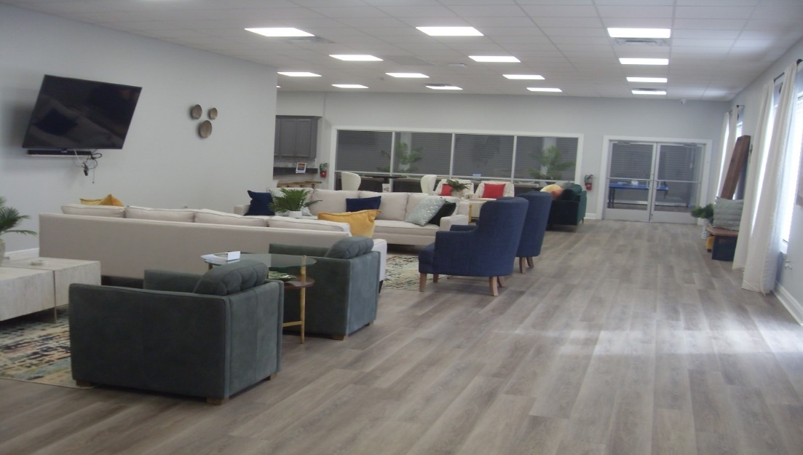

Slide 32
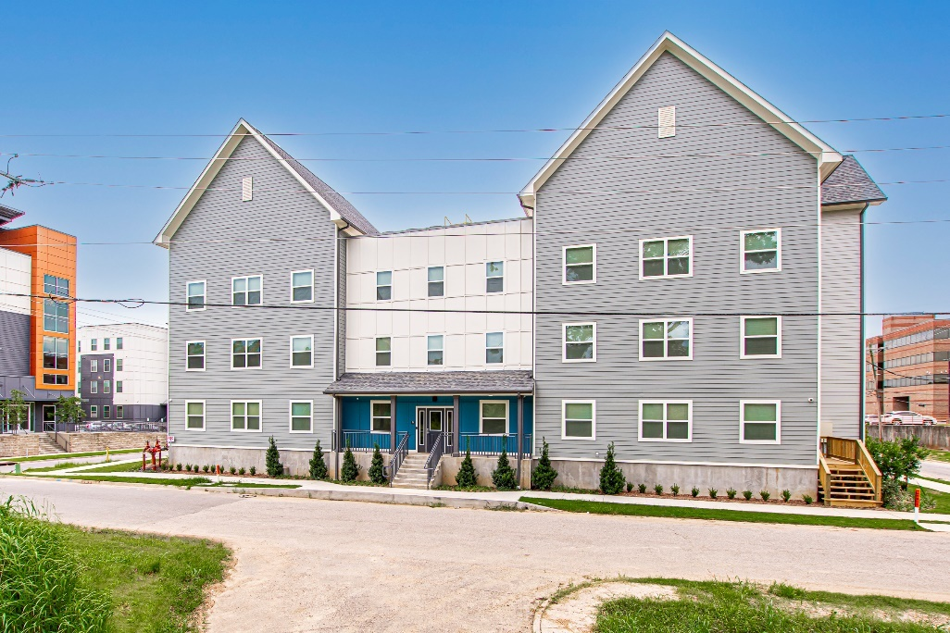
AFFORDABLE COMPLEXES – COMPLETED IN 2021
Only 1 Complex Completed in 2021
Completed in 2019 – 352 Units
Completed in 2020 – 0 Units
Completed in 2021 – 42 Units
The Elysian – Phase 3
(42 Units) 1092 Spanish Town Road

Slide 33
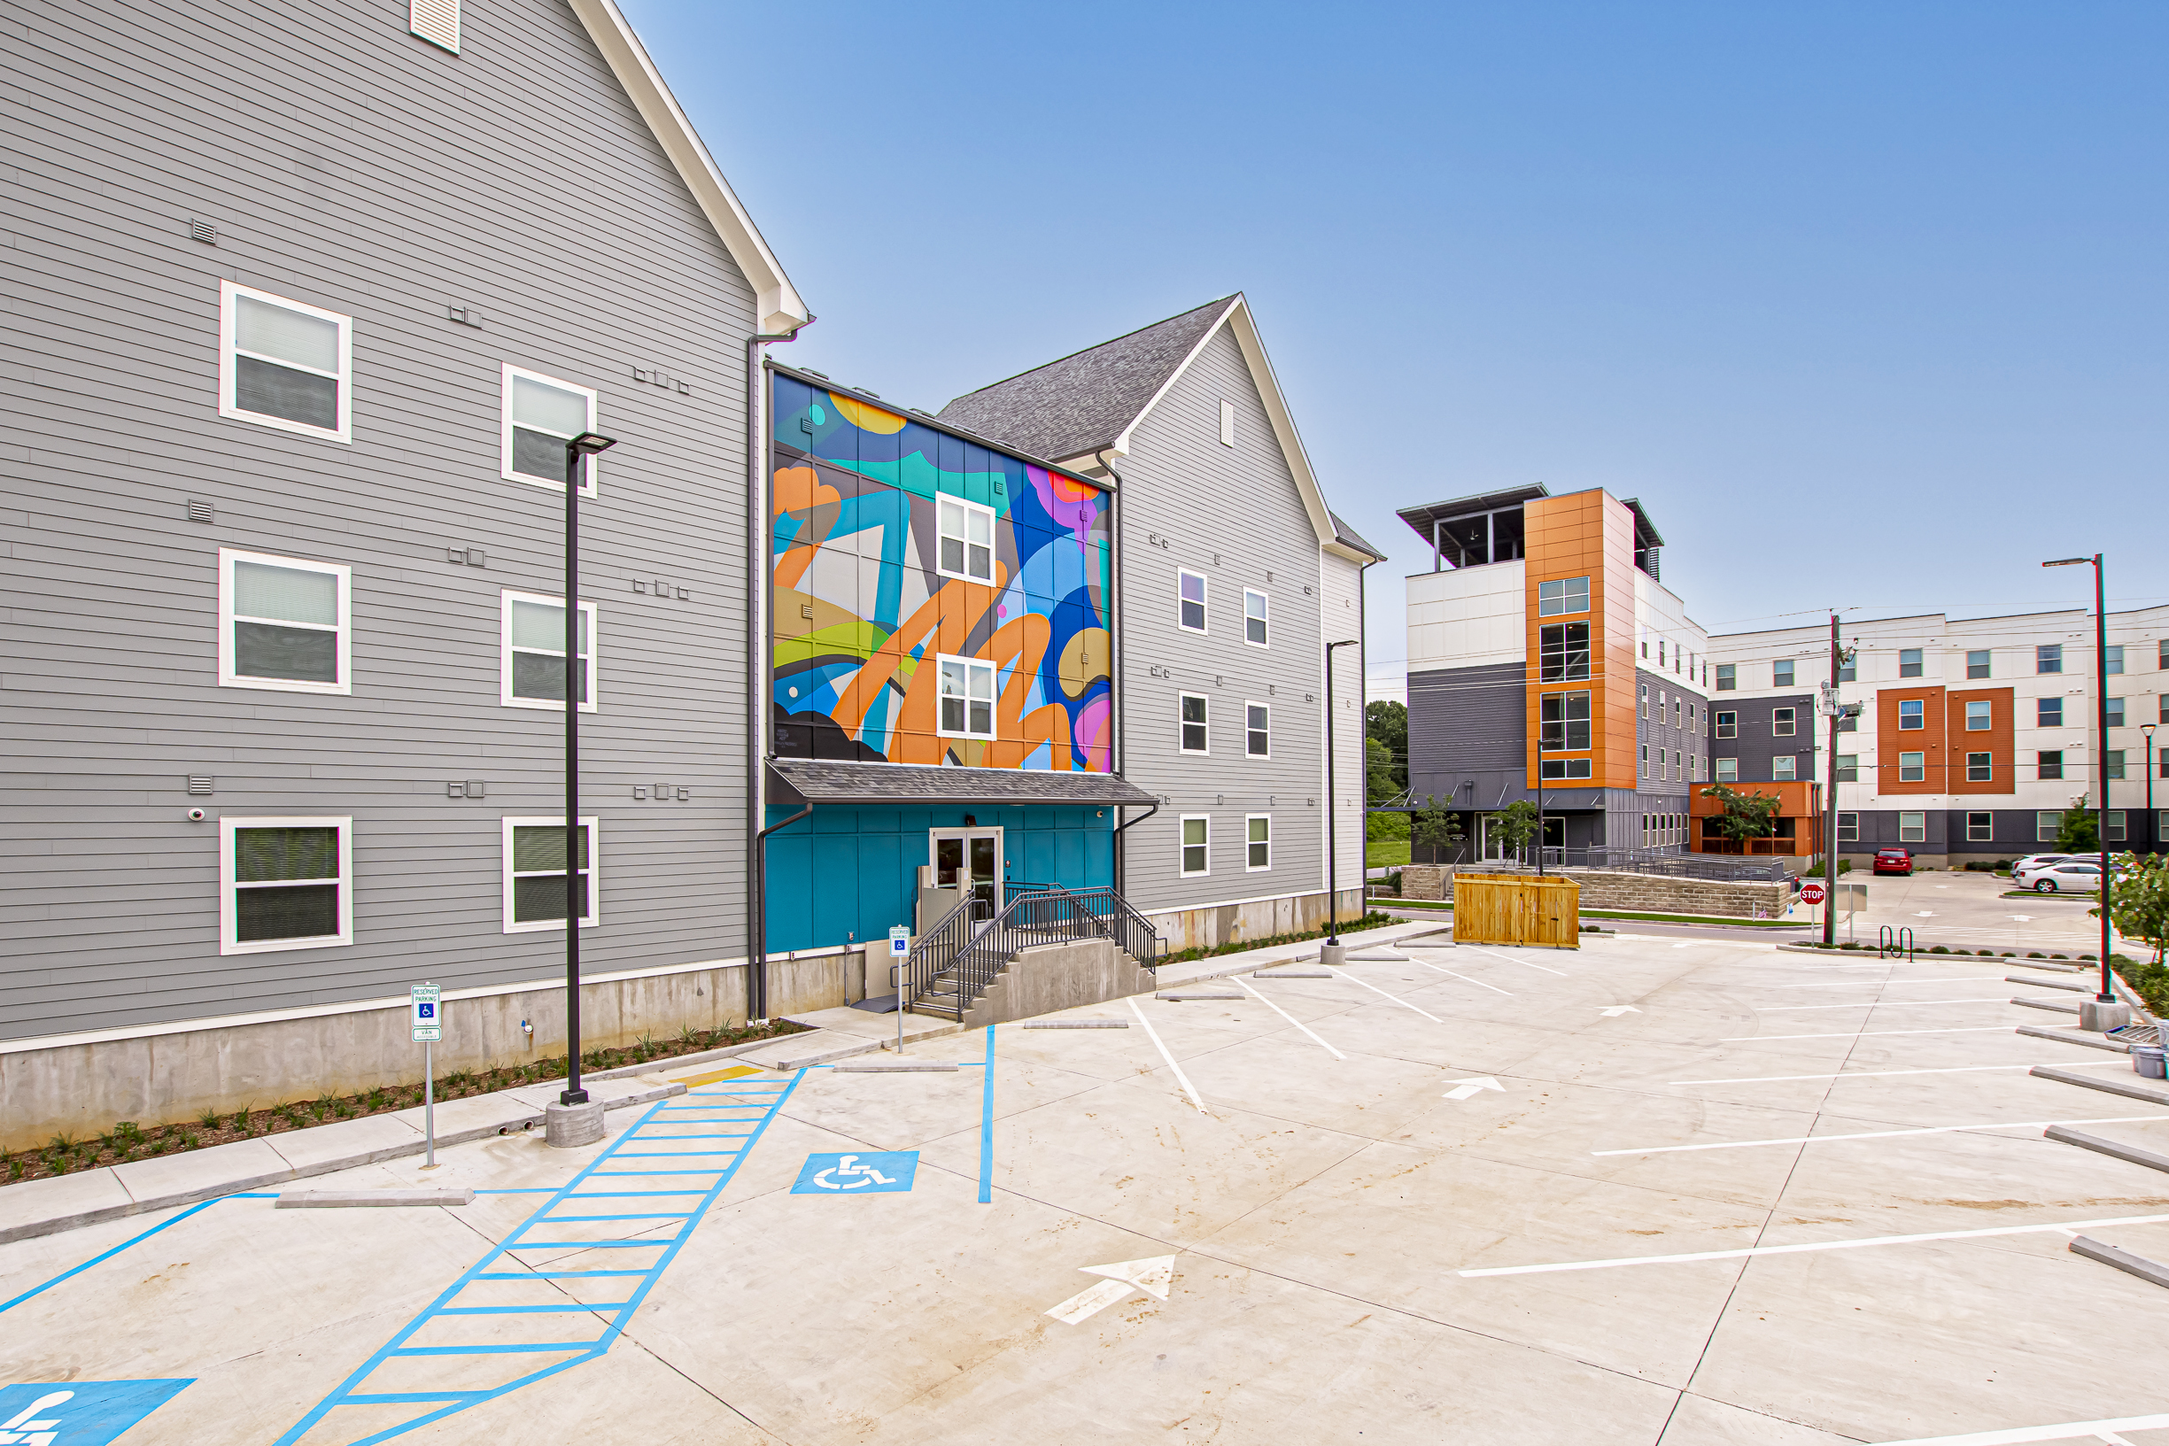
THE ELYSIAN PHASE 3
BATON ROUGE

Slide 34
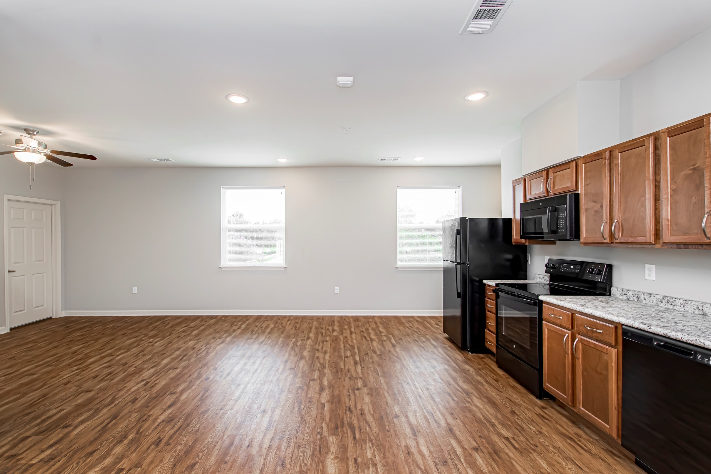
OCCUPIED
VACANT
Living Room

Slide 35
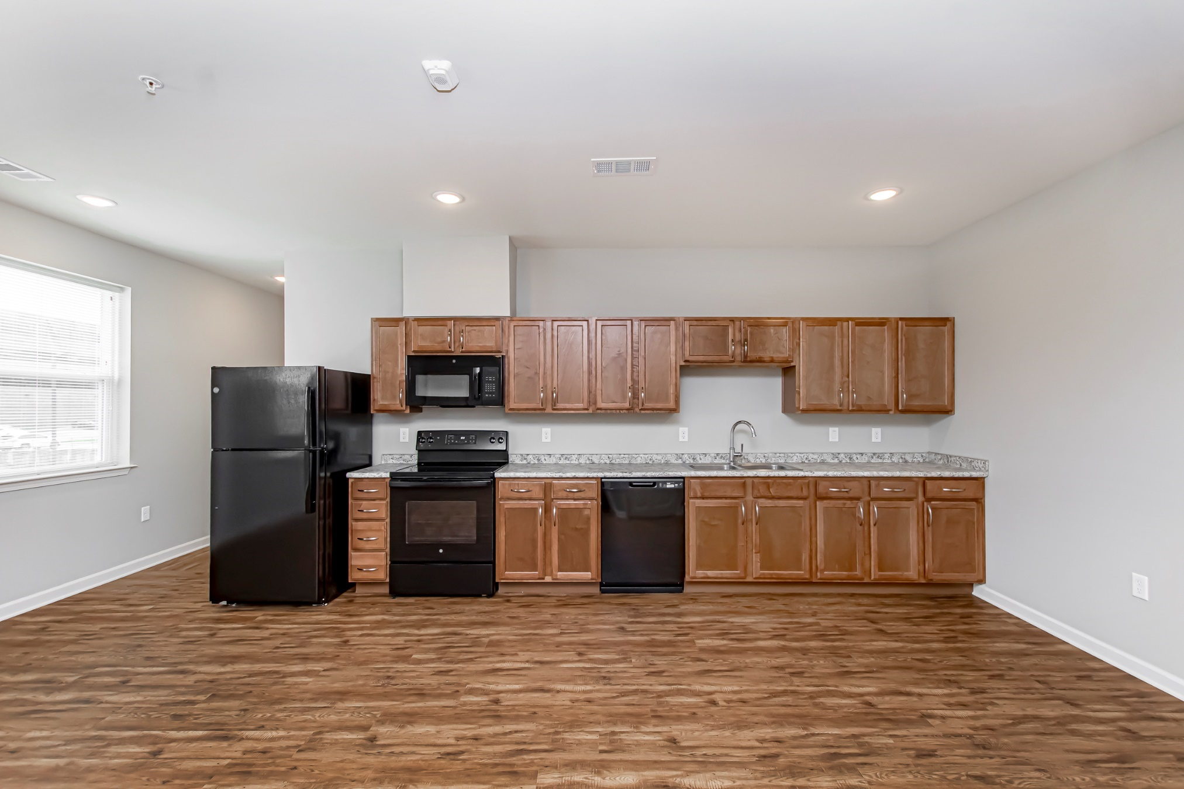
OCCUPIED
VACANT
Kitchen

Slide 36
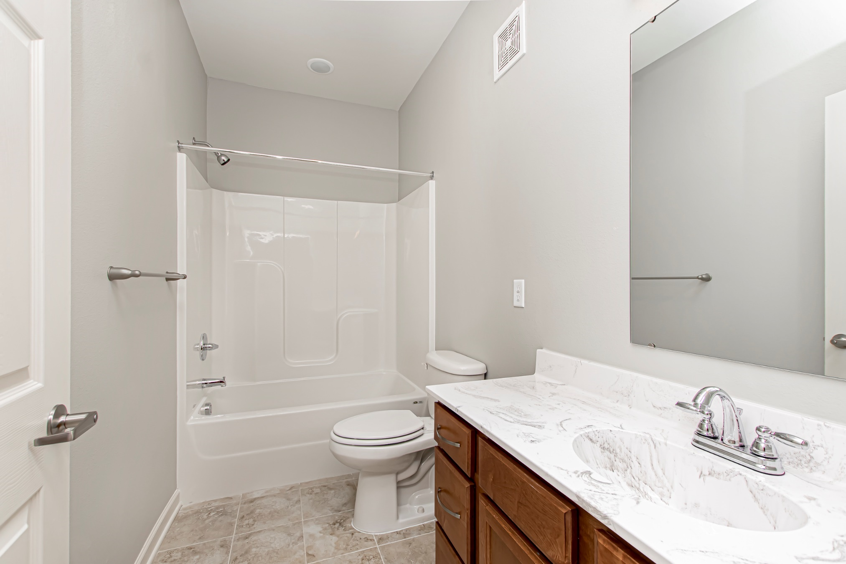
OCCUPIED
VACANT
Bathroom

Slide 37
Name | Address | # of Units
 | Total Student Units | 0
STUDENT COMPLEXES COMPLETED
Student 2018 - 2021
VACANT
Completed in 2018 – 805 Units
Completed in 2019 – 0 Units
Completed in 2020 – 0 Units
Completed in 2021 – 0 Units

Slide 38
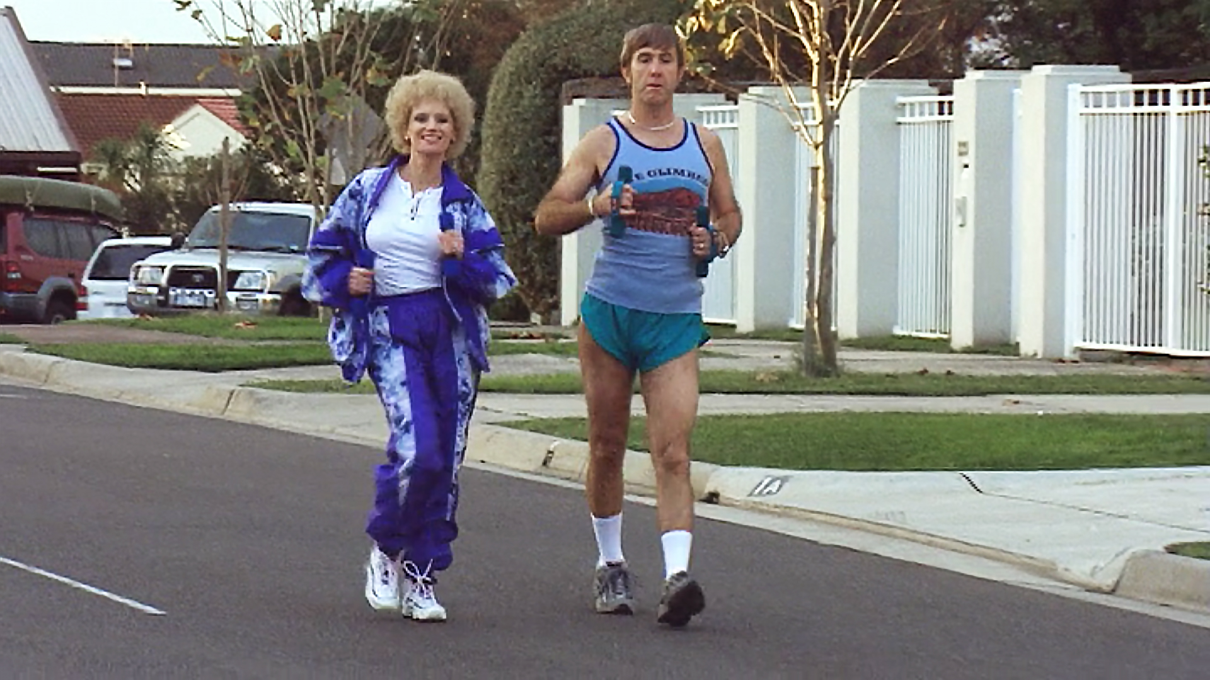
APARTMENTS UNDER CONSTRUCTION 2022-2023

Slide 39
Name | Address | # of Units
River House Phase 2 | 101 River House Place | 42
Residences at Rivermark | 451 Florida Street (CBD) | 144
The Bend on Bluebonnet | Burbank @ Bluebonnet | 309
The Waters at Heritage | LA Hwy @ LA Hwy 44 (Gonzales) | 299
 | Total Conventional Units | 794
COMPLEXES UNDER CONSTRUCTION
Conventional 2022 - 2023
OCCUPIED
VACANT

Slide 40
Name | Address | # of Units
Drakes Landing | North Ardenwood Blvd | 216
Cypress at Gardere | 501 Gardere Lane | 99
Valencia Park | Spanish Town Park at N. 13th | 122
Motor City Apts | North Blvd. @ Scenic Hwy | 110
Lotus Village Seniors | Gracie St. @ Gayosa St. | 116
Reserve at Howell Place | 4201 Ford Street | 300
Capstone at Scottlandville | 8770 Elm Grove Garden Dr | 84
Hollywood Heights | 4065 Hollywood Street | 45
Hollywood Acres | 3901 Hollywood Street | 45
Sherwood Oaks | Darryl Drive | 280
Reserve at Juban Lakes | Buddy Ellis Road | 132
Morningside at Juban Lakes (Senior) | Buddy Ellis Road | 120
 | Total Affordable Units | 1,669
COMPLEXES UNDER CONSTRUCTION
Affordable 2022 - 2023
OCCUPIED
VACANT

Slide 41
AFFORDABLE UNIT CONSTRUCTION
2015 - 2023
OCCUPIED
VACANT
1,669
Affordable Units Under Construction
3,680
Additional Affordable Units Surveyed in 33 Complexes
90.9%
Current Occupancy Ranges from 73% to 100%

Slide 42
COMPLEXES UNDER CONSTRUCTION
Student 2022 - 2023
Name | Address | # of Units
The Vue on Parker | West Parker @ Gourier | 132
 | Total Units | 132
 | Total Beds | 294
OCCUPIED
VACANT

Slide 43
PROPOSED COMPLEXES 2023-2024
 | Total Units | Conventional | Student | Affordable
Total Proposed 2023-2024 Likely | 1,382 | 1,023 | 0 | 359
Total Proposed 2023-2024 Less Likely | 362 | 362 | 0 | 0
Total Proposed/Announced 2023-2024 | 1,744 | 1,385 | 0 | 359

Slide 44
NUMBER OF UNITS COMPLETED/PROPOSED 2012-2023
2015 – 2019
7,822 Units Constructed or 1,564 Units/Yr
2020 – 2021
1,261 Units or 630 Units/Year
2022
2,595 Units U.C.
1,669 Affordable
2006 – 2008
Post Katrina
3,983 Units Constructed or 1,328 Units/Yr
926

Slide 45
SUMMARY AND CONCLUSIONS

Slide 46
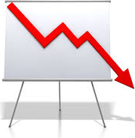
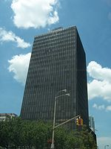
Market Summary - 2021
RENTS
VACANCY
CONSTRUCTION
SALES
Up 9.43% to an Average of $1.16/sf Class A Rents in Baton Rouge Up 21.6%
4.92% Matched Sample 4.88% Full Data Set LSU Area Decreased from 17% to 7%
Only 623 Units Completed in 2020; Lowest Since 2014 Affordable - 1,669 units Under Construction
Record $580 Million in Sales Significant Amount of High Dollar Sales

Slide 47
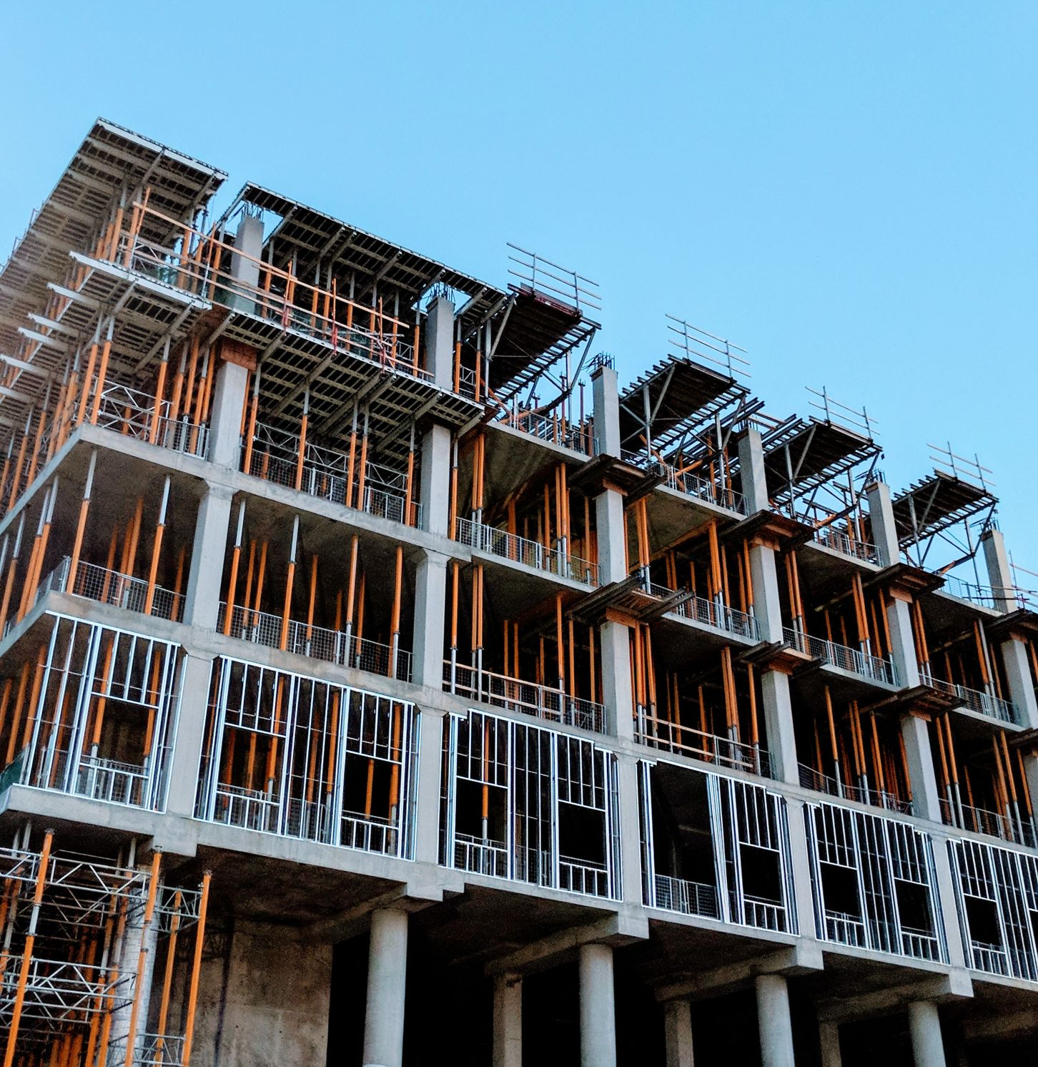
Multifamily Projections 2022-2023
RENTS
VACANCY
CONSTRUCTION
SALES
Continue to INCREASE in 2022 - 2023 at Historical 1% to 3% Level
Remain at Current Overall 5% to 7% Vacancy Levels
Watch Affordable Properties
With Construction Costs and Interest Rates Increasing, Construction of New Units Will Likely Slow Down
Slowdown of Sales Due to Increasing Interest Rates
Still Have Low Inventory and Lots of Money Chasing Deals

Slide 48
MULTIFAMILY COMMITTEE MEMBERS
D. Wesley Moore, II, MAI, CCIM
Cook, Moore, Davenport & Associates
Abby McMasters
Cook, Moore, Davenport & Associates
Mark Segalla
Elifin Realty – Multifamily Division
Deane Bryson
Bearing Point Properties
Laura T. White, CPM
NAI Latter & Blum Property Management
Chris Gremillion, CCIM
Multifamily Division of NAI Latter & Blum
Chad Rigby
Stirling Investment Advisors

Slide 49
THANK YOU
Contact Info
Craig Davenport, MAI
Cook, Moore, Davenport & Associates
www.CookMoore. com
cdavenport@cookmoore.com

