Slide 1


BATON ROUGE
Residential Market
PRESENTED BY
Tom W. Cook MAI
Cook Moore Davenport And Associates

Slide 2


RESIDNETIAL COMMITTEE MEMBERS
Tom W. Cook MAI
Cook Moore Davenport and Associates
Bryton Cox
GBRAR
Jill Sylvest
GBRAR
Richard Rachal, MAI
Cook Moore Davenport and Associates
Robert Beaman
Cook Moore Davenport and Associates

Slide 3

Executive Summary:
Residential markets in most sectors have been healthy.
Dollar Volume was up
Median Home Price was up
Inventory of homes, as exhibited by months of supply rose
Because the data set ends on December 31, 2020, it is not impacted by the COVID 19 pandemic or the 2 trillion-dollar stimulus package, nor does it take into consideration the drop in the price of crude oil to below $30.00 per barrel, all of which is likely to have an impact on the market moving forward.
2020 Report

Slide 4

2021 Report

Slide 5

Executive Summary:
Residential markets in most sectors have been healthy.
Dollar Volume was up
Median Home Price was up
Inventory of homes, as exhibited by months of supply FELL also
Days on Market FELL
Because the data set ends on December 31, 2021, it is not impacted significantly by the rise in interest rates and inflation.
2021 Report

Slide 6
Dollar Volume Entire GBRAR |  |  | Change | Change | Change | Average Change
 | 2020 | 2021 | 2019 to 2020 | 2020 to 2021 | 2019 to 2021 | 2015 to 2019
All Sales All Price Ranges | $3,129,363,927 | $3,792,200,313 | 21.95% | 21.18% | 47.78% | 4.99%
Sale Price $93,999 or Less | $47,828,787 | $43,539,534 | -12.83% | -8.97% | -20.64% | -0.92%
Sale Price $94,000 to $177,999 | $430,741,572 | $383,609,258 | 2.24% | -10.94% | -8.95% | -3.33%
Sale Price $178,000 to $261,999 | $1,003,378,762 | $1,110,351,253 | 20.61% | 10.66% | 33.47% | 6.30%
$262,000 or More | $1,647,414,806 | $2,254,700,268 | 30.96% | 36.86% | 79.23% | 8.29%

Slide 7
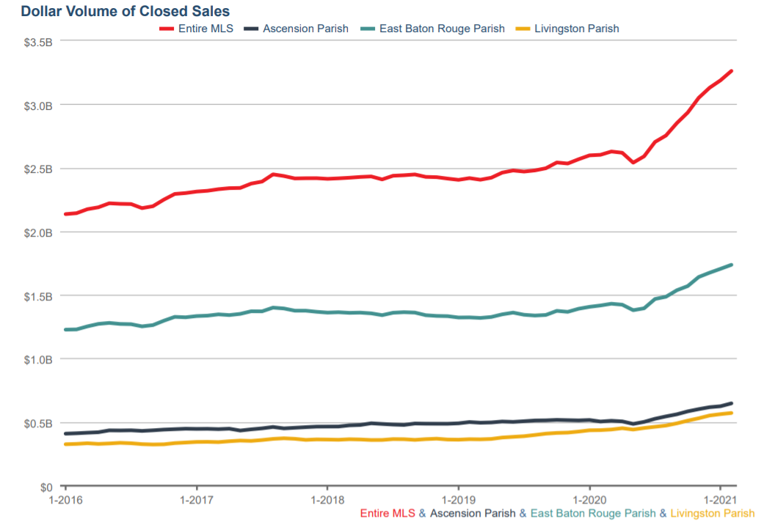

Slide 8
New Homes Entire MLS |  |  | Change | Change | Change | Average Change
 | 2020 | 2021 | 2019 to 2020 | 2020 to 2021 | 2019 to 2021 | 2015 to 2019
All Sales All Price Ranges | $712,088,512 | $777,696,124 | 23.82% | 9.21% | 35.23% | 5.00%
Sale Price $93,999 or Less | $92,000 | $92,000 | 3.37% | 0.00% | 3.37% | NA
Sale Price $94,000 to $177,999 | $36,393,737 | $25,790,613 | 35.15% | -29.13% | -4.23% | -18.15%
Sale Price $178,000 to $261,999 | $273,867,599 | $257,712,183 | 17.60% | -5.90% | 10.66% | 3.45%
$262,000 or More | $402,144,274 | $499,001,541 | 27.58% | 24.09% | 58.31% | 13.02%

Slide 9
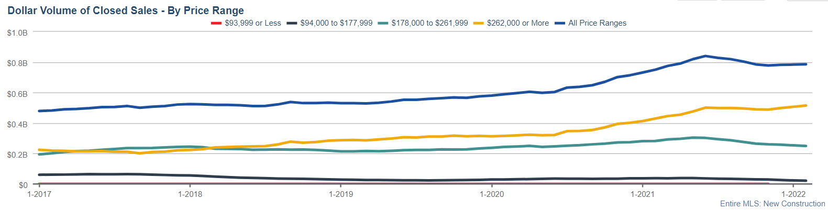

Slide 10


Slide 11
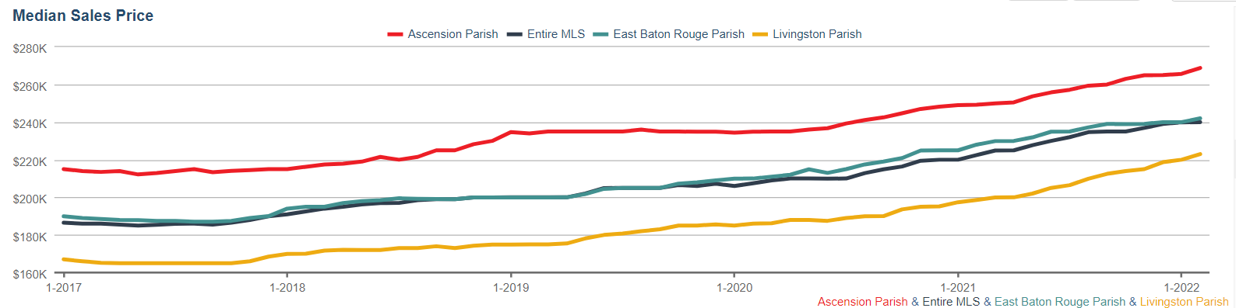

Slide 12
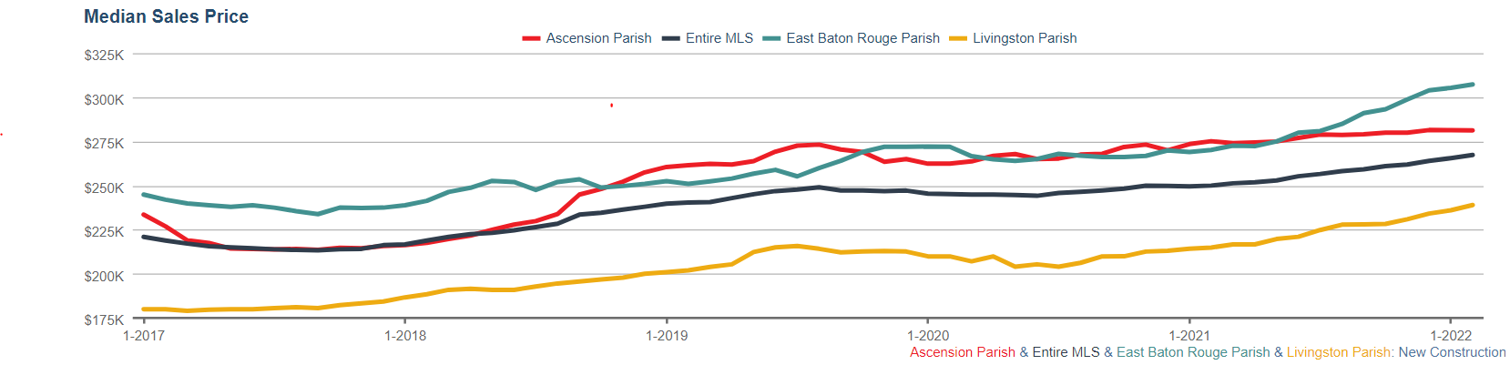

Slide 14
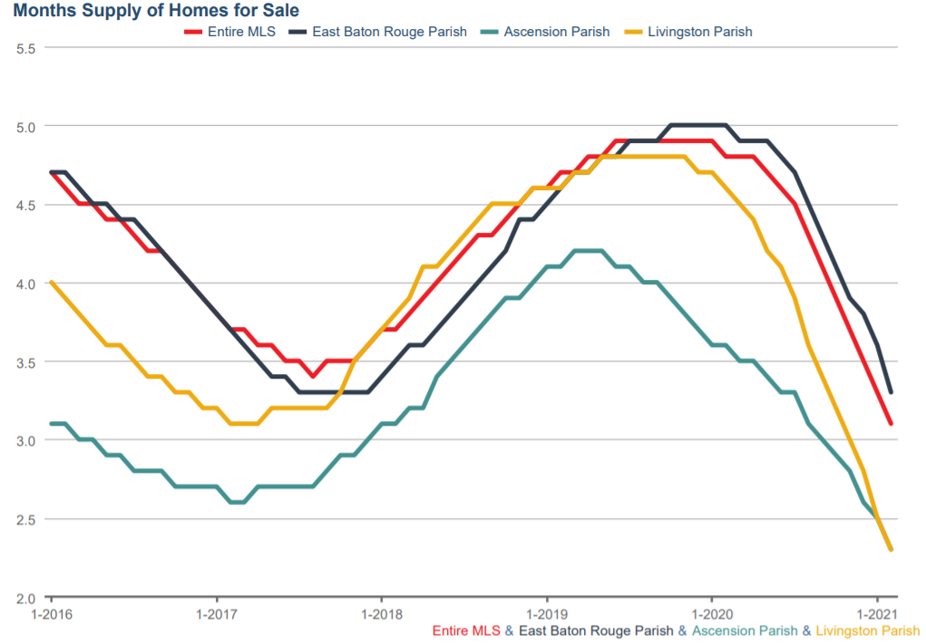

Slide 15
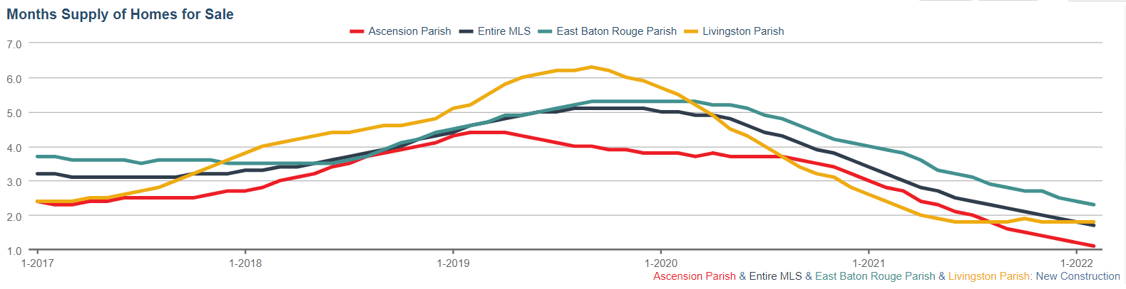

Slide 17
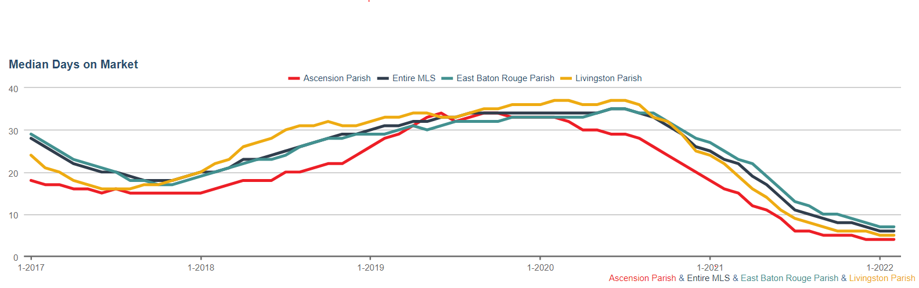

Slide 18
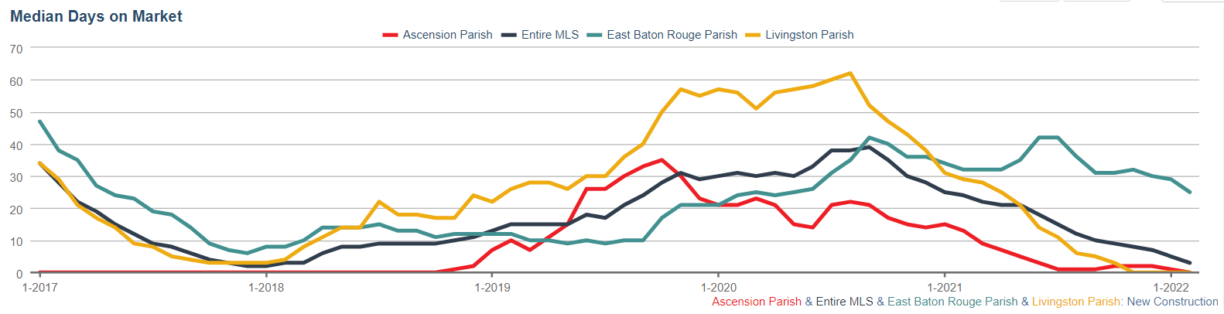

Slide 19
ONCE AGAIN WHY ?
What is the Driving Force

Slide 20
Is it Job Growth?
Are Buyers Coming From The Apartment Rental Market?

Slide 21
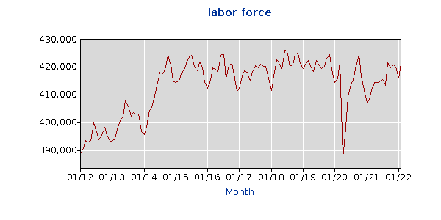

Slide 22
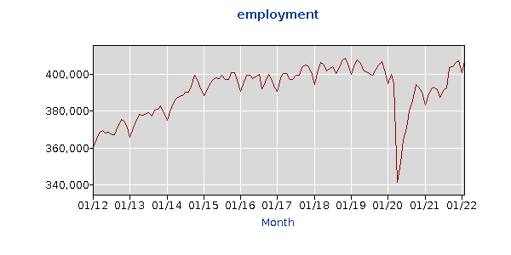

Slide 23

HISTORICAL VACANCY RATES(Matched Sample)
4.92% Vacancy Rate
in 2022

Slide 24
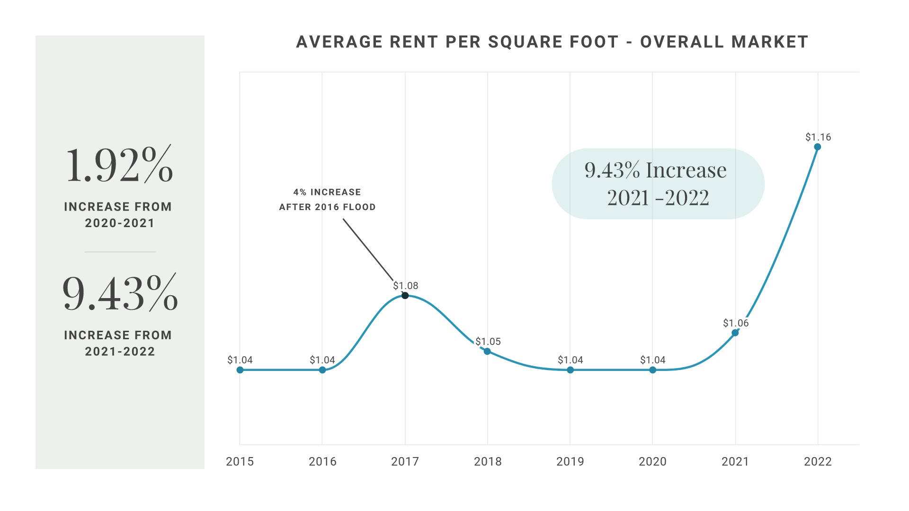
OCCUPIED
VACANT

Slide 25
Millennials Moving Out of Their Parent’s House
Older Folks Moving to be Closer to Children
Divorce
Reduced Number in Household (down from 2.63)
Pent up Demand
Poor Existing Housing Stock
Better Work From Home Environment
More Disposable Income Due to COVID
Lake Charles Relocation
LAST YEAR’S
GUESS
2020

Slide 26
Millennials Moving Out of Their Parent’s House
Older Folks Moving to be Closer to Children
Divorce
Reduced Number in Household (down from 2.63)
Pent up Demand
Poor Existing Housing Stock
Better Work From Home Environment
More Disposable Income Due to COVID
Transfer of Wealth Due to COVID
Immigration
THIS YEAR’S
GUESS

Slide 27
Answer to Market Activity 2020 = INTEREST RATES

Slide 29
Answer to Market Activity 2021 = Interest Rates
(Data Collection Ended 12-31-2021)

Slide 30
Loan Type | Purchase | Refinance
30-Year Fixed | 5.39% | 5.52%
FHA 30-Year Fixed | 5.37% | 5.52%
VA 30-Year Fixed | 5.47% | 5.63%
Jumbo 30-Year Fixed | 4.57% | 4.65%

Slide 31
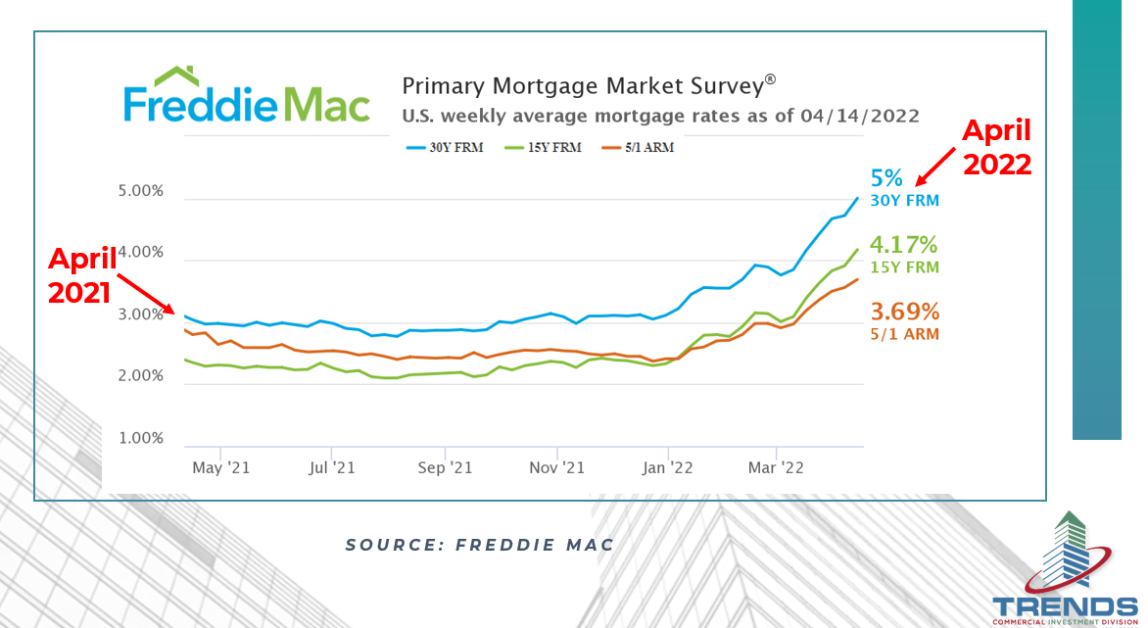

Slide 32
What if Interest Rates Go to 6%
Current Payment on $300K at 3% 30 year Am $1,265
Payment on $300K at 6% 30 year Am $1,800
Difference of $535
Borrowers Will Have to Make about $1,500 more per month to qualify for the Same Mortgage

Slide 33
Income necessary to qualify for a $300,000 mortgage
At 3% Interest 30 Years
$45,000 Per Year
Income necessary to qualify for a $300,000 Mortgage
At 6% Interest 30 Years
$62,000 Per Year

Slide 34
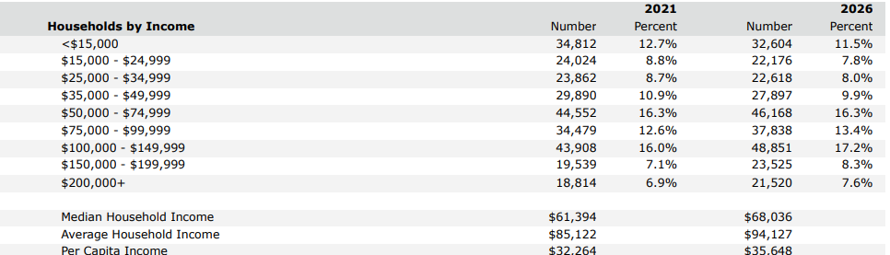

Slide 35
Total Number of Households Making $42,000 to $150,000 About 135,000
Total Households Making 62,000 to $150,000
About 100,000
Loss of Potential Buyers
35,000, or about 25%

Slide 36
What I said to Expect
Last Year 2021

Slide 37
Increasing Prices
Lumber and Material Cost to Continue to Rise (cutting less)
Inventory to Stay Sparce
Above List Offers on Good Homes to Continue
Escalation Clauses / Bidding Wars
Agents Will Have to be More Educated

Slide 38
For well-organized and well-managed home building companies, this decade is going to be the greatest home building opportunity since the 1970s. Charles C. Shinn Ph.D. Shin Consulting the roaring 2020’s

Slide 39
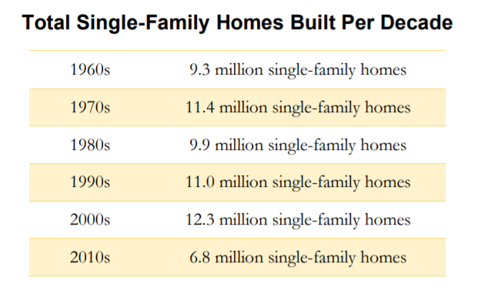

Slide 40
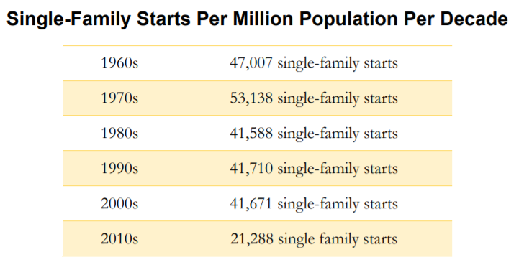

Slide 41
What to Expect for
2022

Slide 42
Increasing Cost of Housing
Decreasing Inventories
More Townhouse Construction
Increasing Interest Rates
Decrease in Dollar Volume
Market Conditions to Cool Off

Slide 43


Slide 44
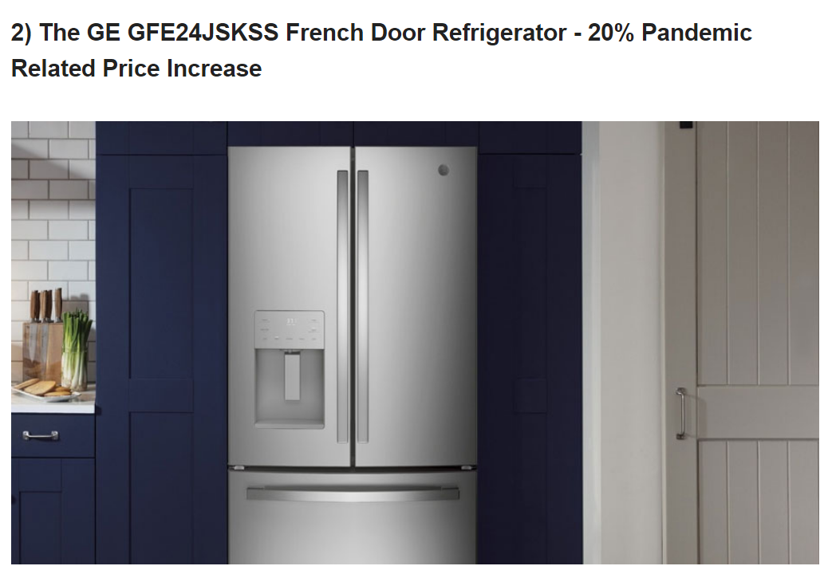

Slide 45
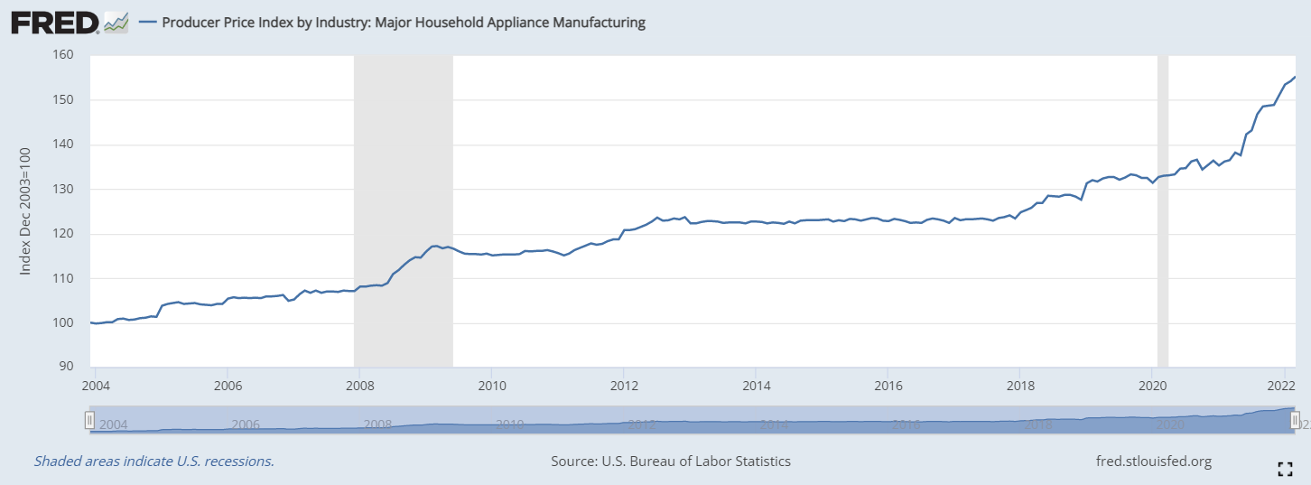
Increase of about 25% from 2019 to 2022

Slide 46
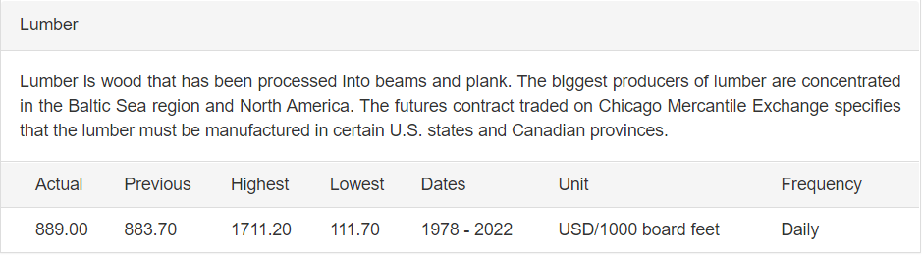

Slide 47
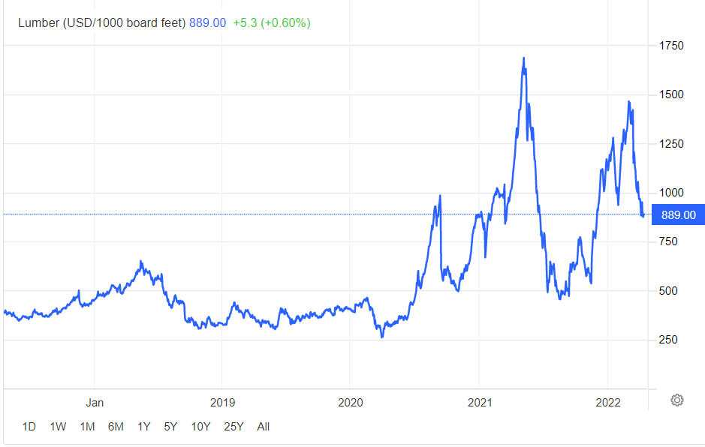

Slide 48
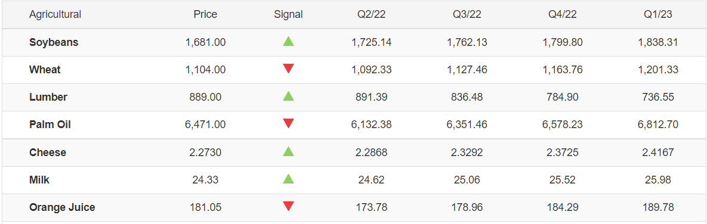
Projected Decrease of about 17% from Q2/22 to Q1/23

Slide 51
New Development

Slide 52
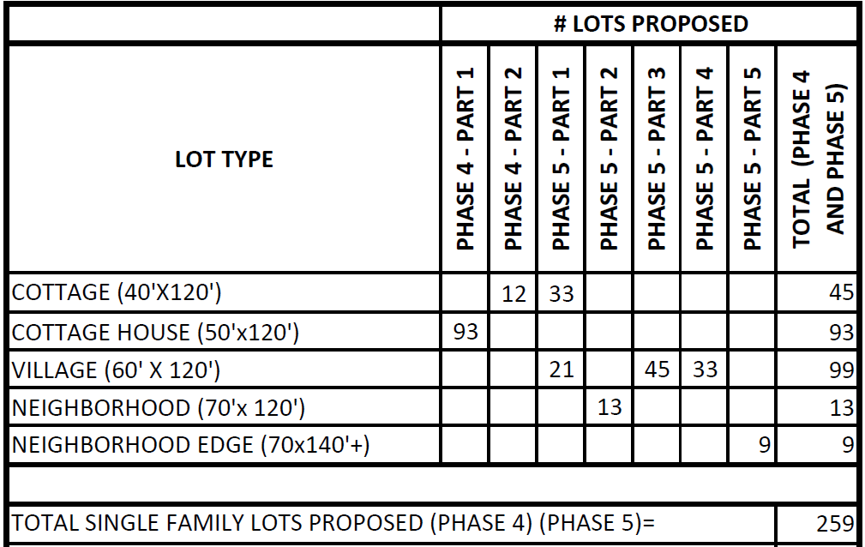
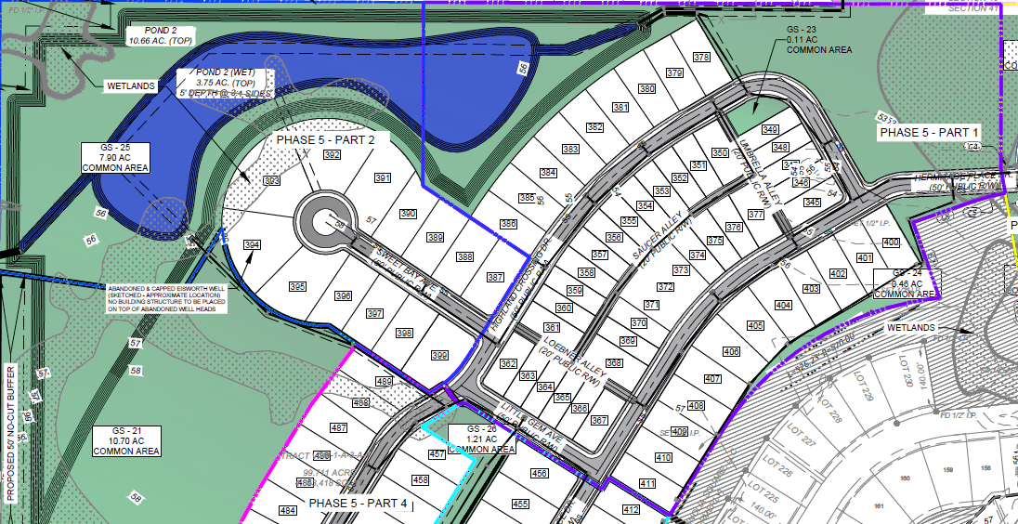
Village at Magnolia Square / Bardwell
Location: Off Lovett Road Central in Baton Rouge
Total lots: 259 Bardwell will Purchase 100 lots over time
Lot Sizes: 40 X 120 to 70 X 140
Home Sizes: 2,250 to 2800 sf living area
Home Price Range: Starting in the $450,000s / $200 per sq/ft
Continue the Highland District (23 Houses Under Construction 17 Sold)
Features: Ponds, playground, pool / Mixed use Development

Slide 53
Village at Magnolia Square / Alvarez
Location: Off Lovett Road Central in Baton Rouge
Total lots: 259 Alvarez will Purchase 93 lots over time
Lot Sizes: 40 X 120 to 70 X 140
Home Sizes: 1,800 to 2,000 sf living area
Home Price Range: Starting in the $325,000s to $400,000
New Concept
Features: Ponds, playground, pool / Mixed use Development

Slide 54
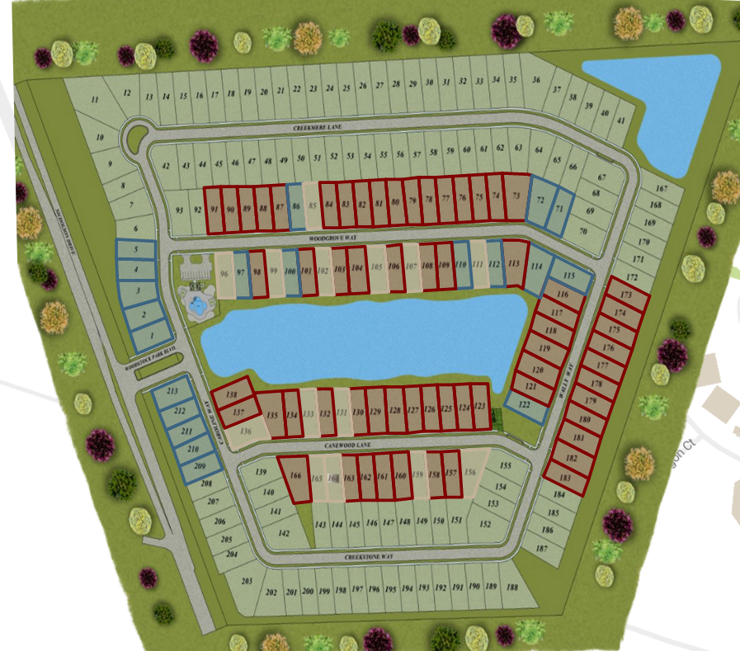
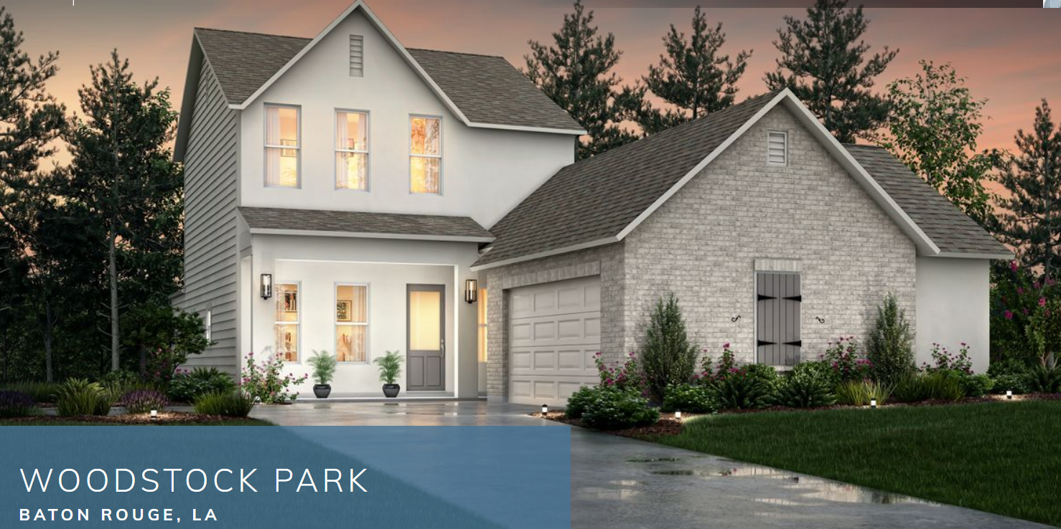
Woodstock Park / Alvarez
Location: Nicholson Drive in Baton Rouge
Total lots: 300
Lot Sizes: 50 x 120
Home Sizes: 1,800 – 2,500 sq. ft. living area
Home Price Range: $350,000 to $550,000
90 homes under construction, taking down 43 more lots in 30 days
Features: Ponds, playground, pool and amenity center, sidewalks, curb and gutter, and community green spaces.

Slide 55
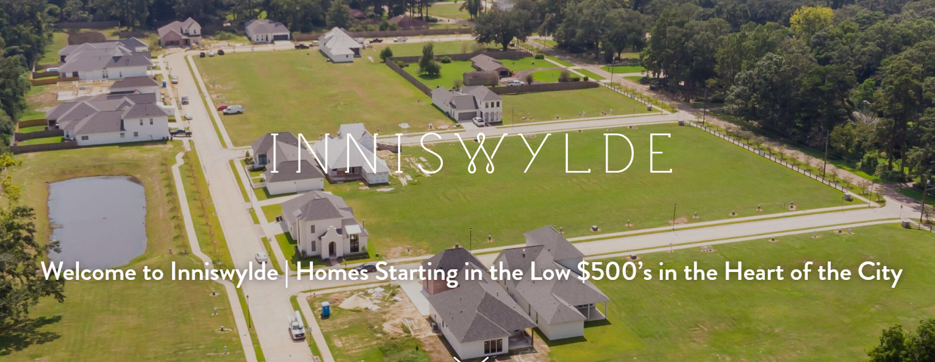
Inniswylde / Bardwell
Location: Inniswold off Bluebonnet Blvd. Baton Rouge
Total lots: 33
Lot Sizes: 50 x 140
Home Sizes: 2,000 - 3,000 sq. ft. living area
Home Price Range: Starting in $500,000s
Features: 6 homes under construction 2 presold Prior to model being completed

Slide 56
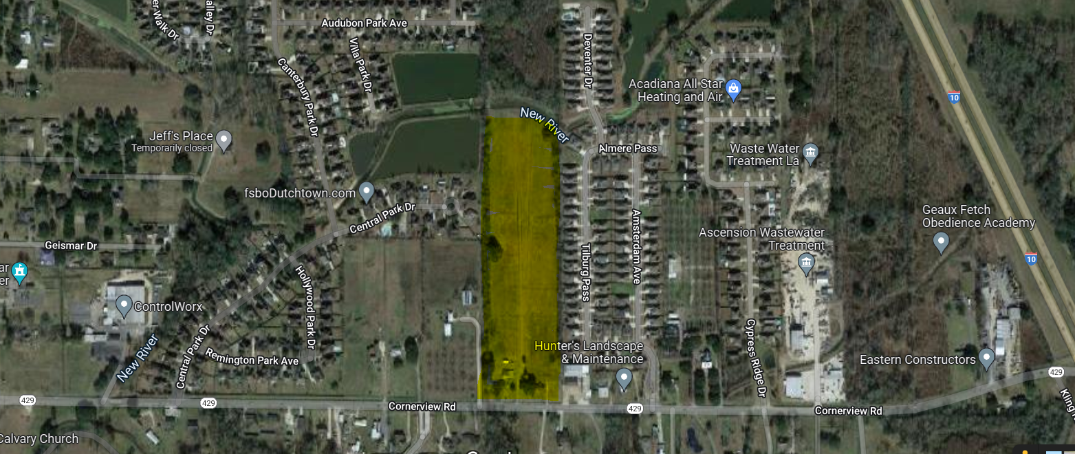
Clare Court | Level Homes
New Community Coming Soon!
Location: On Cornerview Rd., Prairieville, Louisiana
Lot Count: 37
Home Size: Coming Soon
Home Price: Coming Soon
Market Date: Fall 2022
Additional Features/Amenities: Premium water-front homesites

Slide 57
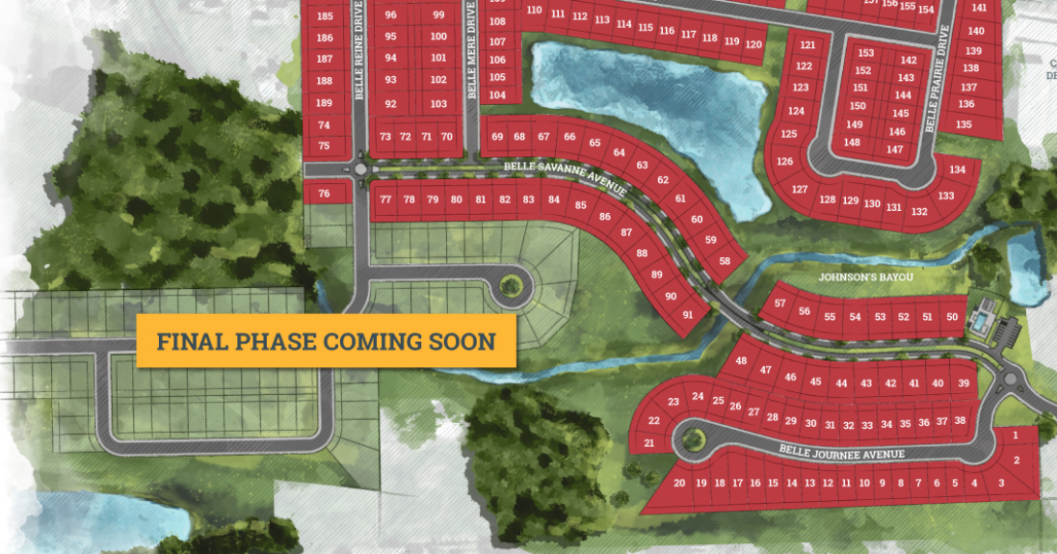
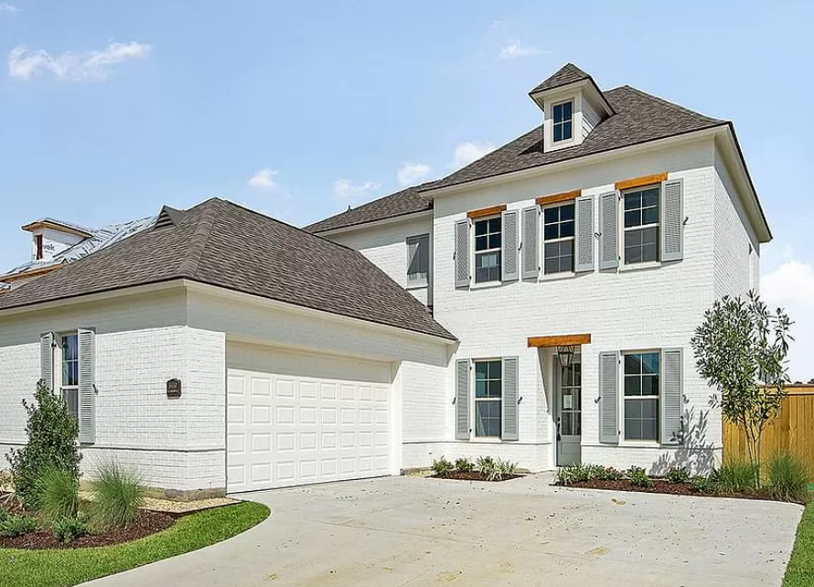
Belle Savanne At Dutchtown | Level Homes
3RD and Final Phase Coming Soon!
Location: Off Old Jefferson, Geismar, Louisiana
Lot Count: 284 total; 95 lots in the final phase
Home Size: 2,200 to 3,200 Phase 1 and Phase 2
Home Price: $300,000 to $450,000
Market Date: Summer 2022
Additional Features/Amenities: Resort-style community pool and cabana — NOW OPEN. Walkable community with scenic lakes and green space. Note: Phase 1 and Phase 2 SOLD OUT

Slide 58
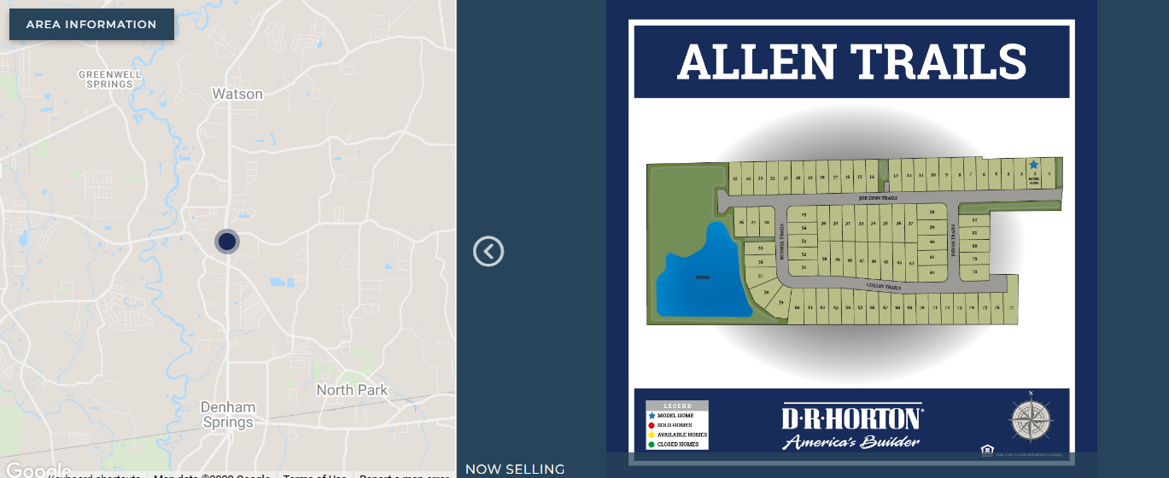
Allen Trails | D.R. Horton
Coming Soon: June 2022
Location: Off LA Hwy 16 South of LA 1025, Livingston Parish
Total lots: 82
Lot Sizes: 50 X 150
Home Sizes: 1,447 - 2,133sq. ft. living area
Home Price: From $267,900
Features: Pond, playground, and curb and gutter.

Slide 59
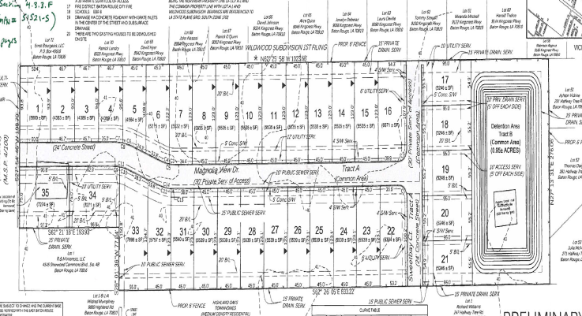
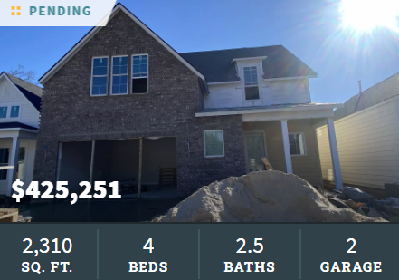
Magnolia Crossing / Level Homes
NEW - Baton Rouge, on Staring Lane near Highland Road
Lot count: 32 lots
Starting price in: Originally Projected in $300s+
Prices now: $425,000 and UP
Home Size: 1,700 to 2,400 SF
Homes Under Construction and Pending Sales

Slide 60
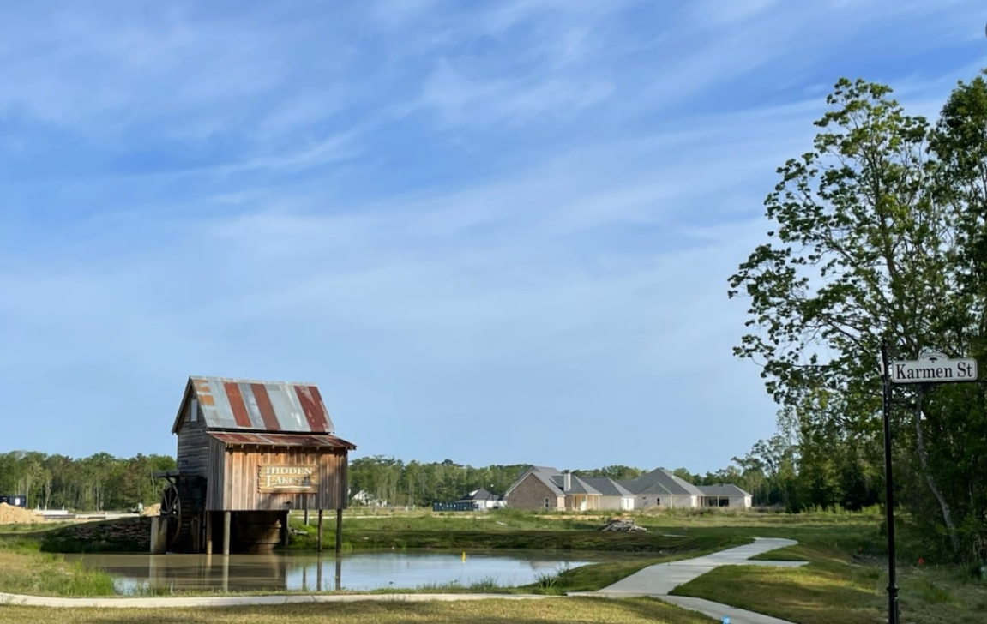
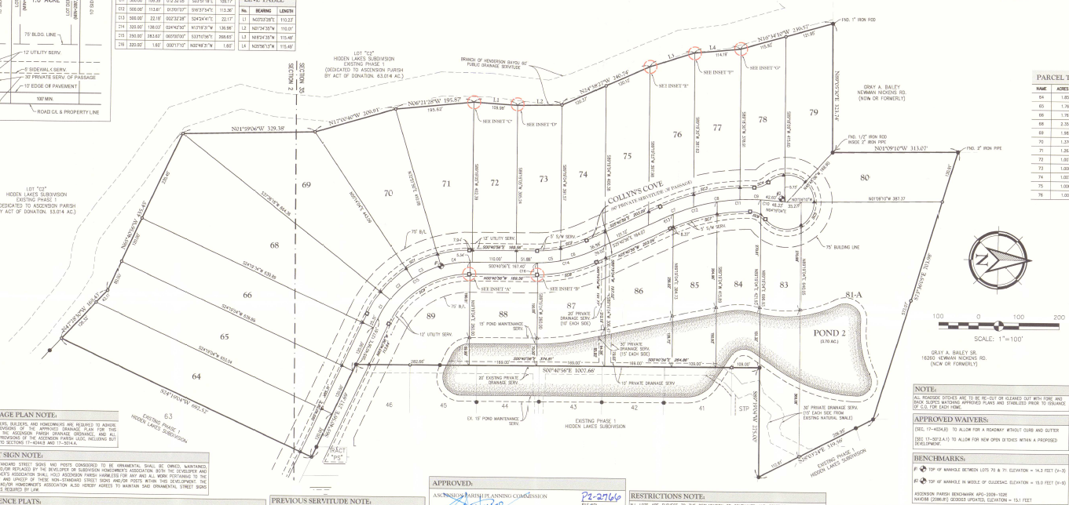
Hidden Lakes / Chris Ingram
Location: Off Norwood Road, Prairieville
Total Lots: 89
Price Range of Lots: $120,000 to $140,000
Lot Size: 1 acre to 3 acres; 125 Front Feet
Lots Closed: 31 Sales in 14 months
Mostly Custom Homes, one Spec Home Listed in MLS for $697,700

Slide 61
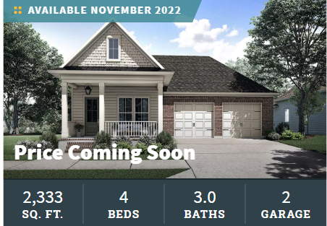
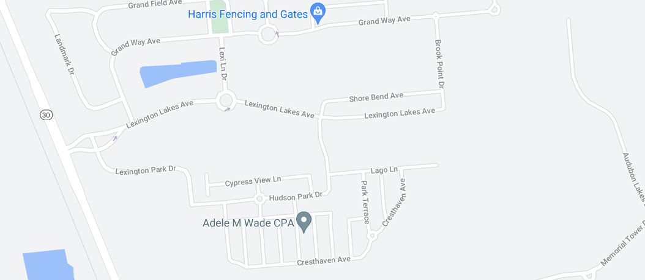
WATER’S EDGE | Level Homes
New Community!
Location: Baton Rouge, Louisiana — Inside Lexington Estates
Lot Count: 76 In Phase 1
Home Price: From $410s; Last Year $300,000s
Home Size: 1,670 To 2,600 SF
Market Date: NOW SELLING
Additional Features/Amenities: Gated community with lakes and green space. Resort-style community pool and cabana, located near major golf course, L’Auberge Casino, shopping, dining, and entertainment. Premium water-front homesites

Slide 62
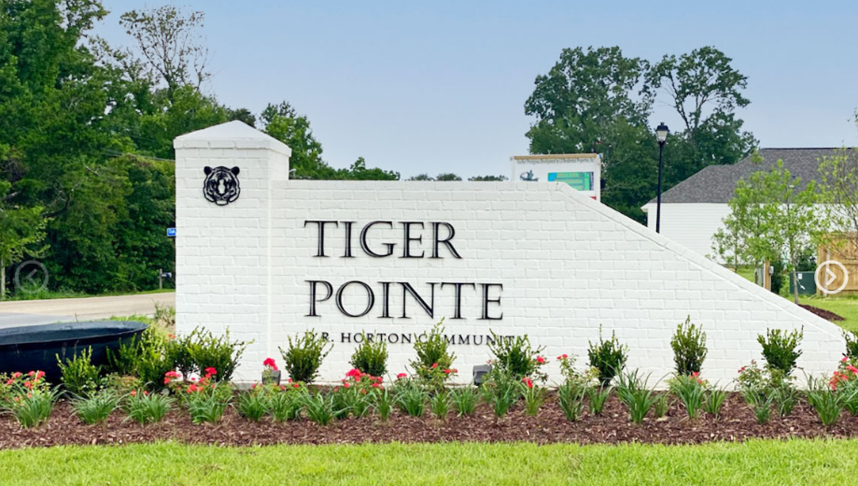
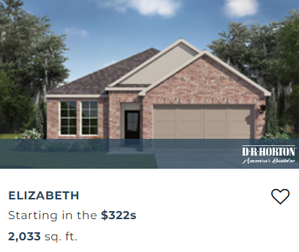
Tiger Pointe | D.R. Horton
Location: Off Tiger Bend, Baton Rouge
Total lots: 52
Lot Sizes: 40 x 135 & 35 x70
Home Sizes: 1,858 - 2,532 sq. ft. living area
Home Price Range: Starting in the $300,000s
Features: Pond, community green space, sidewalks, and curb and gutter.

Slide 63
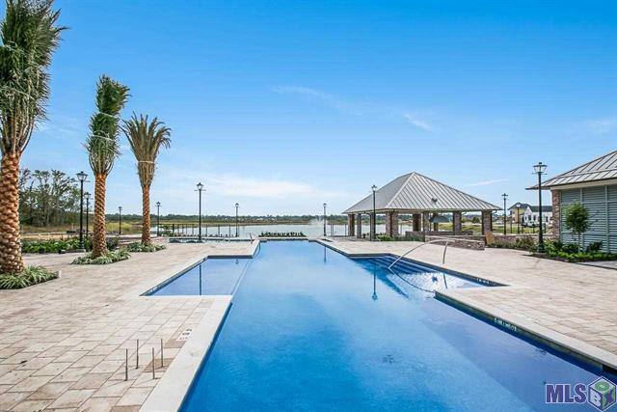
The Lakes at Harveston Phase 1 | John Fetzer and Mike Wampold
Number of Lots: 186
From 3-11-2022 to 4-25-2022: 11 Home Sales Reported to MLS
Price Per Square Foot: $264.18 to $317.77
Median Home Price Per Square Foot: $274.03
Lot Price(s) from $120,000 to $130,000
Lot Size: 45 to 65 x 120’ to 140’
Home Size: 2,000 to 3,000 SF
Home Price Range: $590,000 to $1,100,000
Additional Features:
  Community Center overlooking the 50 acre Harveston Lake with fountains
    Community Building
    Fitness Center
    Cabana with Grill
    Pool and Splash Pad
    Mail Center
    Multi-Use Trails and Walks

Slide 64

THANK YOU

