Slide 1


BATON ROUGE
RETAIL MARKET
PRESENTED BY
Charlie Colvin, CCIM, Momentum Commercial Real Estate

Slide 2


RETAIL COMMITTEE MEMBERS
Charlie Colvin, CCIM
Momentum Commercial Real Estate
Jonathan Walker, CCIM
Maestri Murrell, Inc.
Dottie Tarleton, CCIM
Stirling Properties
Clay Furr
Momentum Commercial Real Estate
Colin Smith
Kurz & Hebert Commercial Real Estate
Andrew D’Ostilio
NAI Latter & Blum
Matthew Shirley, CCIM
Saurage Rotenberg Commercial Real Estate
Ransom Pipes, CCIM
Maestri Murrell, Inc.
Ben Graham, CCIM
Stirling Properties
Will Chadwick, MBA
Elifin Realty
Drew Whitaker
Cook Moore Davenport & Associates
Reiss Weil
Beau Box Commercial Real Estate

Slide 3

COVID 19
UPDATE
- Vaccine Rollout
- Loosening of restrictions
- Return to in store shopping
- Supply Chain Disruptions
- Increased Construction Costs

Slide 4


Last Years Predictions
- Vacancy rates will remain flat in 2021
- Modest increases in total rent
- Expansion of existing projects
- Continued acceleration of E-Commerce
- Charlie@momentum-commercial.com

Slide 5

2022 Shopping Center Survey
2021 2022
Total Area Surveyed: 8,382,198 SF 8,707,198 SF
Number of Centers: 120 127
Average Rent: $19.78 PSF $19.60 PSF
Area Vacancy Rate: 10.50% 8.81%

Slide 6
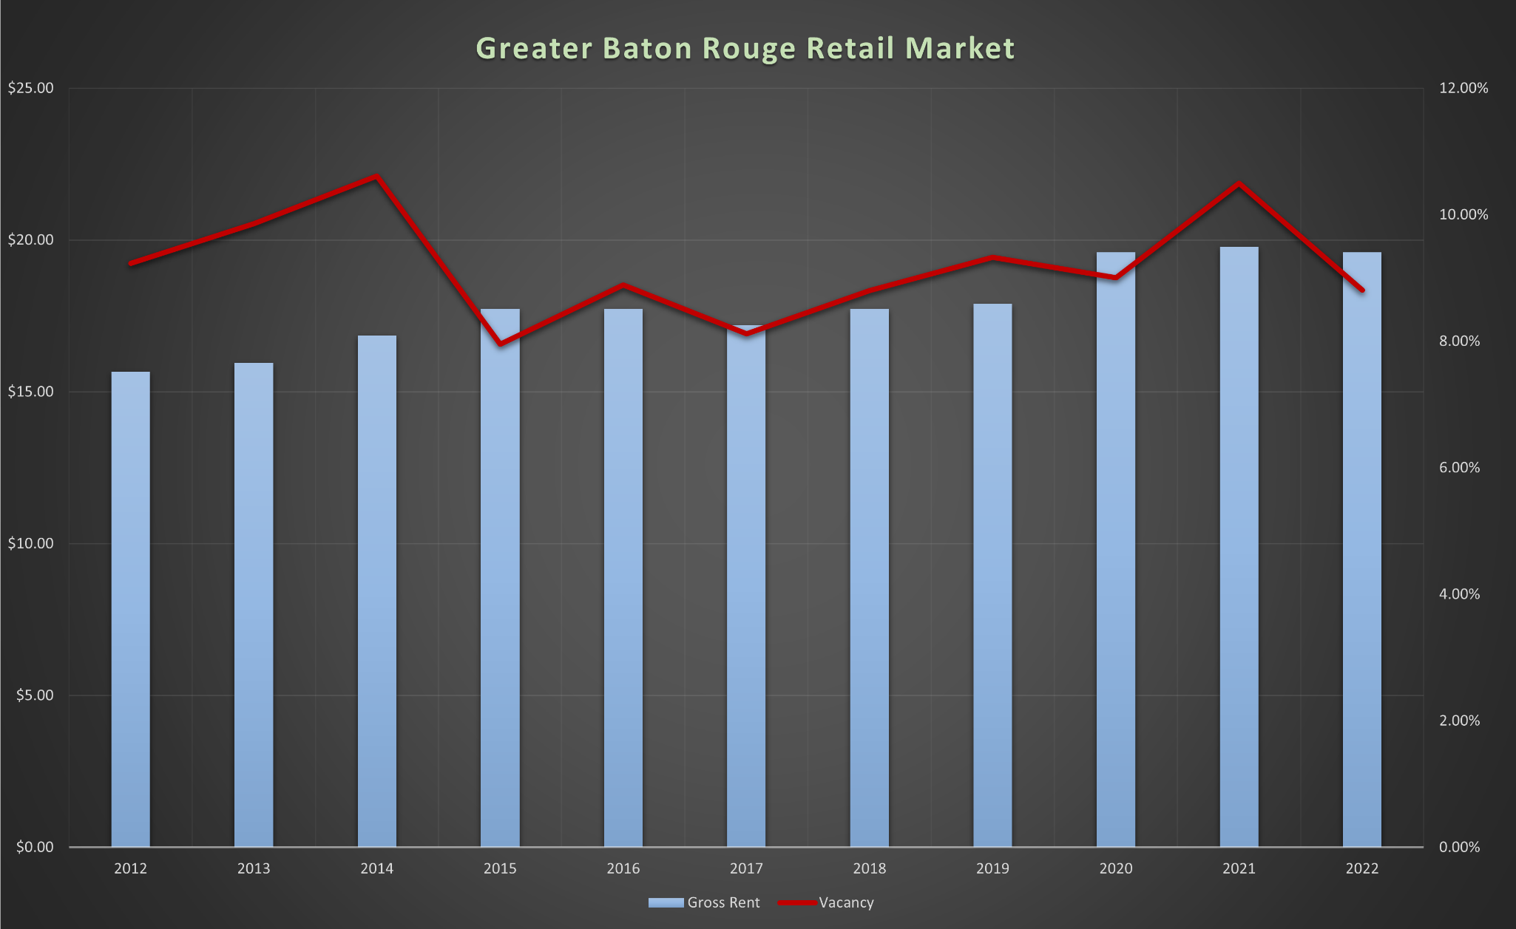

Gross Rents & Vacancy Rates

Slide 7
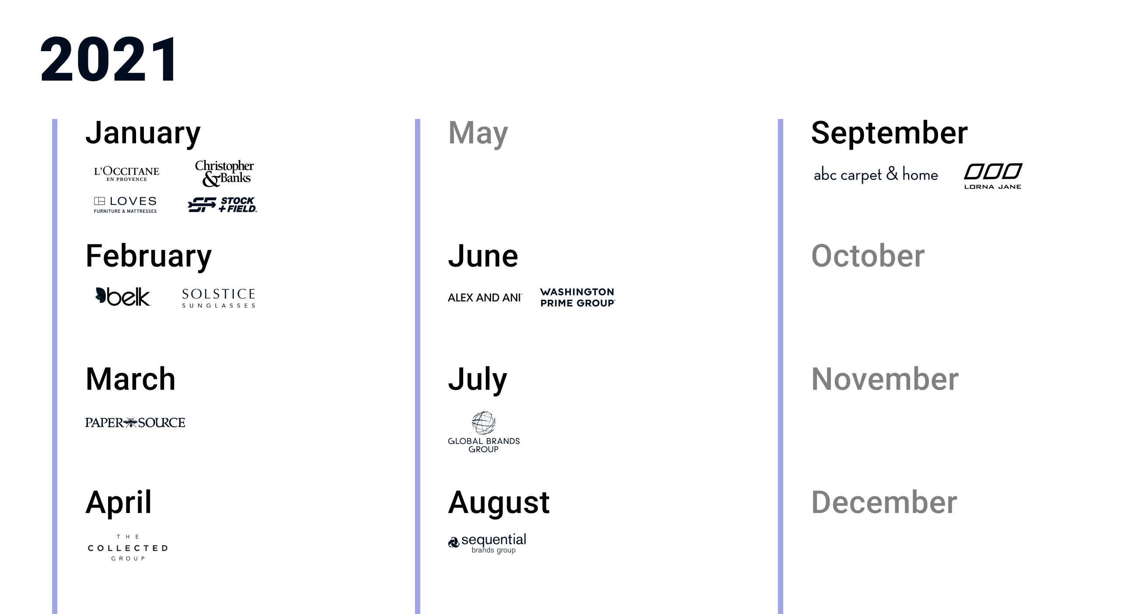
Retail Bankruptcies

Slide 8
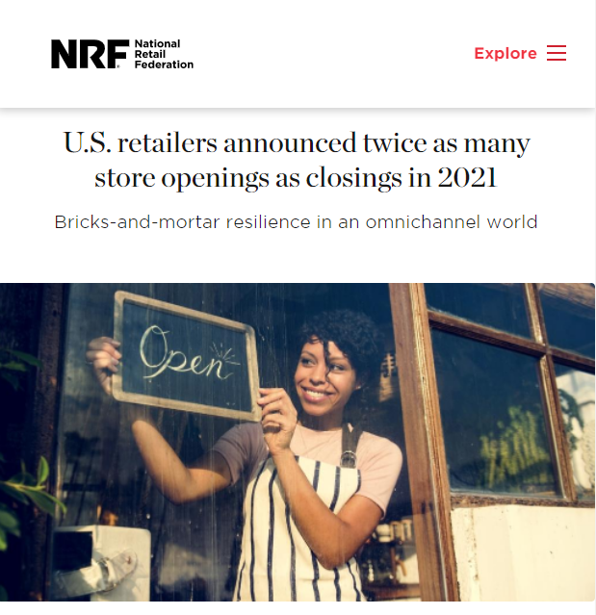

Slide 9
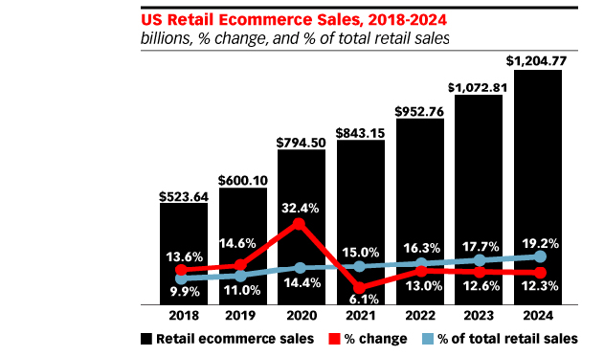

Slide 10
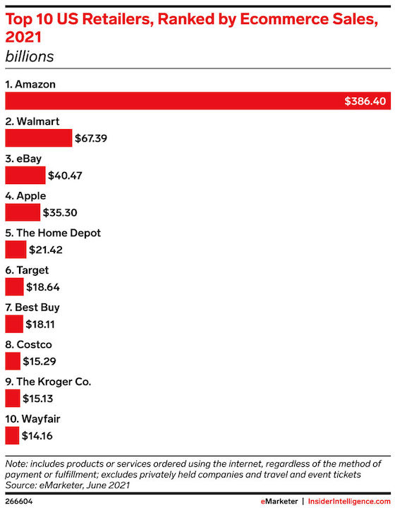

Slide 11
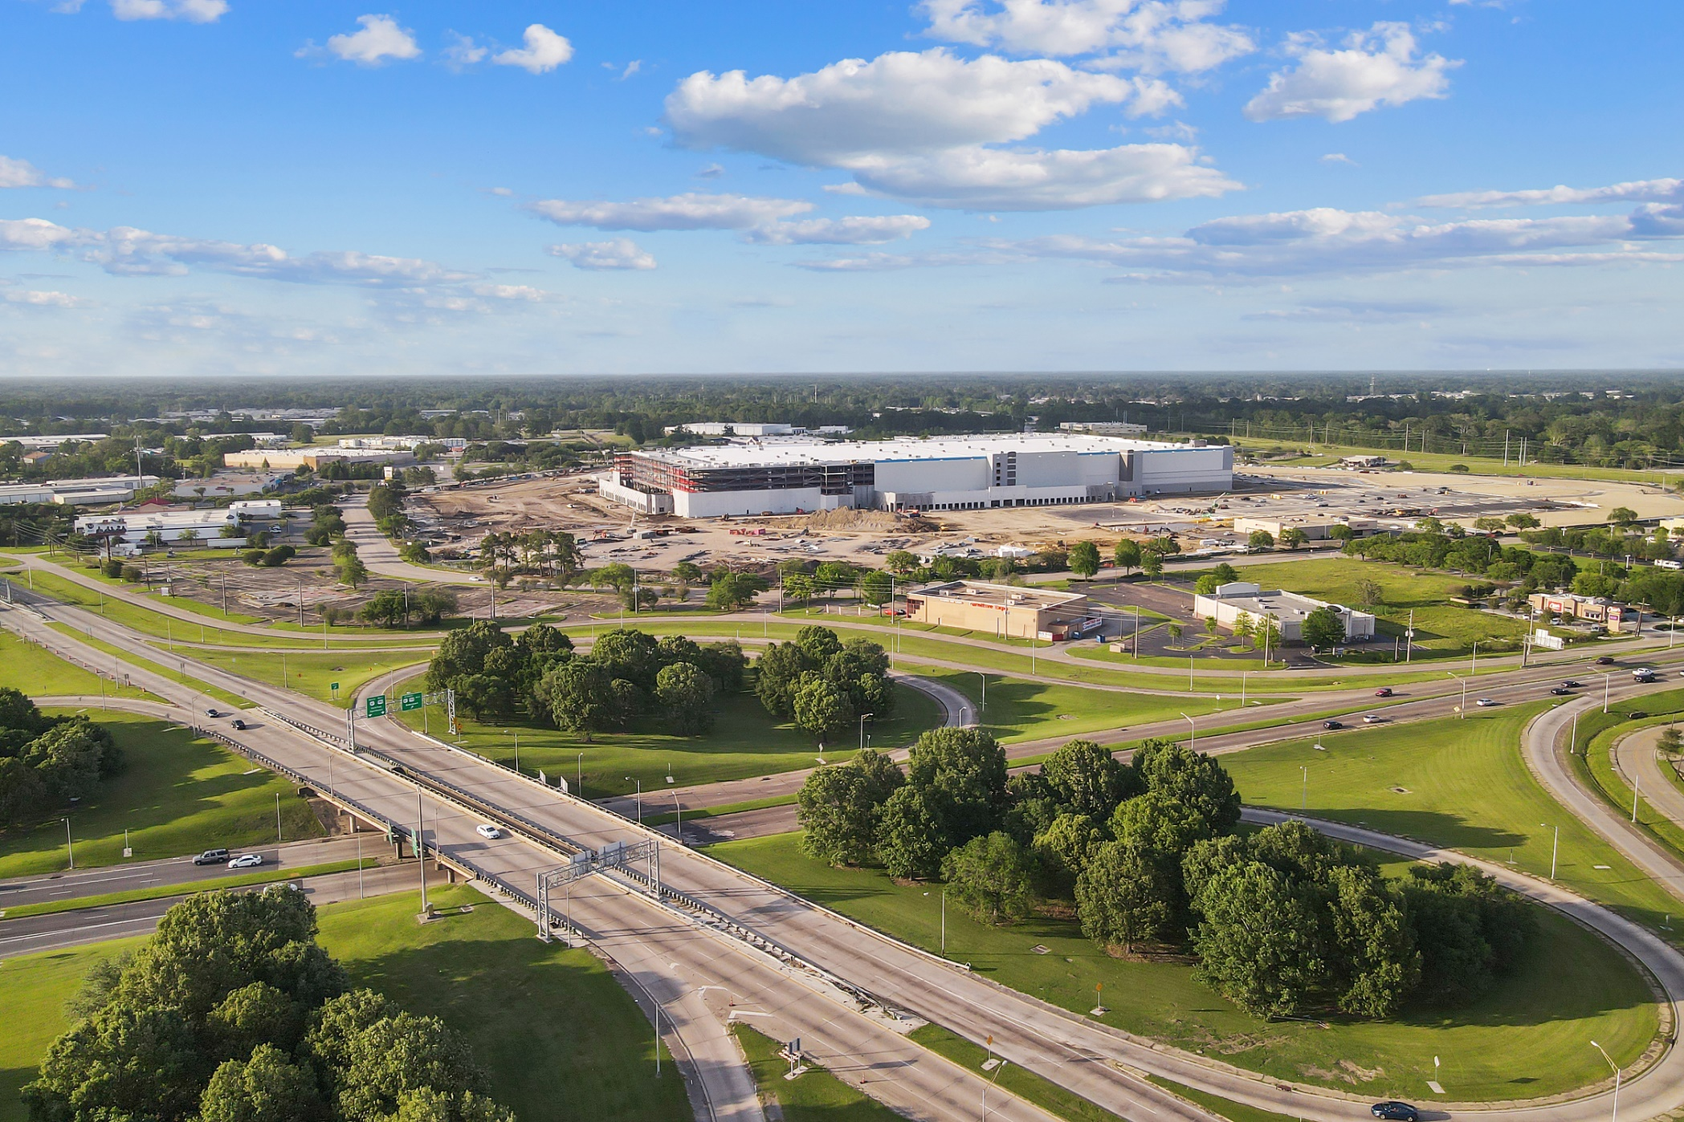
Amazon Progress

Slide 12
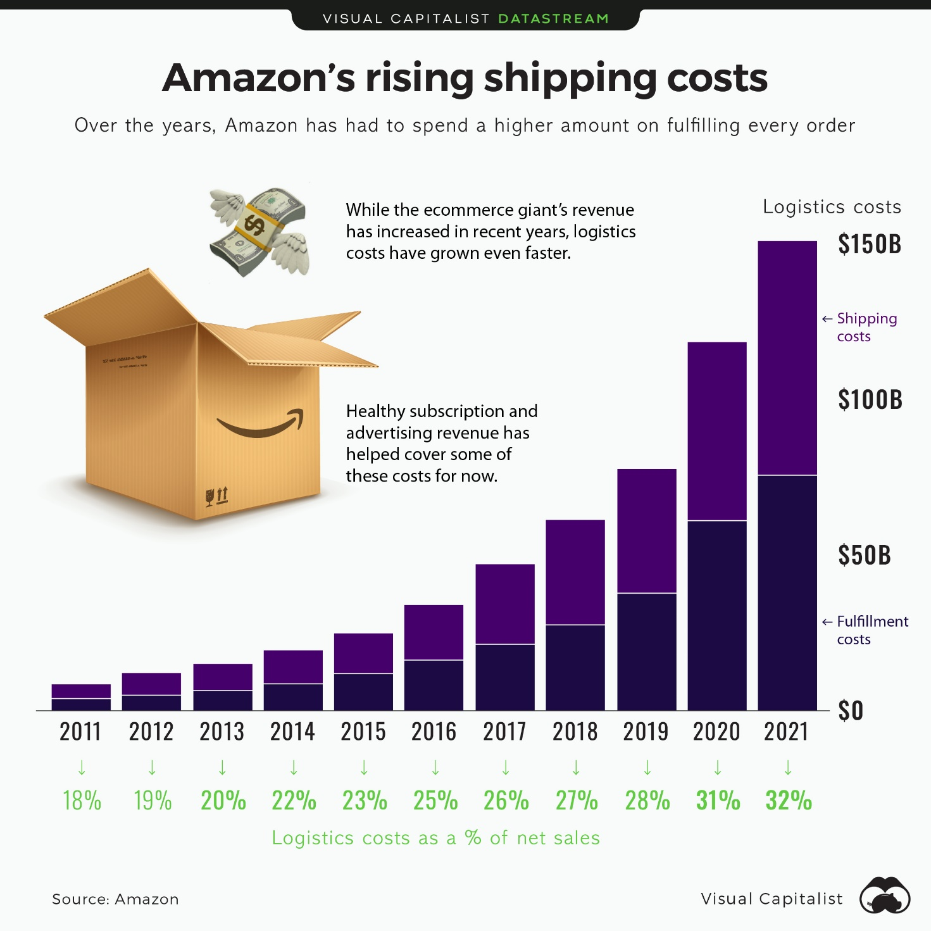

Slide 13
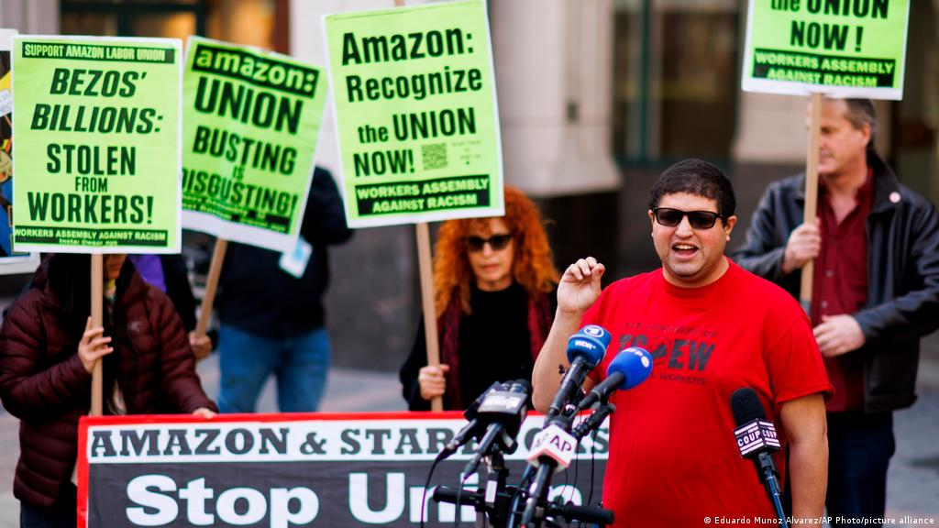

Slide 14
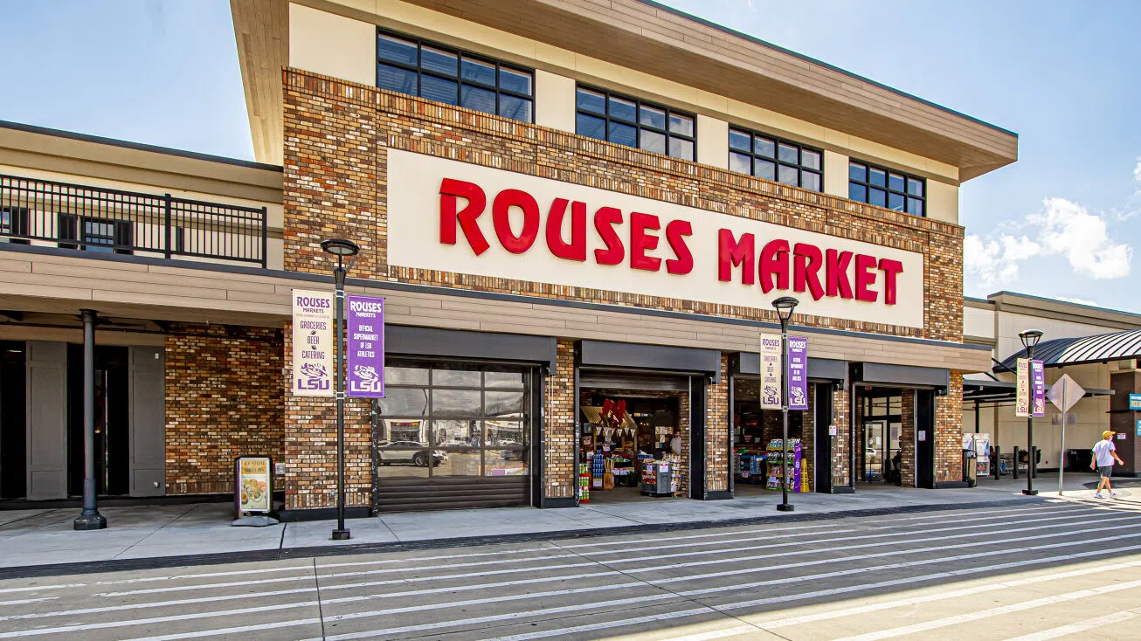
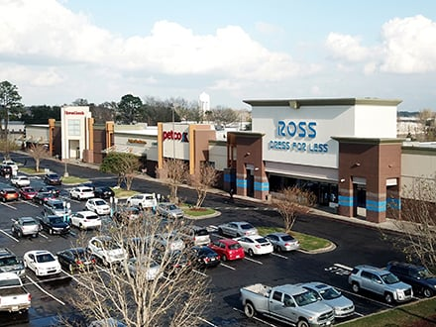
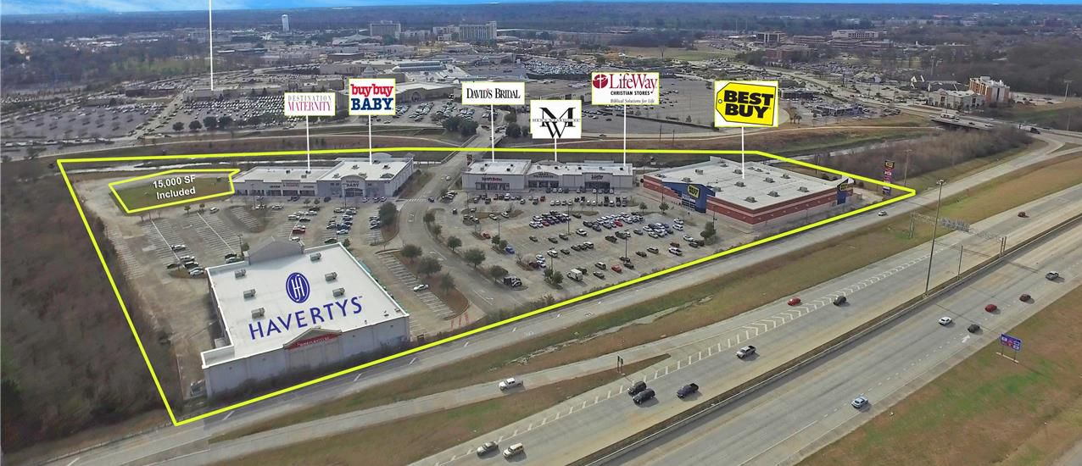
Huge Sales in 2021
Arlington Marketplace $30 Million
Siegen Plaza - $ 10 OVC
Bluebonnet Parc - $17.2 Million

Slide 15
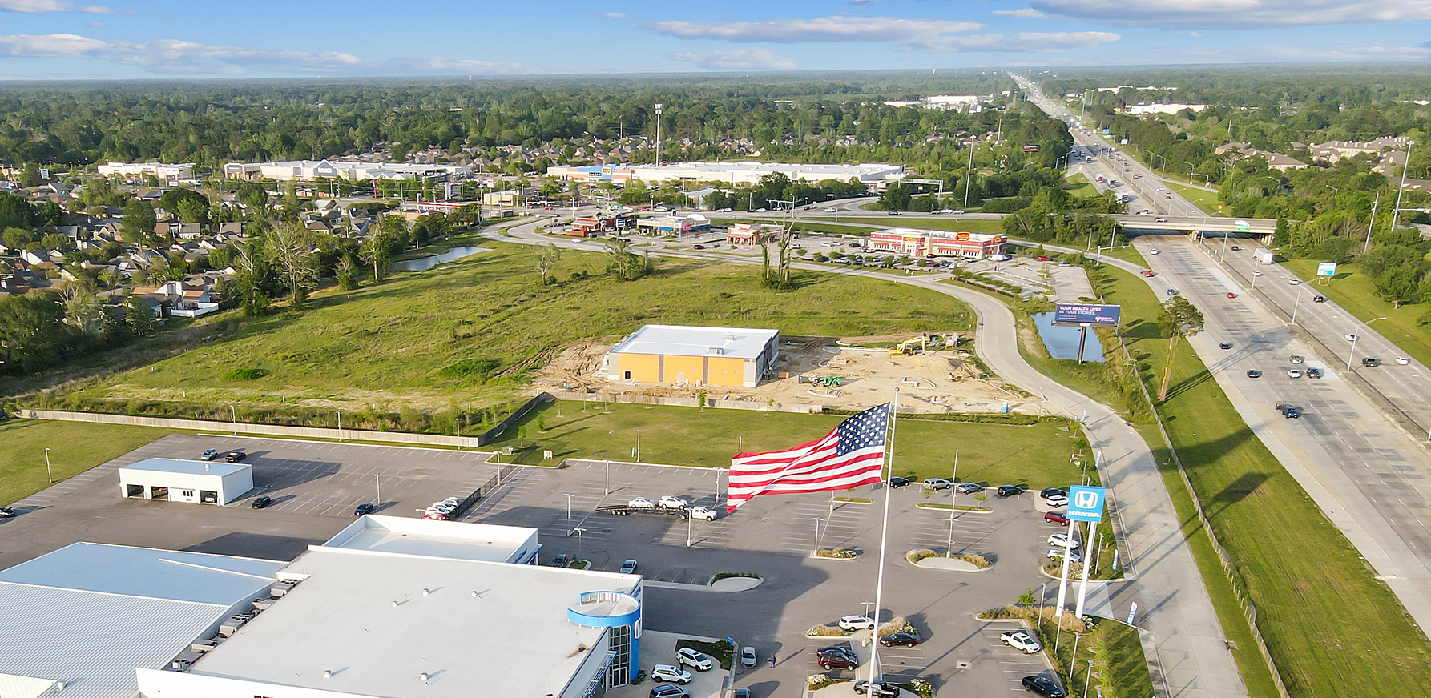
Retail to Multifamily

Slide 16
Retail to Multifamily

Slide 17











New to Market Retailers

Slide 18




















Expanding Retailers / Restaurants

Slide 19
Project Updates

Slide 20
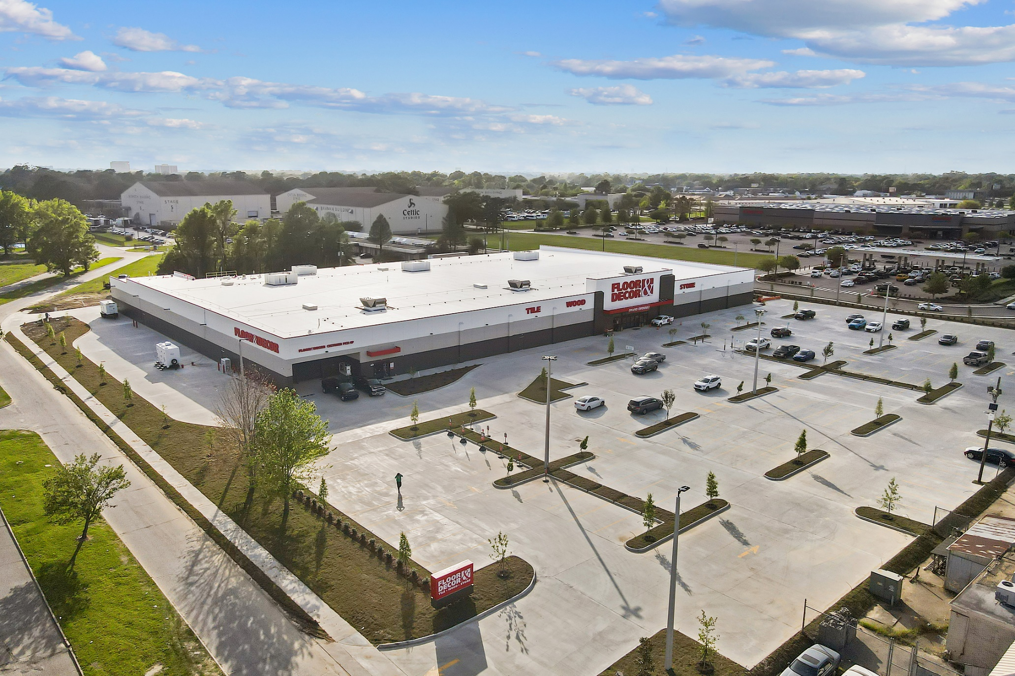
Floor & Décor – Airline Hwy

Slide 21
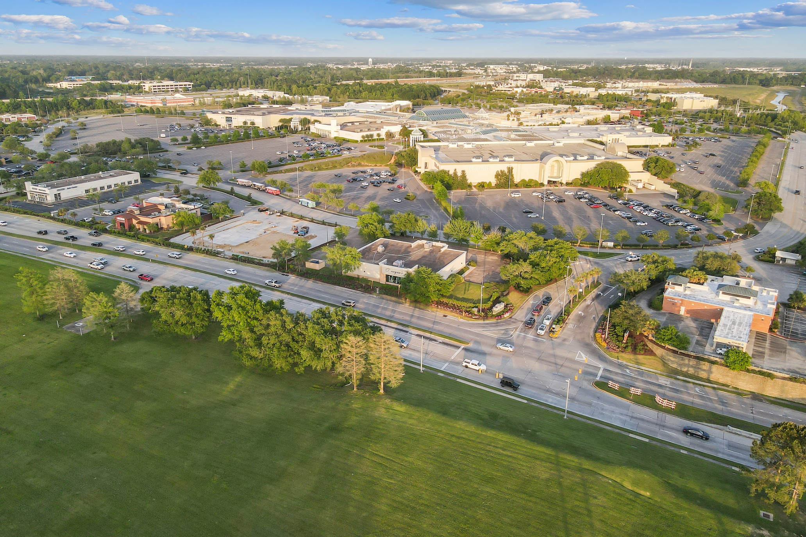
Mall of Louisiana

Slide 22
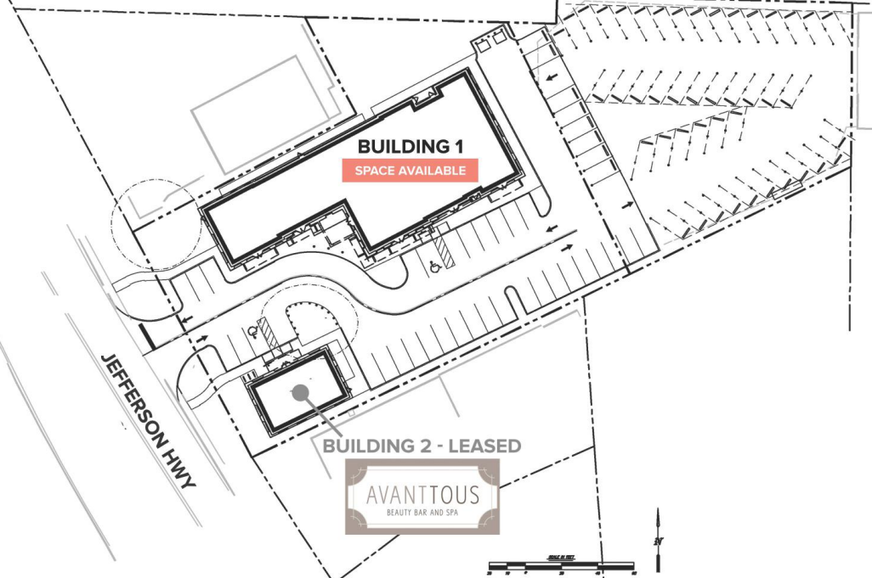
Coterie Exchange

Slide 23
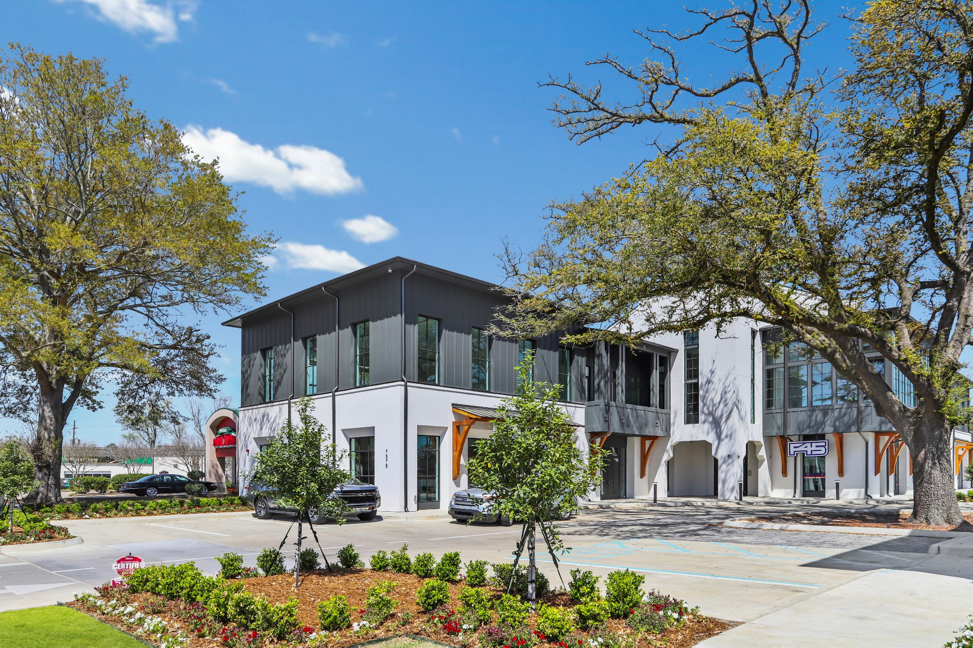
Coterie Exchange

Slide 24
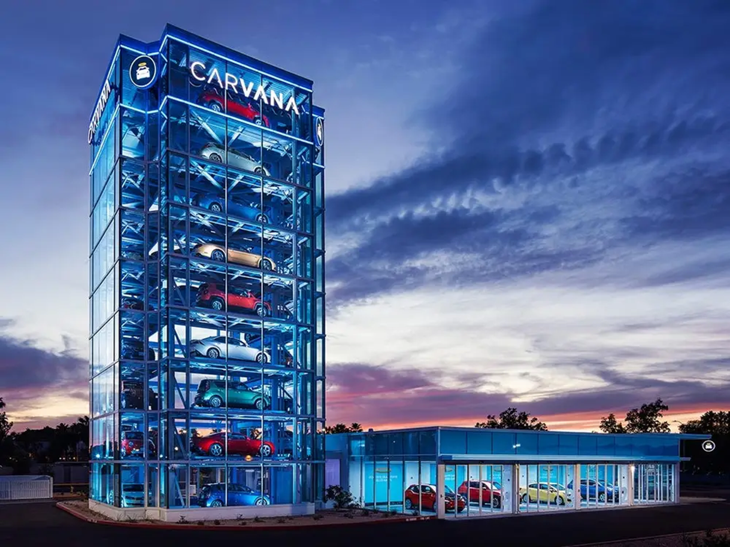
Carvana – Siegen Lane

Slide 25
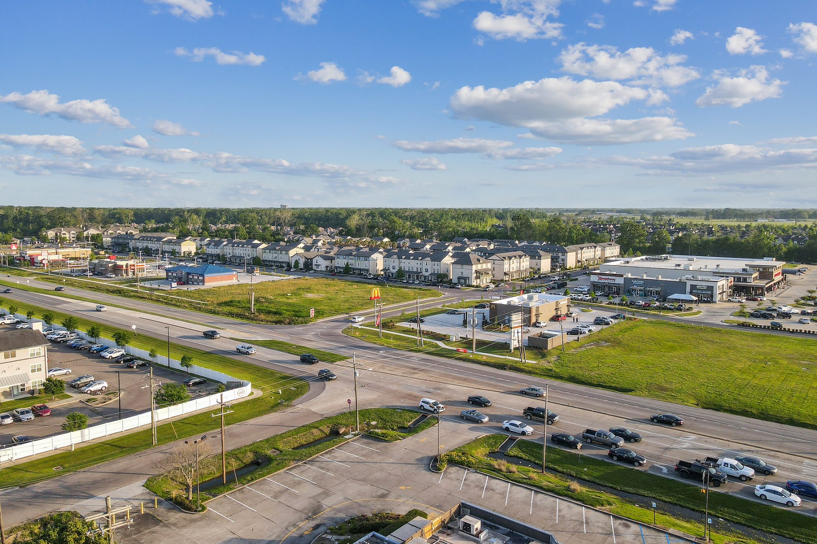
Burbank @ West Lee Drive

Slide 26
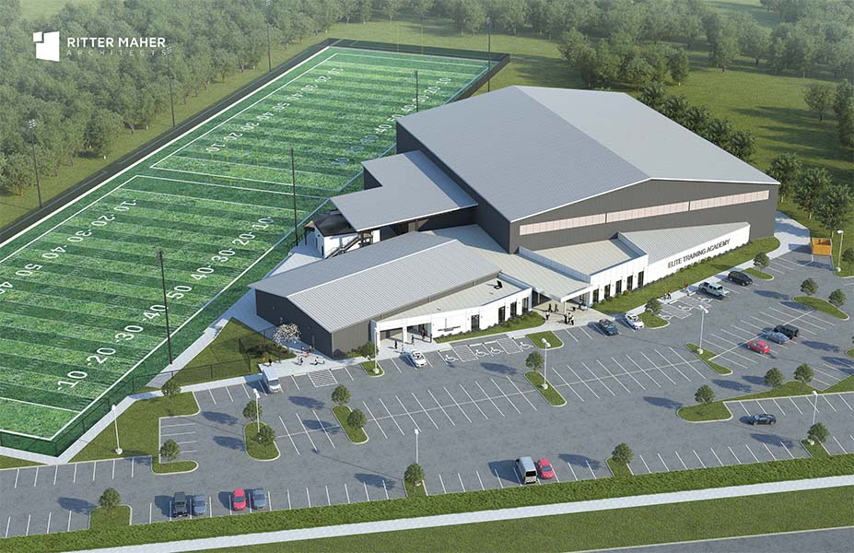
Burbank @ West Lee Drive

Slide 27
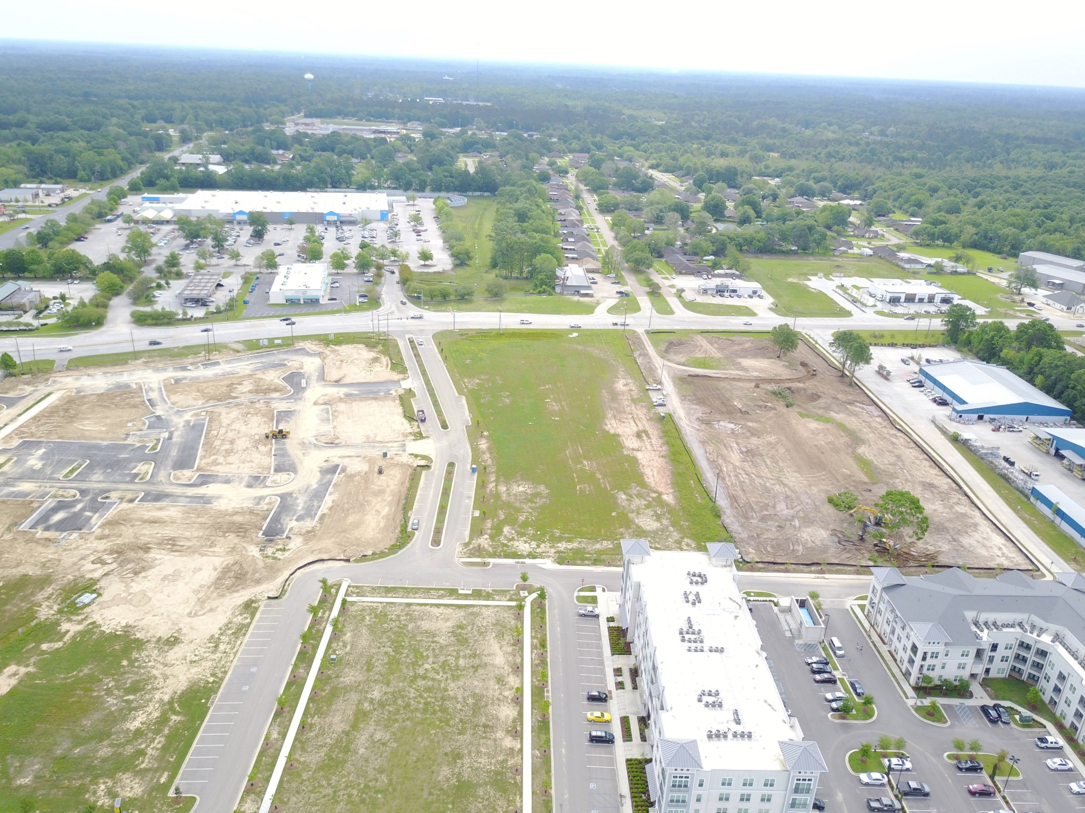
Shoe Creek - Central

Slide 28
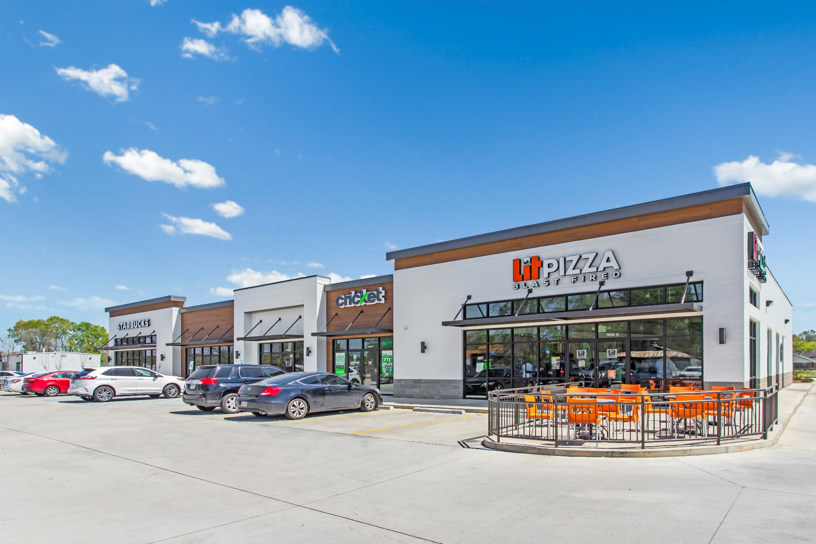
Sullivan Road - Central

Slide 29
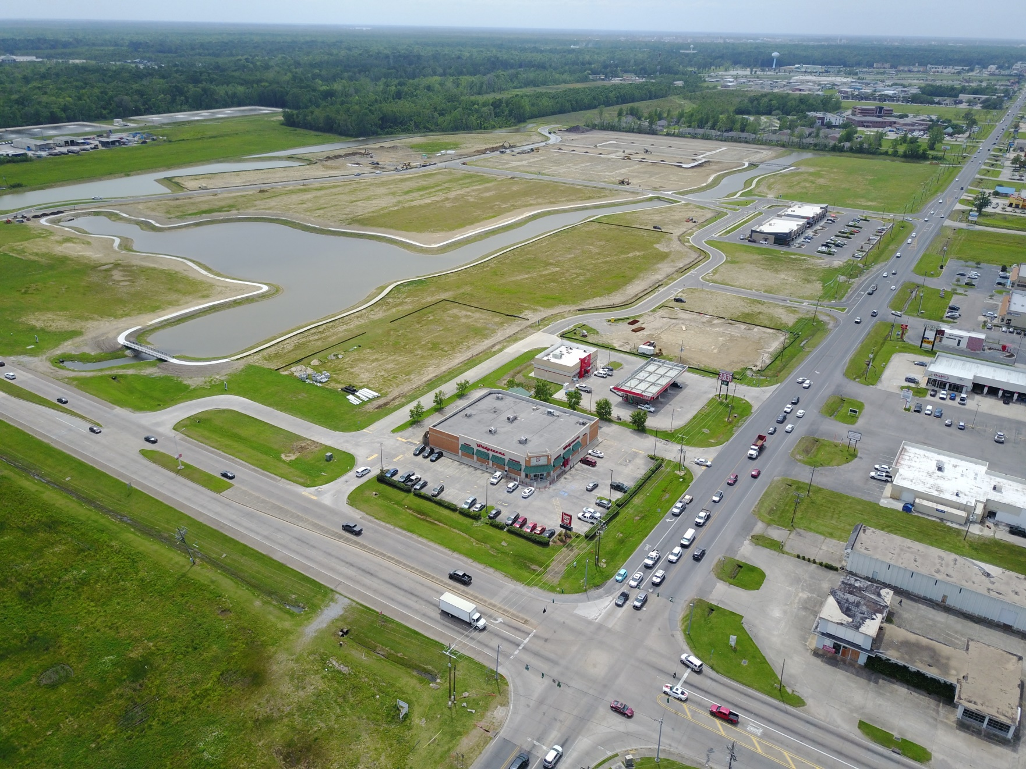
Heritage Crossing - Gonzales

Slide 30
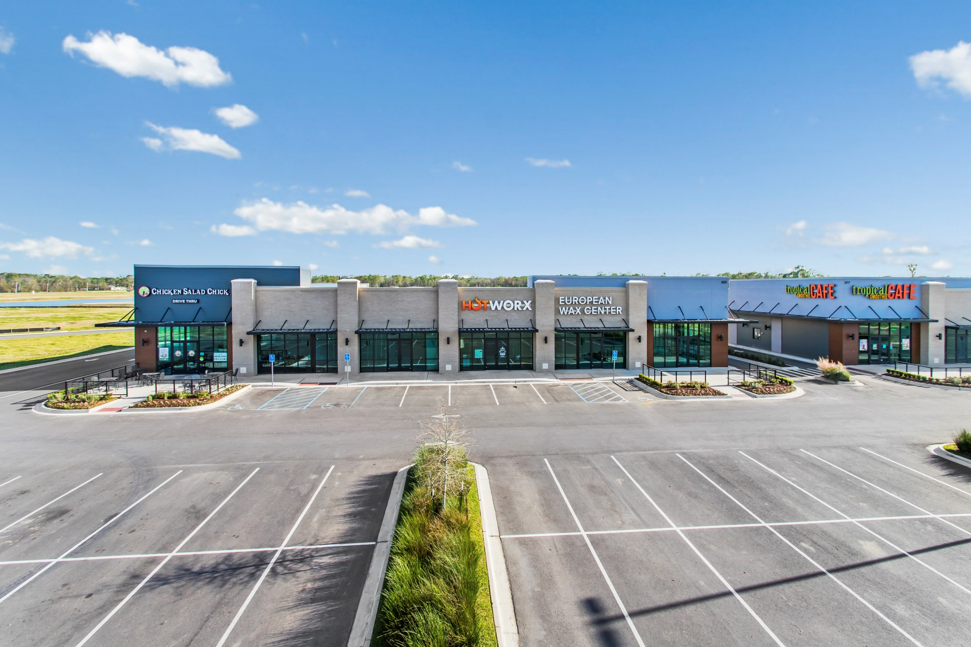
Heritage Crossing - Gonzales

Slide 31
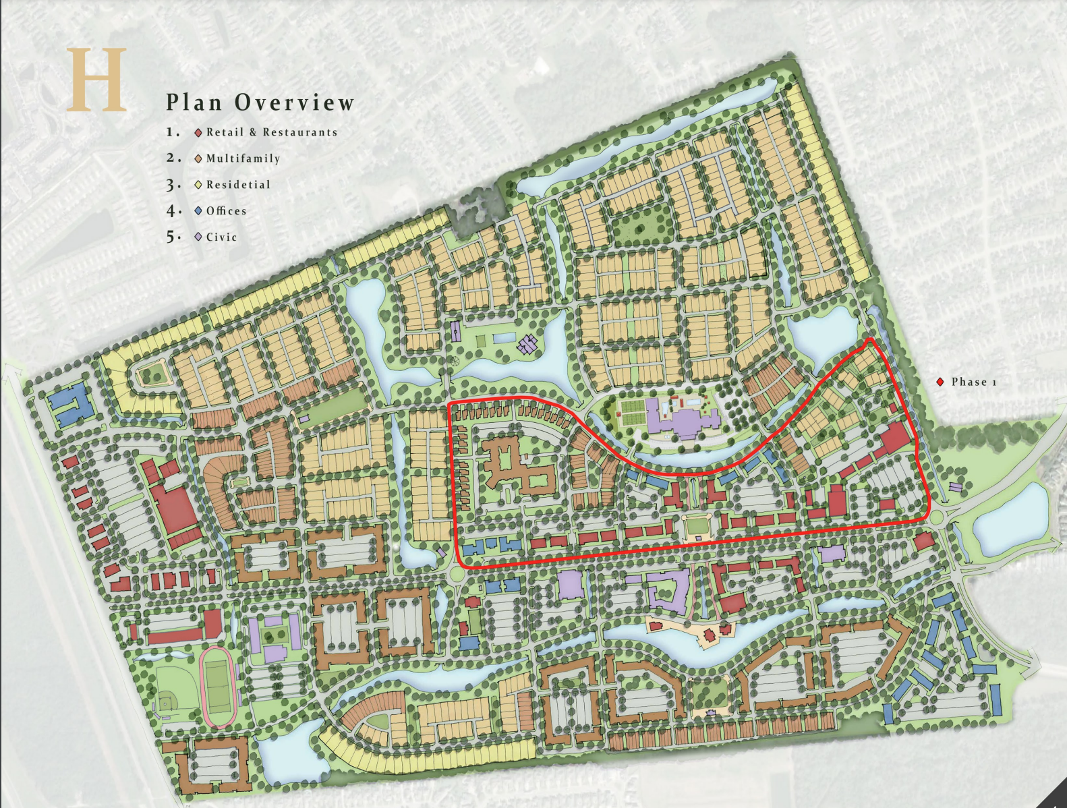
Harveston

Slide 32
Harveston

Slide 33

Other Development to Watch in 2022
- Long Farm
- City Square East
- Materra
- Govt. Street

Slide 34
Retail Challenges
- Inflation / Higher Gas Prices
- Higher Interest Rates
- Supply Chain Disruptions
- Labor Challenges

Slide 35
Overview / Predictions
- Vacancy to Stay in the 9-10% Range
- Minimal market-wide rent increases
- Expansion of exiting developments

Slide 36

THANK YOU!
Special Thanks To: Jill Sylvest, Ken Damann, Stephen Eisenbraun – Fotosold &
Trends Steering Committee

