Slide 1
BATON ROUGE
RETAIL MARKET
PRESENTED BY
Charlie Colvin, CCIM, Momentum Commercial Real Estate

Slide 2
RETAIL COMMITTEE MEMBERS
Charlie Colvin, CCIM
Momentum Commercial Real Estate
Jonathan Walker, CCIM
Maestri Murrell, Inc.
Dottie Tarleton, CCIM
Stirling Properties
Clay Furr
Momentum Commercial Real Estate
Colin Smith
Kurz & Hebert Commercial Real Estate
Andrew D’Ostilio, CCIM
NAI Latter & Blum
Matthew Shirley, CCIM
Saurage Rotenberg Commercial Real Estate
Ransom Pipes, CCIM
Maestri Murrell, Inc.
Ben Graham, CCIM
Stirling Properties
Will Chadwick, MBA
Elifin Realty
Drew Whitaker
Cook Moore Davenport & Associates
Cade Bogan
Beau Box Commercial Real Estate

Slide 3
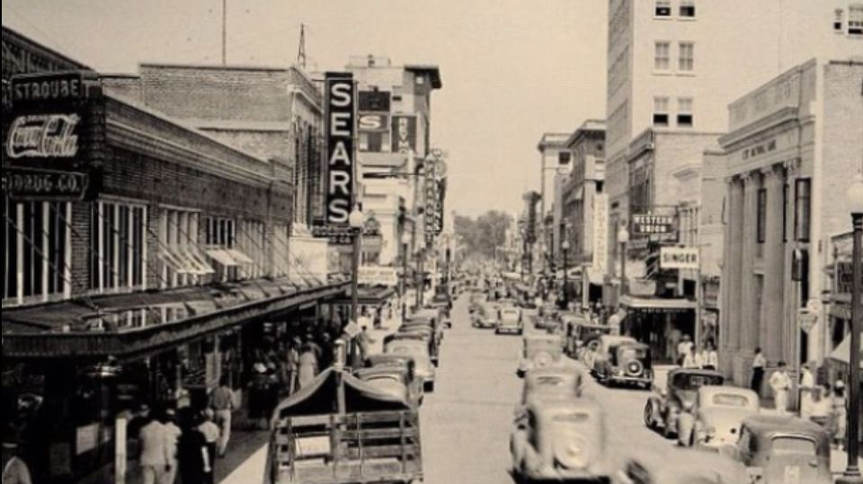
"The future ain't what it used to be."
-Yogi Berra
HWY 30
CORRIDOR

Slide 4
LAST YEARS PREDICTIONS
Vacancy to Stay in the 9-10% Range
Minimal market-wide rent increases
Expansion of exiting developments
Charlie@momentum-commercial.com

Slide 5
RETAIL CHALLENGES
Inflation / Higher Gas Prices
Higher Interest Rates
Supply Chain Disruptions
Labor Challenges

Slide 6
2023 SHOPPING CENTER SURVEY
2022 2023
Total Area Surveyed: 8,707,198 SF 8,454,959
Number of Centers: 127 123
Average Rent: $19.60 PSF $19.83 PSF
Area Vacancy Rate: 8.81% 7.17%

Slide 7
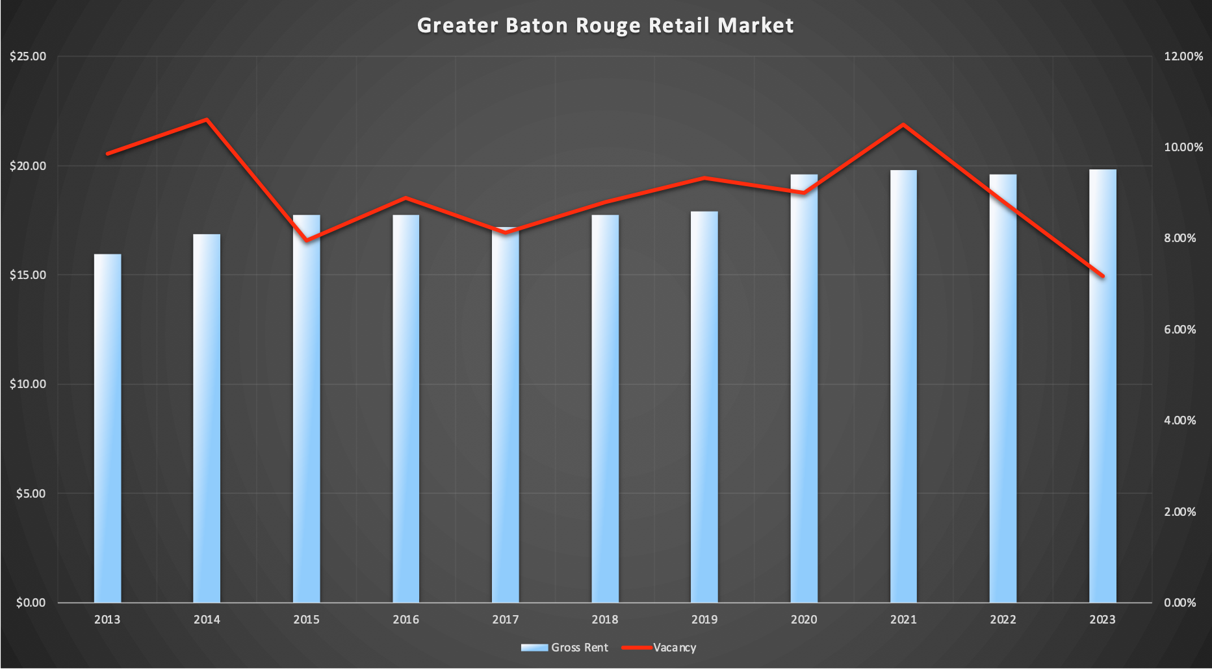
GROSS RENTS & VACANCY RATES

Slide 8
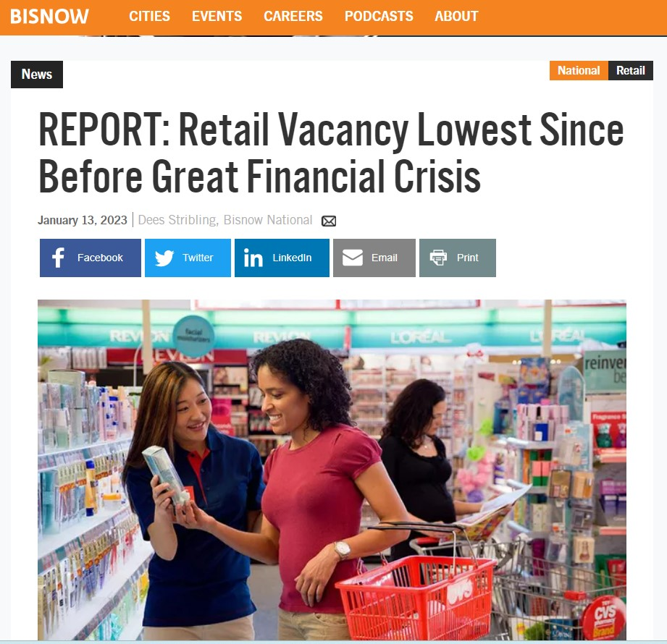

Slide 9
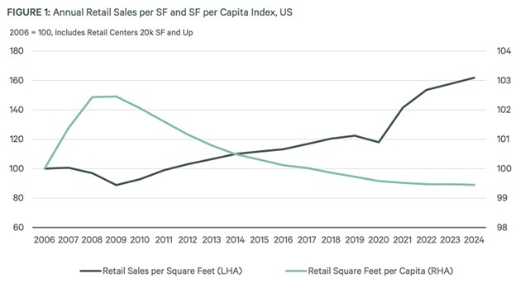
Annual Retail Sales PSF and SF per Capita, US
Costar, St. Louis FRED, CBRE Research, CBRE EA, Q4 2022

Slide 10
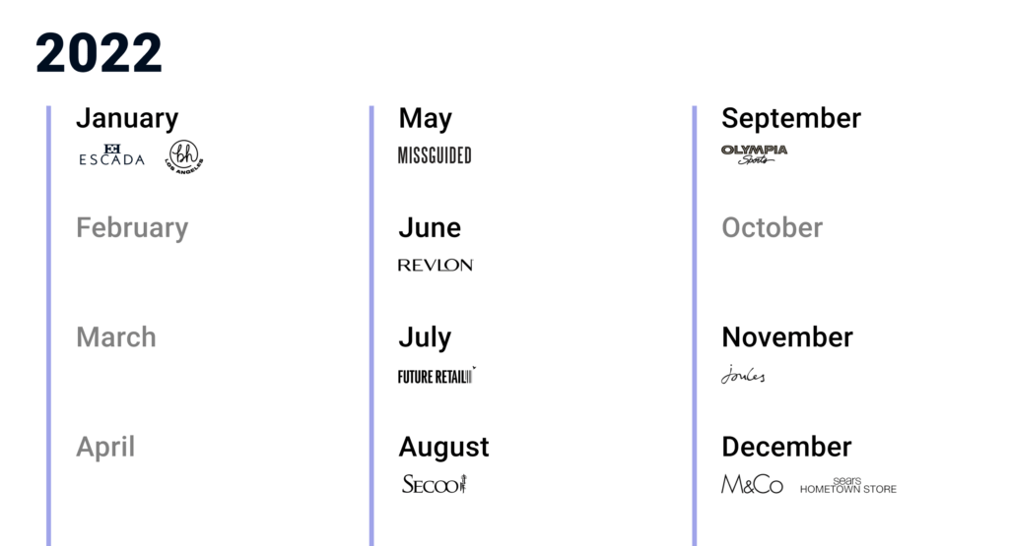
RETAIL BANKRUPTCIES
2023

Slide 11
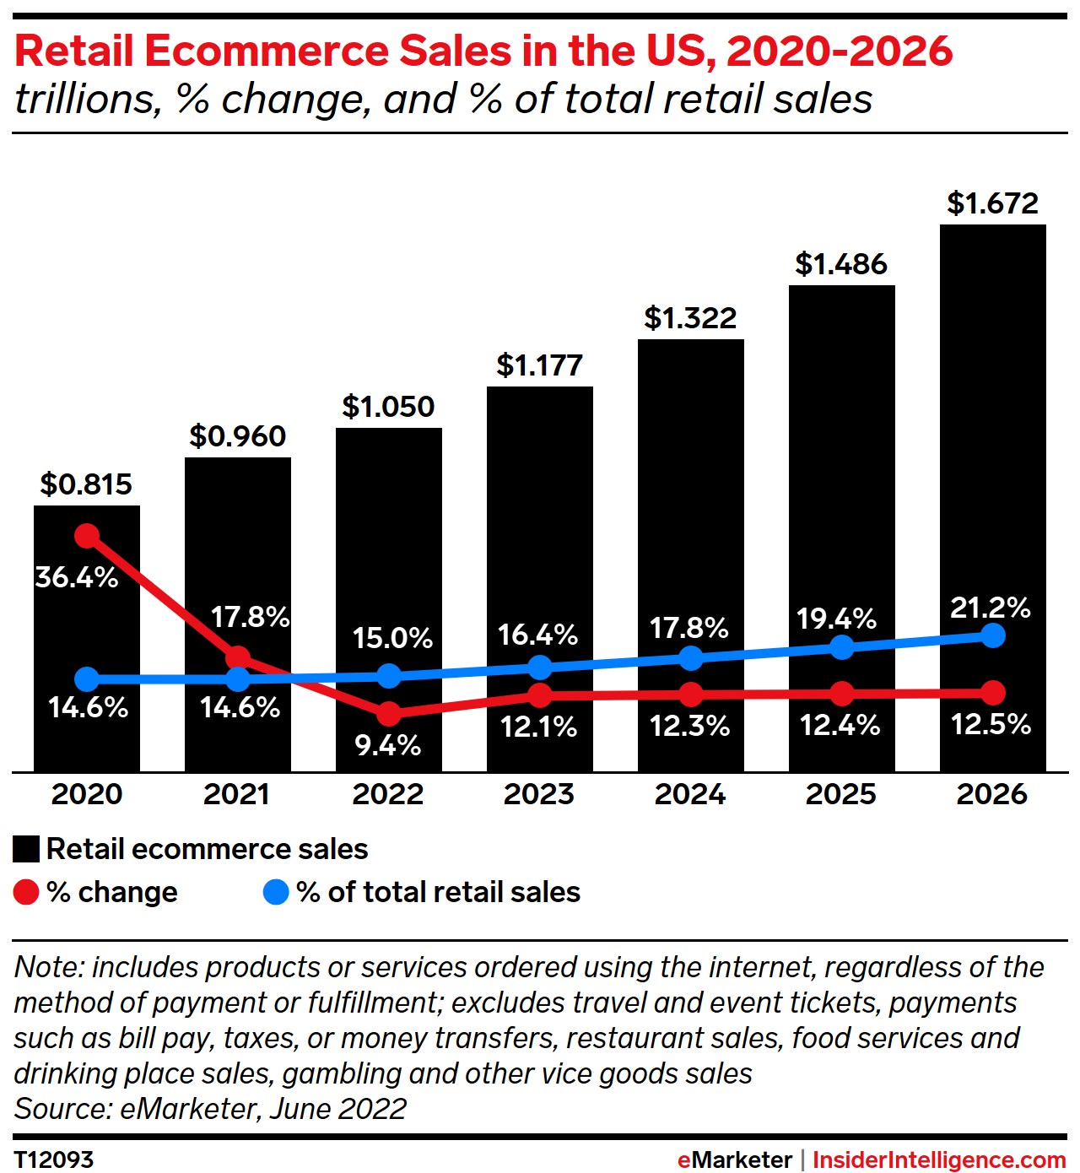

Slide 12
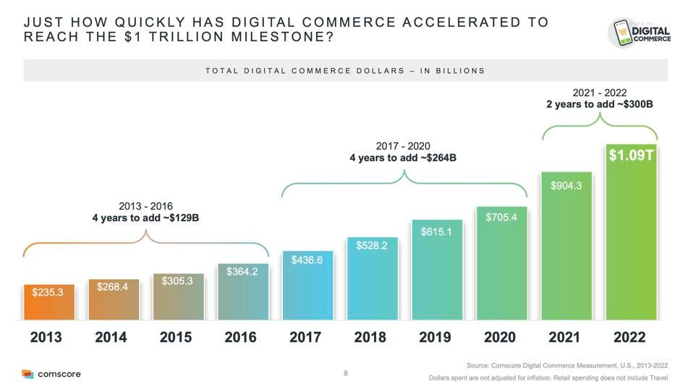

Slide 13
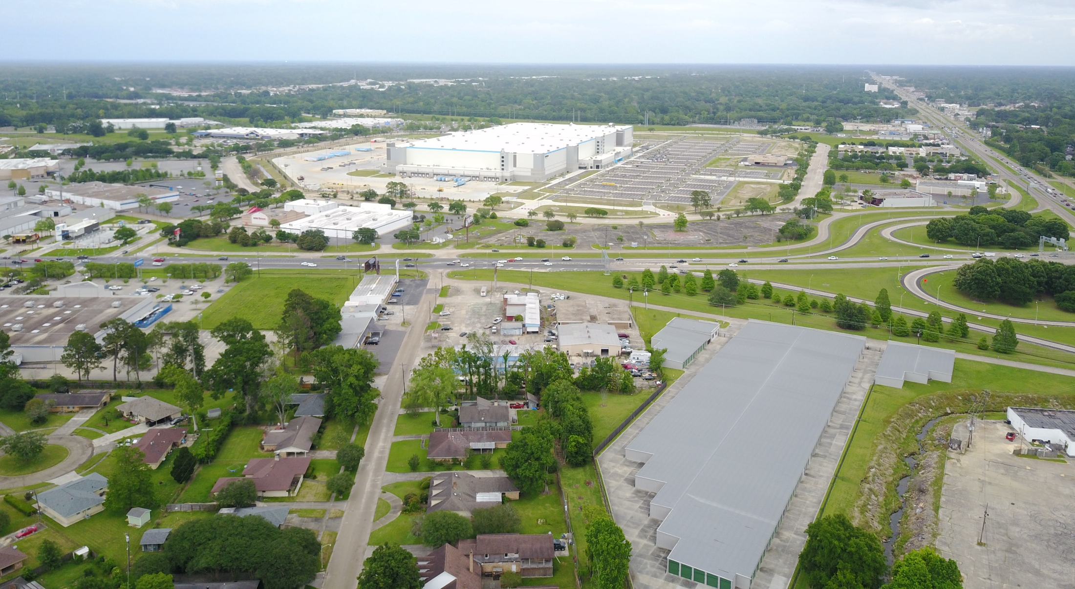
AMAZON UPDATE

Slide 14
AMAZON
UPDATE

Slide 15
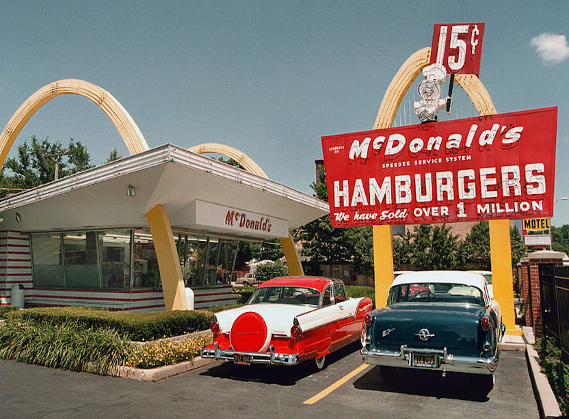
DRIVE THRU
The First Drive-­Thru Opened In 1947

Slide 16
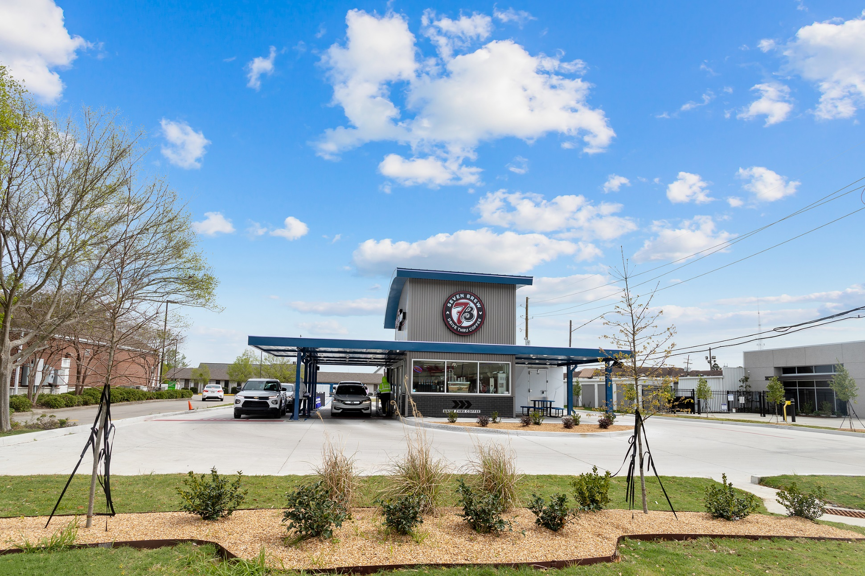
DRIVE THRU ONLY – 7 BREW

Slide 17
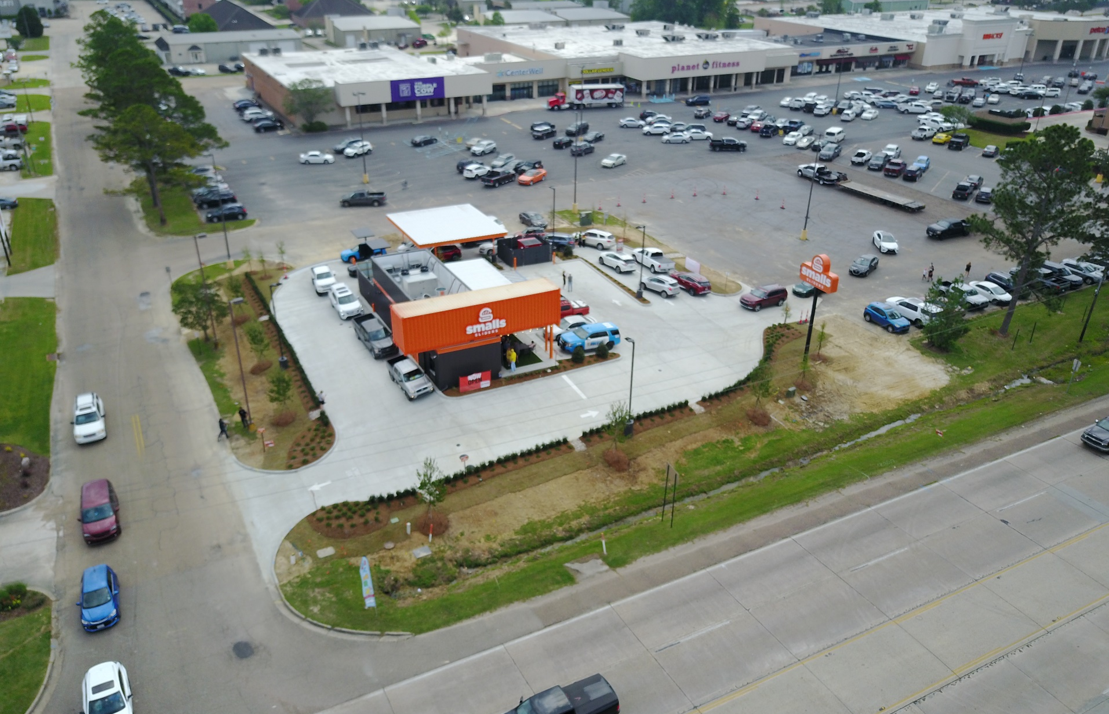
SMALLS SLIDERS – DENHAM SPRINGS

Slide 18
RETAIL FACING LABOR CHALLENGES
Automation
Creative Incentives
Scheduling Flexibility

Slide 19
RETAIL FACING INFLATION CHALLENGES

Slide 20
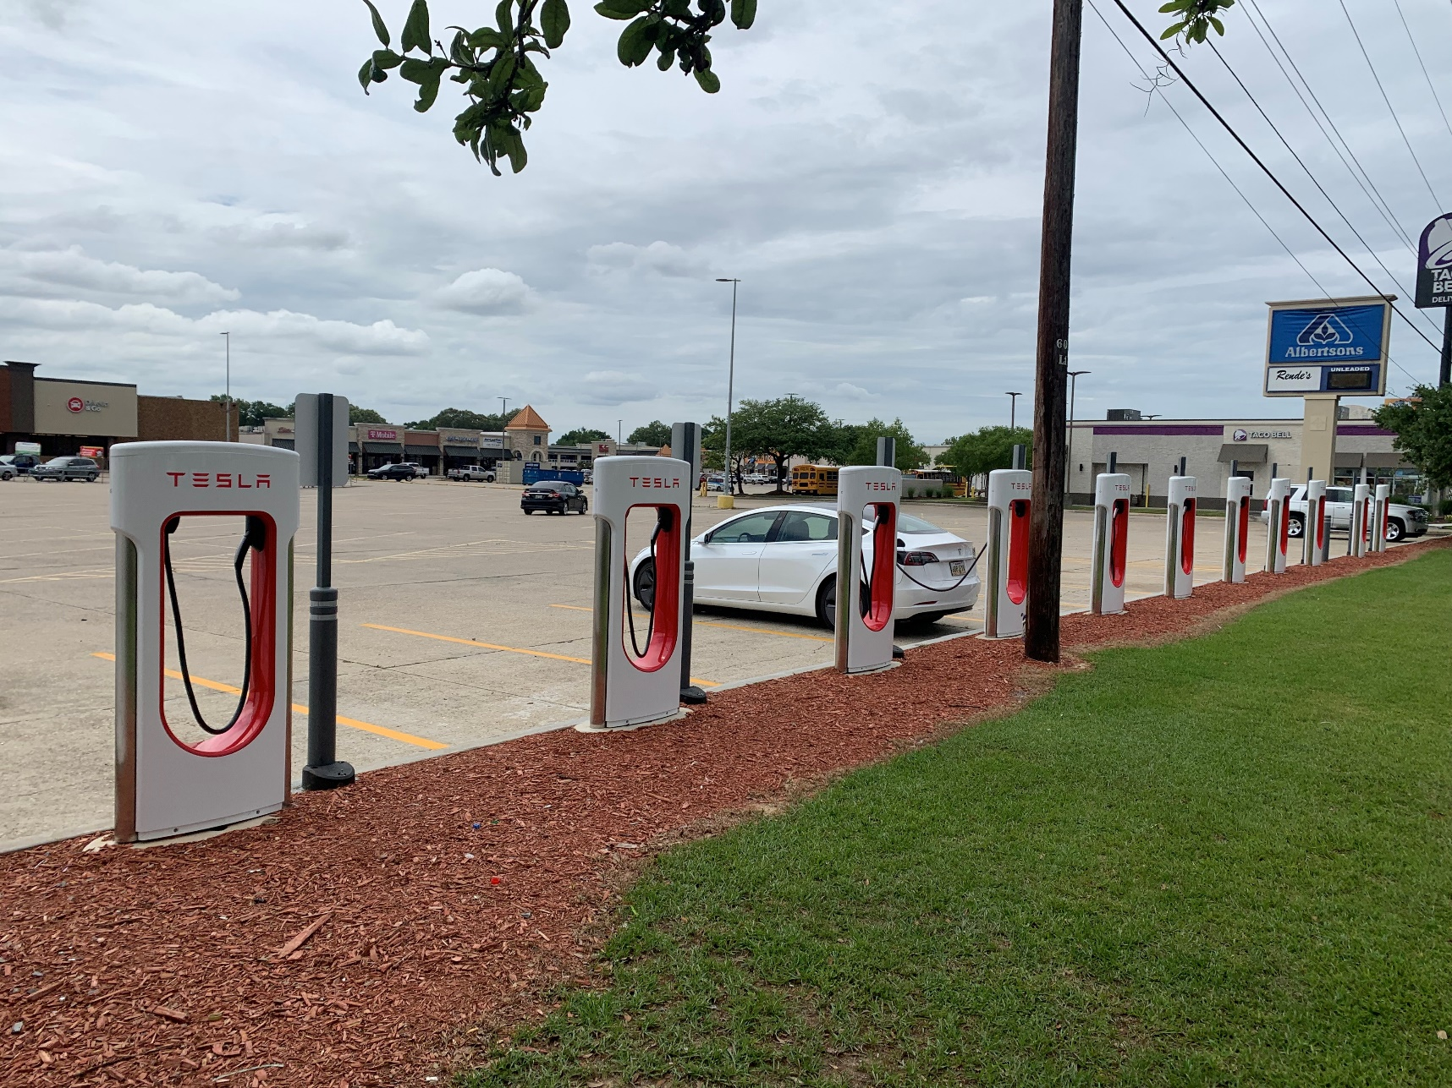
OUTPARCEL DEVELOPMENT

Slide 21
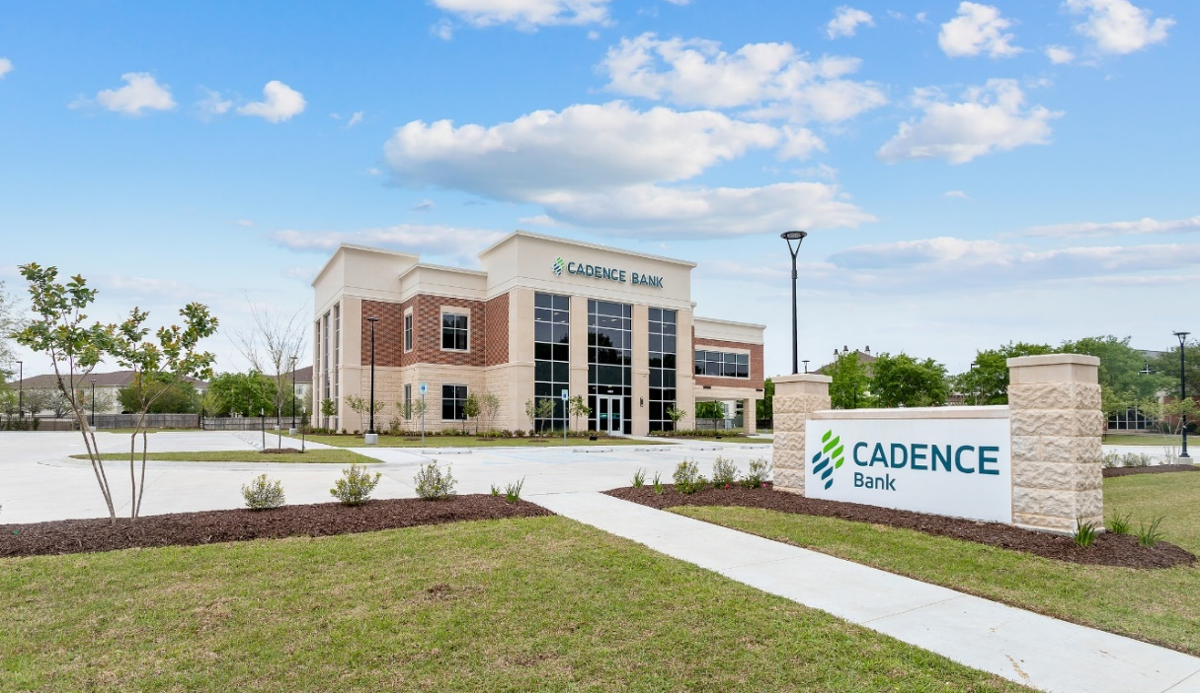
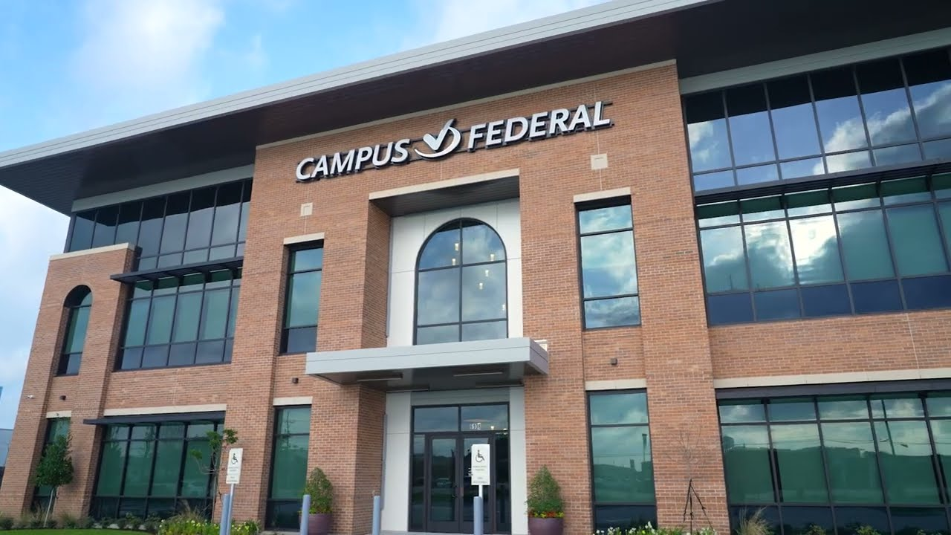
BANKS & CREDIT UNIONS REMAINED ACTIVE IN 2022

Slide 22
Project Updates

Slide 23
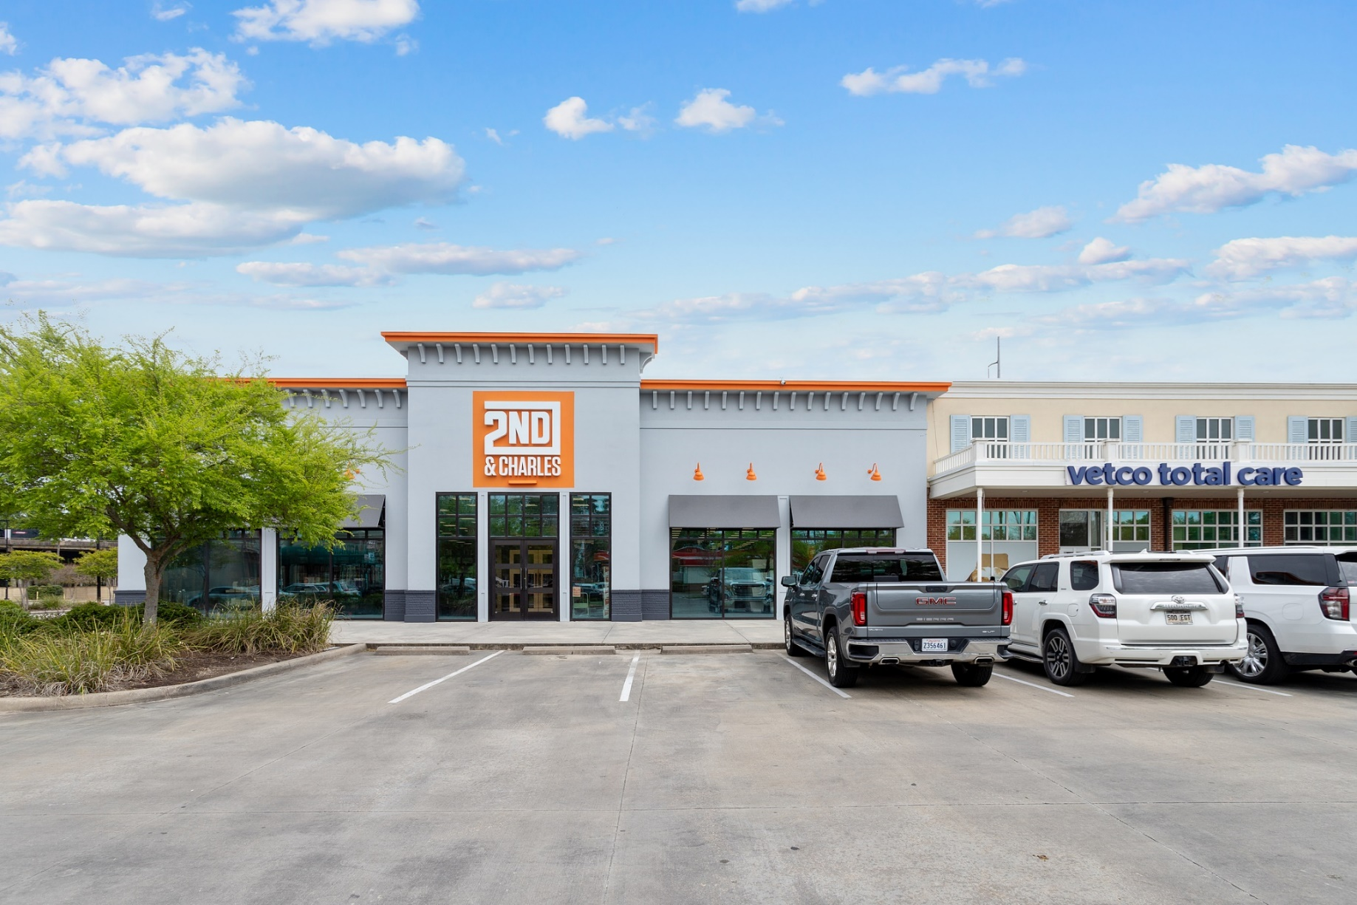
ACADIAN VILLAGE

Slide 24
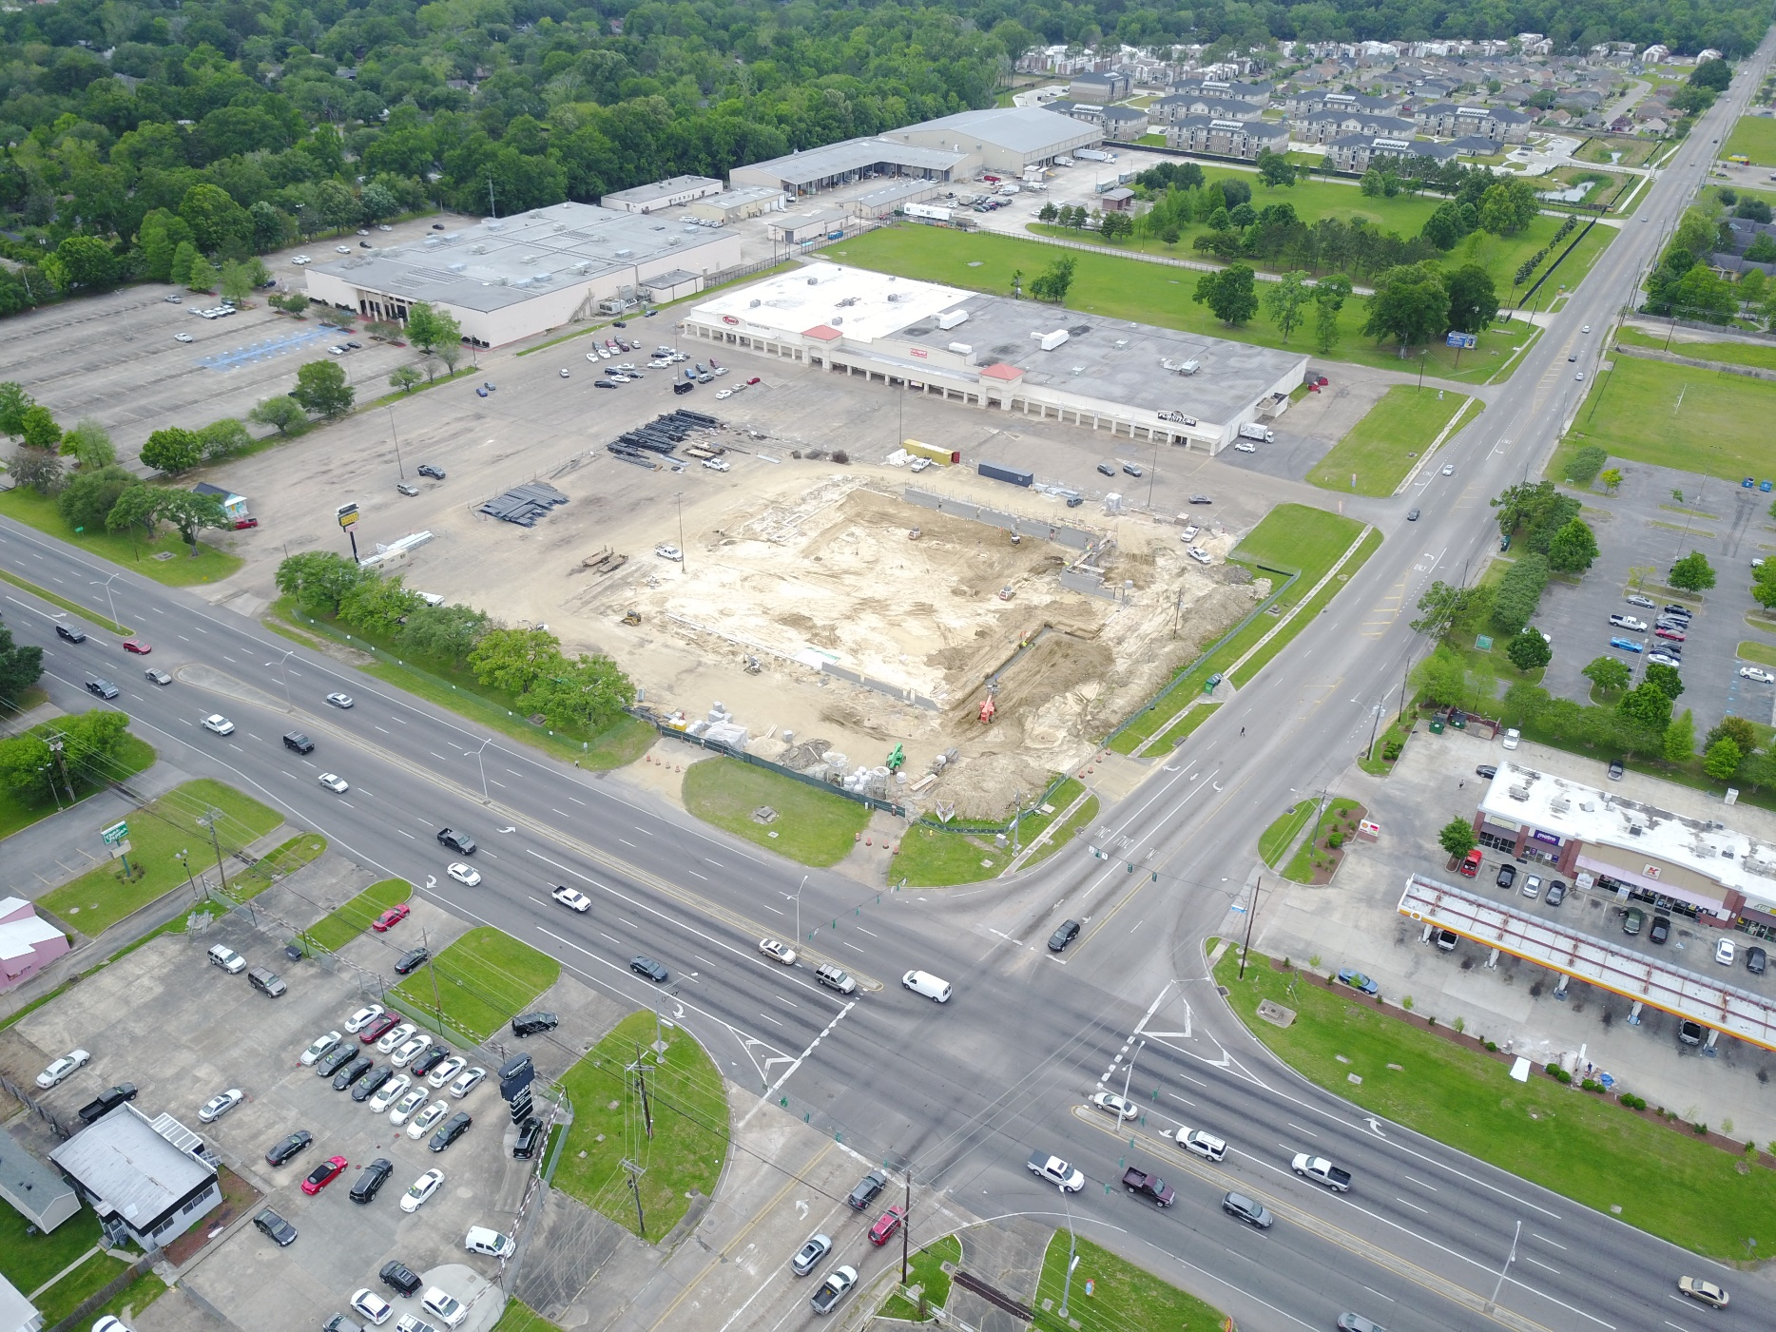
FLORIDA BLVD
@ ARDENWOOD

Slide 25
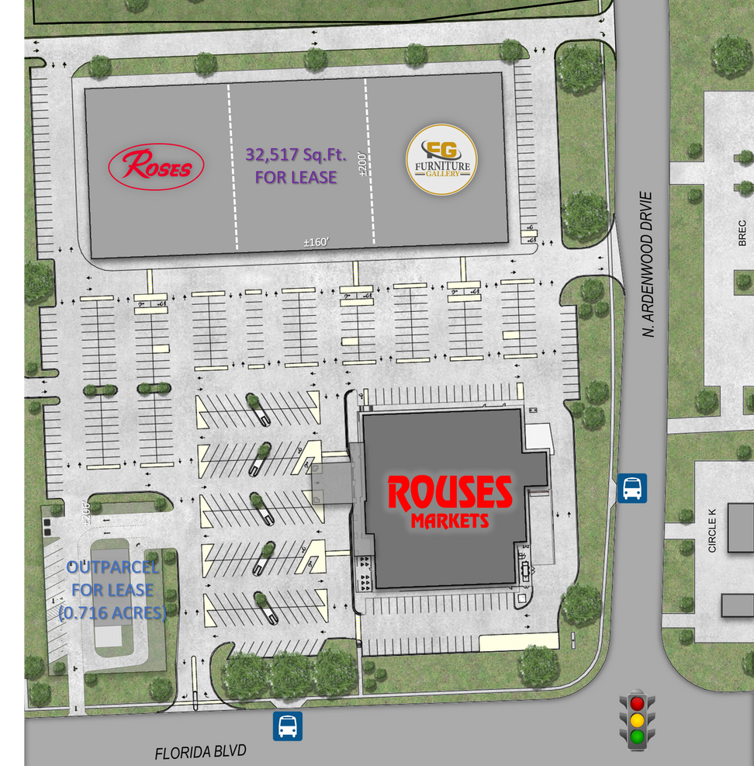
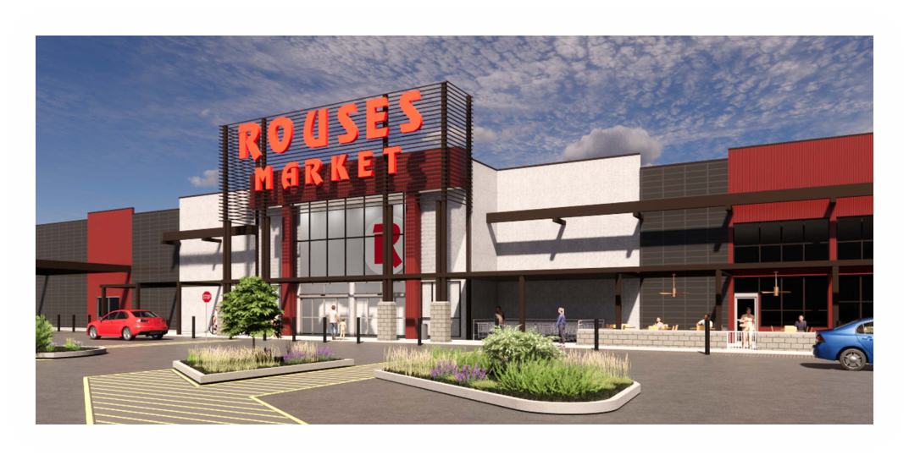
FLORIDA BLVD
@ ARDENWOOD

Slide 26
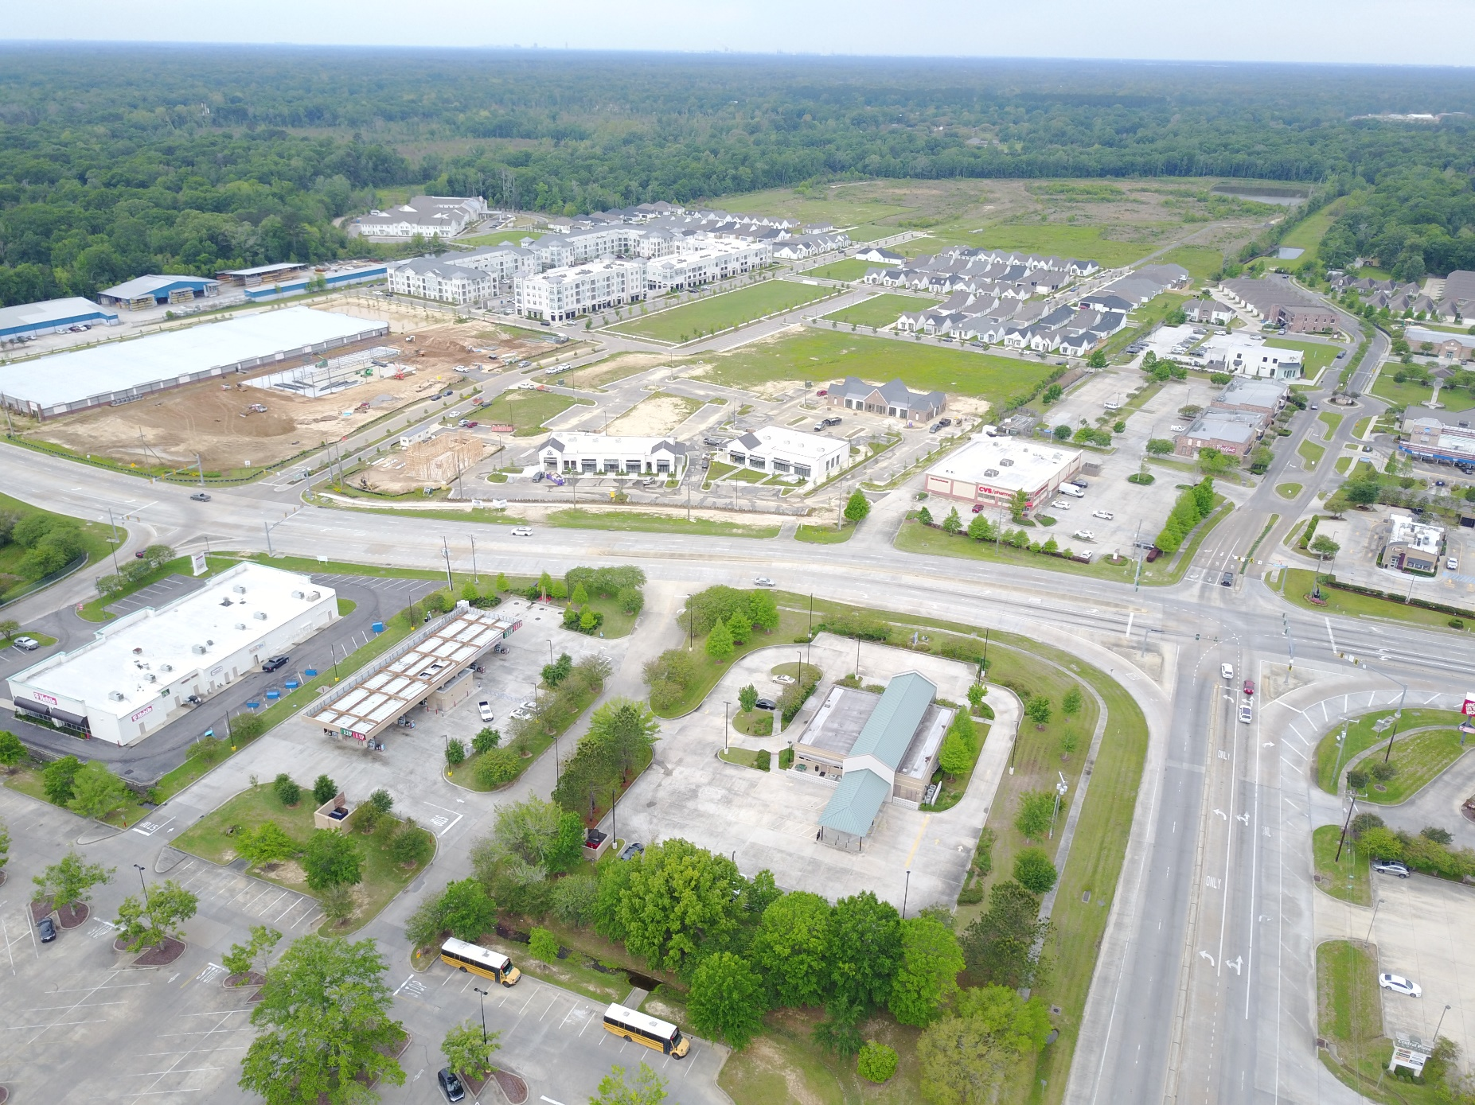
SHOE CREEK - CENTRAL

Slide 27
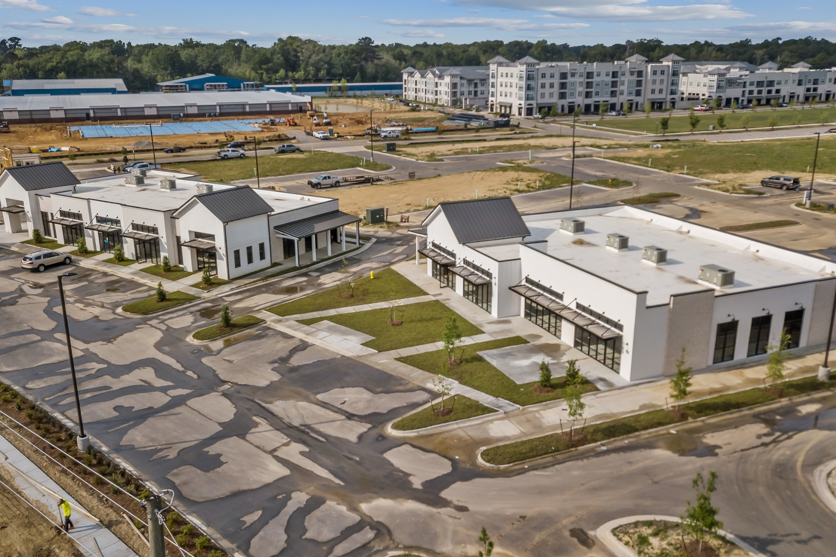
SHOE CREEK - CENTRAL

Slide 28
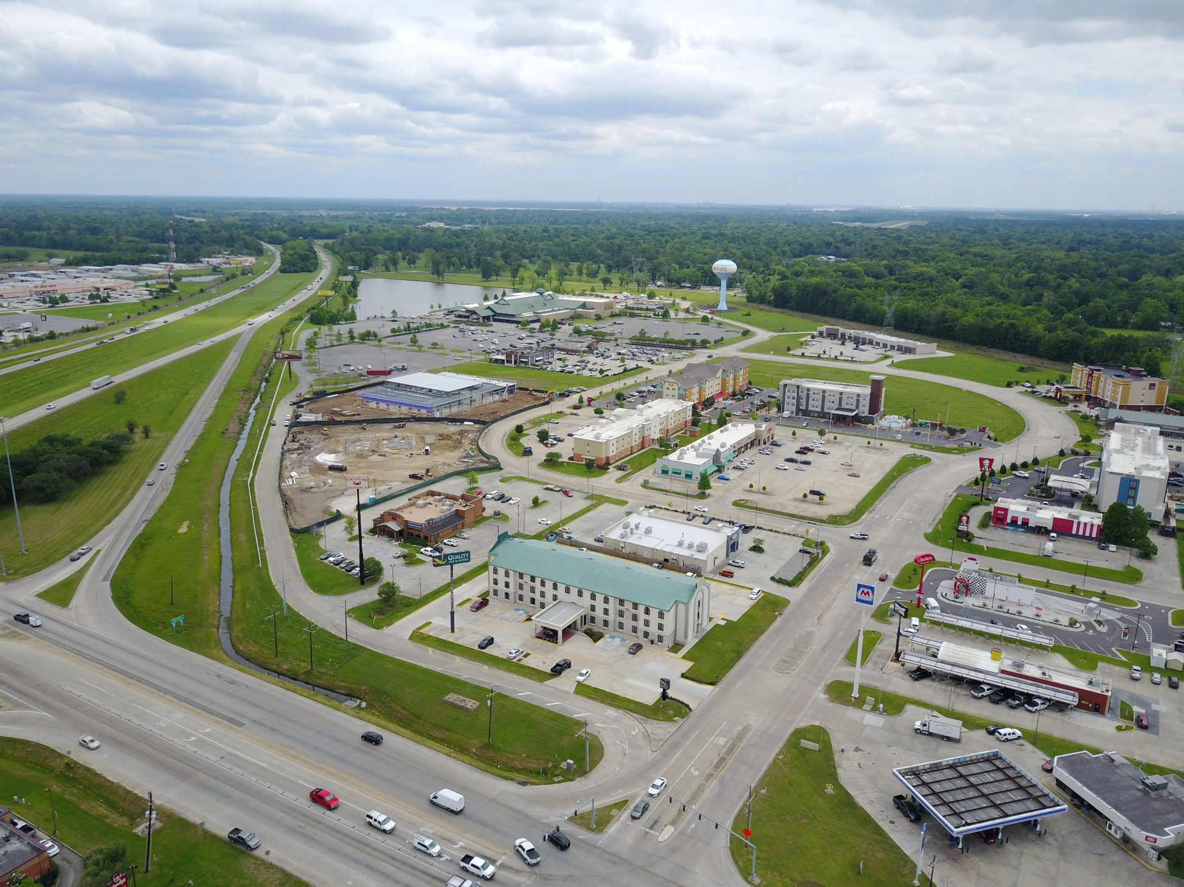
HWY 30 @ I-10 - GONZALES

Slide 29
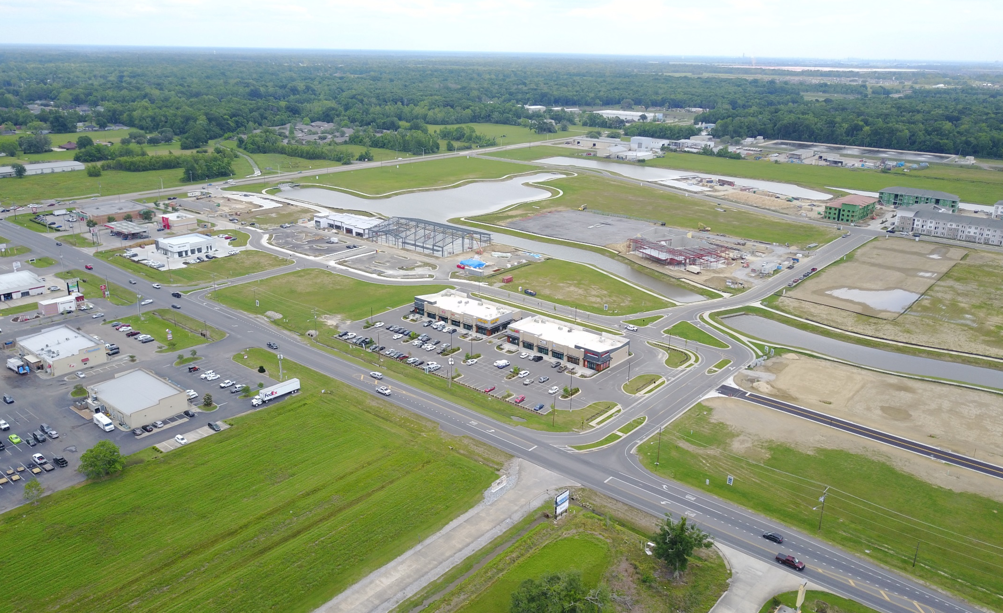
HERITAGE CROSSING - GONZALES

Slide 30
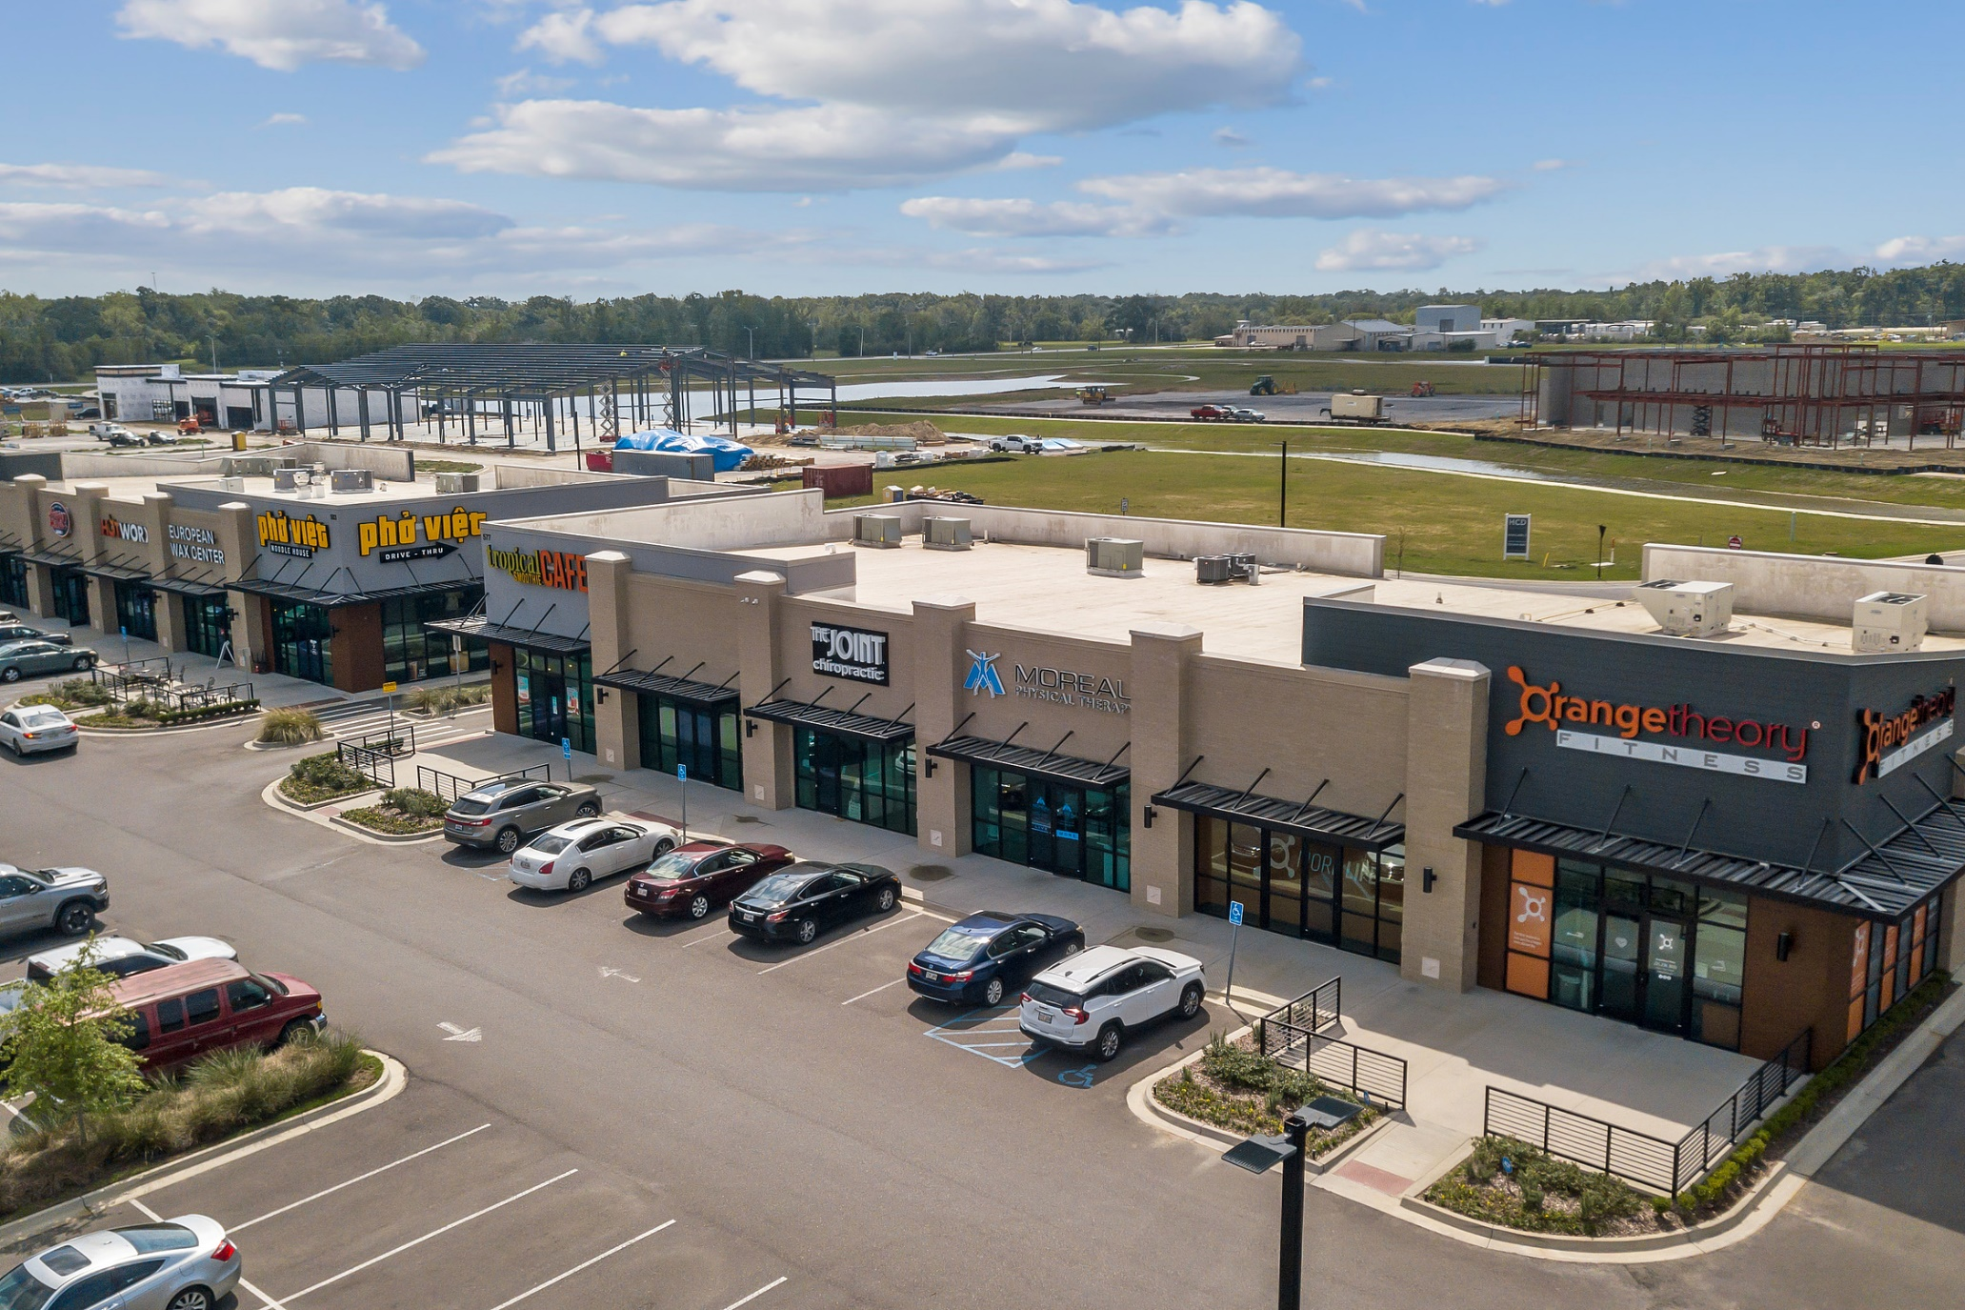
HERITAGE CROSSING - GONZALES

Slide 31
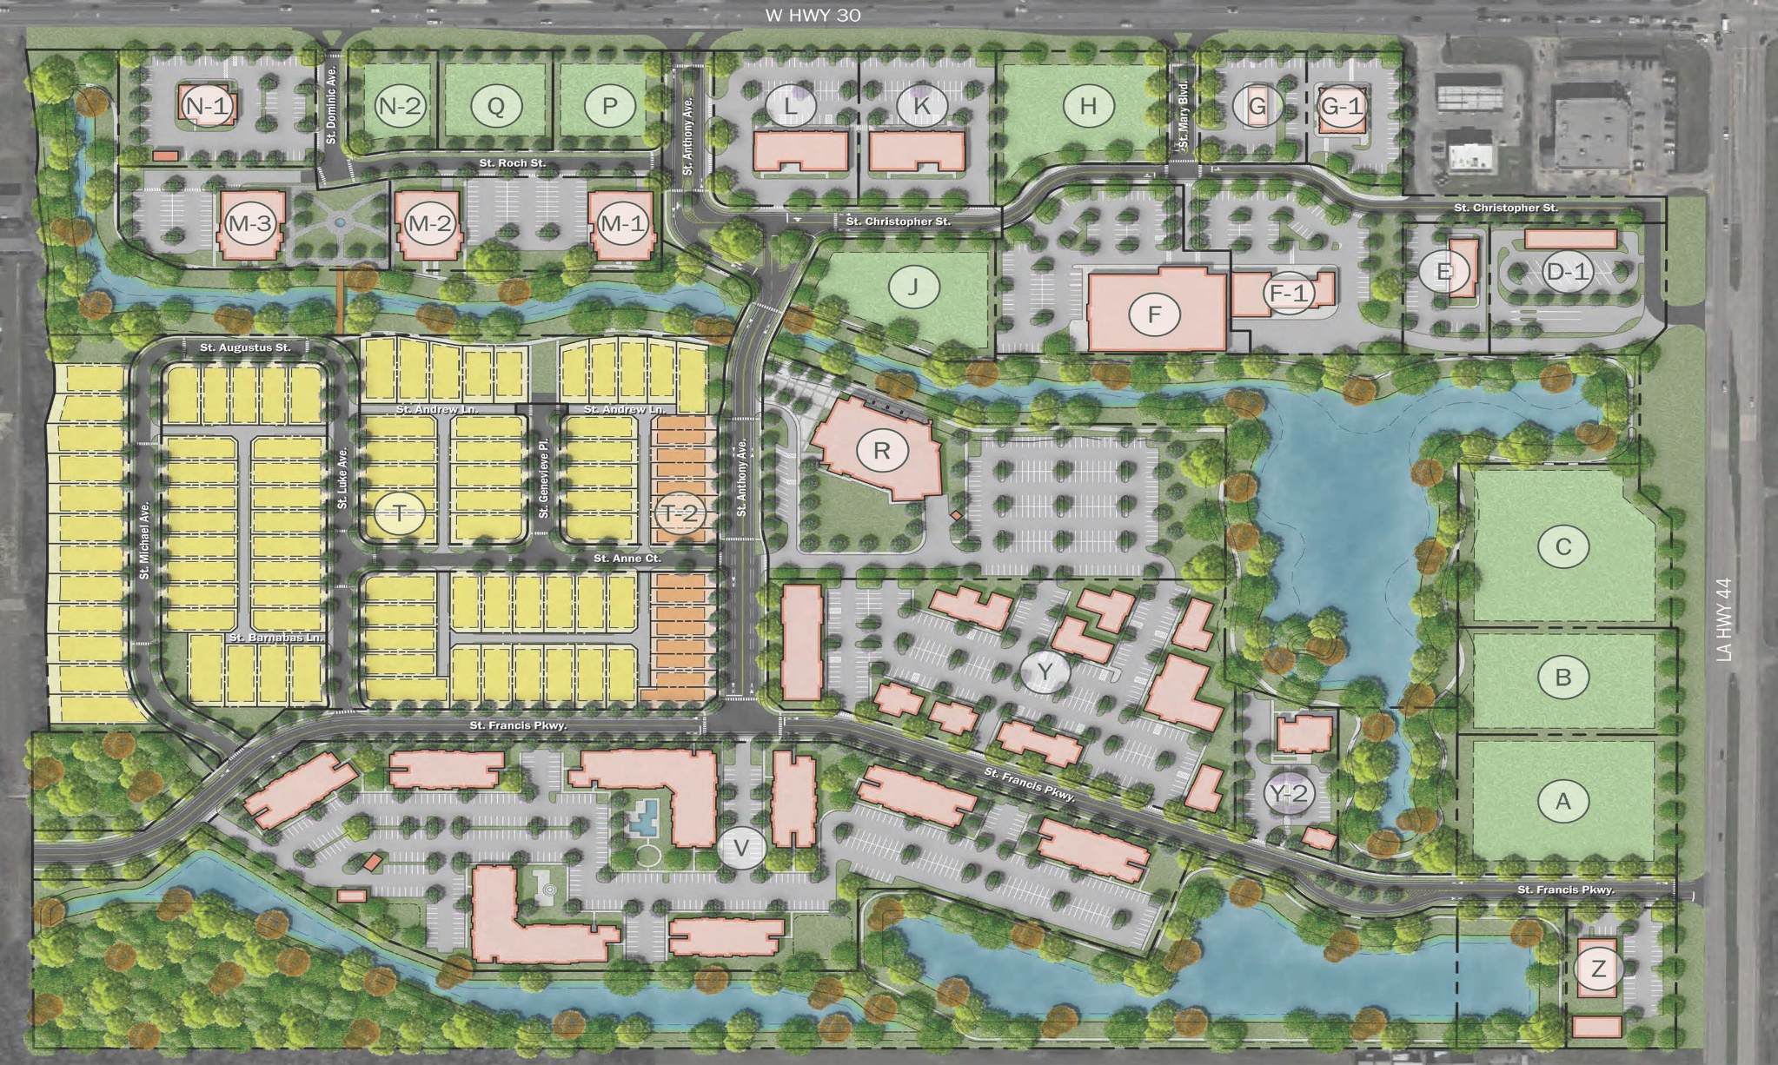
HERITAGE CROSSING - GONZALES

Slide 32
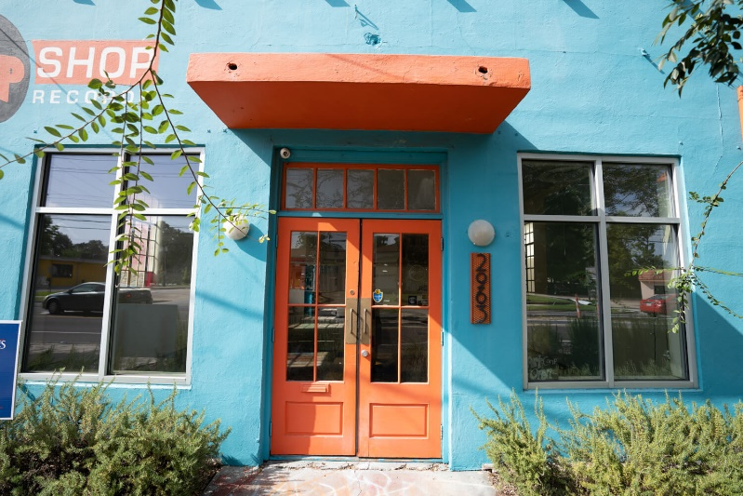
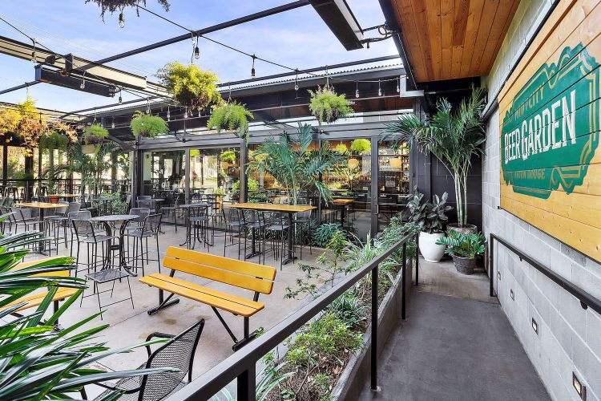
MID-CITY – GOVERNMENT STREET
Former Garden District Nursery
YMCA Redevelopment

Slide 33
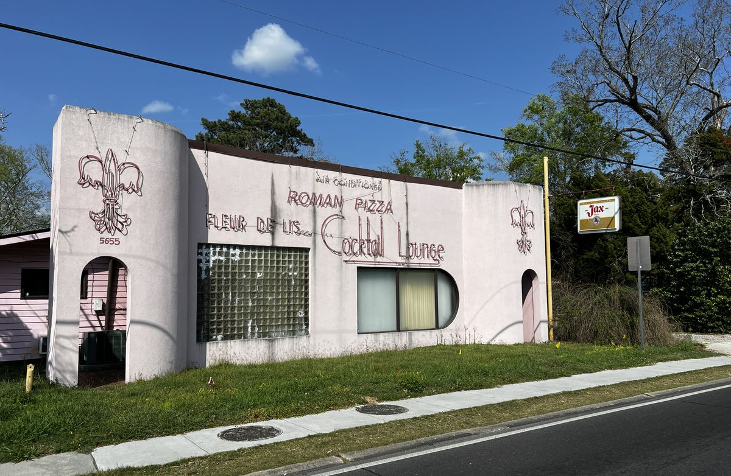
MID-CITY – GOVERNMENT STREET

Slide 34
OTHER DEVELOPMENT TO WATCH IN 2023
Harveston
Long Farm
City Square East
Nicholson / River District

Slide 35
OVERVIEW / PREDICTIONS
Vacancy to return to 8-9% Range
Minimal market-wide rent increases
Fewer Larger Centers Trading Hands
Increase in Retail Bankruptcies

Slide 36
"You've got to be very careful if you don't know where you're going because you might not get there."
-Yogi Berra

Slide 37
THANK YOU!
Special Thanks To: Jill Sylvest, Ken Damann, Stephen Eisenbraun – Fotosold &
Trends Steering Committee

