Slide 1


FINANCE
PRESENTED BY
Brian S. Andrews, CMB
Executive Director of the Real Estate Research Institute
Hermann Moyse, Jr. / Louisiana Bankers Association Instructor in Banking
E. J. Ourso College of Business, Department of Finance
Louisiana State University

Slide 2


FINANCE COMMITTEE MEMBERS
Jim Purgerson, CCIM
Committee Chair
Citizens Bank & Trust
Brian S. Andrews, CMB
Speaker and TRENDS Magazine Research
The Real Estate Research Institute
At LSU’s E. J. Ourso College of Business
Scott Gaudin
Currency Bank
Holly Hidalgo-DeKeyzer
Investar Bank
C. Brett Blanchard
Cadence Bank
Tommy Kehoe
Eustis Commercial Mortgage
T. Jefferson Fair
American Planning Corporation

Slide 3
TEAM FINANCE
The Economy
Commercial Mortgage Trends
Residential Mortgage Trends

Slide 4

The Economy

Slide 5
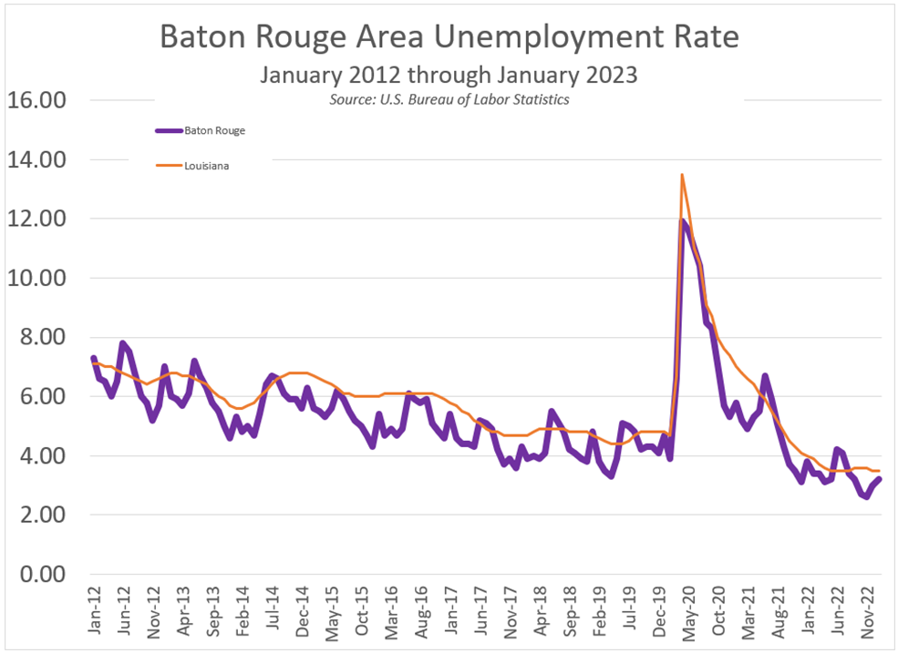

Slide 6
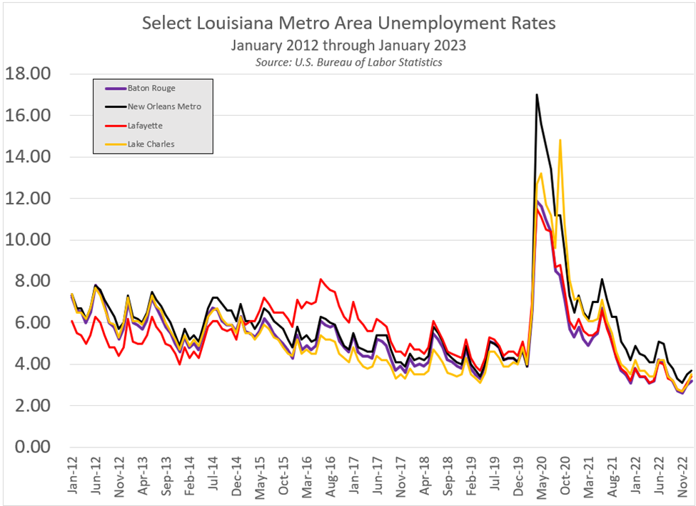

Slide 7
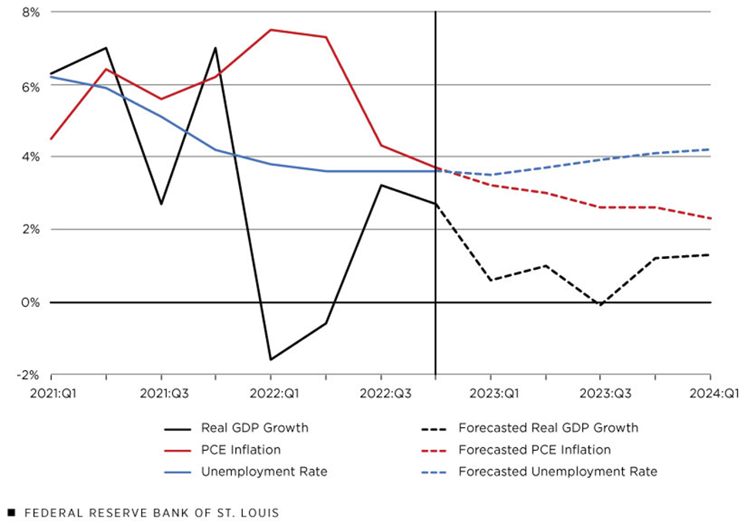
Consensus Forecasts for Real GDP Growth, PCE Inflation and Unemployment in 2023

Slide 8
Interest Rates

Slide 9
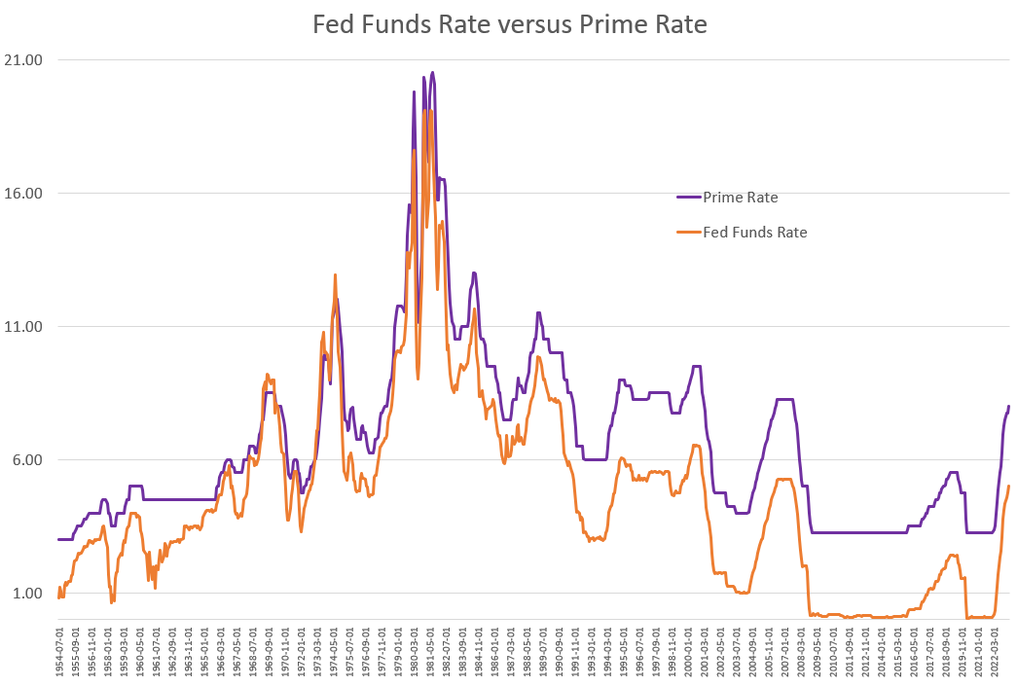

Slide 10
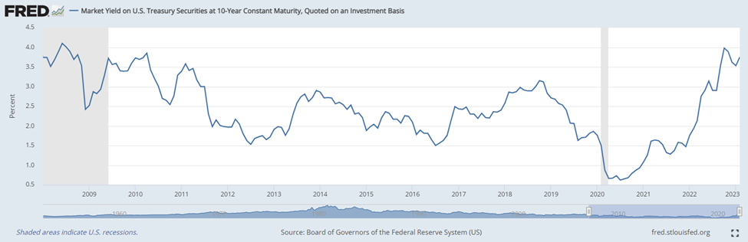

Slide 11
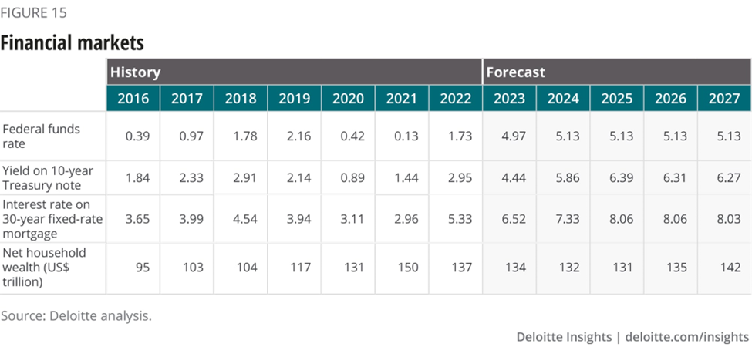

Slide 12
The Banks,
Savings & Loans, Credit Unions

Slide 13


Slide 14
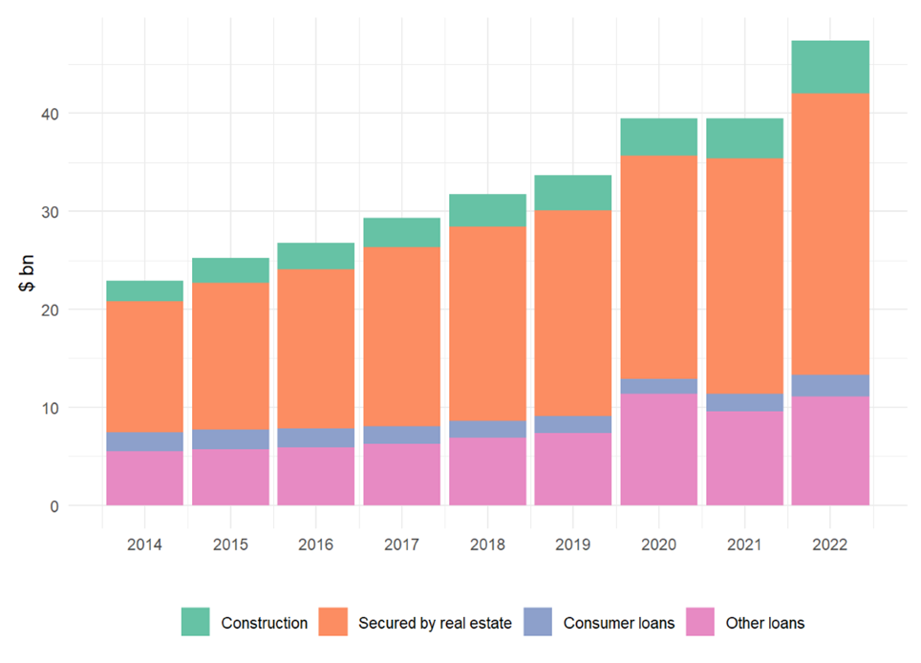
Loan Composition at Louisiana-Chartered Financial Institutions
Source: Call Reports as of December 31st

Slide 15
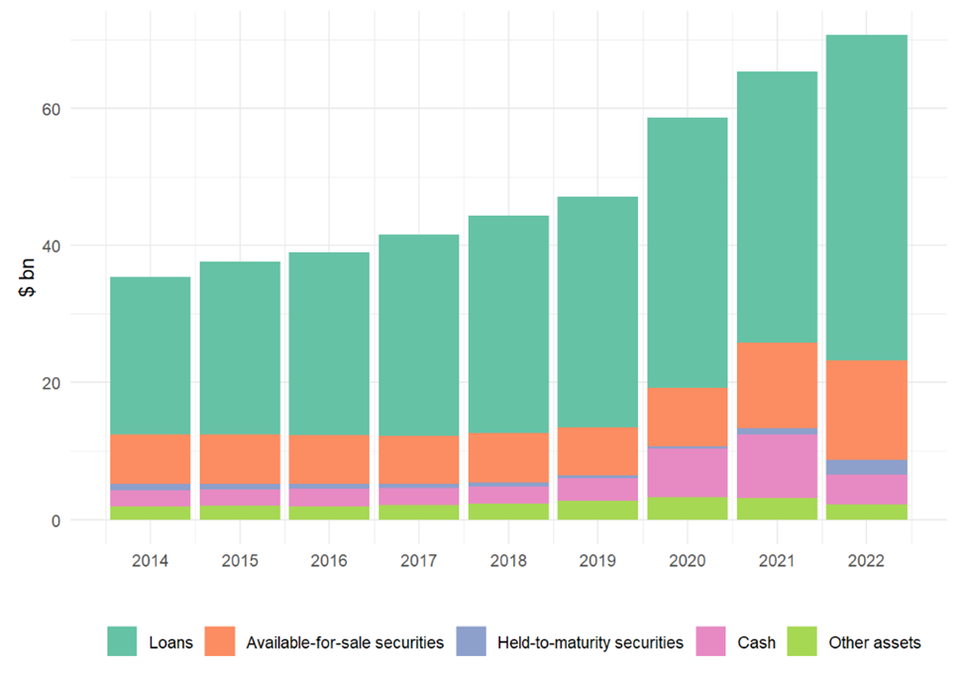
Asset Composition at Louisiana-Chartered Financial Institutions
Source: Call Reports as of December 31st

Slide 16
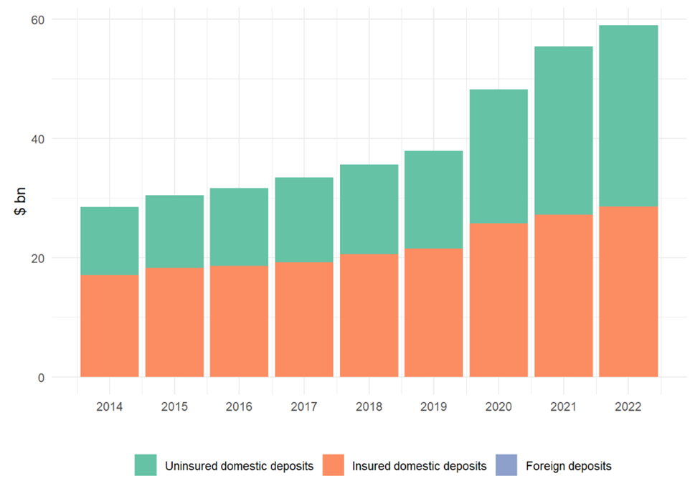
Deposit Composition at Louisiana-Chartered Financial Institutions
Source: Call Reports as of December 31st

Slide 17
Commercial
Real Estate
Finance

Slide 18
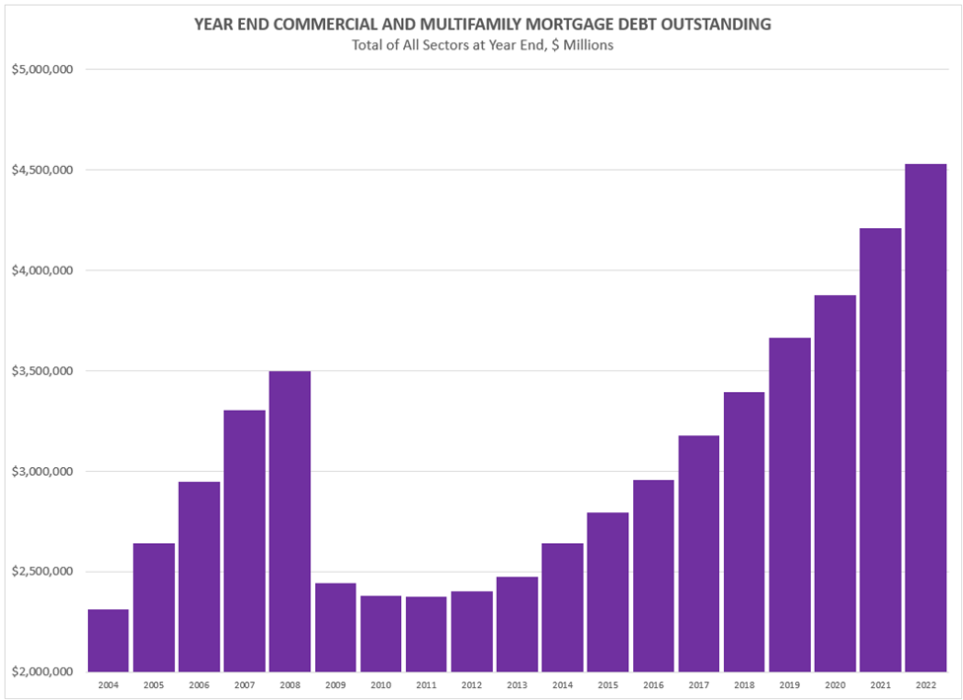
Source: Mortgage Bankers Association Commercial/Multifamily Data Books

Slide 19
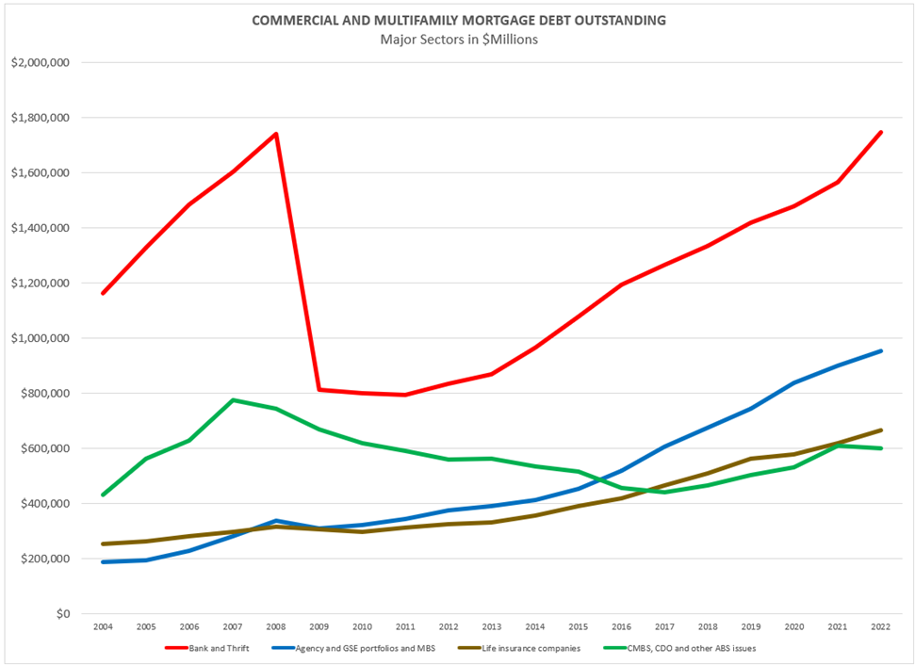
Source: Mortgage Bankers Association Commercial/Multifamily Data Books

Slide 20
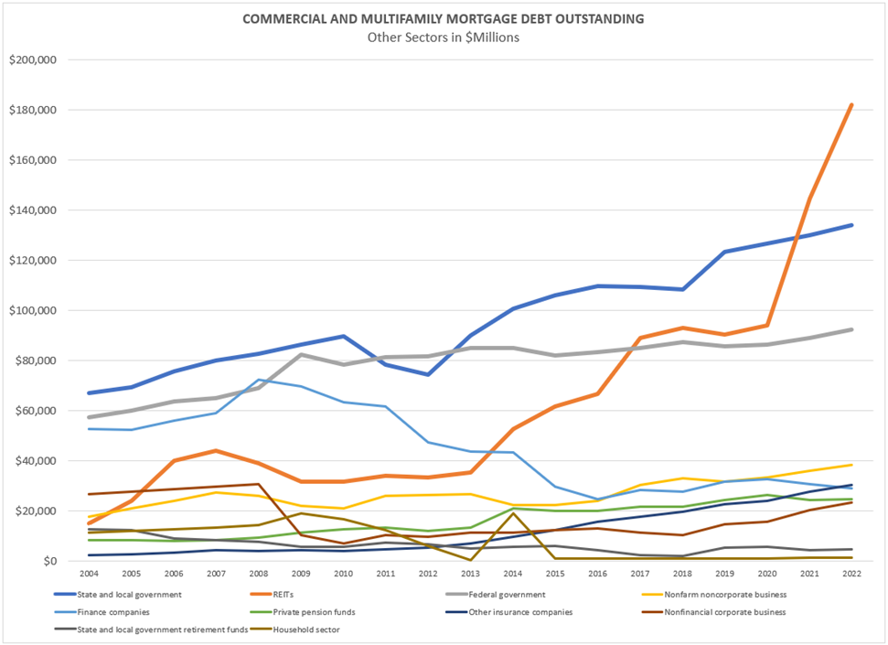
Source: Mortgage Bankers Association Commercial/Multifamily Data Books

Slide 21
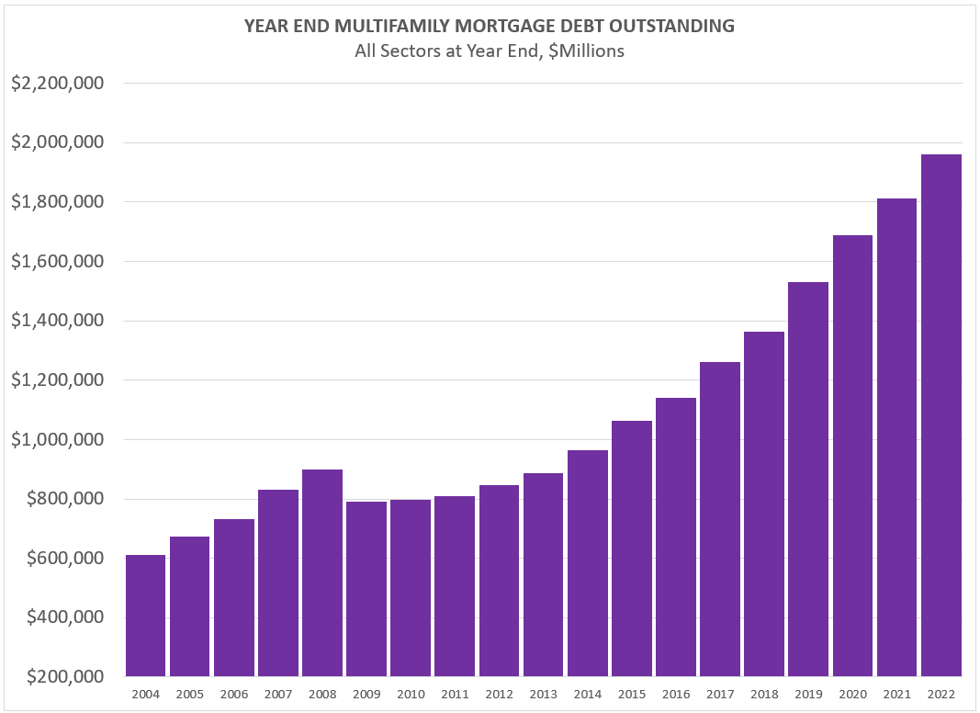
Source: Mortgage Bankers Association Commercial/Multifamily Data Books

Slide 22
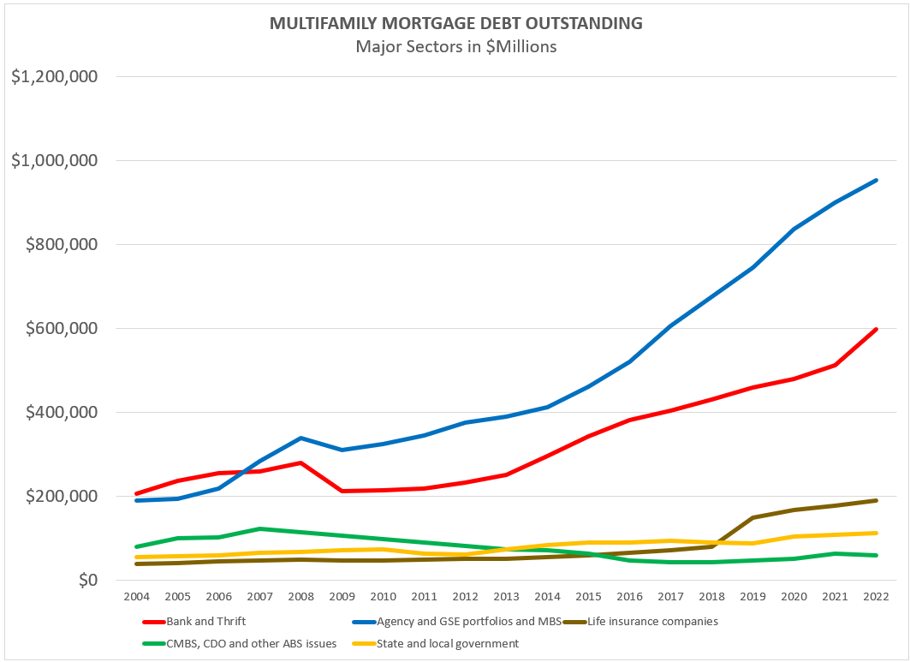
Source: Mortgage Bankers Association Commercial/Multifamily Data Books

Slide 23
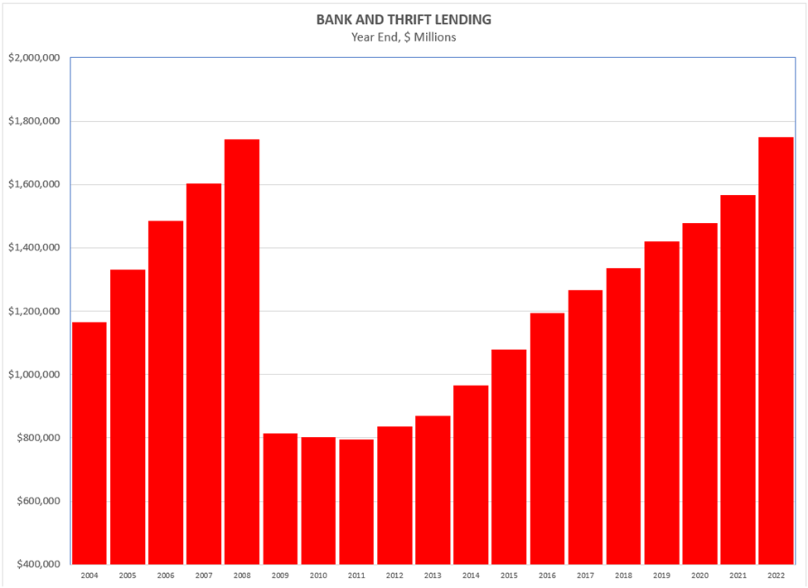
Source: Mortgage Bankers Association Commercial/Multifamily Data Books

Slide 24
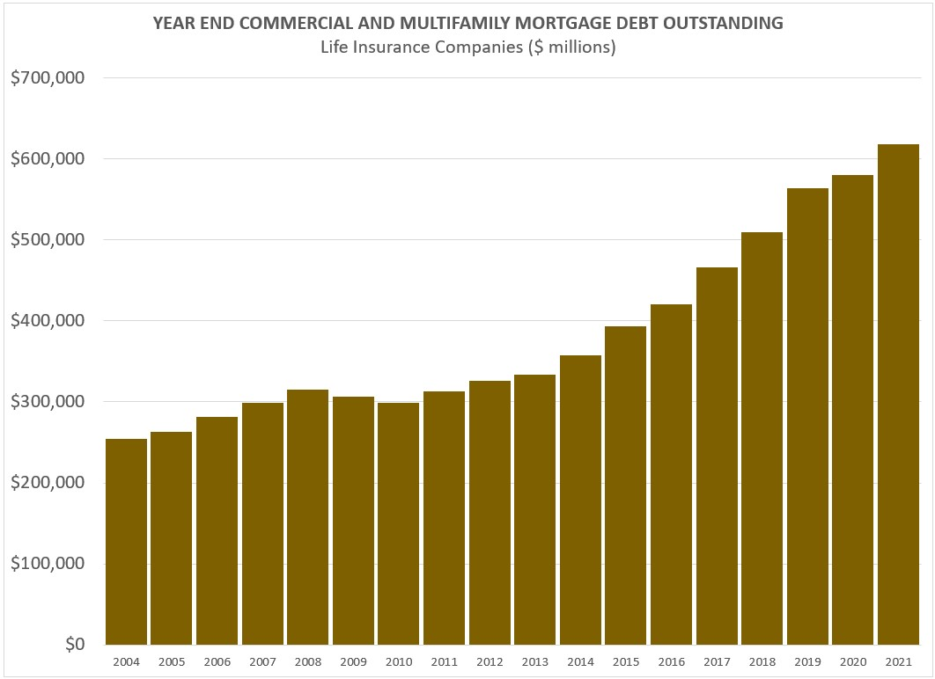
Source: Mortgage Bankers Association Commercial/Multifamily Data Books

Slide 25
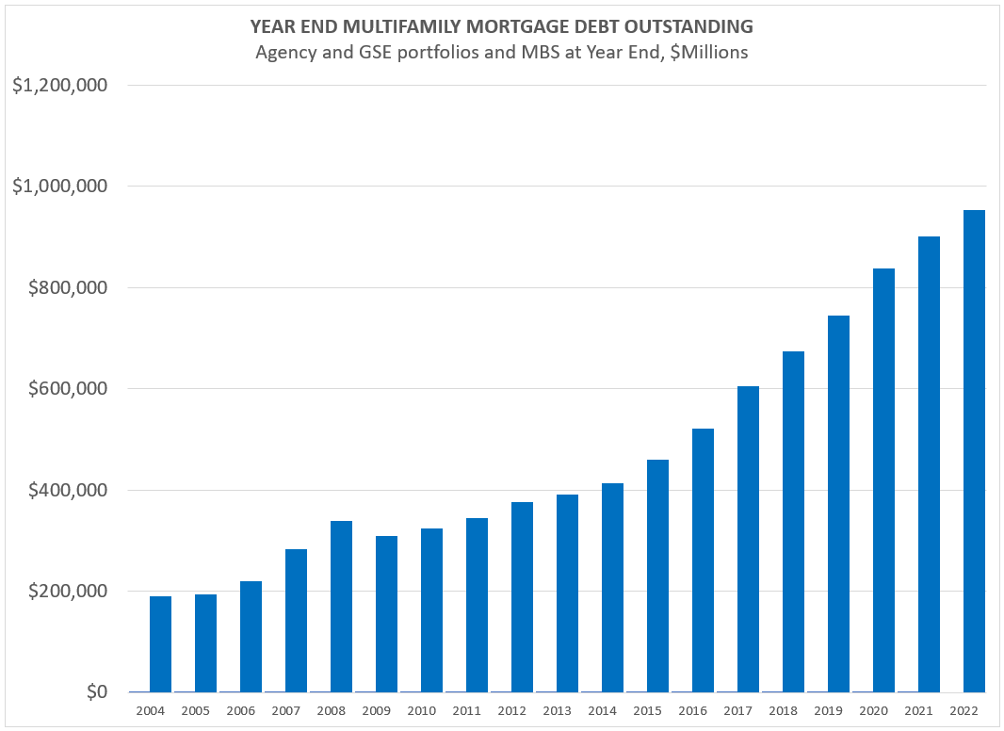
Source: Mortgage Bankers Association Commercial/Multifamily Data Books

Slide 26
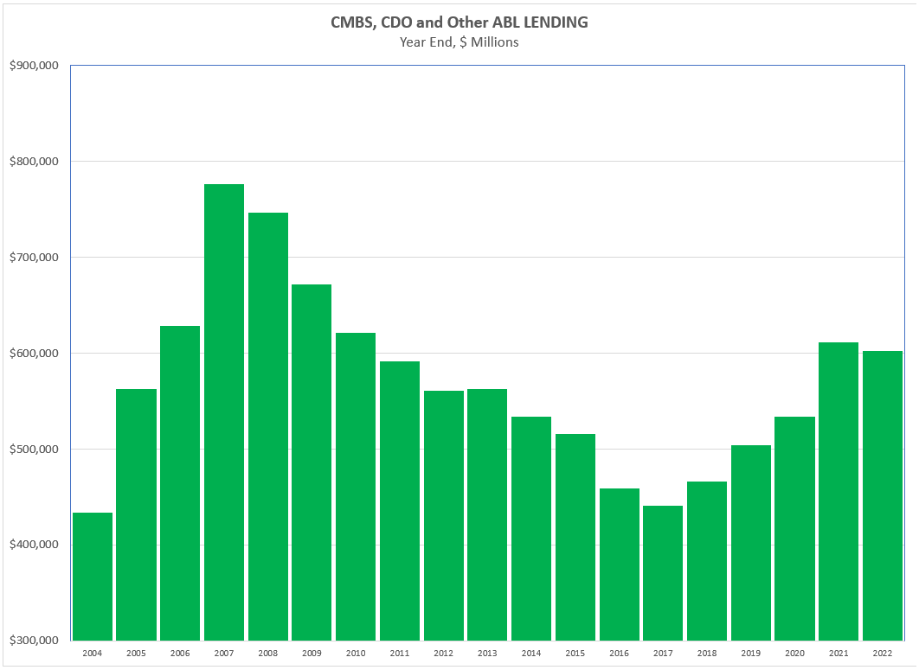
Source: Mortgage Bankers Association Commercial/Multifamily Data Books

Slide 27
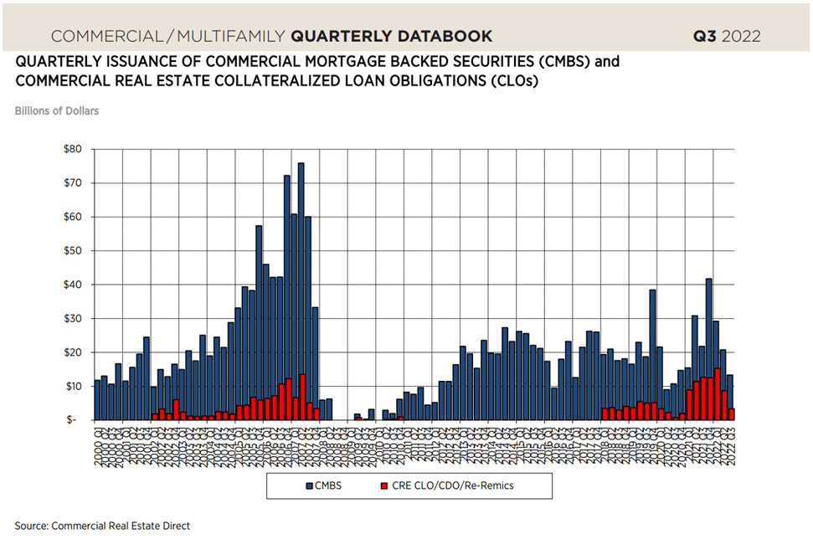
Source: Mortgage Bankers Association Commercial/Multifamily Data Books

Slide 28
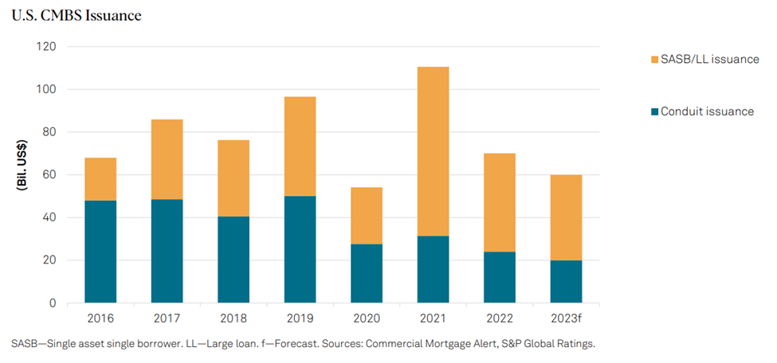

Slide 29
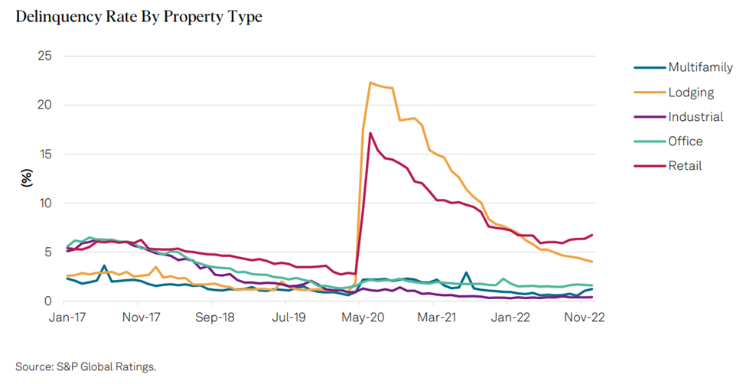

Slide 30
Residential
Real Estate
Finance

Slide 31
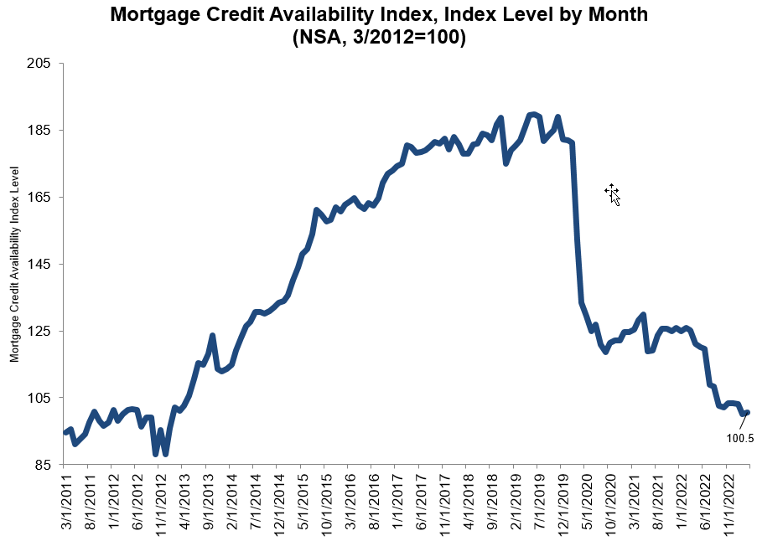

Slide 32
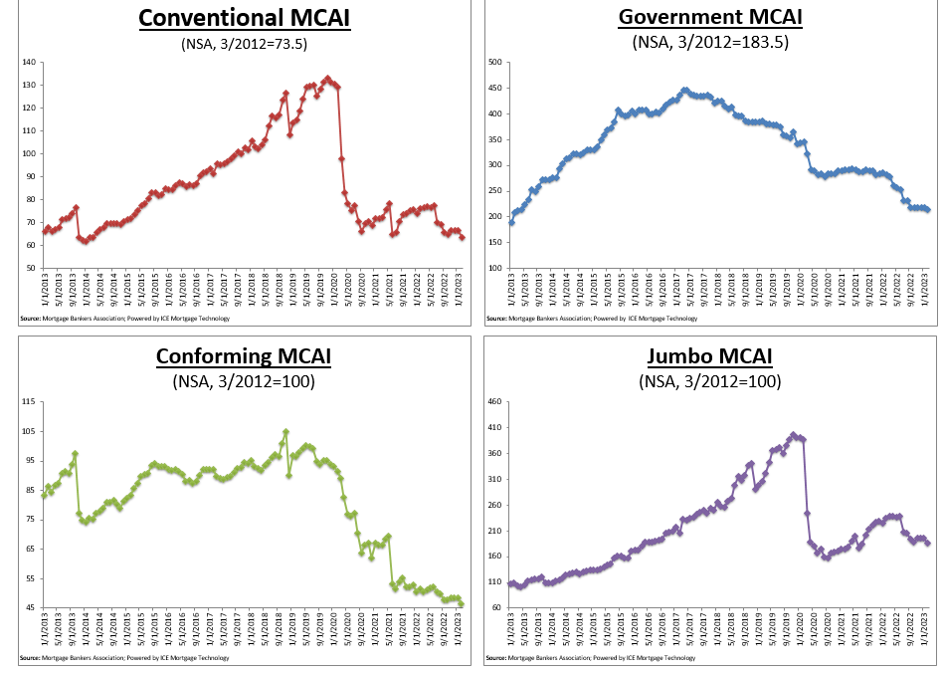

Slide 33


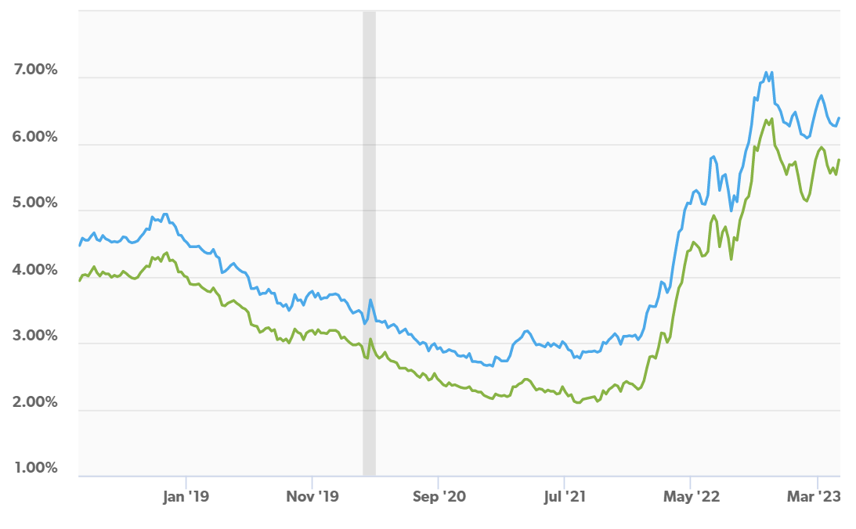

Slide 34
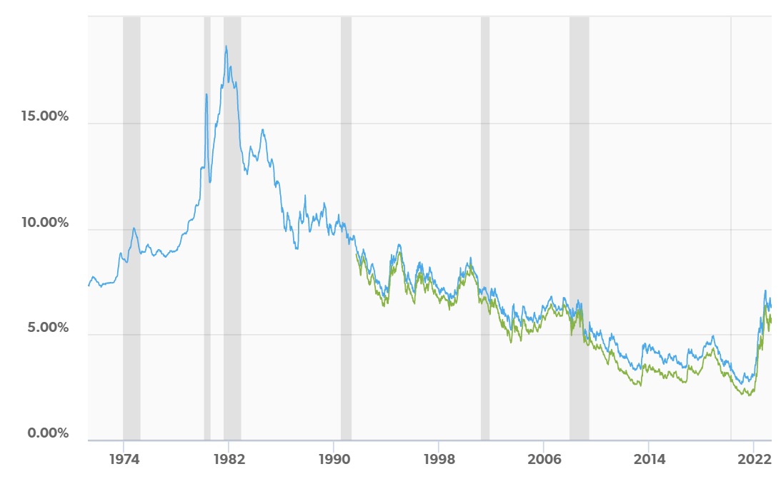

Slide 35
What Do Mortgage Lenders Look For?
Credit Score
Payment History
Income and Employment History
Debt-to-Income Ratio
Assets
Down Payment

Slide 36
Credit Scores and Credit Reports
Most medical debt to be removed from credit reports
‘Buy now, pay later’ accounts added to credit files
Free credit reports available through the end of 2023
New emphasis on ‘trended data’

Slide 37
Average FICO Scores in Louisiana
Area | Median Score | National City Rank
Baton Rouge | 670 | 2105
New Orleans | 535 | 2563
Lafayette | 687 | 1701
Shreveport | 652 | 2416

Slide 38


Slide 39
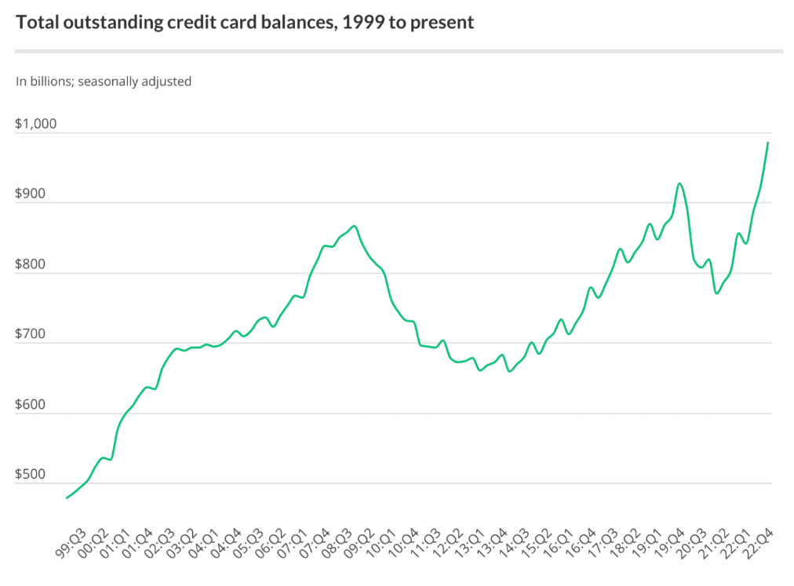

Slide 40
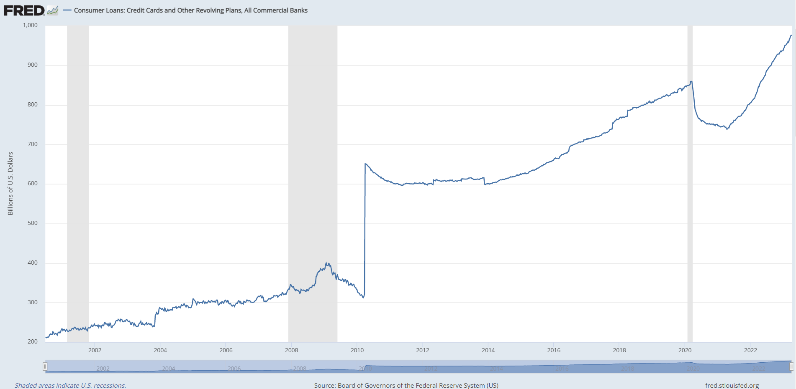

Slide 41
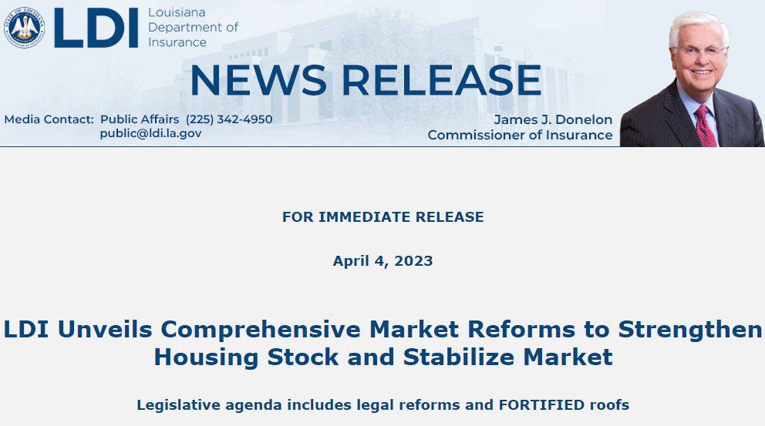

Slide 42


Slide 43
Wrap-Up

Slide 44
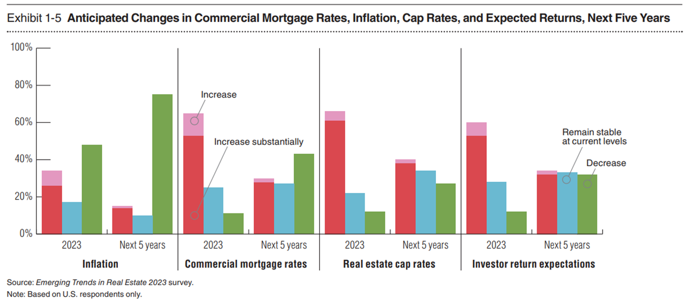

Slide 45
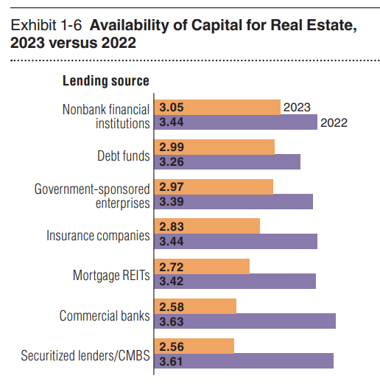
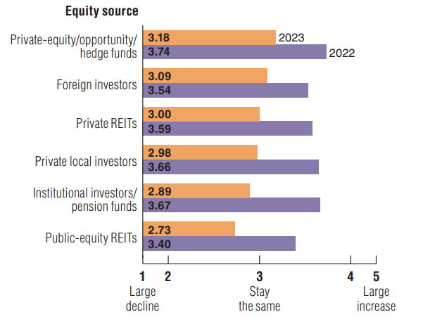

Slide 46
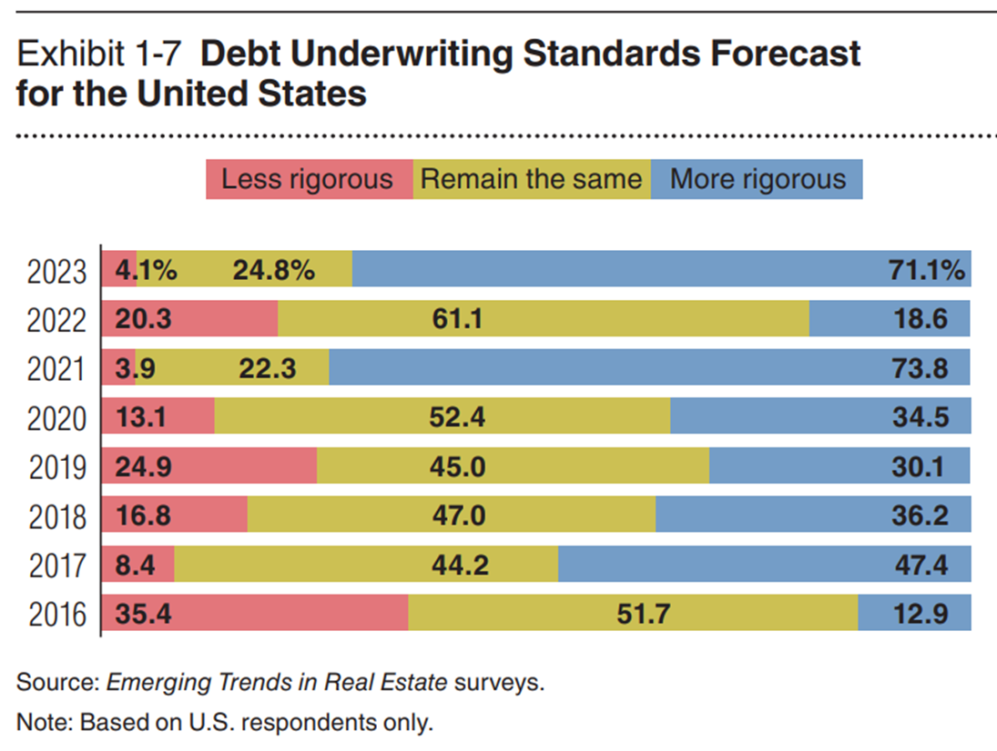

Slide 47
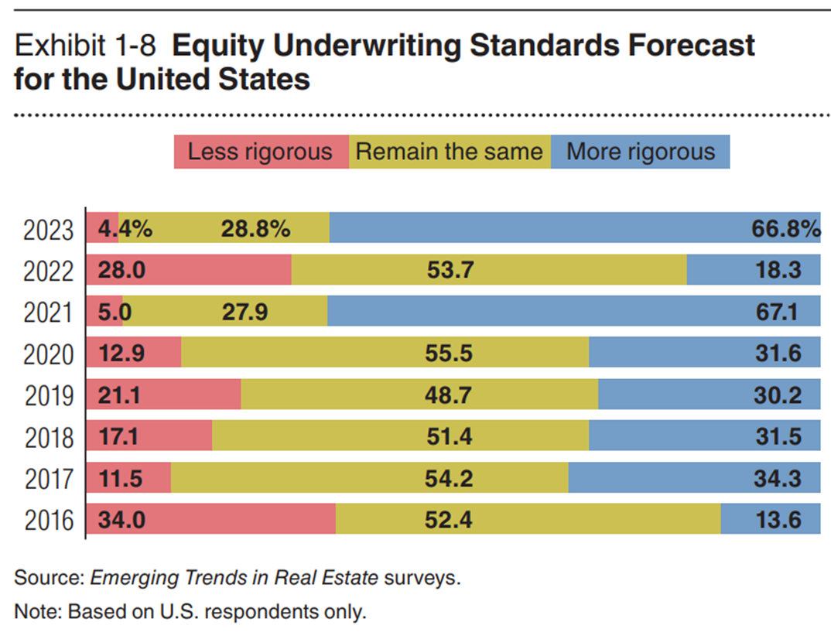

Slide 48

THANK YOU

