Slide 1


BATON ROUGE
OFFICE MARKET
PRESENTED BY
Branon W. Pesnell, CCIM, SIOR
Corporate Realty

Slide 2


OFFICE COMMITTEE MEMBERS
Branon Pesnell, CCIM, SIOR
Corporate Realty
Jonann Stutzman
NAI Latter & Blum
Gary Black
Wampold Companies
W. Foster Murphy
Stirling

Slide 3


Slide 4
EXECUTIVE OVERVIEW
TRENDS IN THE OFFICE SECTOR
National office statistics on the decline
A looming debt crisis
Office Space Utilization and the true measure of occupancy
Rise of operating expenses (OPEX)
Increase in Tenant Improvement (TI) cost
Aging office product exodus

Slide 5

2022
National Office Market
Q4 2022
The United States office market continued to soften through the third quarter of 2022 due to growing economic headwinds and continued caution among occupiers to undertake long-term, growth-focused office commitments.
As of Q4 2022 there was a negative absorption rate of 37.4 million square feet
National vacancy rates increased 114 basis points to 17.6% in Q4 2022
As of Q1 2023 the vacancy rates have risen to 20%
Average asking rents are $38.86 per square foot, up by 0.3% over 2021
Source – JLL U.S. Office Outlook, Q4 2022

Slide 6
2023
Looming Debt Crisis
The commercial mortgage-backed securities (CMBS) delinquency rate for office properties jumped 55 basis points to 2.38 percent up from 1.67 percent a year ago
Special servicing rates rose 60 basis points to 4.43 percent
JP MorganChase analyst estimate that 21% of office loans are destined to go bad
$270 billion in commercial real estate loans coming due in 2023. Roughly $80 billion are on office properties
70% of commercial mortgage loans are held by small banks
Negative perception of office combined with low space utilization have softened lenders appetite for office product
Source: Trepp, JP MorganChase

Slide 7
UTILIZATION
Commercial Office Space
Office space utilization showcases true occupancy
Hybrid work model is driving demand for office space
Average national office utilization rates are less than 50% of pre Covid levels according to Kastle
Baton Rouge office space utilization hovers around 60%

Slide 8
OPEX
Commercial Office Space
Annual inflation reached a 40 year high in September 2022
Annual inflation rate as of February 2023 increased by 6% over the prior year
Uncontrollable Operating Expenses ( taxes, insurance, utilities) are skyrocketing
Controllable Operating Expenses like repairs, maintenance, and supplies are also on the rise
Tenants are aggravated by Base Year Reconciliations
Landlords are resetting Base Year Expense Stops

Slide 9
Tenant Improvements
Commercial Office Space
Global pandemic created problems in supply chain
Inflation driving up cost of transportation and shipment
General inflation has increased the cost of supplies such as lumber, sheetrock, copper, and steel
It is estimated construction cost rose by over 60% immediately post pandemic
Local contractors estimate commercial construction cost are currently 20%-30% higher than pre pandemic levels

Slide 10
The Aging Exodus
Commercial Office Space
Older buildings devoid of significant capital improvements have seen a rise in vacancy since 2020
Newer or recently repositioned buildings in well-located areas are generating healthy leasing activity and consistently improving daily occupancy
Tenants are exhibiting a Flight to Quality
Baton Rouge has a high number of aged Class B/C buildings that are becoming difficult to lease
Tenants are seeking “ready to lease” spaces and rejecting dated suites

Slide 11
Pulse of the Office Market
What Brokers Reported in 2022
Deals are taking longer to transact
Companies are averaging a 10% - 15% reduction in space when they renew
Tenants are requesting shorter, more flexible lease terms
Office Condo market remained strong
Overall leasing activity was slow but there have been signs of activity in Q1 2023

Slide 12
BATON ROUGE MSA
OFFICE MARKET 2023
4.22 MILLION
SQUARE FEET
2.09 MILLION
SQUARE FT.
Class B/C
OCCUPIED
VACANT
Class A
Condo A/B
1.69 MILLION
SQUARE FT. CONDO

Slide 13
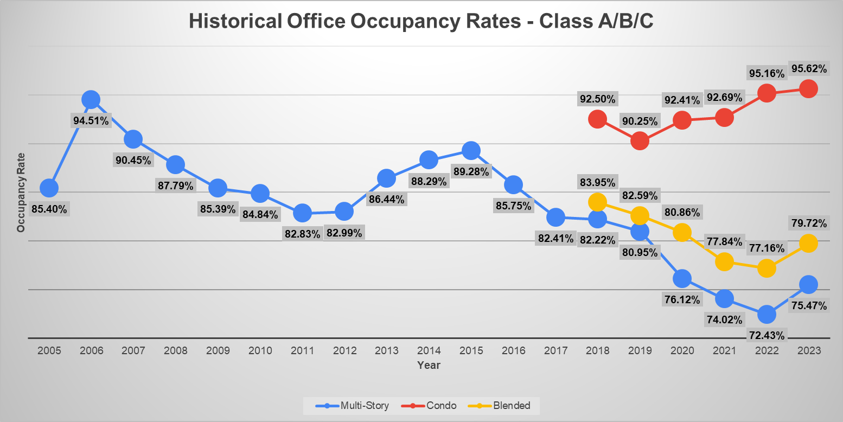

Slide 14
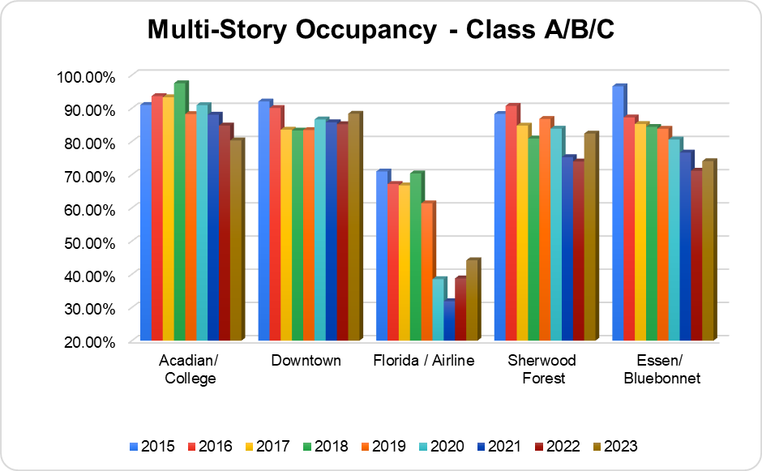
Overall Multi-Story Occupancy
75.47%

Slide 15
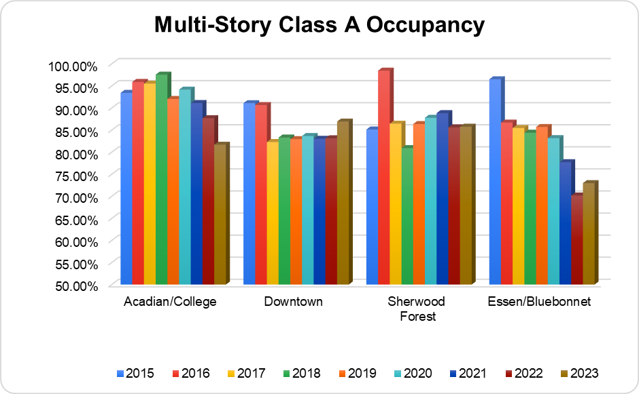
Average Class A Occupancy
79.42%

Slide 16
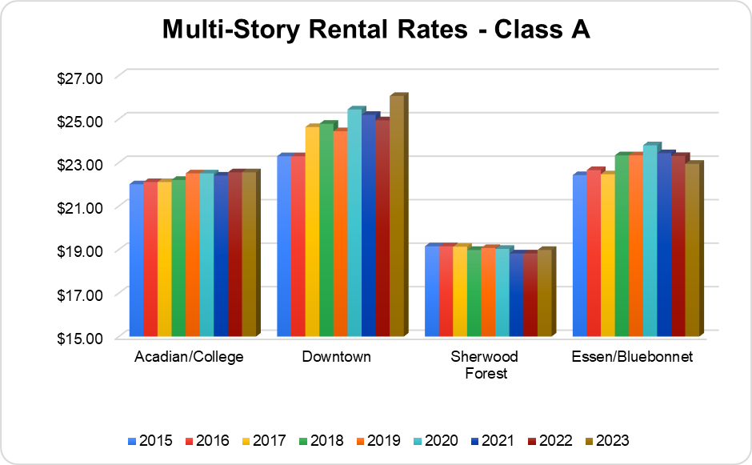
Average Class A Rental Rate
$22.63 PSF

Slide 17
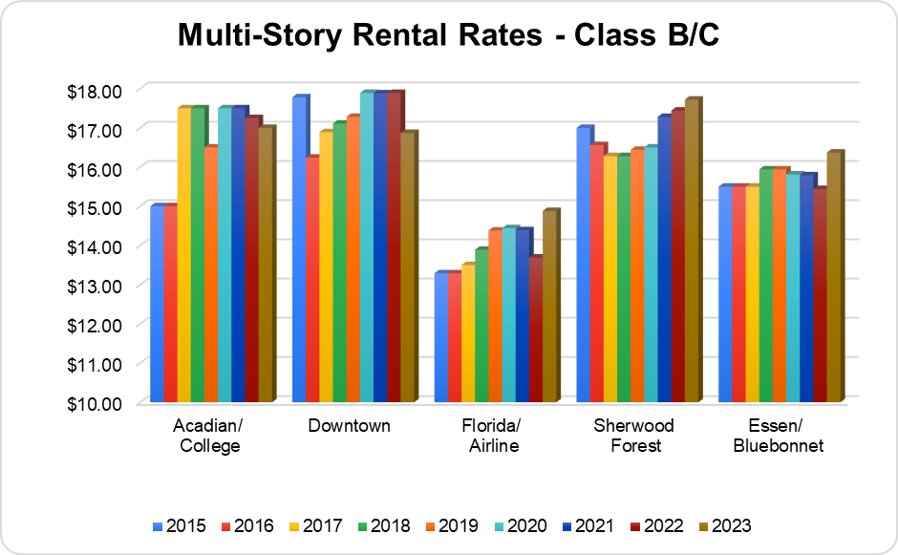
Average Class B/C Rental Rate
$16.57 PSF

Slide 18
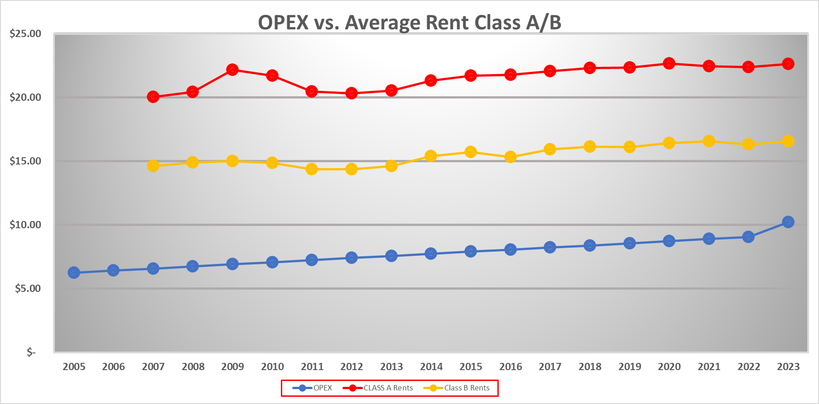

Slide 19
Office Market Forecast
So what does this all mean?
Rents are going to have to rise to counter rising OPEX and TI costs
Development activity will be slow to nonexistent due to high interest rates, slowing demand, and increased construction cost
Market will remain flat with little to no new tenant activity
Buildings with “ready to lease” spaces will see the most activity
Commercial Loans for speculative office will be difficult to obtain
The market will remain favorable for tenants in negotiations
Tenants will demand more flexible lease terms

Slide 20
Office Market Forecast
How Does Baton Rouge Compare
Positives
Office Space utilization is higher than the national average
Baton Rouge saw positive absorption of office space in 2022
Landlords are spending money to upgrade aging office product
State government and a strong petrochemical industry insulate the market
Negatives
A large amount of older aged buildings in the marketplace
Small number of new tenants entering the Baton Rouge market

Slide 21
Notable Deals
In 2023
CitiPlace II
Rivermark Centre
263 Third Street
5900 Florida Blvd.
4455 American Way
Acadian Centre

Slide 22
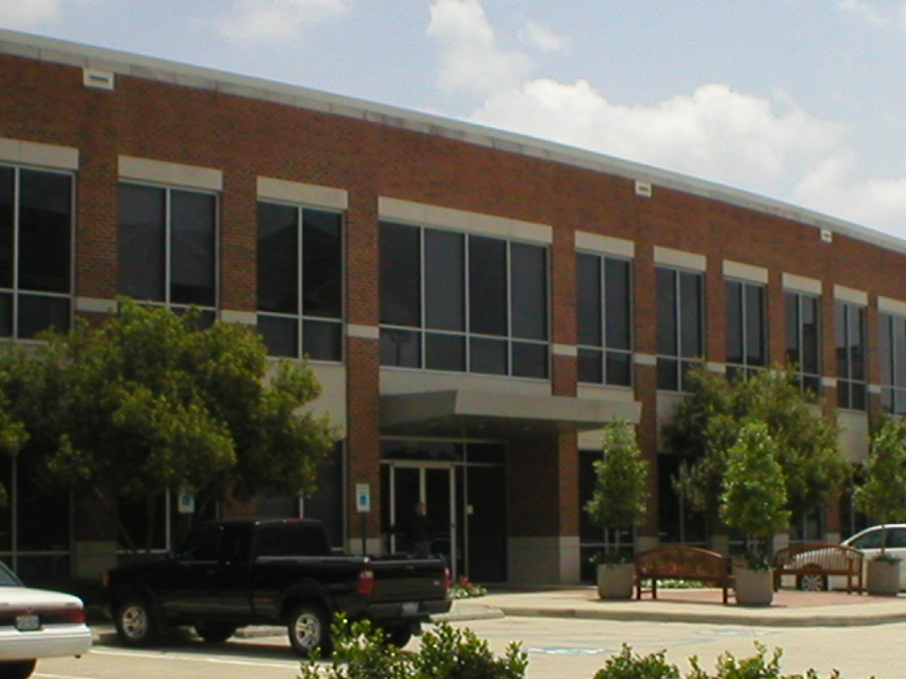
Recent Sale
CitiPlace II
31,516 SF
$6.8 Million
$218 psf

Slide 23
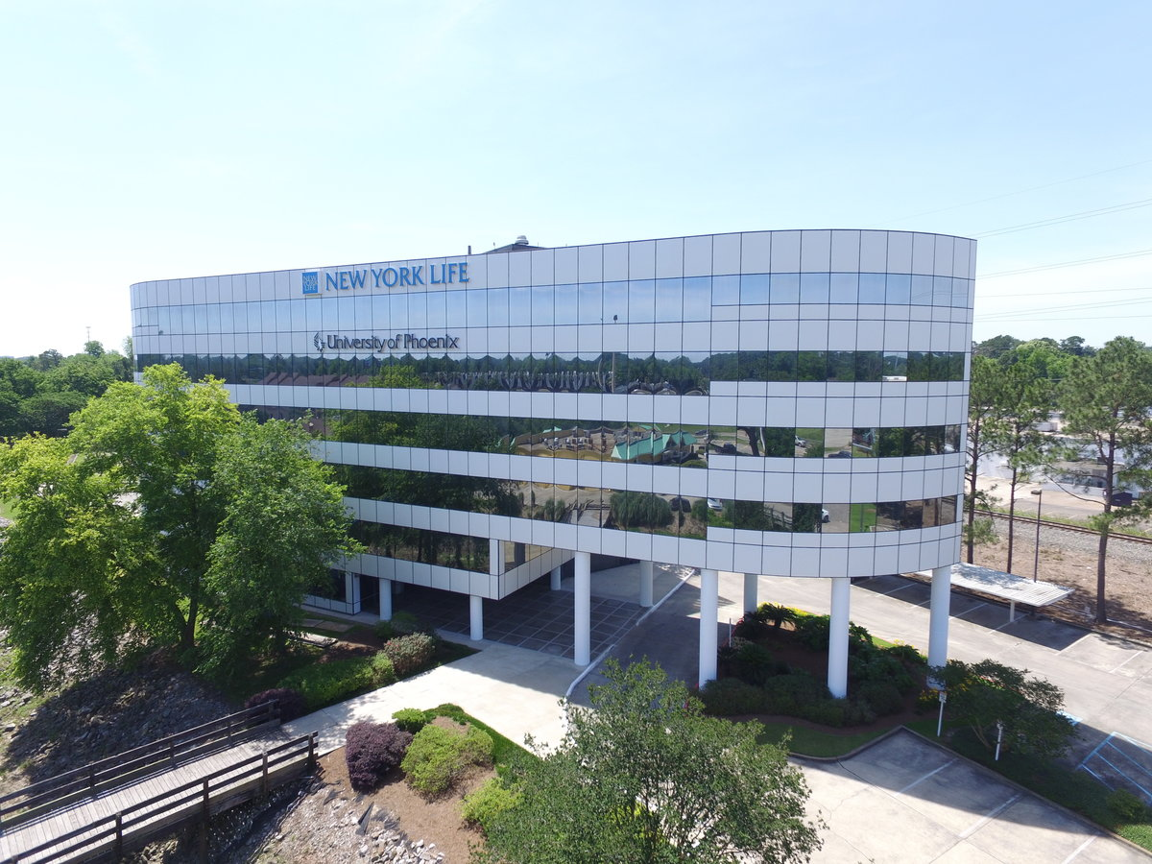
On the Market
Acadian Centre
74,589 SF
$9.5 Million
$127 psf

Slide 24
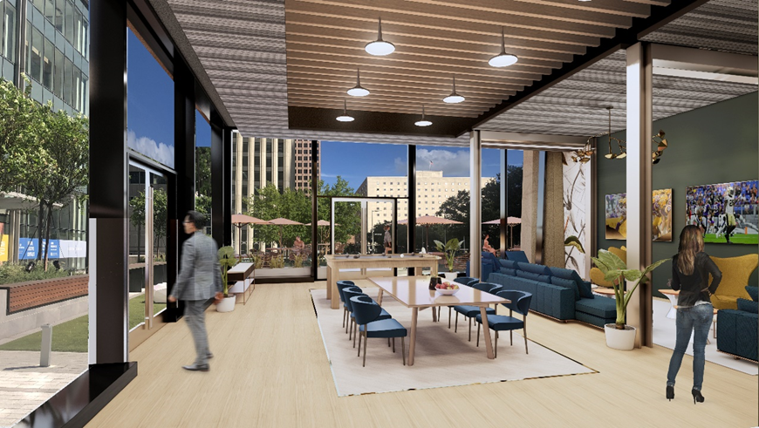
Redevelopment
I & II Rivermark
Centre
283,782 SF

Slide 25
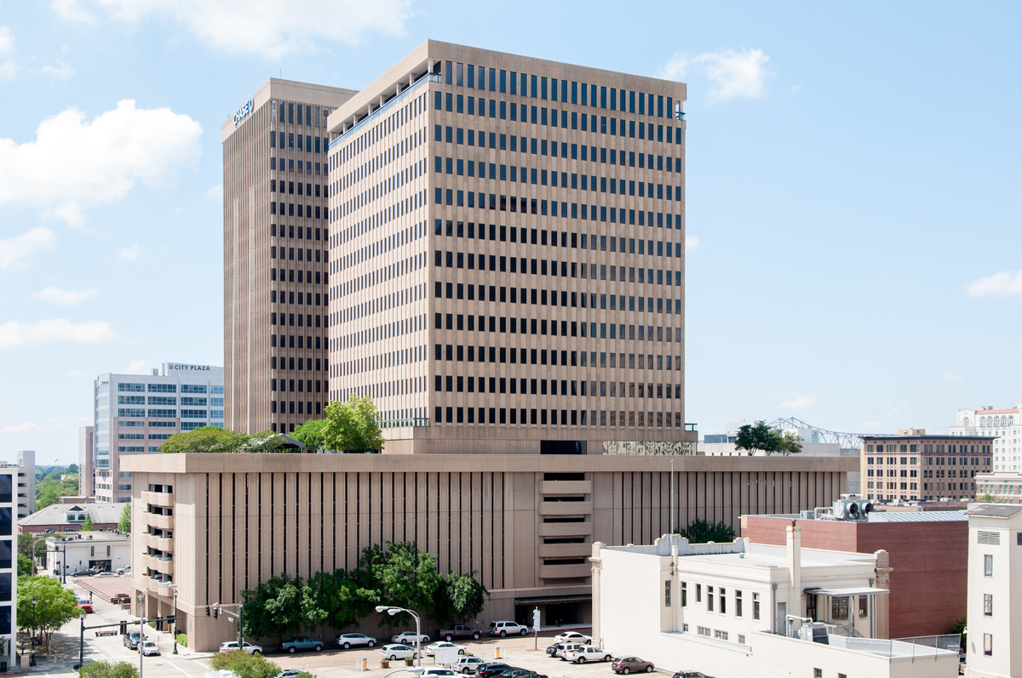

Slide 26
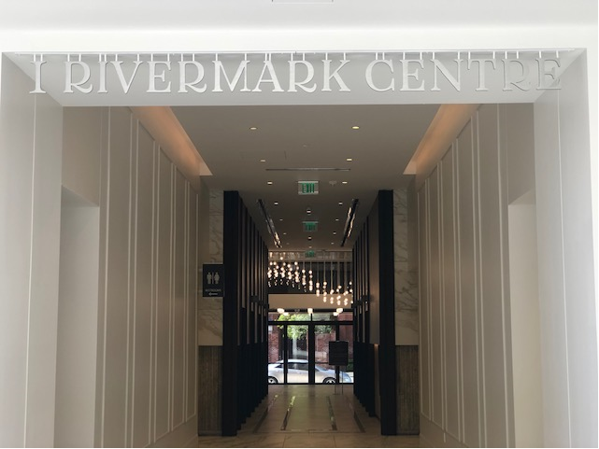

Slide 27
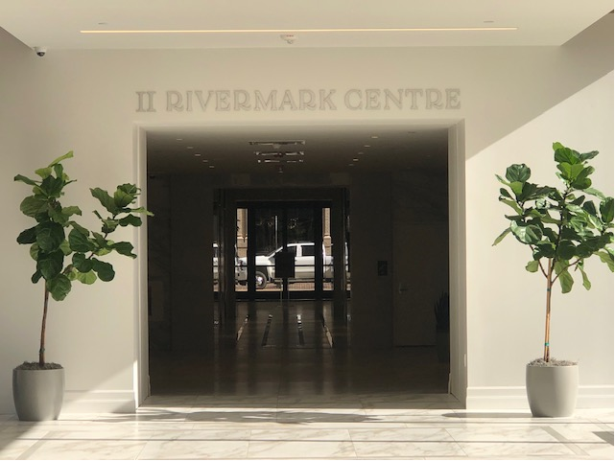

Slide 28
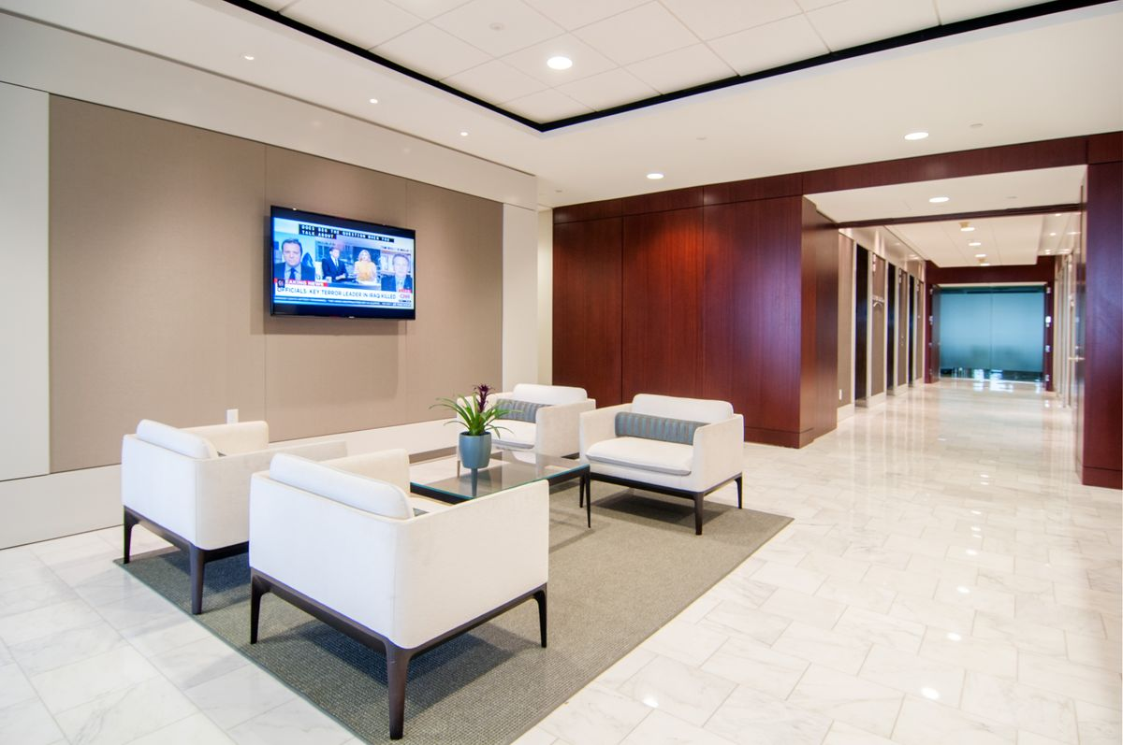

Slide 29
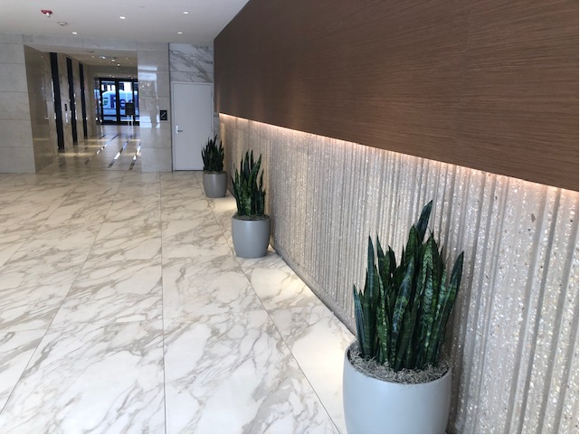

Slide 30
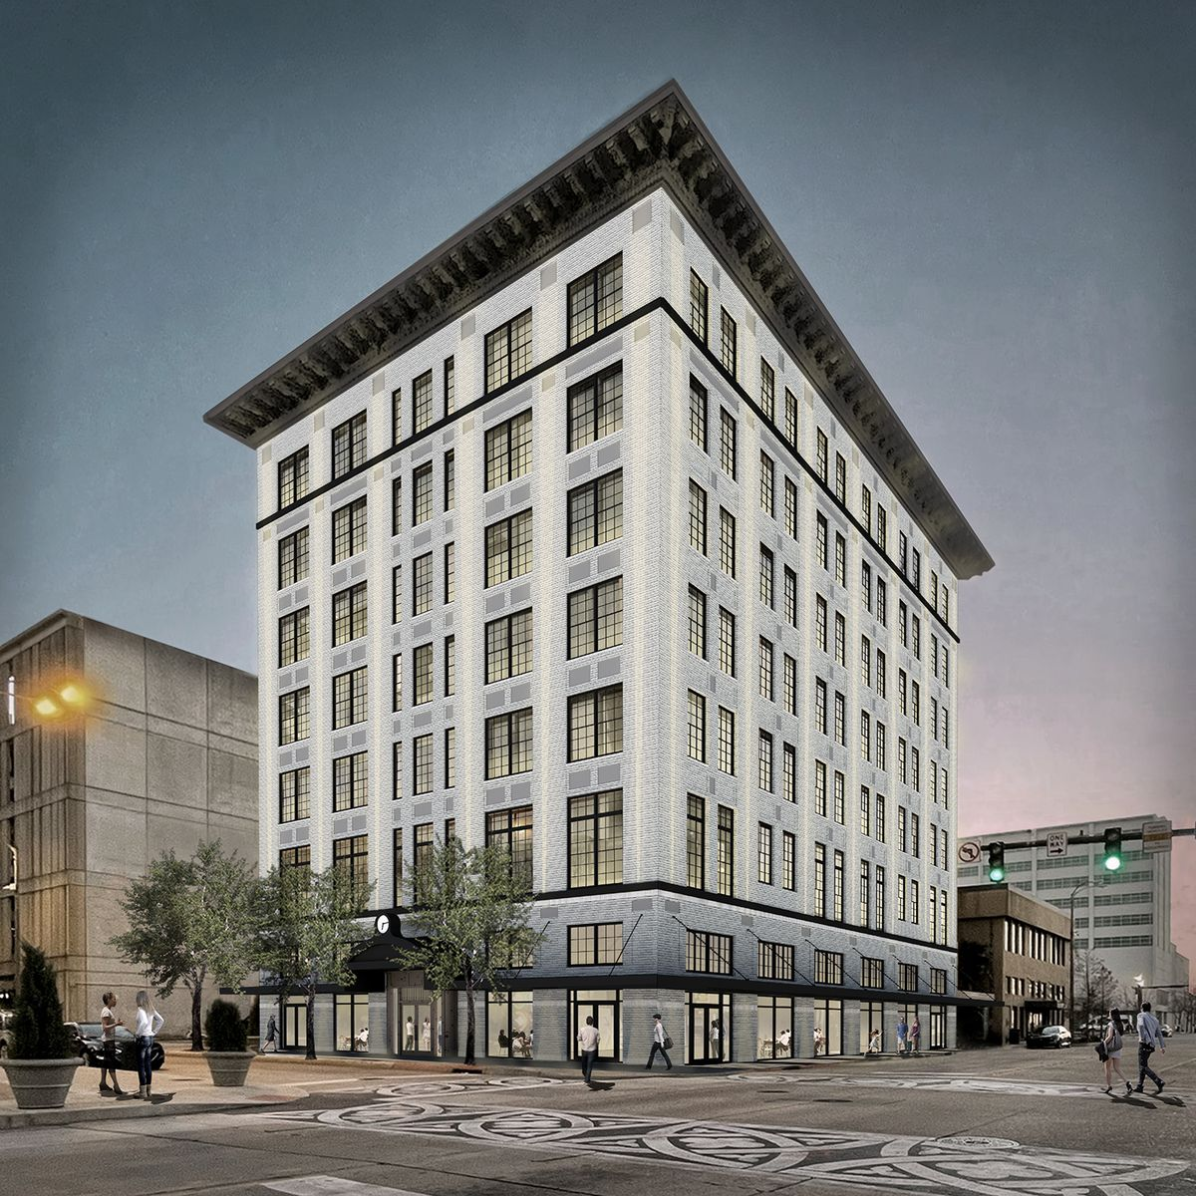
Redevelopment
263 Third Street
48,393 SF

Slide 34
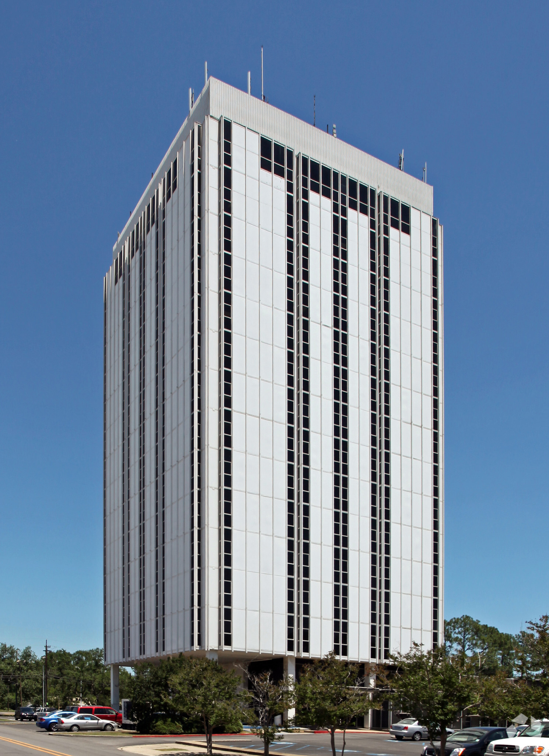
Redevelopment
5700 Florida Blvd.
86,312 SF

Slide 35
Redevelopment
4455 American Way
70,000 SF

Slide 36
Redevelopment
4455 American Way
70,000 SF

Slide 37


Slide 40

THANK YOU

