Slide 1
BATON ROUGE
Residential Market
PRESENTED BY
Tom W. Cook MAI
Cook Moore Davenport And Associates

Slide 3
Outline / Summary
Look at Historical Information from 2022
Review Predictions From 2022
Make Predictions For 2023
Review New Developments Planned

Slide 4
Review of 2022 Summary
Market Conditions Remain Strong
2022 Dollar Volume Down 9.55% 2021 Dollar Volume Up 21.18%
Median Sale Price Rose by 6.69%
The Median rose from $239,000 to $255,000
Months Supply Rose by 31.25%
Months' Supply in 2022 2.1 Months' Supply in 2021 was 1.6

Slide 5
Dollar Volume Entire GBR MLS |  | Change | Change | Change | Average Change
 |  | 2021 to 2022 | 2020 to 2021 | 2019 to 2021 | 2015 to 2019
All Sales All Price Ranges |  | -9.55% | 21.18% | 47.78% | 4.99%
Sale Price $93,999 or Less |  | -17.82% | -8.97% | -20.64% | -0.92%
Sale Price $94,000 to $177,999 |  | -29.37% | -10.94% | -8.95% | -3.33%
Sale Price $178,000 to $261,999 |  | -23.50% | 10.66% | 33.47% | 6.30%
$262,000 or More |  | 0.85% | 36.86% | 79.23% | 8.29%

Slide 6
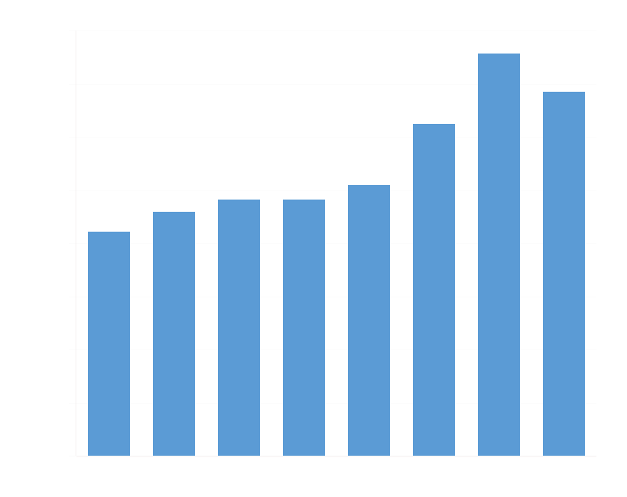
Dollar Volume Entire MLS
Entire MLS All Homes

Slide 7
New Home Dollar Volume Entire MLS |  | Change | Change | Change | Average Change
 |  | 2021 to 2022 | 2020 to 2021 | 2019 to 2021 | 2015 to 2019
All Sales All Price Ranges |  | 4.04% | 12.25% | 38.82% | 6.20%
Sale Price $93,999 or Less |  | 0.00% | 0.00% | 3.37% | NA
Sale Price $94,000 to $177,999 |  | -53.52% | -29.13% | -4.23% | -18.15%
Sale Price $178,000 to $261,999 |  | -28.80% | -5.90% | 10.66% | 3.45%
$262,000 or More |  | 34.73% | 24.09% | 58.31% | 13.02%

Slide 8
Dollar Volume Entire MLS
New Home Sales

Slide 9
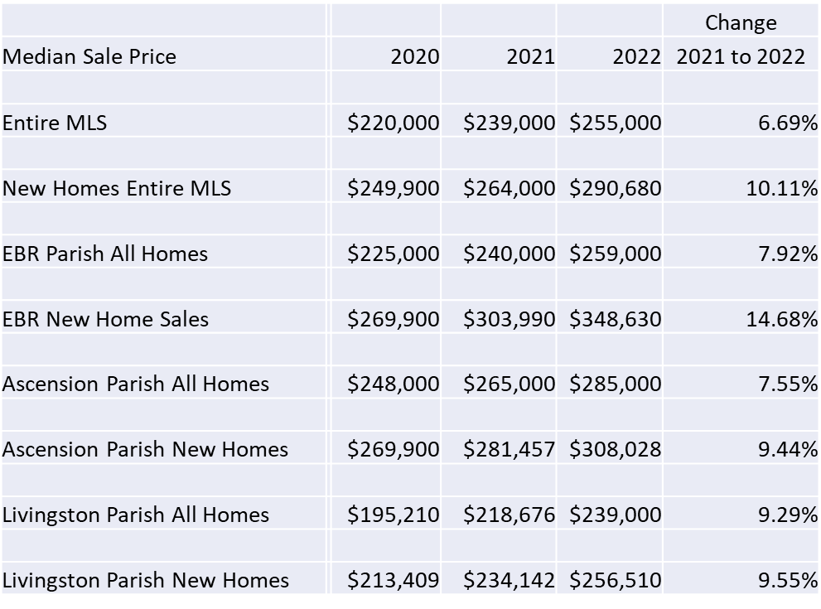

Slide 10
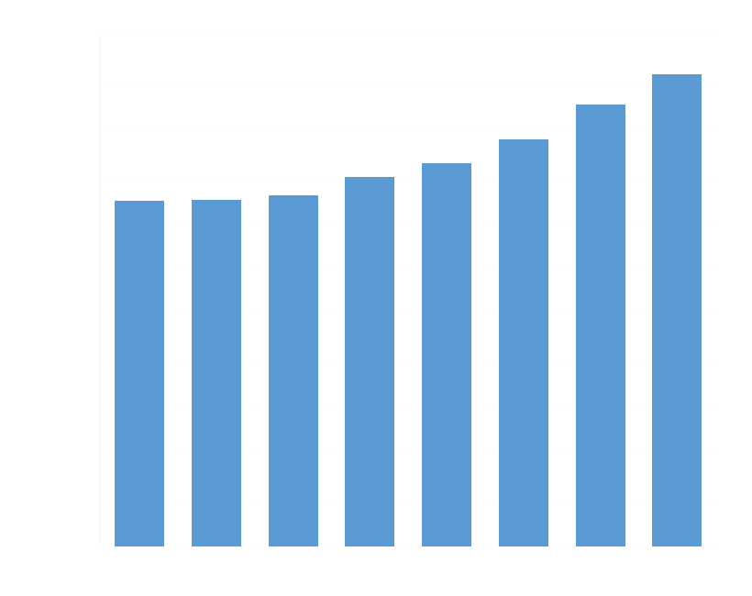
Median Home Price Entire MLS Area
All Homes

Slide 11
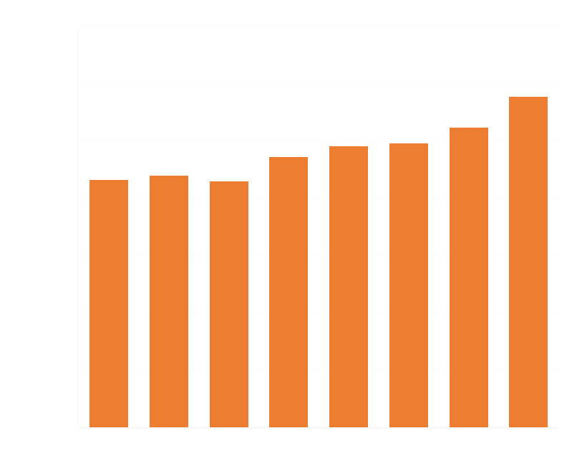
Median Home Price Entire MLS Area
New Homes

Slide 12
 |  |  |  |  | Change | Change
Months' Supply |  | 2020 | 2021 | 2022 | 2021 to 2022 | 2020 to 2021
Entire MLS |  | 3.5 | 1.6 | 2.1 | 31.25% | -54.29%
New Homes Entire MLS |  | 3.6 | 1.9 | 2.9 | 52.63% | -47.22%
EBR Parish All Homes |  | 3.8 | 1.7 | 1.9 | 11.76% | -55.26%
EBR New Home Sales |  | 4.1 | 2.5 | 4.4 | 76.00% | -39.02%
Ascension Parish All Homes |  | 2.6 | 1.1 | 1.4 | 27.27% | -57.69%
Ascension Parish New Homes |  | 3.2 | 1.3 | 1.6 | 23.08% | -59.38%
Livingston Parish All Homes |  | 2.8 | 1.3 | 1.6 | 23.08% | -53.57%
Livingston Parish New Homes |  | 2.8 | 1.8 | 2.3 | 27.78% | -35.71%

Slide 13
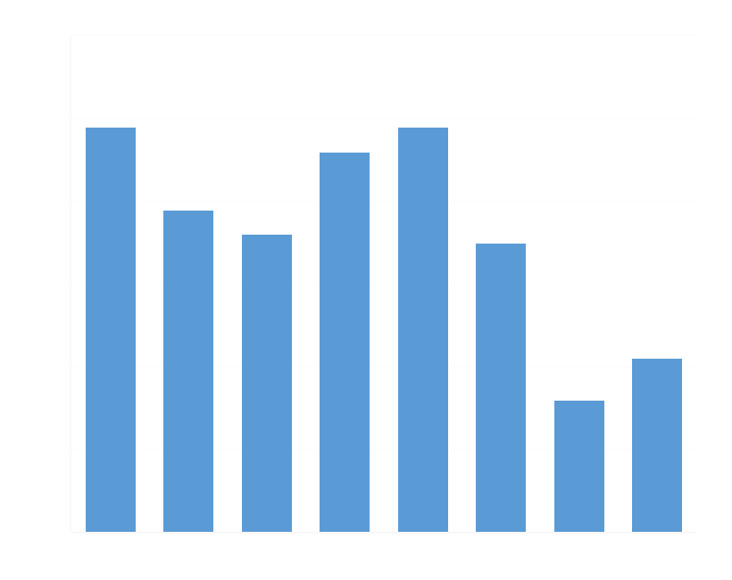
Months Supply
All Homes

Slide 14
Months Supply
New Homes

Slide 16
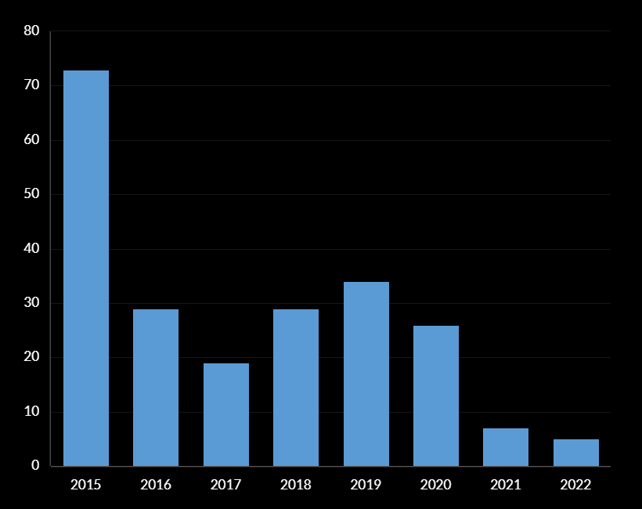
Median Days on Market
All Homes

Slide 17
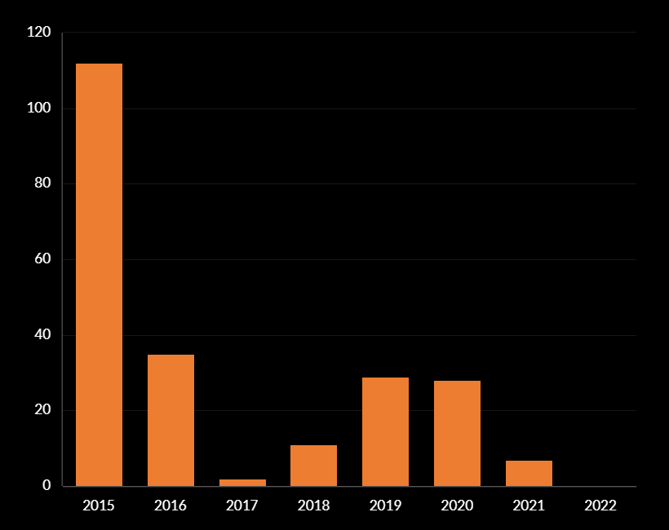
Median Days on Market
New Home

Slide 18
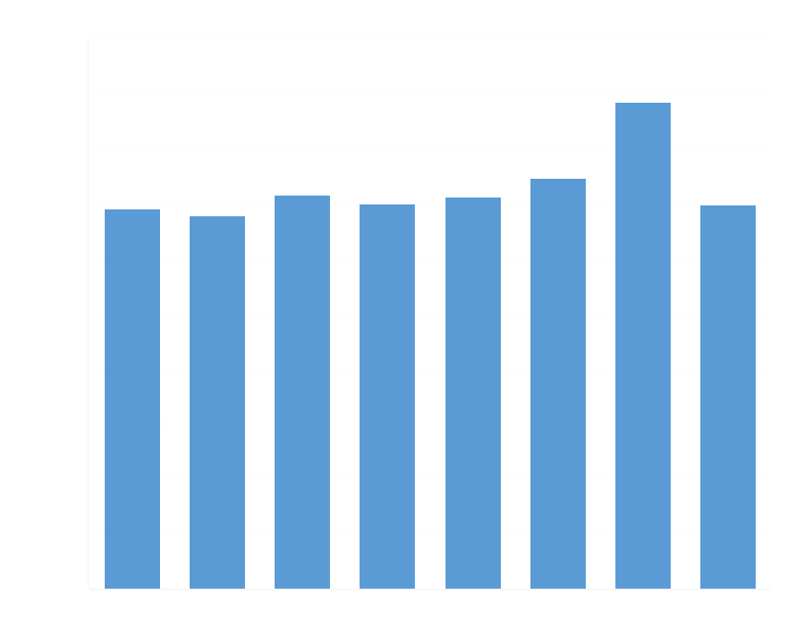

Slide 22
LAND SALES 2022 and 2023

Slide 24
2022 Predictions
Increasing Cost of Housing MSP $239K to $255K
Decreasing Inventories Months Supply Rose 21%
More Townhouse Construction Increase of 195%
Increasing Interest Rates Up Slightly
Decrease in Dollar Volume 9.55% Drop from 2022
Market Conditions to Cool Off

Slide 25
What if Interest Rates Go to 6%
Current Payment on $300K at 3% 30 year Am
$1,265
Payment on $300K at 6% 30-year Am
$1,800
Difference of $535
Borrowers Will Have to Make about $1,500 More per month to qualify for the Same Mortgage

Slide 26
Income necessary to qualify for a $300,000 mortgage
At 3% Interest 30 Years
$45,000 Per Year
Income necessary to qualify for a 300,000 Mortgage
At 6% Interest 30 Years
$62,000 Per Year

Slide 27
Total Number of Households Making $42,000 to $150,000 About 135,000
Total Households Making 62,000 to $150,000
About 100,000
Loss of Potential Buyers
35,000 or about 25%

Slide 28
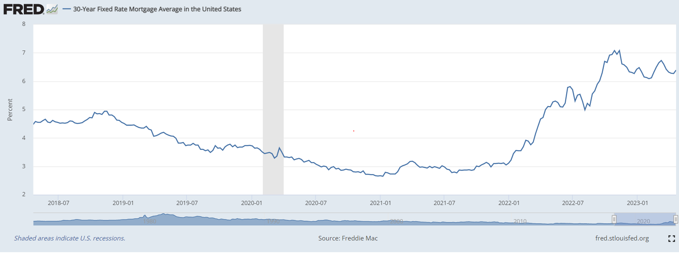
11/2020 Mortgage Rates Were around 3% 4/2023 is 6.39%

Slide 29
HOMES FOR SALE

Slide 30
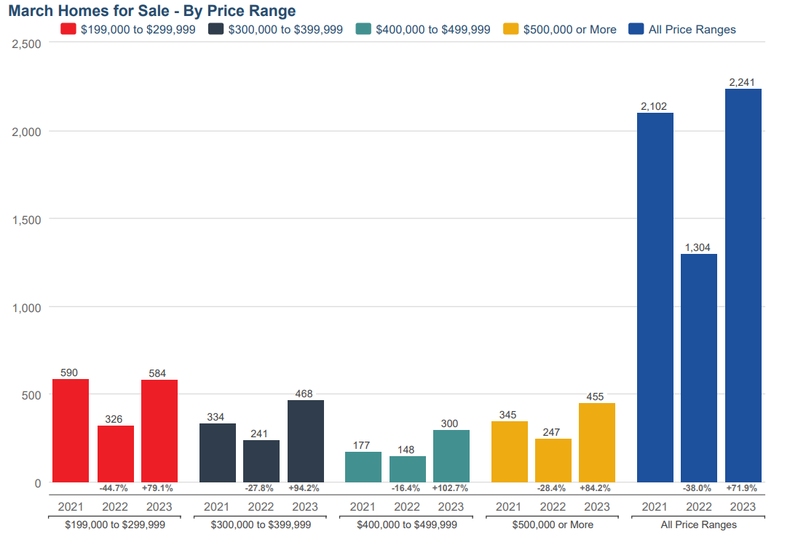
All Homes Listed for Sale GBRMLS

Slide 31
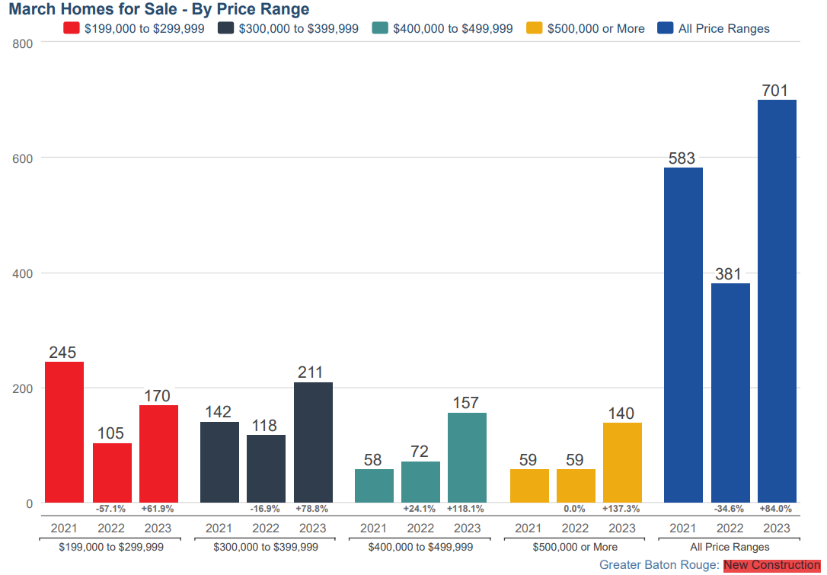
New Homes Listed For Sale GBR MLS

Slide 32
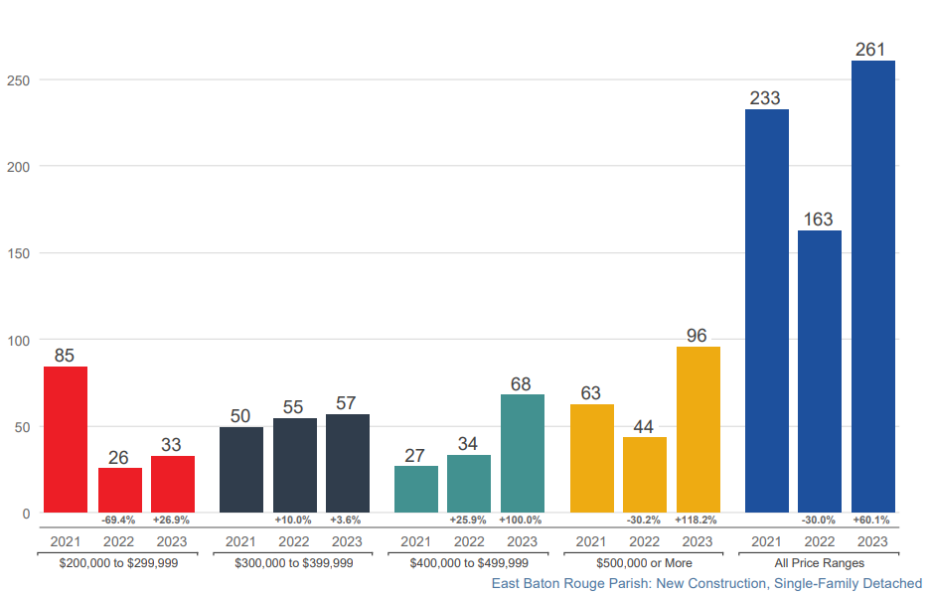
New Homes Listed For Sale EBR

Slide 33
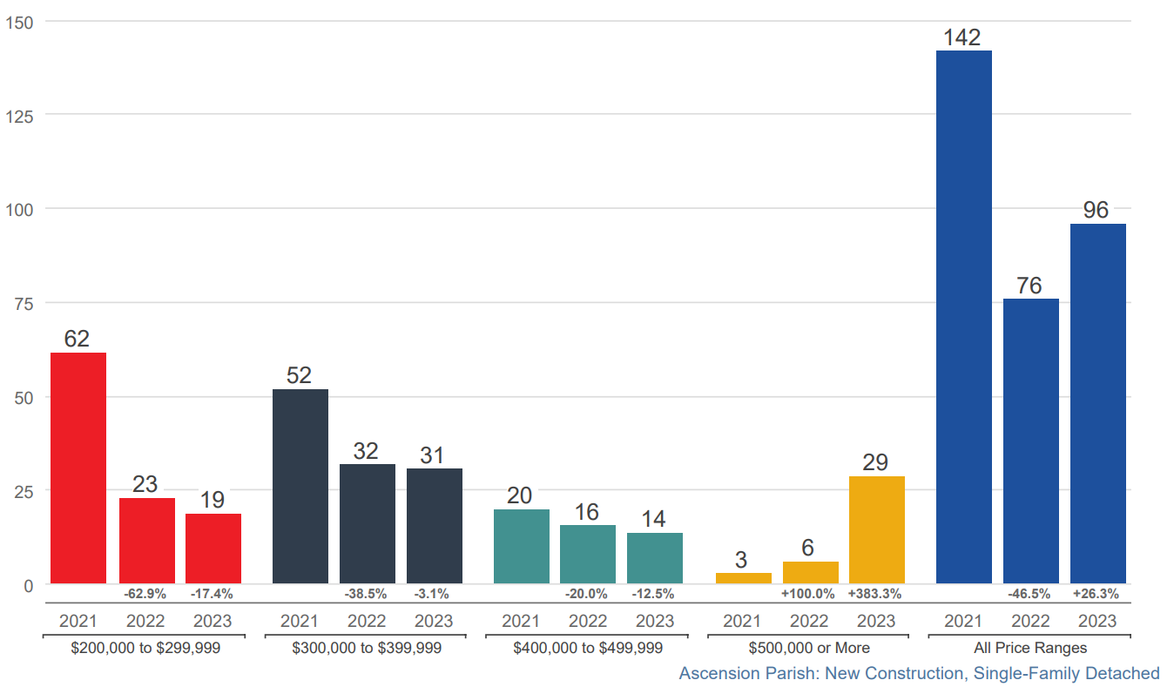
New Homes Listed for Sale Ascension

Slide 34
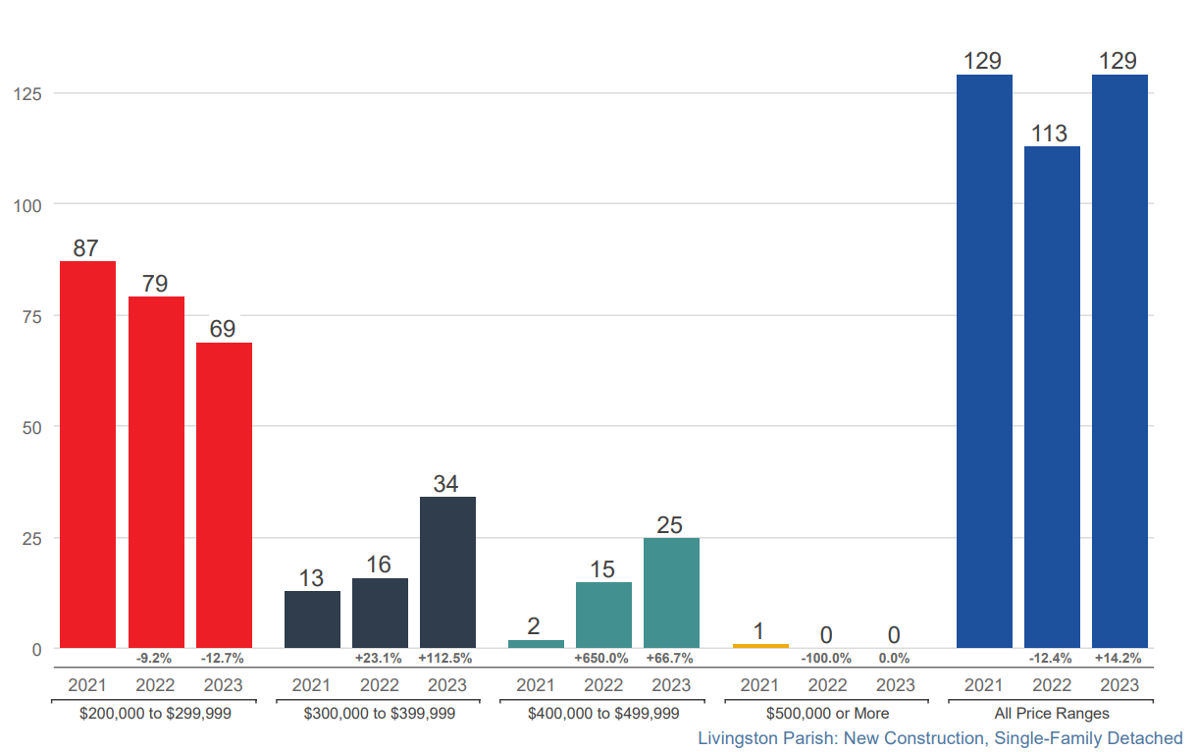
New Homes Listed for Sale Livingston

Slide 35
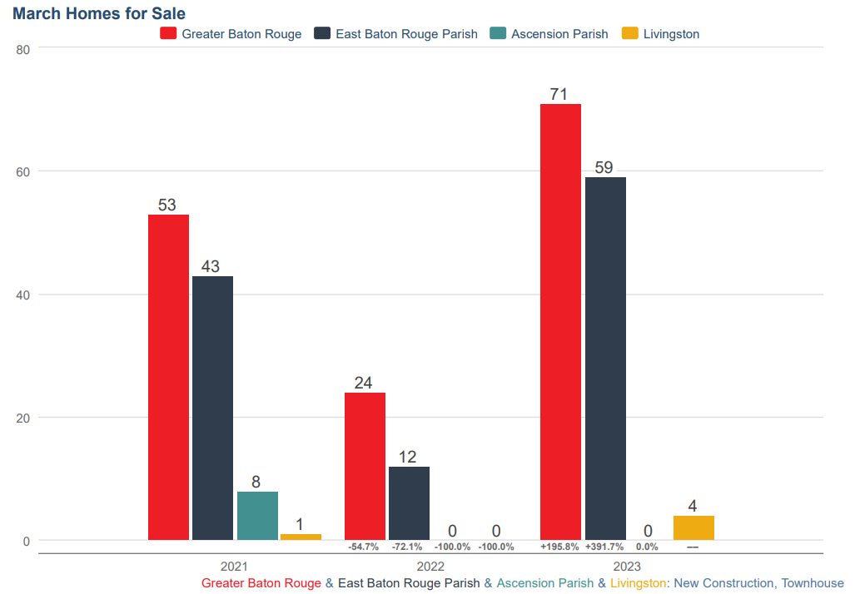
Townhouses Listed for Sale

Slide 36
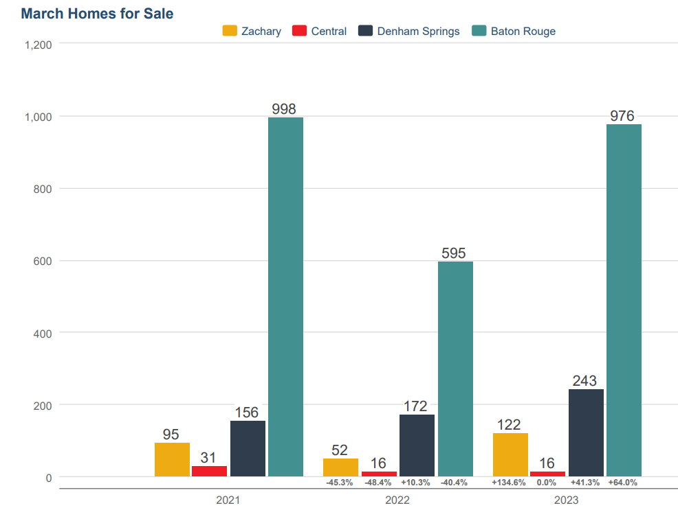
Homes For Sale By City

Slide 37
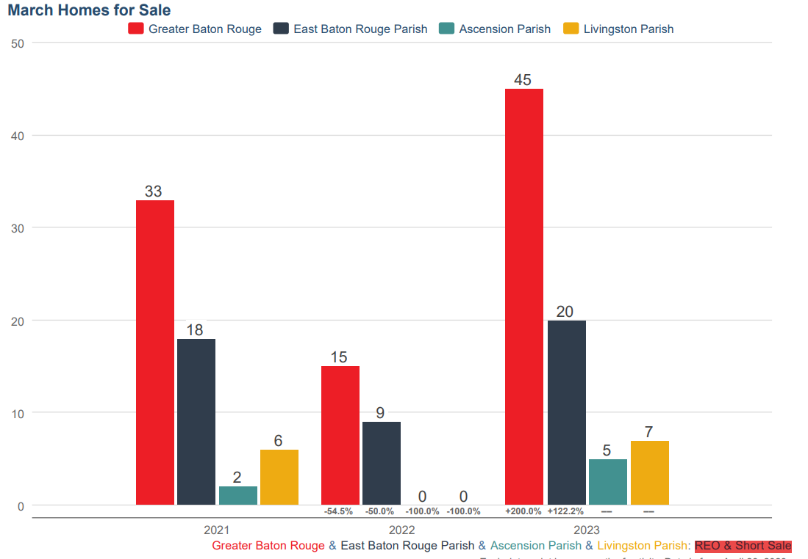
REO and Short Sales

Slide 38
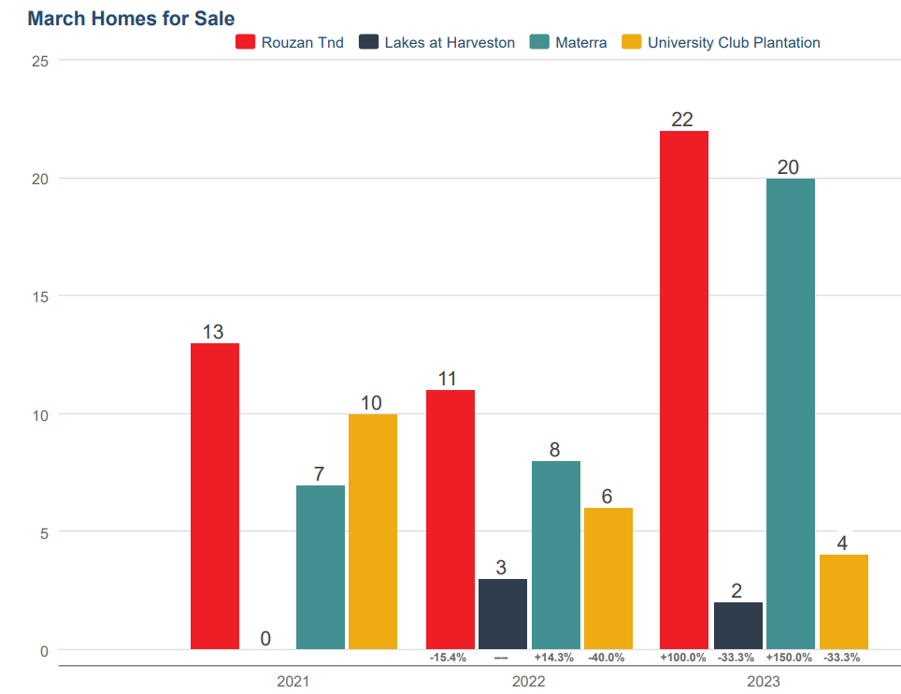
Homes For Sale Sample Subdivision

Slide 39
For well-organized and well-managed home building companies, this decade is going to be the greatest home building opportunity since the 1970s. Charles C. Shinn Ph.D. Shin Consulting the roaring 2020’s

Slide 40
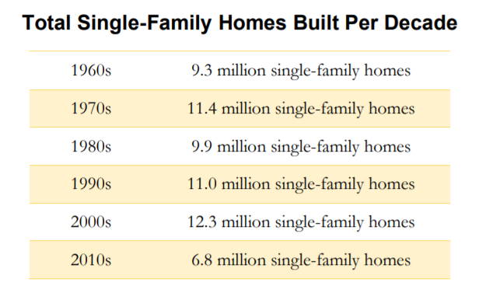

Slide 41
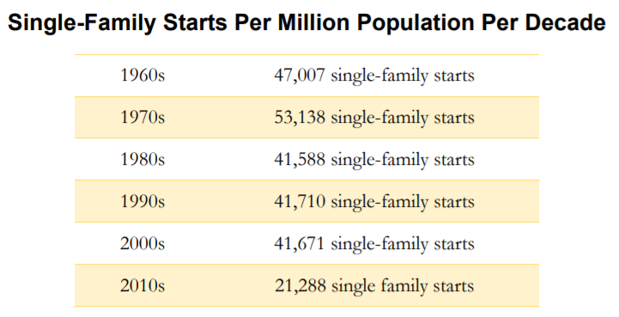

Slide 42
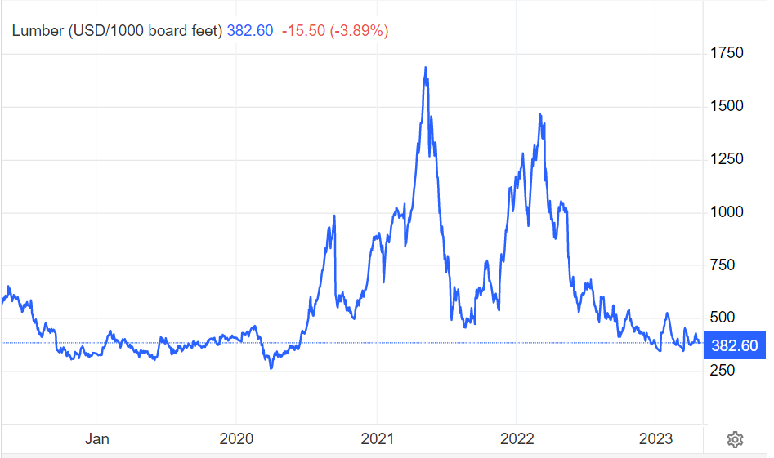
5/2022 High Price $1,686 Per 1000 Board feet
4/2023 $382.60 Per 1000 Board Feet

Slide 43
Predictions 2023
Market Conditions Remain Strong / Viable
Dollar Volume to Decrease in 2023
Median Sale Price To Rise Again
Construction Cost and Inflation Will Push Prices Up
Months Supply Will Fall
Lack of Inventory / Acceptance of Interest Rates

Slide 44
Market Participants Comments
“Developers will Continue to Close Lots”
Contractual Obligation
Fear of the Scarcity of Lot Availability in the future but lots will be taken down more slowly
“RACE to the Bottom / Retch and Rally”
Get Rid of Inventory and Move On
“Land Prices Will Fall / Land Prices Will Rise/ There Is No Land”
“Bankers Need to Help, Interim Interest is DOUBLE”
“November / December Really Bad Months, Feb March was better”
“More and More incentives and Value Engineering”
Lots Will Get More and More Scarce
Development Cost / Competition from Municipalities/ Regulations (Storm Water and Sewer) Difficulty in working with regulating authorities

Slide 45
Market Participants Comments
“I Do not Go to Trends It is for Commercial Agents”
“Home Prices Will fall by 8% to 10%”
“According to Redfin News GBRMSA had the greatest decrease In the USA in pending Sales falling, 62% In 2022” (this is true I checked)
“We looked at 25 deals in Southeast ---- None of them worked”
“Lot Prices have hit a celling builders can only pay so much. We are shifting to rentals Townhouses and Multifamily.”
“Moratoriums have had an impact. Stringent regulations are now the Moratorium.”
“Tom Cook’s Presentations are the best” (this is true I checked)

Slide 46
New Development

Slide 47
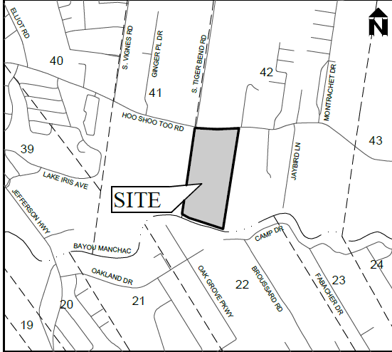
Woodhill
American Homeland Kevin Nguyen
Hoo Shoo Too and South Tiger Bend
Number of Lots: 194
Proposed Development
Closed on Land 4-23
$36,000/ acre
24 Month Development Projected
Lot Price(s) around TBD
Lot Size: 45 to 65 x 120’ to 140’
Home Price Range: Around $500,000
Additional Features:
16- acre Common Area
4-acre Lake
1.26 Acre Water Pond

Slide 48
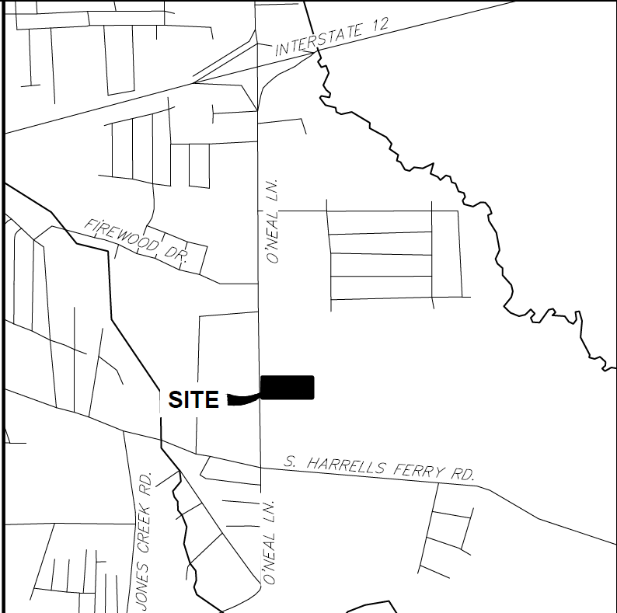
High Cross Townhomes
Tower Capitol for Alvarez Construction O’Neal Lane South of I-12
Number of Lots: 52
Townhouse Attached Construction
Under Construction
Lot Price Sold in Bulk
Lot Size: 25 x 90
Home Prices $250k to $275k

Slide 49
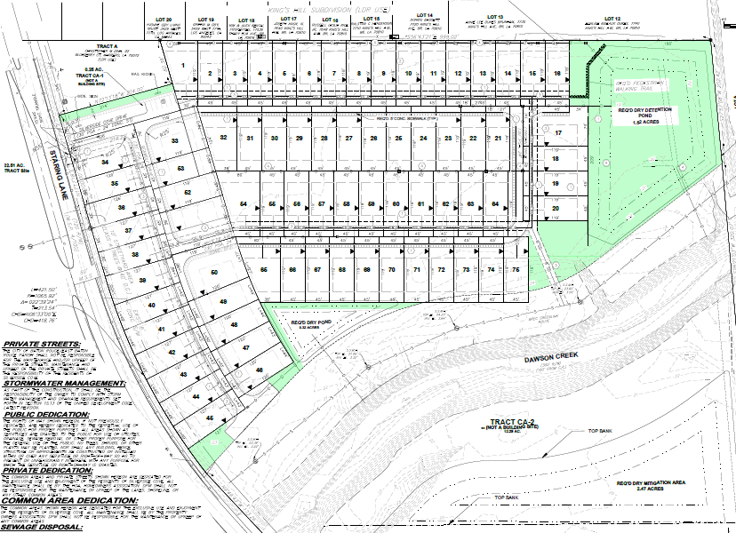
Silverside Cove
Alvarez Construction
Location: Staring Lane South of Perkins
Art Lancaster and Tower Capital
Lot Count: 75
Lot Size: 45’ x 120’
Home Size: 1700 sqft to 2500 sqft
Home Price: $275,000 to $350,000
Market Date: Under Construction Clearing

Slide 50
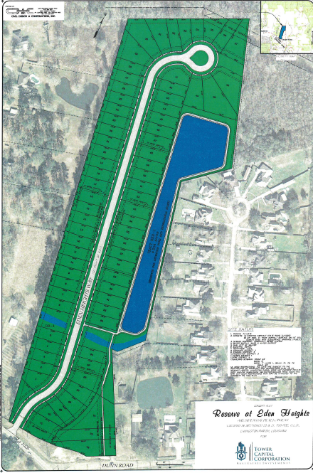
Eden Way
Tower Capitol / Alvarez Construction
Dunn Road / Lockhart Rd Livingston
Number of Lots: 73 SFR
Under Construction
Lot Size: 60 x 130
Bulk Sales: $55,000 to $65,000/ lot
Home Price Range: $250k to $350k

Slide 51
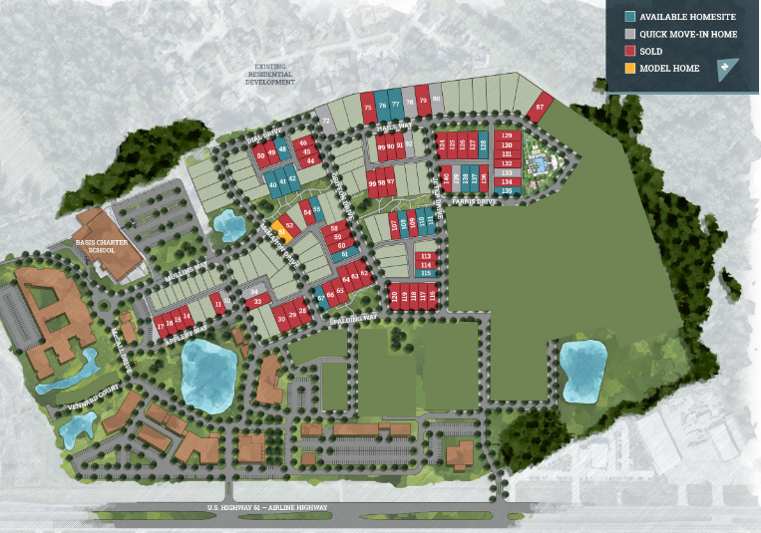
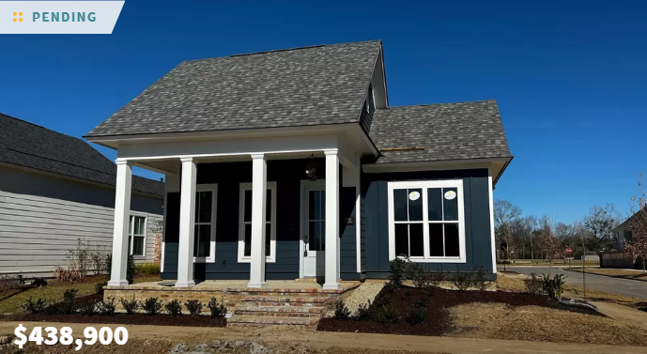
Materra Phase 2
Woman’s Hospital
Number of Lots: 92 SFR
Under Construction
Lot Size: Variers
Home Price Range: $400k to $700k

Slide 52
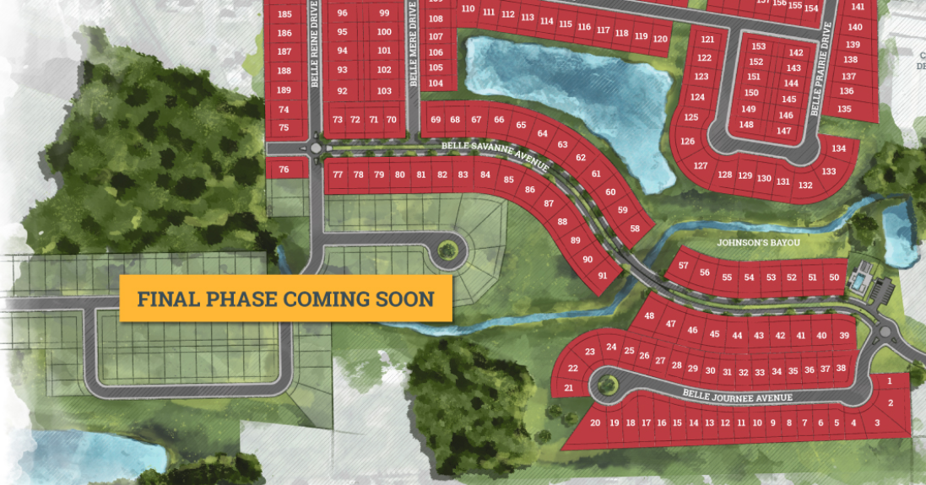
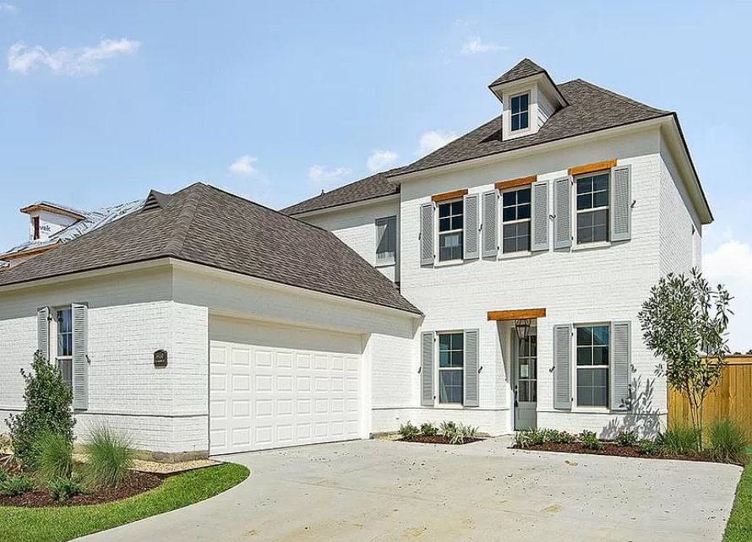
Belle Savanne At Dutchtown | Level Homes
3RD And Final Phase Now Selling
Location: Off Old Jefferson Geismar, Louisiana
Lot Count: 284 total; 95 lots in the final phase
Home Size: 2,200 to 3,200 Phase 1 and Phase 2
Last Years Advertised Home Price: $300,000 to $450,000
Now Selling from the $360,000’s AND UP
Additional Features/Amenities: Resort-style community pool and cabana — NOW OPEN. Walkable community with scenic lakes and green space. Note: Phase 1 and Phase 2 SOLD OUT

Slide 53
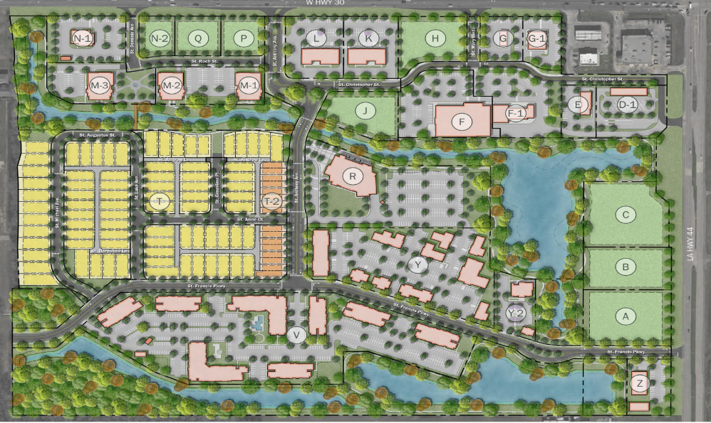
Heritage Crossing
Double D of Louisiana
LA Hwy 44 and LA Hwy 30 Ascension
Number of Lots: 79 SFR and 17 TH
Under Construction
Closed on Land 4-23
Multifamily The Waters Edge 300 units
Retail Development Completed
Office 60,000 sqft
Lot Size: 45 to 55 x 120’ to 140’
Bulk Sales: $97,500 Per lot
Home Price Range: Around $500,000
Additional Features: TND Town Center

Slide 54
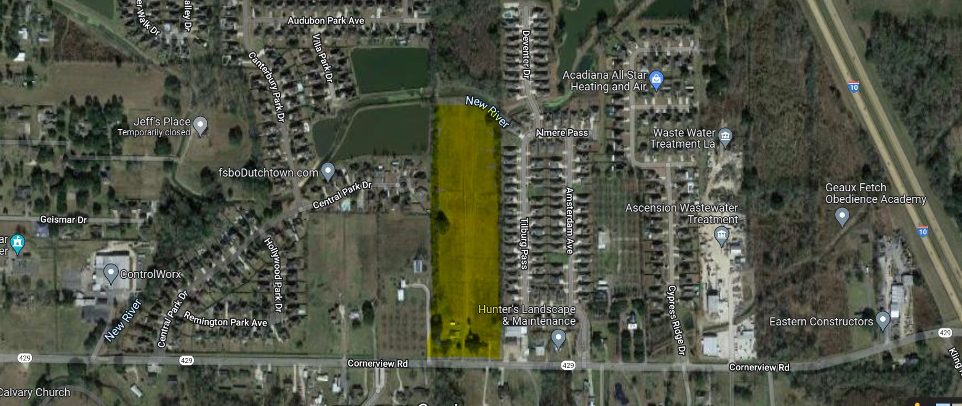
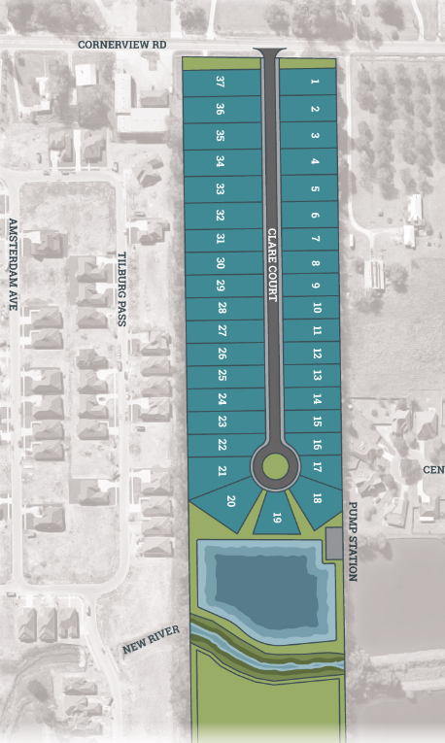
Clare Court | Level Homes
Location: On Cornerview Rd., Prairieville, Louisiana
Lot Count: 37
Home Size: 1900 sqft to 2500 sqft 15 Available Floor Plans
Home Price: Coming Soon
Market Date: Now Selling
Additional Features/Amenities: Premium water-front homesites

Slide 55
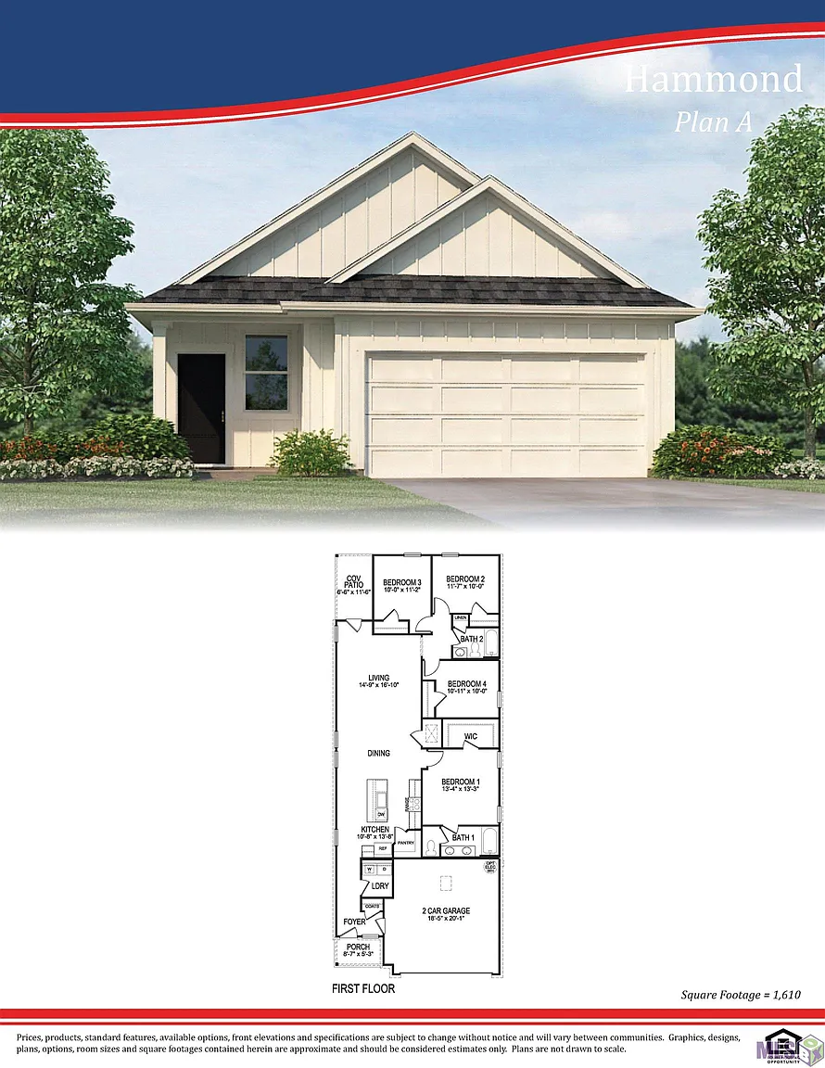
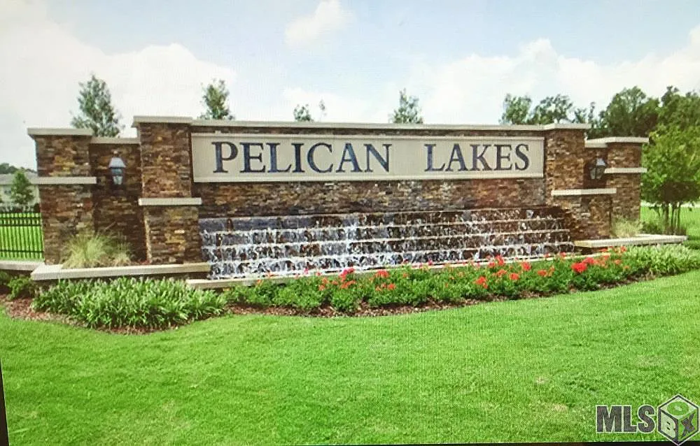
Pelican Lakes| D.R. Horton
New Phase Coming Soon: July 2023
Location: Baton Rouge off Burbank
Total lots: 122
Lot Sizes: 40 X 110
Home Sizes: 1,380 – 1,610 sq. ft. living area
Home Prices $270,000 to $320,000
Features: Ponds, playground, pool and clubhouse

Slide 56
Delaune Estates | Level Homes
New Community Coming Soon!
• Location: Hwy 73 Near I-10 Prairieville, Louisiana
• Lot count: 245
• Home Price: coming soon
• Home Size: 1,757 to 3,210 SF
• Market Date: late 2023
• Additional Features/Amenities:
• Premium water-front homesites

Slide 57
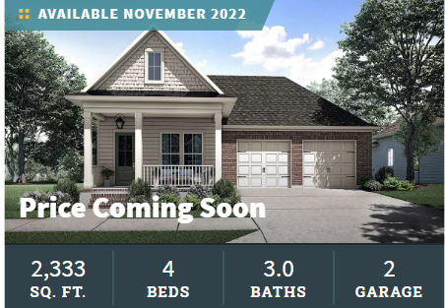
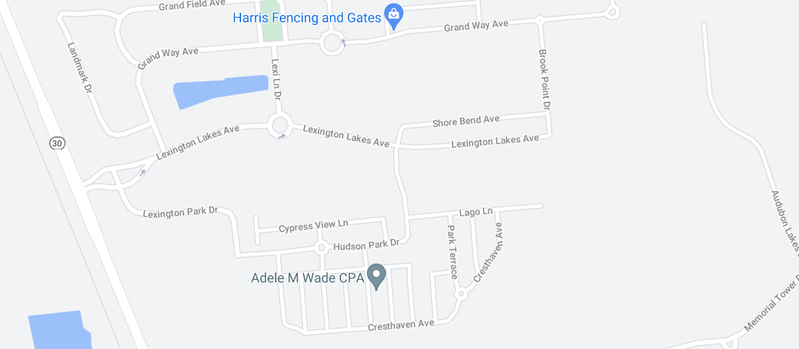
WATER’S EDGE | Level Homes
New Community!
Location: Baton Rouge, Louisiana — Inside Lexington Estates
Lot Count: 76 In Phase 1
Home Price: From $410s Last Year $300,000s
Home Size: 1,670 To 2,600 SF
Market Date: NOW SELLING
Additional Features/Amenities: Gated community with lakes and green space. Resort-style community pool and cabana, located near major golf course, L’Auberge Casino, shopping, dining, and entertainment. Premium water-front homesites

Slide 58
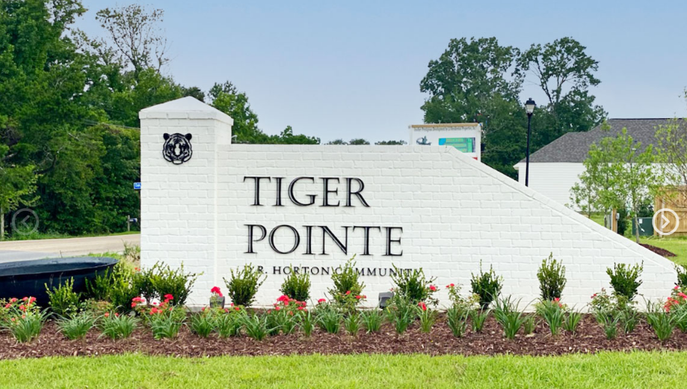
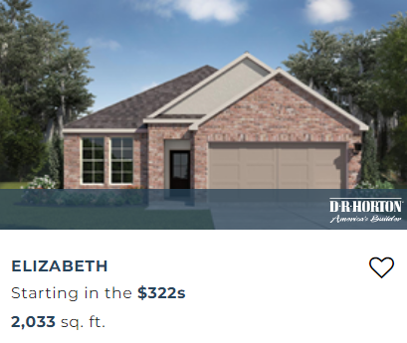
Tiger Pointe | D.R. Horton
Location: Baton Rouge off Tiger Bend
Total lots: 52
Lot Sizes: 40 x 135 & 35 x70
Home Sizes: 1,858 - 2,532 sq. ft. living area
Home Price Range: Starting in the $300,000s
Features: Pond, community green space, sidewalks, and curb and gutter.

Slide 59
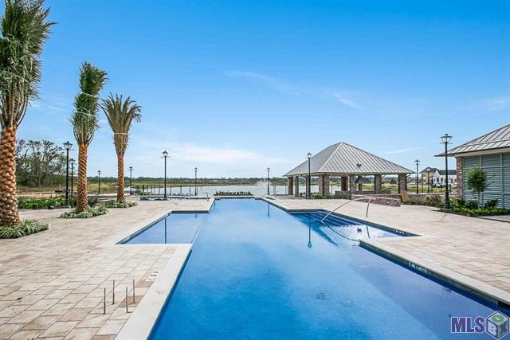
Lakes at Harveston | John Fetzer and Mike Wampold
Number of Lots: 186
From 3-11-2022 to 4-25-2022: 11 Home Sales Reported to MLS March of 2023 Closed 5 sales
Price Per Square Foot $264.18 to $317.77
Median Home Price Per Square Foot $2743 2022
Median Home Price Per Square Foot $292 2023
Lot Price(s) from $120,000 to $130,000
Lot Size: 45 to 65 x 120’ to 140’
Home Size: 2,000 to 3,000 Square Foot
Home Price Range: $590,000 to $1,100,000
Additional Features:
Community Center overlooking the 50- acre Harveston Lake with fountains
Community Building
Fitness Center
Cabana with Grill
Pool and Splash Pad
Mail Center
Multi-Use Trails and Walks

Slide 60
THANK YOU

