Slide 1
BATON ROUGE
INDUSTRIAL MARKET
PRESENTED BY
Evan Scroggs, SIOR, CCIM
Managing Principal
Lee & Associates
escroggs@lee-associates.com

Slide 2
INDUSTRIAL COMMITTEE MEMBERS
Evan Scroggs, SIOR, CCIM
Chairman
Lee & Associates
Scot Guidry, CCIM
Mike Falgoust & Associates
Todd Pevey, MPA
St. John Properties
Grey Mullins, CCIM
Grey Mullins Commercial Properties
Brent Garrett, CCIM, SIOR
Beau Box Commercial Real Estate
David Lakvold, MAI, SRA
The Lakvold Group
Alex McCollam
NAI Latter & Blum
Lance Ginn, CCIM
Beau Box Commercial Real Estate

Slide 3
Last Year’s Outlook
Vacancy will fall below 3% possibly lower
Rental rates will continue to increase
Sale Prices will remain high - $120 - $140/SF will become the norm
Cap Rates will remain low but rising interest rates could finally begin to move cap rates up
Headwinds - Construction costs both on new construction and for TI and rising interest rates

Slide 4
2023 Industrial Trends
Defining the Dataset (Geography and Type)
National Trends
Local Trends
Developing Demand Drivers
A Case Study to Consider
Notable Projects
Outlook

Slide 5
The Dataset
(Geography and Type)

Slide 6
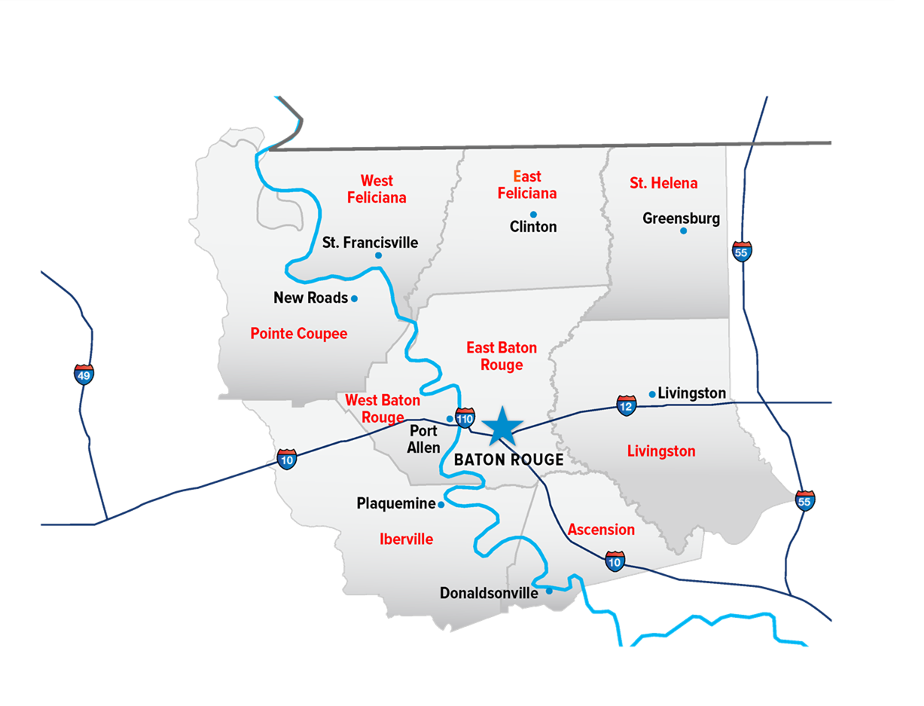
Baton Rouge MSA

Slide 7
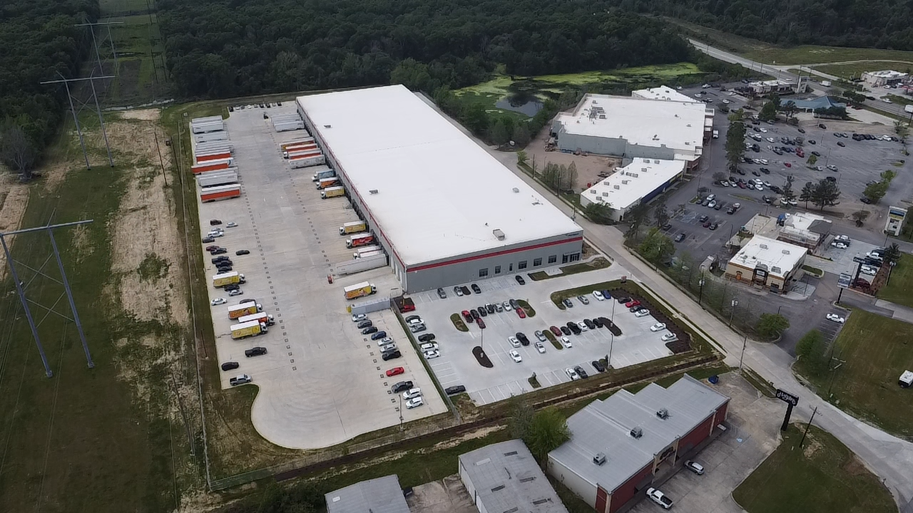
Bulk Warehouse/Distribution

Slide 8
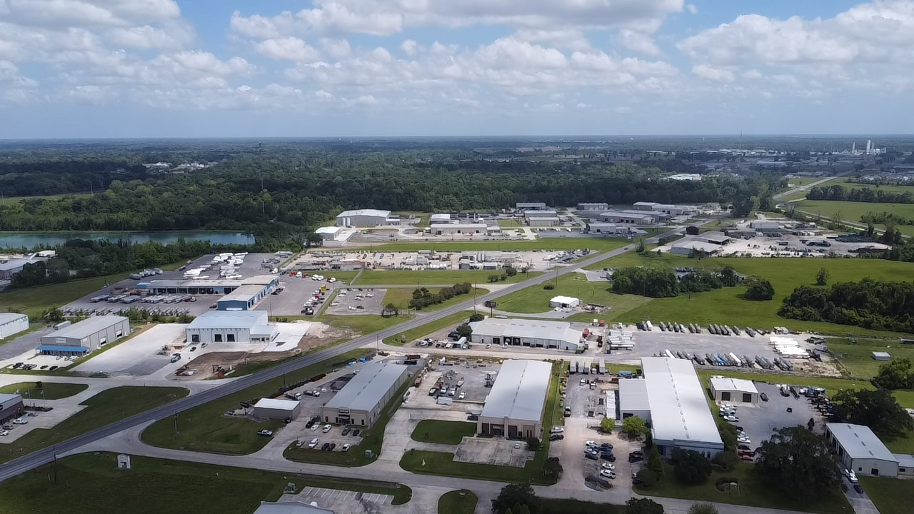
Office-Warehouse

Slide 9
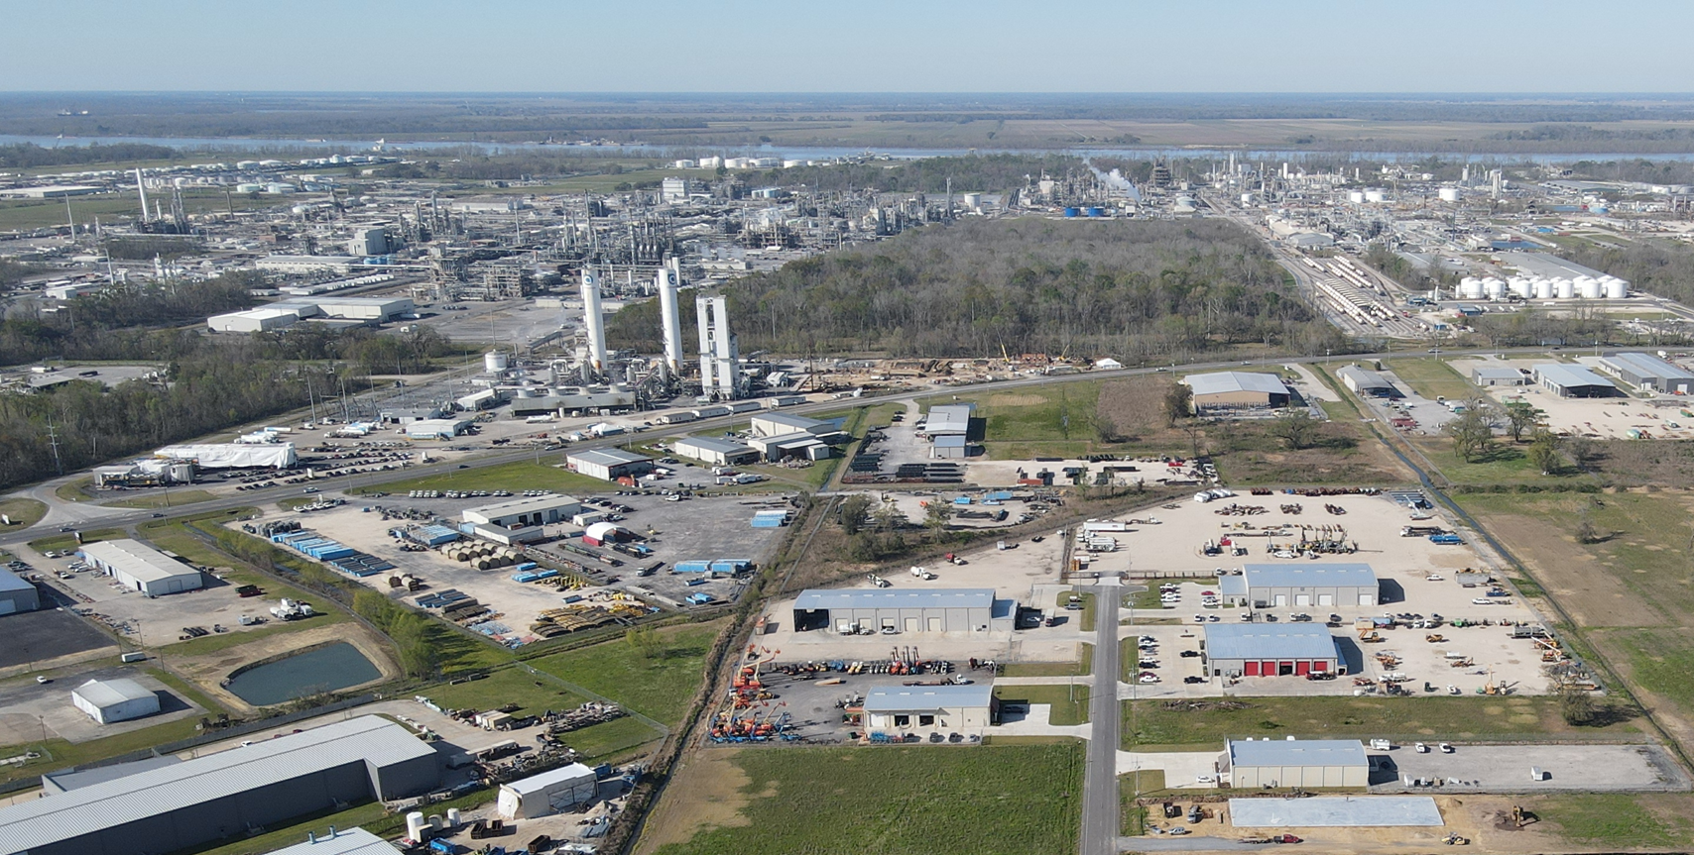
Office-Warehouse

Slide 10
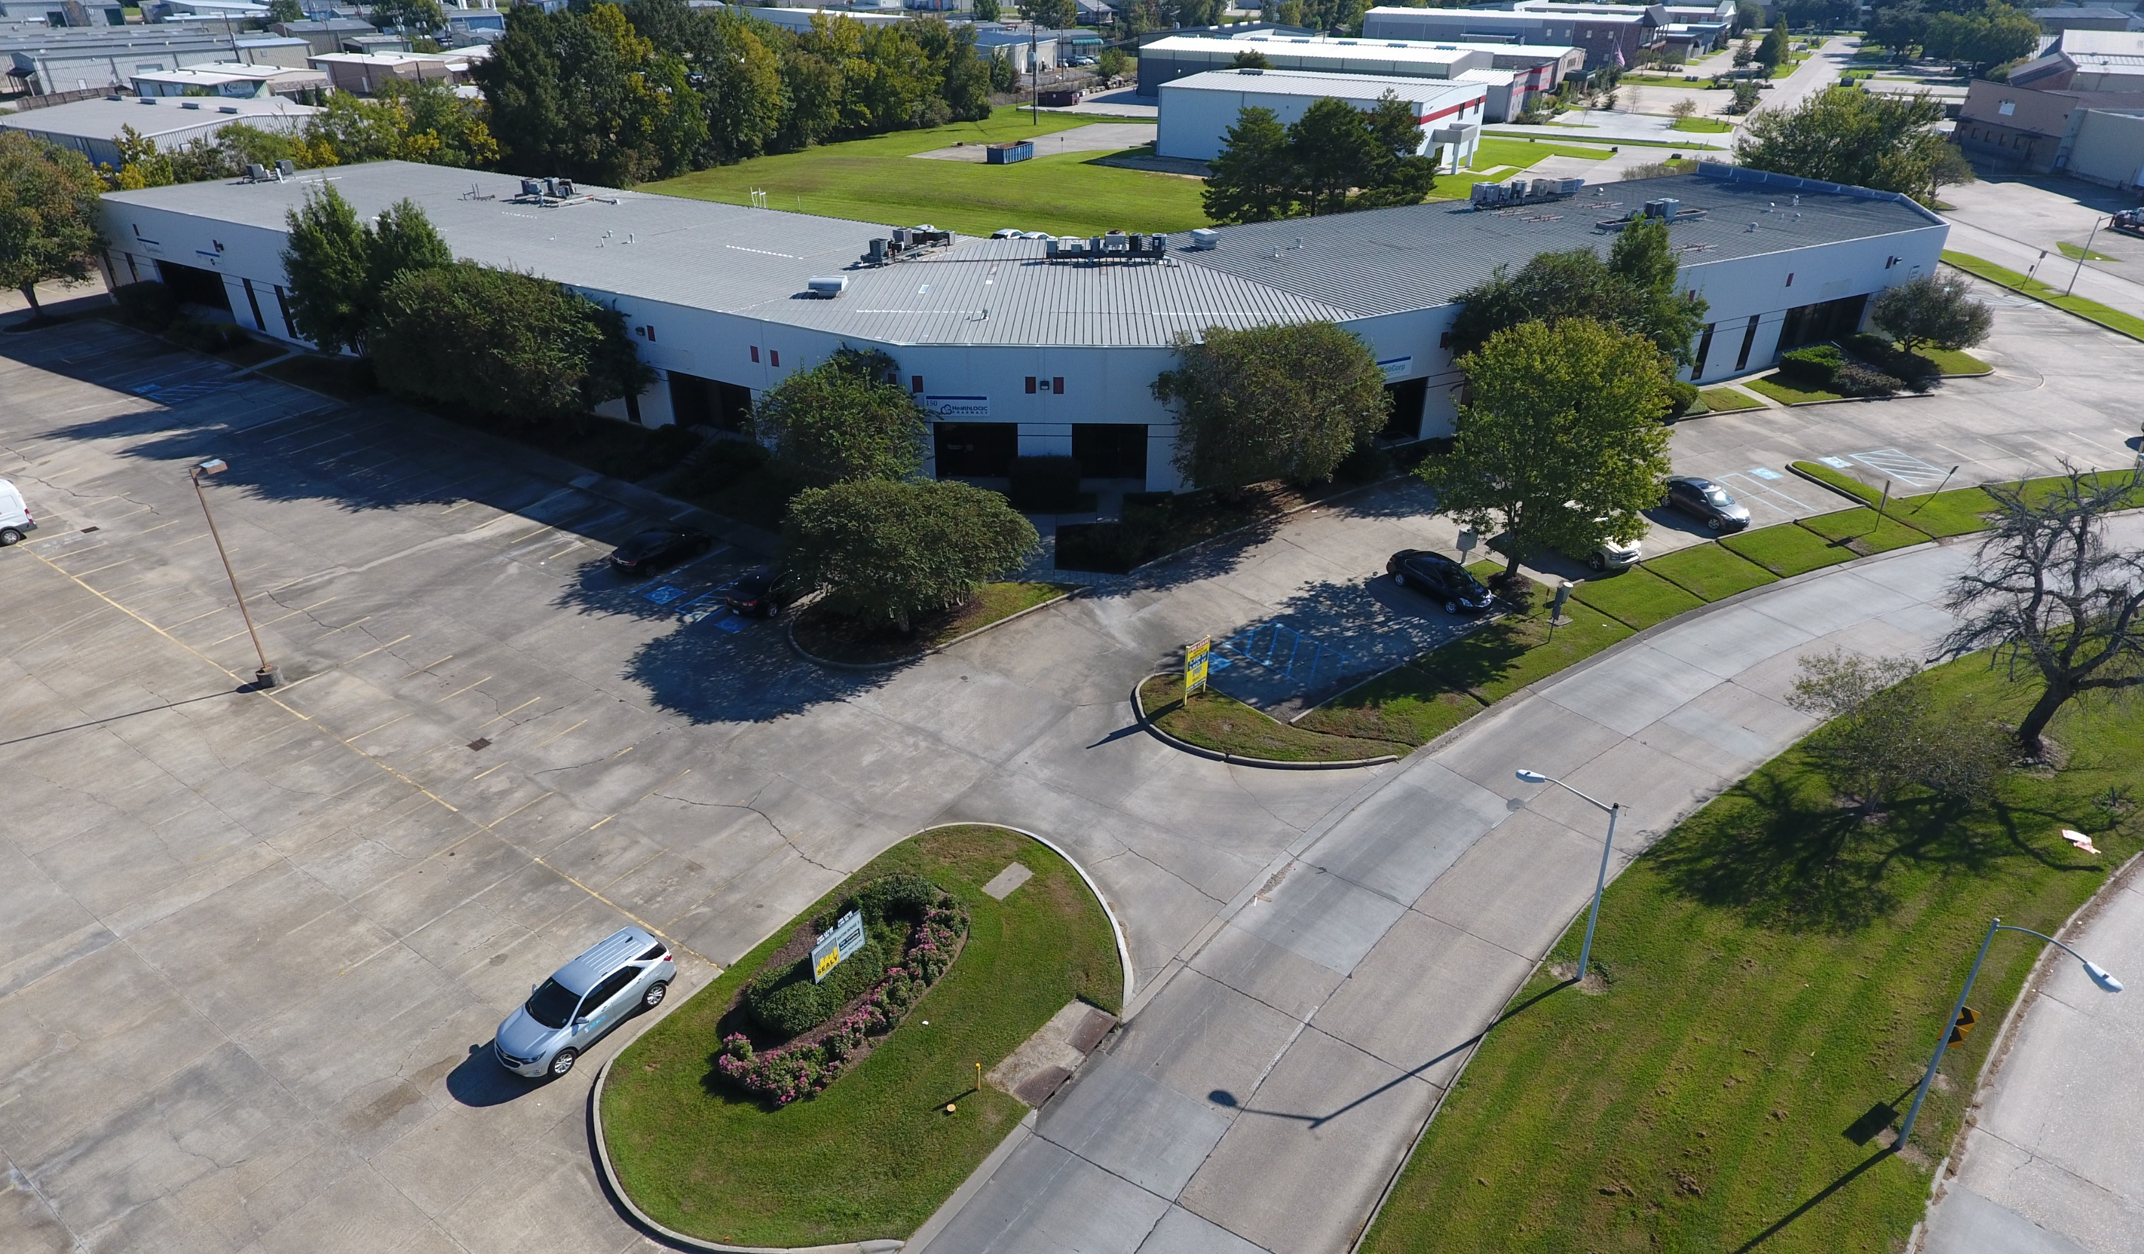
Flex Space

Slide 11
National Trends

Slide 12
Record Low Vacancy Rate (2.9%) reached in Q2 of 2022.
National Vacancy Rate was 3.3% at the end 2022.
Seven straight quarters of declining vacancy
Four consecutive quarters of record setting vacancy.
477.3M SF of net absorption. (2021:561.4M)
495M SF of completions – an all time high
682.6M SF currently under construction
18.6% rent growth
Cap Rates are still low and not keeping pace with rising interest rate.

Slide 13
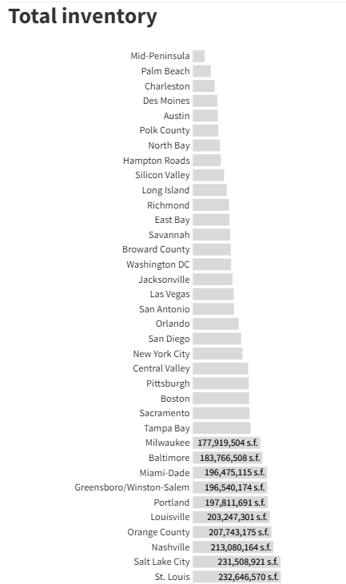
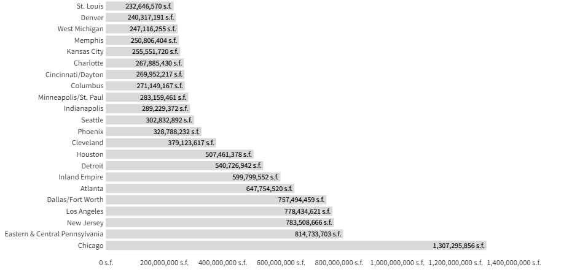
Baton Rouge – 36.58M
507M
647M
757M
Dallas – 48M in new construction deliveries in 2022
Atlanta – 45M in new construction deliveries in 2022

Slide 14
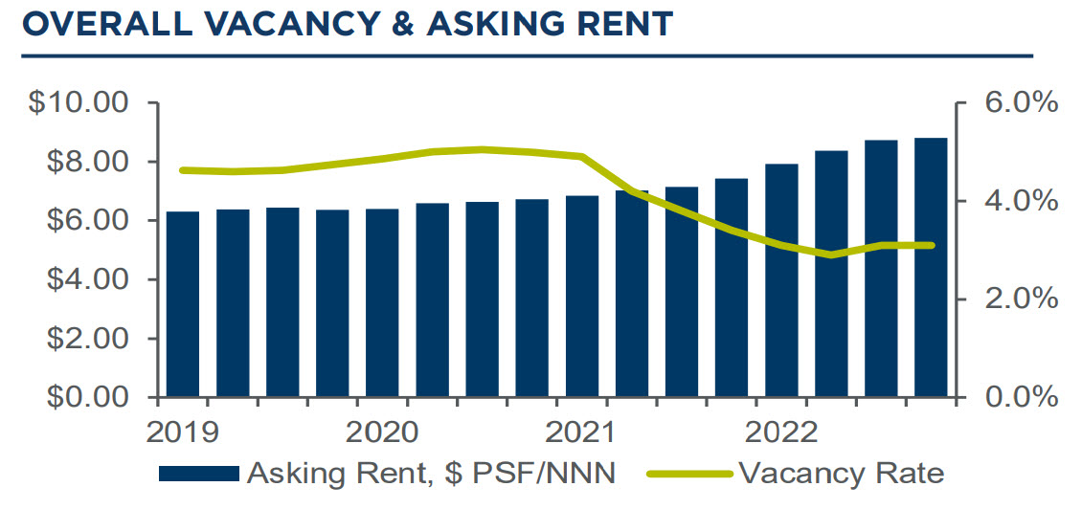
National Vacancy and Rent Trends

Slide 15
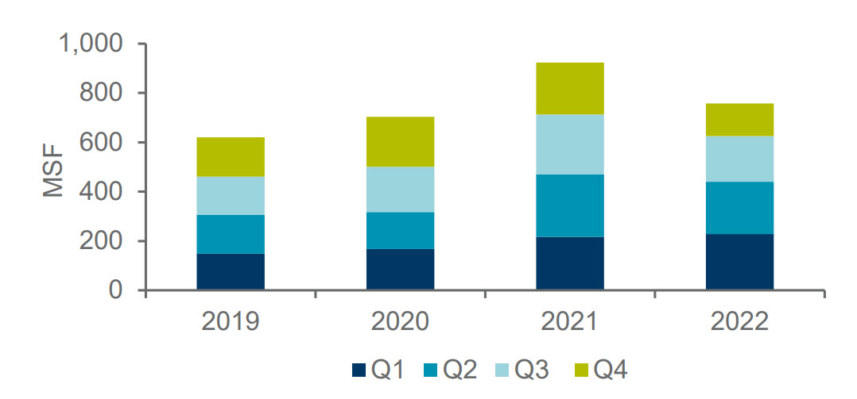
New Leasing Activity

Slide 16
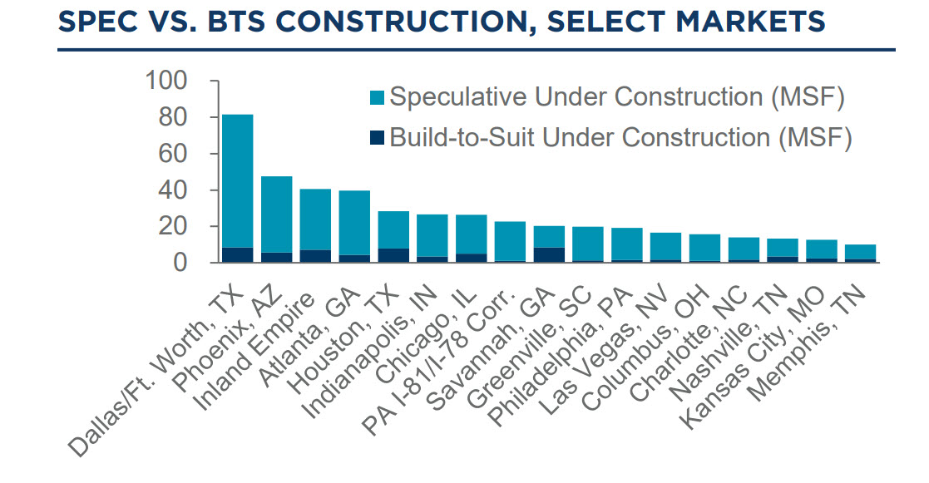

Slide 17
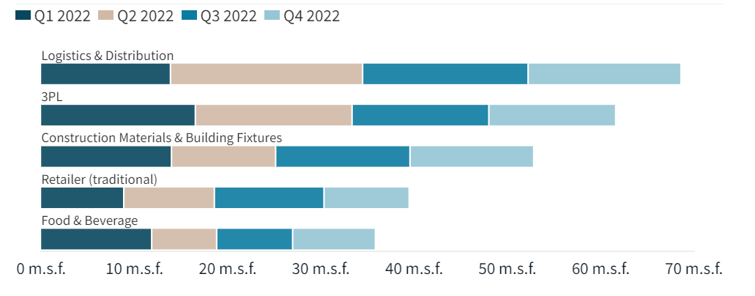
Leasing Activity Trend

Slide 18
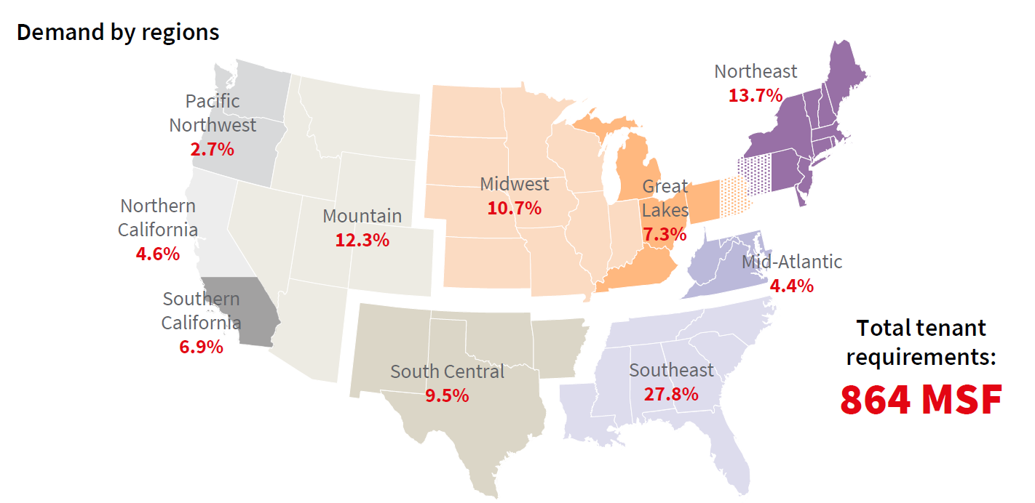
Leasing Activity Trend

Slide 19
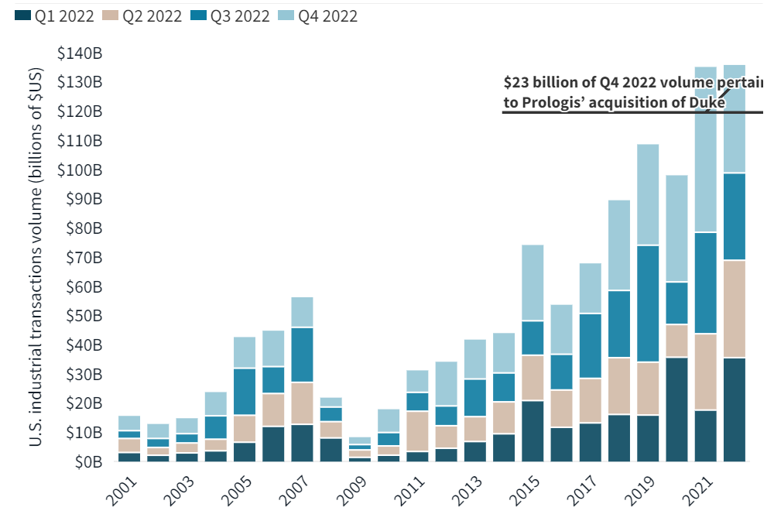
Industrial Transaction Volume

Slide 20
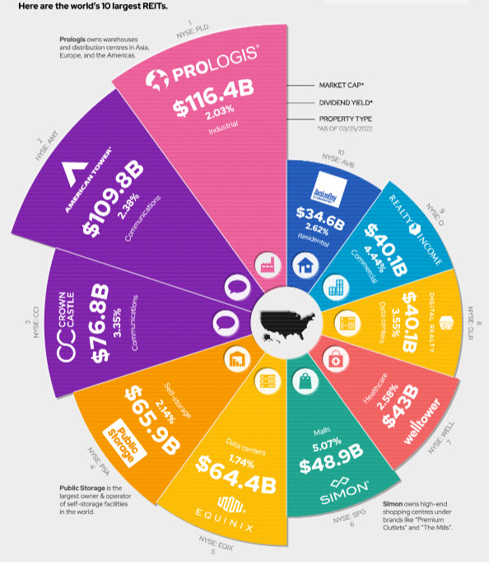
Largest REIT in the world is PROLOGIS
Only own industrial assets – primarily distribution warehouse
The $116.4B was prior to the $23B Duke acquisition.
Industrial Real Estate has evolved into a/the preferred asset class for institutional capital.

Slide 21
Local Trends

Slide 22
Second Consecutive Year with Record Low Vacancy Rate (1.97%)
Nearly 5.0M SF of net absorption
Less than 100K SF under construction at the end of 2022.
Cap Rates are still compressed, and good assets are still hard to find
Chronically underbuilt
Rental Rates are seeing significant increases.

Slide 23
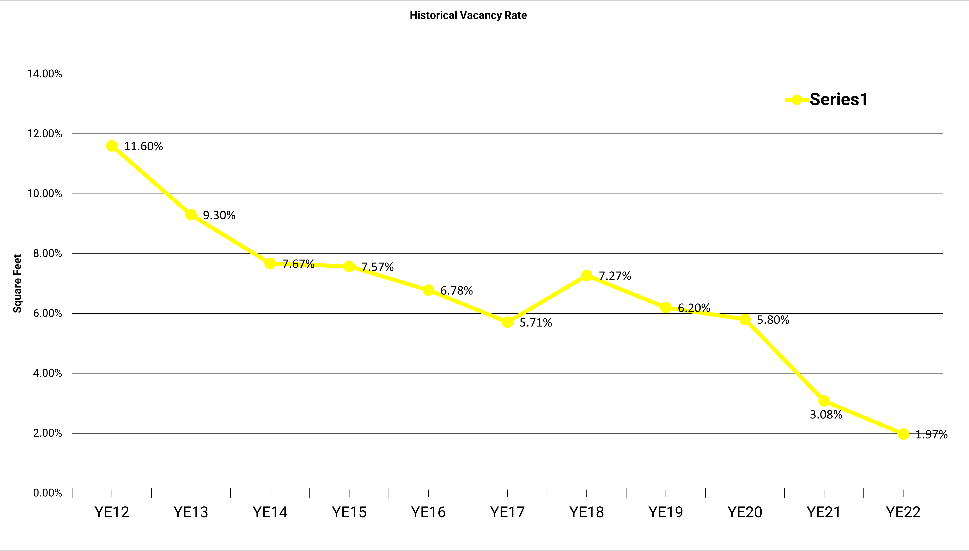
Vacancy Rate Trends

Slide 24
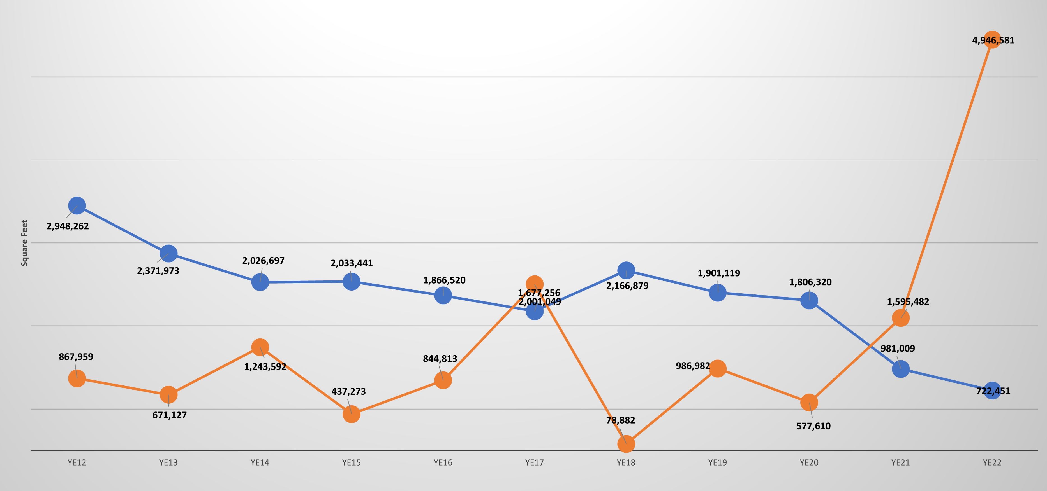
Historical Vacancy vs. Absorption
Vacancy
Absorption

Slide 25
Construction vs. Absorption
Year | Annual Construction | Annual Absorption | Surplus/Defiecit
2013 | 738,459.00 | 671,127.00 | 67,332.00
2014 | 969,344.00 | 1,243,592.00 | (274,248.00)
2015 | 204,892.00 | 437,273.00 | (232,381.00)
2016 | 2,122,199.00 | 844,813.00 | 1,277,386.00
2017 | 533,752.00 | 2,001,049.00 | (1,467,297.00)
2018 | 478,433.00 | 78,882.00 | 399,551.00
2019 | 684,459.00 | 986,982.00 | (302,523.00)
2020 | 843,035.00 | 577,610.00 | 265,425.00
2021 | 4,608,585.00 | 1,595,482.00 | 3,013,103.00
2022 | 286,991.00 | 4,946,581.00 | (4,659,590.00)
Average | 1,147,014.90 | 1,338,339.10 | (191,324.20)

Slide 26
Rent Growth
Lack of supply is driving rental rate increases
This is compounded by rising construction costs
And the triple whammy is rising interest rates leading to higher debt service costs.
The new normal - $12.00 - $15.00/SF rates on Office Warehouses
$10.00 - $12.00/SF on Distribution
Will tenants pay???

Slide 27
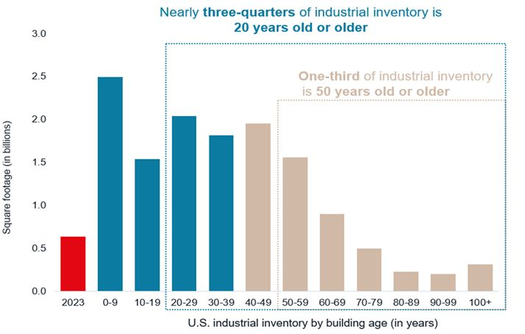
Aging Inventory

Slide 29
Developing Demand Drivers

Slide 30
What’s driving demand?
Petro Chem is still the driving force for demand from service and supply companies
Petro Chem crossover and move into off site bulk warehouse
Amazon/e-commerce
Food and Beverage
Healthcare/Medical
Logistics and Distribution
Reshoring of Manufacturing

Slide 31
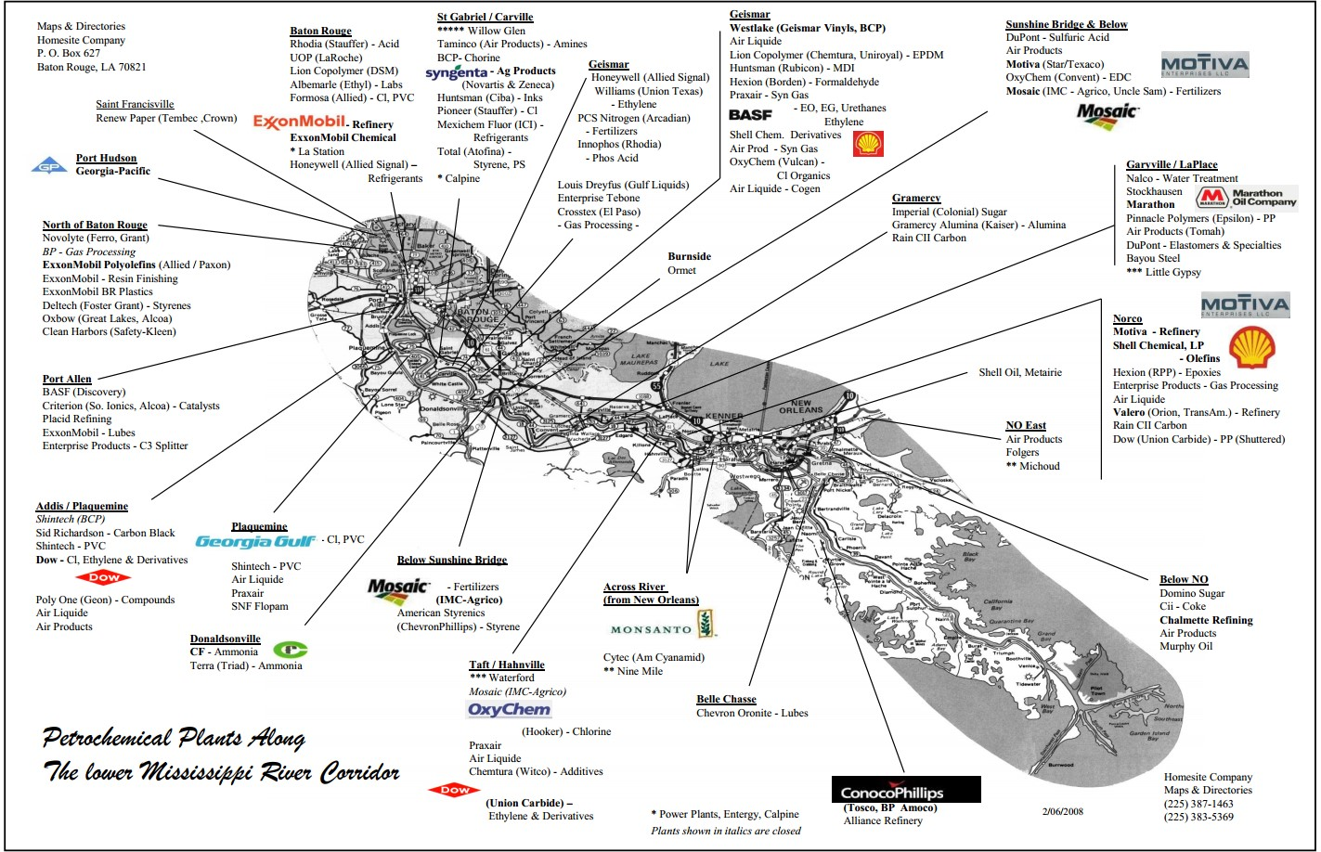

Slide 32
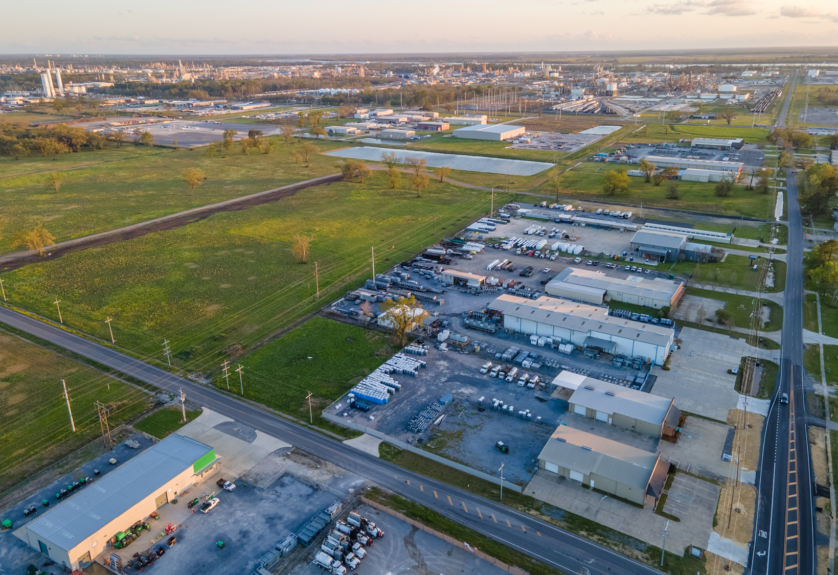

Slide 33
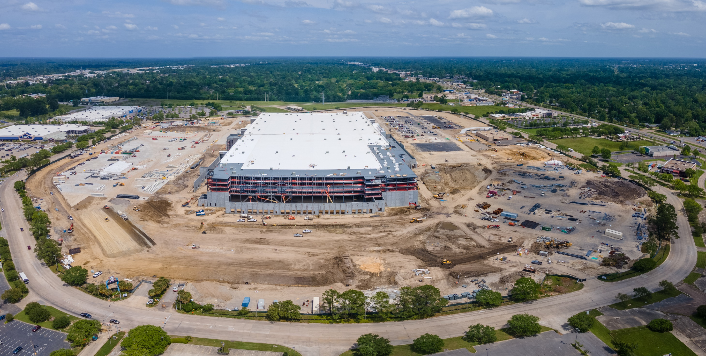
Amazon – 3,800,000 SF

Slide 34
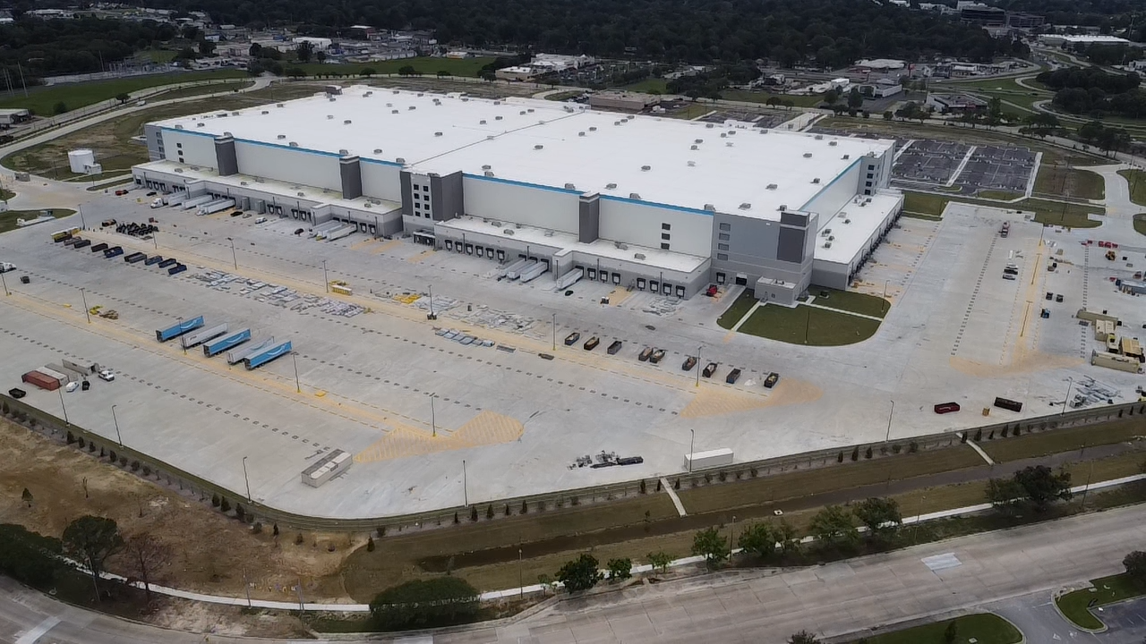

Slide 35
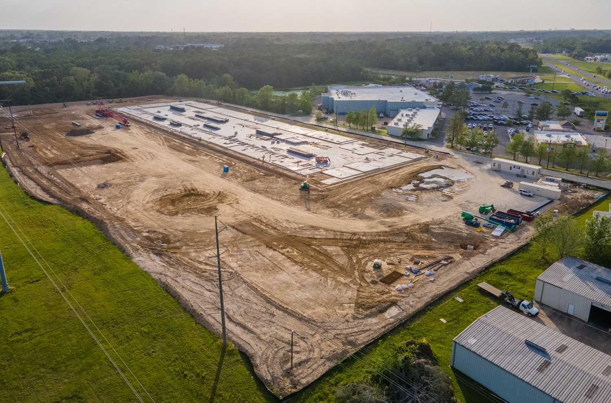
Frito-Lay – 150,000 SF
Completion: Q1 2023

Slide 36
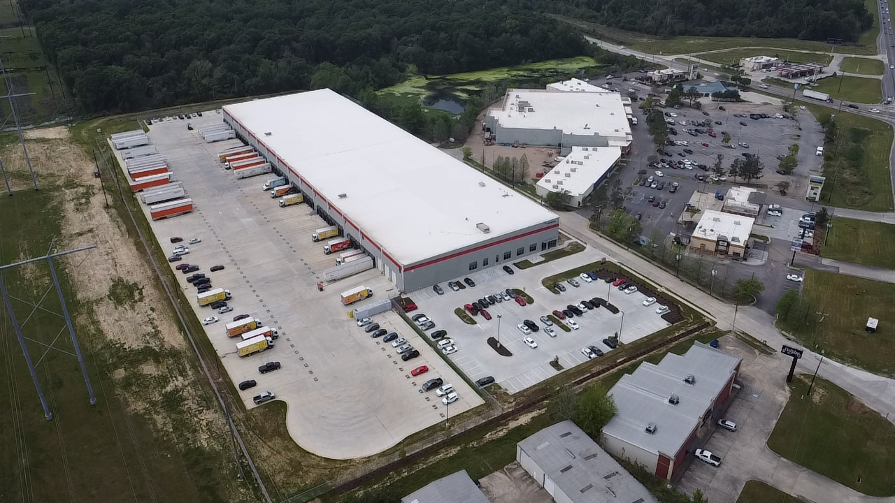
Frito-Lay – 150,000 SF
Completed: Q1 2023

Slide 37
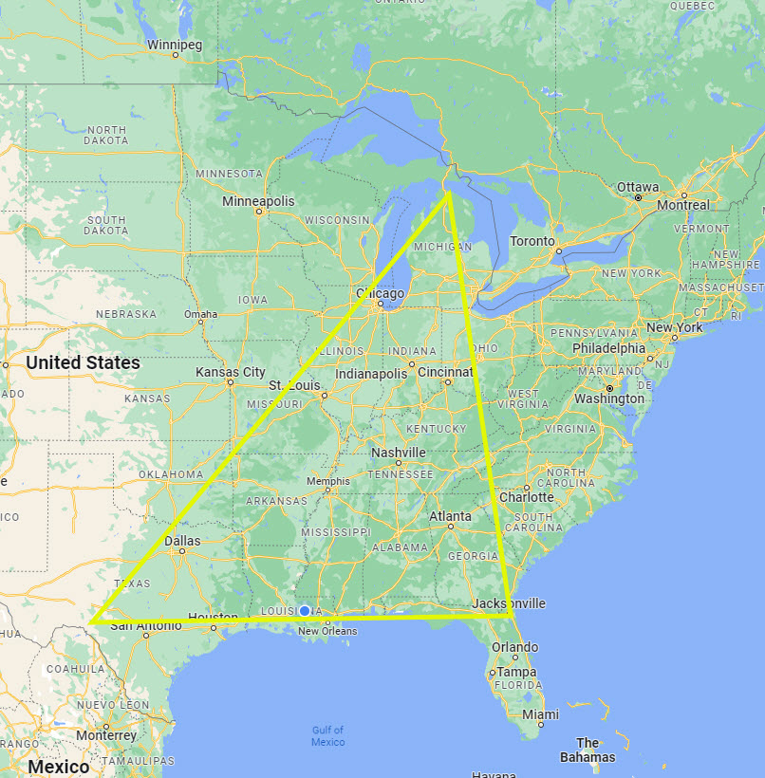
Reshoring of Manufacturing
Companies looking to bring their manufacturing to North America from China and Southeast Asia.
Stability and certainty are the driving forces
Estimated that 350K jobs have or will be created with reshore announcements made to date.
The Golden Triangle and Northern Mexico look to benefit the most
EV, EV components, batteries and microchips

Slide 38
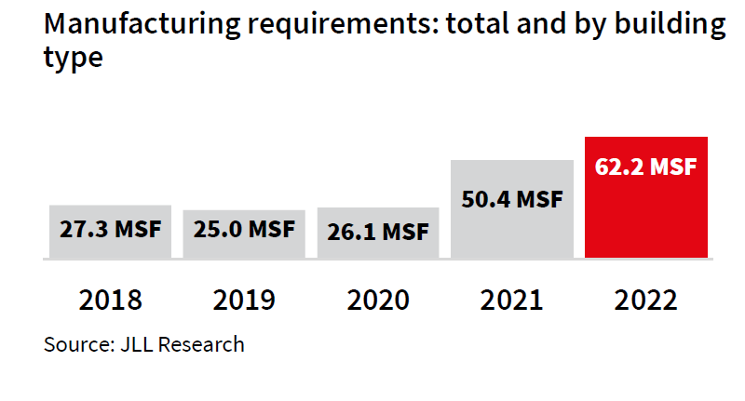

Slide 39
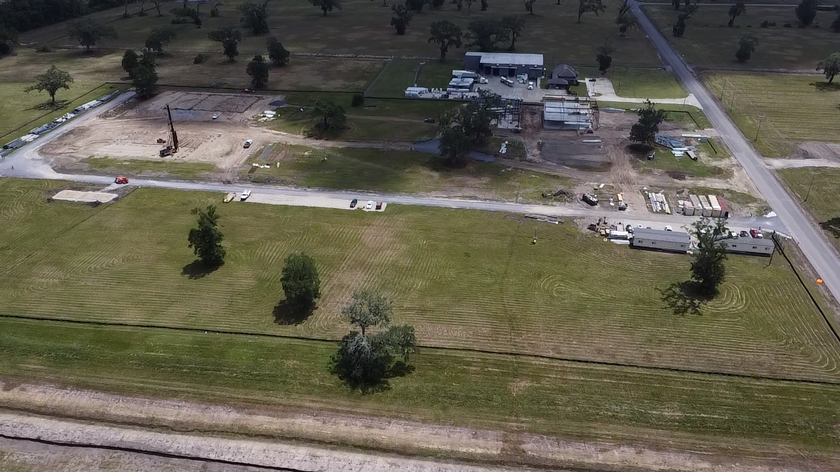
More Manufacturing
Skyfall Biologicals
$35M Manufacturing Facility
Manufacturing an insect repellant and a preservative for storing potatoes

Slide 40
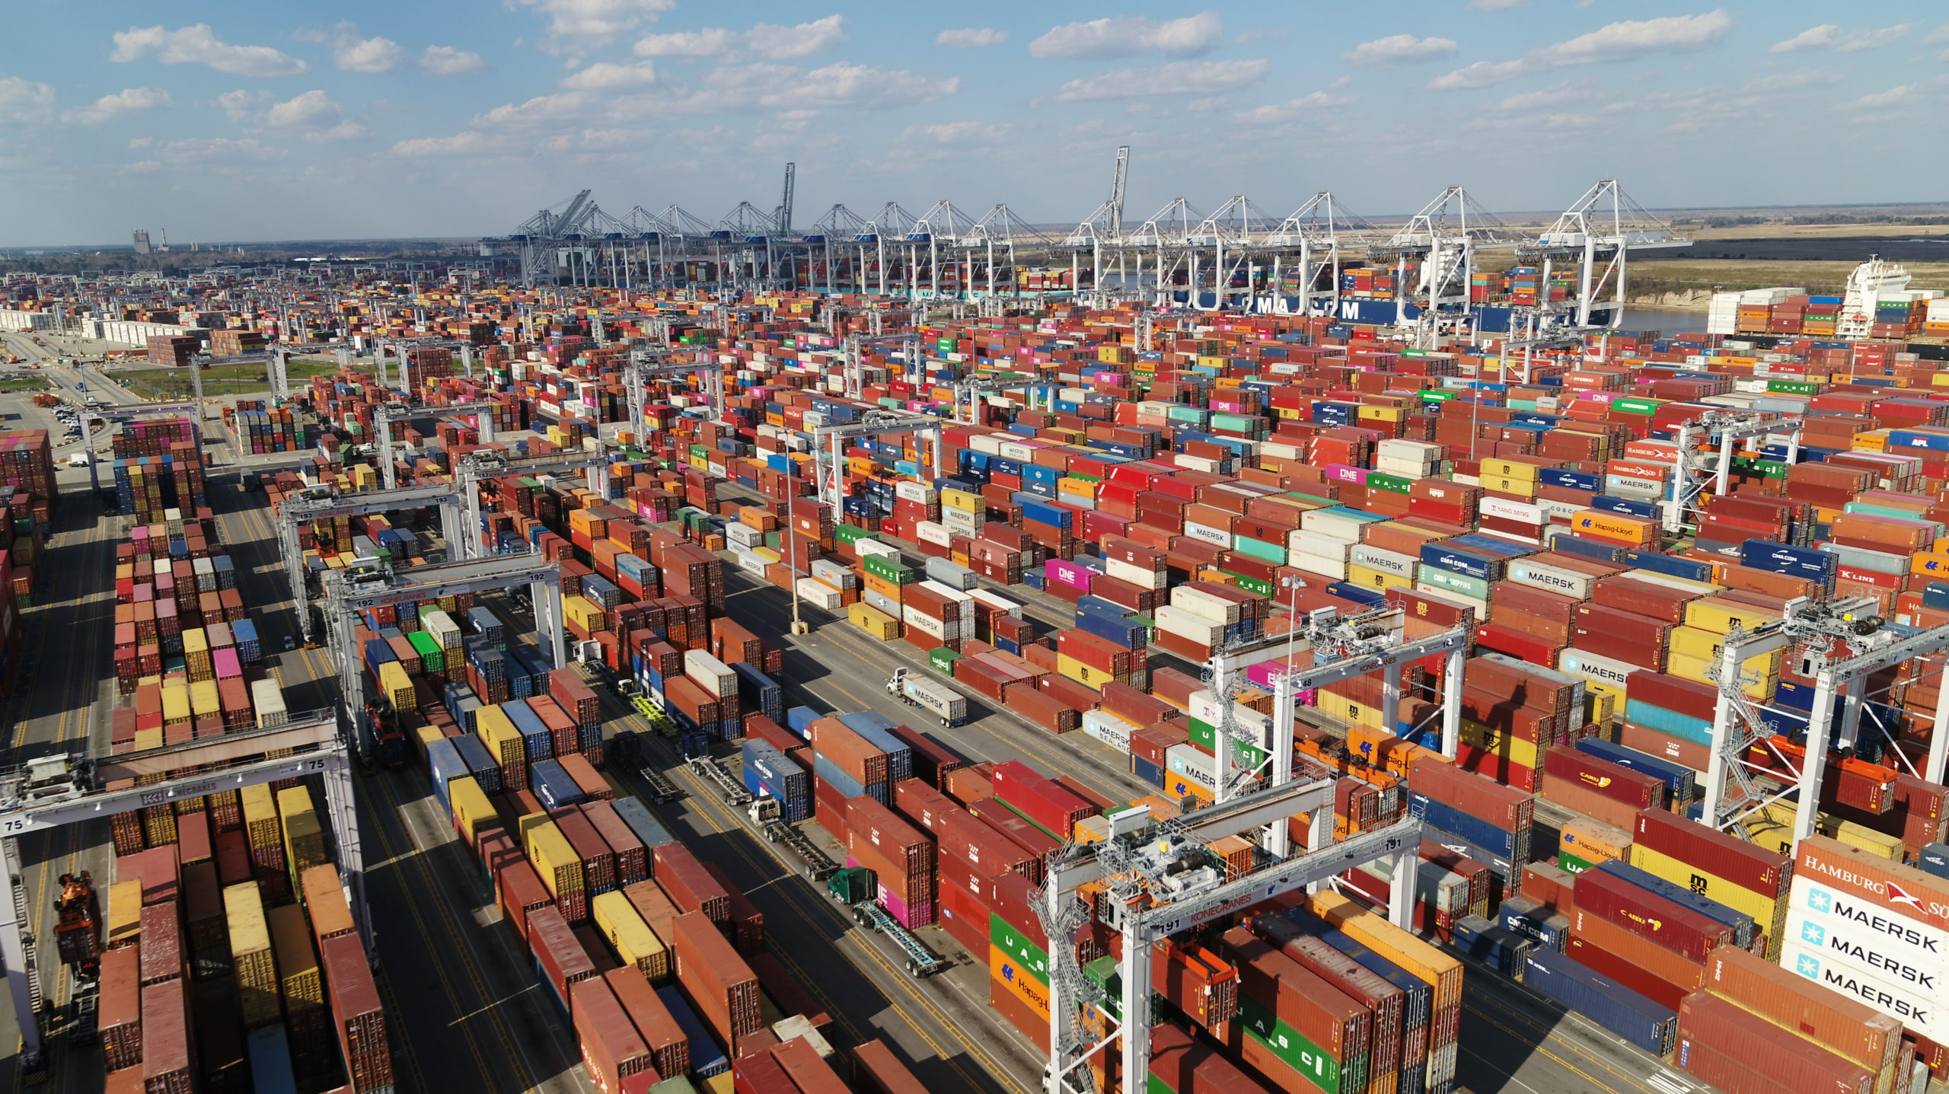
Case Study – Savannah, GA

Slide 41
Case Study – Savannah, GA
MSA of 400K
100M SF of Warehouse
15M SF delivered in 2022 alone
Sub 3.0% Vacancy Rate
What is going on?!?!
Port of Savannah is the economic engine.
4th most active port in the nation at 5.763M TEU’s in 2022
For comparison, Port of New Orleans moved 433K TEUs in 2022

Slide 42
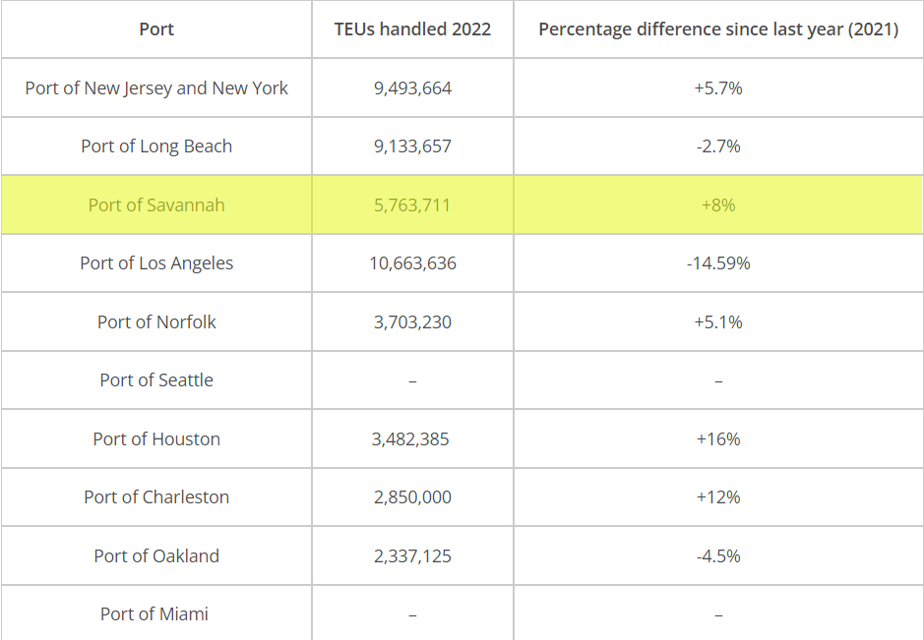
Case Study – Savannah, GA
Port of Mobile set a record in 2022 for handling 563K TEUs
How can Baton Rouge and Louisiana get in on this action??

Slide 43
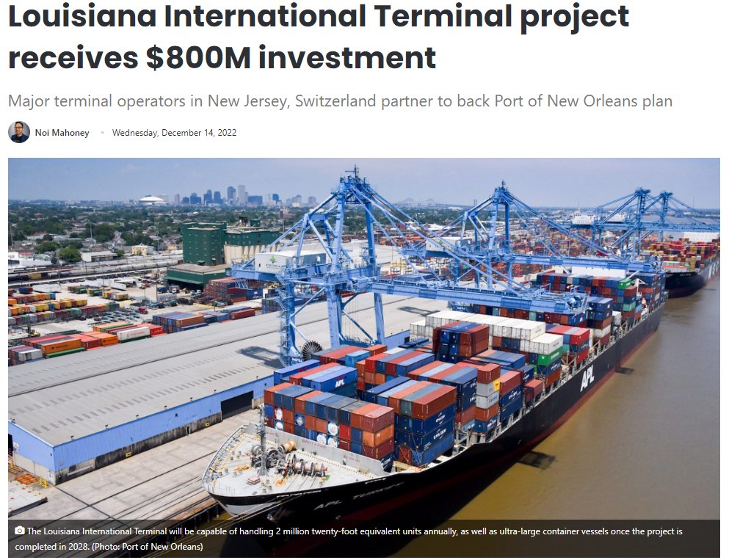
Louisiana International Terminal
Private-Public Partnership
Ports of America (NJ Based) and Mediterranean Shipping Company (Geneva, Switzerland)
$1.8B investment; $800M from the state.
Port of NOLA Current capacity is 1.0M TEUs annually
LIT has a 2.0M TEU Capacity

Slide 44
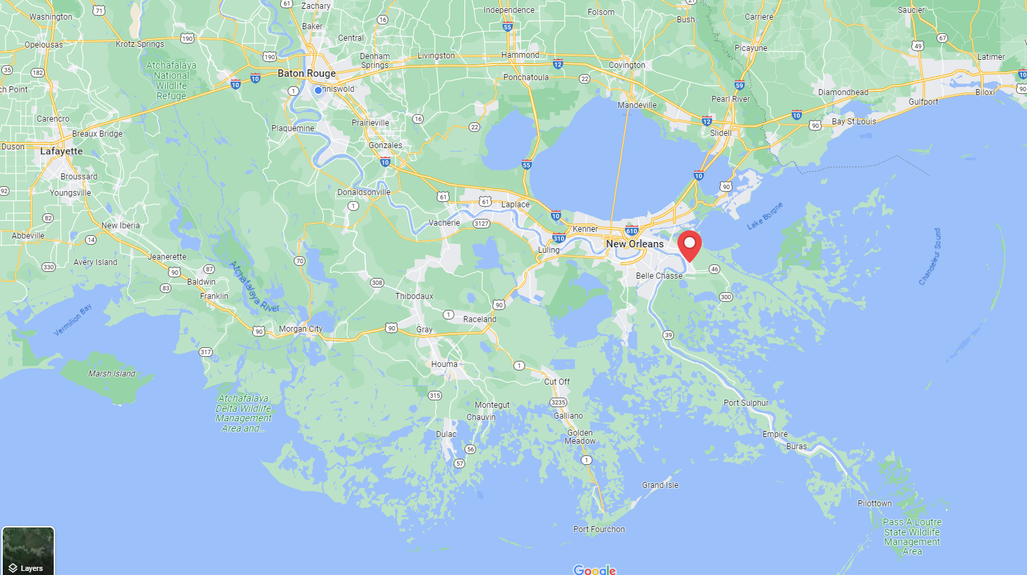

Slide 45
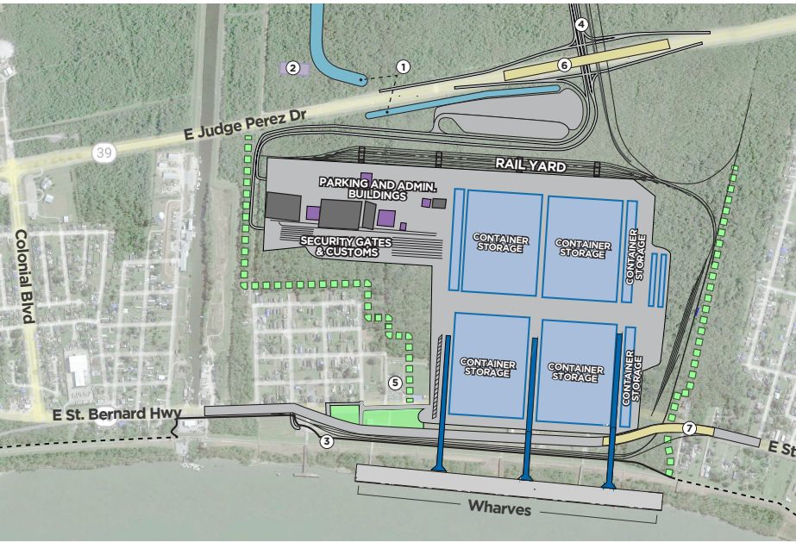
Louisiana International Terminal
1,000 Acres
350-acre container facility
3,500’ wharf
50’ depth from LIT to mouth of river

Slide 46
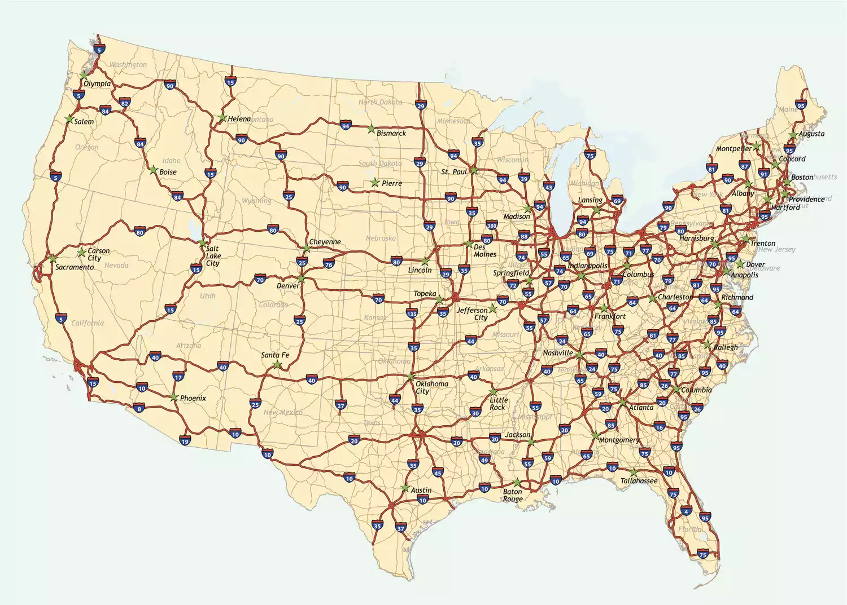

Slide 48
But what about supply?
The Baton Rouge MSA still has a supply problem
Underbuilt annually by 191K SF
Only 90K under construction at the end of 2022.
10-year average absorption of 1.338M
Very likely the Baton Rouge MSA will still be underbuilt in 2023.
Market could add 1.566M SF of vacant space to be at a 6% vacancy rate.
Some relief may be in sight with a couple of spec projects that broke ground earlier this year.

Slide 49
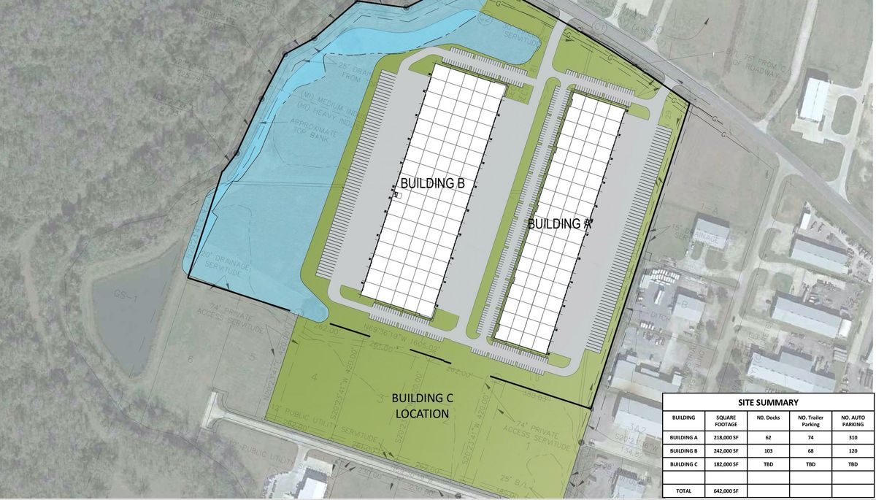
Gateway Industrial Park
Phase I – 218K SF
Phase II – 242K SF
Q4 of 2023 Delivery on Phase I
Provident Realty Advisors out of Dallas is the developer

Slide 50
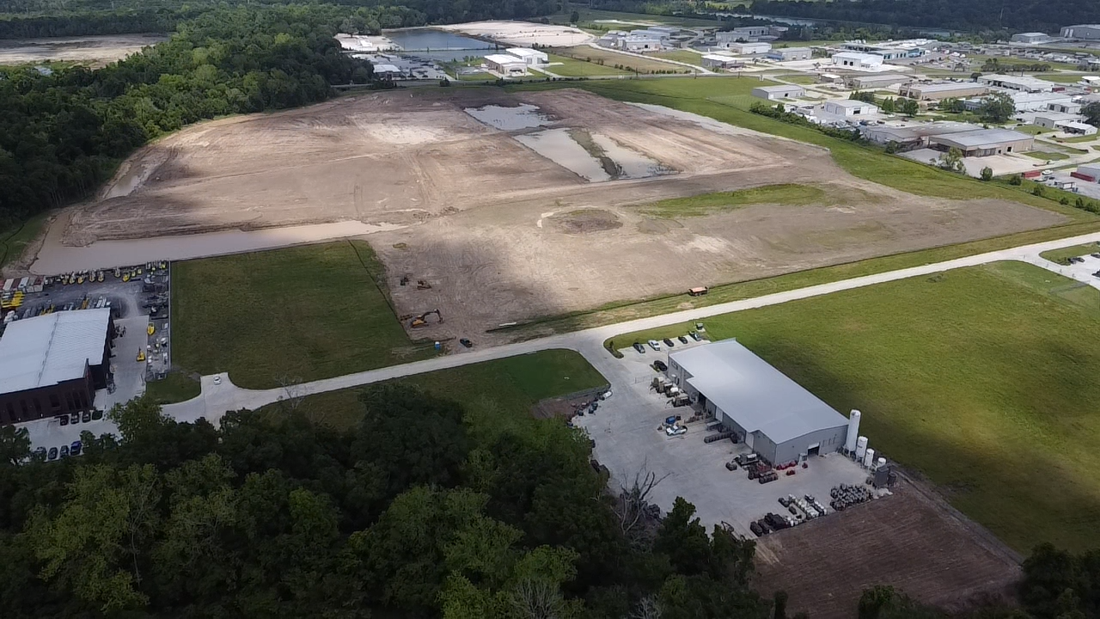

Slide 51
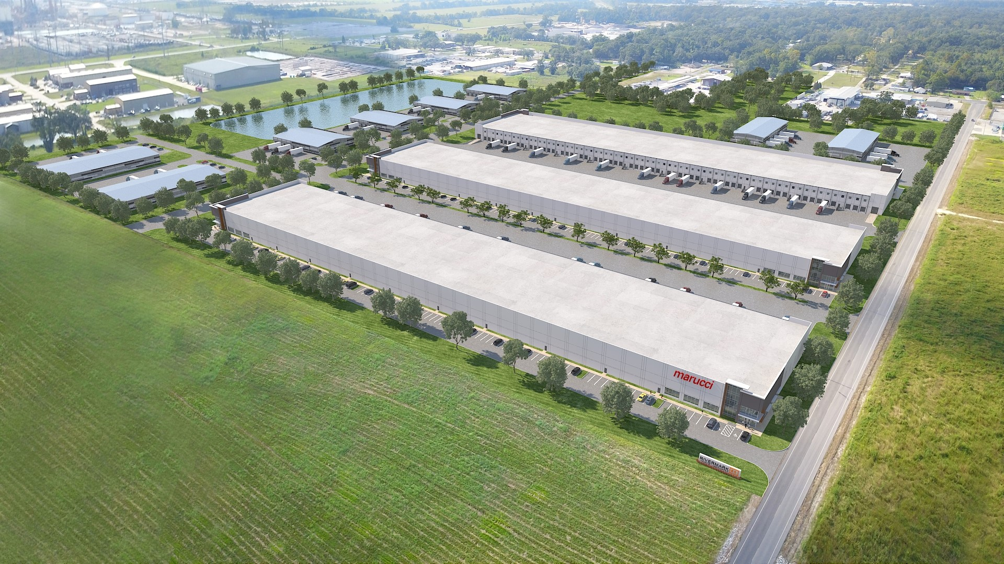
96 Acre Site
Can accommodate up to 1.45M SF
Phase I – 200K SF
Q4 of 2023 Delivery on Phase I
Local Developer Chad Brossett

Slide 52
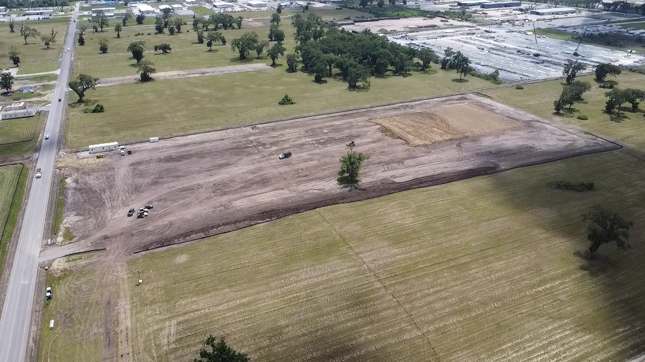

Slide 53
Outlook

Slide 54
What to watch for:
Vacancy will likely rise because it can’t go much lower.
Should stay below 3%
Rental rates will continue to increase as new inventory comes online
Sale Prices will remain high - $125 - $150/SF is the norm on newer, well-located product.
Stalemate between Buyers and Sellers not agreeing on market value
More announcements on the economic development front – both Petrochem and manufacturing

Slide 55
THANK YOU
PRESENTED BY
Evan Scroggs, SIOR, CCIM
Managing Principal
Lee & Associates
escroggs@lee-associates.com

