Slide 1


CRE Economic Update:
A Clear Transition Period
PRESENTED BY
Kevin Fagan, Sr Director and Head of CRE Economic Analysis – Moody’s Analytics CRE

Slide 2
Macro Picture
An economy in transition

Slide 3

Start Positive: No Recession in 2022
Baseline Outlook, No Recession in 2023, weighted to downside
GDP forecast:
2023 2024
1.23% 2.46%
SOURCE: US BEA, Moody’s Analytics

Slide 4
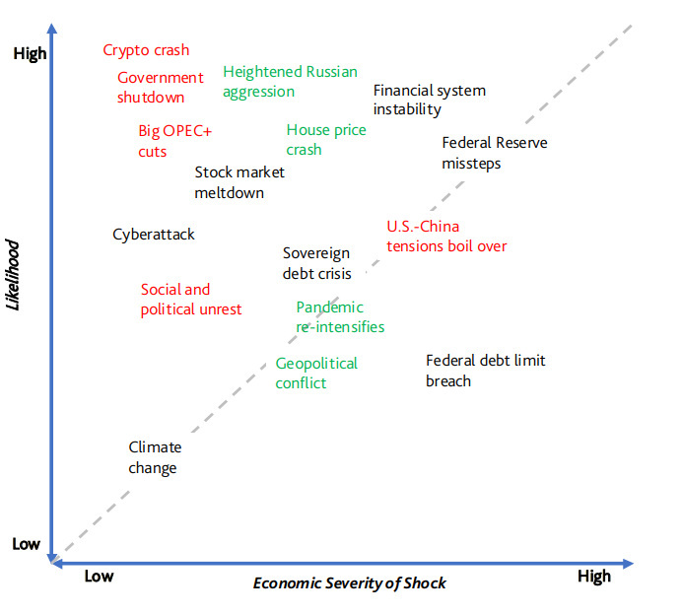
Exogenous Disruptions Increasingly Likely
Red = increasing probability
Green = decreasing probability
Source: Moody’s Analytics

Slide 5

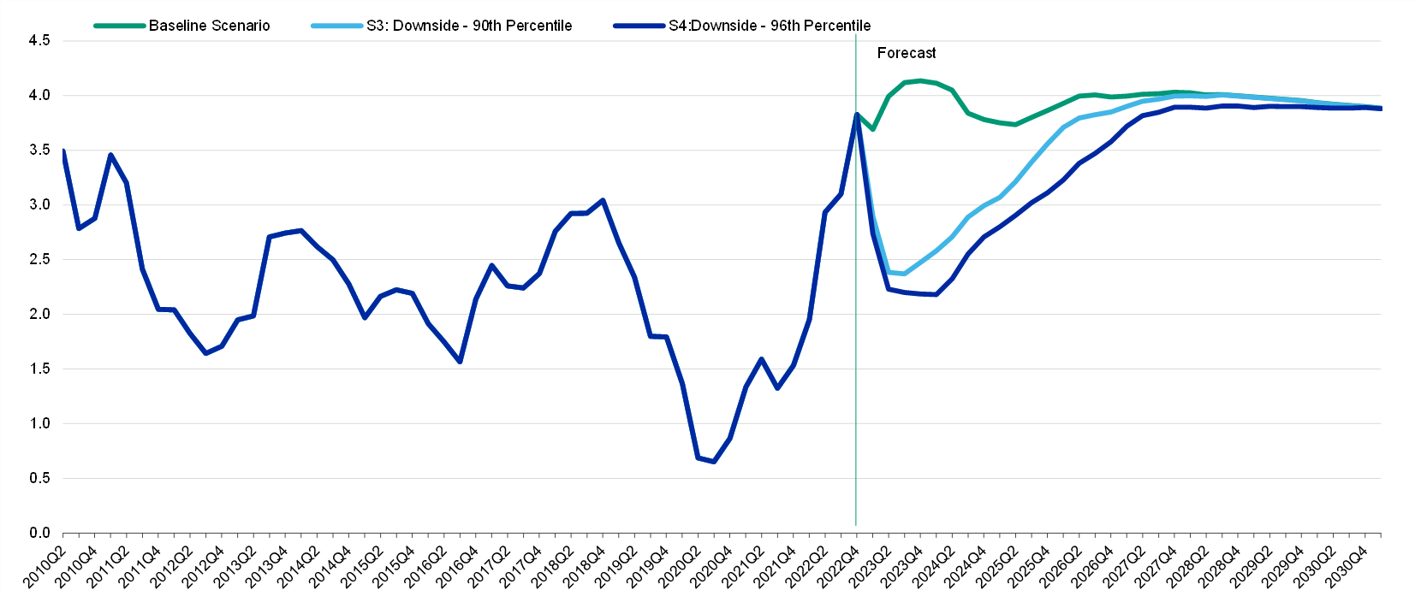

Rates Still Have Upward Pressure
Forecast Peak in Late 2023, Early 2024
Source: FRB, Moody’s Analytics

Slide 6
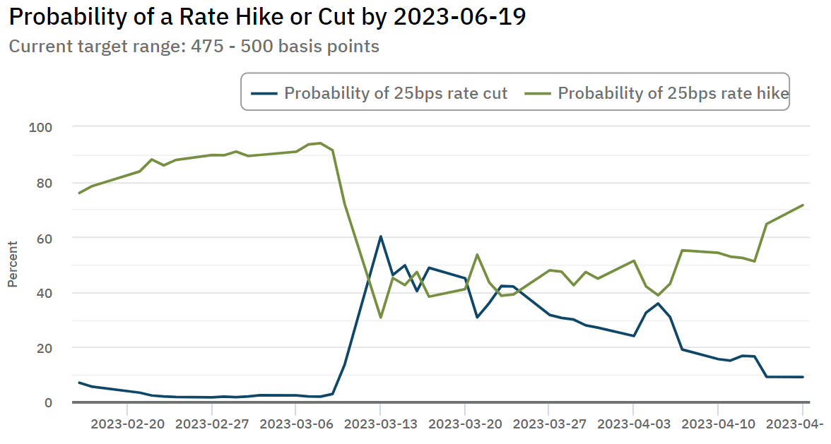
Monetary Policy Nearly Shifted on Banking Scare
Source: Atlanta Fed: Market Probability Tracker
Source: FRB, Moody’s Analytics

Slide 7
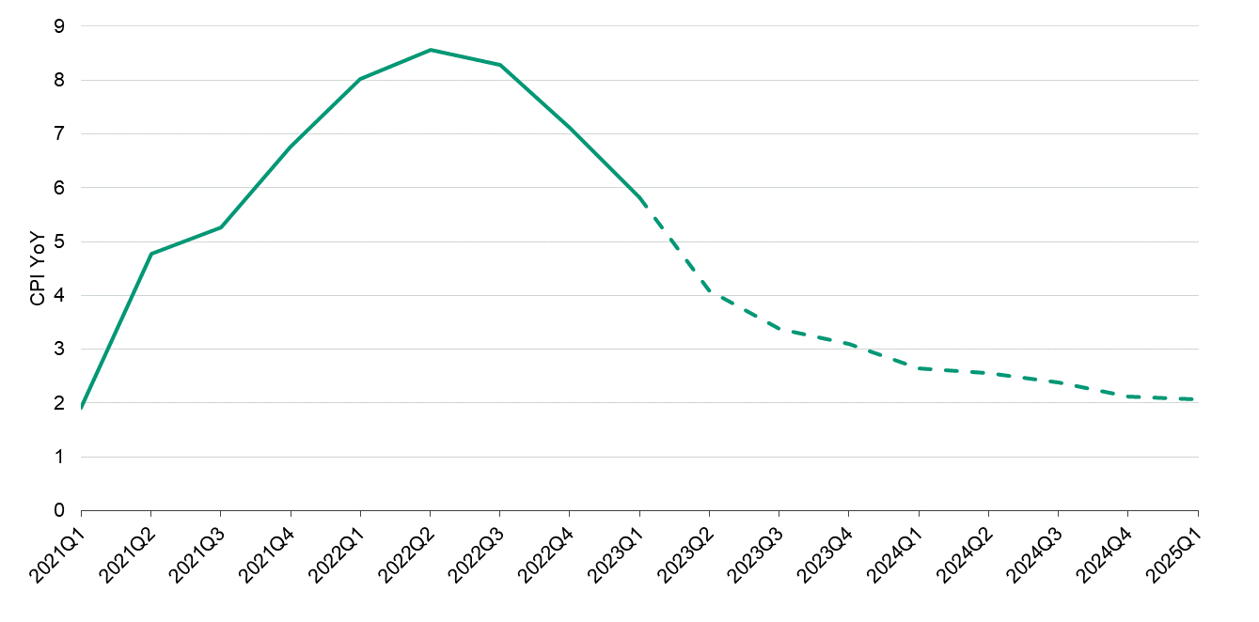
So, are on the right track?
Generally, yes. Watch oil prices and tough “supercore” inflation from non-housing services-oriented labor wages
Source: Moody’s Analytics, BLS

Slide 8
Inflation is caused by?
  Too much money chasing too few goods
Demand
Employment and Income
Expectations*
Supply
Supply Chain
Energy Prices
Labor Costs
Productivity

Slide 9
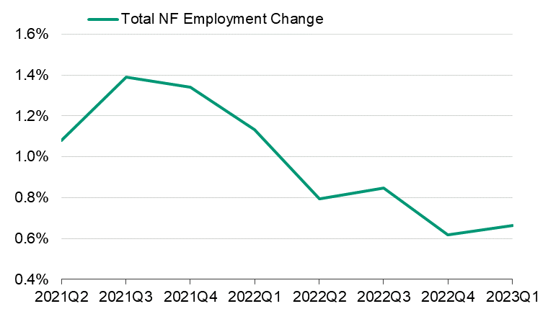
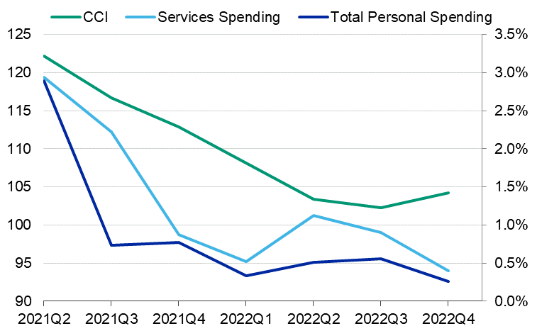
Fighting Inflation – When a Bad Things a Good Thing
Source: Moody’s Analytics, BLS, Confidence Board

Slide 10
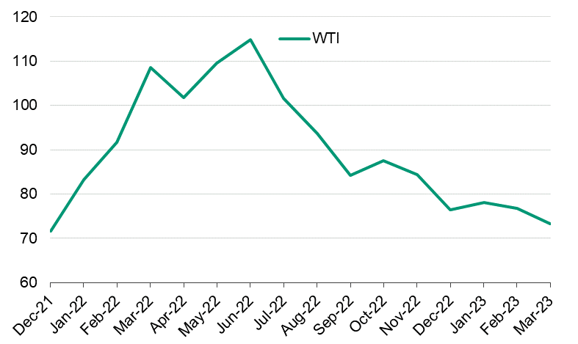
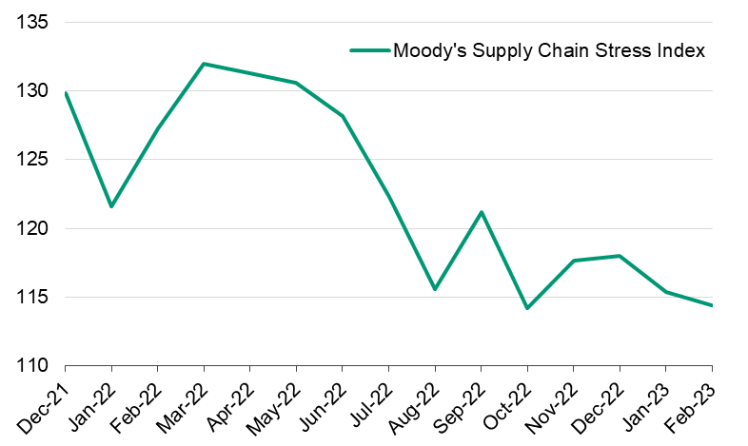
Fighting Inflation – When a Good Things a Good Thing
Source: Moody’s Analytics, US EIA

Slide 11
If optimistic outcome, is all well?
  -Not quite (“Slowcession”)
  Positive but Slow GDP growth 0-1.5%
  Unemployment rate slightly increases to ~4% as Fed watches “supercore” inflation from non-housing services wages
If pessimistic outcome, is all hell?
  -Not quite (this is not 2008)
  Negative GDP growth 1 - 2%
  Unemployment rate increases to 6 - 8%

Slide 12
CRE Capital Markets
Rate pressure roils the lending and transaction markets

Slide 13
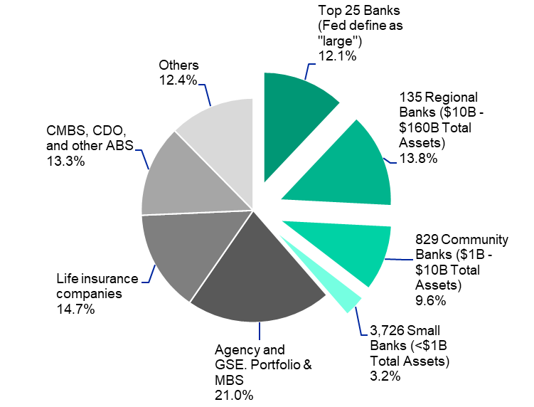
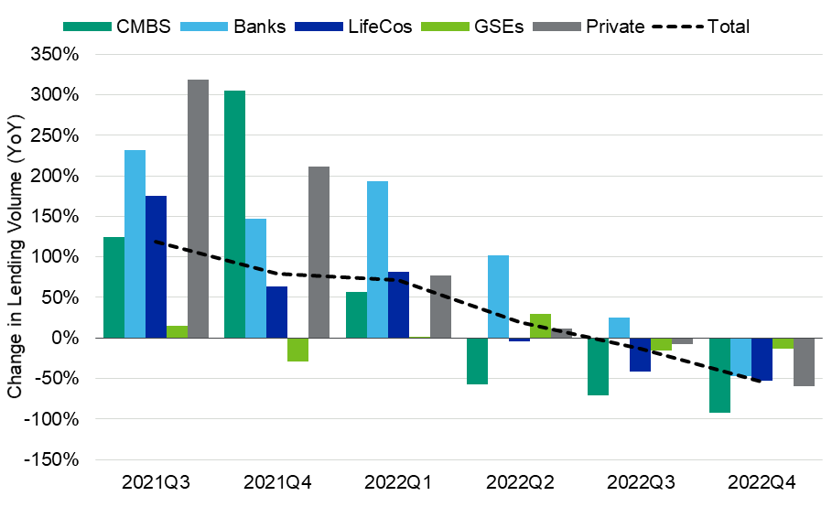
Banking Crisis Controlled, but Will Spur Issues
Sources: MBA, FDIC, Moody’s Analytics CRE

Slide 14
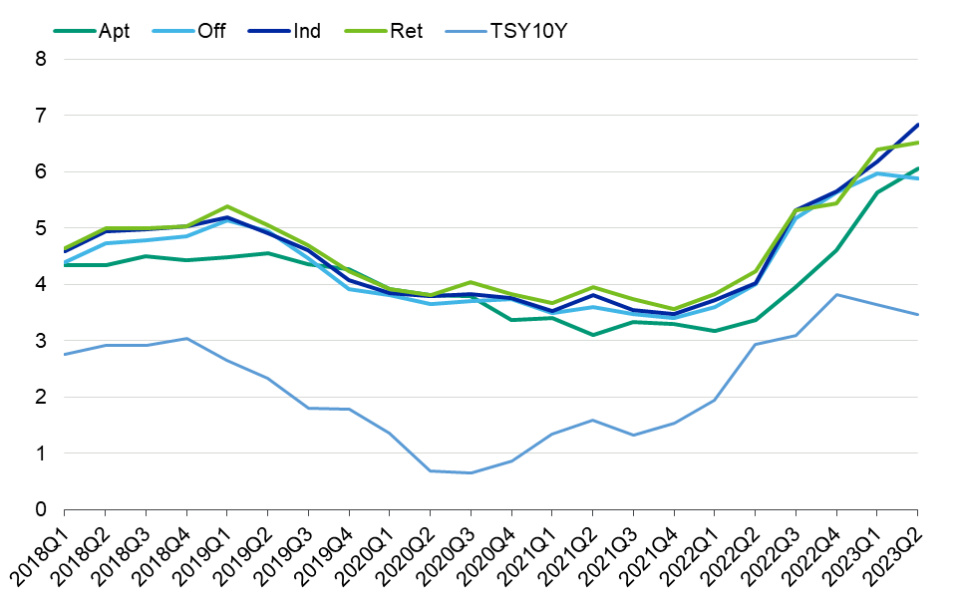
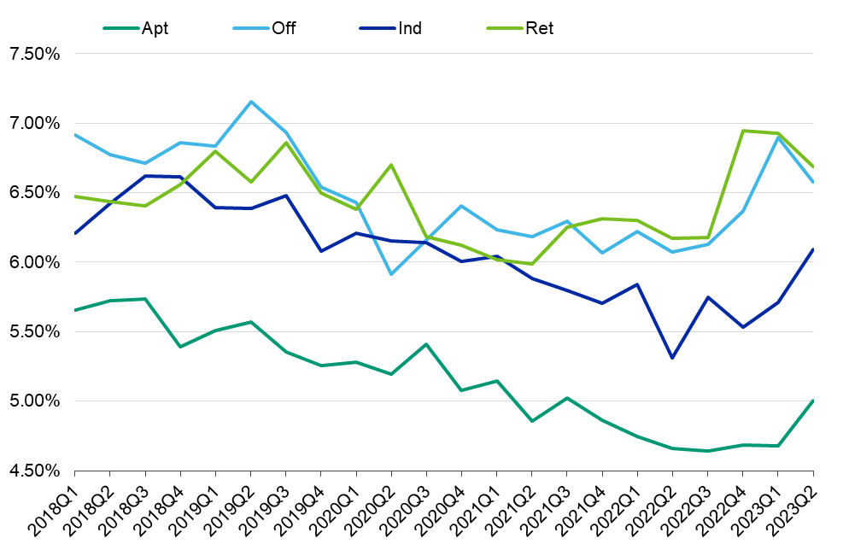
Cost of Capital and Cap Rates Have (Mostly) Followed the Fed
Loan Interest Rates
Property Cap Rates
SOURCE: Moody’s Analytics CMBS

Slide 15
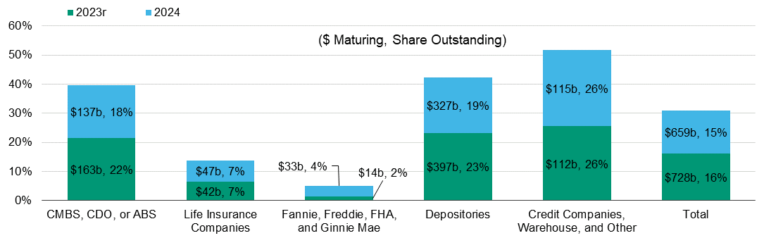
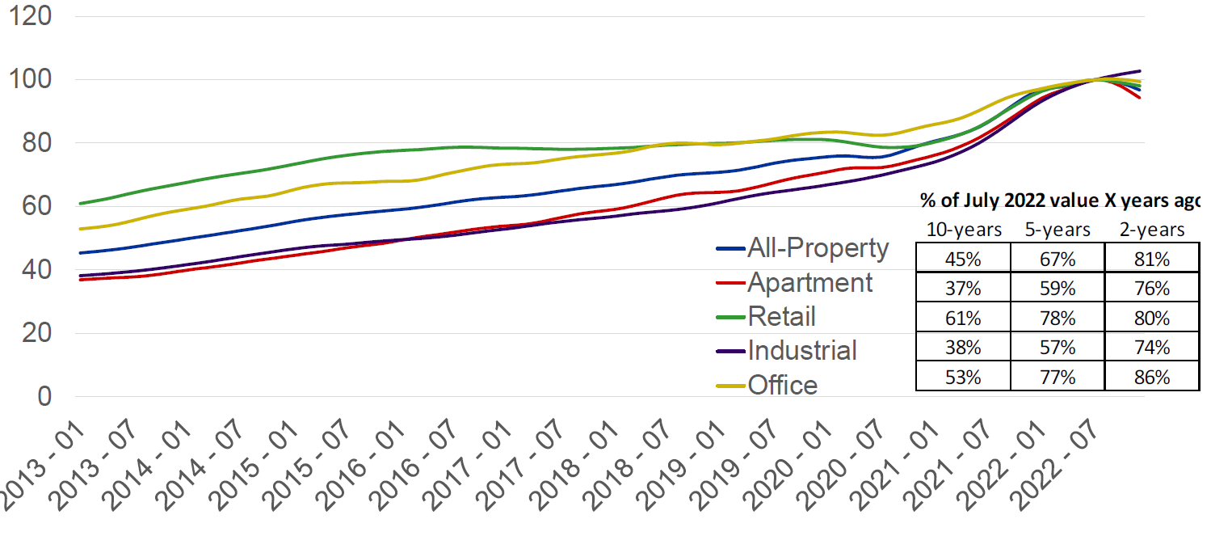
Watch Upcoming Maturities; Pressure on Values
- Likely will add momentum to price trends
SOURCE: Moody’s Analytics CMBS, MSCI

Slide 16
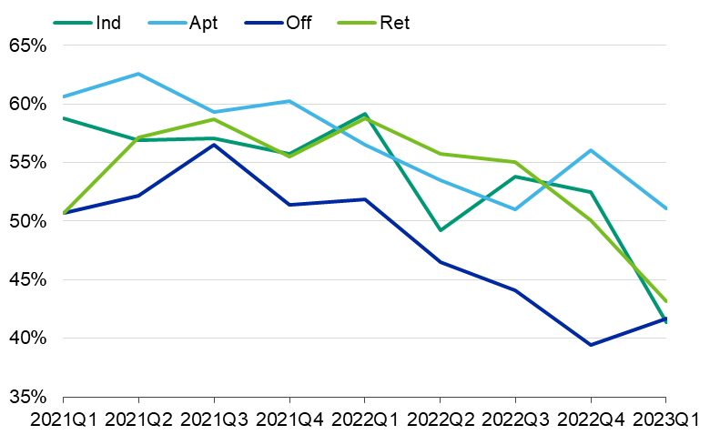
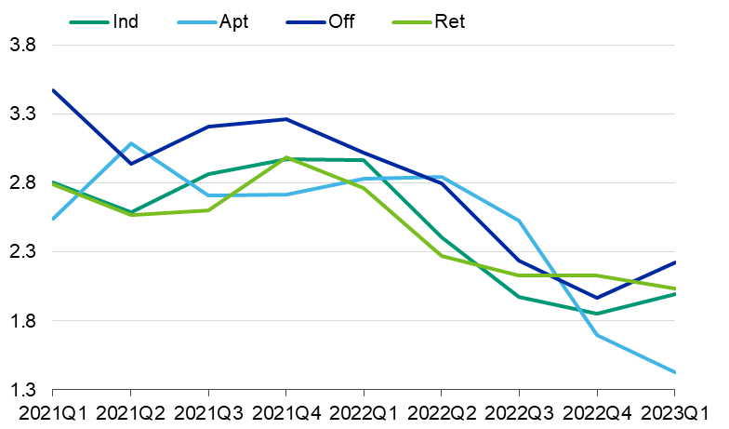
DSCR and LTV Moves Lower as Rates Rise
Big Pressure on Volume at Current Levels
LTVs
DSCRs
SOURCE: Moody’s Analytics CMBS
Sources: Moody’s Analytics CRE, Moody’s Analytics CMBS

Slide 17
Negative Leverage Hits New Highs for Hot Asset Classes
SOURCE: Moody’s Analytics CMBS
Sources: Moody’s Analytics CRE, Moody’s Analytics CMBS

Slide 18
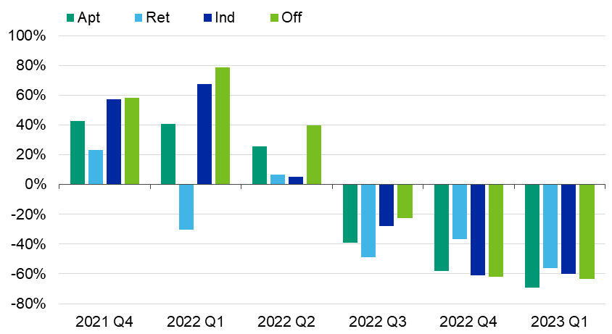
Brakes Have Slammed on the Transaction Market
Impact Across the Board
SOURCE: Moody’s Analytics CRE
Source: Moody’s Analytics CRE. Note: Volume includes only the four core asset classes of multifamily, office, industrial and retail.

Slide 19
Total Returns Move Decidedly Negative
(Except for Hotels!)
SOURCE: NCREIF
Source: NCREIF (total return on institutional properties in the NCREIF database)

Slide 20
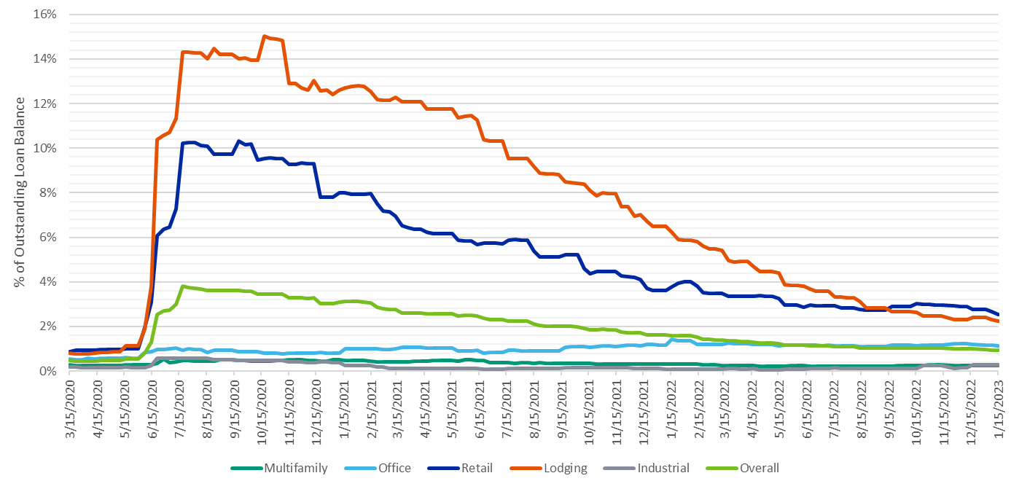
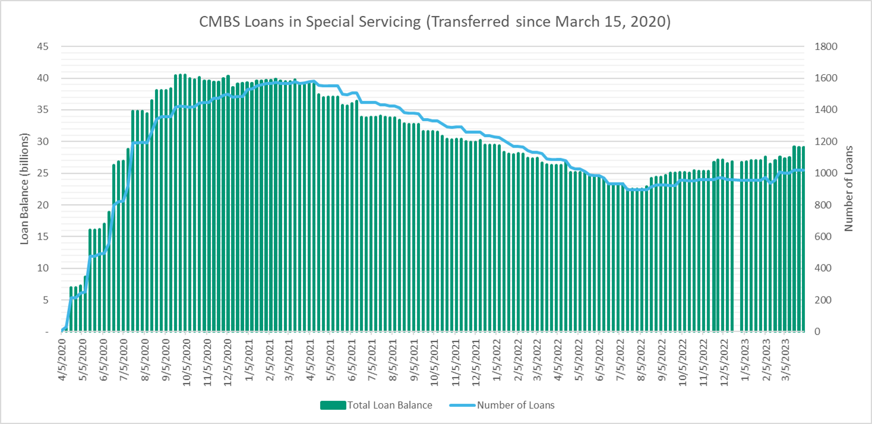
Loan Performance Holds Steady, But Sands are Shifting
Delinquent CMBS Loans by Property Type
CMBS Loans in Special Servicing
SOURCE: Moody’s Analytics CMBS
Sources: Moody’s Analytics CMBS (60+ days delinquent loans)

Slide 21
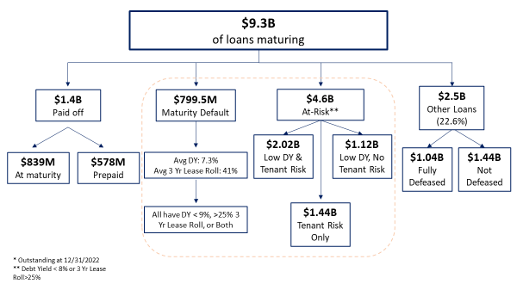
Maturities Will Reveal a Nuanced Shake Out:
CMBS Office Maturities
Sources: MBA, Moody’s Analytics
SOURCE: Moody’s Analytics CMBS

Slide 22
CRE Space Markets
Slowdown a smoother landing than the capital markets

Slide 23
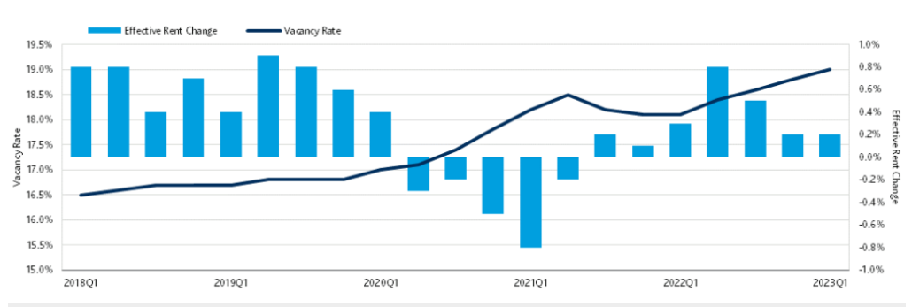
Office Approaching Record Vacancies
Vacancies near 1991 high; 40-50% of ’23 maturities refi-challenged
SOURCE: Moody’s Analytics CRE
Sources: Moody’s Analytics Q1 2023 Preliminary Trends

Slide 24
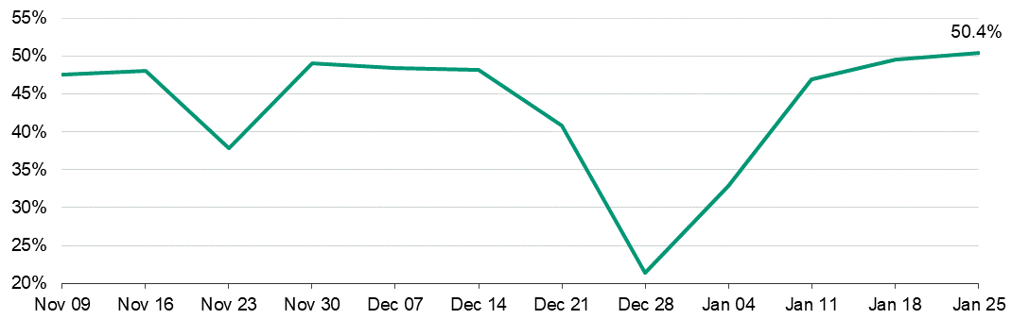
Office Utilization Rate Tops 50% (Finally)
SOURCE: Moody’s Analytics CRE

Slide 25
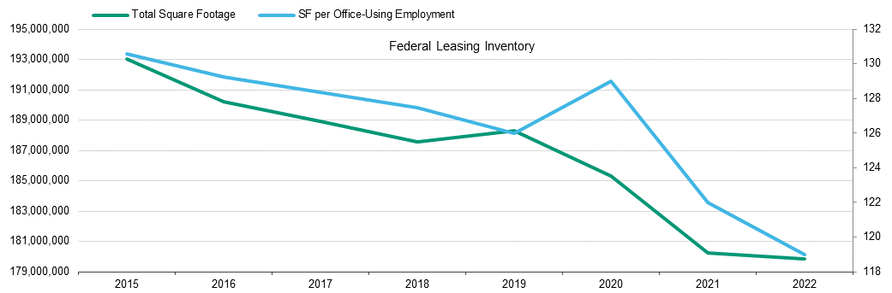
Reduction of Space Isolated to Certain Tenant Types so Far (US Gov’t Been at It for a While)
SOURCE: Moody’s Analytics CRE

Slide 26
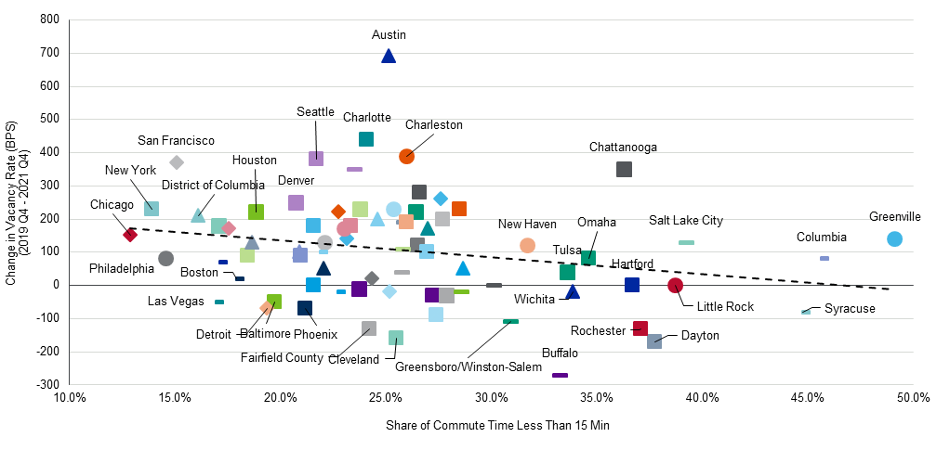
See Differentiation in Office in Different Ways
Source: Kastle Systems
SOURCE: Moody’s Analytics CRE, US BOC

Slide 27
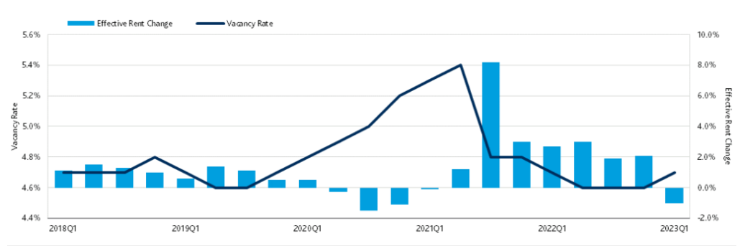
Multifamily Showing Cracks
Strained by supply, affordability issues, very tight asset pricing
SOURCE: Moody’s Analytics CRE
Sources: Moody’s Analytics Q1 2023 Preliminary Trends

Slide 28
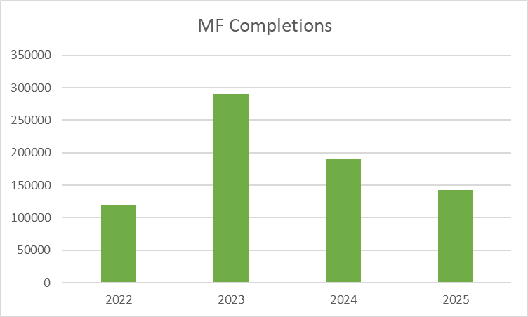
Record Supply is Coming
The pipeline is large but…
  It is mostly due to lower than average deliveries in 2022
    Labor, materials, uncertainty, financing cost
  The two year avg. (’22-’23) will be fairly average
Source: Moody’s Analytics
SOURCE: Moody’s Analytics CRE

Slide 29
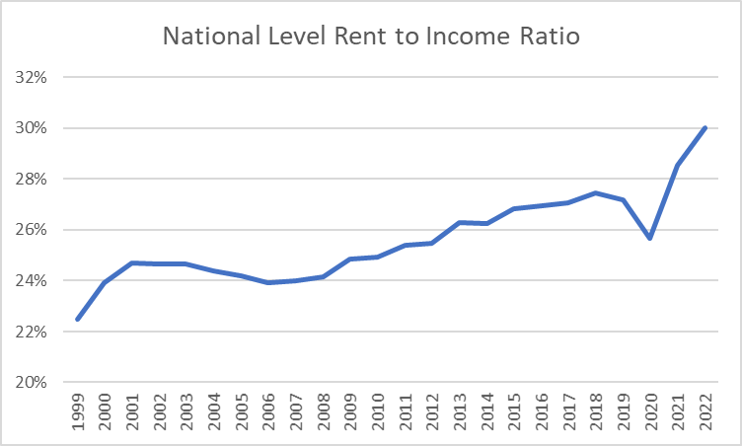
Affordability Pressure
National level Rent-to-income Ratio crests 30% for first time
SOURCE: Moody’s Analytics CRE, BLS, US BOC
Source: Moody’s Analytics

Slide 30
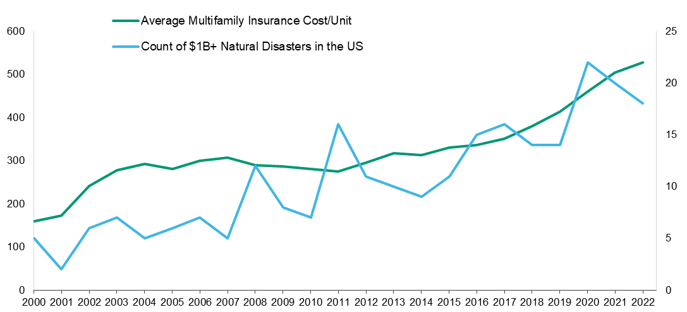
Secular Shift in Insurance Expense Growth
(Not unique to multifamily, all property types)
SOURCE: Moody’s Analytics CRE, NOAA
Source: Moody’s Analytics

Slide 31
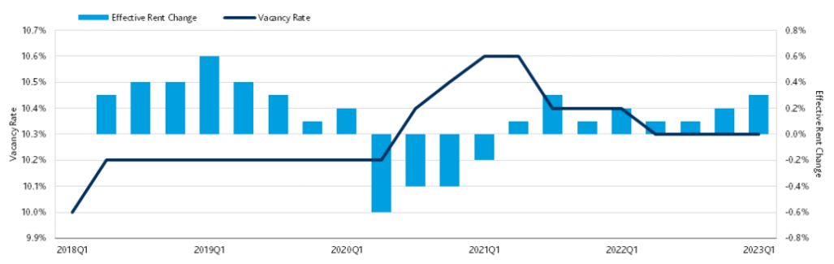
Retail Slow and Steady by Procyclical
As go retail expenditures, goes retail
SOURCE: Moody’s Analytics CRE

Slide 32
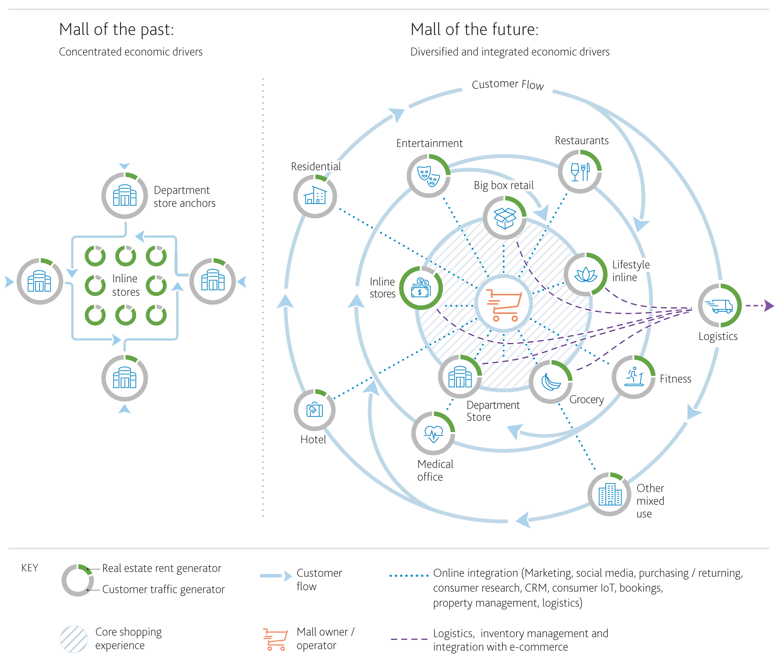
Retail Evolution
Happening:
Diverse Demand Drivers Required to Survive
Tremendous Mixed-Use/Lifestyle Activity
Repurposing now has a model
SOURCE: Moody’s Analytics CRE
Source: Moody’s Analytics CRE

Slide 33
Industrial: Is The Slowdown Here?
Flex/R&D
  Flex/R&D vacancies hovered at slightly above 5% in the latter half of 2022, but trended flat in the fourth quarter.
  Effective rent growth slowed markedly in the fourth quarter, reflecting pause/retraction of space demand
Effective Rent Growth
Vacancy Rate
Warehouse/
Distribution
  Warehouse/distribution vacancies are at record lows, but were flat at approximately 4% in the last two quarters of 2022.
  Effective rent growth remained positive but are off quarterly highs from the first half of 2022, reflecting pause/retraction of space demand
SOURCE: Moody’s Analytics CRE

Slide 34

THANK YOU

