Slide 1
2023
BATON ROUGE
MULITFAMILY TRENDS
PRESENTED BY
Craig Davenport, MAI
Cook, Moore, Davenport & Associates
www.CookMoore.com
cdavenport@cookmoore.com

Slide 2
2018 - 2021
2021 - 2022

Slide 3
2023
2023

Slide 4
2023 Rental Survey
FULL DATA SET
MATCHED SAMPLE
250+ Complexes
39,443+ Units
230+ Complexes
34,950+ Units

Slide 5
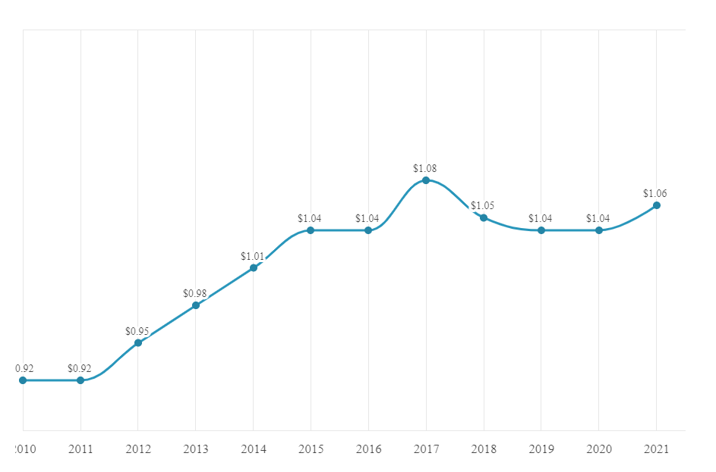
AVERAGE RENT PER SQUARE FOOT - OVERALL MARKET
10%
4% INCREASE
AFTER 2016 FLOOD
INCREASE AFTER KATRINA
4%
KATRINA
HANGOVER
INCREASE AFTER 2016 FLOOD
1% - 3%
ANNUAL GROWTH

Slide 6
AVERAGE RENT PER SQUARE FOOT - OVERALL MARKET
11.3% Increase 2021 - 2023
1.7%
INCREASE FROM 2022-2023
AFTER 2016 FLOOD
4% INCREASE
9.4%
INCREASE FROM 2021-2022

Slide 7
HISTORICAL VACANCY RATES
(Matched Sample)
4.81% Vacancy Rate in 2023

Slide 8
SUBMARKET ANALYSIS
(Matched Sample)
Submarket | Avg Rent/SF 2023 | Rent Change Since 2022 | Rent Change Since 2020
Baton Rouge – Class A | $1.46 | +0.7% | +19.7%
Central Business District (CBD) | $1.67 | +3.7% | +7.1%
LSU By-the-Bed | $1.57 | +4.7% | +9.0%
LSU Standard | $1.14 | +4.6% | +11.8%
Ascension – Class A | $1.33 | +7.2% | +20.9%
Livingston – Class A | $1.07 | +1.9% | +13.8%

Slide 9
SUBMARKET ANALYSIS
(Matched Sample)
Submarket | Vacancy 2023 | Vacancy 2022 | Vacancy 2021 | Vacancy 2020 | Vacancy 2018
Baton Rouge – Class A | 5.13% | 4.23% | 7.35% | 9.91% | 5.99%
Central Business District (CBD) | 10.0% | 10.0% | 9.81% | 8.75% | 8.17%
Ascension – Class A | 6.52% | 1.36% | 6.03% | 5.87% | 7.92%
Livingston – Class A | 4.64% | 3.66% | 5.89% | 8.83% | 6.24%
LSU By-the-Bed | 3.88% | 7.04% | 17.08% | 15.89% | 15.80%
LSU Standard | 4.37% | 5.30% | 13.90% | 12.78% | 12.01%
Strong Markets Across the Board

Slide 10
LSU STUDENT APARTMENT MARKET
FALL 2019 ENROLLMENT
FALL 2021 ENROLLMENT
FALL 2022 ENROLLMENT
30,634
33,519
34,483
On-Campus Enrollment
All-Time High Enrollment
2022 Largest Freshman Class in LSU History
Limited On-Campus Housing

Slide 11
CONSTRUCTION CLASS ANALYSIS
(Matched Sample)
 | Avg Rent/SF | Rent Change Since 2022 | Rent Change Since 2021
Class A | $1.46 | +3.6% | +11.5%
Class B | $1.16 | +2.7% | +11.7%
Class C/D | $0.98 | +3.2% | +12.6%
Vacancy 2023 | Vacancy 2022 | Vacancy 2021
4.80% | 4.98% | 10.82%
4.56% | 4.18% | 8.05%
4.95% | 5.30% | 7.85%
Average Class A Rent is $1,535/month
Average Class B Rent is $1,148/month
Average Class C/D Rent is $862/month

Slide 12
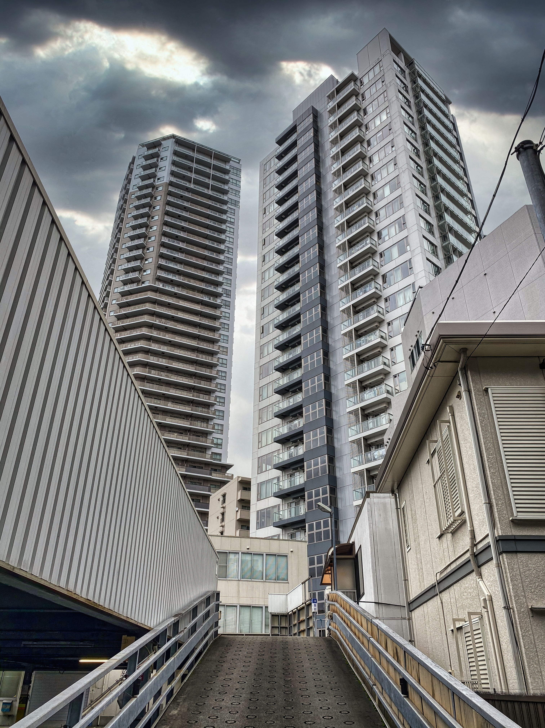
Baton Rouge and Overall Market
Other Trends in the Multifamily Market
YEAR OF THE I’S
Interest Rates – Inflation -- Insurance
INCREASED INSURANCE COSTS
Historically $350 - $450/unit
Increased to $500 - $750/unit
Now $1,000 to $1,800/unit, with some over $2,000/unit
OTHER OPEX COSTS INCREASING
Payroll Costs – Up
Materials Costs – Up
Services Costs (Exterminating, Grounds, etc.) - Up
2022 ---
2023

Slide 13
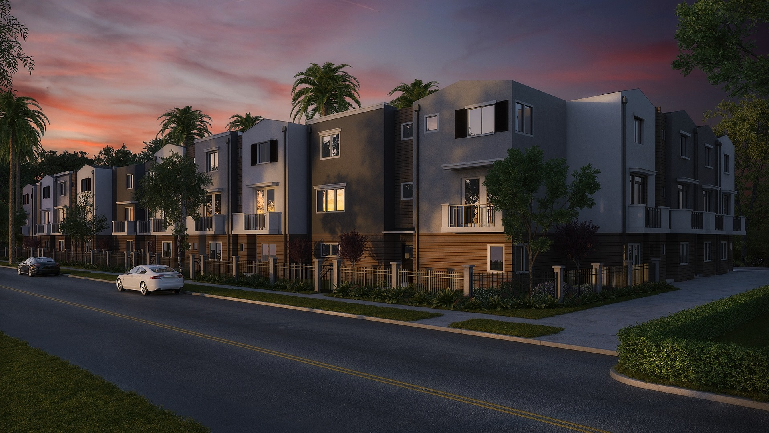
APARTMENT SALES FOR 2022

Slide 14
2022 – State and Regional
Prior to 2021, there were a total of 2 non-student apartment complexes (25+ units) in Louisiana that had sold for more than $190,000/unit (1 in Baton Rouge and 1 in New Orleans)
In 2021, there were a total of 8 complexes in Louisiana that sold for more than $190,000/unit
In 2022, there were 10 more complexes in Baton Rouge that sold for more than $190,000/unit
9 of the top 10 largest commercial sales this year in the Baton Rouge area were apartment complexes

Slide 15
CHICAGO
NEW YORK
ATLANTA
LOS ANGELES
VACANT
FLORIDA
KUSHNER COMPANIES
BROOKLYN
OCCUPIED
DALLAS

Slide 16
APARTMENT SALES VOLUME
(25+ UNIT COMPLEXES)
TOTAL SALES VOLUME 2017-2020
$1,027,819,950
Year | # Complexes | Total Volume
2017 | 38 | $367,350,000
2018 | 25 | $241,869,100
2019 | 27 | $194,616,850
2020 | 23 | $223,984,000
2021 | 40 | $580,029,500
OCCUPIED
VACANT
TOTAL SALES VOLUME 2021-2022
$1,475,129,500
2022 | 61 | $895,100,000

Slide 17
APARTMENT SALES VOLUME
2022 By Quarter
FNMA
DUS 10-Yr 12/31/2021
3.27%
Quarter | # Sales | Total Volume
1st Qtr | 16 | $191,780,000
2nd Qtr | 20 | $421,350,000
3rd Qtr | 17 | $194,580,000
4th Qtr | 8 | $87,360,000
FNMA
3.90%
5.47%
5.99%
6.49%
OCCUPIED
VACANT
1st Qtr 2023 | 3 | $18,824,000
6.71%

Slide 18
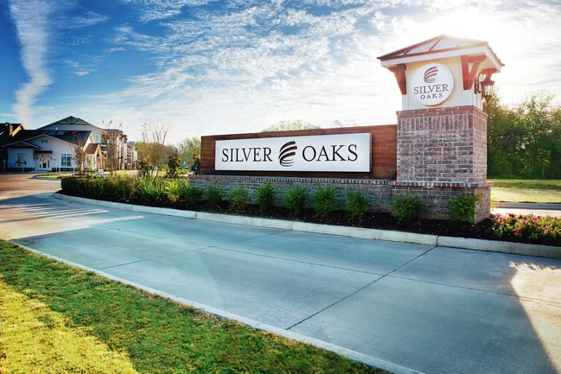
SILVER OAKS
14496 AIRLINE HWY GONZALES
Date | May 20, 2022
Price | $76,850,000
Price /SF | $253.53
Price/Unit | $228,720

Slide 19
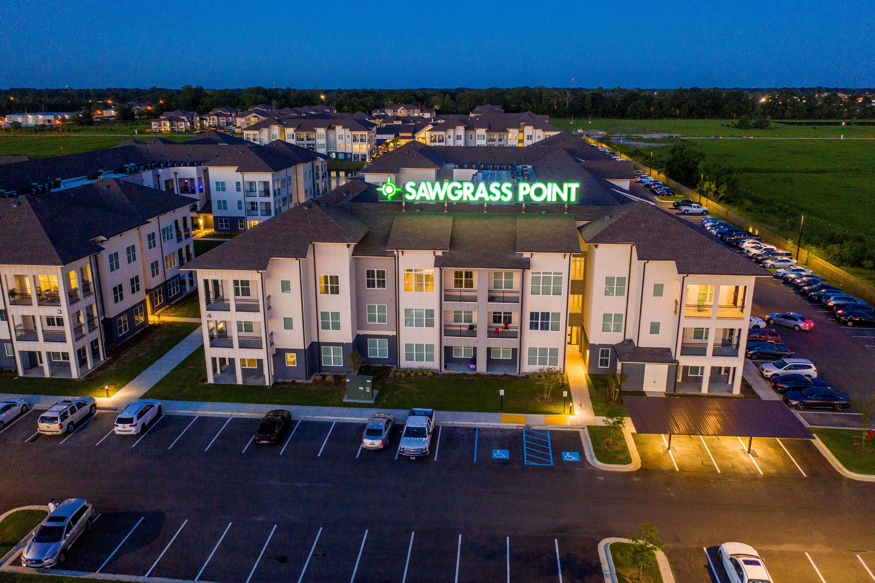
SAWGRASS POINT
2163 VETERANS BLVD GONZALES
Date | May 4, 2022
Price | $75,350,000
Price /SF | $260.58
Price/Unit | $277,020

Slide 20
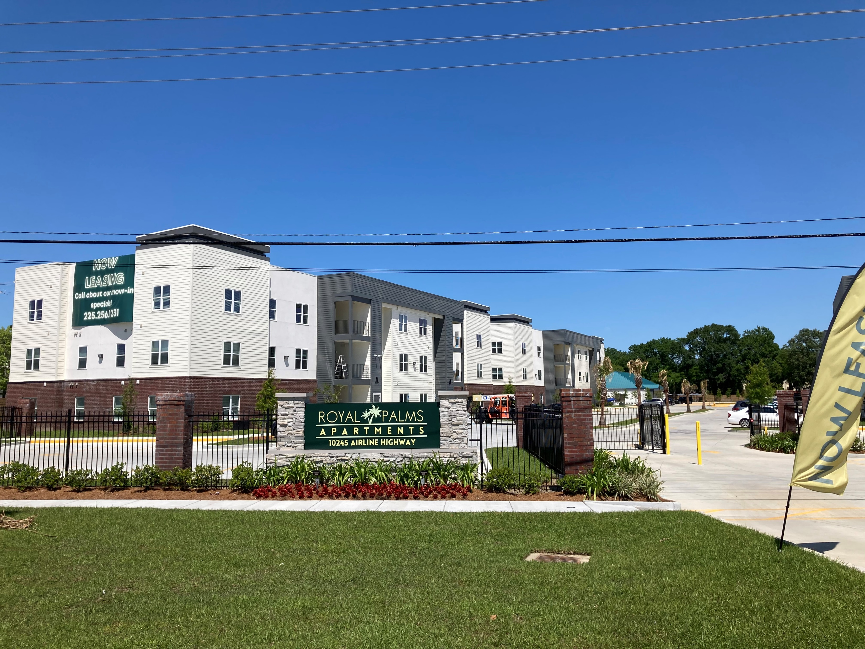
ROYAL PALMS
10245 AIRLINE HIGHWAY
Date | September 23, 2022
Price | $30,000,000
Price /SF | $285.96
Price/Unit | $238,100

Slide 21
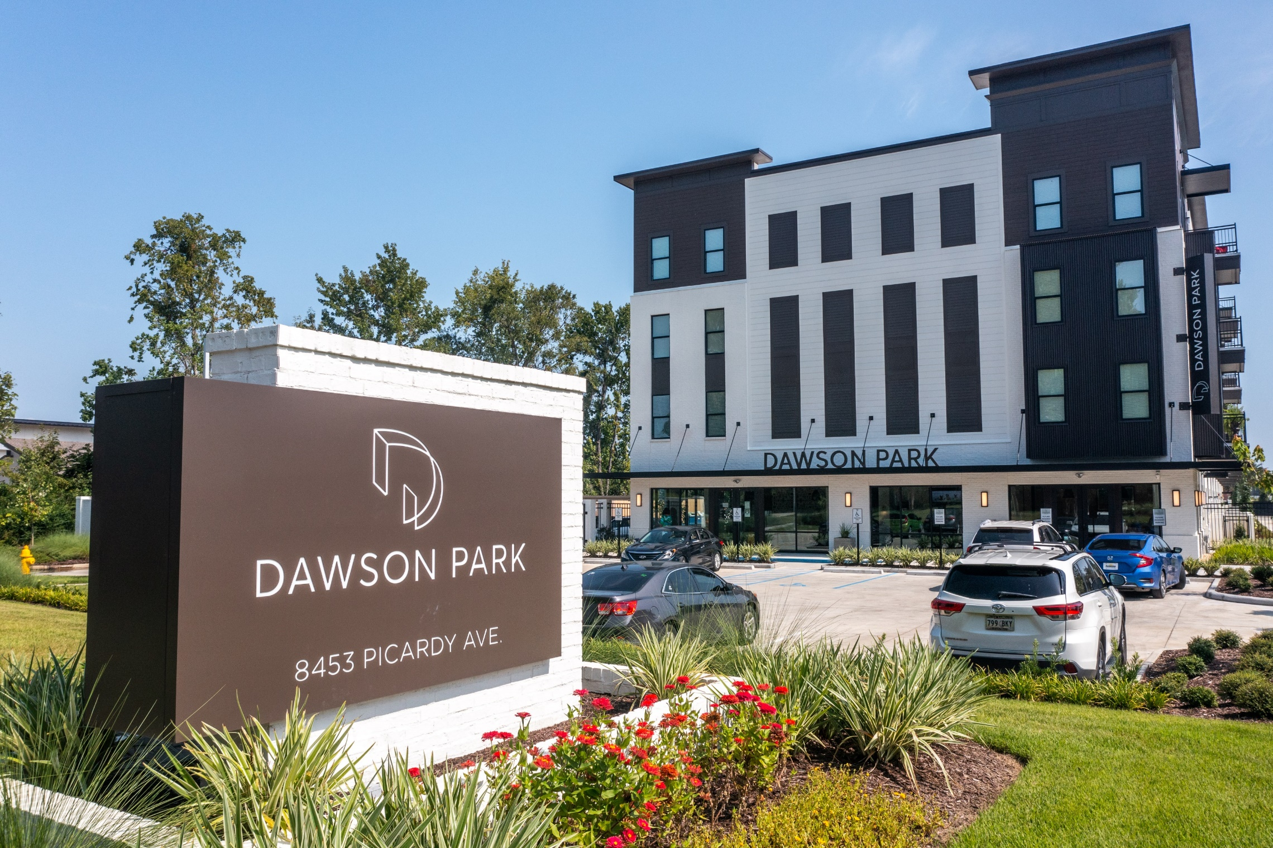
DAWSON PARK
8453 PICARDY AVENUE
Date | June 30, 2022
Price | $45,725,000
Price /SF | $321.11
Price/Unit | $295,000

Slide 22
OTHER SELECT PROPERTY SALES 2022
Name | Address | # of Units | Price/Unit
Terraces at Perkins Rowe | 10202 Perkins Road | 226 | $184,956
Lakeside Oaks | 13170 Dutchtown Rd | 252 | $200,000
Palms at Sunset Lake | 4150 McHugh Road (Zachary) | 144 | $217,458
The Commerce Bldg | 333 Laurel Street | 93 | $265,484
Hidden Oaks at Siegen | 6630 Siegen Lane | 312 | $126,603
Exchange at BR | 449 Ben Hur Road | 299
Arlington Cottages | 550 Ben Hur Road | 179
OCCUPIED
VACANT

Slide 23
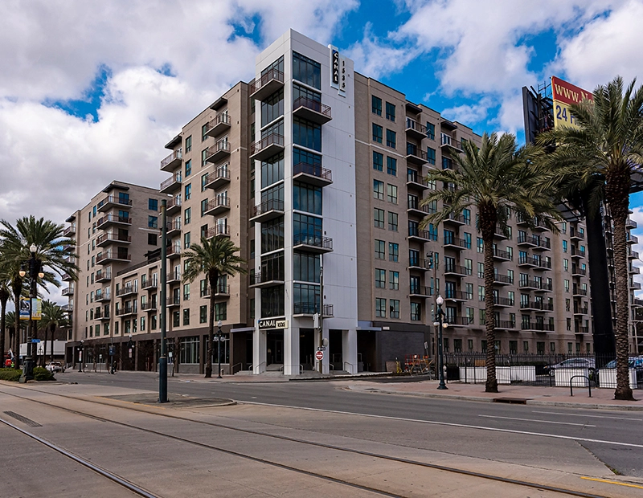
CANAL 1535
1535 CANAL STREET
NEW ORLEANS
Date | April 27, 2022
Price | $120,000,000
Price /SF | $402.54
Price/Unit | $363,635

Slide 24
Baton Rouge and Overall Market
Other Trends in the Multifamily Sales Market
CAP RATES
Cap Rates have been increasing 50 to 75 Basis Points
SALES TRANSACTIONS
Not likely to see many big transactions like previous years
FORECLOSURES
Foreclosures are up and are likely to increase over the next year
2022 ---
2023

Slide 25
COMPLETED COMPLEXES 2022

Slide 26
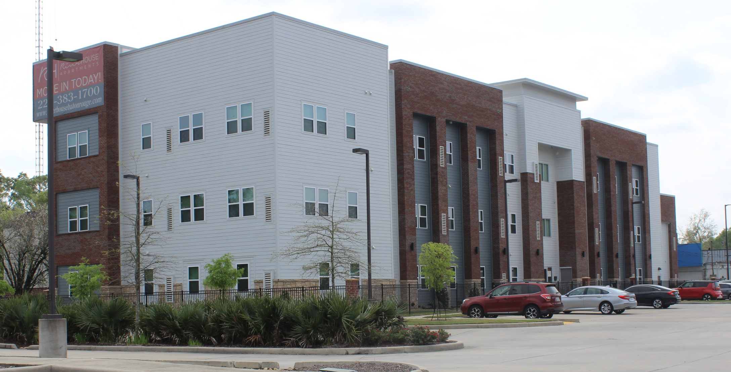
CONVENTIONAL COMPLEXES – COMPLETED IN 2022
Only 1 Complex Completed in 2022
Completed in 2019 – 1,225 Units
Completed in 2020 – 638 Units
Completed in 2021 – 581 Units
Completed in 2022 – 42 Units
River House – Phase 2
(42 Units) 101 River House Place
Fewest in Single Year
Since 2014

Slide 27
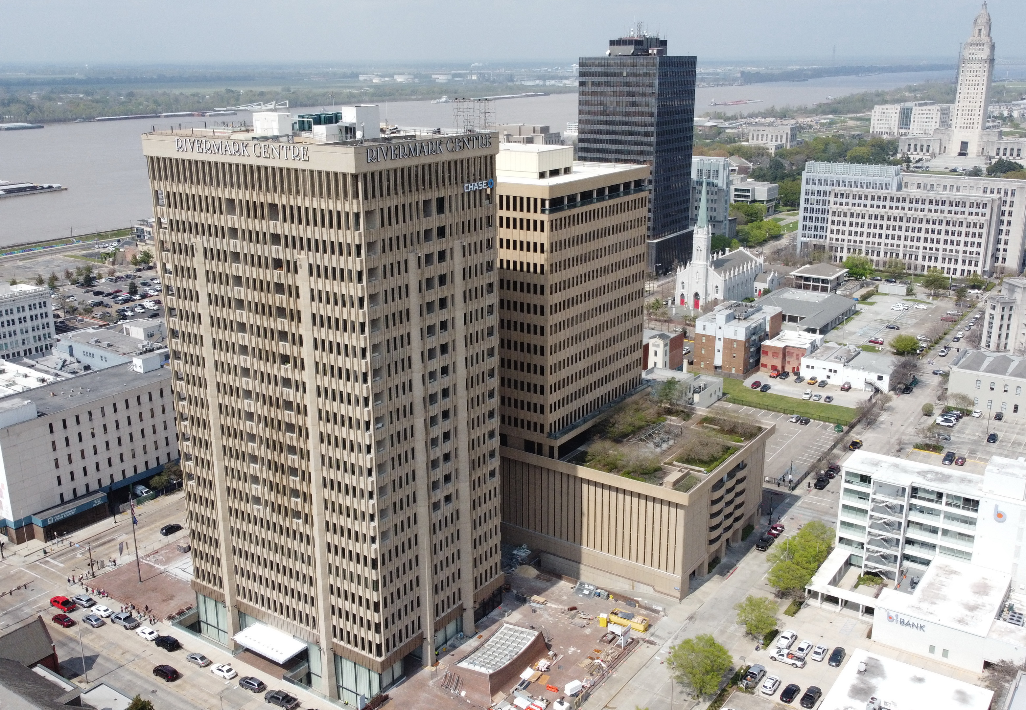
The Residences
at
Rivermark
OCCUPIED
VACANT

Slide 28
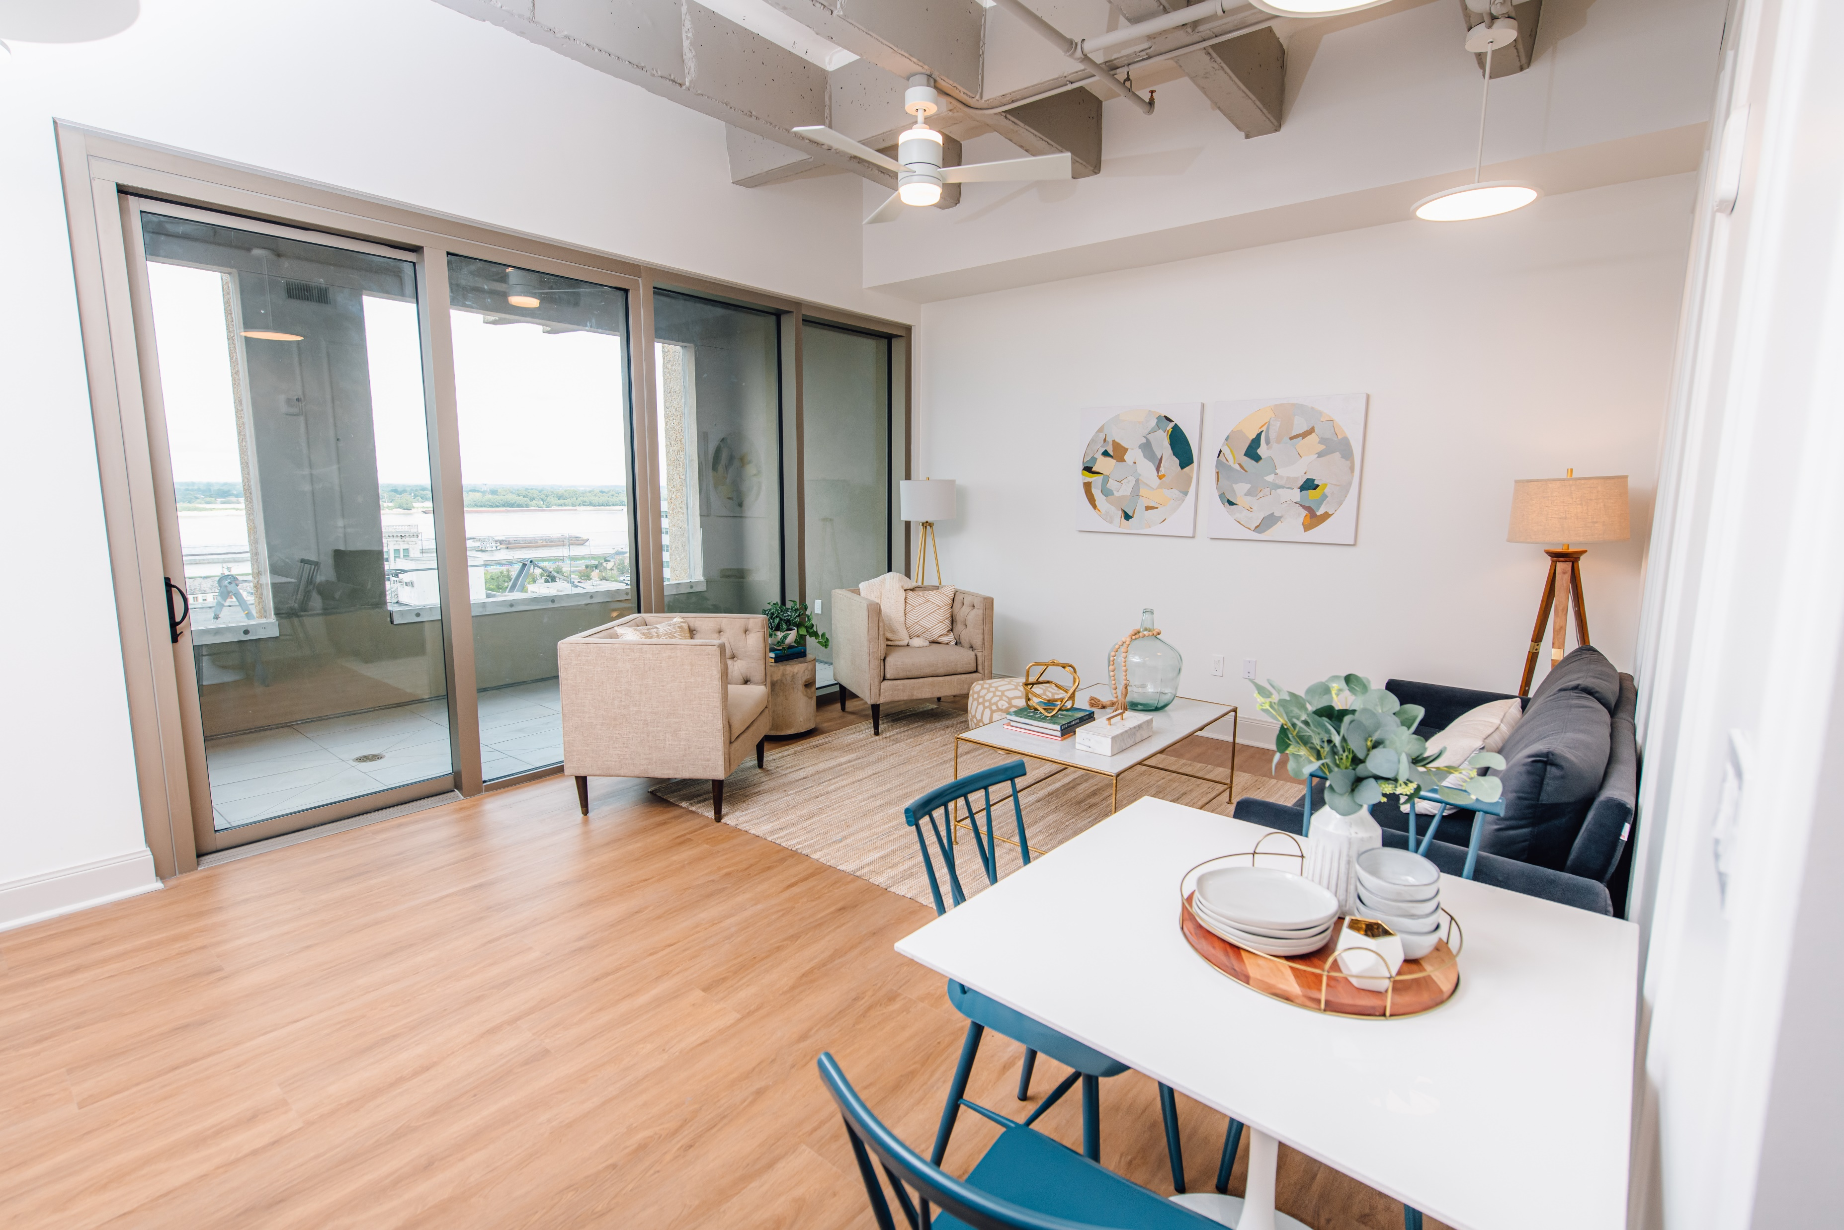
Living Room
OCCUPIED
VACANT

Slide 29
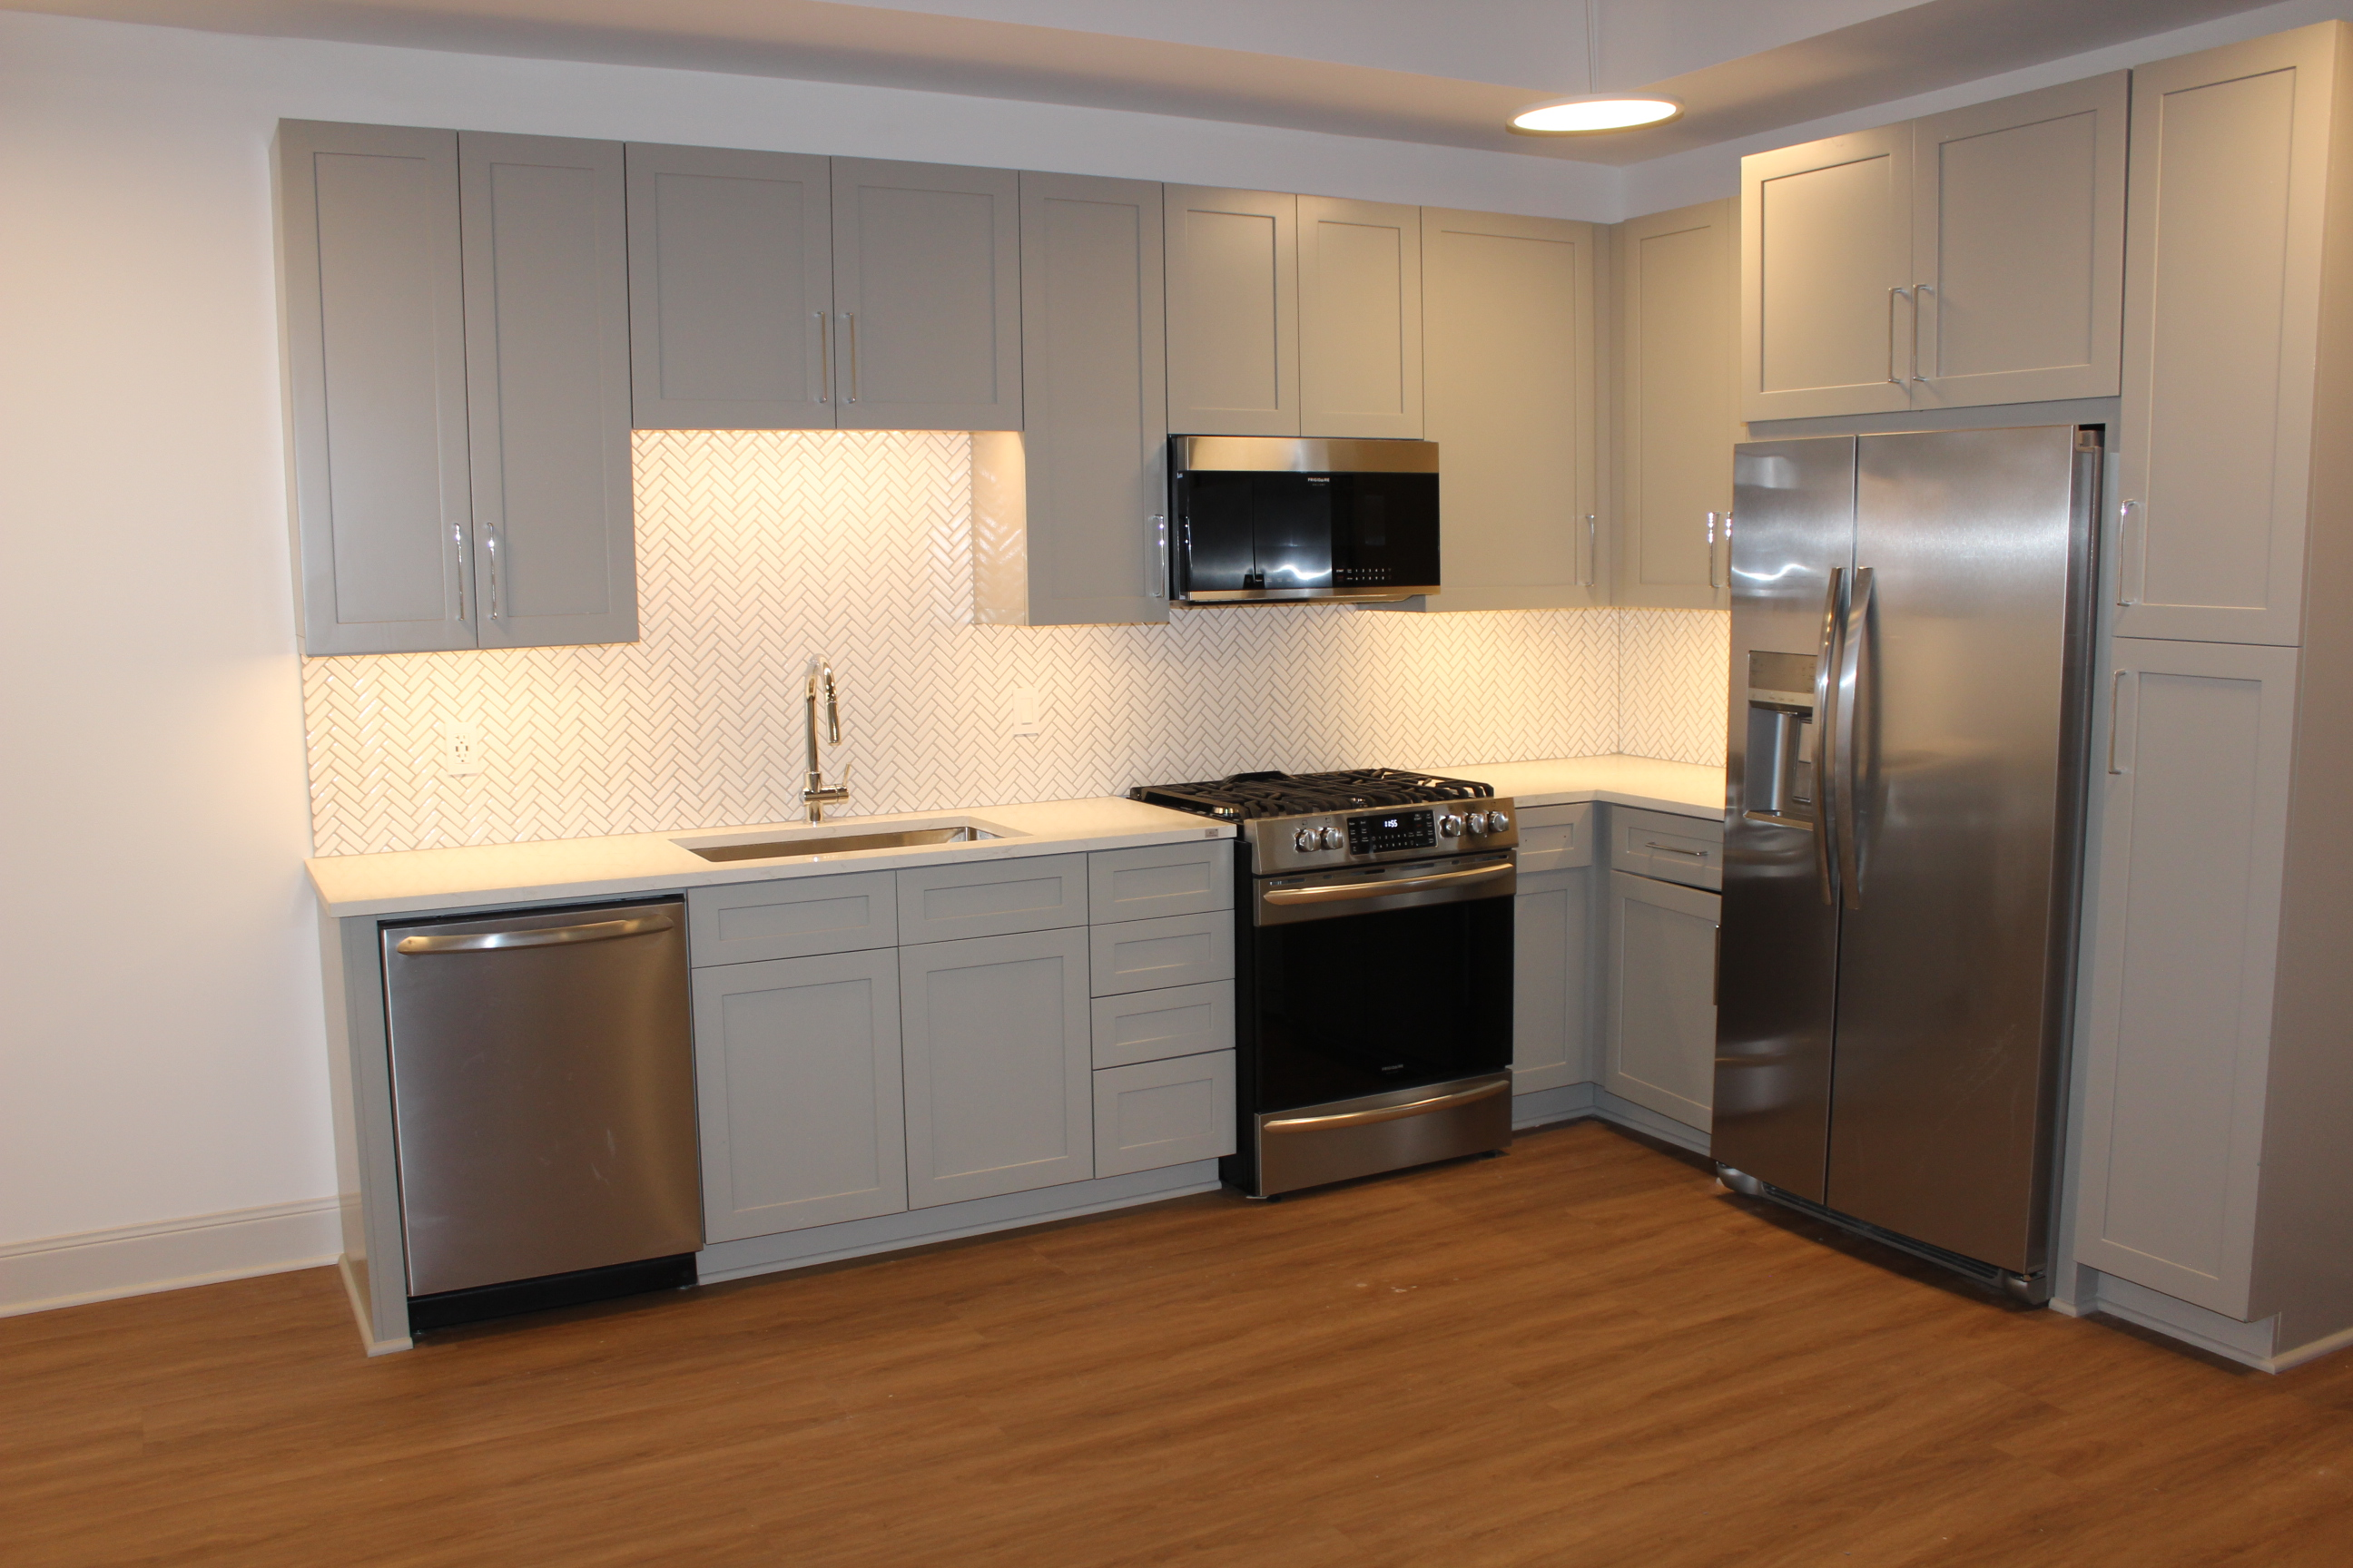
OCCUPIED
VACANT
Kitchen

Slide 30
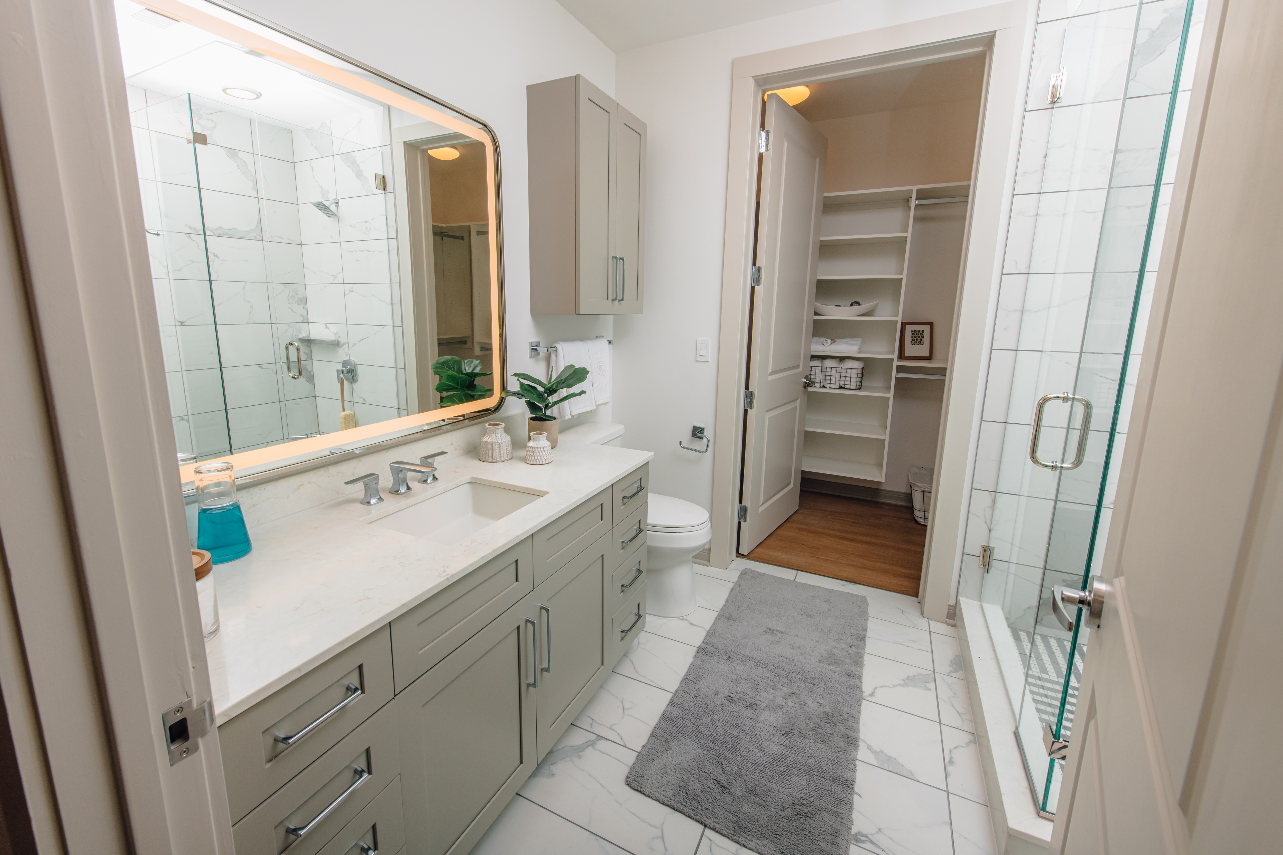
Bathroom
OCCUPIED
VACANT

Slide 31
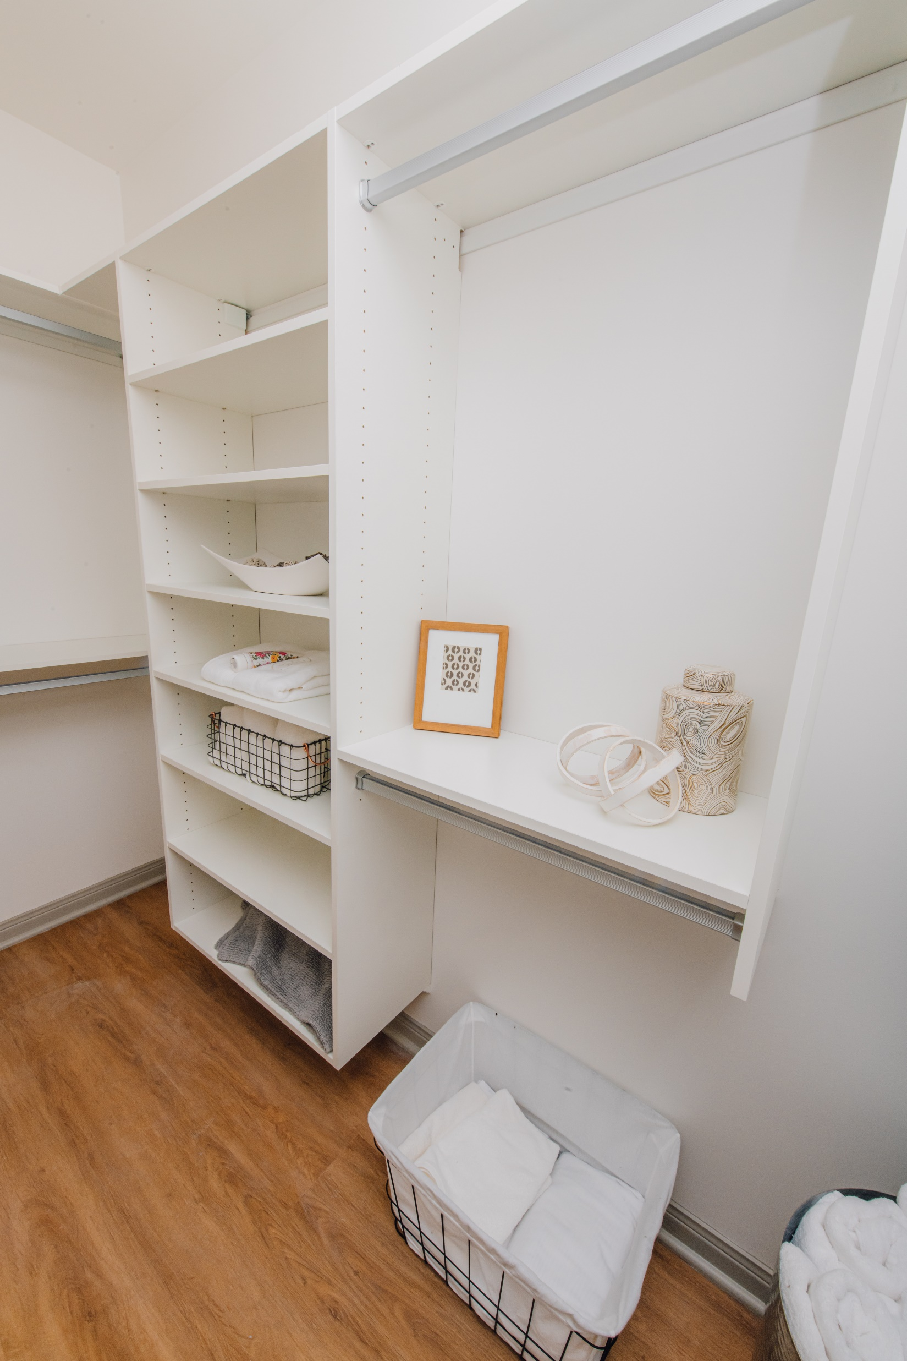
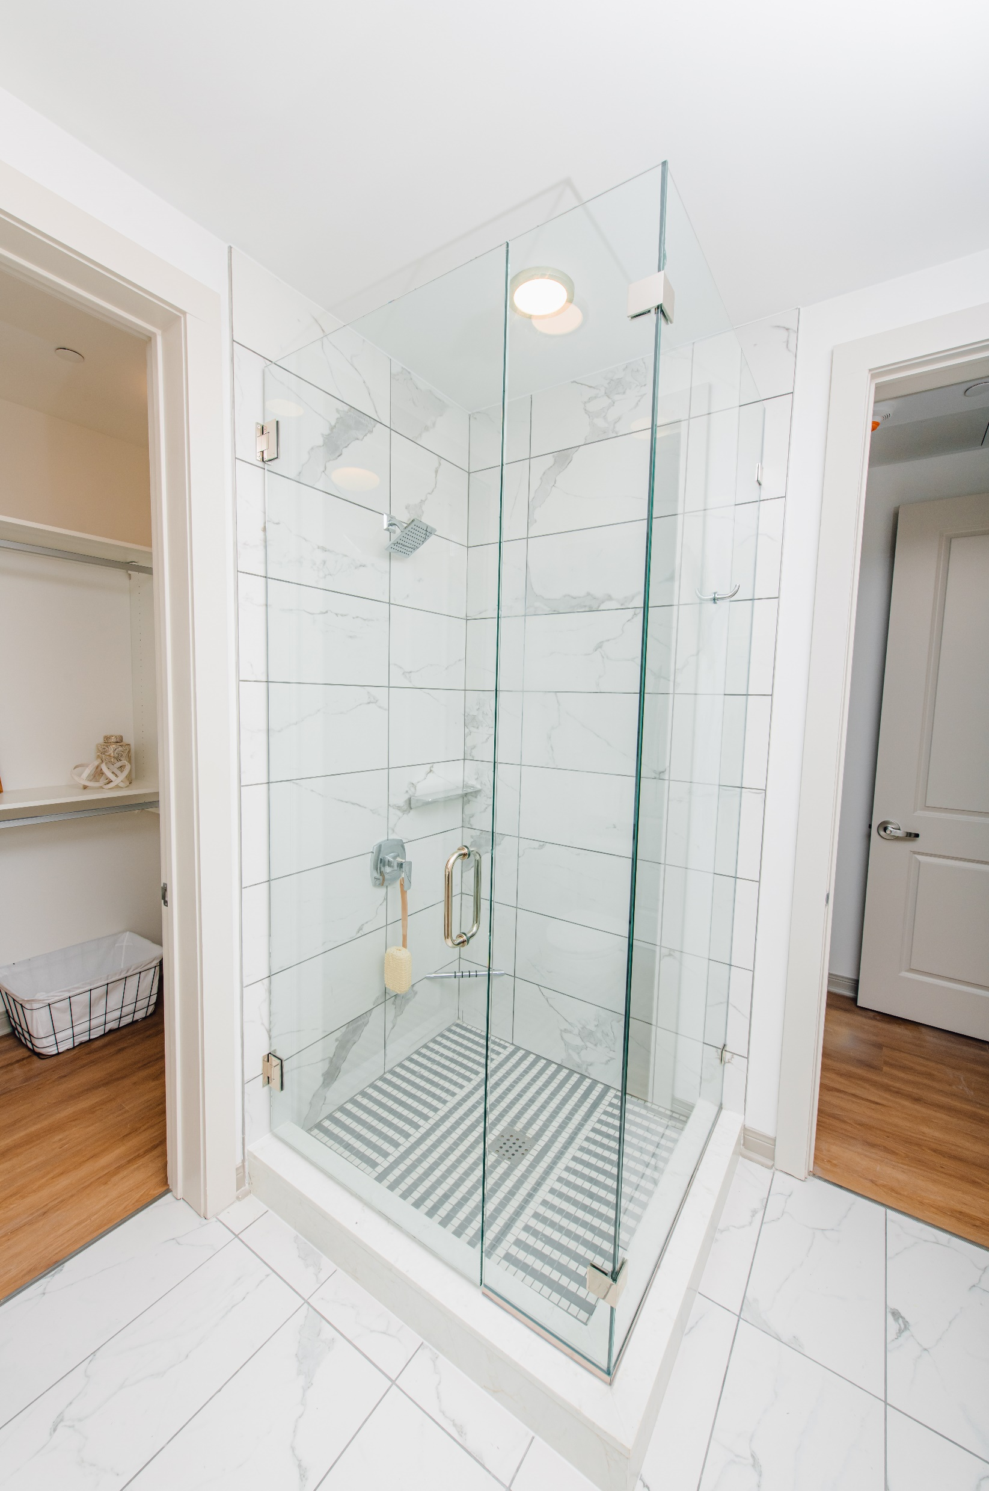
Bathroom
OCCUPIED

Slide 32
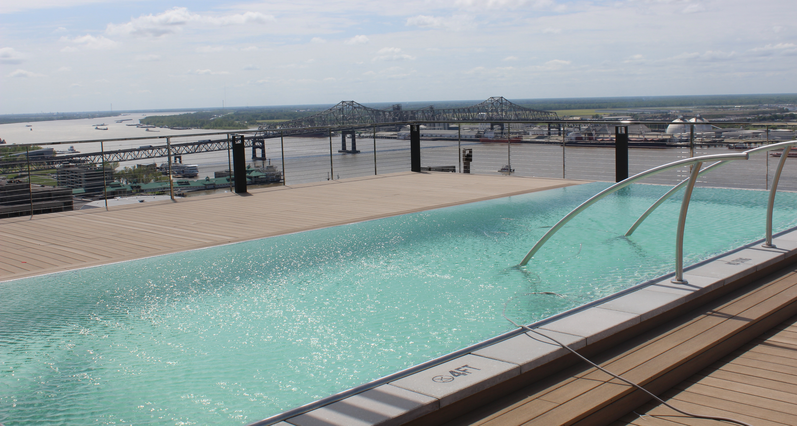
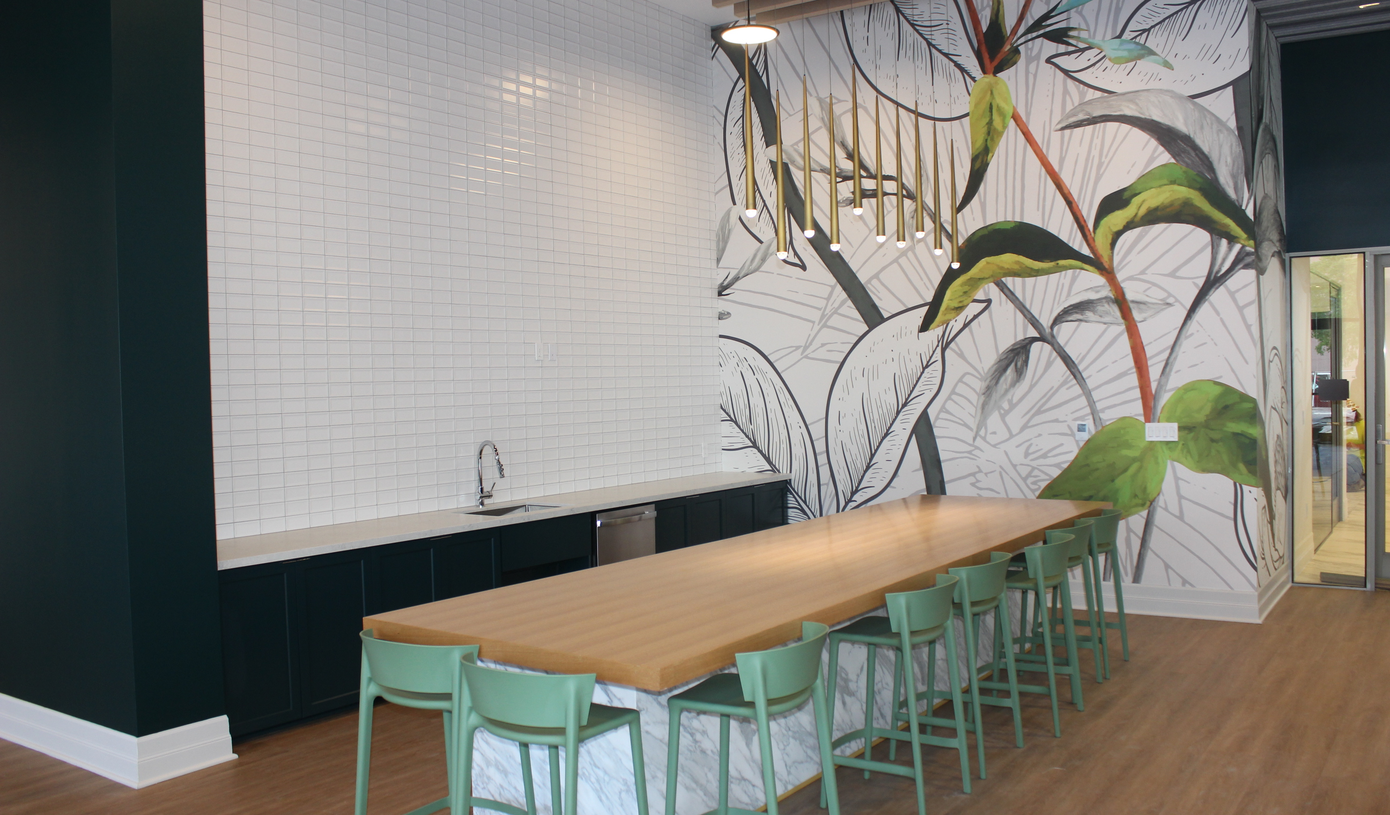
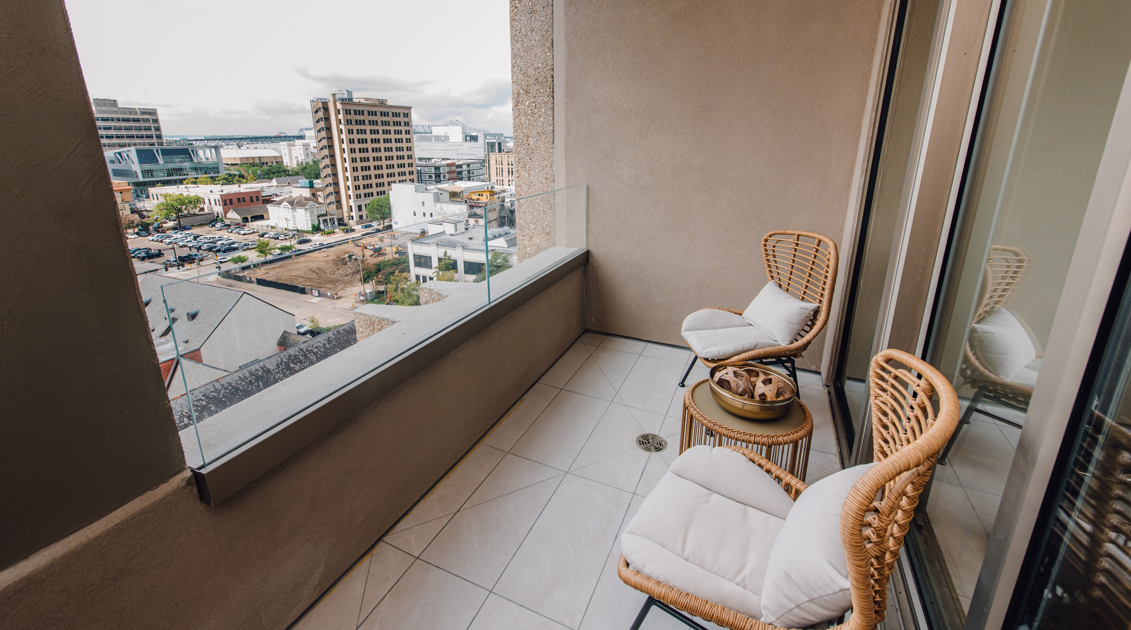

Slide 33
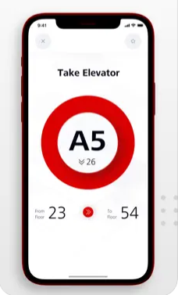
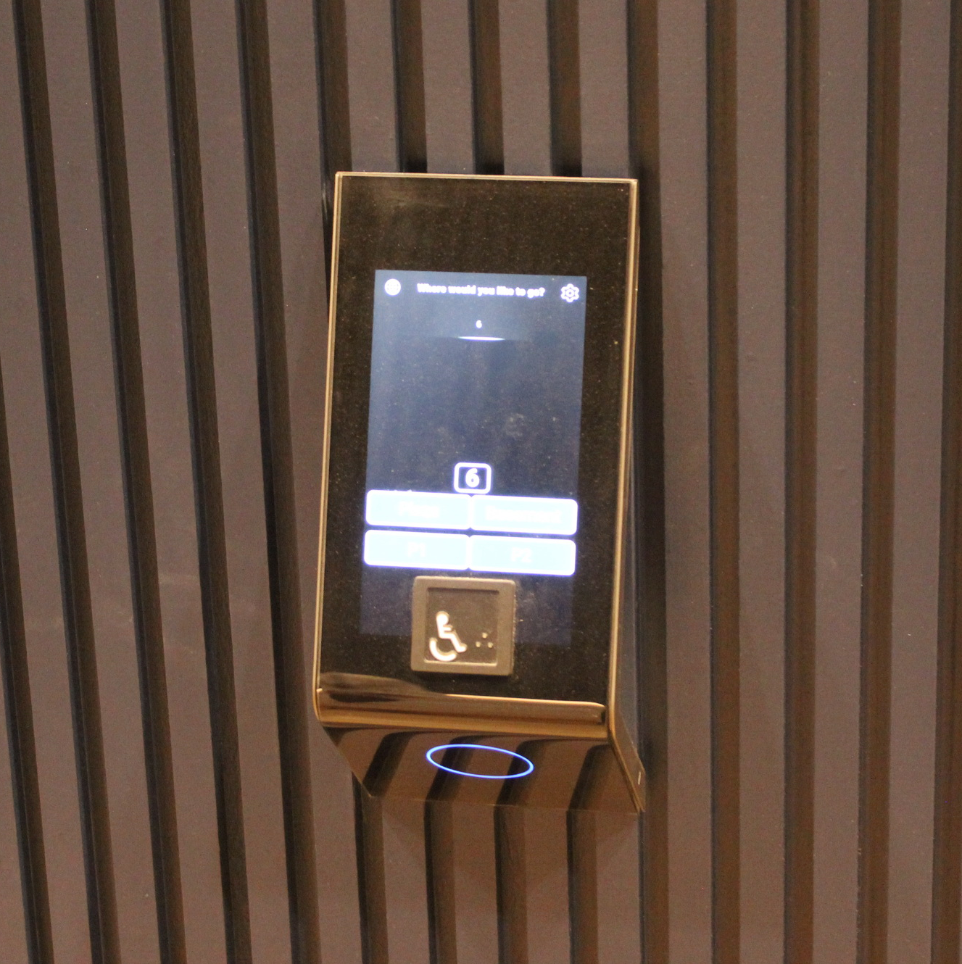
MyPort Elevator App

Slide 34
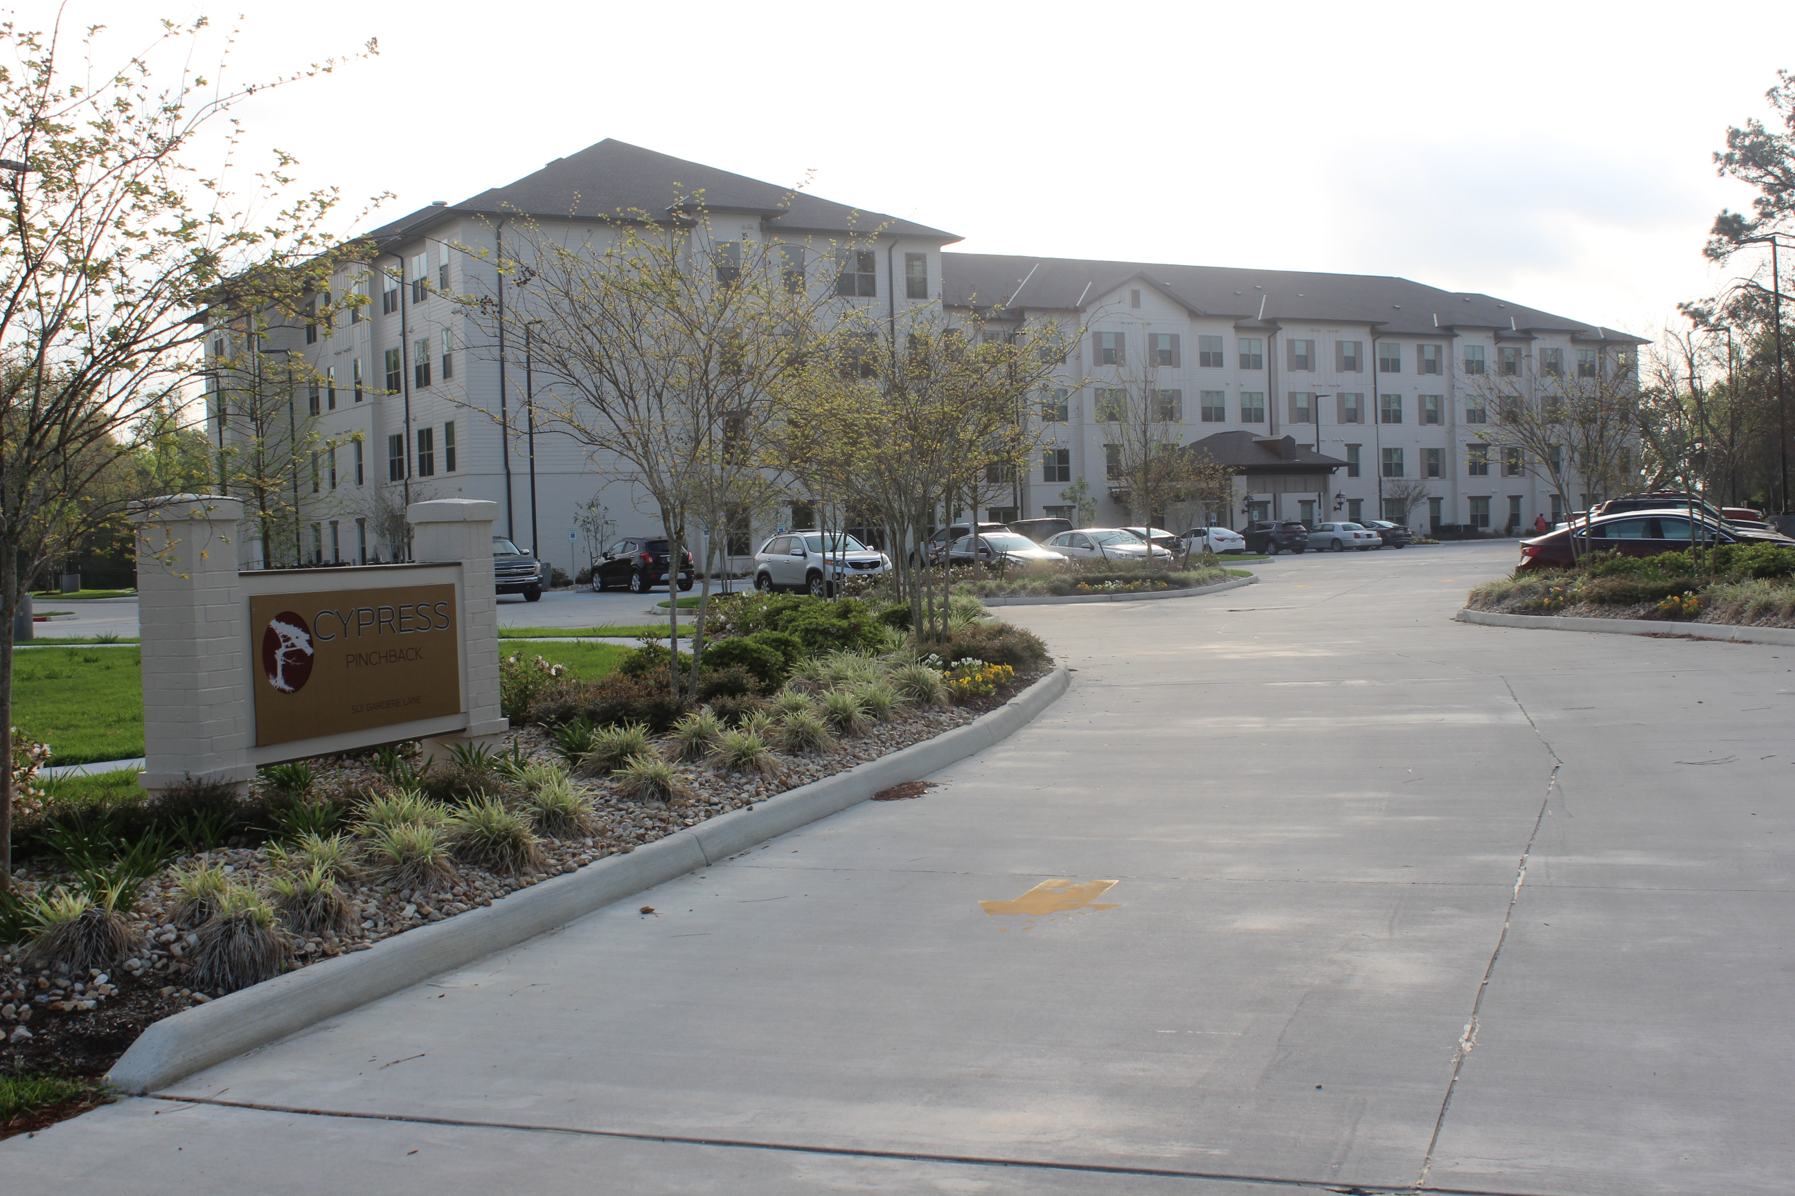
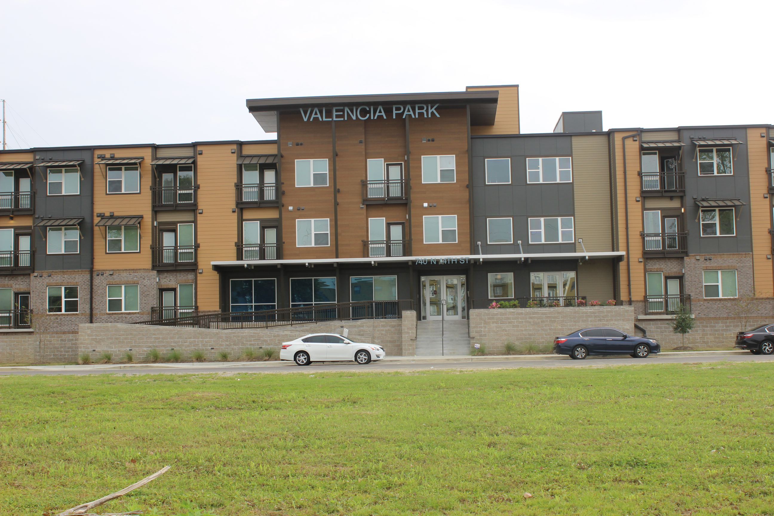
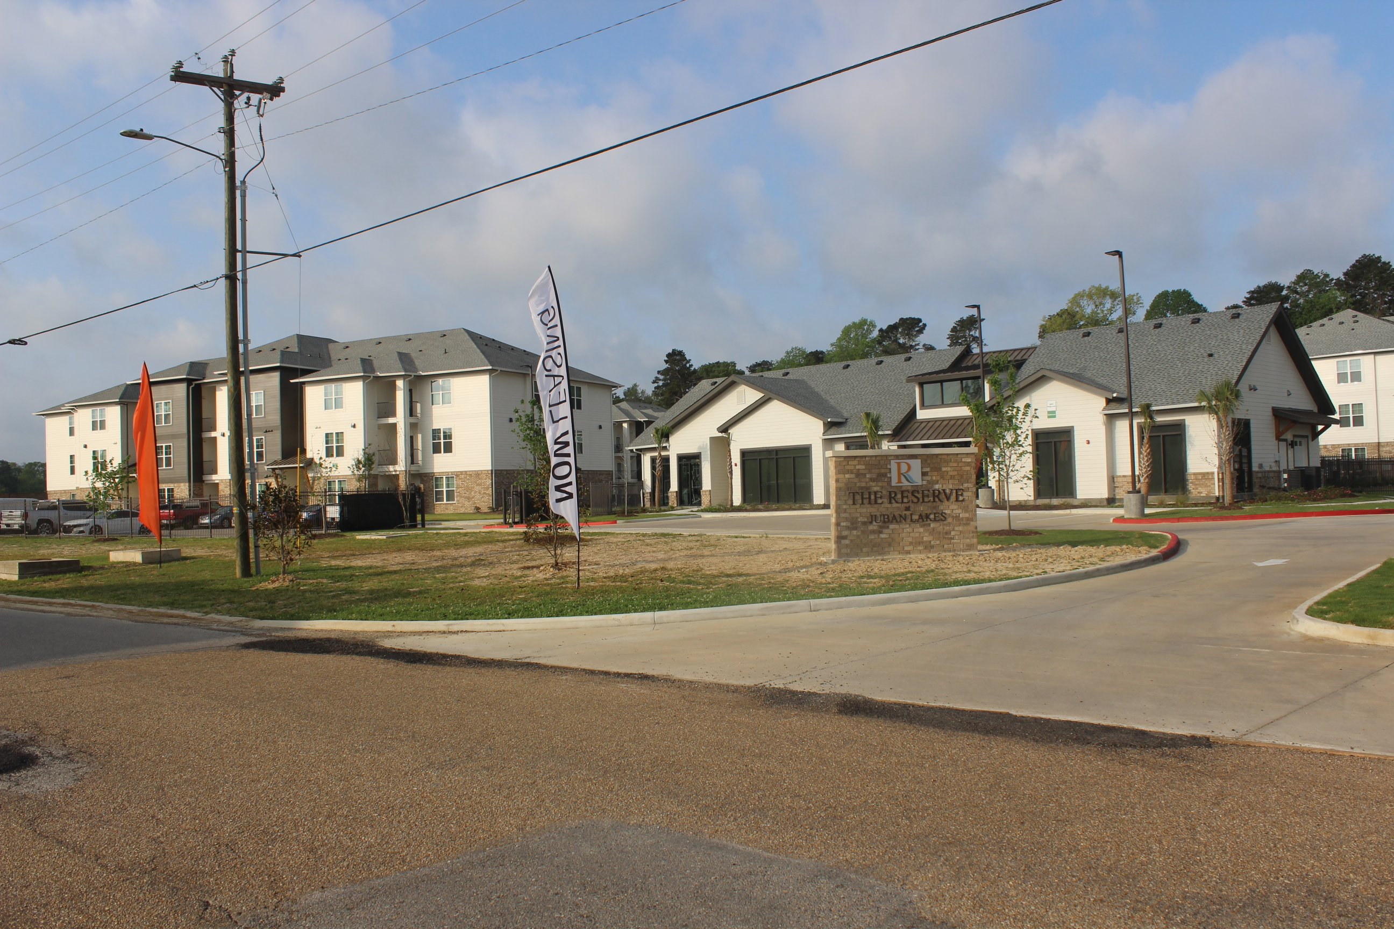
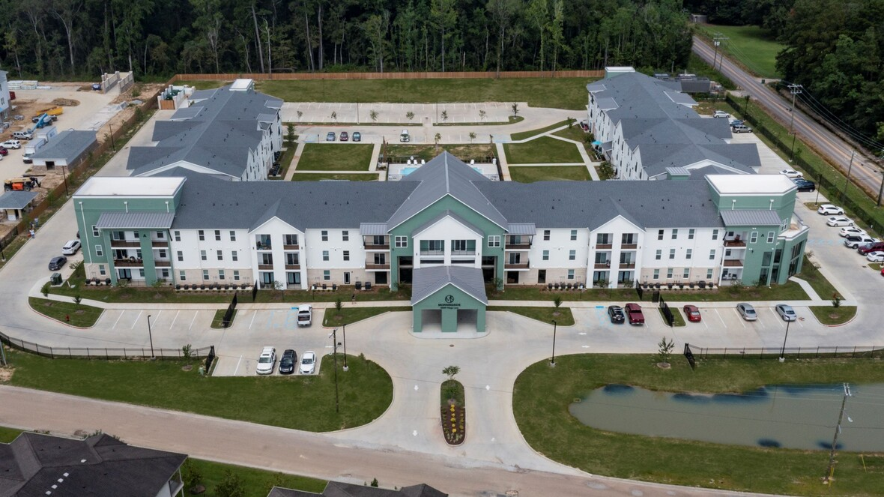
AFFORDABLE COMPLEXES – COMPLETED IN 2022
Completed
2019 352 Units
2020 0 Units
2021 42 Units
2022 473 Units
Cypress at Pinchback (99 Units) 501 Gardere Lane
Valencia Park (122 Units) 740 North 14th Street
Reserve at Juban Lakes (132 Units)
26915 Village Lane, Denham Springs
Morningside at Juban Lakes (120 Units) 26989 Village Lane, Denham Springs)

Slide 35
VALENCIA PARK
APARTMENTS
BATON ROUGE

Slide 36
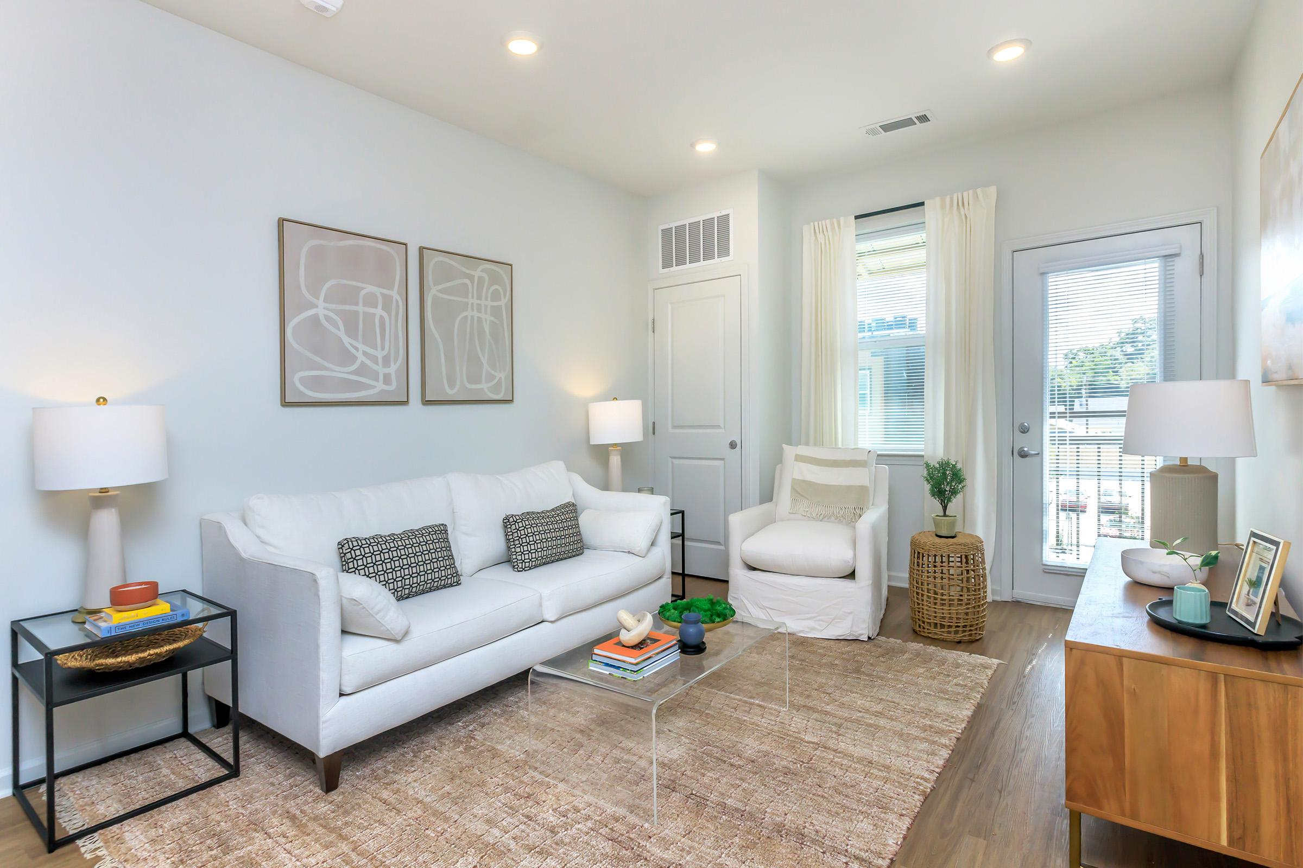
LIVING ROOM

Slide 37
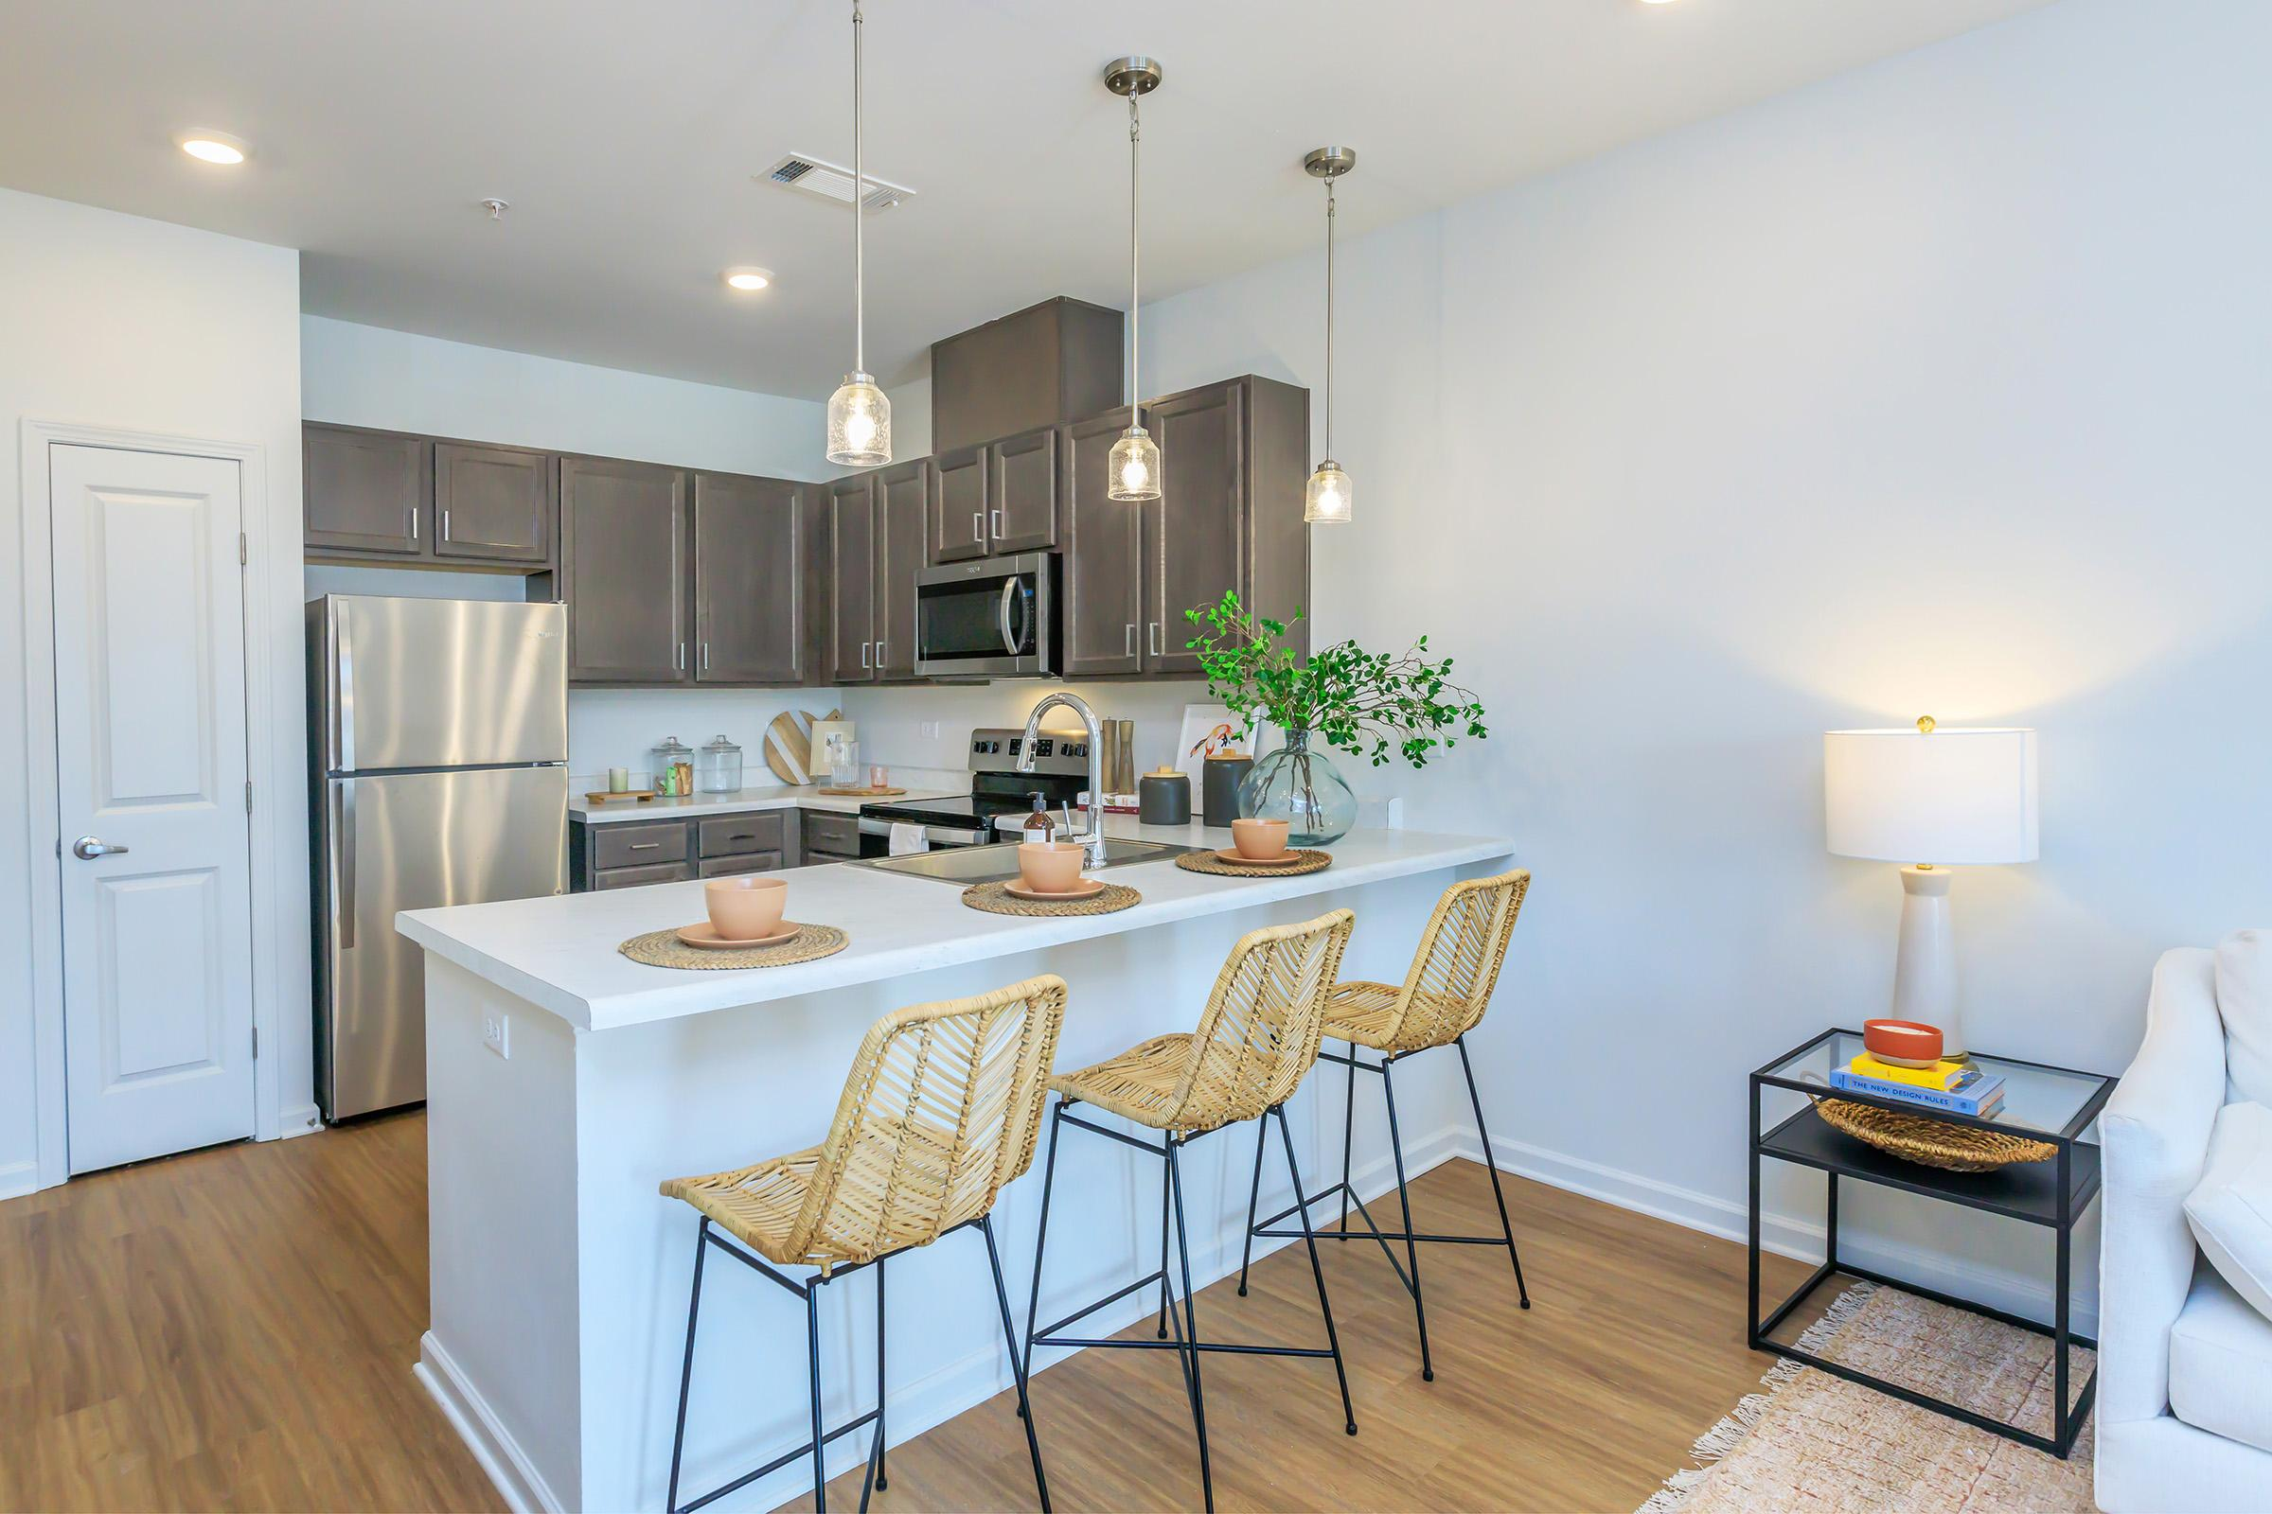
KITCHEN

Slide 38
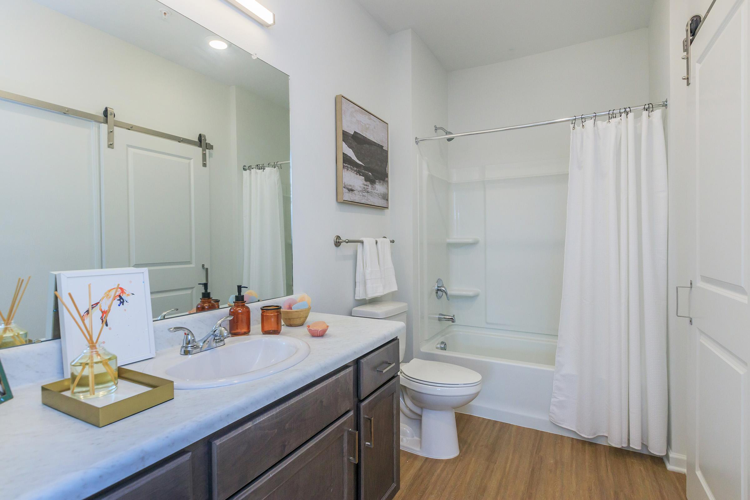
BATH
ROOM

Slide 39
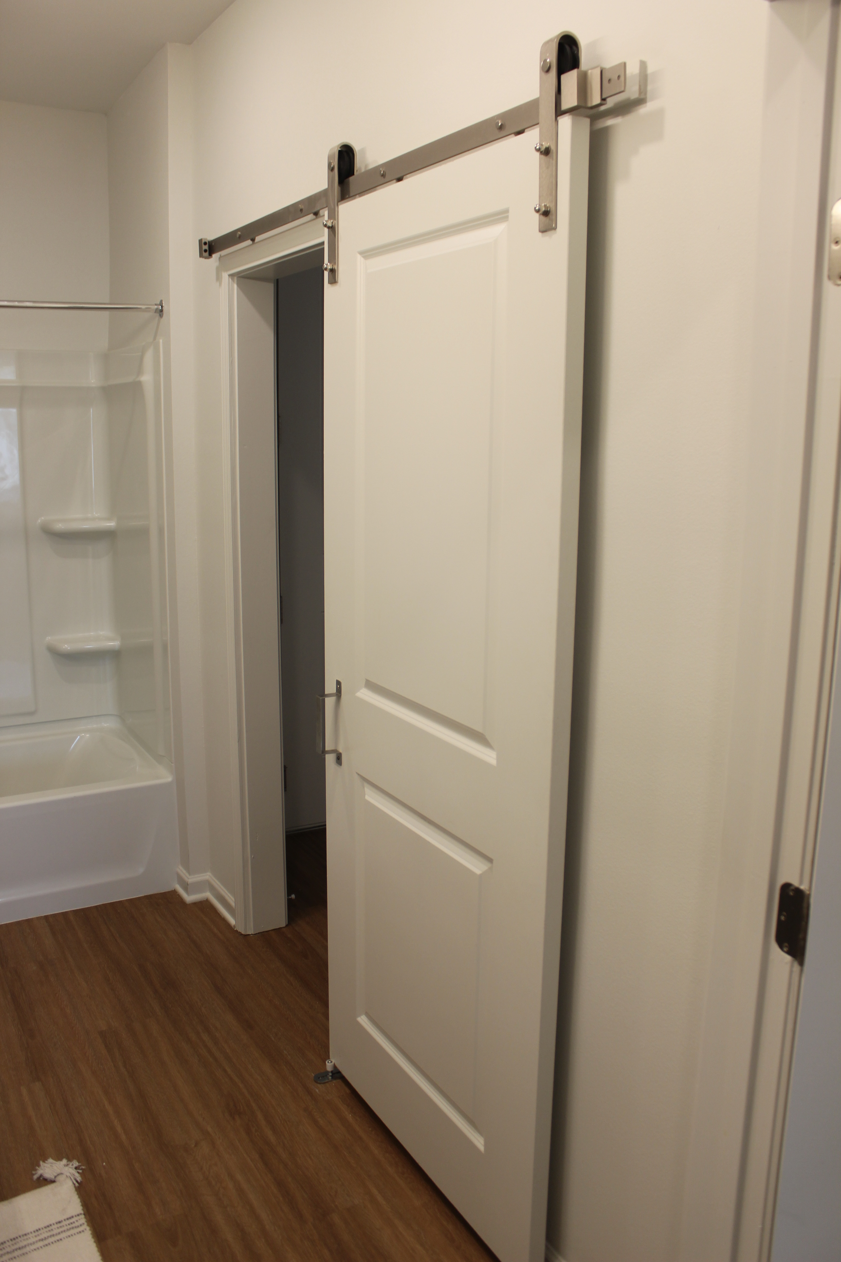
BATH
ROOM

Slide 40
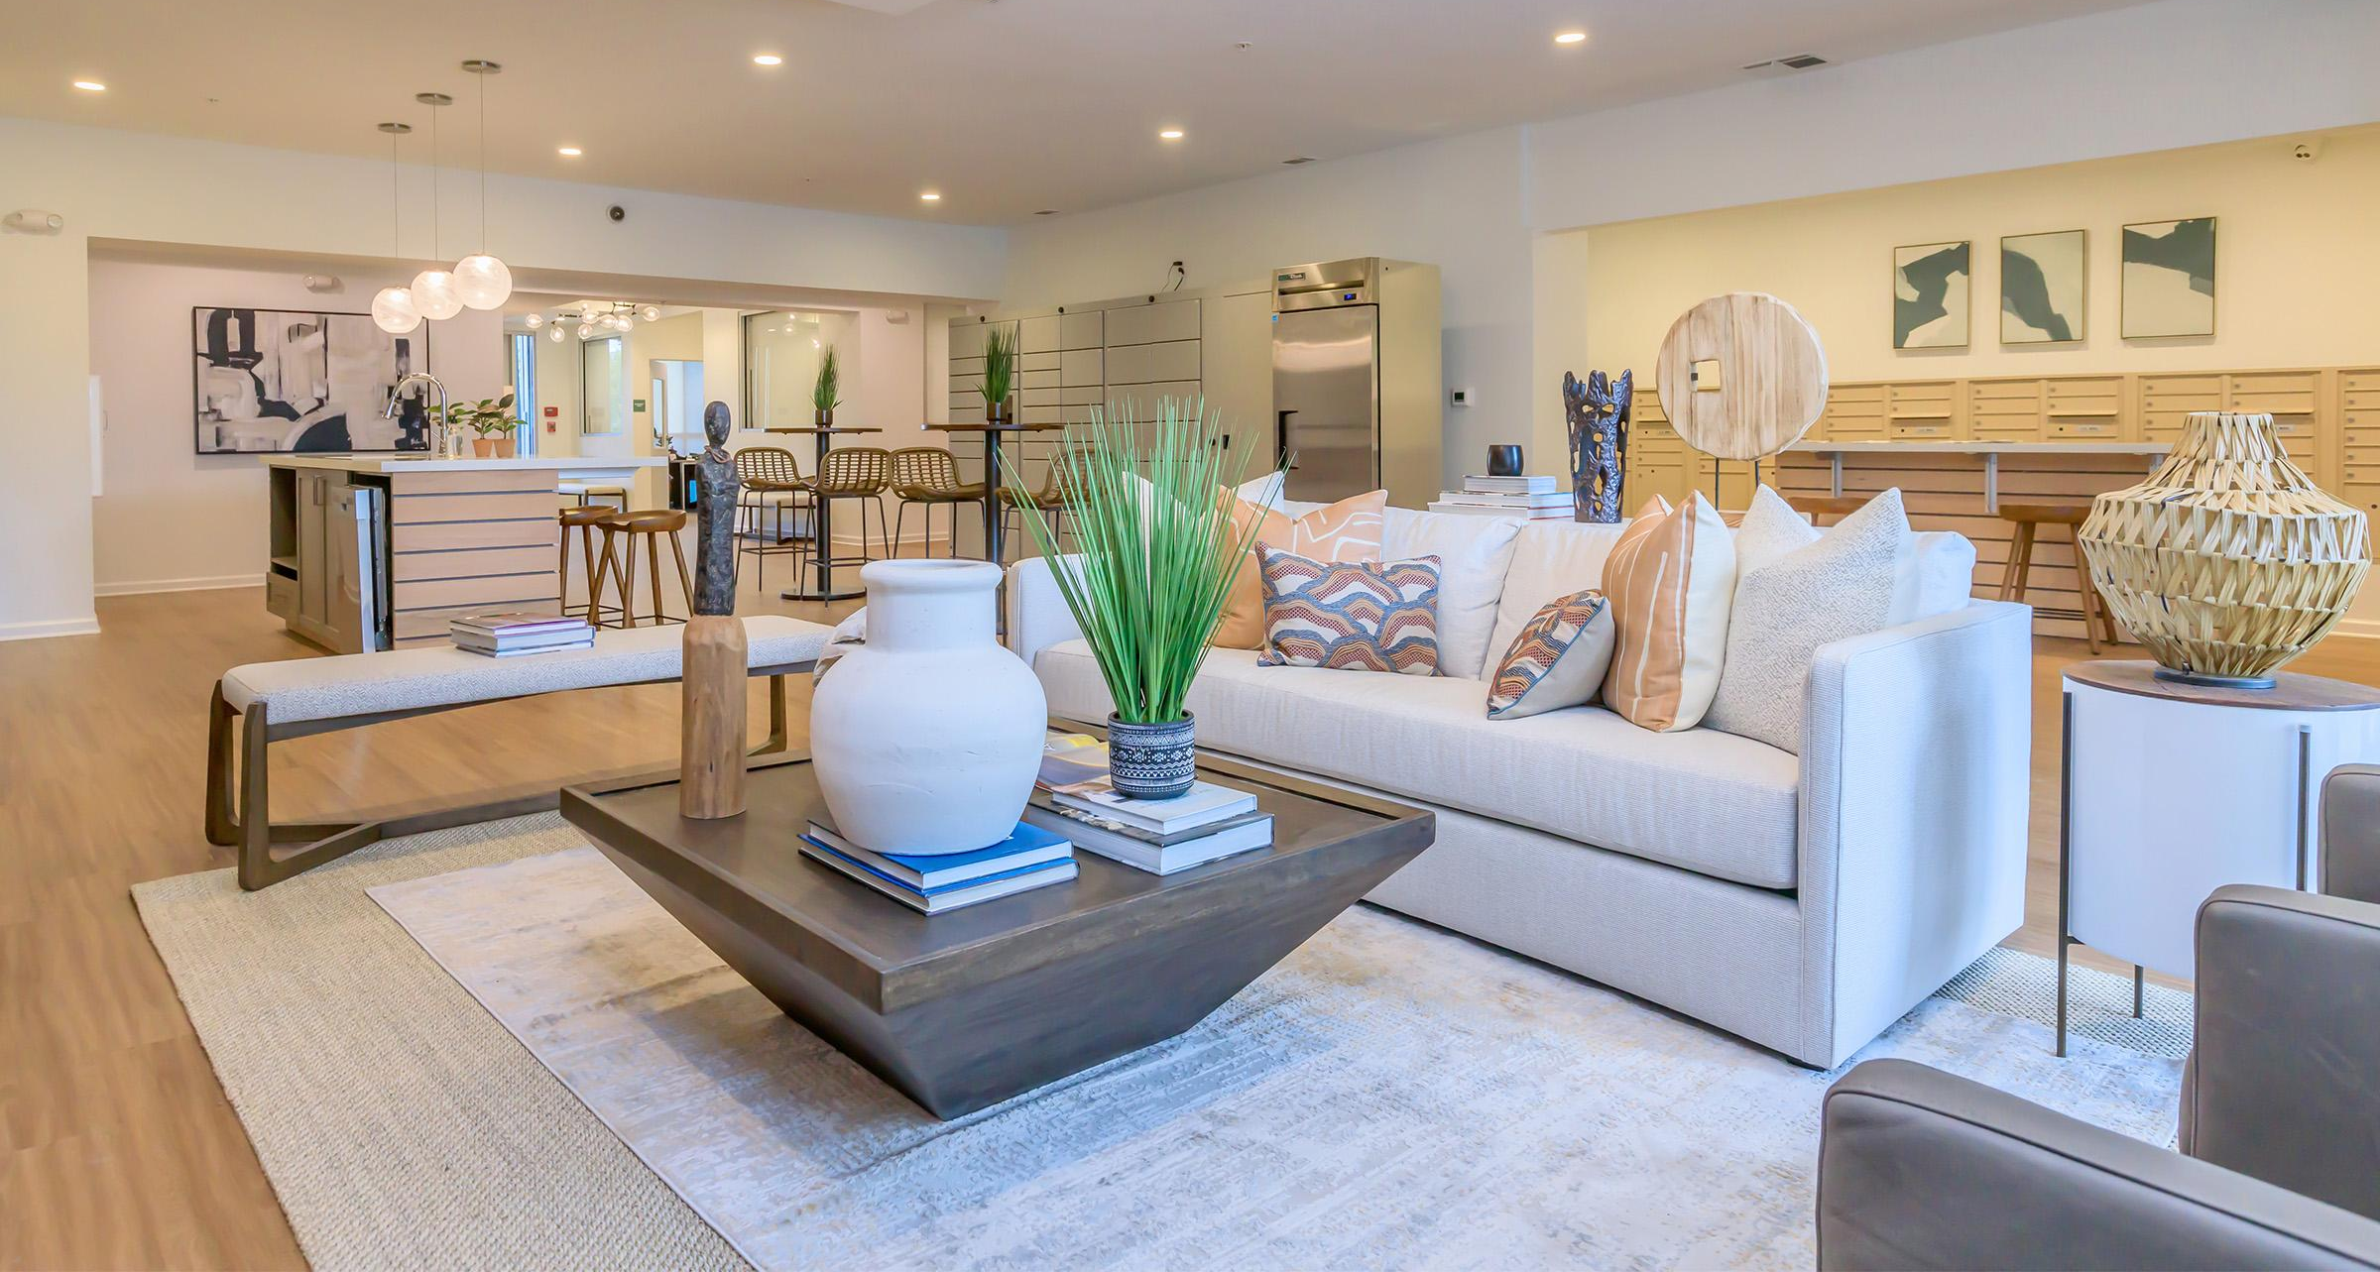
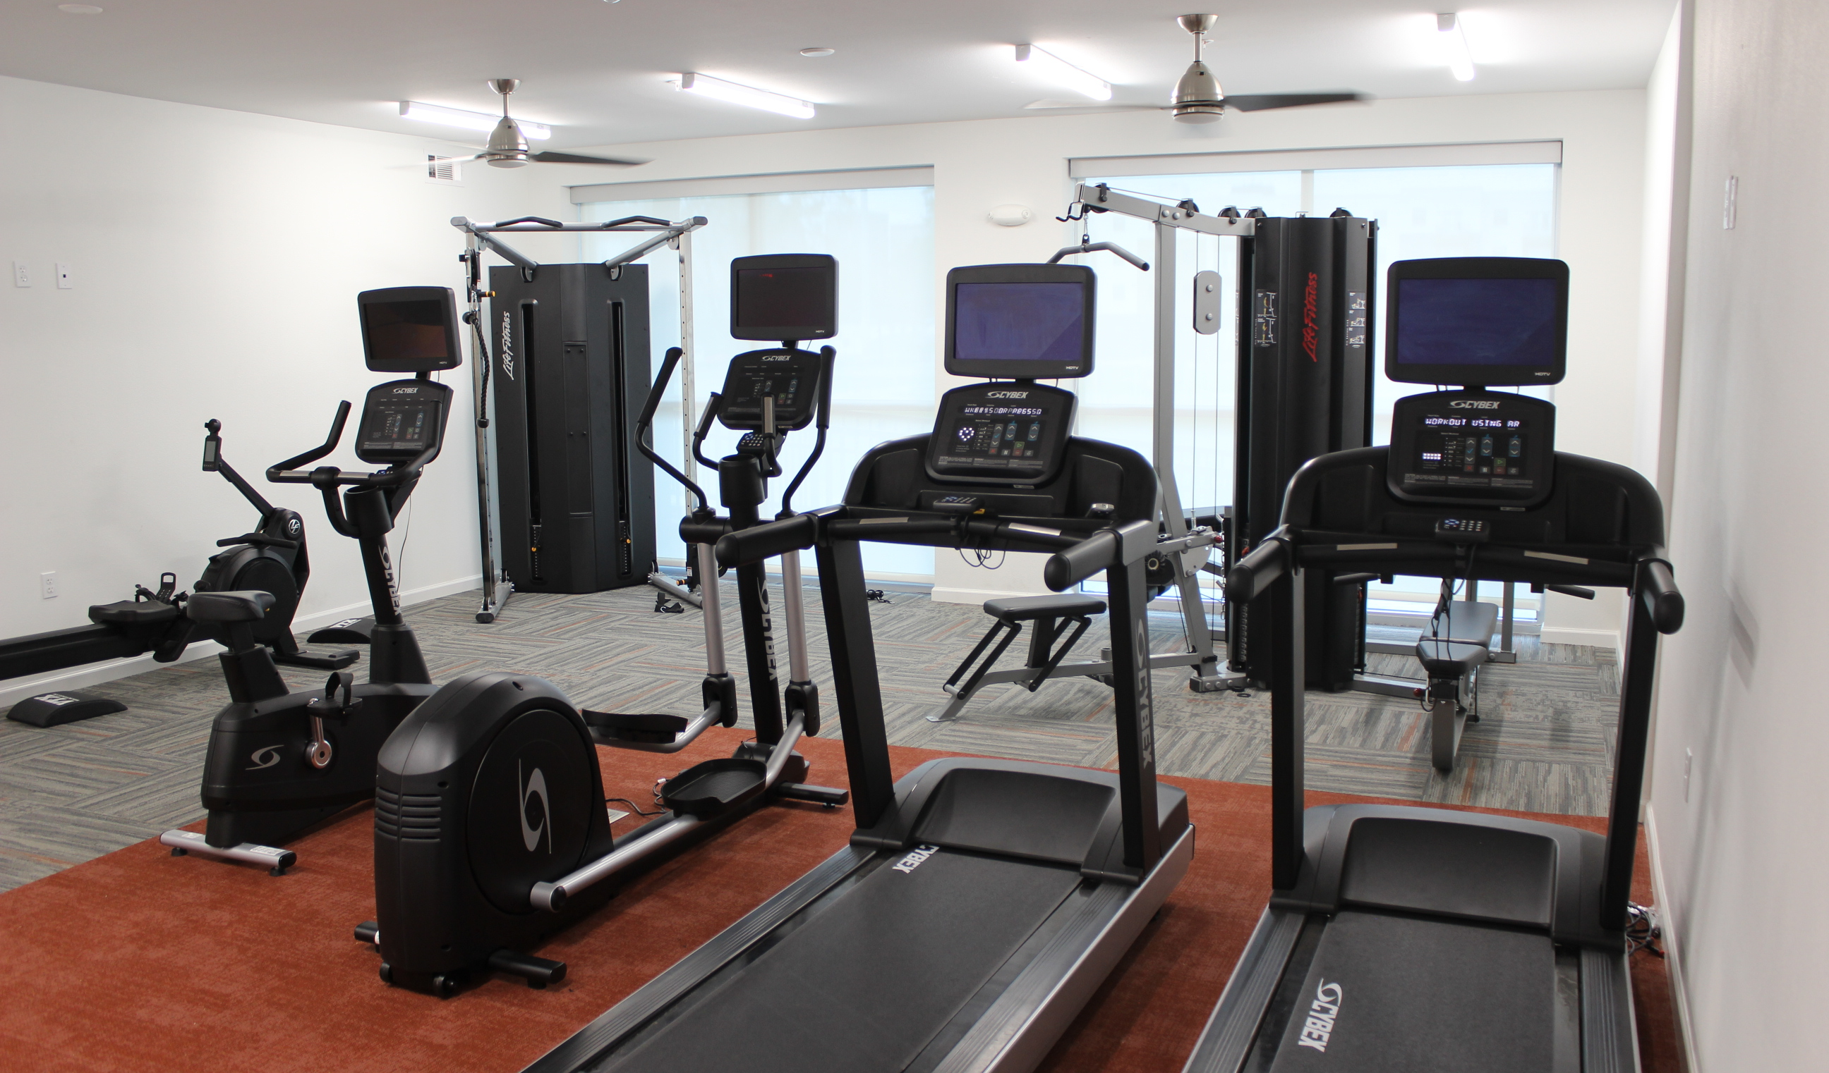
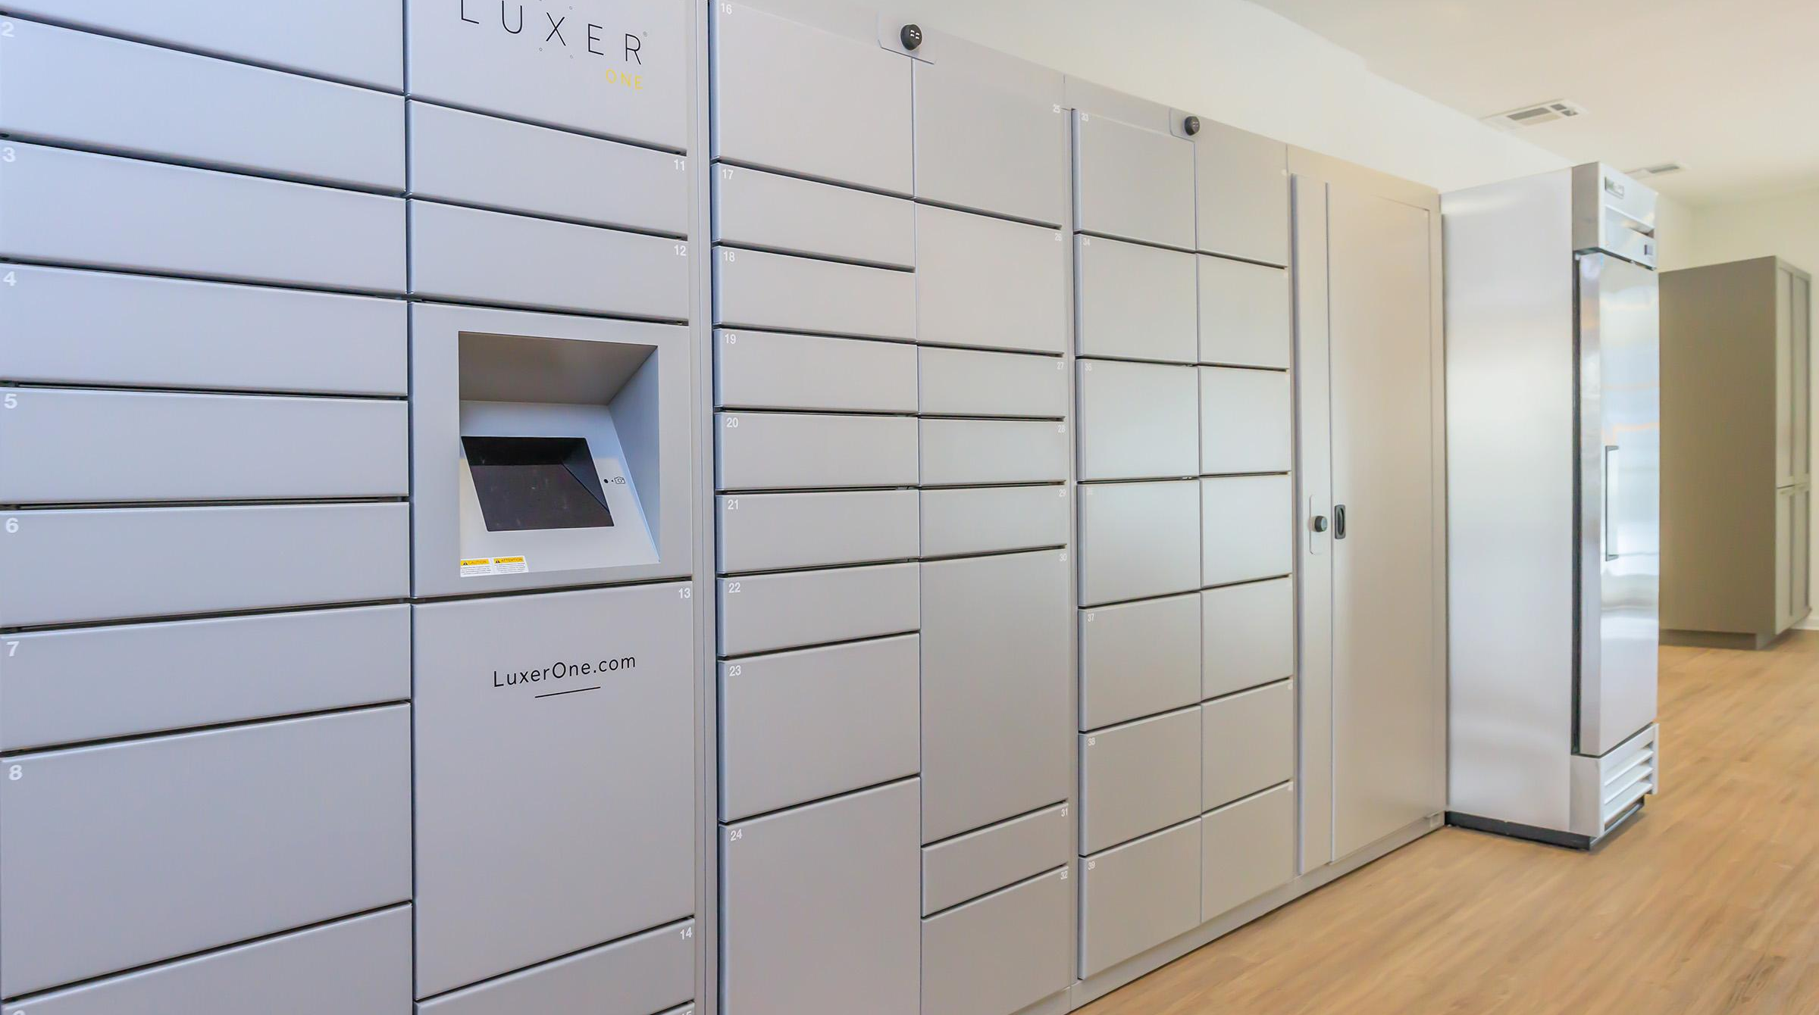

Slide 41
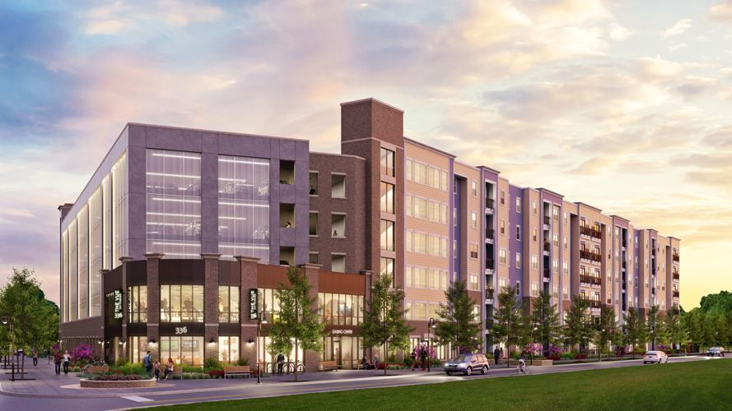
STUDENT COMPLEXES – COMPLETED IN 2022
No Student Complexes Completed Since 2018
Completed in 2018 – 805 Units
Completed in 2019 – 0 Units
Completed in 2020 – 0 Units
Completed in 2021 – 0 Units
Completed in 2022 – 0 Units
The Vue on Parker
(132 Units – 294 Beds) West Parker at Gourier

Slide 42
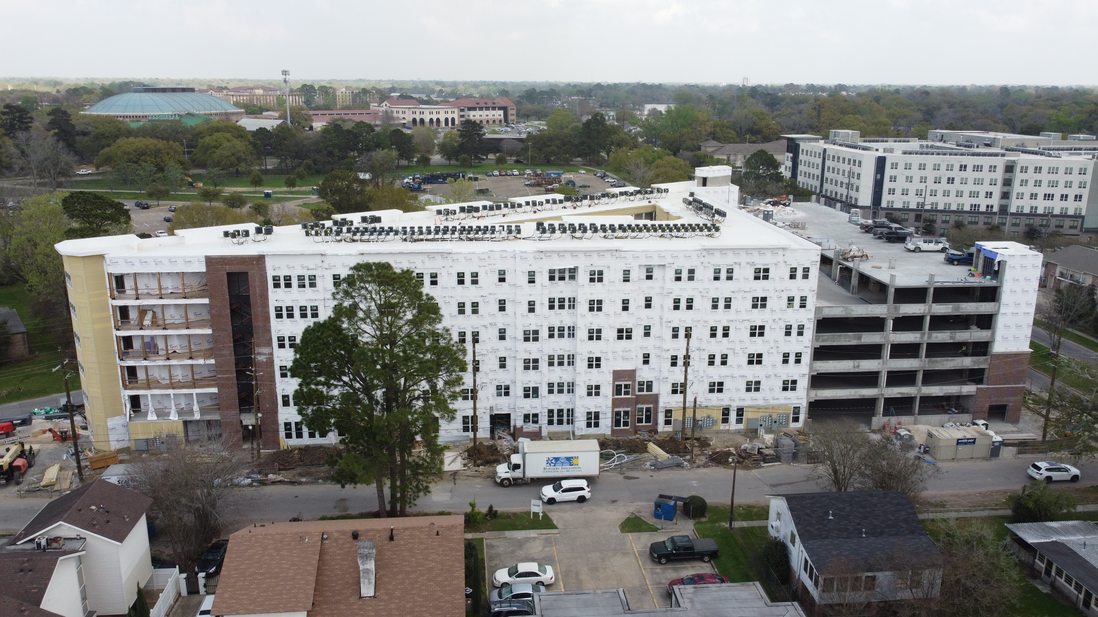
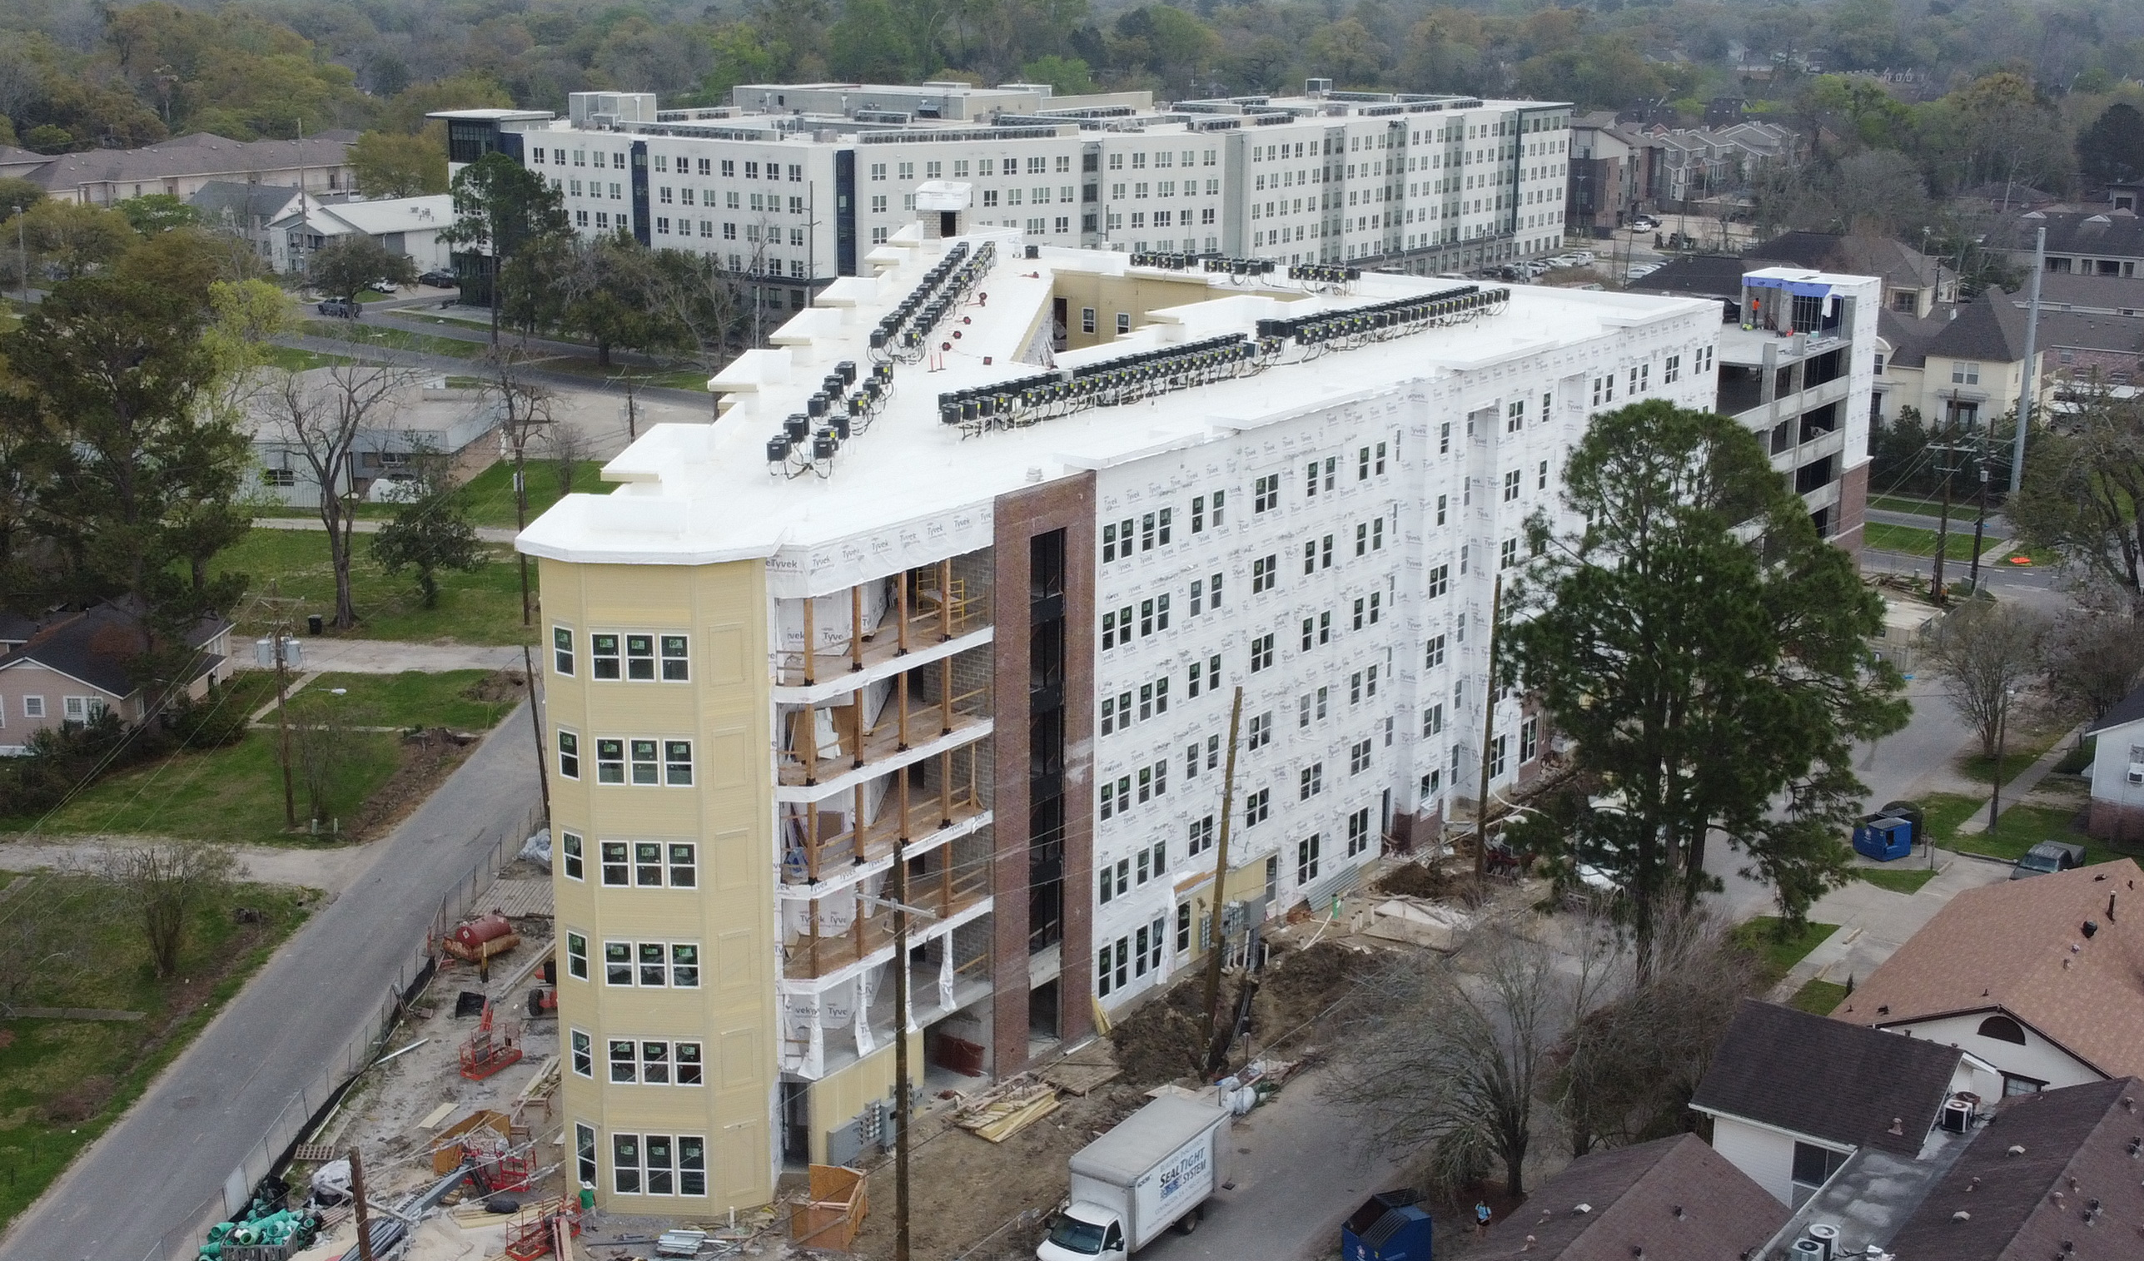
The Vue
on Parker

Slide 43
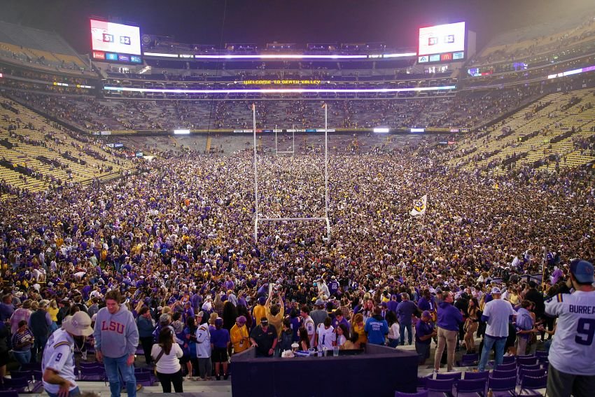
APARTMENTS UNDER CONSTRUCTION 2023-2024

Slide 44
COMPLEXES UNDER CONSTRUCTION
Student 2023 - 2024
Name | Address | # of Units
The Vue on Parker | West Parker @ Gourier | 132
 | Total Units | 132
 | Total Beds | 294
OCCUPIED
VACANT

Slide 45
Name | Address | # of Units
River Mark Centre | 451 Florida Street (CBD) | 168
The Waters on Millerville | Greens Blvd at Millerville | 295
Cedar Grove Townhomes | 14810 Old Jefferson Hwy | 100
The Bend on Bluebonnet | Burbank @ Bluebonnet | 309
Rue Venelle | Rouzan – Perkins Road | 277
The Waters at Heritage | LA Hwy @ LA Hwy 44 (Gonzales) | 299
Oak Heritage Townhomes | 37586 Grand Oaks Dr (Prairieville) | 56
 | Total Conventional Units | 1,504
COMPLEXES UNDER CONSTRUCTION
Conventional 2023 - 2024
OCCUPIED
VACANT

Slide 46
Name | Address | # of Units
Drakes Landing | North Ardenwood Blvd | 216
Motor City Apts | North Blvd. @ Scenic Hwy | 110
Lotus Village Seniors | Gracie St. @ Gayosa St. | 116
Reserve at Howell Place | 4201 Ford Street | 300
Capstone at Scottlandville | 8770 Elm Grove Garden Dr | 84
Hollywood Heights | 4065 Hollywood Street | 45
Hollywood Acres | 3901 Hollywood Street | 45
Sherwood Oaks | Darryl Drive | 280
 | Total Affordable Units | 1,196
COMPLEXES UNDER CONSTRUCTION
Affordable 2023 - 2024
OCCUPIED
VACANT

Slide 47
AFFORDABLE UNIT CONSTRUCTION
2015 - 2024
OCCUPIED
VACANT
1,196
Affordable Units Under Construction
4,286
Additional Affordable Units Surveyed in 38 Complexes
91%
Current Occupancy Ranges from 75% to 100%

Slide 48
PROPOSED COMPLEXES 2024-2025
 | Total Units | Conventional | Student | Affordable
Total Proposed 2024-2025 Likely | 2,196 | 1,261 | 0 | 935
Total Proposed 2024-2025 Less Likely | 869 | 683 | 0 | 186
Total Proposed/Announced 2024-2025 | 3,065 | 1,944 | 0 | 1,121

Slide 49
NUMBER OF UNITS COMPLETED/PROPOSED 2012-2024
2023 U.C.
1,196 Affordable
1,636 Market
2015 – 2019
7,822 Units Constructed or 1,564 Units/Yr
2020 – 2022
1,776 Units or 592 Units/Year

Slide 50
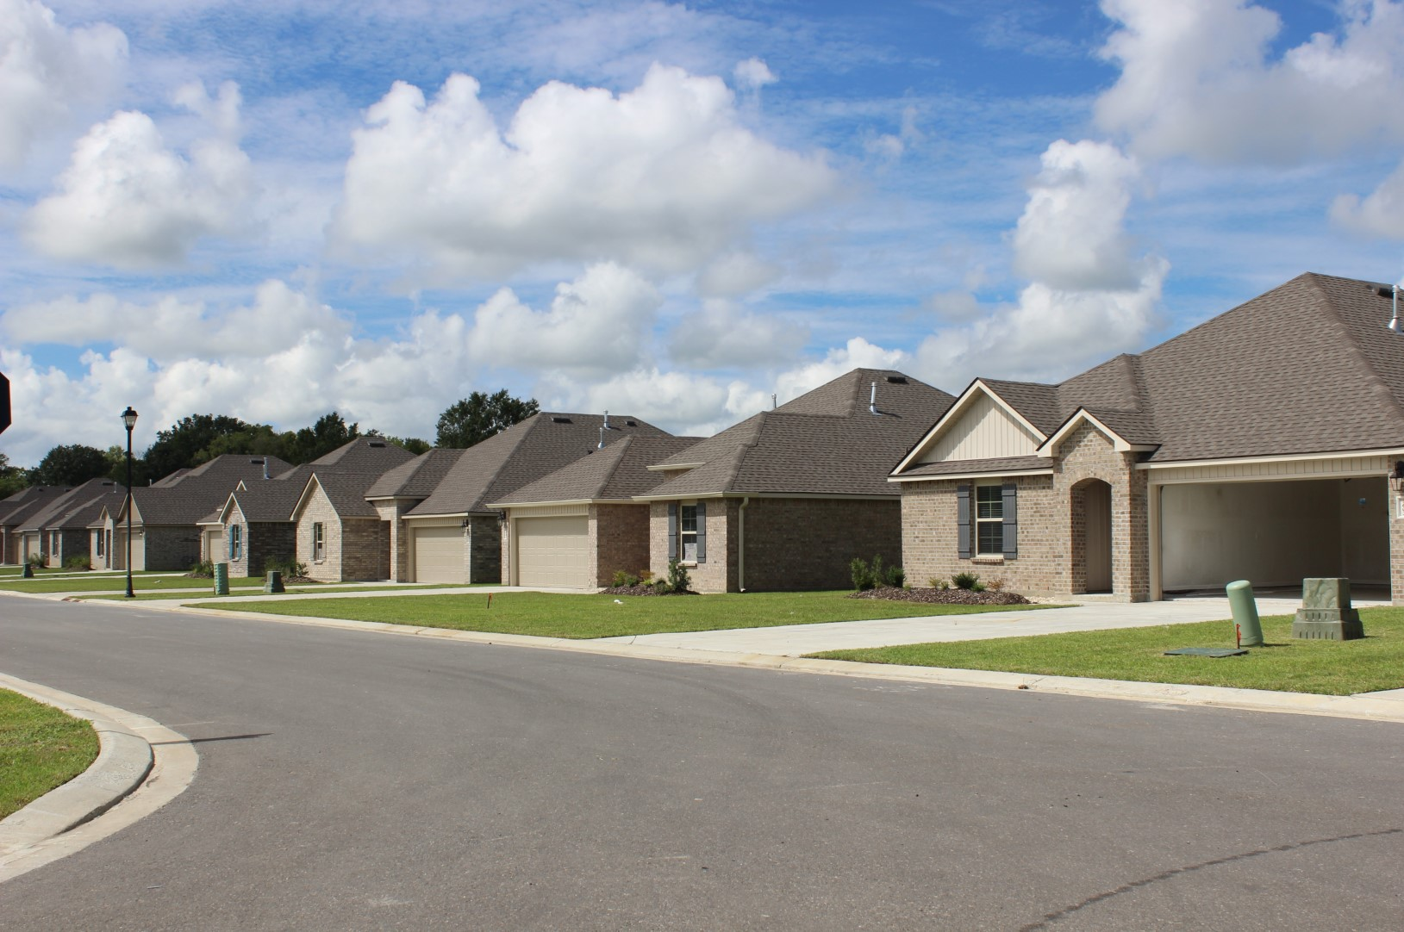
Baton Rouge and Overall Market
Other Trends in the Rental Housing Market
SINGLE-FAMILY RESIDENTIAL RENTAL COMPLEXES
Entire single-family subdivisions for rent instead of for sale
BLACKROCK/VANGUARD
Shadow market of single-family homes purchased for rentals
2022 ---
2023

Slide 51
SUMMARY AND CONCLUSIONS

Slide 52
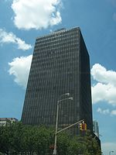
Market Summary - 2022
RENTS
VACANCY
CONSTRUCTION
SALES
Up 1.7% to an
Average of $1.18/sf Up 11.3% from
2021 to 2023
4.81% Matched Sample LSU Area at 3.88%
Only 515 Units Completed in 2022; Lowest Since 2014 2,832 Units Under Construction
Record $895+ Million in Sales Significant Slowdown in 4th Qtr 2022 and
1st Qtr 2023

Slide 53
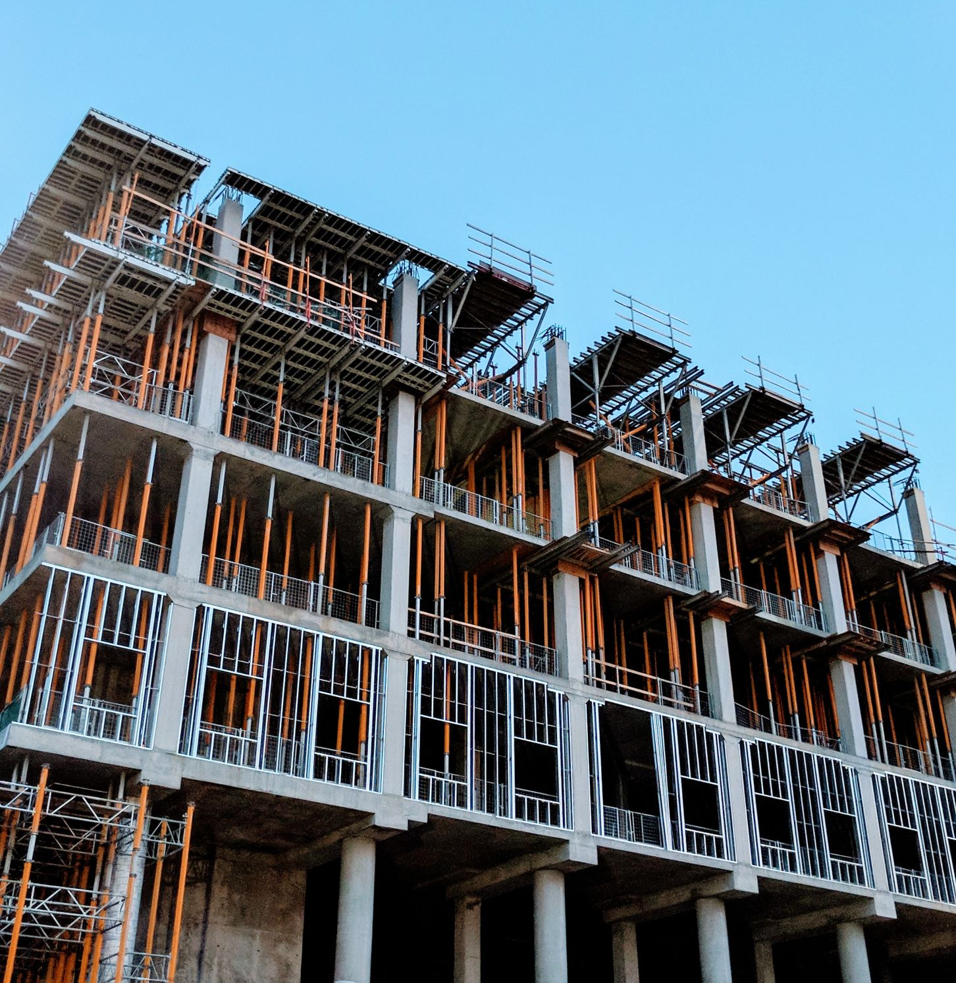
Multifamily Projections 2023-2024
RENTS
VACANCY
CONSTRUCTION
SALES
Continue to INCREASE in 2023 - 2024
at Historical
1% to 3% Level
Remain at Current Overall 5% to 7% Vacancy Levels
Watch Affordable Properties
With Interest Rates Increasing, Construction of New Units Will Likely Slow Down
Significant Slowdown of Sales Due to Increasing Interest Rates

Slide 54
MULTIFAMILY COMMITTEE MEMBERS
D. Wesley Moore, II, MAI, CCIM
Cook, Moore, Davenport & Associates
Abby McMasters
Cook, Moore, Davenport & Associates
Mark Segalla
Elifin Realty – Multifamily Division
Deane Bryson
Bearing Point Properties
Laura T. White, CPM
NAI Latter & Blum Property Management
Chris Gremillion, CCIM
Multifamily Division of NAI Latter & Blum
Chad Rigby
Stirling Investment Advisors

Slide 55
THANK YOU
Contact Info
Craig Davenport, MAI
Cook, Moore, Davenport & Associates
www.CookMoore. com
cdavenport@cookmoore.com

