Slide 1


FINANCE
PRESENTED BY
Jim Purgerson, CCIM – Citizens Bank & Trust

Slide 2


FINANCE COMMITTEE MEMBERS
Jim Purgerson, CCIM
Trends Speaker
Citizens Bank & Trust
Brian S. Andrews, CMB
TRENDS Magazine Research
The Real Estate Research Institute
At LSU’s E. J. Ourso College of Business
David Miller
Citizens Bank & Trust
Jake Vascocu
Bank of St. Francisville
T. Jefferson Fair
American Planning Corporation

Slide 3
TEAM FINANCE
Home mortgage rates
Survey of Local Bankers
  Appetite for loans based on property type
  Interest rate trends by certain property types (and owner occupied / non-owner occupied)
  Impact of rate increases on loan renewals
  Debt Service Coverage requirements
  Impact of Rising Insurance Costs
  Rising CRE Delinquency Rates
  Banker Concerns & Hot Topics for Regulators

Slide 4
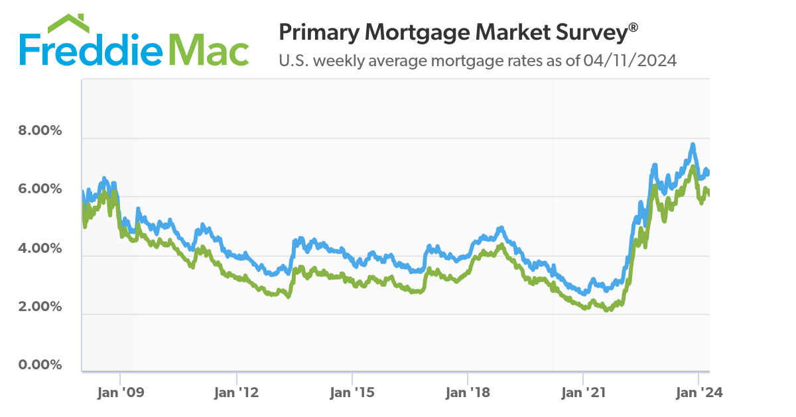


U.S. weekly average mortgage rates 2008 - 2024
October 26, 2023
30 Yr 7.79%
2008
30 Yr 6.63%
April 17, 2024
30 Yr 7.10%
January 7, 2021 30 Yr 2.65%
2012
30 Yr 3.31%
SOURCE: FREDDIE MAC

Slide 5
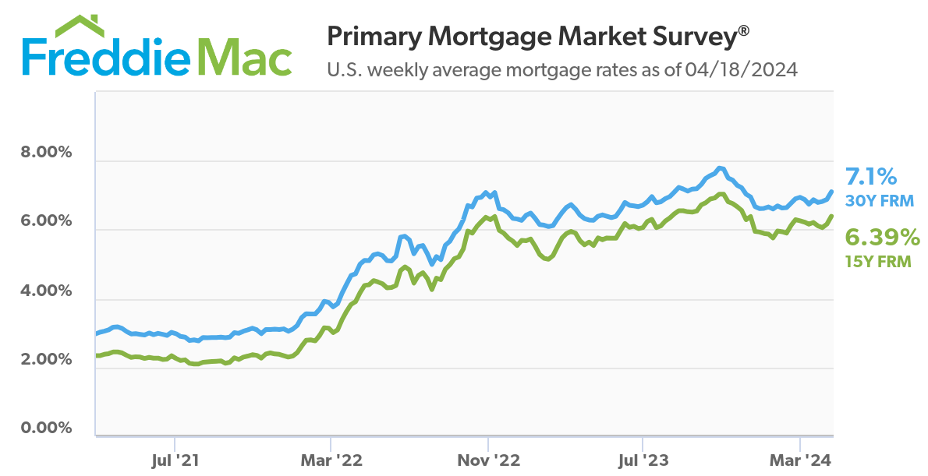
October 26, 2023
30 Yr 7.79%
April 2024
30 Yr 7.10%
August 2021
30 Yr 2.77%
SOURCE: FREDDIE MAC

Slide 6
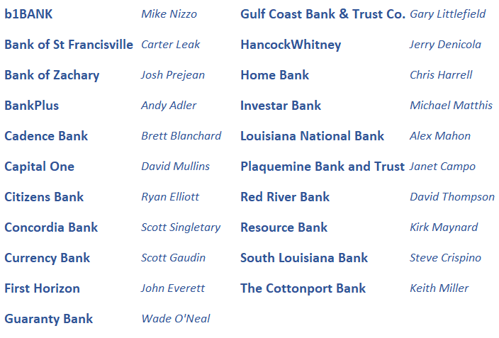
BANKER SURVEY
Survey of Local Financial Institutions
Rates
Appetite for
Property Types
Debt Coverage Ratios
Impact of rising interest rates
Rising Insurance Costs
Regulator Concerns

Slide 7
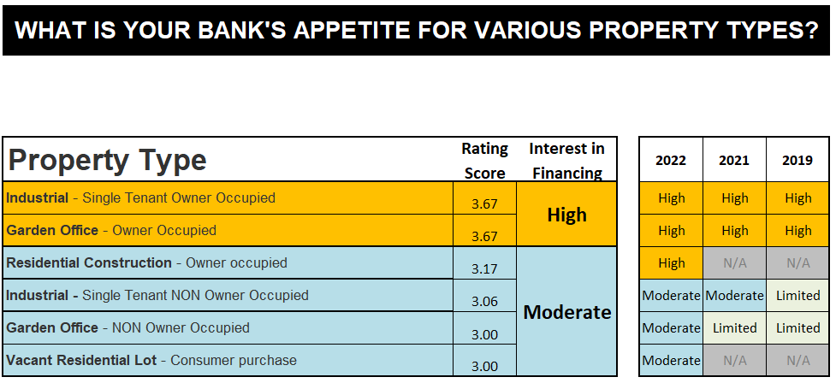

Slide 8
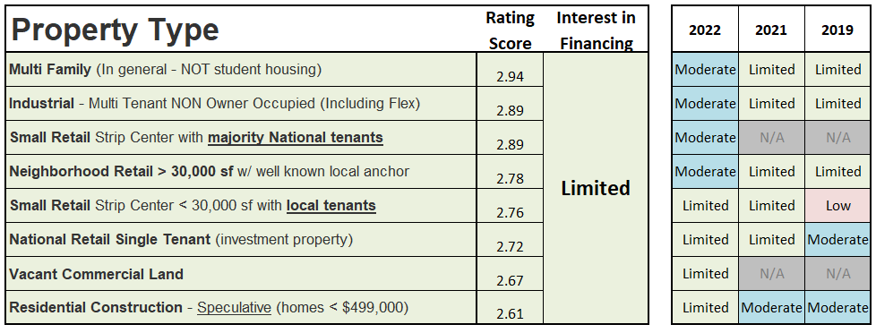

Slide 9
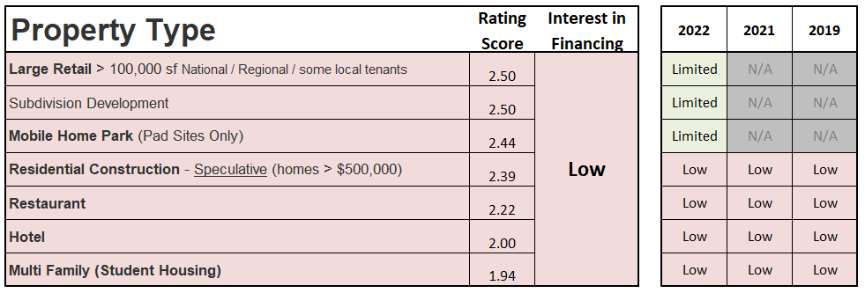

Slide 10
Fixed Interest Rates – average interest rates offered on the following loan types
(assuming moderate to high credit quality)
2024
% Change
2022 to 2024
2022
2021
Owner Occupied - Three (3) Year fixed
8.21%
4.37%
N/A
+87%
Owner Occupied - Five (5) Year fixed
8.29%
4.61%
3.87%
+80%
Owner Occupied - Seven (7) Year fixed*
8.29%
4.81%
4.13%
+72%
Owner Occupied - Ten (10) Year fixed*
8.22%
5.02%
4.34%
+63%
Non-Owner Occupied - Three (3) Year fixed
8.60%
4.65%
N/A
+85%
Non-Owner Occupied - Five (5) Year Fixed
8.68%
4.95%
4.40%
+74%
Non-Owner Occupied - Seven (7) Year Fixed*
8.68%
5.07%
4.69%
+71%
Non-Owner Occupied - Ten (10) Year Fixed
Majority of banks not offered
Majority of banks not offered
Majority of banks not offered
* 7 and 10-year fixed: many tied to swap agreements with “exit fees”

Slide 11

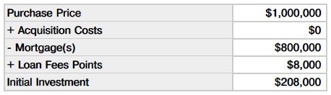

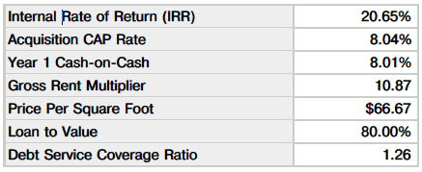

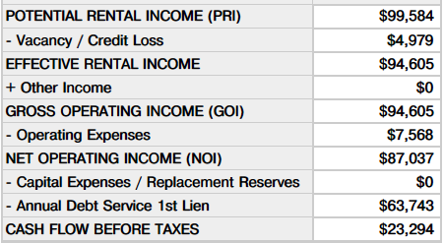
2019 VS 2024
Effect of Rising Interest Rates
2019 ~ 5.00% Interest Rate

Slide 12

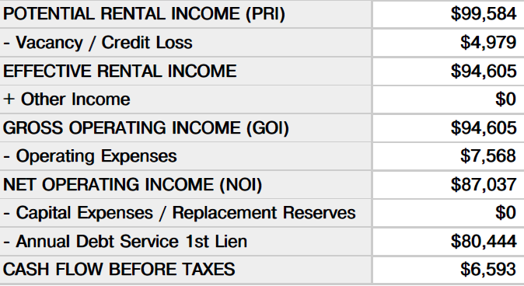
2019 VS 2024
Effect of Rising Interest Rates
2024 ~ 8.68% Interest Rate

Slide 13
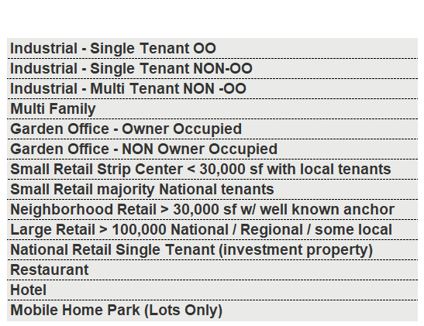





DEBT COVERAGE RATIOS
Typical debt coverage minimum based on property type

Slide 14

HAZARD & FLOOD INSURANCE
Increases in insurance costs
  Potential effect on:
    Net Operating Income
    Debt Coverage Ratios
    Property values
Example: $10,000 premium – increase of 25% to $12,500
  $2,500 Increase
  8% Cap Rate
  $31,250 Decrease in Property Value
89% of Banks polled say it will have an impact on underwriting

Slide 15
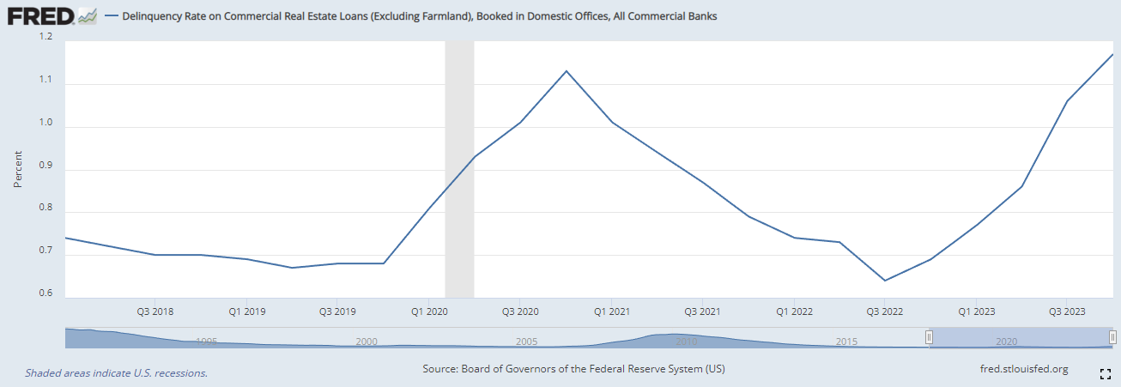
Rising CRE Delinquency Rates
National Delinquency Rate on Commercial Real Estate Loans
(Excluding Farmland), All Commercial Banks
CRE delinquency rates are up 95% from Q3 2022

Slide 16
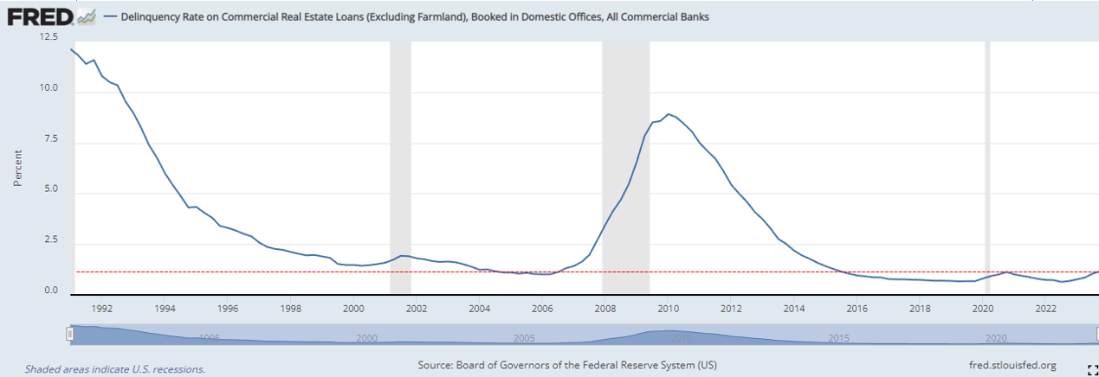
Rising CRE Delinquency Rates
…are still much better than almost all of 1991-2016
National Delinquency Rate on Commercial Real Estate Loans
(Excluding Farmland), All Commercial Banks
CRE delinquency rates are still historically low (1.17% in Q4 2023 vs. 1.02% bottom in 2006, which was the lowest from 1991-2016)

Slide 17
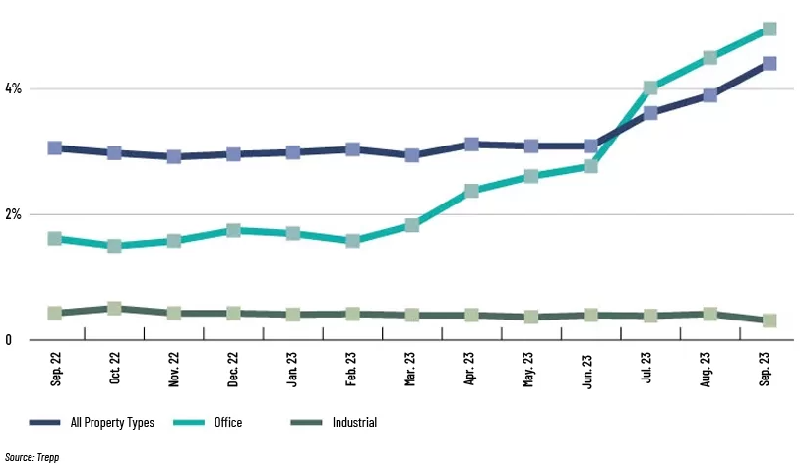
Rising CRE Delinquency Rates
…but office & industrial property delinquencies are a concern

Slide 18
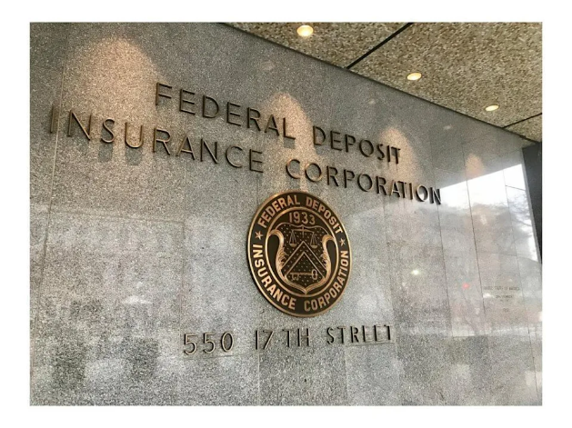

Hot Topics for Bank Regulators
Rising Rates’ Impact on Debt Coverage Ratios (Stress Testing Loan Portfolio)
Increased Flood & Hazard Insurance
Compression of Debt Coverage Ratios
Appraised Values
Concerns that the appraised values won't keep up with the costs of properties
Liquidity (i.e. Lending Capacity)
  72% of banks surveyed are requiring a deposit relationship along with a loan
Lack of regulators(understaffed)
Exam teams from other states & remote exams
Lack of understanding of Louisiana markets
Young, new, inexperienced examiners

Slide 19

THANK YOU

