Slide 1


BATON ROUGE
INDUSTRIAL MARKET
PRESENTED BY
Evan Scroggs, SIOR, CCIM
President & Managing Principal
Lee & Associates
escroggs@lee-associates.com

Slide 2


INDUSTRIAL COMMITTEE MEMBERS
Evan Scroggs, SIOR, CCIM
Chairman
Lee & Associates
Scot Guidry, CCIM
Mike Falgoust & Associates
Todd Pevey, MPA
St. John Properties
Grey Mullins, CCIM
Grey Mullins Commercial Properties
Brent Garrett, CCIM, SIOR
Beau Box Commercial Real Estate
David Lakvold, MAI, SRA
The Lakvold Group
Alex McCollam
NAI Latter & Blum
Tom McGee
Lee & Associates

Slide 3


Industrial is Sexy?
Pre-Covid
Post-Covid

Slide 4
Industrial Real Estate as:
A highly desirable asset type
An in-demand property type for users – both buyers and tenants
An underbuilt product type nationally and locally

Slide 5

Industrial Real Estate 2021 & 2022
Industrial Real Estate 2023

Slide 6
2023 Industrial Trends
Defining the Dataset (Geography and Type)
National Trends
Local Trends
Demand Drivers
Infrastructure
Notable Projects
Outlook

Slide 7
The Dataset
(Geography and Type)

Slide 8
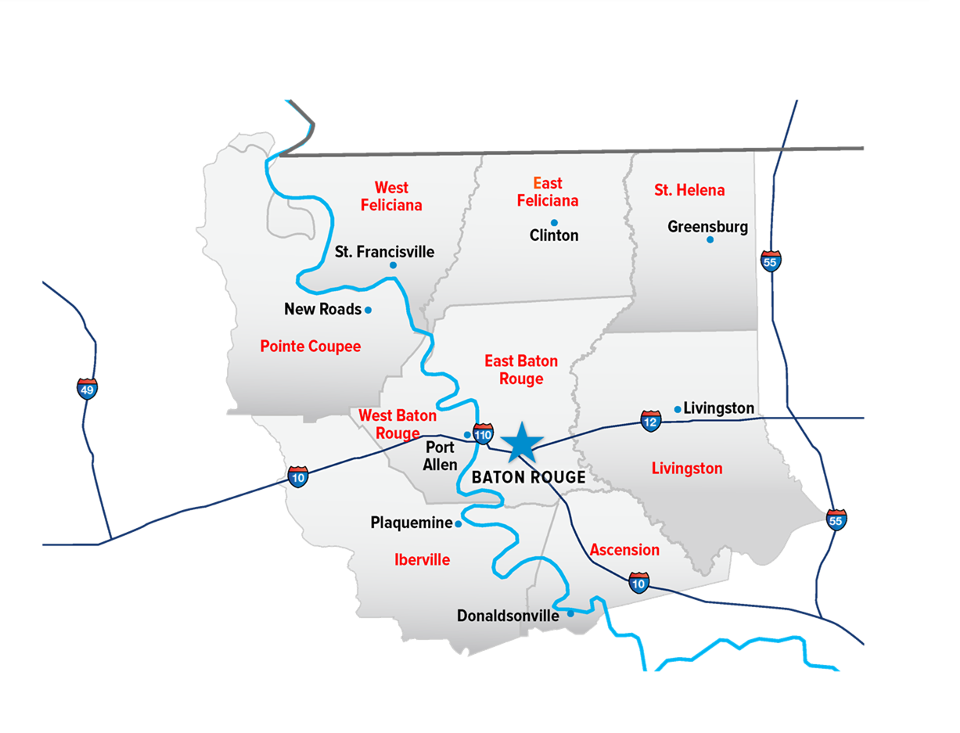
Baton Rouge MSA

Slide 9
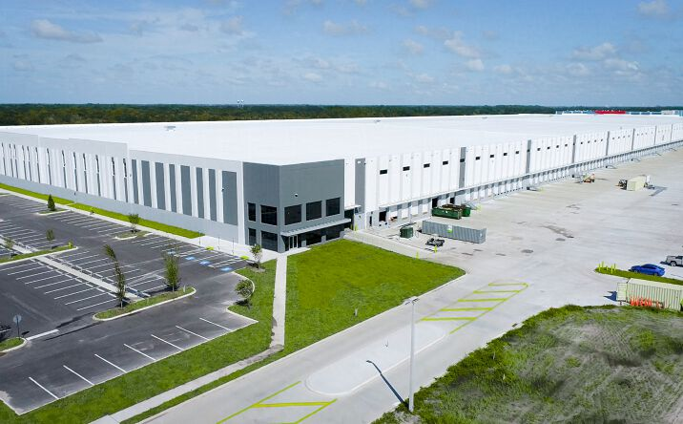
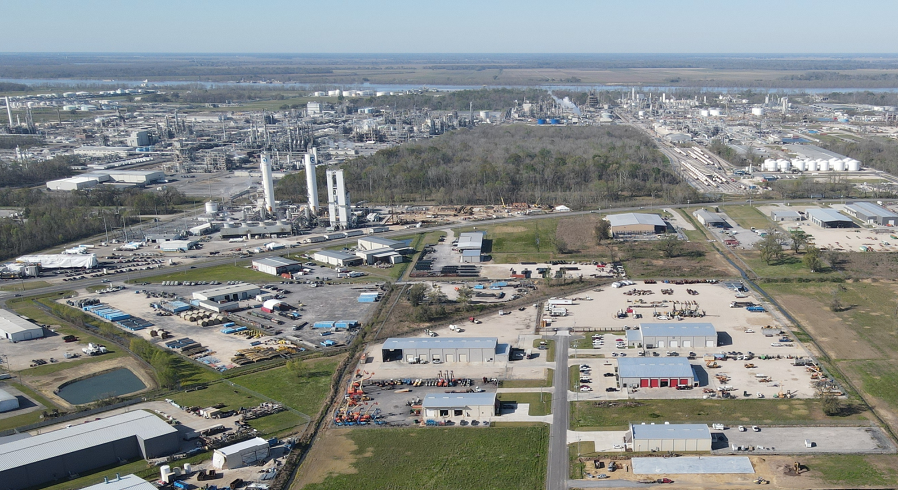
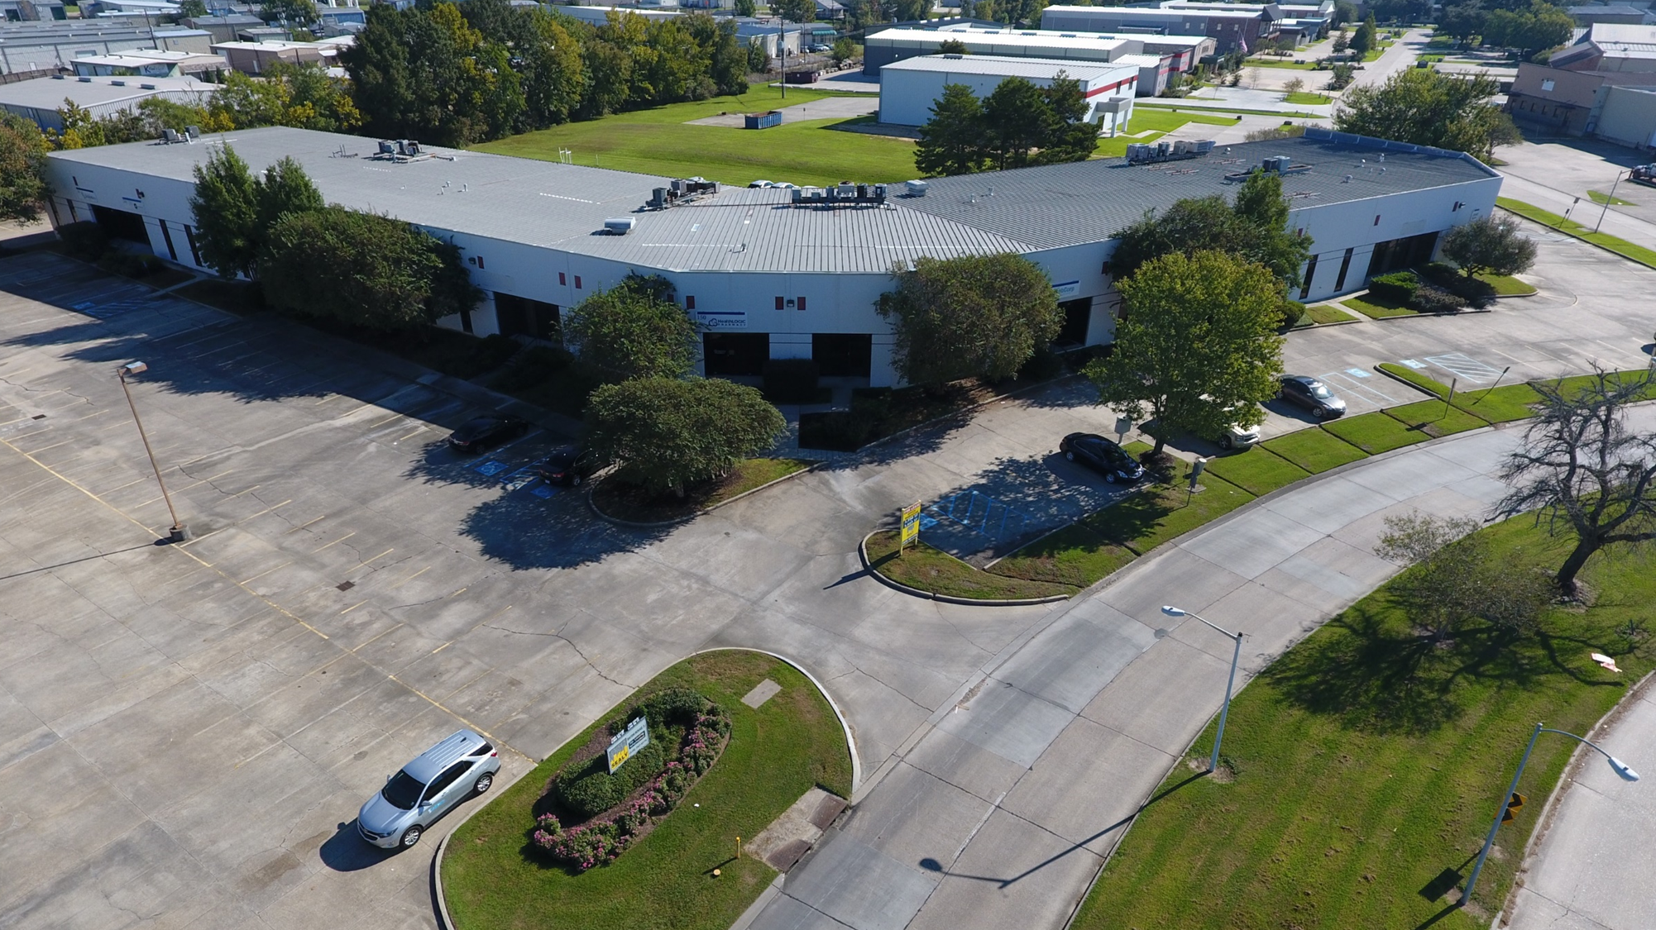
Bulk Warehouse/Distribution

Slide 10
National Trends

Slide 11
After reaching record low Vacancy Rate (2.9%) reached in Q2 of 2022, there has been a steady increase in vacancy over the last six quarters.
National Vacancy Rate was 3.3% at the end 2022 and finished 2023 at 5.7%
Market softening has been driven by slower tenant absorption in 2023 coupled with record breaking new construction deliveries during the same period.

Slide 12
Net Absorption
2021: 561.4M SF
2022: 477.3M SF
2023: 214.8M SF
New Deliveries
2021: 350M SF
2022: 495M SF
2023: 593.5M SF
2019 - 2023: 2Billion SF
Under Construction
2021: 467.0M SF
2022: 682.6M SF
2023: 407.6M SF
Rent Growth
2022: 18.6%
2023: 12.3%
Pre-Pandemic Avg: 5.5%

Slide 13
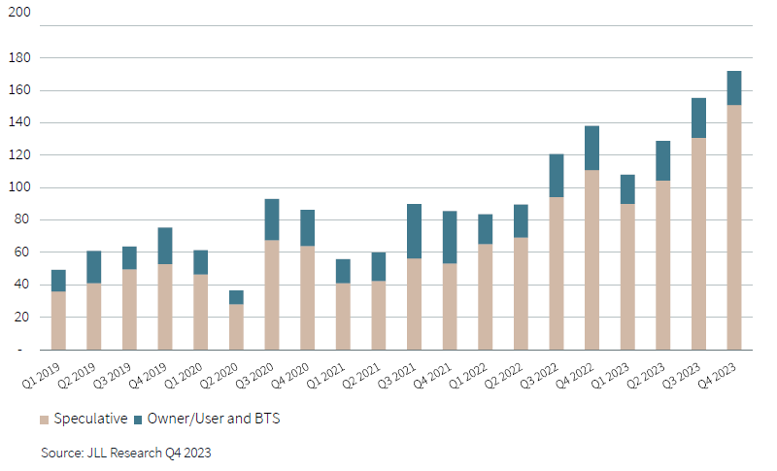
Development Trends

Slide 14
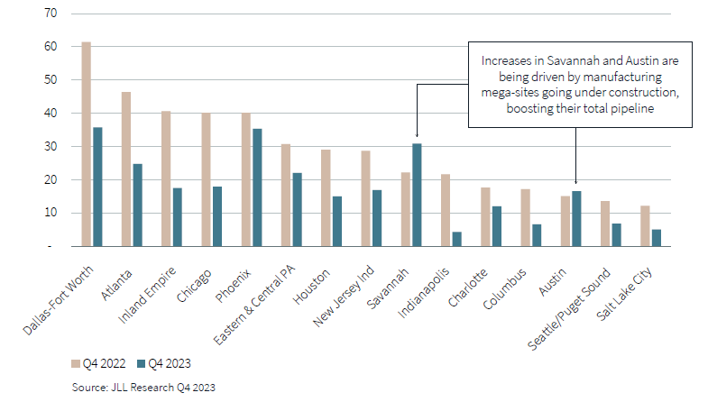
Development Activity

Slide 15
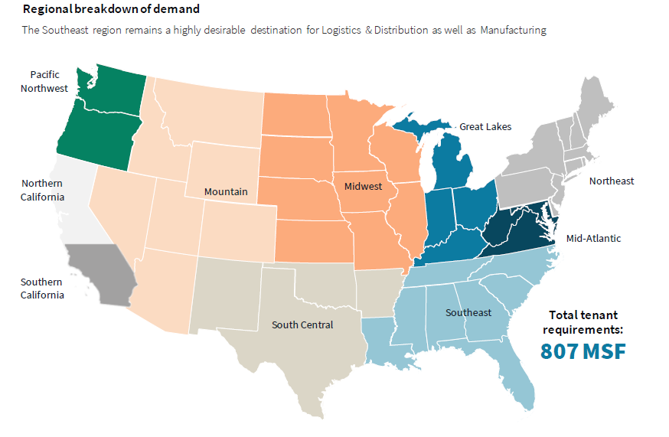
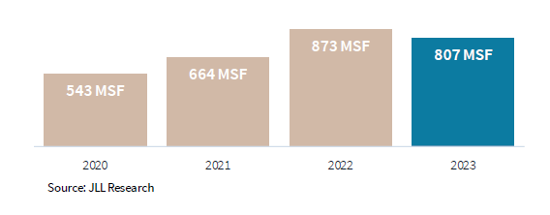
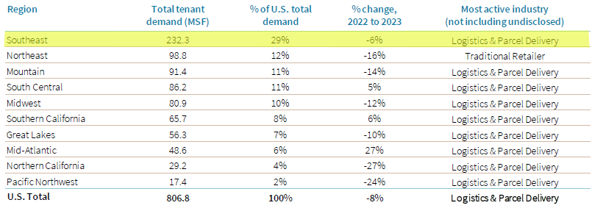
Leasing Activity Trend

Slide 16
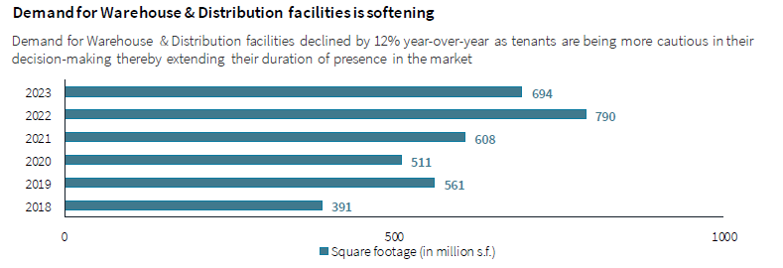
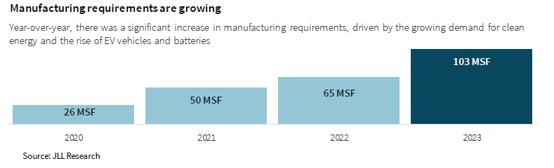
Demand Trends

Slide 17
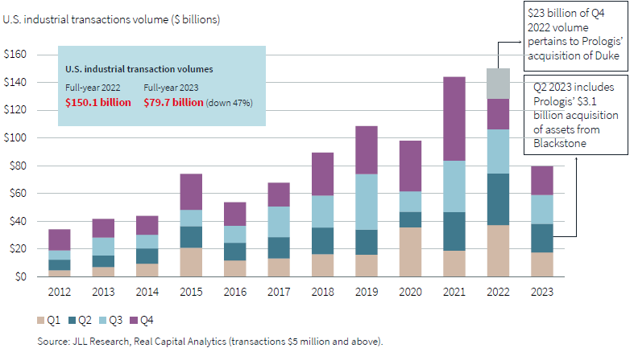
Industrial Transaction Volume

Slide 18
Local Trends

Slide 19
Last Year’s Outlook
Vacancy will likely rise because it can’t go much lower.
Should stay below 3%
Rental rates will continue to increase as new inventory comes online
Sale Prices will remain high - $125 - $150/SF is the norm on newer, well-located product.
Stalemate between Buyers and Sellers not agreeing on market value
More announcements on the economic development front – both Petrochem and manufacturing

Slide 20
A Tale of Two Markets
Vacancy saw a nominal increase to 2.45% from 1.97% in 2022
Absorption cratered from nearly 5.0M SF in 2022 to 663K SF in 2023 (not an indicator of demand but rather limited supply)
This was predictable based on the lack of construction at the end of 2022(90,464 SF total)
Only 229K SF under construction at the end of 2023.
Continue to be chronically underbuilt
Rental Rates continue to have upward pressure due to lack of supply, cost of construction, and cost of capital.

Slide 21
Local Trends Executive Summary
 | YE 2022 | YE 2023
Total Inventory | 36,579,845 SF | 37,437,587 SF
Vacant Space | 722,451 SF | 917,485 SF
Occupied Space | 35,857,394 SF | 36,520,102 SF
Vacancy Rate | 1.97% | 2.45%
Net Absorption | 4,946,581 SF | 662,708 SF
Space Under Construction | 90,464 SF | 228,703 SF

Slide 22
Vacancy Rate Trends

Slide 23
Historical Vacancy vs. Absorption
Vacancy
Absorption

Slide 24
Vacancy Unpacked
Functional Vacancy closer to 2.05% (Former Louisiana Creamery Accounts for 139K of the 917K SF. It’s a redevelopment site.
This would reduce the gross vacancy in the market to 778K SF. 722K SF of gross vacancy in 2022
Currently, there are no existing vacancies of 50K SF in the market.
Since Q1 of 2023 – tracked 5.8M SF of inquiries – total of 35 tenants – ranging from local companies to Fortune 50 companies.
Avg. Requirement is 135K – 200K SF
Leasing Gridlock with no where to place these requirements

Slide 25
Construction vs. Absorption
Year | Annual Construction | Annual Absorption | Surplus/Deficit
2013 | 738,459.00 | 671,127.00 | 67,332.00
2014 | 969,344.00 | 1,243,592.00 | (274,248.00)
2015 | 204,892.00 | 437,273.00 | (232,381.00)
2016 | 2,122,199.00 | 844,813.00 | 1,277,386.00
2017 | 533,752.00 | 2,001,049.00 | (1,467,297.00)
2018 | 478,433.00 | 78,882.00 | 399,551.00
2019 | 684,459.00 | 986,982.00 | (302,523.00)
2020 | 843,035.00 | 577,610.00 | 265,425.00
2021 | 4,608,585.00 | 1,595,482.00 | 3,013,103.00
2022 | 286,991.00 | 4,946,581.00 | (4,659,590.00)
2023 | 985,090.00 | 662,708.00 | 322,382.00
Average | 1,132,294 | 1,276,918.00 | (144,623.64)

Slide 26
Rent Growth Proven
Last year, the question was “will tenants pay the higher rates required to make new construction deals pencil?”
2023 was a proof of concept year that showed tenants will pay for new, quality space.
The new normal - $12.00 - $15.00/SF rates on Office Warehouses
$10.00 - $12.00/SF on Distribution
In some instances, these rates are even higher.
Flight to quality is real!
But...
More important and pressing to tenants than quality, is availability.

Slide 27
Comparing Markets
 | Baton Rouge | Lafayette | New Orleans | Mobile | Savannah | Charleston | Greenville | Houston
Total Inventory | 37,437,587 | 26,420,406 | 84,335,804 | 38,162,768 | 126,123,239 | 106,000,000 | 239,660,664 | 809,697,460
Vacancy | 917,485 | 792,612 | 2,192,730 | 1,793,650 | 11,224,968 | 6,360,000 | 19,891,835 | 55,869,124
Occupied | 36,520,102 | 25,627,794 | 82,143,074 | 36,369,118 | 114,898,271 | 99,640,000 | 219,768,829 | 753,828,336
Vacancy Rate | 2.45% | 3.00% | 2.60% | 4.70% | 8.90% | 6.00% | 8.30% | 6.90%
Absorption | 662,708 | (320,000) | (296,000) | 512,000 | 15,331,772 | 1,546,537 | 7,162,476 | 18,856,140
New Construction | 228,703 | 150,000 | 344,000 | 206,000 | 9,865,055 | 8,561,315 | 8,962,537 | 22,018,691
Asking Rents | $9.48 | $9.54 | $10.56 | $7.74 | $7.28 | $7.98 | $4.91 | $8.94
MSA Population | 870,569 | 478,384 | 1,510,562 | 430,197 | 404,798 | 745,000 | 975,480 | 7,340,000

Slide 28
Demand Drivers

Slide 29
What’s driving demand?
Petro Chem is still the driving force for demand from service and supply companies
Petro Chem crossover and move into off site bulk warehouse
Amazon/e-commerce
Food and Beverage
Logistics and Distribution
Reshoring of Manufacturing
Construction

Slide 30
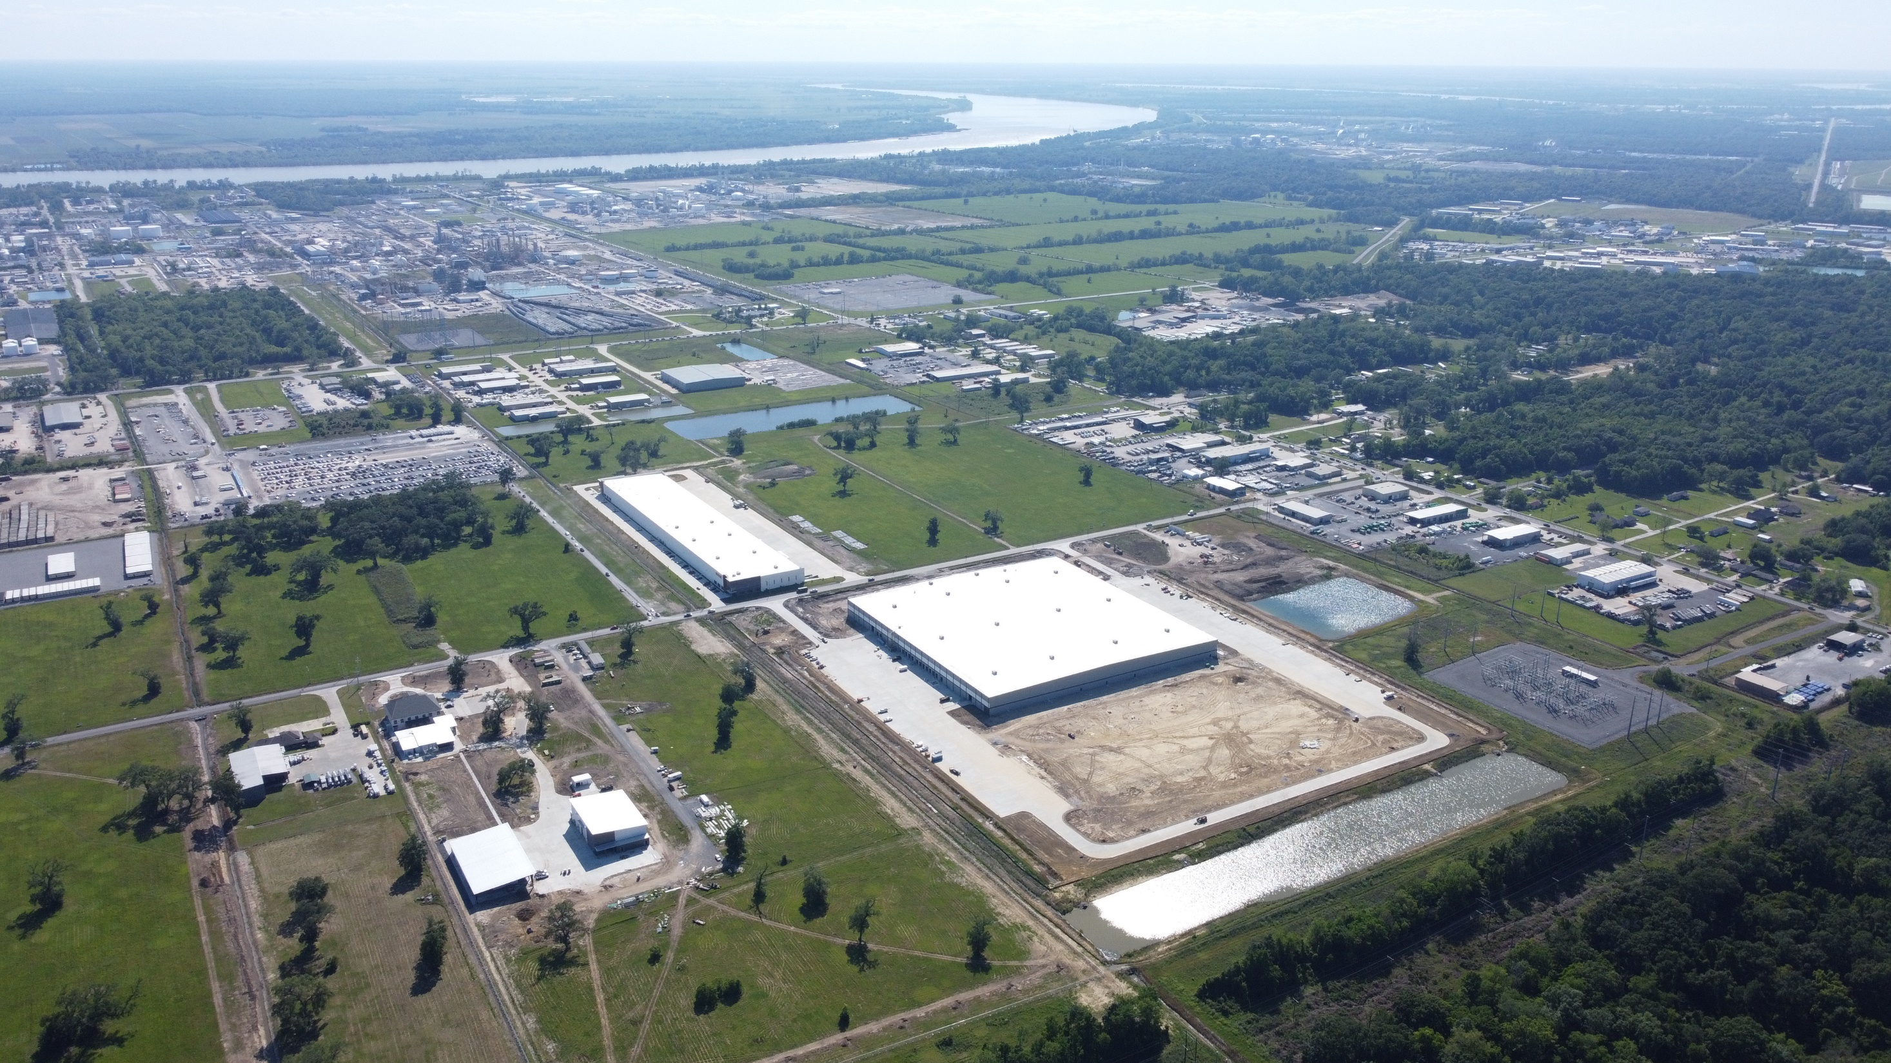

Slide 31
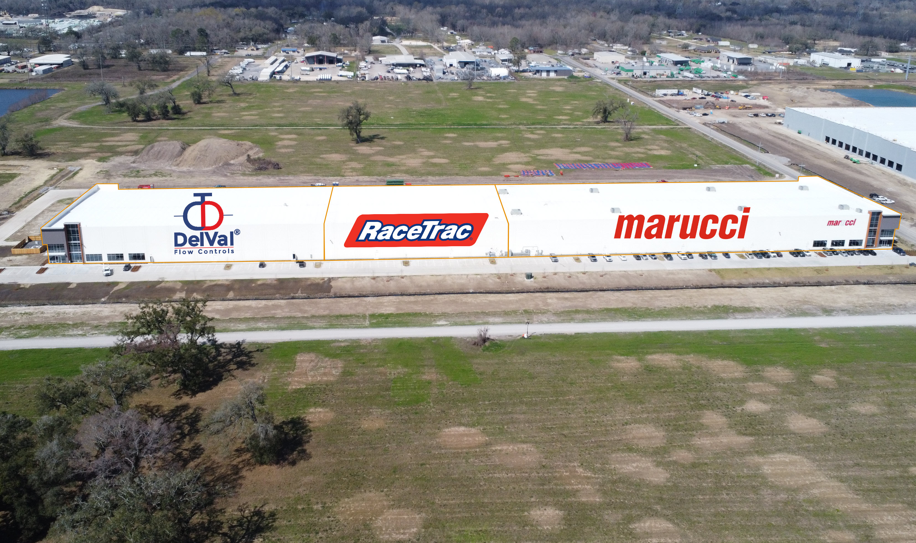

Slide 32
What About Infrastructure?

Slide 33
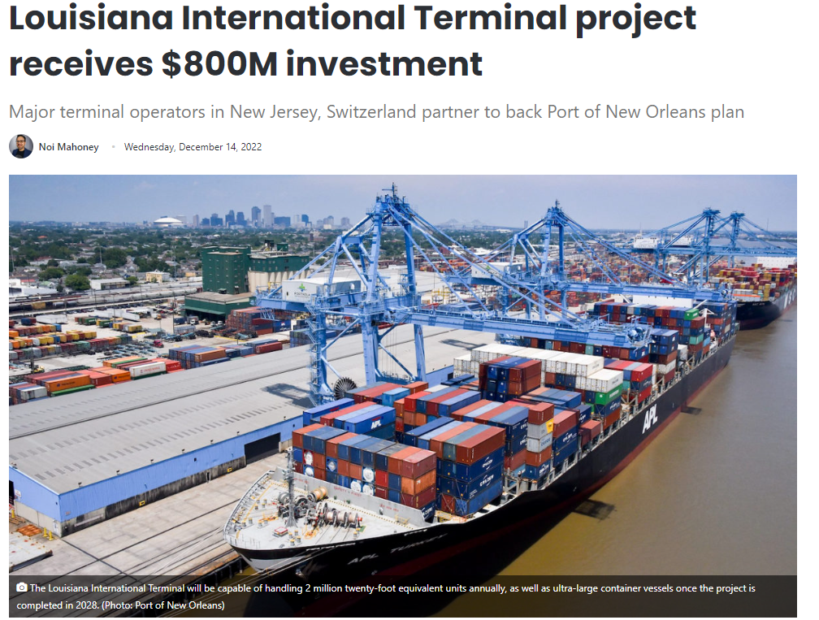
Louisiana International Terminal Update
Private-Public Partnership
Ports of America (NJ Based) and Mediterranean Shipping Company (Geneva, Switzerland)
$1.8B investment; $800M from the state.
Port of NOLA Current capacity is 1.0M TEUs annually
LIT has a 2.0M TEU Capacity

Slide 34
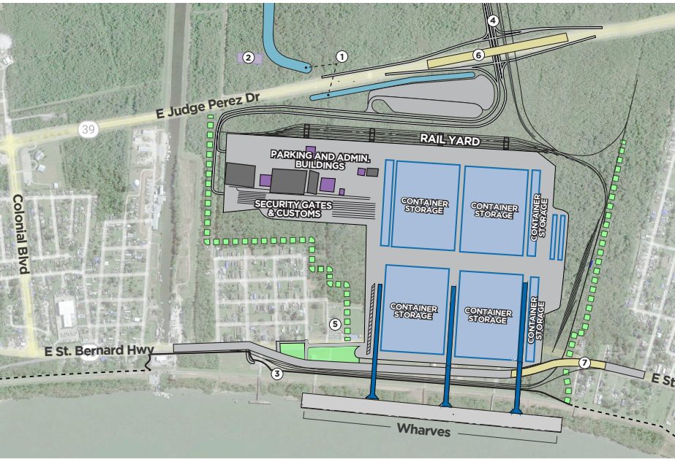
Louisiana International Terminal
1,000 Acres
350-acre container facility
3,500’ wharf
50’ depth from LIT to mouth of river

Slide 35
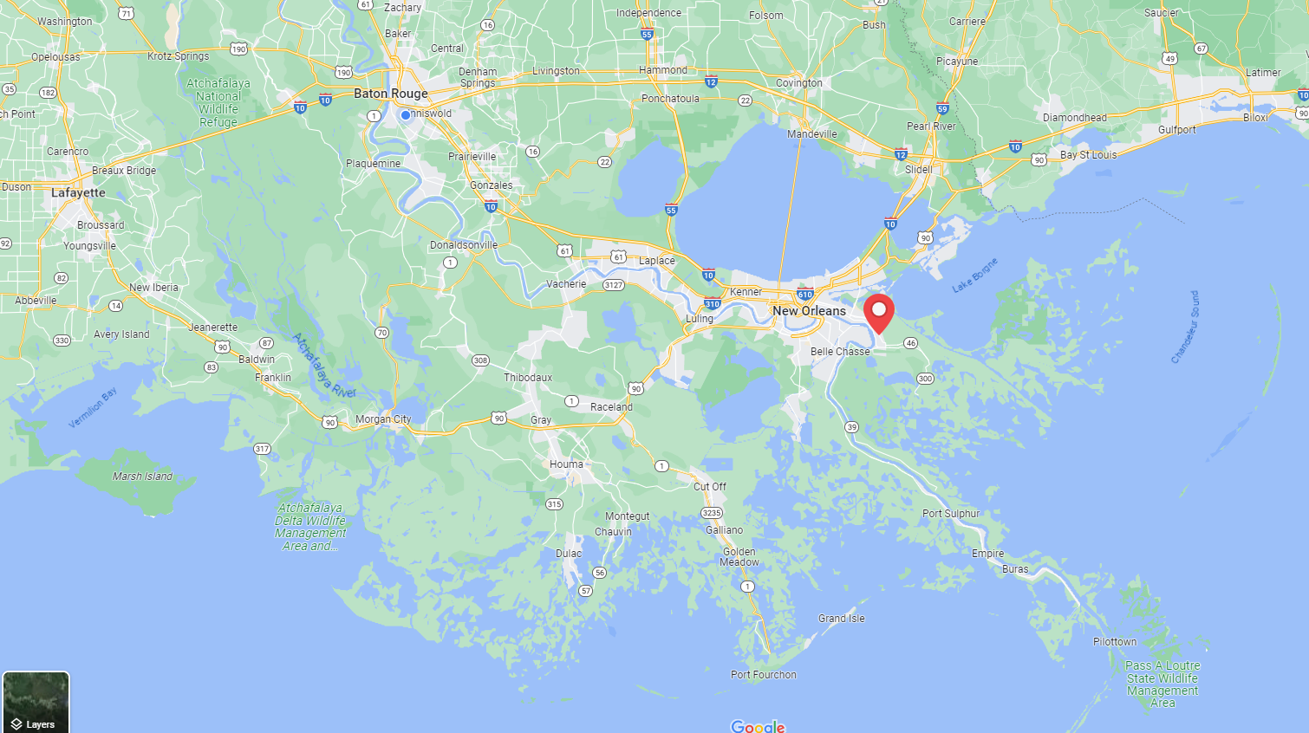

Slide 36

Louisiana International Terminal
$226M Landmark Grant through USDOT and the Infrastructure Act. An additional $73M was awarded through the MEGA Grant Program.
Nearly half of the states $800M obligation has been secured.
Opponents raised concerns about the site/location of the Port, lobbying for a more southern location

Slide 37
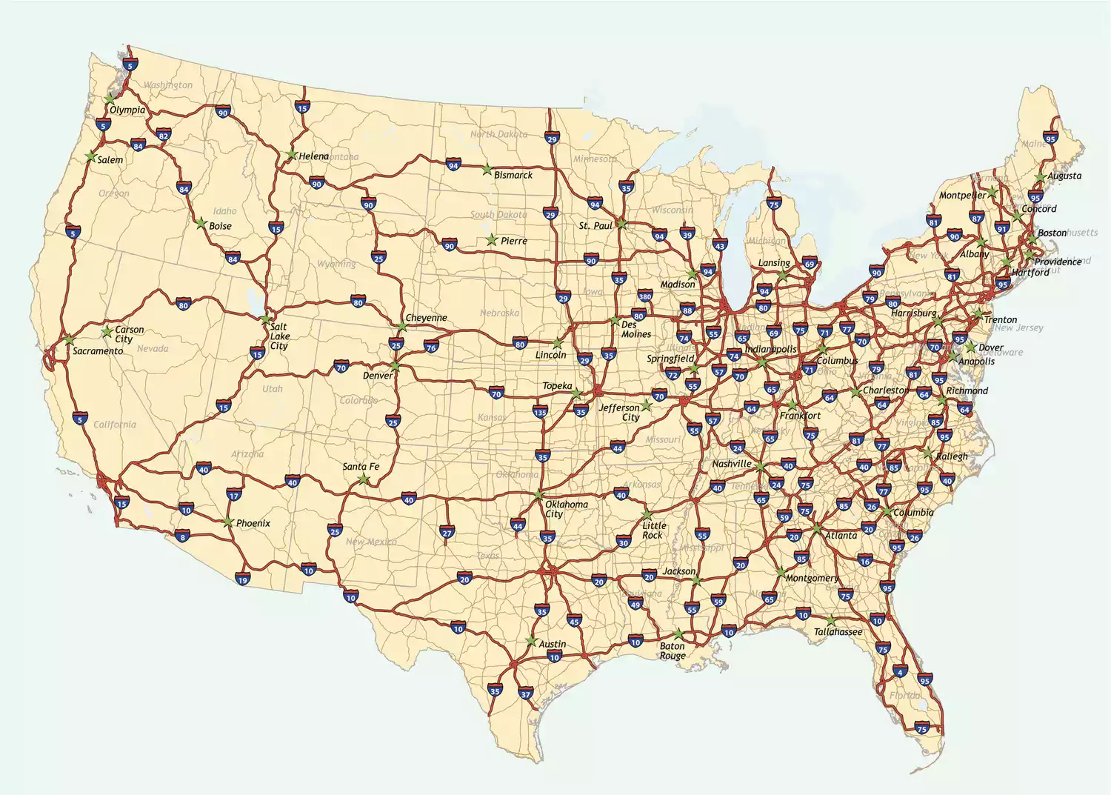
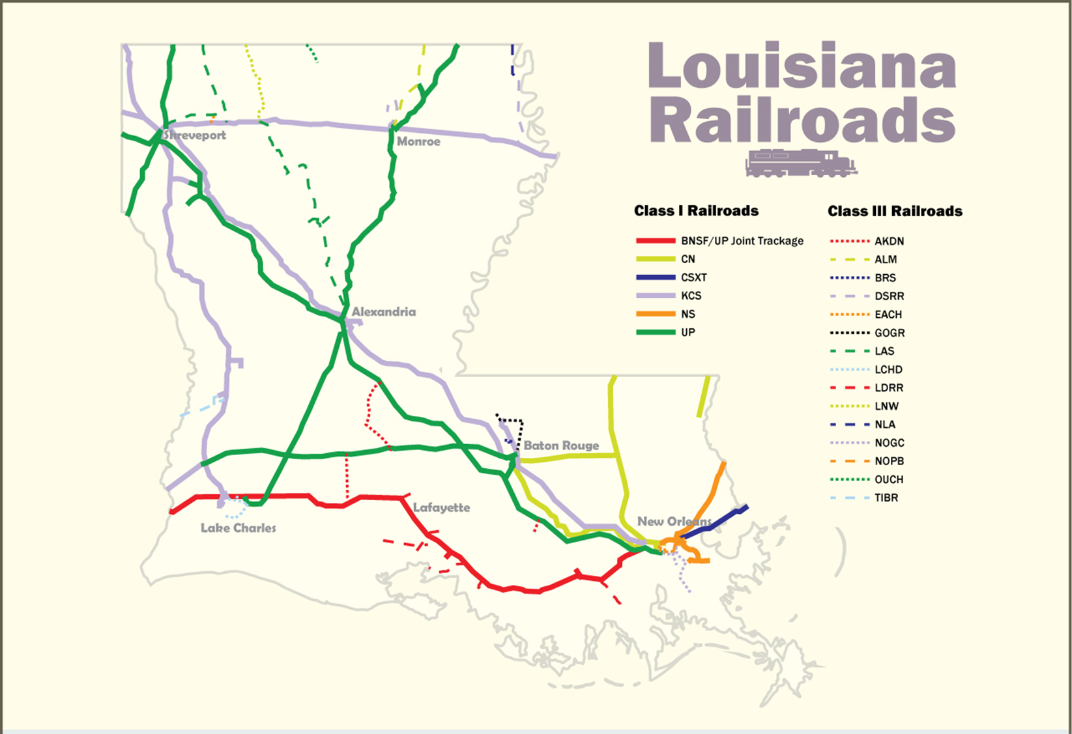

Slide 38
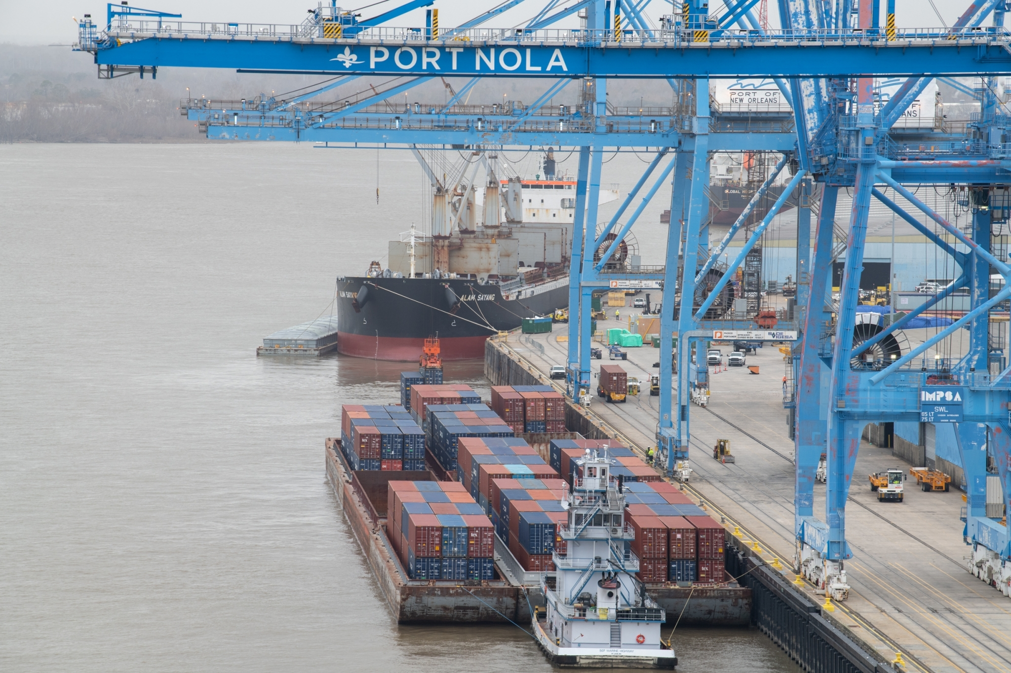
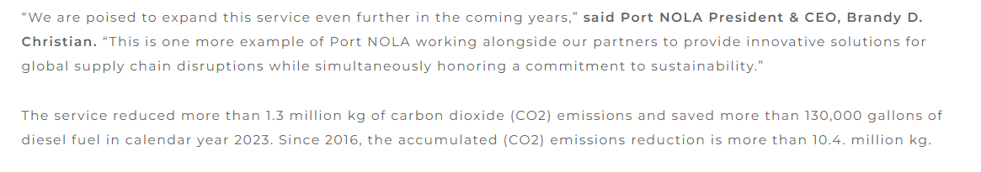
Port of NOLA and Port of Greater Baton Rouge set a record in 2023 for 20,500 containers moved between the two ports.
Unique value proposition for South Louisiana providing more options in the multimodal transport market.
Container to Barge

Slide 39
Projects

Slide 40
But what about supply?
The Baton Rouge MSA still has a supply problem
Underbuilt annually by 144K SF
Only 228K under construction at the end of 2023.
10-year average absorption of 1.132M
Baton Rouge MSA was underbuilt in 2023. Will likely remain underbuilt for the foreseeable future.
Lack of Spec development at scale to solve this problem.

Slide 41
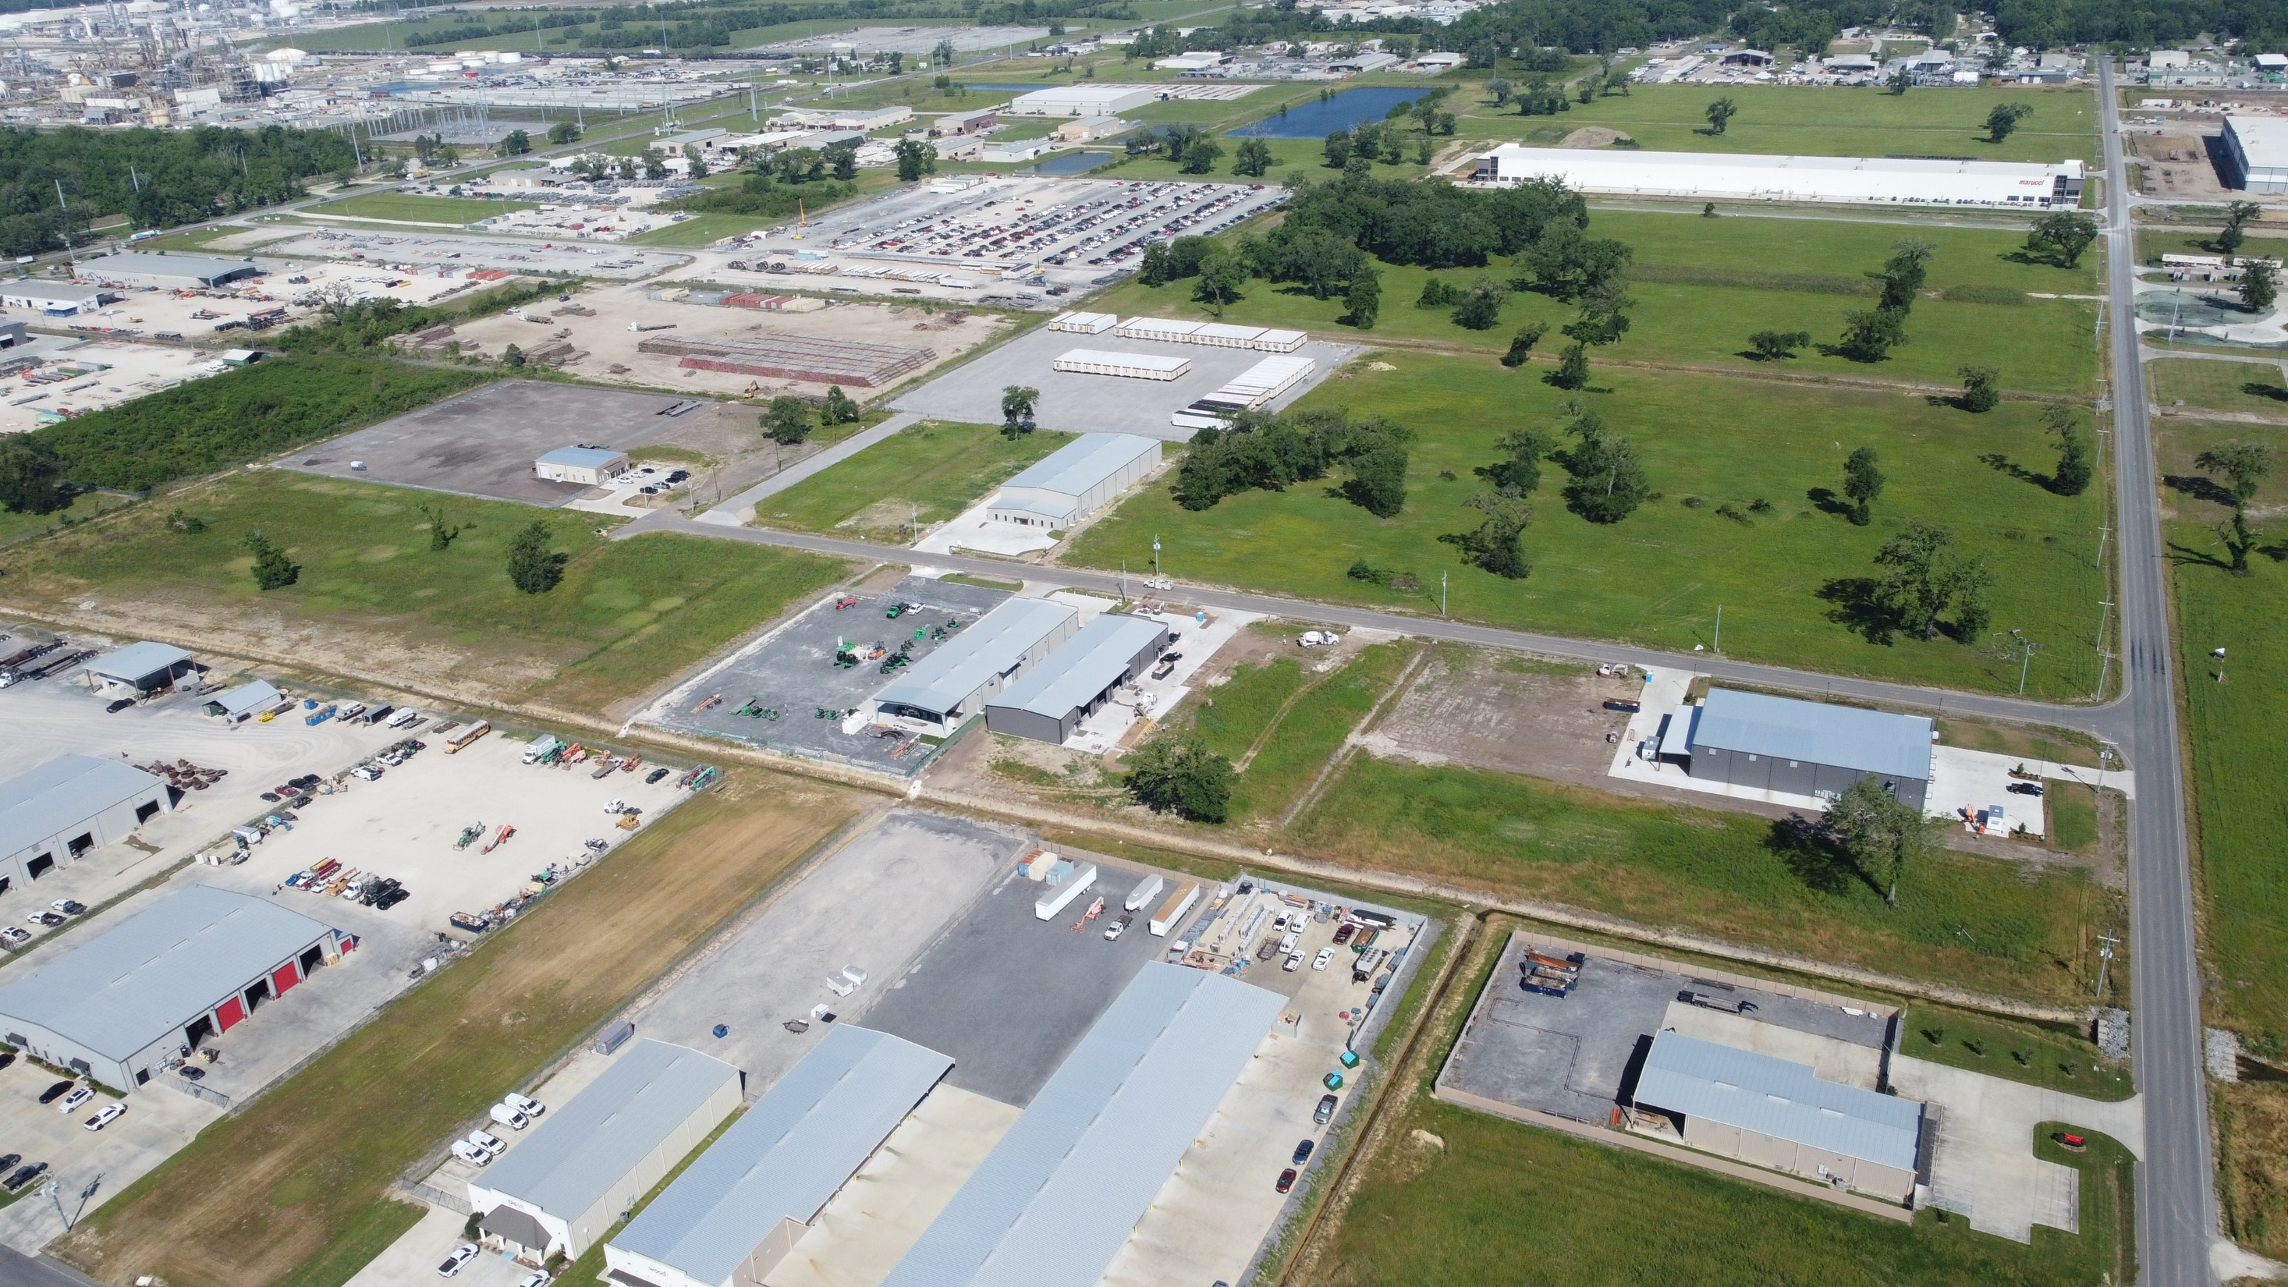

Lyle Drive

Slide 42
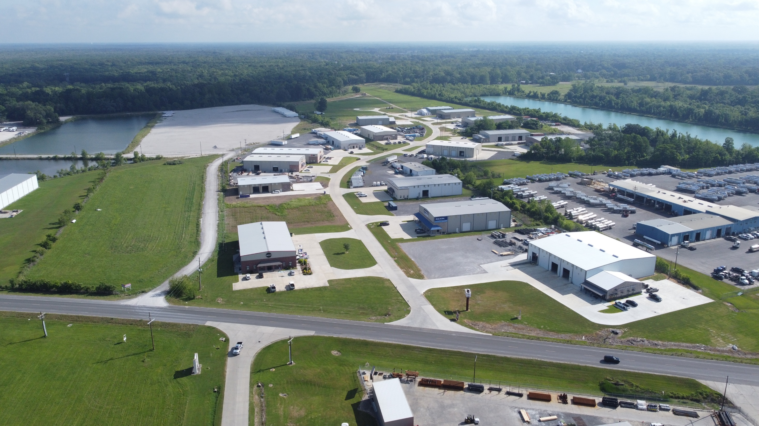
Copperhead

Slide 43
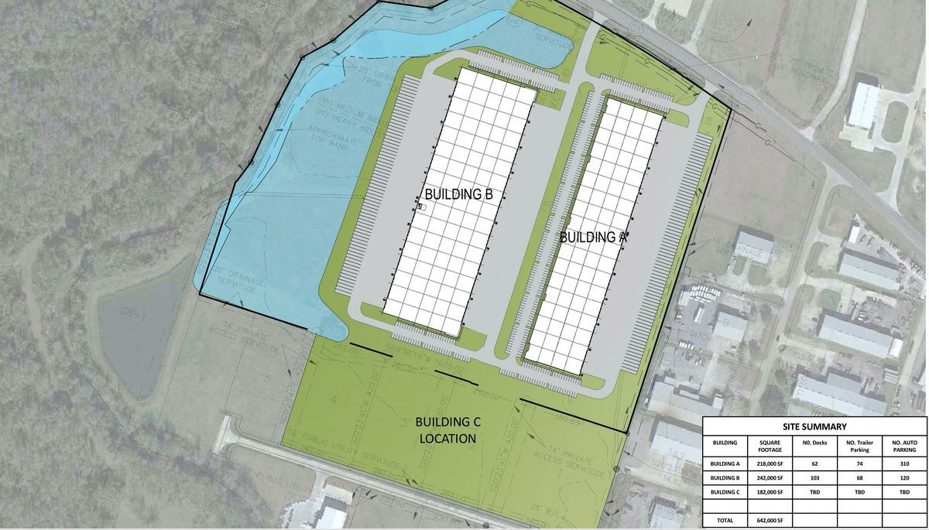
Gateway Industrial Park
Phase I – 218K SF
Phase II – 242K SF
Q4 of 2023 Delivery on Phase I
Provident Realty Advisors out of Dallas is the developer

Slide 44
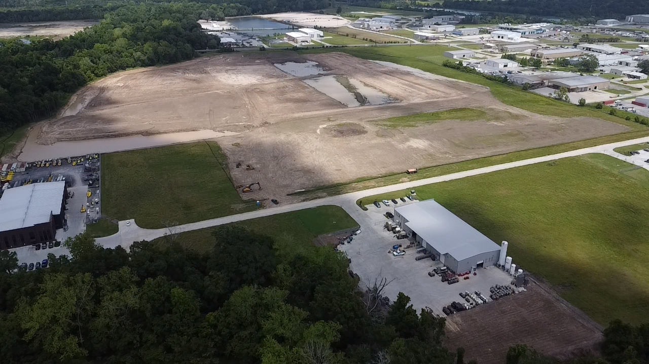

Slide 45
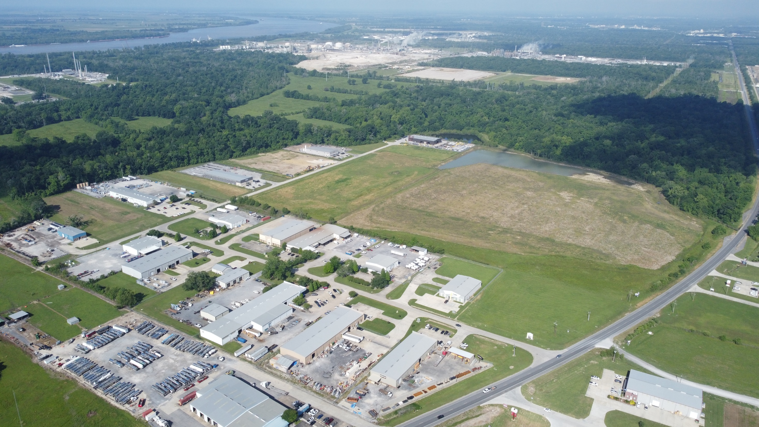

Slide 46
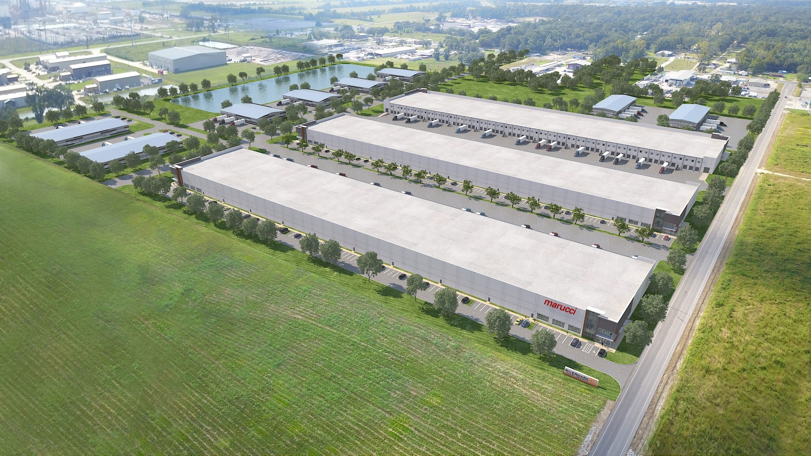

96 Acre Site
Can accommodate up to 1.45M SF
Phase I – 200K SF
Q4 of 2023 Delivery on Phase I
Local Developer Chad Brossett

Slide 47
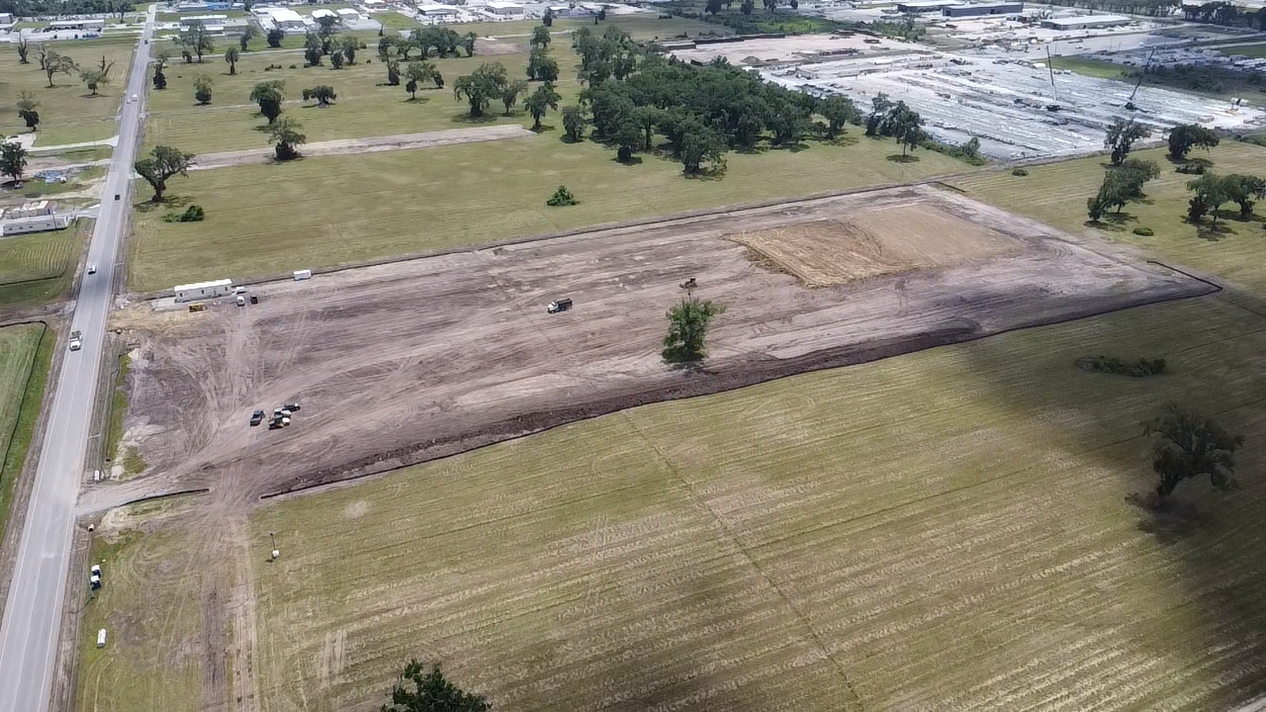


Slide 48
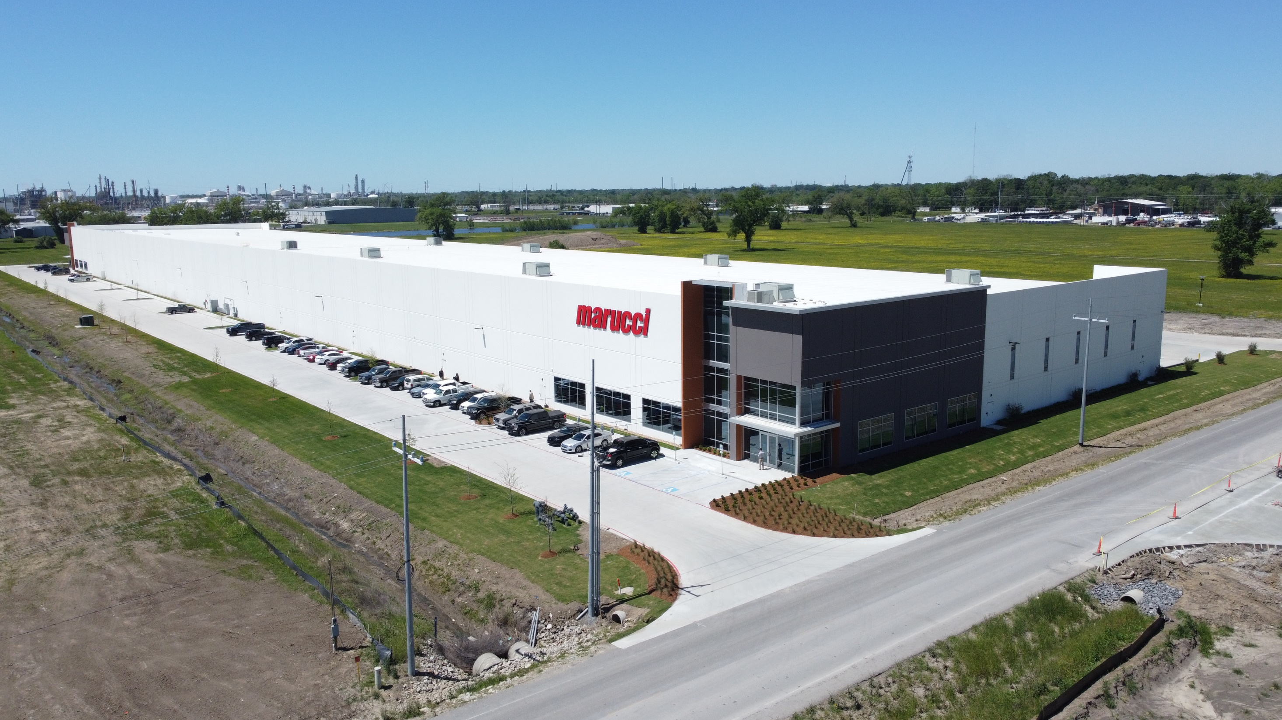

Slide 49
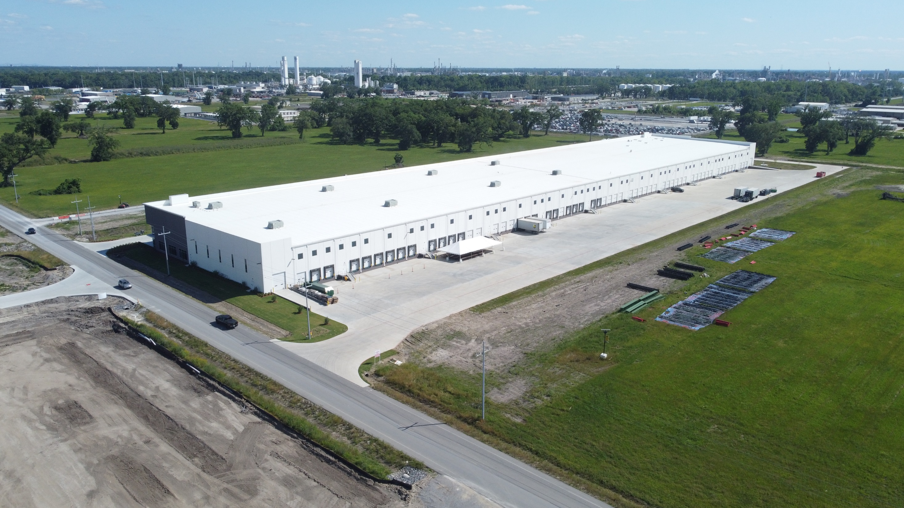

Slide 50
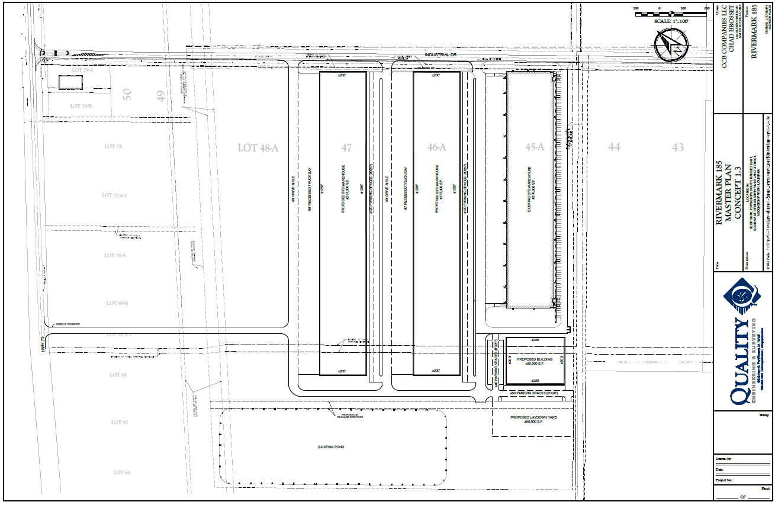

Slide 51
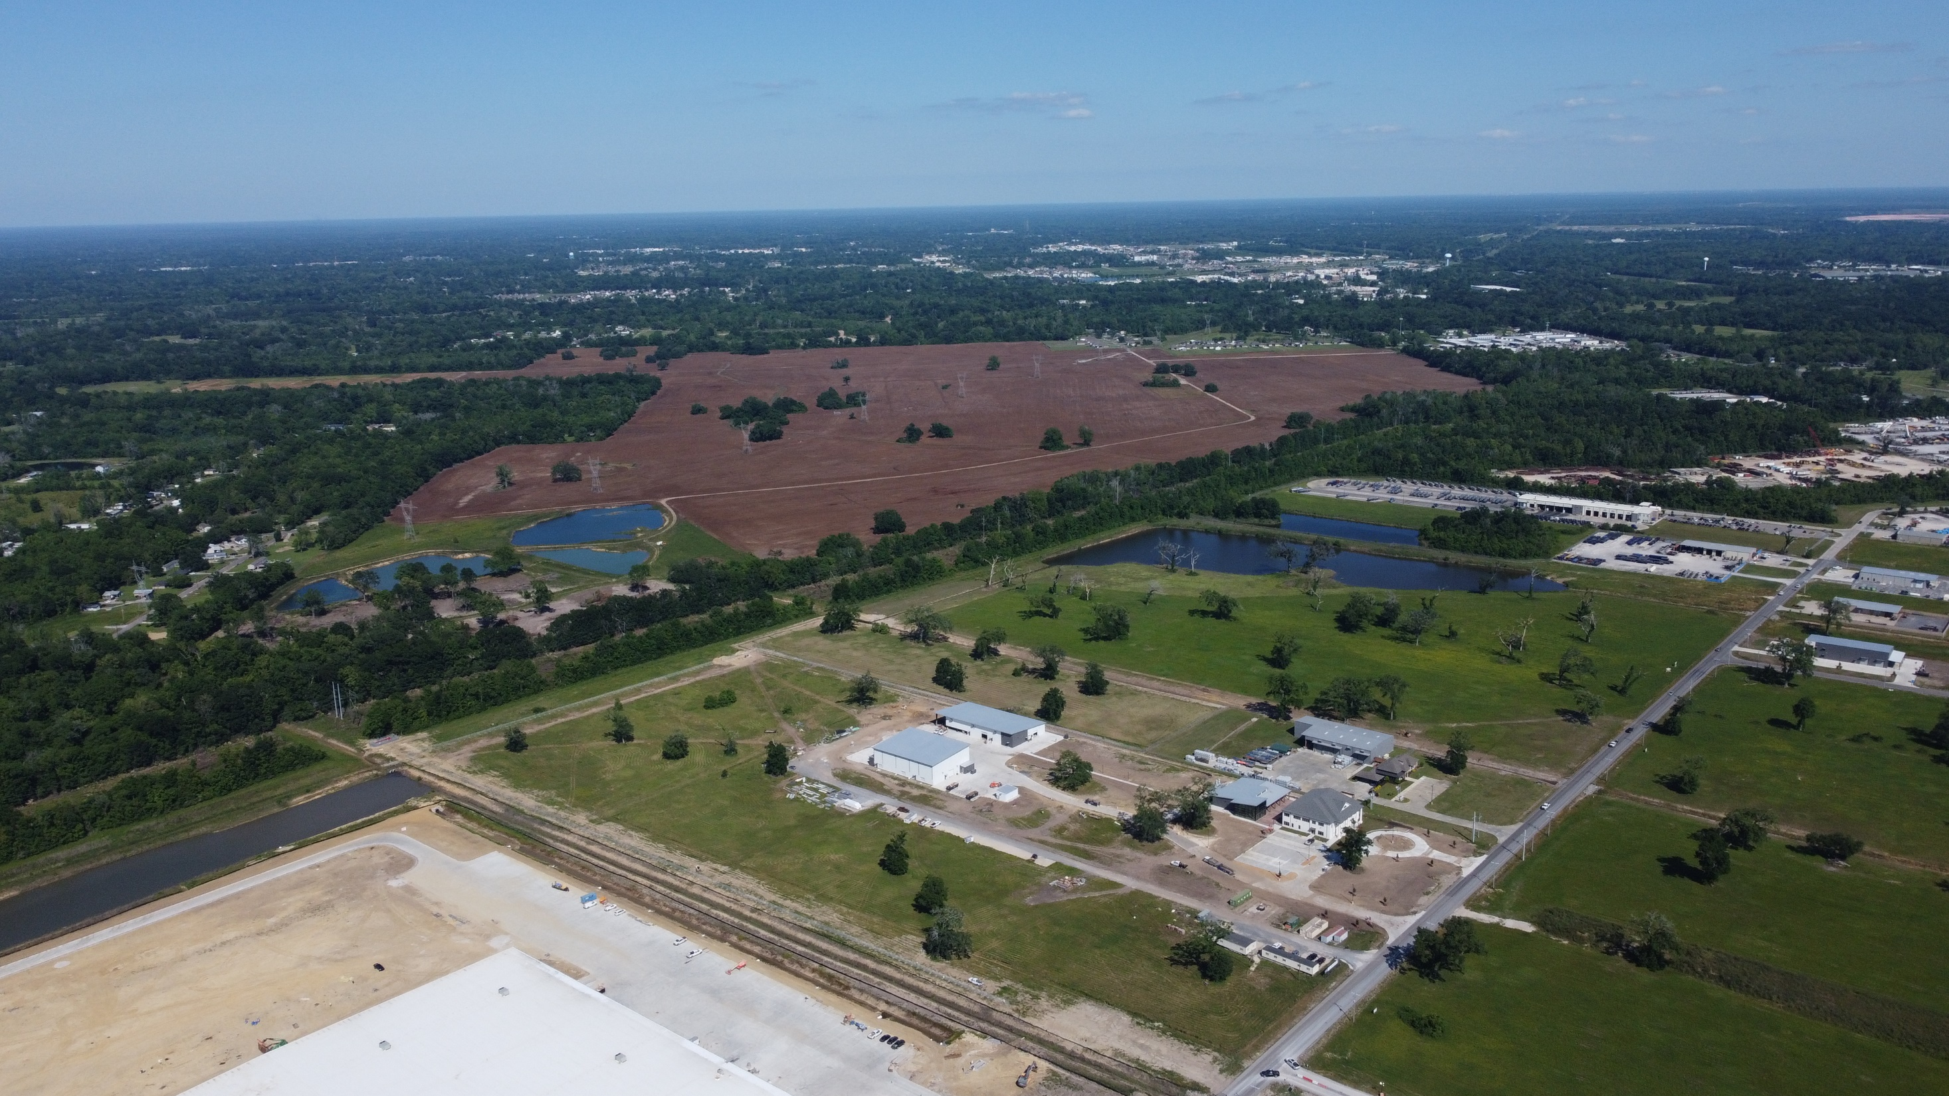

Slide 52
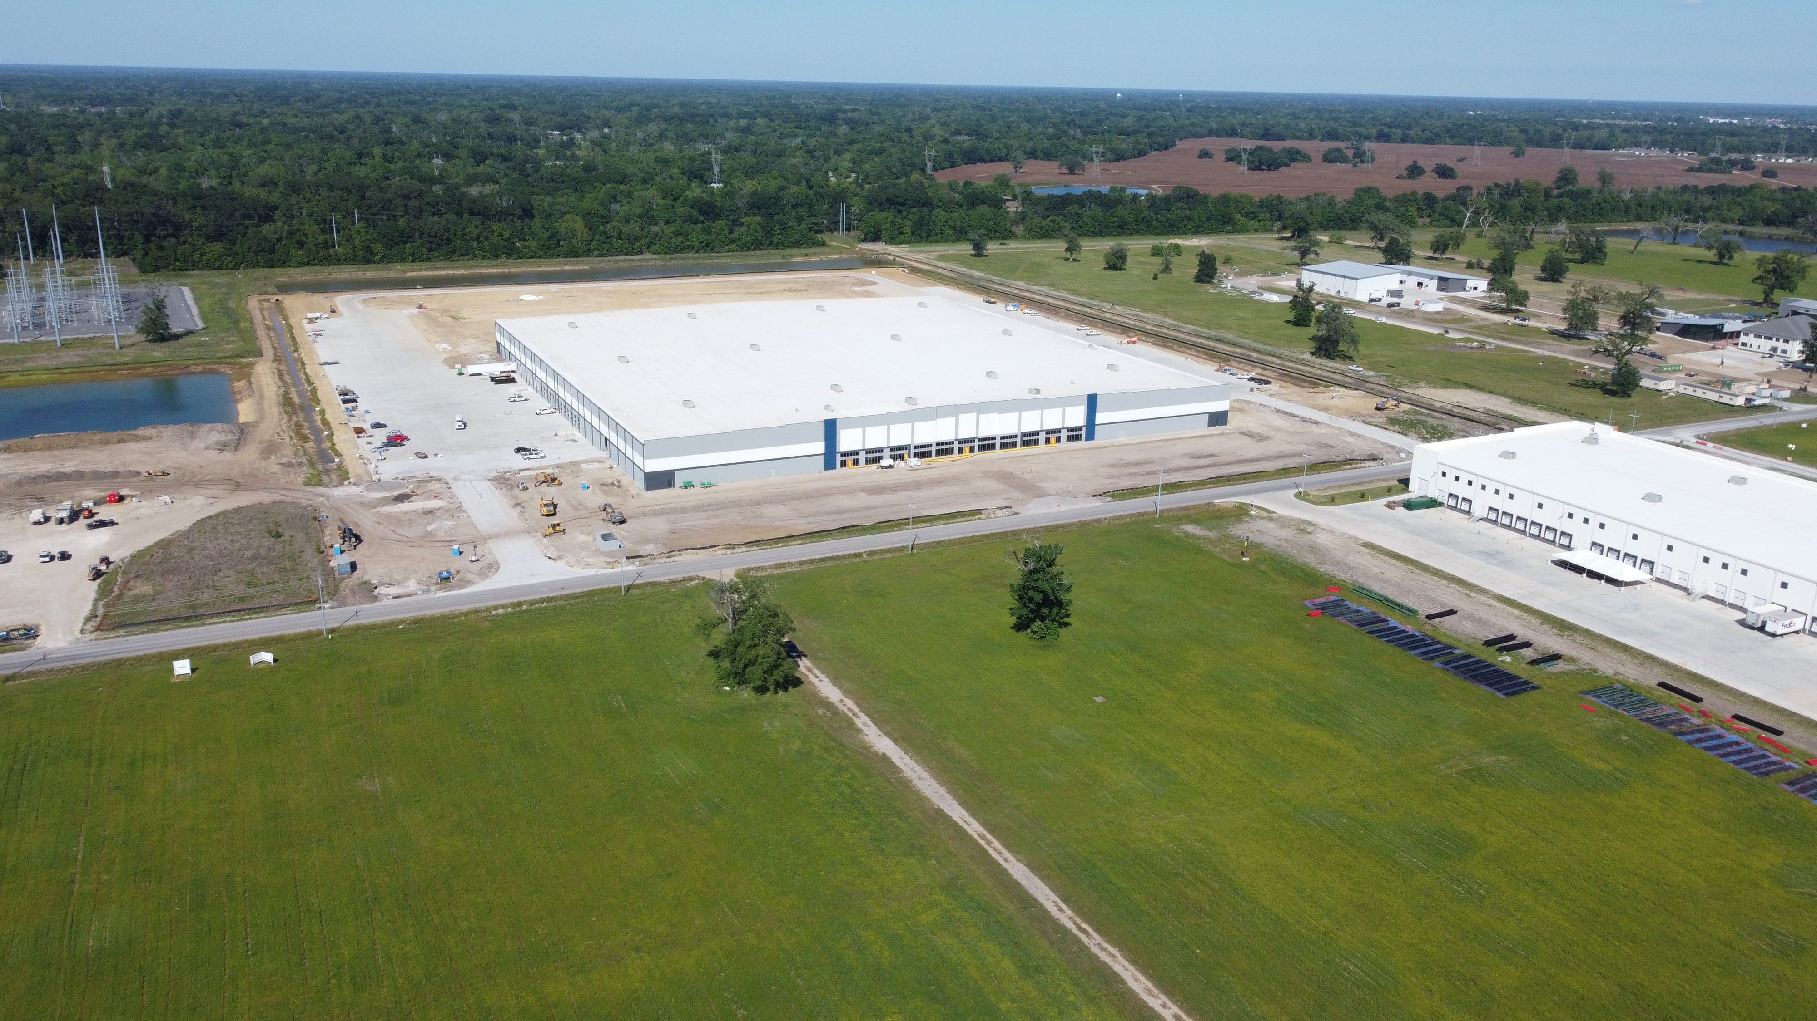

Slide 53
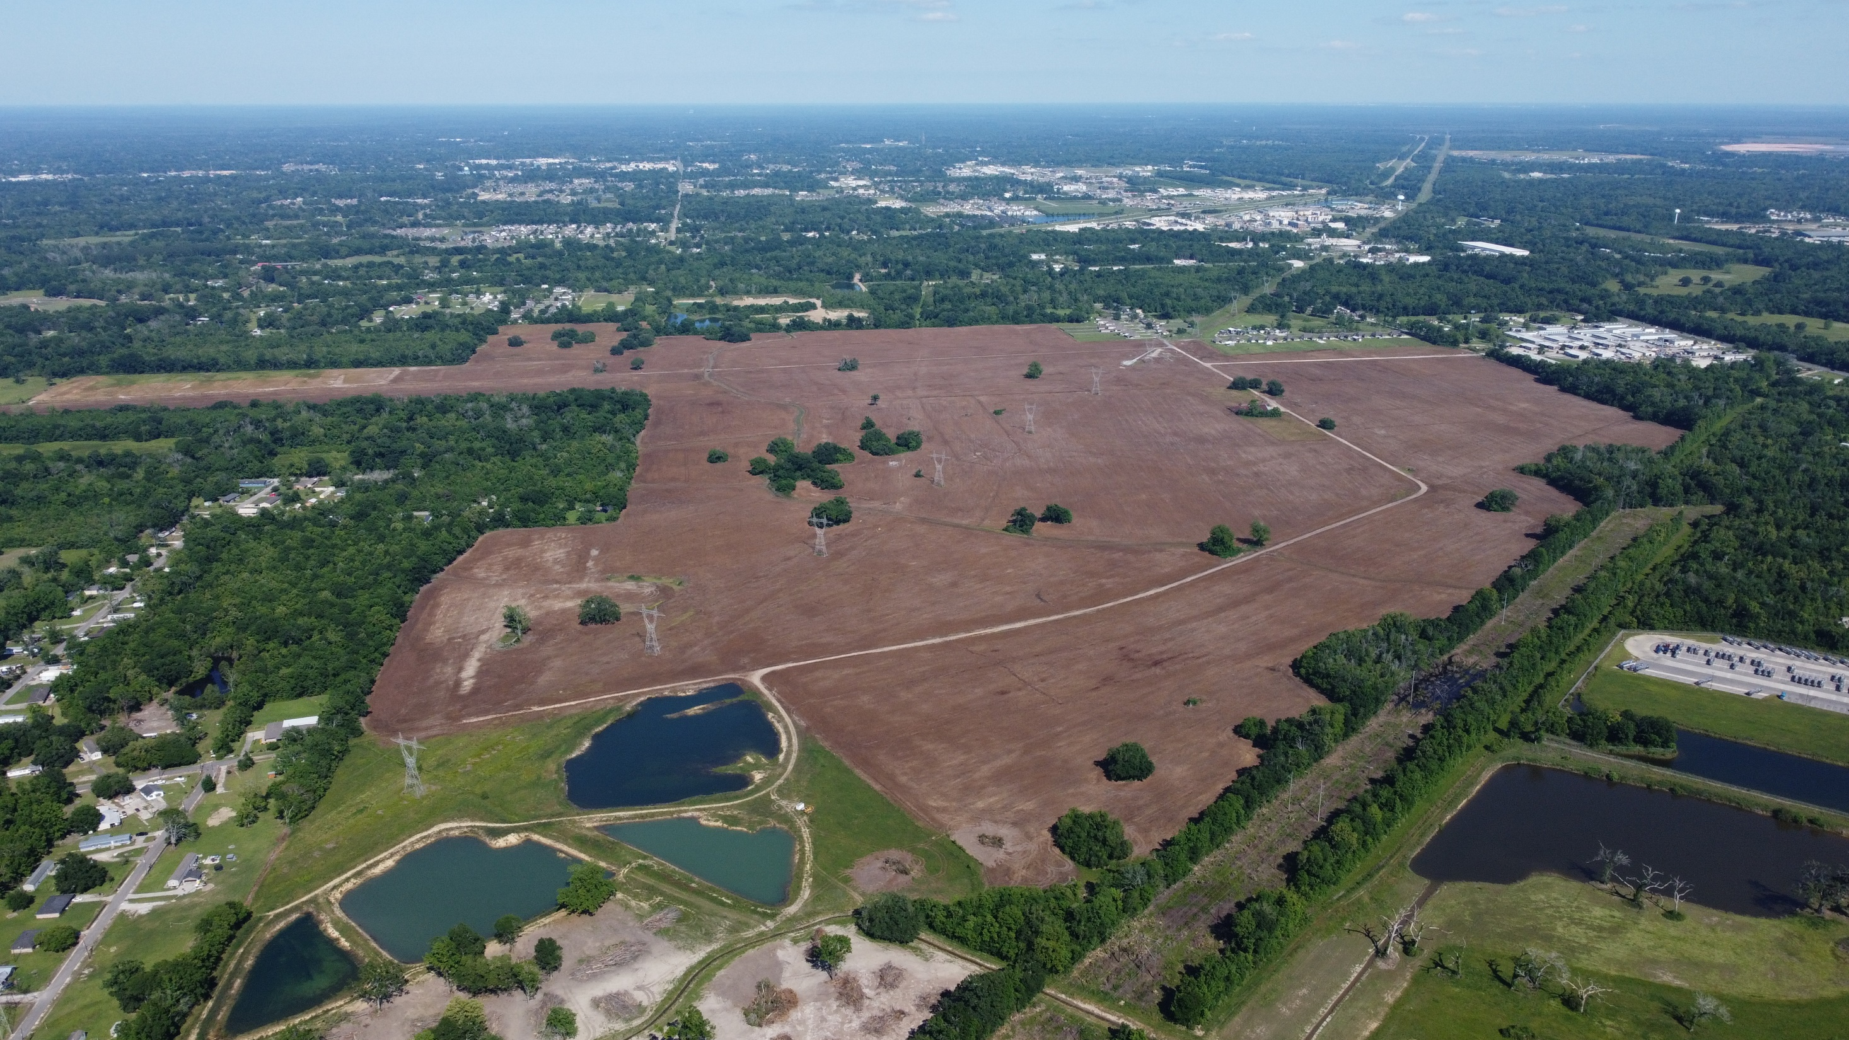

Ascension Commerce II

Slide 54
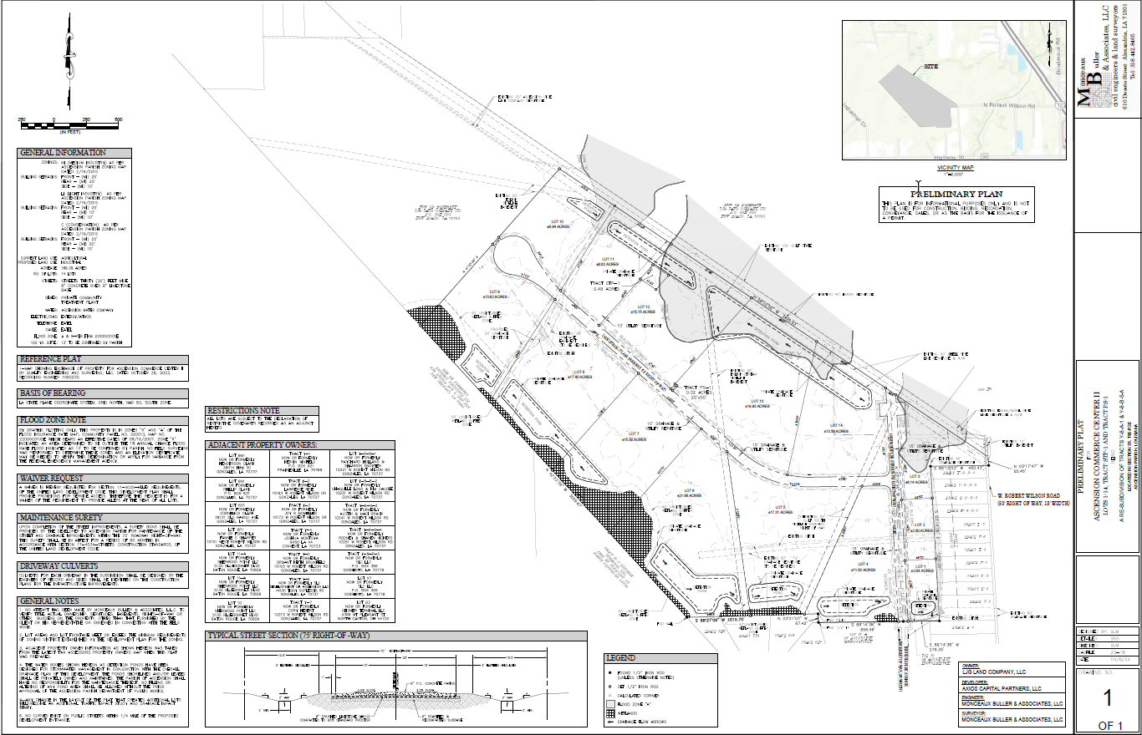
Ascension Commerce II

Slide 55
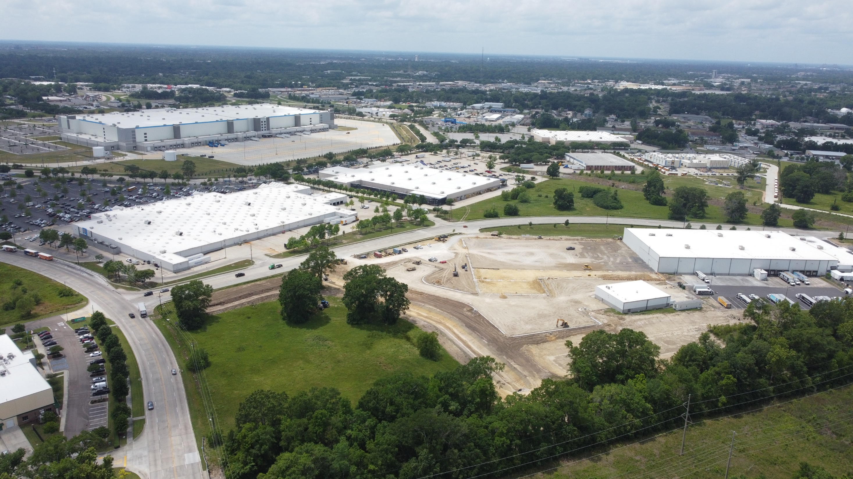
Crescent Crown

Slide 56
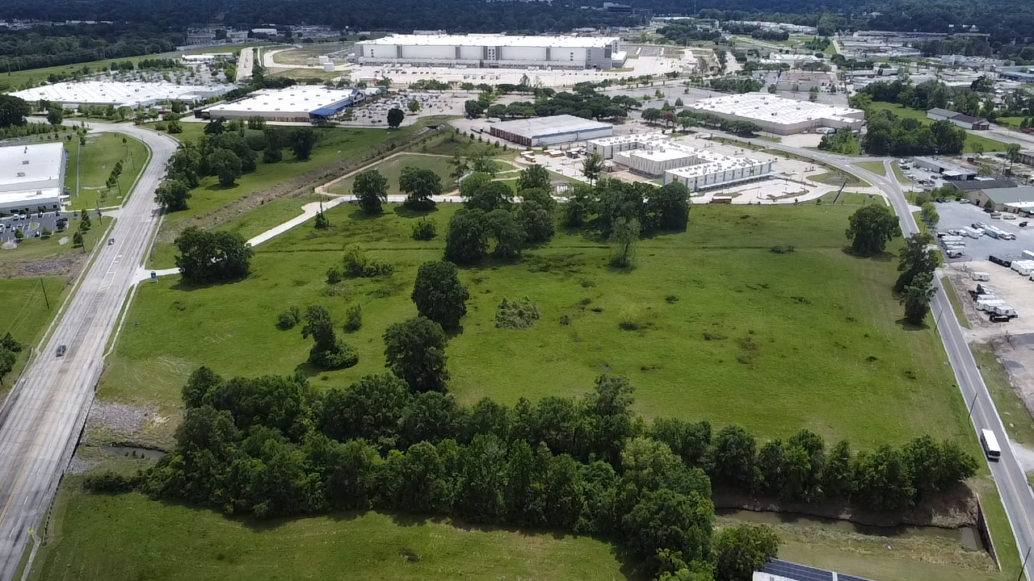
61 North

Slide 57
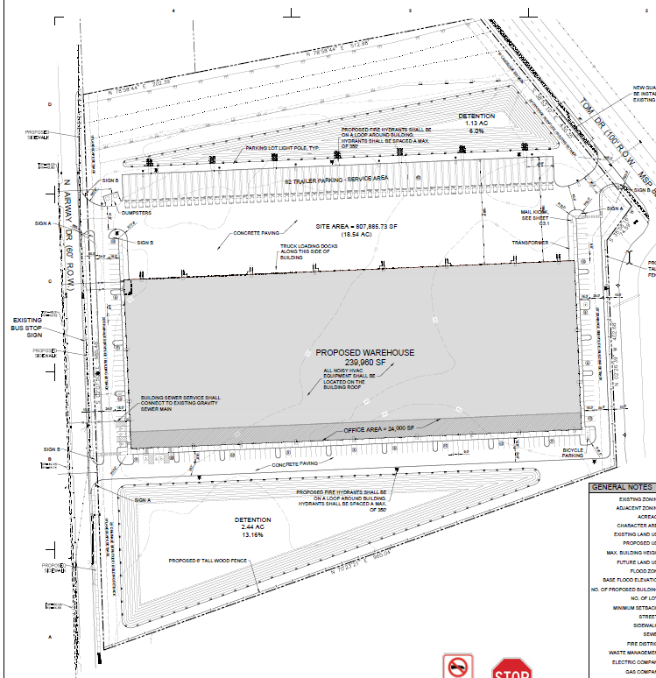
61 North

Slide 58
61 North

Slide 59
61 North

Slide 60
Outlook

Slide 61
What to watch for:
Vacancy will remain below 3%
Rental rates will stabilize after two years of steady rent growth.
Market will remain tight with limited to no inventory of existing space above 50K SF.
Sales on quality buildings will be limited.
More announcements on the economic development front – both Petrochem and manufacturing
Increase in land sale volume.

Slide 62

THANK YOU
PRESENTED BY
Evan Scroggs, SIOR, CCIM
President & Managing Principal
Lee & Associates
escroggs@lee-associates.com

