Slide 1


BATON ROUGE
RETAIL MARKET
PRESENTED BY
Charlie Colvin, CCIM, Momentum Commercial Real Estate

Slide 2


RETAIL COMMITTEE MEMBERS
Charlie Colvin, CCIM
Momentum Commercial Real Estate
Jonathan Walker, CCIM
Maestri Murrell, Inc.
Dottie Tarleton, CCIM
Stirling Properties
Clay Furr
Momentum Commercial Real Estate
Colin Smith
Kurz & Hebert Commercial Real Estate
Andrew D’Ostilio, CCIM
NAI Latter & Blum
Matthew Shirley, CCIM
Saurage Rotenberg Commercial Real Estate
Ransom Pipes, CCIM
Maestri Murrell, Inc.
Ben Graham, CCIM
Stirling Properties
Will Chadwick, MBA
Elifin Realty
Drew Whitaker
Cook Moore Davenport & Associates
Cade Bogan
Beau Box Commercial Real Estate

Slide 3
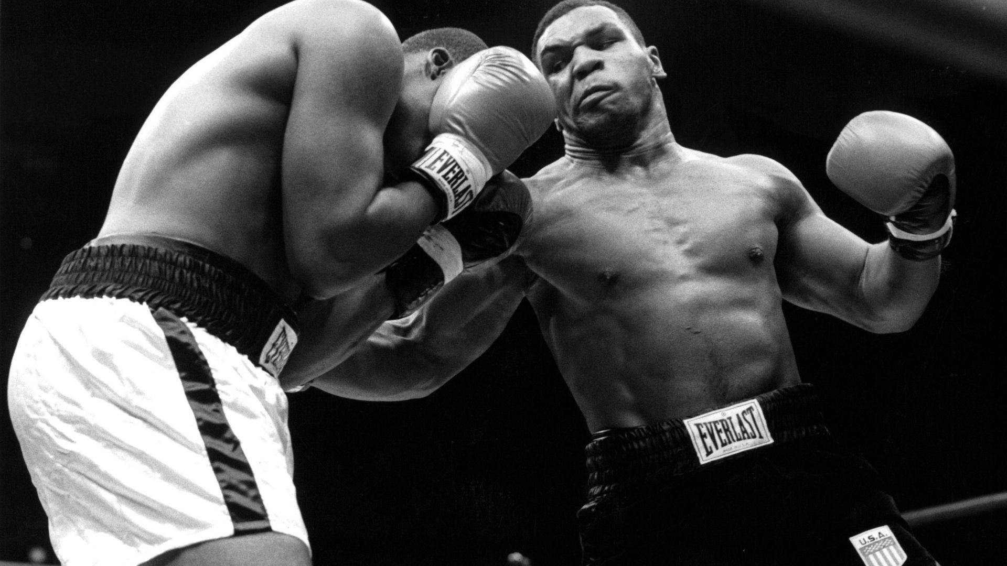
“Everyone has a plan, until they get punched in the mouth.”

Slide 4

LAST YEARS PREDICTIONS
Vacancy to return to 8-9% Range
Minimal market-wide rent increases
Fewer Larger Centers Trading Hands
Increase in Retail Bankruptcies
Charlie@momentum-commercial.com

Slide 5

2024 SHOPPING CENTER SURVEY
2023 2024
Total Area Surveyed: 8,454,959 SF 8,371,167
Number of Centers: 123 129
Average Rent: $19.83 PSF $20.68 PSF
Area Vacancy Rate: 7.17% 8.02%

Slide 6
GROSS RENTS & VACANCY RATES

Slide 7
Vacancy Rate by Area
Geographic Area | Number of Responding Centers | Vacancy Rate | Change from Previous Period | Rent + Reimb. Collections in $/SF
Area 1 (South of I-10 & West of Airline) | 41 | 4.36% | -0.19% | $25.95
Area 2 (North of I-10 & South/West of Airline) | 18 | 9.76% | 3.04% | $17.71
Area 3 (North of Choctaw & North/East of Airline) | 8 | 5.04% | -10.64% | $14.28
Area 4 (South of Choctaw & East of Airline) | 31 | 14.45% | 4.12% | $16.61
Area 5 (Zachary) | 7 | 5.95% | 0.28% | $18.38
Area 6 (Ascension Parish) | 16 | 6.92% | 4.79% | $21.26
Area 7 (Livingston Parish) | 8 | 10.00% | 6.78% | $20.97
Total | 129 | 8.02% | 0.85% | $20.68

Slide 8
Vacancy Rate by Area

Slide 9
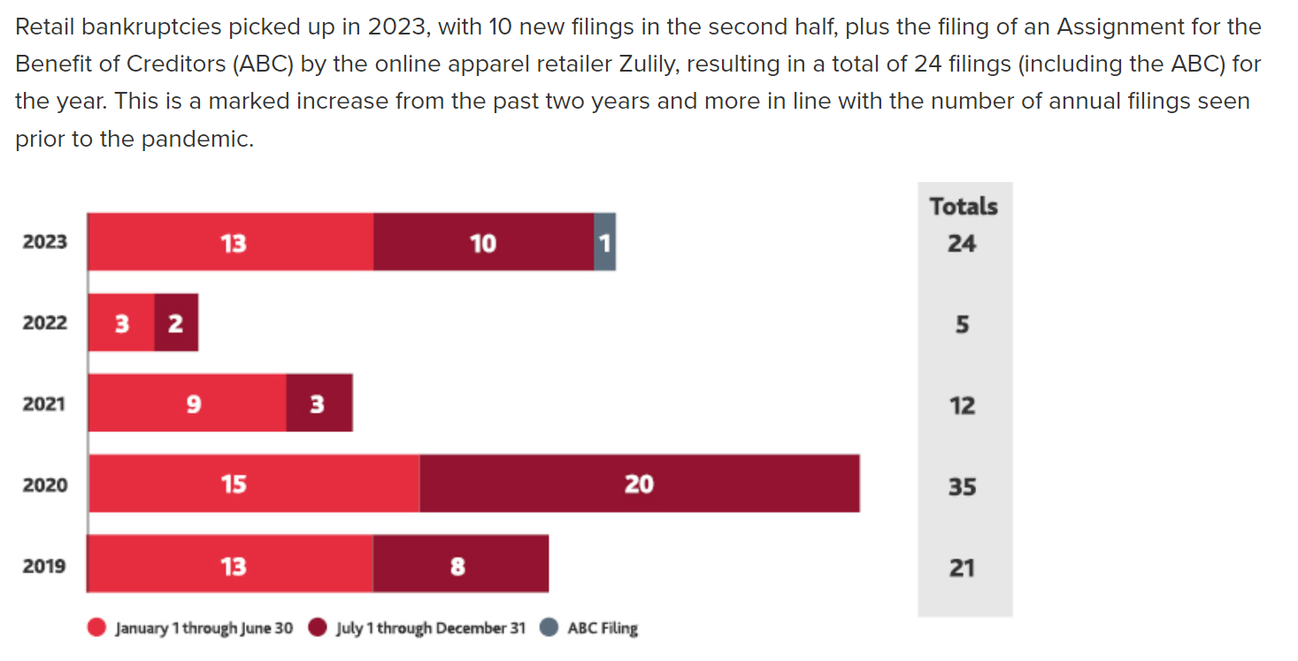
RETAIL BANKRUPTCIES

Slide 10
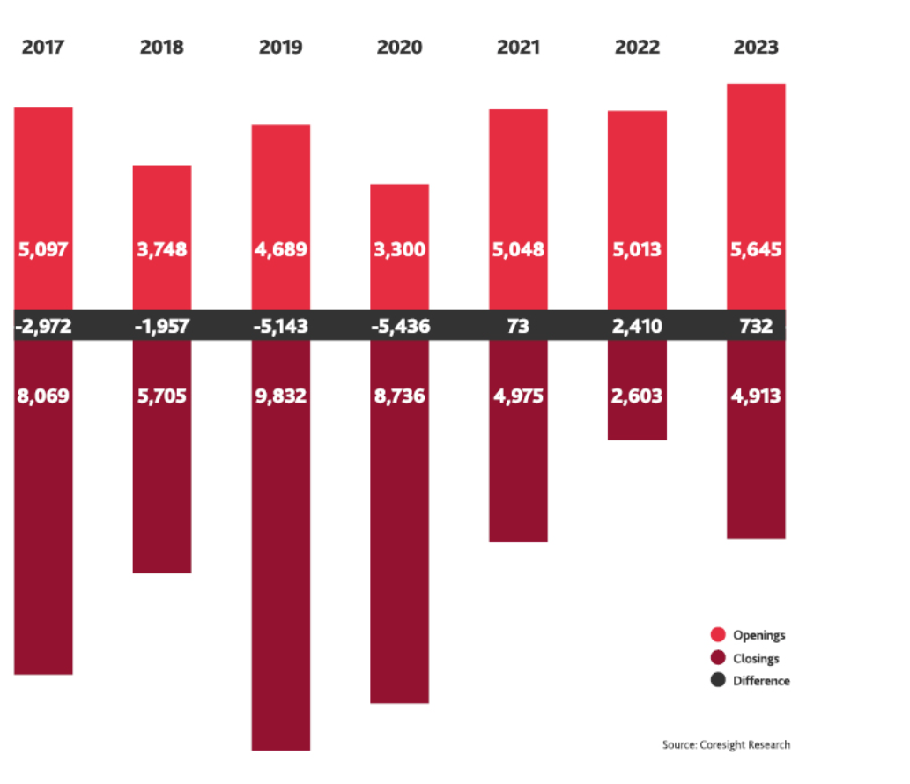
Store Opening and Closings

Slide 11

RETAILER
CHALLENGES
Labor Force
Consumer Debt
Organized Retail Crime

Slide 12
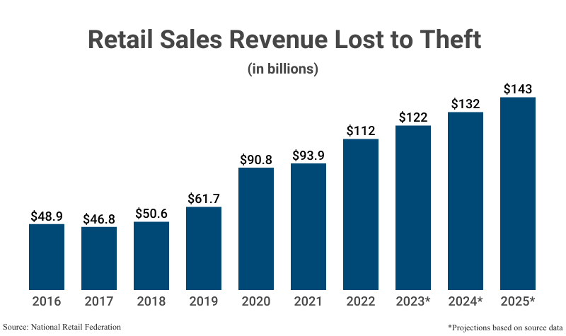
Organized Retail Crime (ORC)

Slide 13
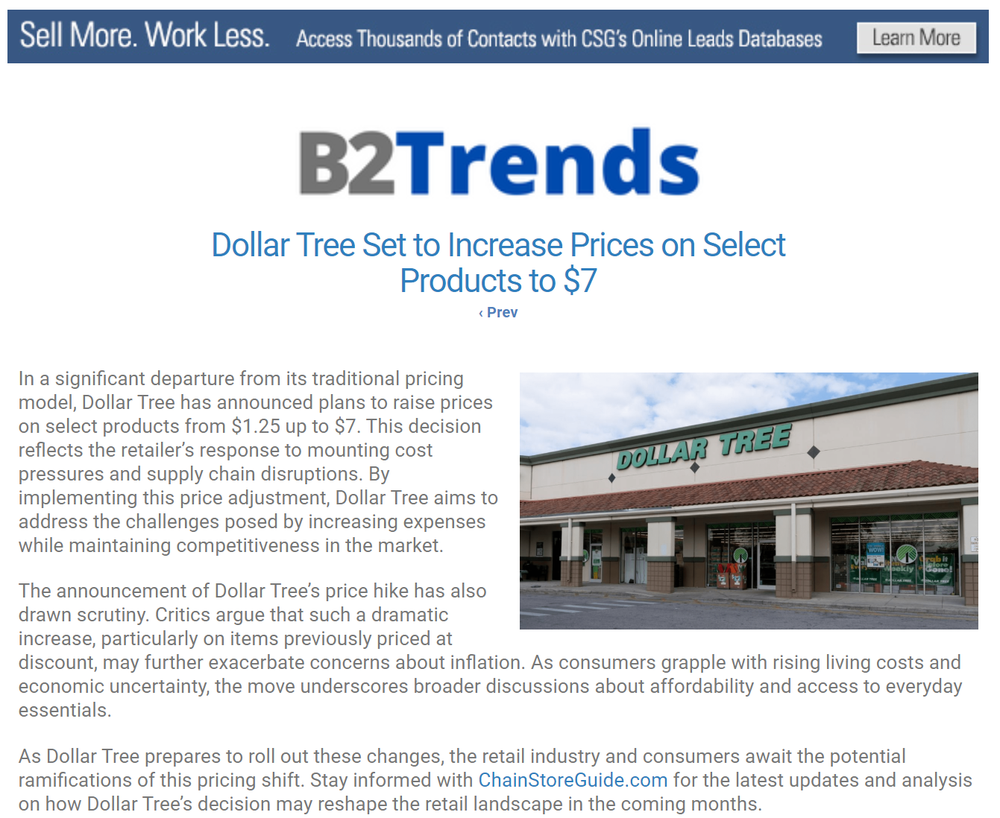
Inflation

Slide 14
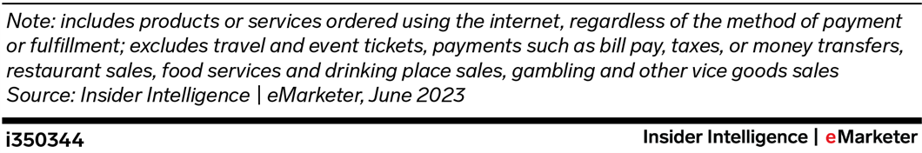
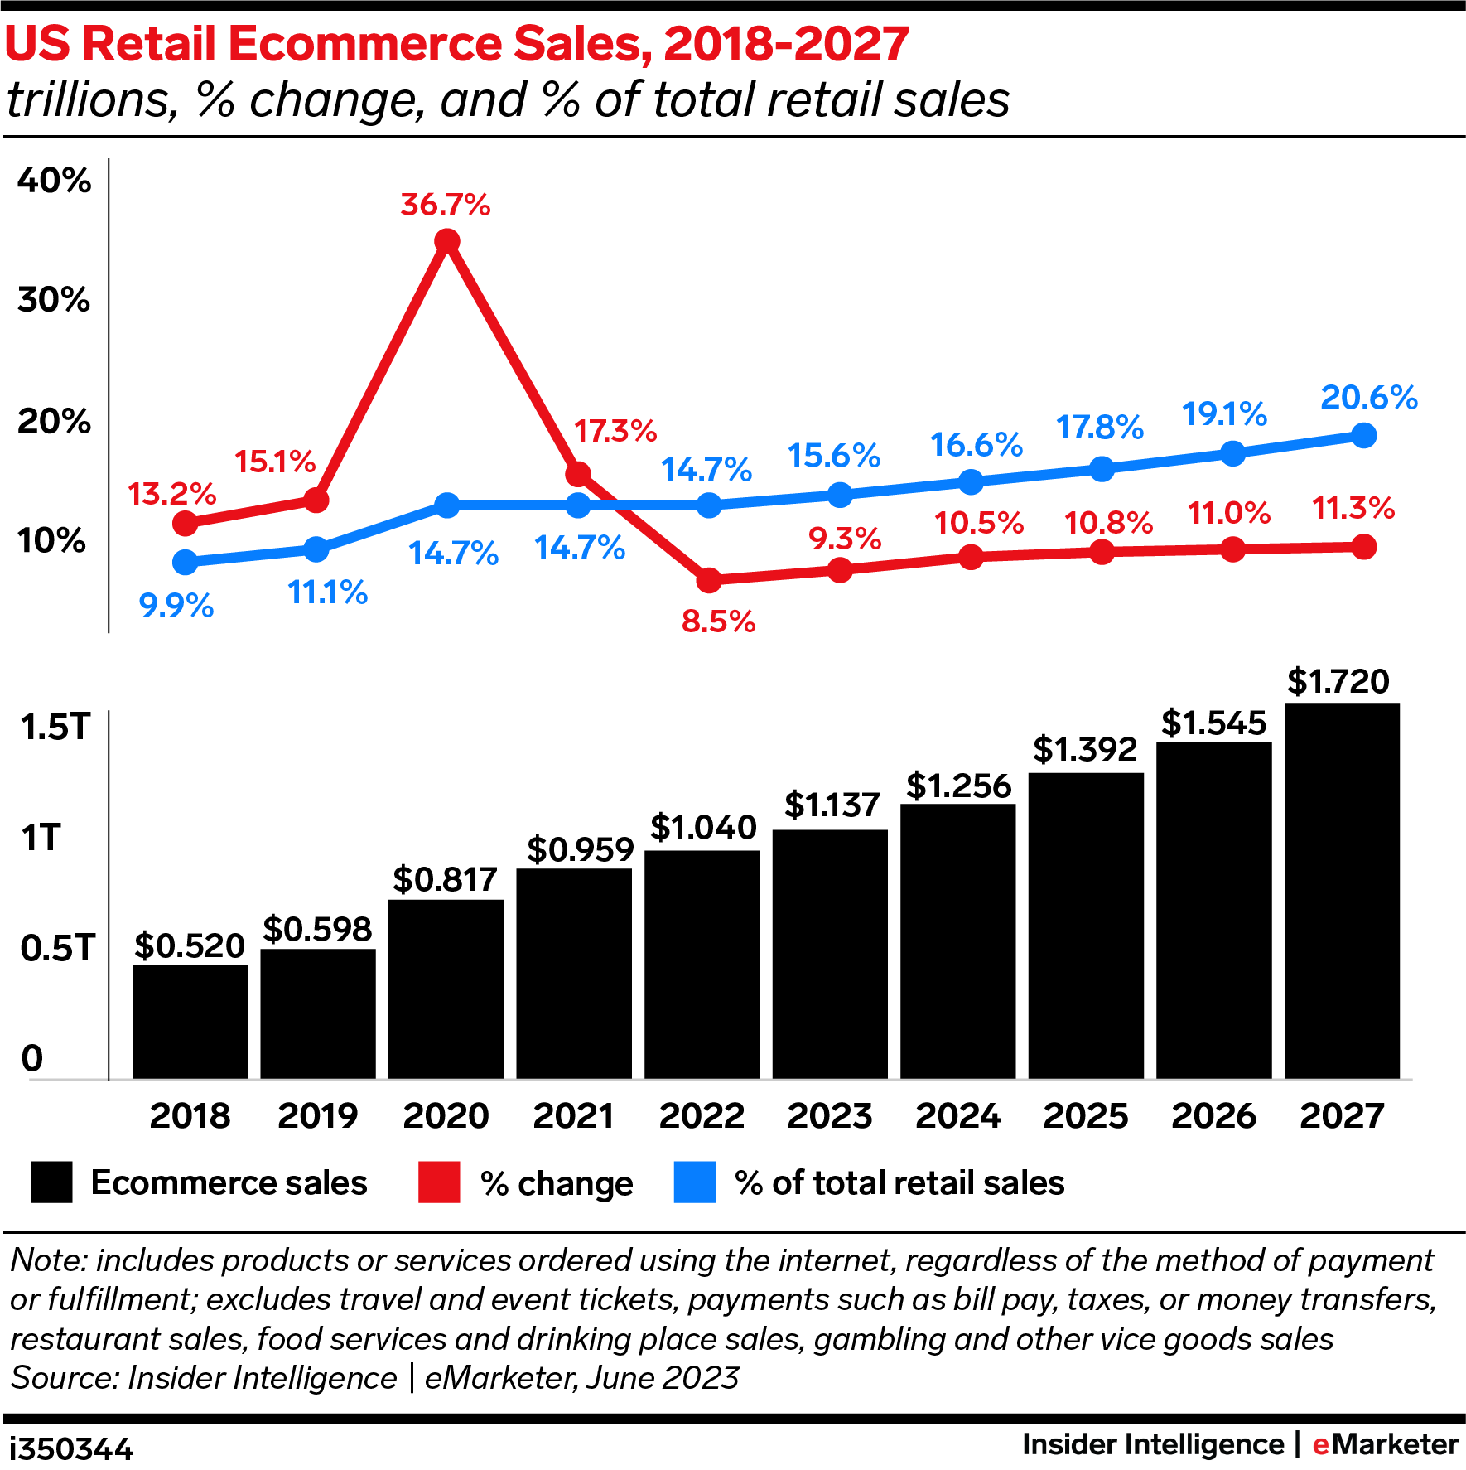

Slide 15
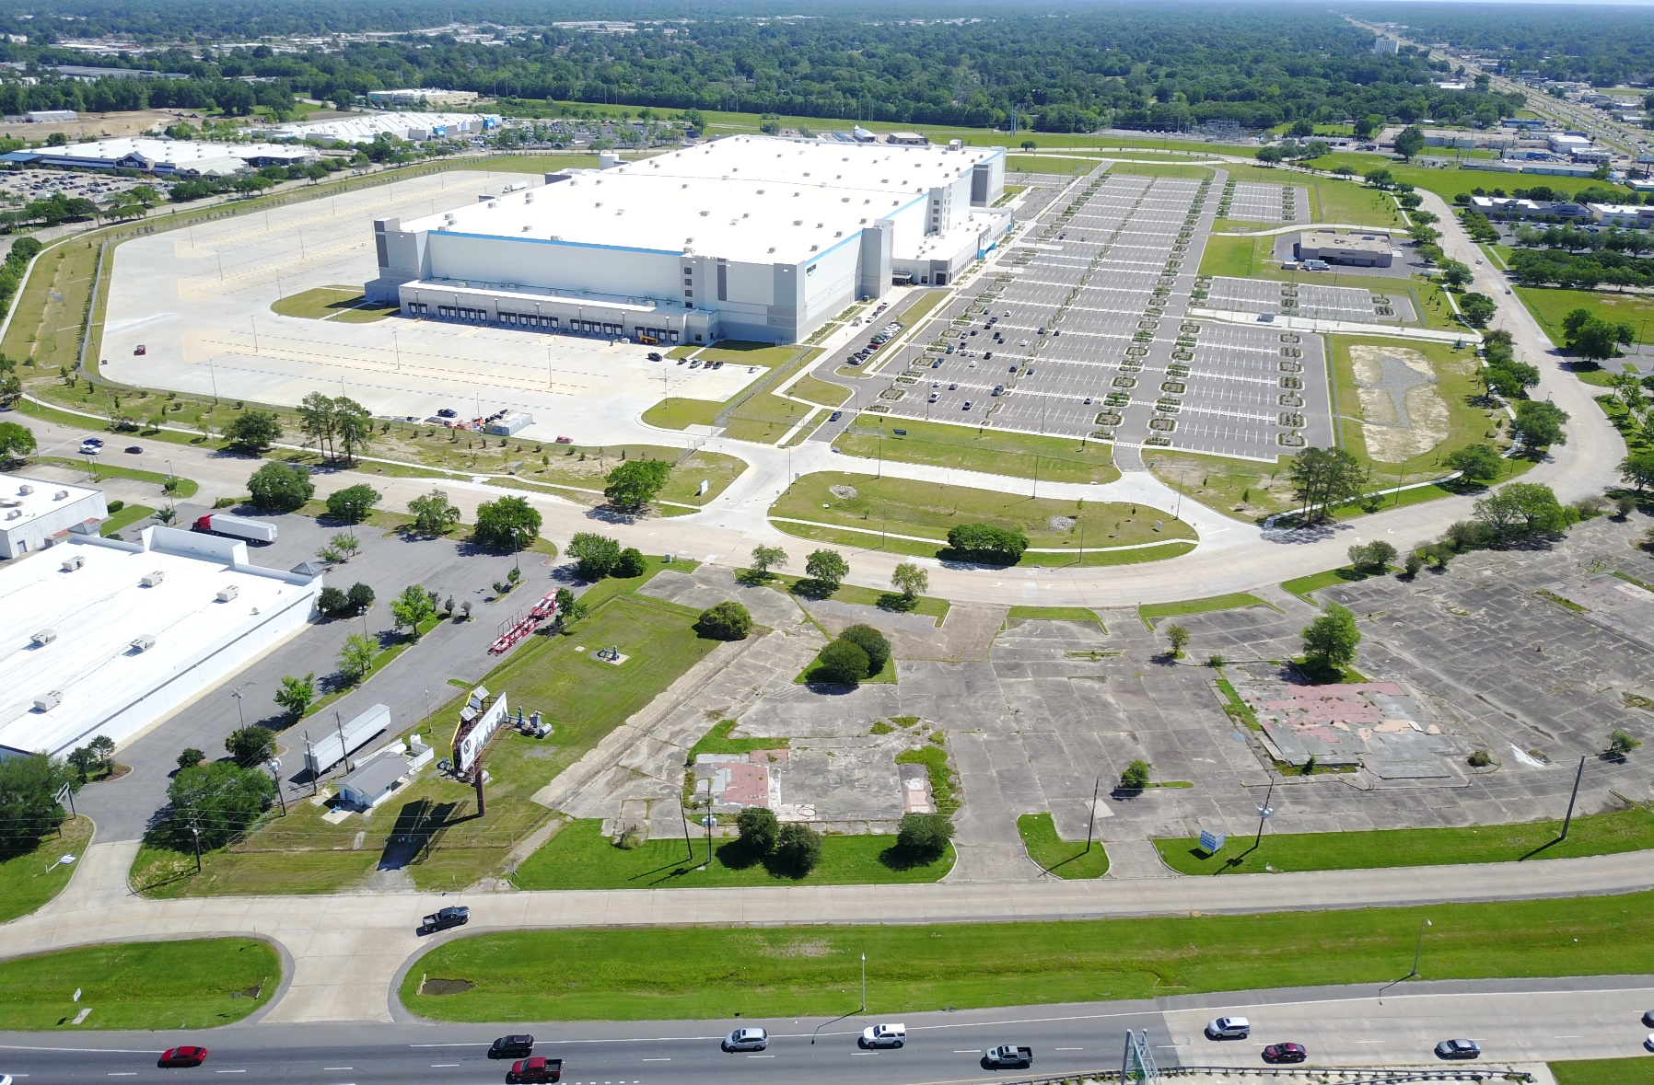
AMAZON UPDATE

Slide 16
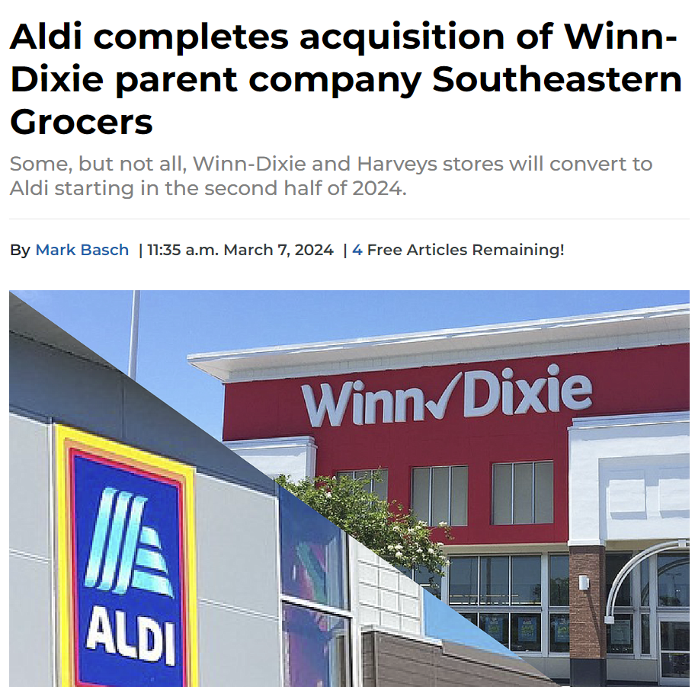
Grocery Mega Mergers

Slide 17

Grocery Mega Mergers
The Federal Trade Commission sued to block the largest proposed supermarket merger in U.S. history
Albertsons and Kroger will sell off more locations as they try to win regulatory approval for Kroger's $24.6 billion takeover of Albertsons.

Slide 18

Artificial Intelligence
Generative AI in Retail
Customer and Operational Benefit
Future of Physical and Digital Retail:

Slide 19
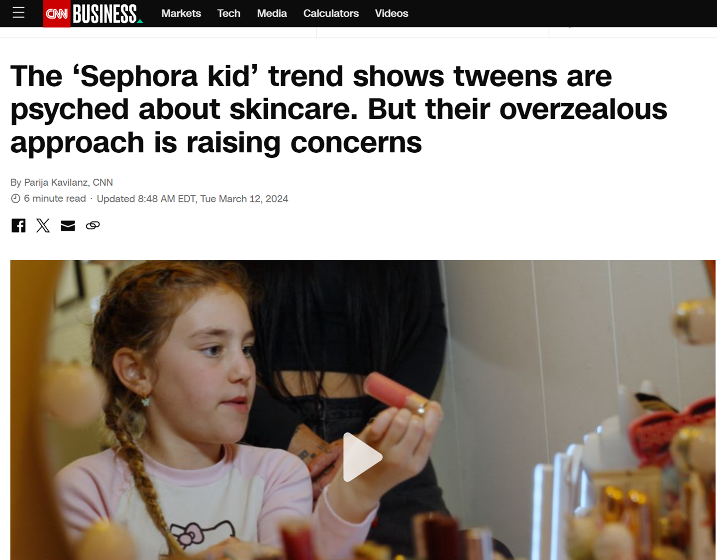
Skincare

Slide 20
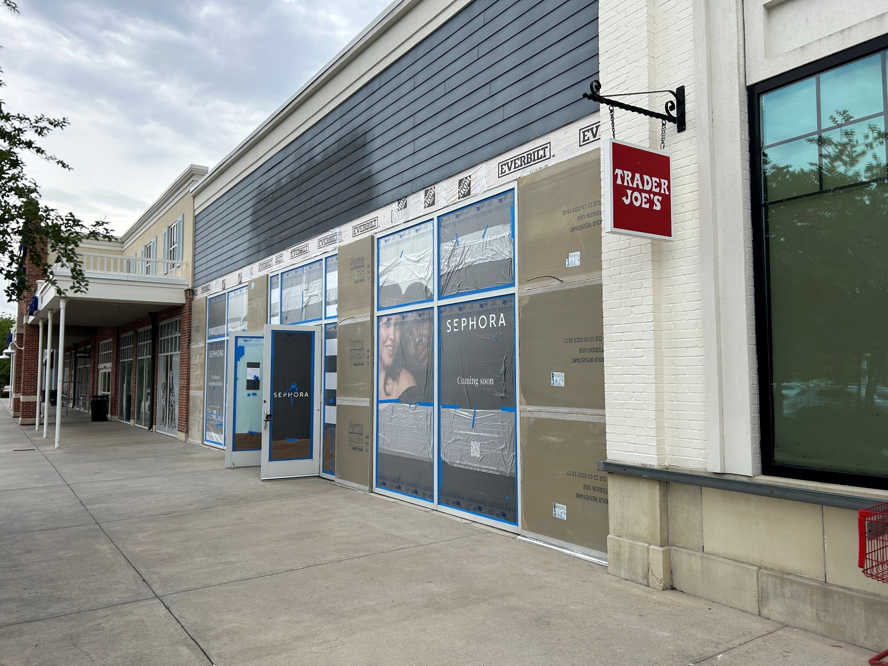
ACADIAN VILLAGE

Slide 21
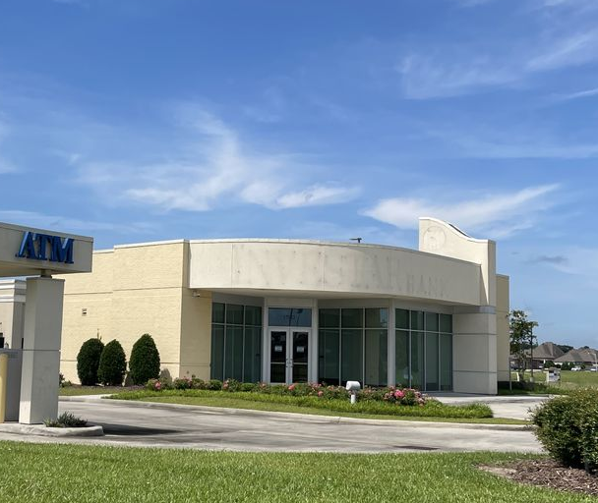
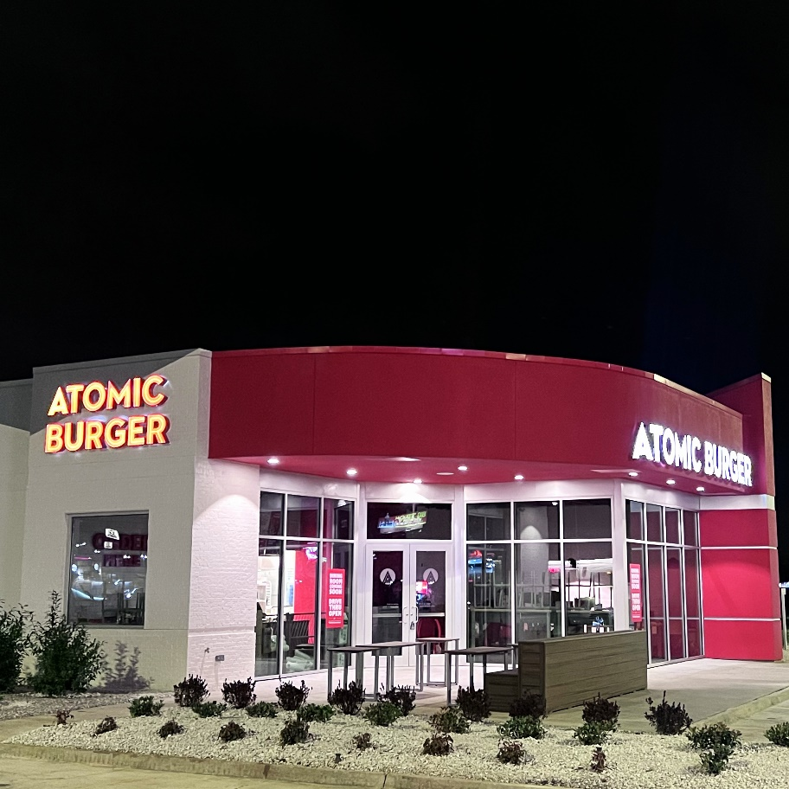
Banks to Burgers

Slide 22
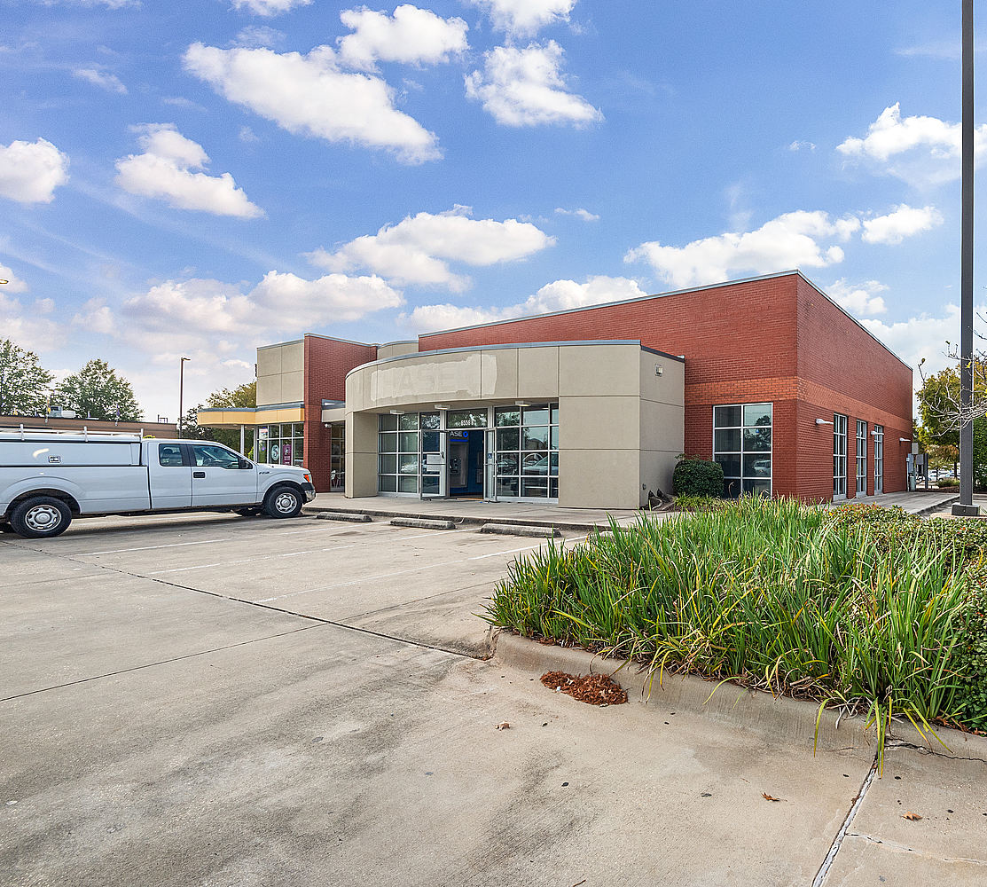
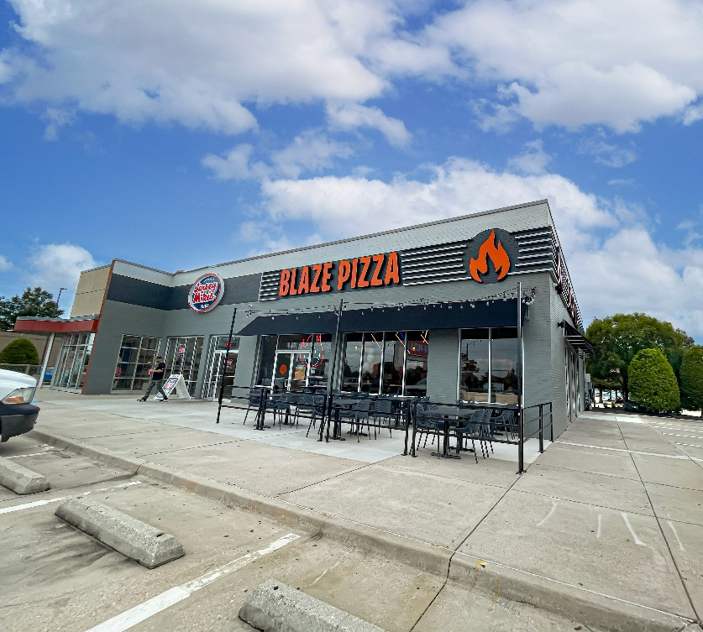
Banks to Burgers Fast Casual

Slide 23
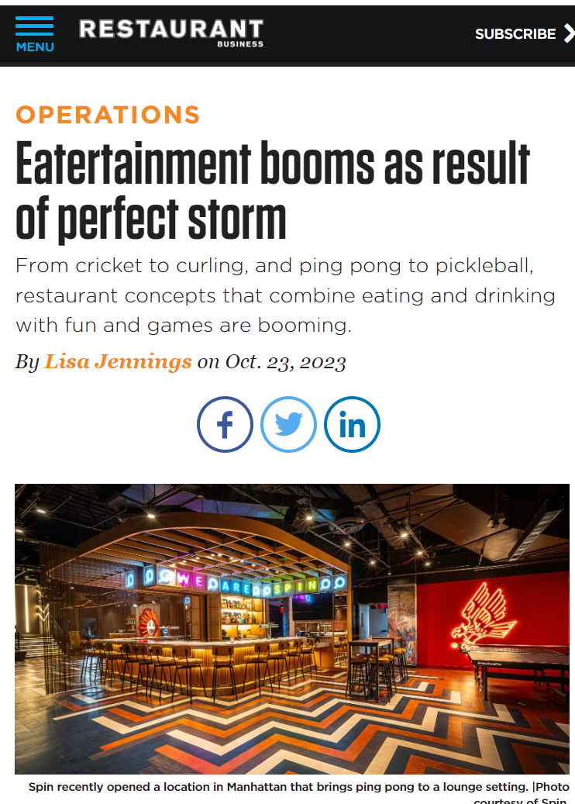
Entertainment remains active
Post-Pandemic Surge in Entertainment
Investment and Technological Innovation
Economic Viability and Growth

Slide 24
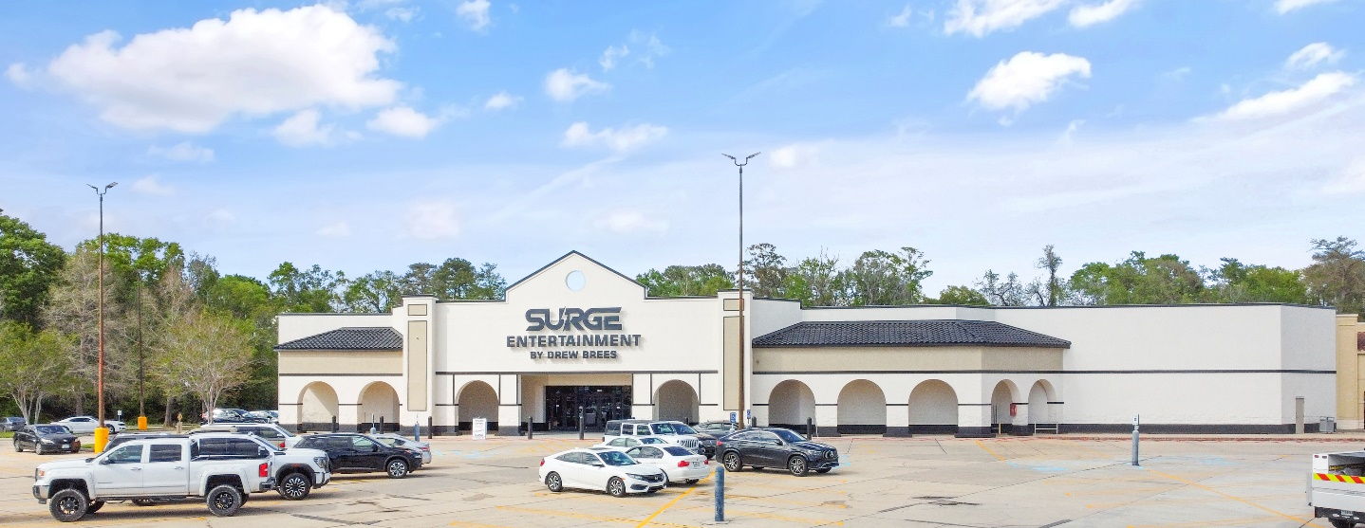
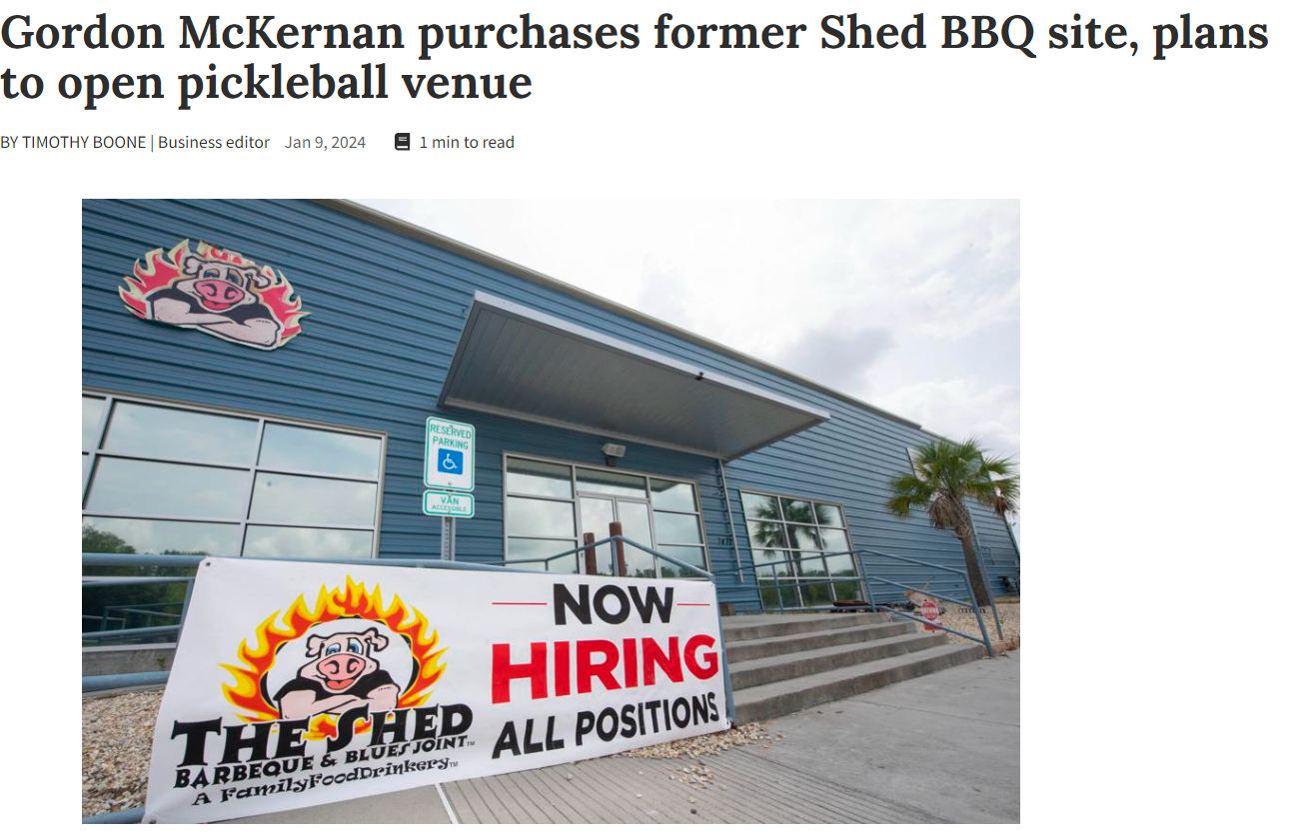
Entertainment remains active

Slide 25
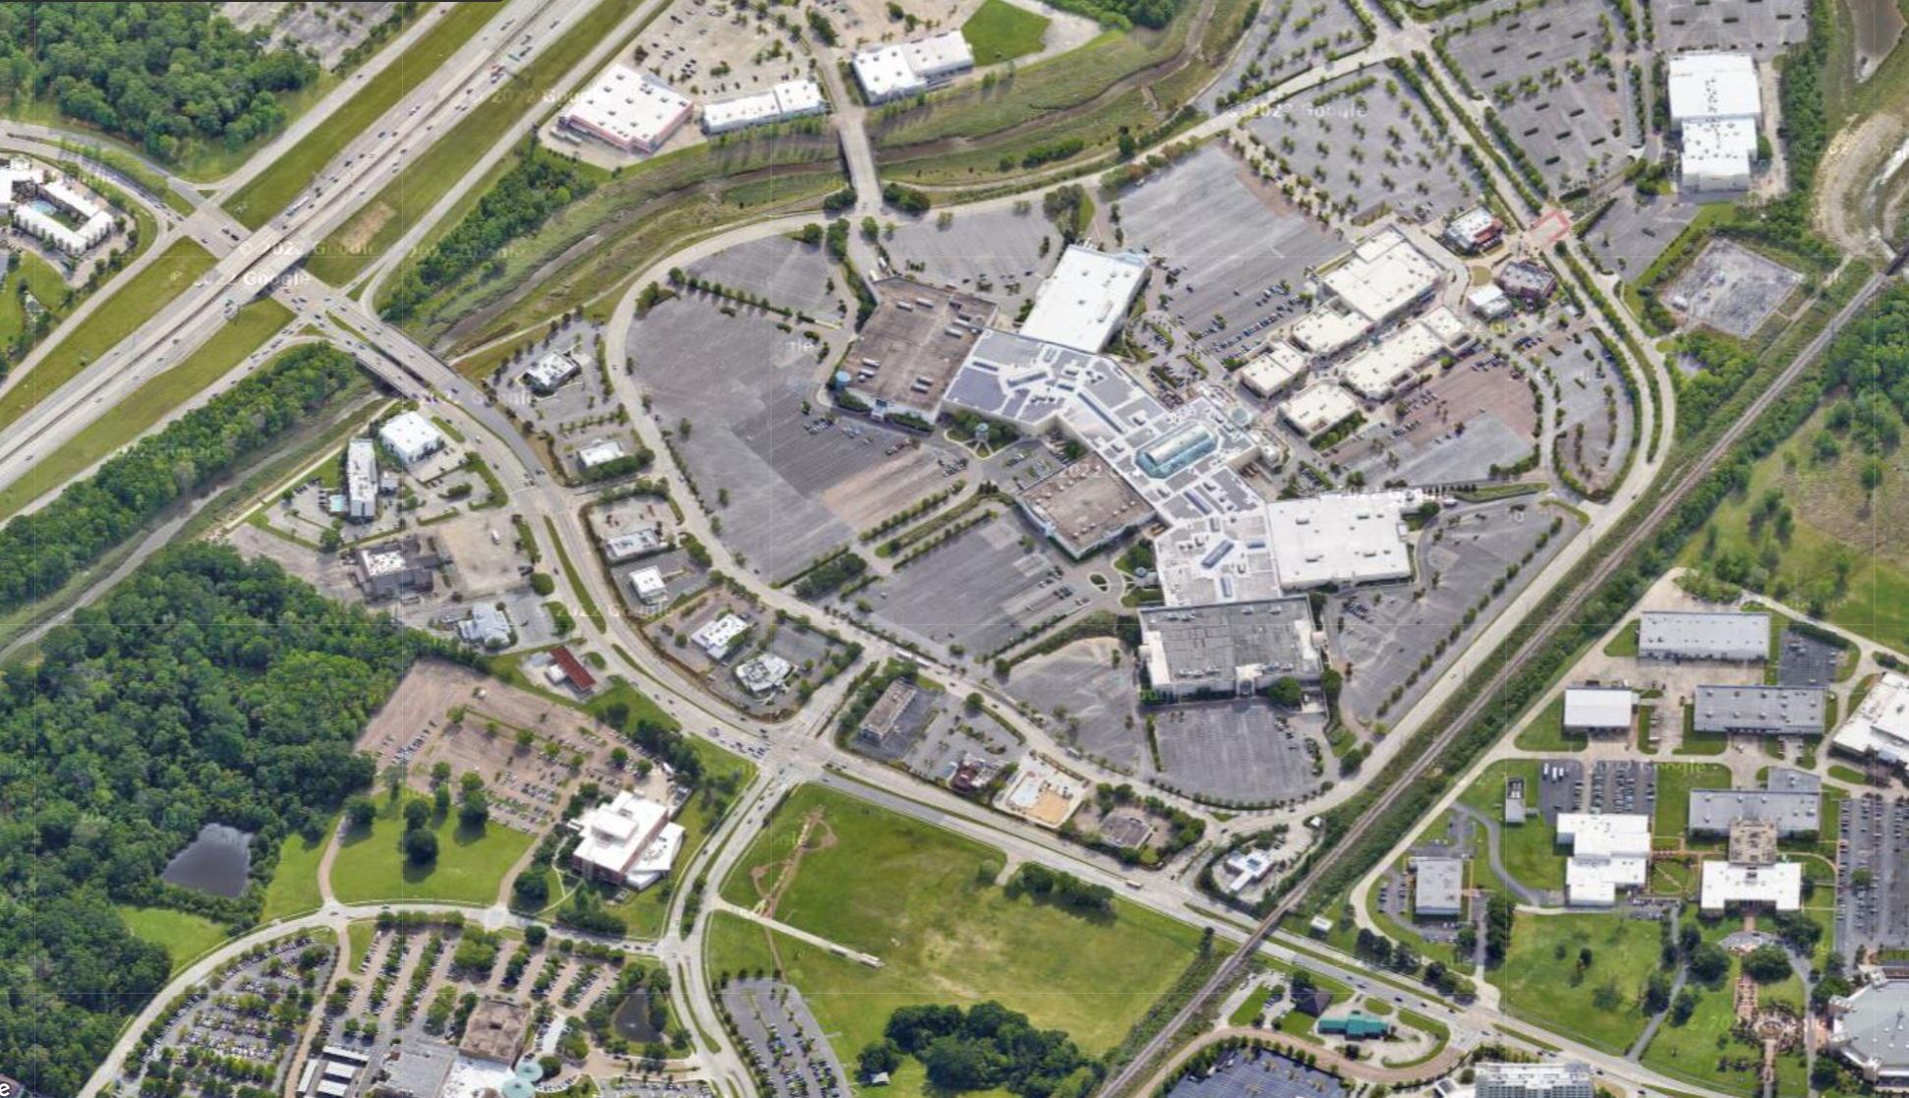
Mall of Louisiana

Slide 26
Project Updates

Slide 27
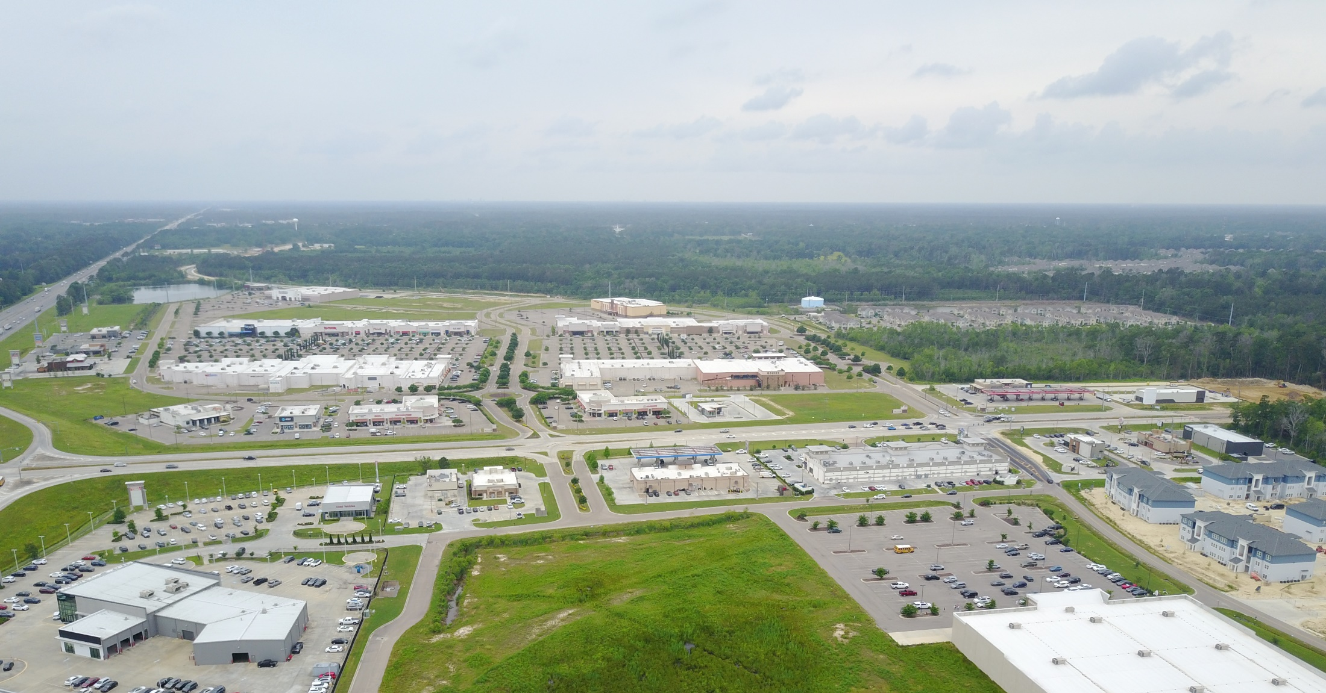
Juban Crossing – Denham Springs

Slide 28
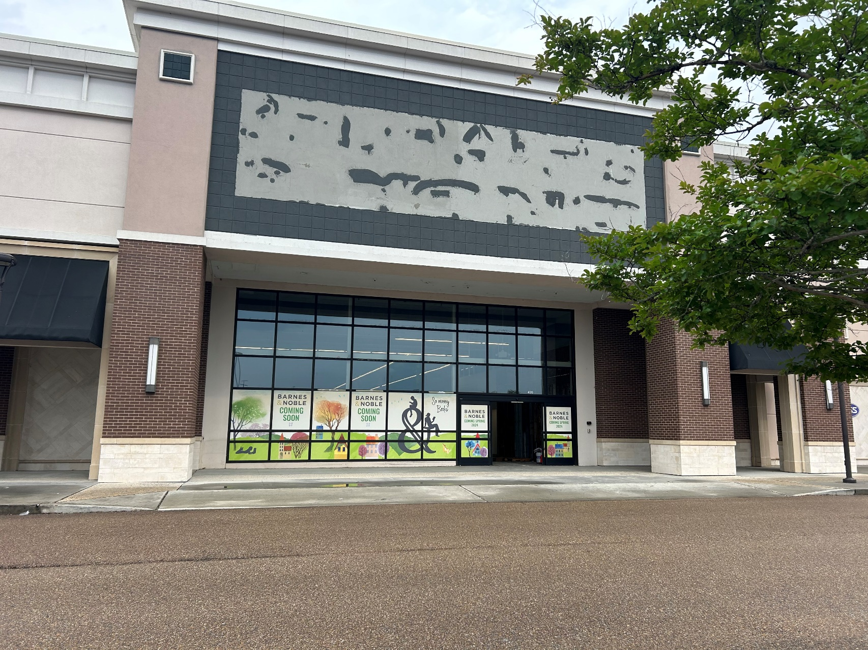
Juban Crossing – Denham Springs

Slide 29
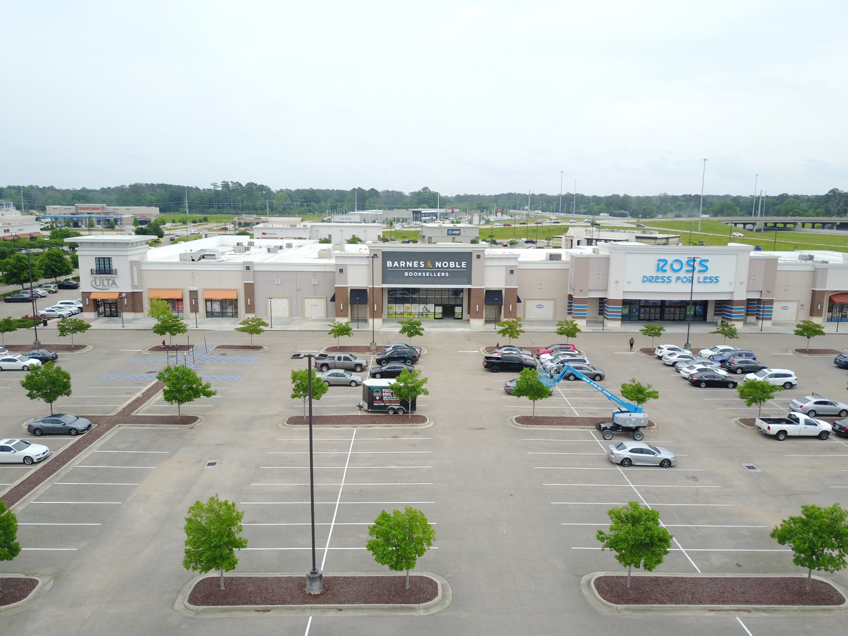
Juban Crossing – Denham Springs

Slide 30
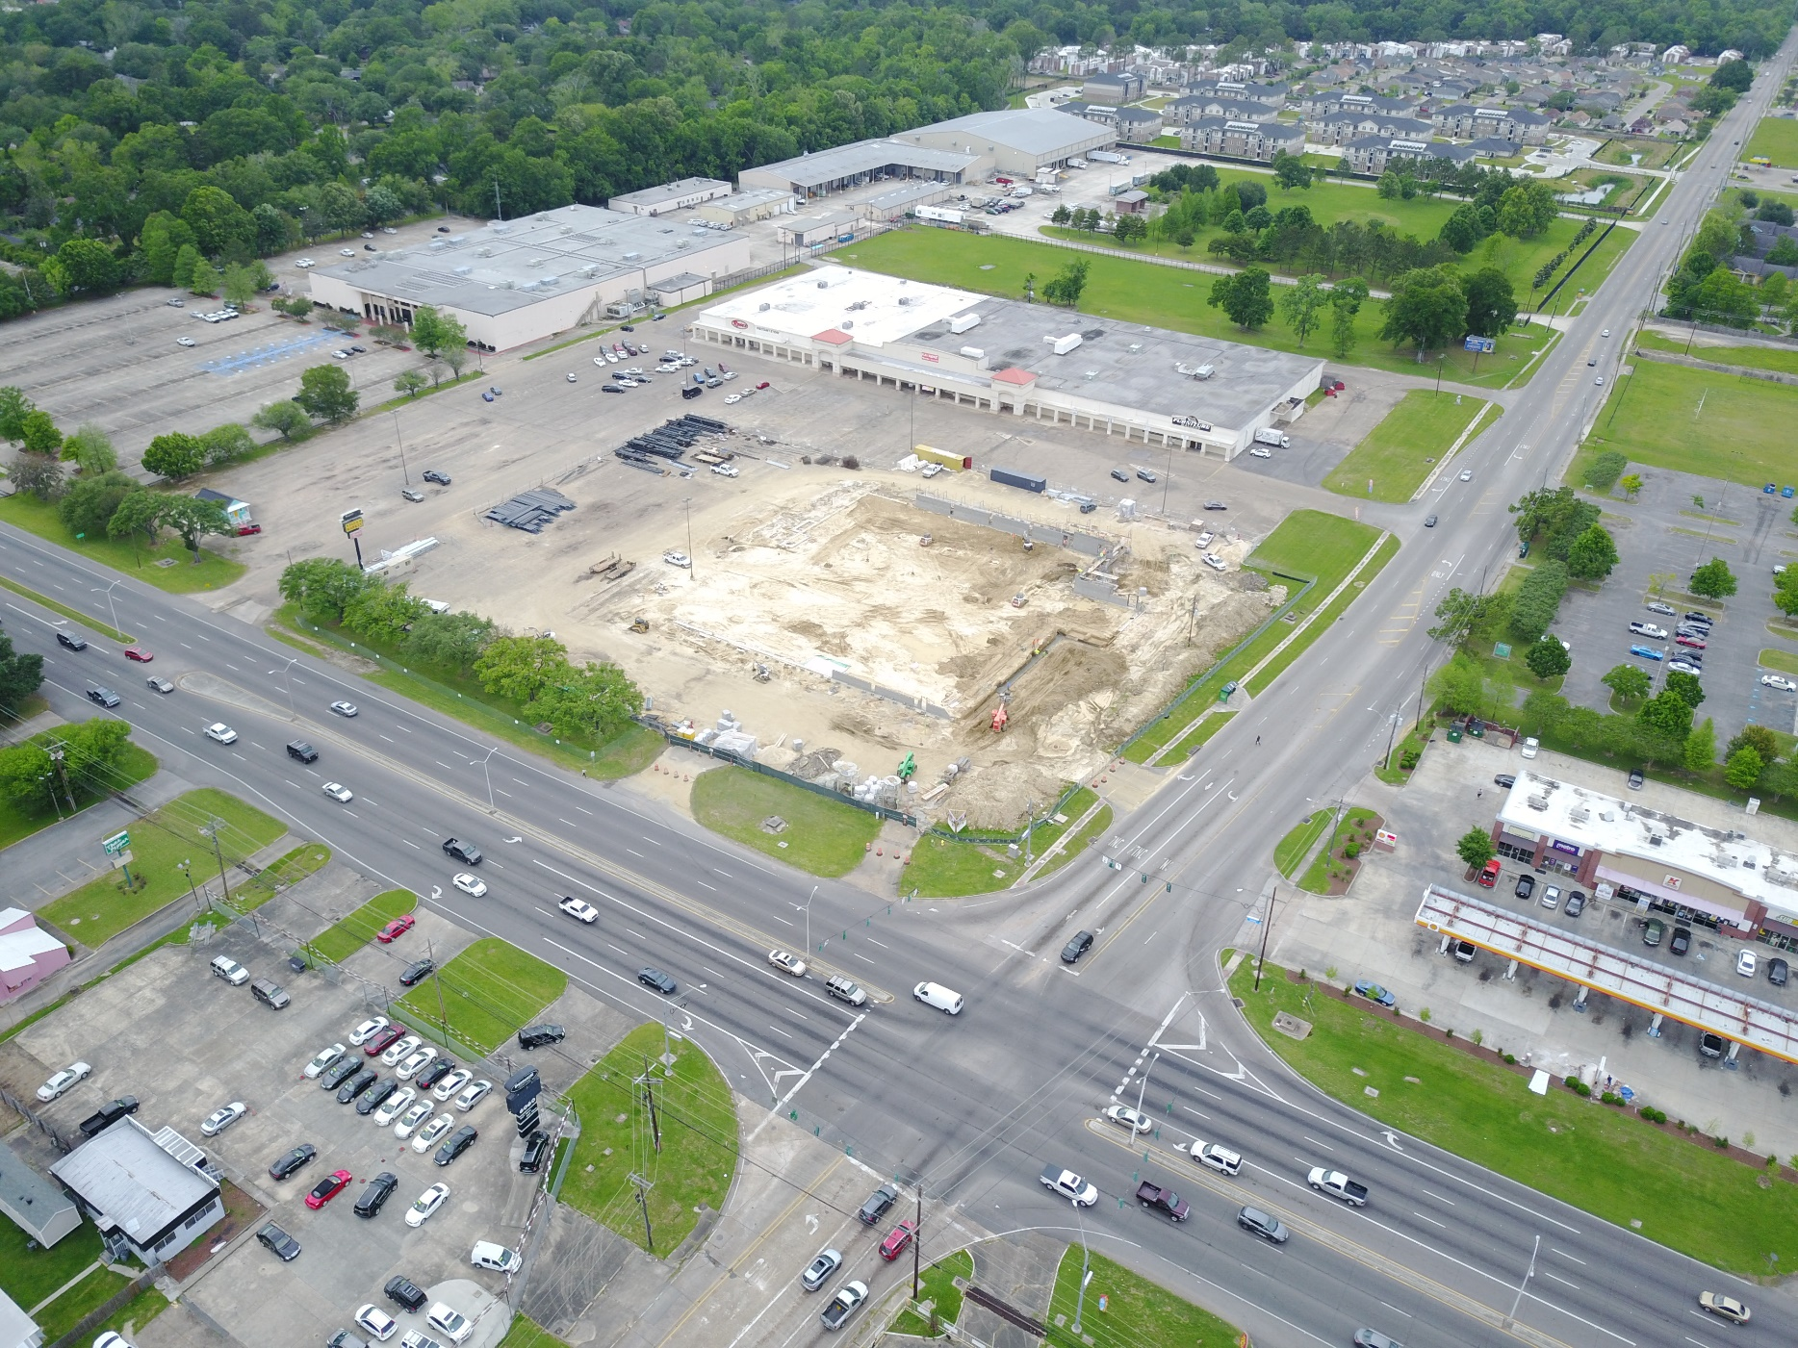
FLORIDA BLVD
@ ARDENWOOD

Slide 31
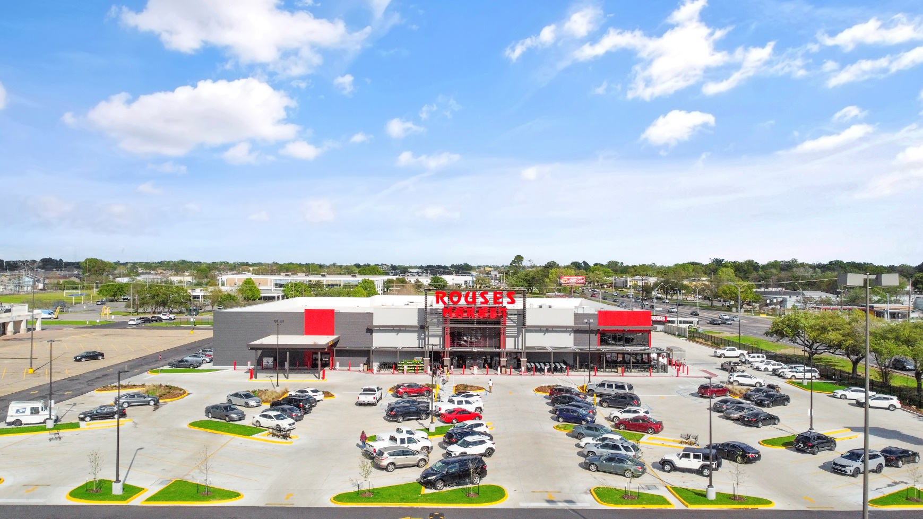
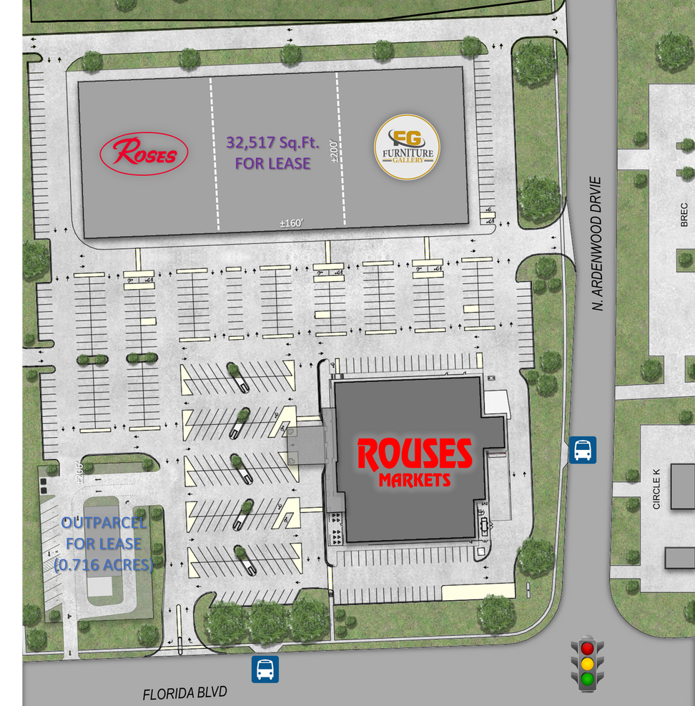
FLORIDA BLVD @ ARDENWOOD

Slide 32
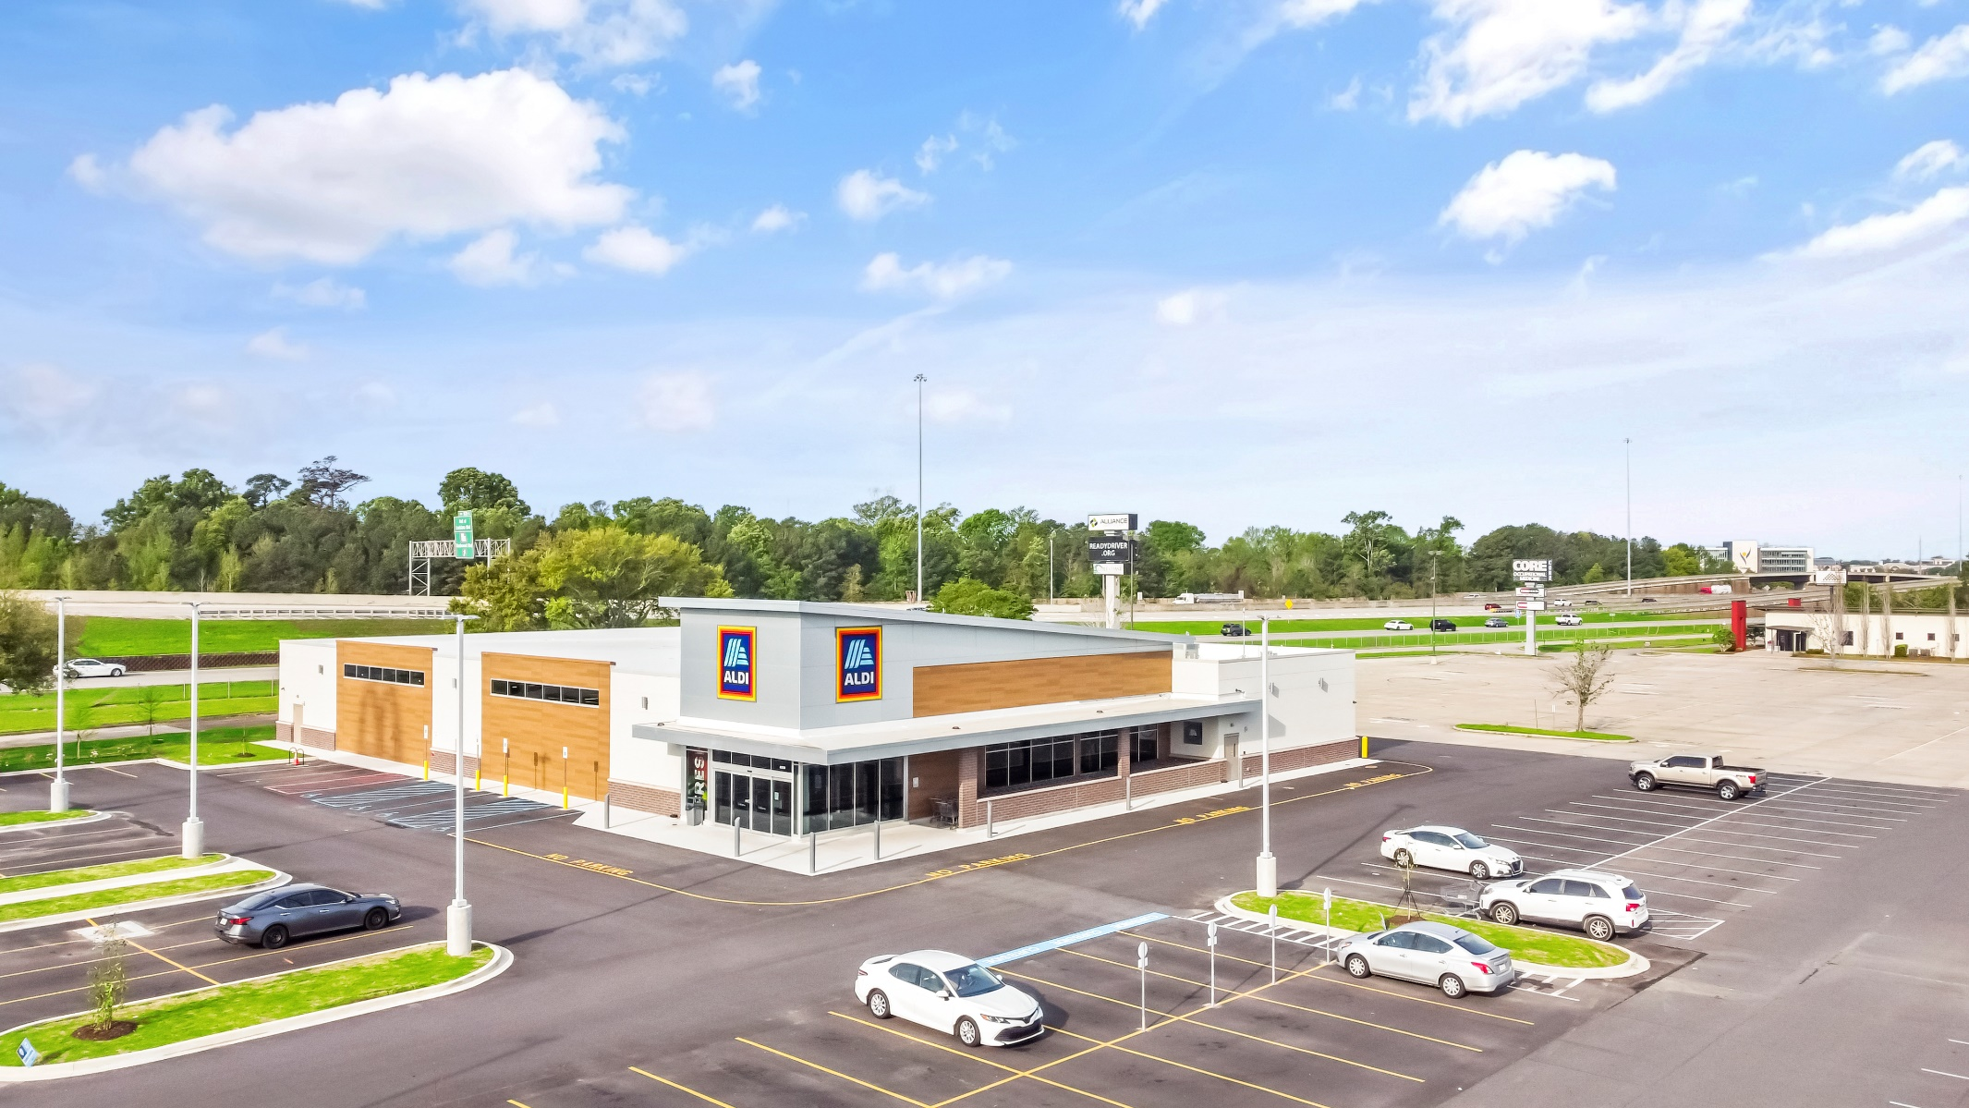
Siegen Lane - ALDI

Slide 33
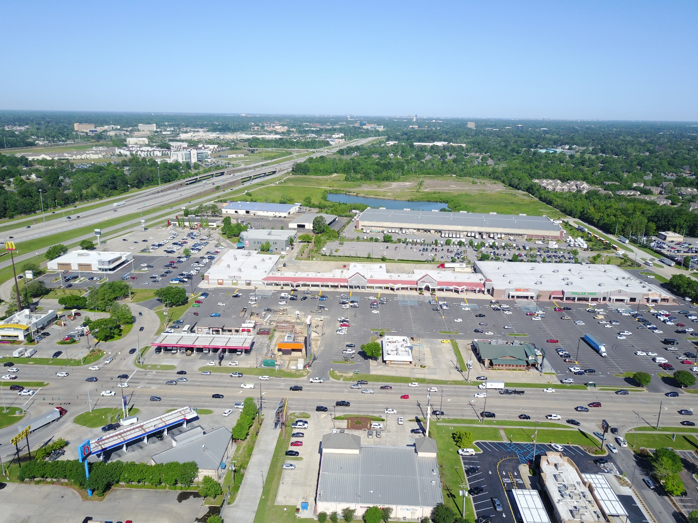
Siegen Lane - ALDI

Slide 34
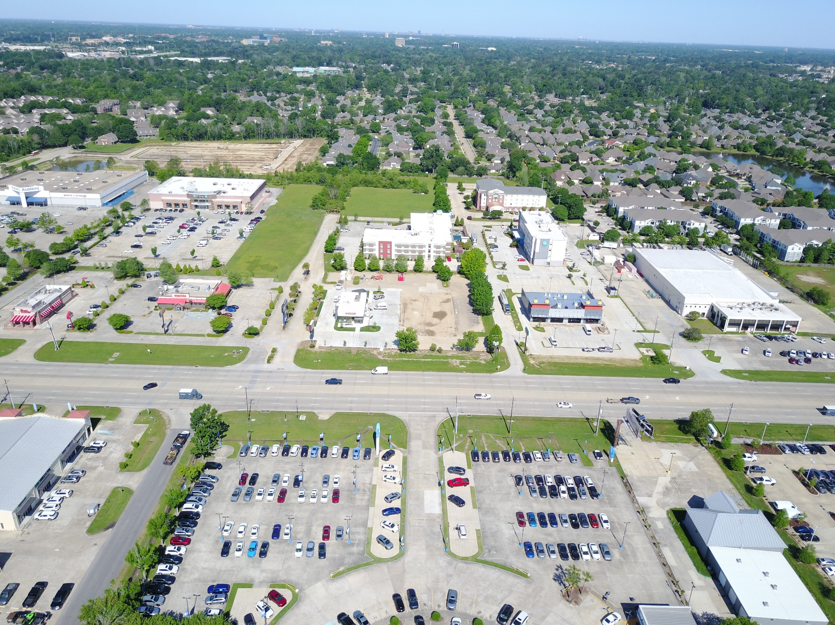
Siegen – Chipotle

Slide 35
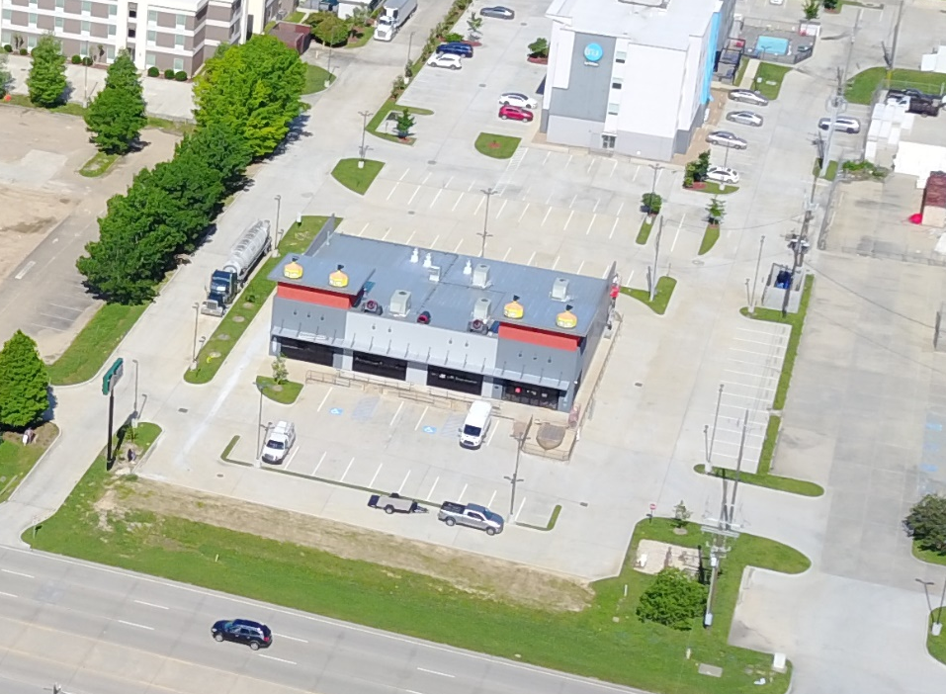
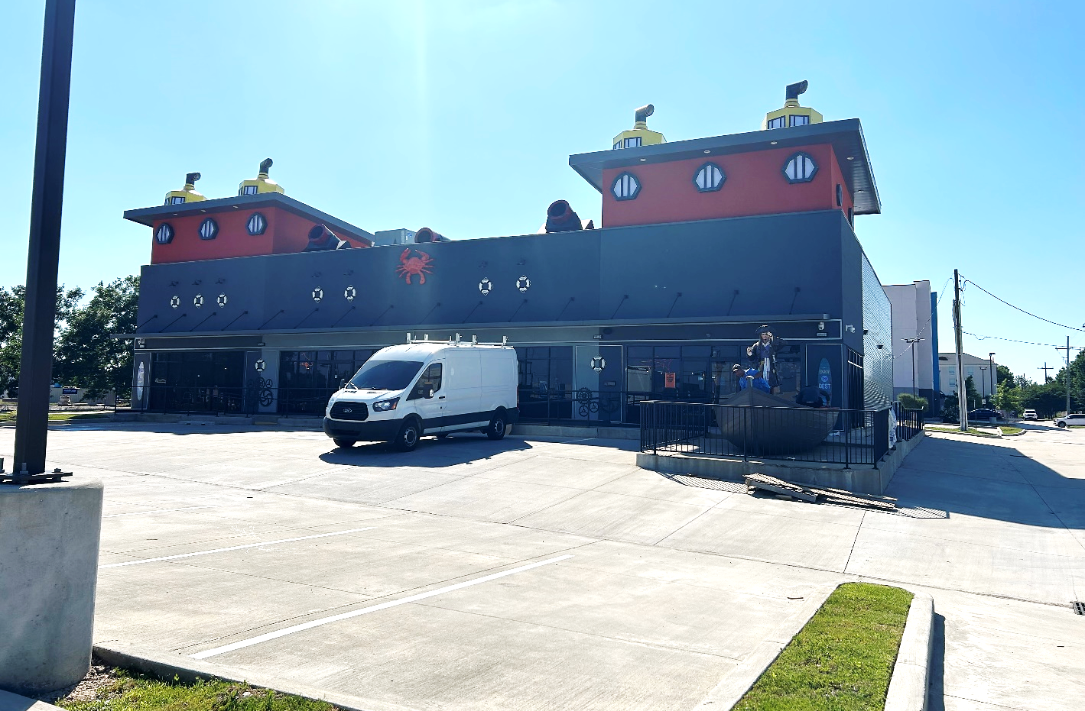
Siegen Lane

Slide 36
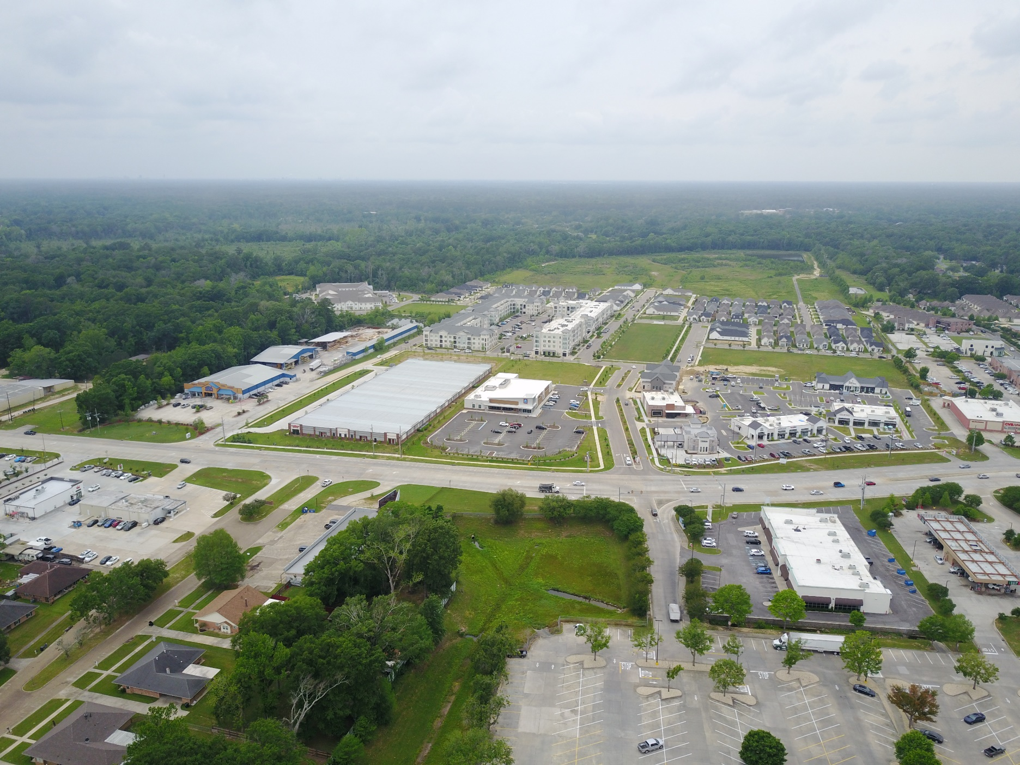
SHOE CREEK - CENTRAL

Slide 37
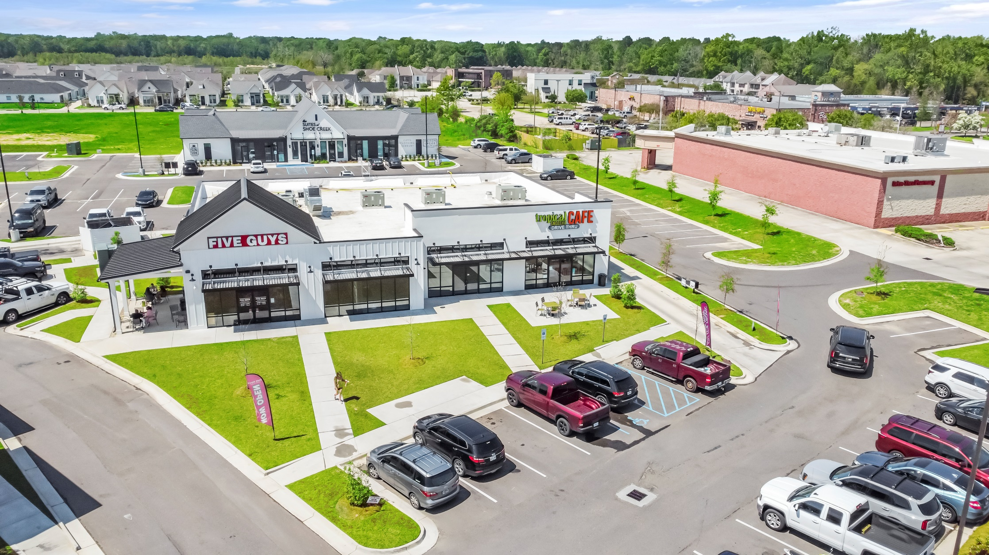
SHOE CREEK - CENTRAL

Slide 38
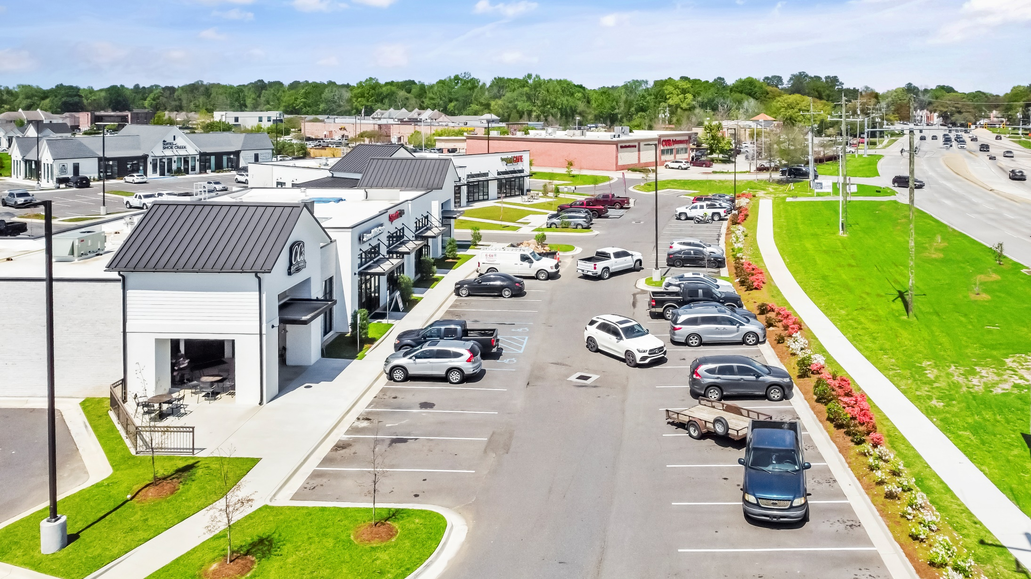
SHOE CREEK - CENTRAL

Slide 39
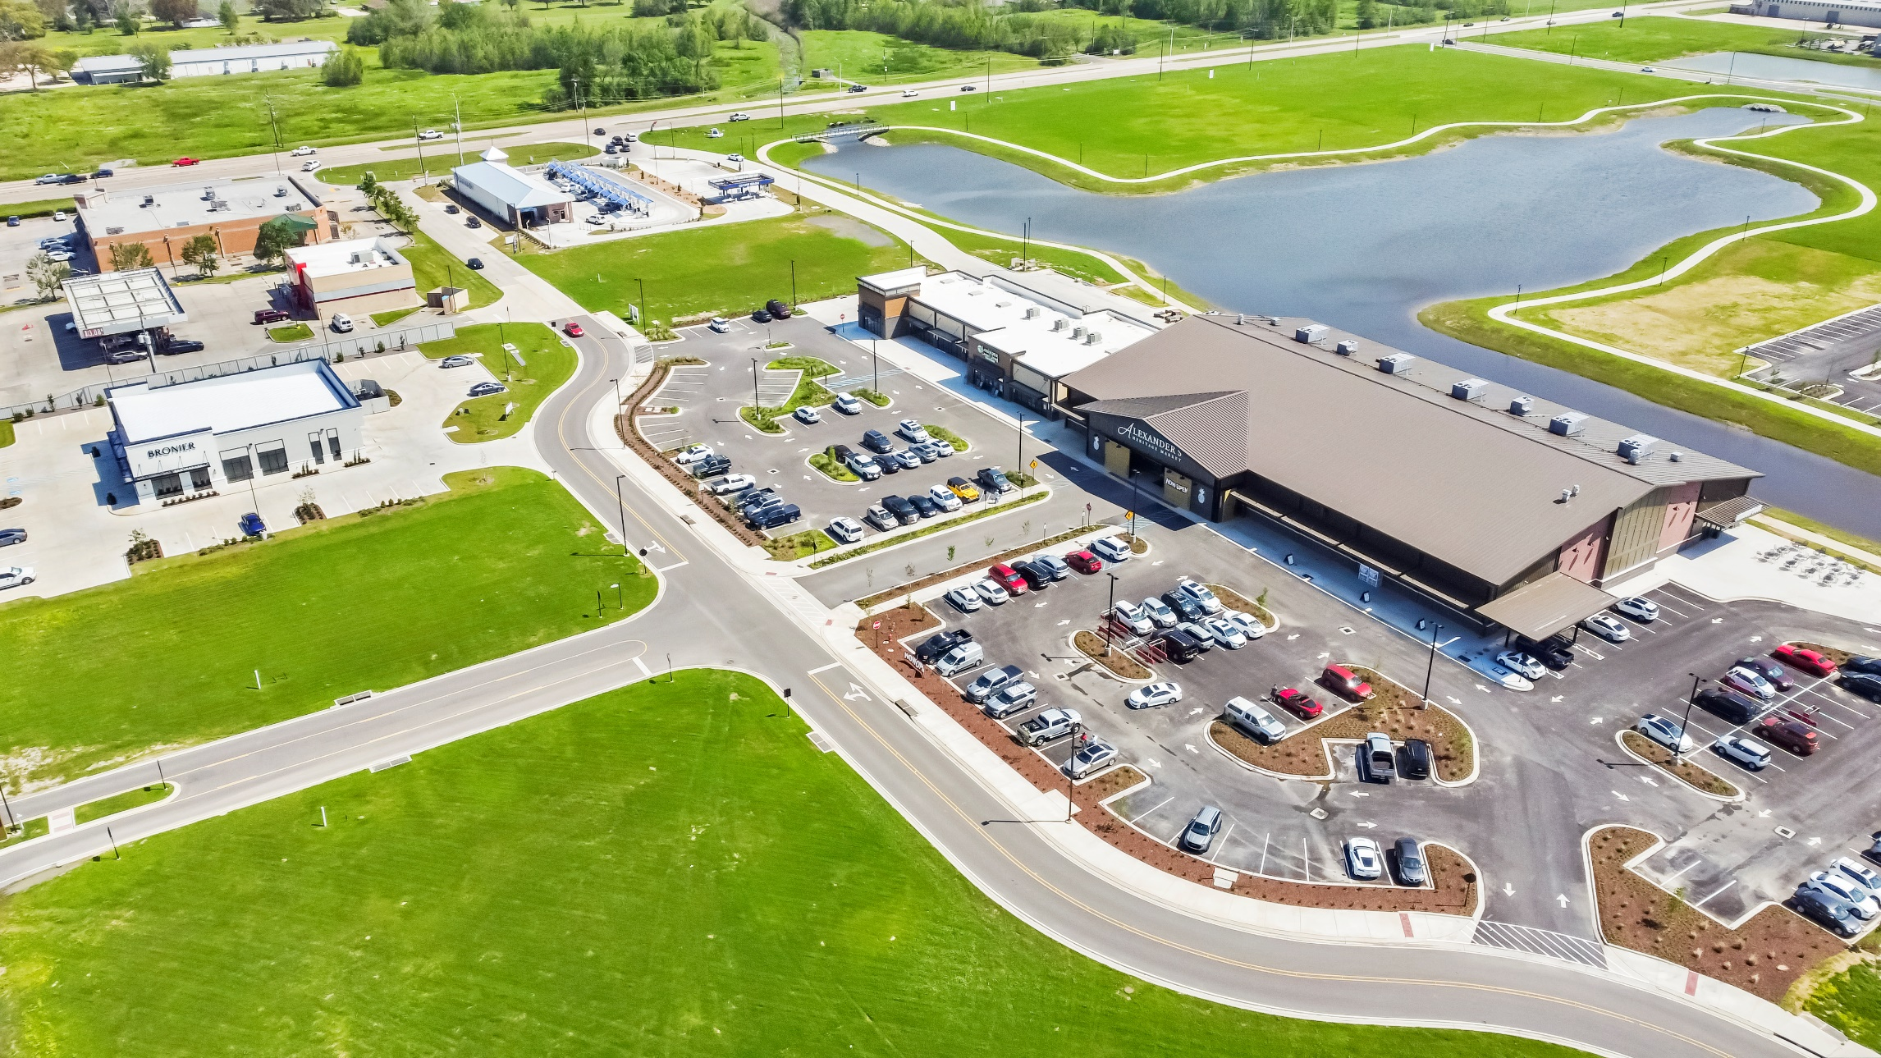
HERITAGE CROSSING - GONZALES

Slide 40
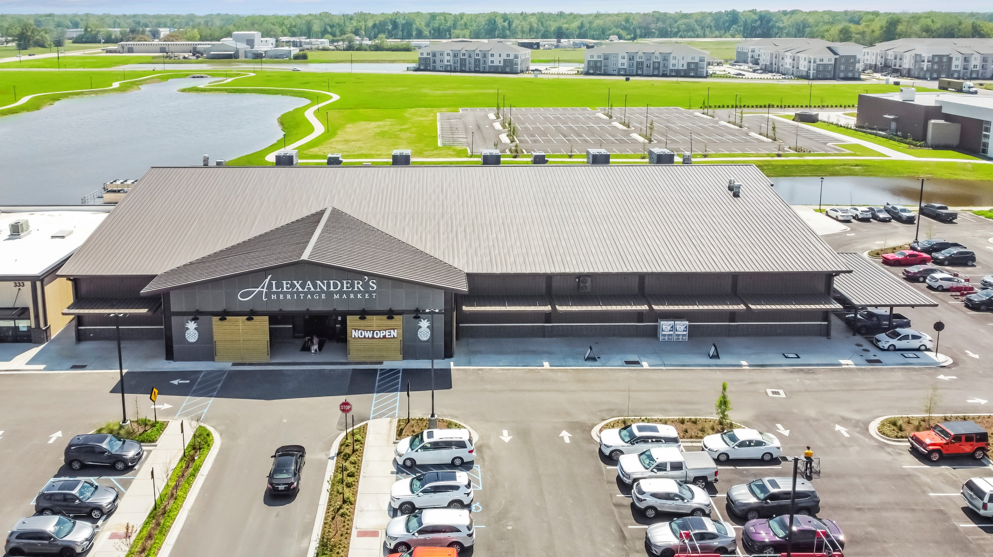
HERITAGE CROSSING - GONZALES

Slide 41
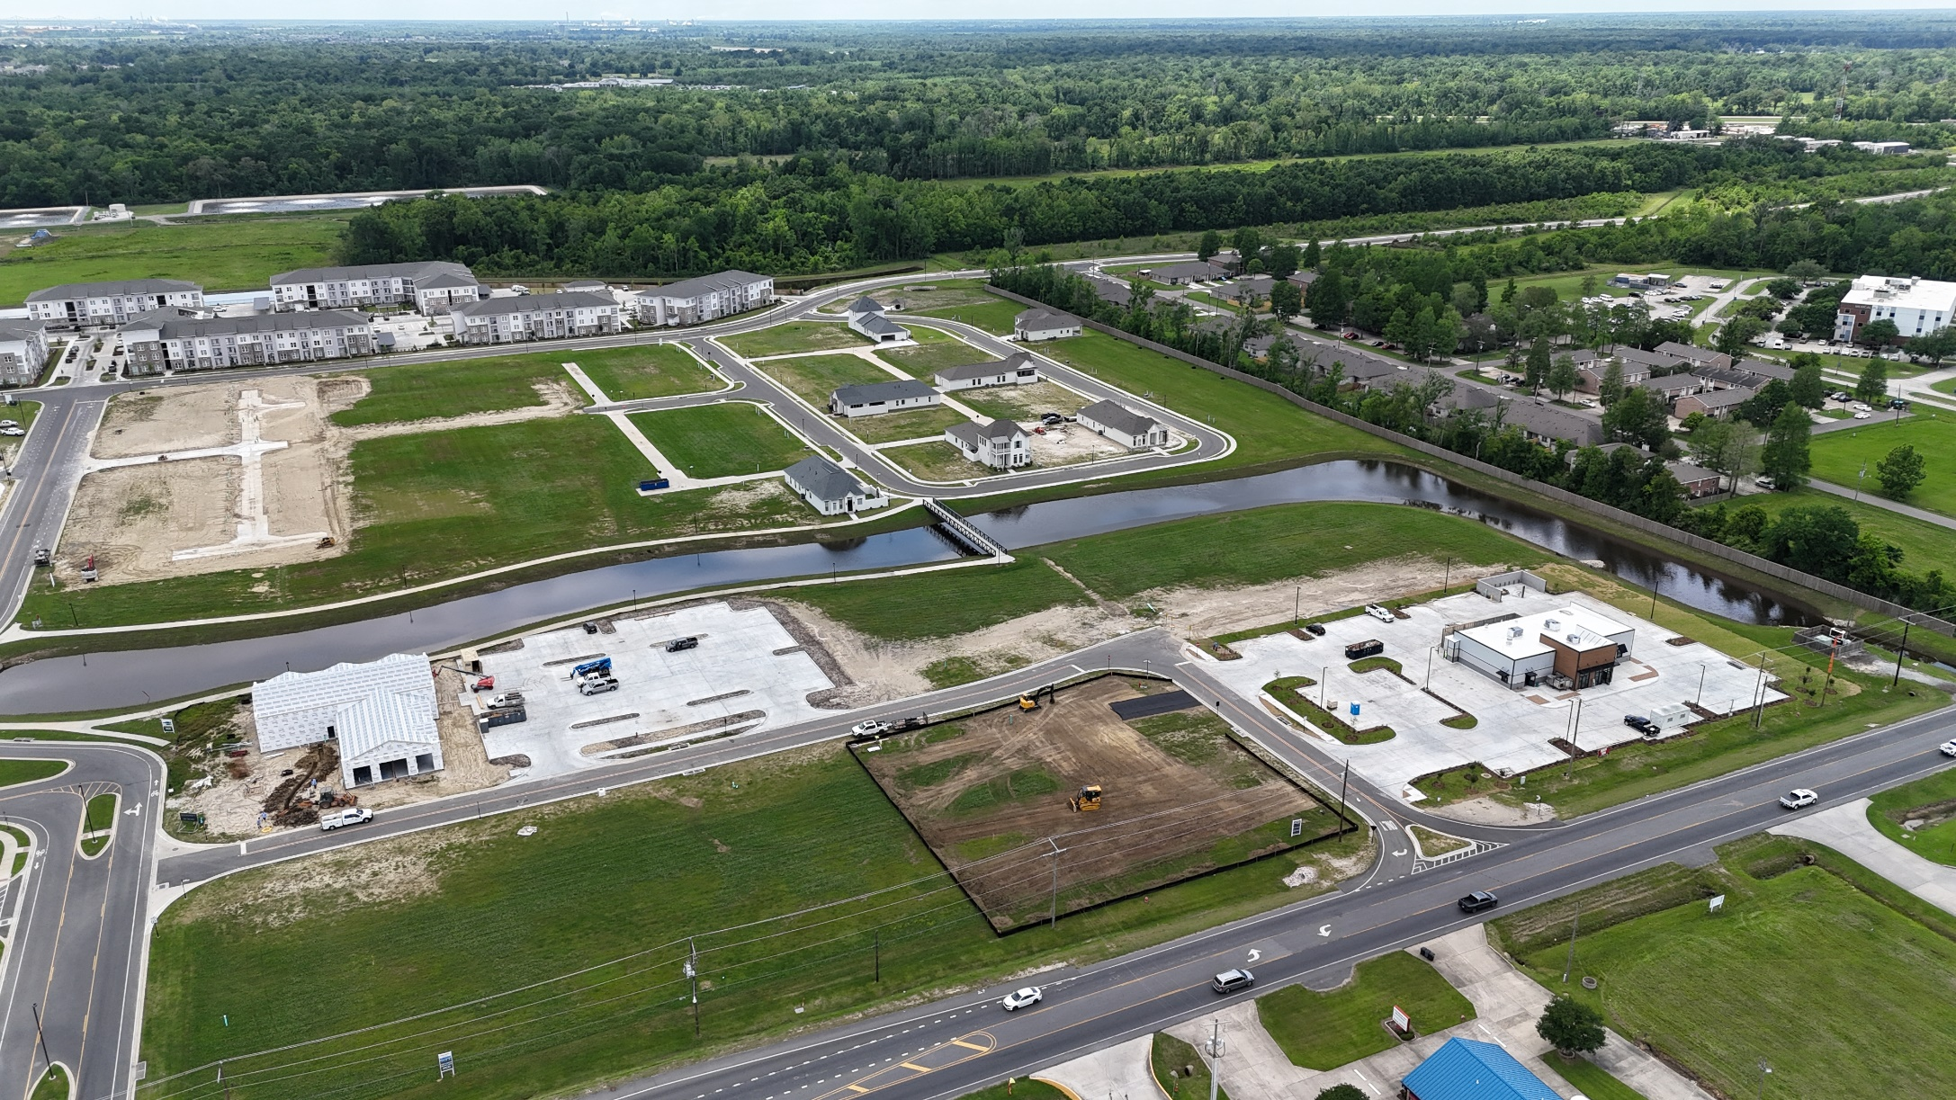
HERITAGE CROSSING - GONZALES

Slide 42
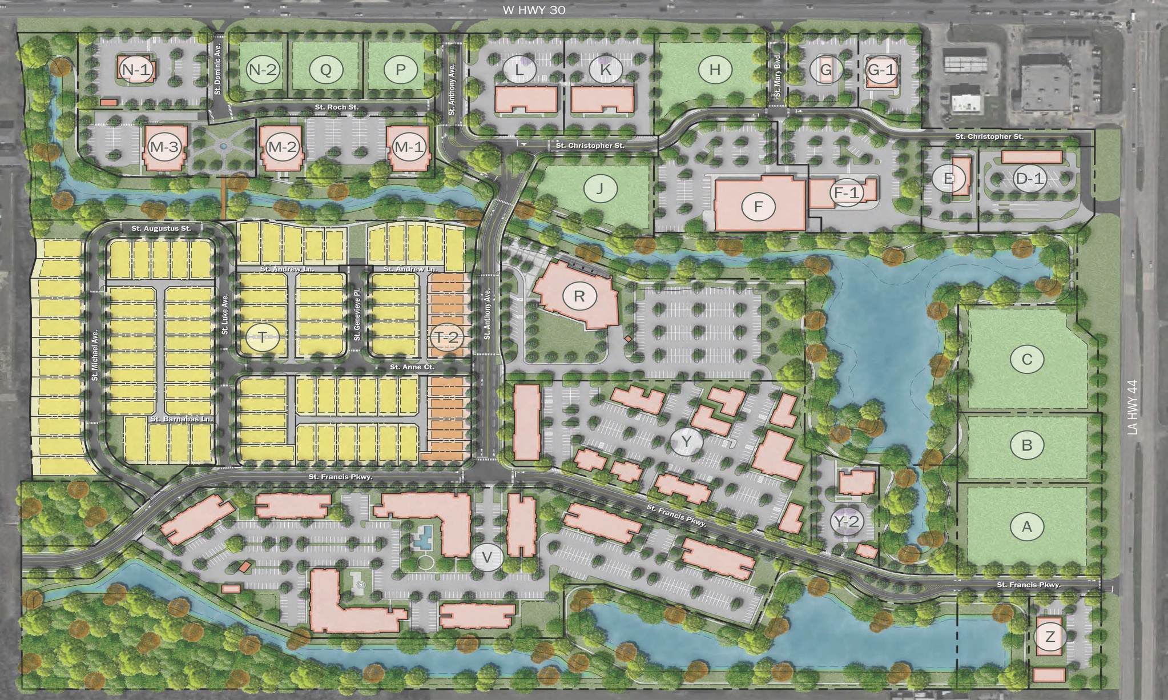
HERITAGE CROSSING - GONZALES

Slide 43
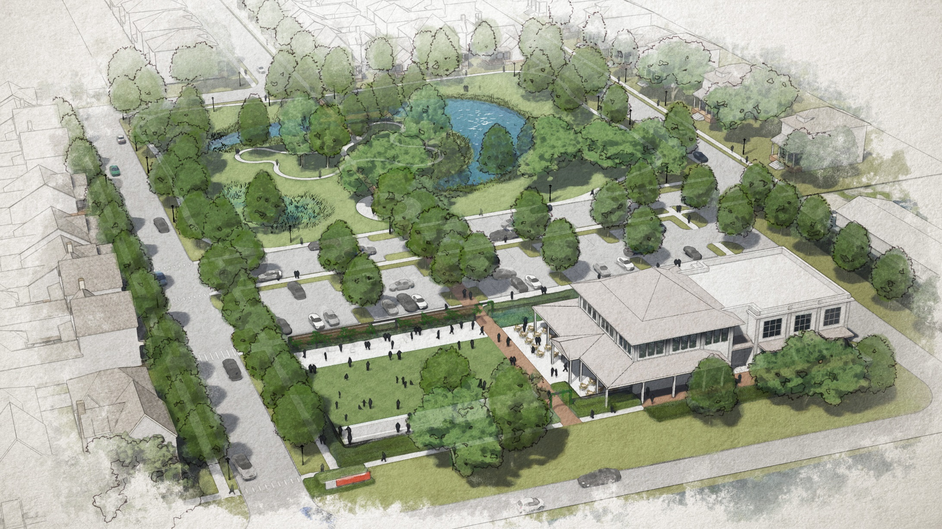
Benton at Magnolia Woods – Highland Road

Slide 44
Benton at Magnolia Woods – Highland Road

Slide 45
Benton at Magnolia Woods – Highland Road

Slide 46
OVERVIEW / PREDICTIONS
Vacancy to remain in 8-9% Range
Minimal market-wide rent increases
Some continued expansion at existing mixed-use developments
Charlie@momentum-commercial.com

Slide 47

“It's not whether you get knocked down, it's whether you get up”
- Vince Lombardi.

Slide 48

THANK YOU!
Special Thanks To: Jill Sylvest, Ken Damann, Stephen Eisenbraun & Trends Steering Committee

