Slide 1


2024
BATON ROUGE
MULTIFAMILY TRENDS
PRESENTED BY
Craig Davenport, MAI
Cook, Moore, Davenport & Associates
www.CookMoore.com
cdavenport@cookmoore.com
PRESENTED BY
Mark Segalla
ELIFIN
www.elifinrealty.com
msegalla@elifinrealty.com

Slide 2
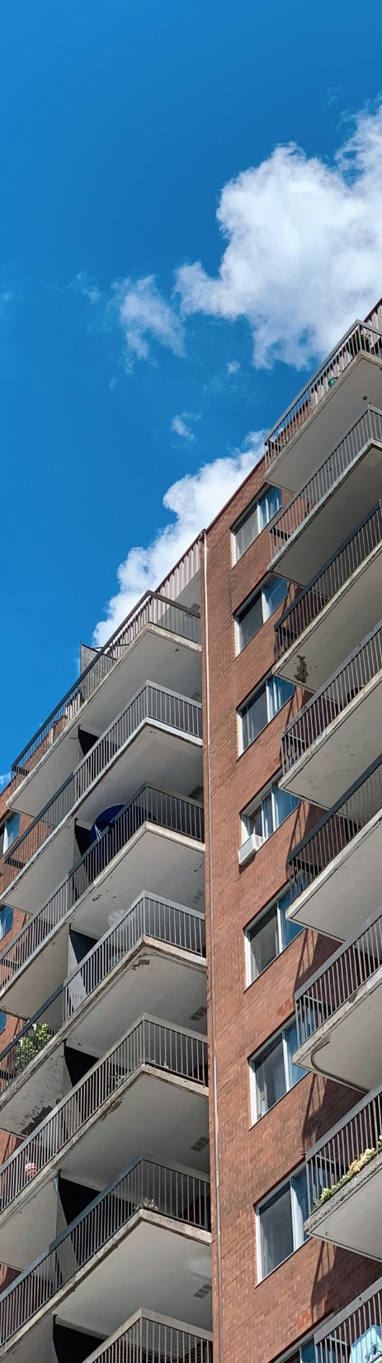


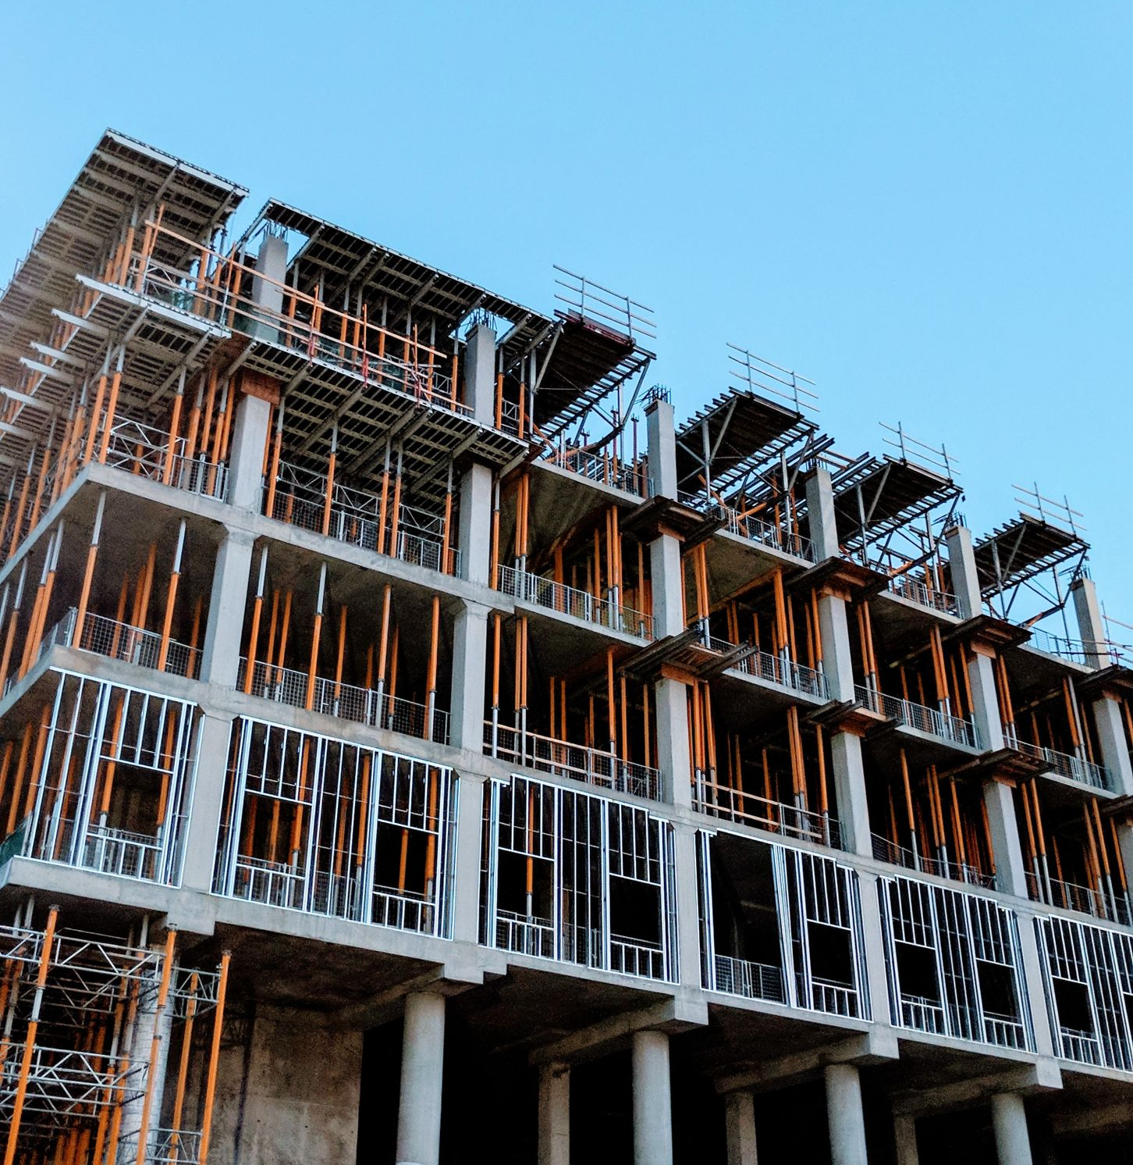

Multifamily Projections Last Year
RENTS
VACANCY
CONSTRUCTION
SALES
Continue to INCREASE in 2023 - 2024
at Historical
1% to 3% Level
Remain at Current
Overall 5% to 7% Vacancy Levels
Watch Affordable Properties
With Interest Rates Increasing,
Construction of New
Units Will Likely Slow Down
Significant Slowdown of Sales Due to Increasing Interest Rates

Slide 3



2024 Rental Survey
FULL DATA SET
240+ Complexes
38,500+ Units

Slide 4


AVERAGE RENT PER SQUARE FOOT - OVERALL MARKET
15.1% Increase 2021 - 2024
2.5%
INCREASE FROM 2023-2024
4% INCREASE
AFTER 2016 FLOOD
15.1%
INCREASE FROM 2021-2024

Slide 5

HISTORICAL VACANCY RATES
(Matched Sample)
5.57% Vacancy Rate in 2024

Slide 6
SUBMARKET ANALYSIS
(Matched Sample)
Submarket | Avg Rent/SF 2024 | Rent Change Since 2022 | Rent Change Since 2020
Baton Rouge – Class A | $1.44 | -4.0% | +18.0%
Central Business District (CBD) | $1.62 | -9.4% | +1.7%
Ascension – Class A | $1.33 | +8.1% | +34.1%
Livingston – Class A | $1.07 | -1.4% | +27.5%
LSU By-the-Bed | $1.57 | +20.0% | +23.2%
LSU By-the-Unit | $1.14 | +1.8% | +8.82%

Slide 7


LSU STUDENT APARTMENT MARKET
FALL 2019 ENROLLMENT
FALL 2021 ENROLLMENT
FALL 2022 ENROLLMENT
FALL 2023 ENROLLMENT
26,686
28,891
29,592
30,606
On-Campus Enrollment
A 14.7% Increase from 2019 – 2023
All-Time High Enrollment
Limited On-Campus Housing

Slide 8
SUBMARKET ANALYSIS
(Matched Sample)
Submarket | Vacancy 2024 | Vacancy 2023 | Vacancy 2022 | Vacancy 2021
Baton Rouge – Class A | 5.40% | 5.13% | 4.30% | 7.35%
Central Business District (CBD) | 8.46% | 8.21% | 10.0% | 9.81%
Ascension – Class A | 4.40% | 4.78% | 2.34% | 6.03%
Livingston – Class A | 5.44% | 4.52% | 3.30% | 5.89%
LSU By-the-Bed | 6.74% | 3.88% | 7.04% | 17.08%
LSU By-the-Unit | 9.75% | 4.37% | 5.30% | 13.90%
Significant Amount of Boarded Up Units and Vacant Units in Some Areas

Slide 9
CONSTRUCTION CLASS ANALYSIS
(Matched Sample)
 | Avg Rent/SF | Rent Change Since 2023 | Rent Change Since 2022
Class A | $1.52 | +2.7% | +6.3%
Class B | $1.15 | -0.9% | +1.8%
Class C/D | $1.01 | +2.0% | +5.2%
Vacancy 2024 | Vacancy 2023 | Vacancy 2022
6.15% | 4.80% | 4.87%
5.96% | 4.46% | 4.16%
4.89% | 4.95% | 5.34%
Average Class A Rent is $1,562/month
Average Class B Rent is $1,137/month
Average Class C/D Rent is $887/month

Slide 10
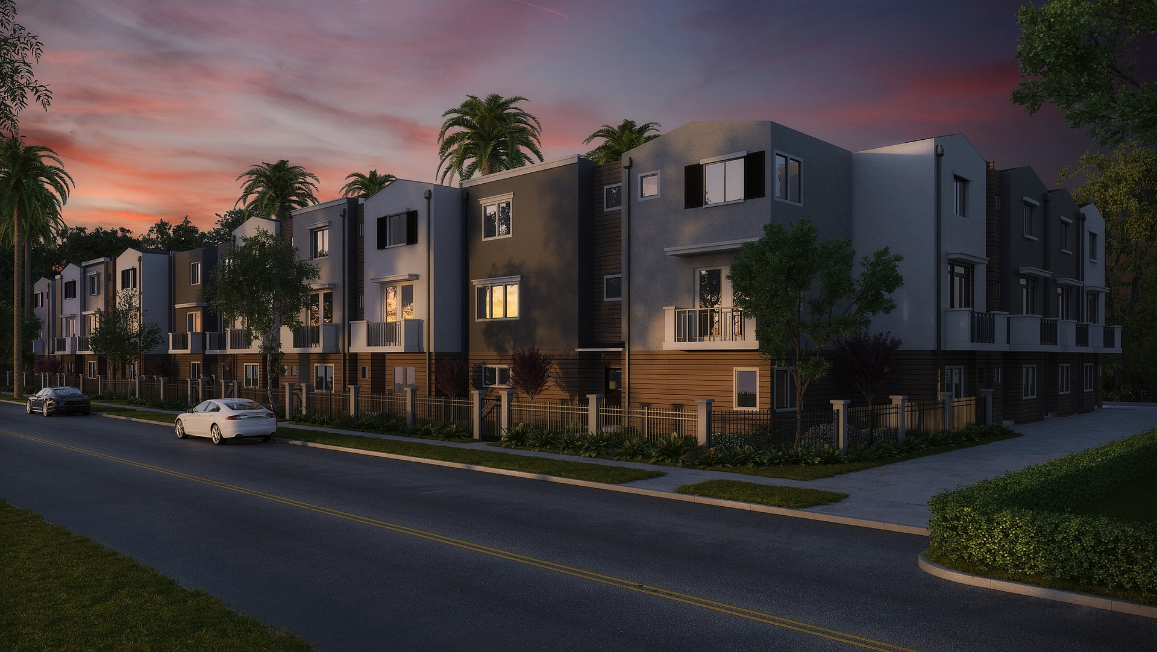
APARTMENT SALES FOR 2023

Slide 11
APARTMENT SALES VOLUME
(16+ UNIT COMPLEXES)
Year | # Complexes | Total Volume
2017 | 38 | $367,350,000
2018 | 25 | $241,869,100
2019 | 27 | $194,616,850
2020 | 23 | $223,984,000
2021 | 40 | $580,029,500
2022 | 61 | $895,100,000
TOTAL SALES VOLUME 2017-2020
$1,027,819,950
OCCUPIED
VACANT
TOTAL SALES VOLUME 2021-2022
$1,475,129,500
2023 | 17 | $188,627,900
If You Remove 5 Student Properties
2023 | 12 | $32,577,900

Slide 12
APARTMENT SALES VOLUME 2022-2023
Quarter | # Sales | Total Volume | w/o Student
1Q 2022 | 16 | $191,780,000
2Q 2022 | 20 | $421,350,000
3Q 2022 | 17 | $194,580,000
4Q 2022 | 8 | $87,360,000
1Q 2023 | 4 | $21,550,000 | $6,550,000
2Q 2023 | 8 | $144,463,000 | $3,425,000
3Q 2023 | 3 | $13,915,000 | $13,915,000
4Q 2023 | 2 | $8,700,000 | $8,700,000
FNMA
3.90%
5.47%
5.99%
6.49%
FNMA DUS
10-Yr
12/31/2021
3.27%
OCCUPIED
VACANT
6.32%
6.71%
7.31%
6.61%
Interest Rates Reached 7.79% in October 2023
1Q 2024 | 3 | $23,350,000
6.11%

Slide 13
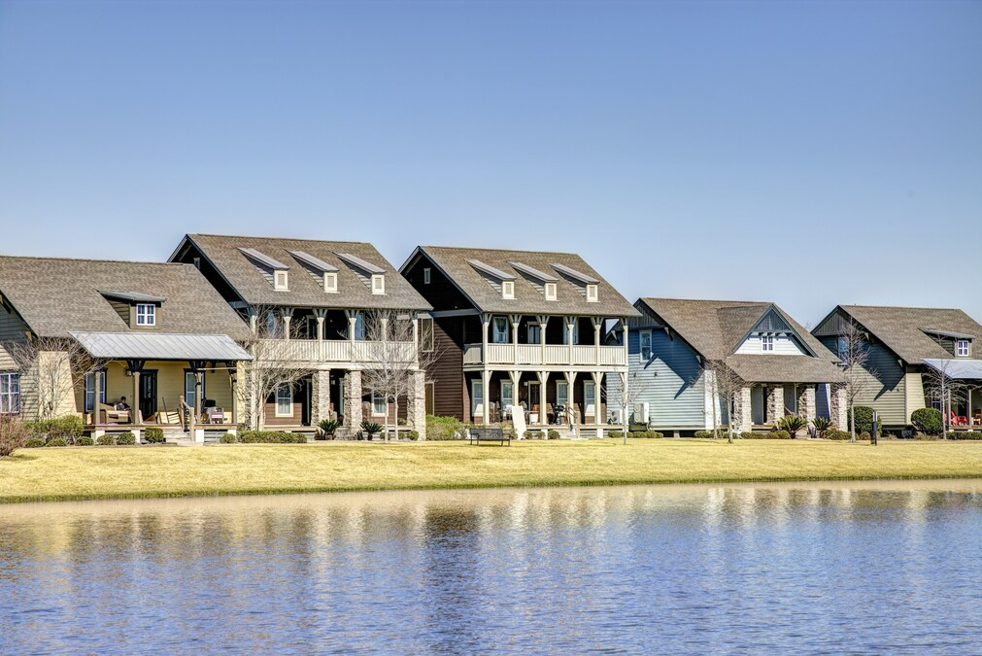
LODGES AT 777
777 Ben Hur Road
Date | June 21, 2023
Price | $84,400,000
Price /SF | $175.58
Price/Unit | $220,942
Price/Bed | $65,426

Slide 14
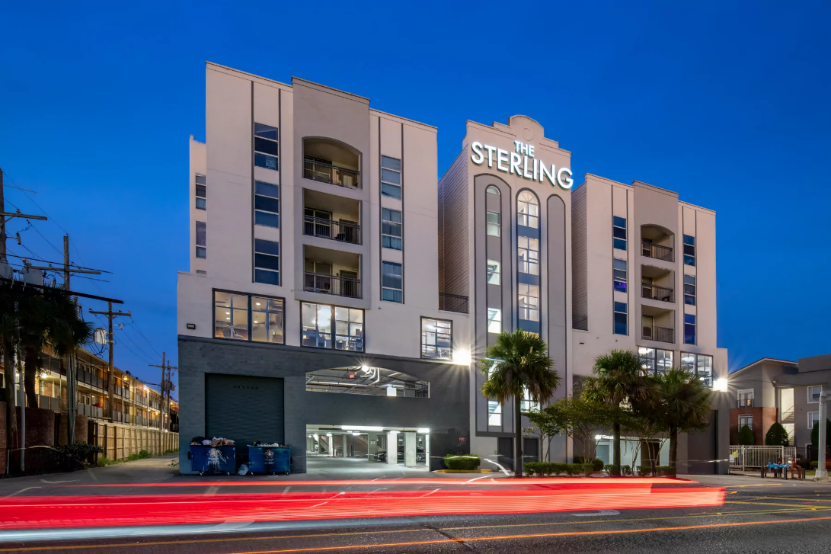
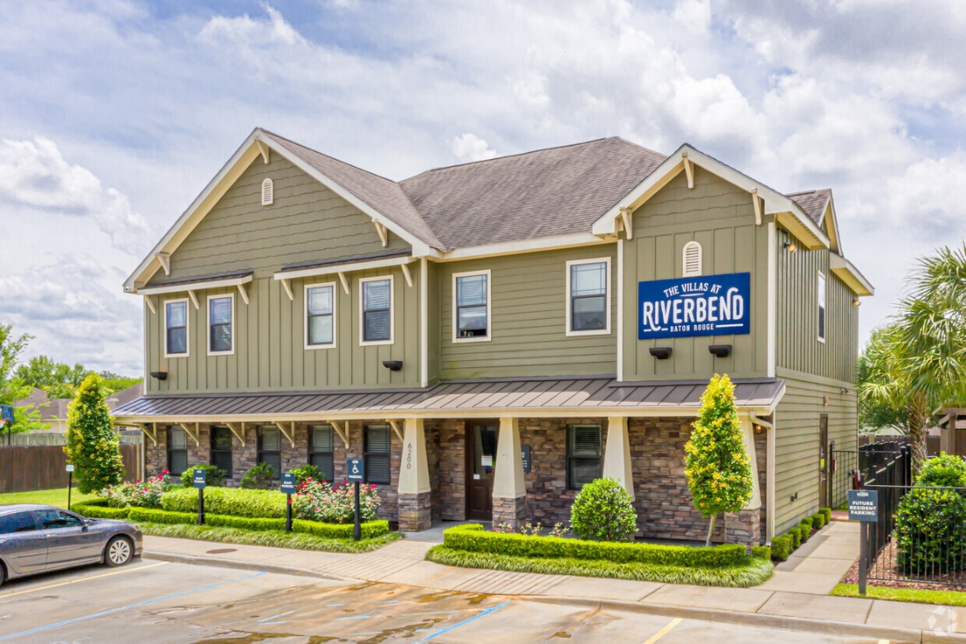
STUDENT TRANSACTIONS
Sterling Northgate
$15,000,000
Price/Unit | $153,061
Price/Bed | $44,118
Villas at Riverbend
$23,750,000
Price/Unit | $226,190
Price/Bed | $77,110

Slide 15
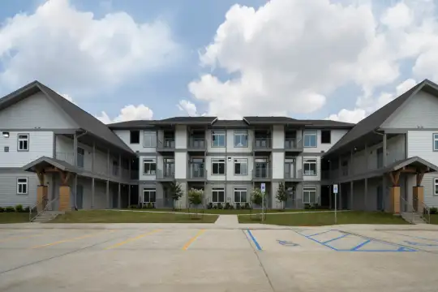
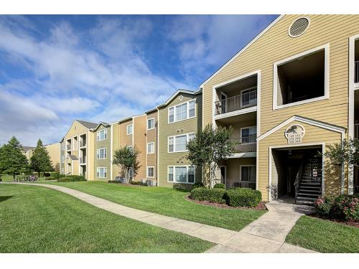
STUDENT TRANSACTIONS
The Oliver
$21,750,000
Price/Unit | $153,061
Price/Bed | $44,118
The Armstrong
$11,150,000
Price/Unit | $83,209
Price/Bed | $29,654

Slide 16
STUDENT PROPERTY SALES 2023
Name | Address | Sale Price | # of Units | Price/Unit | # of Beds | Price/Bed
Sterling Northgate | 3135 Highland Road | $15,000,000 | 98 | $153,061 | 340 | $44,118
The Oliver | 4500 Burbank Drive | $21,750,000 | 192 | $113,281 | 532 | $40,883
Villas at Riverbend | 5689 River Road | $23,750,000 | 105 | $226,190 | 308 | $77,110
The Armstrong | 4600 Burbank Drive | $11,150,000 | 134 | $83,209 | 376 | $29,654
Lodges at 777 | 777 Ben Hur Road | $84,400,000 | 382 | $220,942 | 1,290 | $65,426
OCCUPIED
VACANT
Total Volume $156,050,000

Slide 17
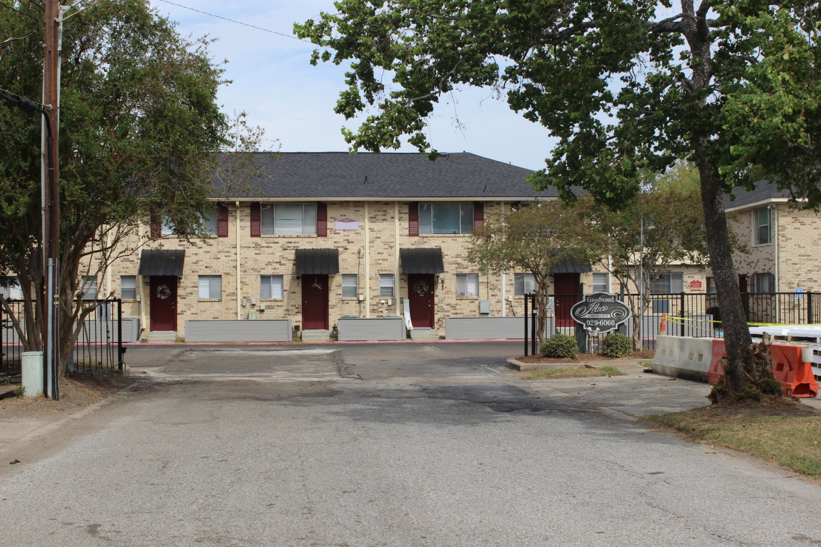
GOODWOOD PLACE / MARQUETTE
356 – 459 APARTMENT COURT
Date | August 11, 2023
Price | $13,200,000
Price /SF | $64.35
Price/Unit | $63,461

Slide 18
OTHER SELECT PROPERTY SALES 2023
Name | Address | # of Units | Price/Unit
Perkins Palms | 7268 Perkins Road | 29 | $56,897
Meadowbrook | 3700 East Brookstown Rd | 200 | $35,250
 | 8 Other Smaller Complexes
OCCUPIED
VACANT
Total Volume $32,575,000

Slide 19
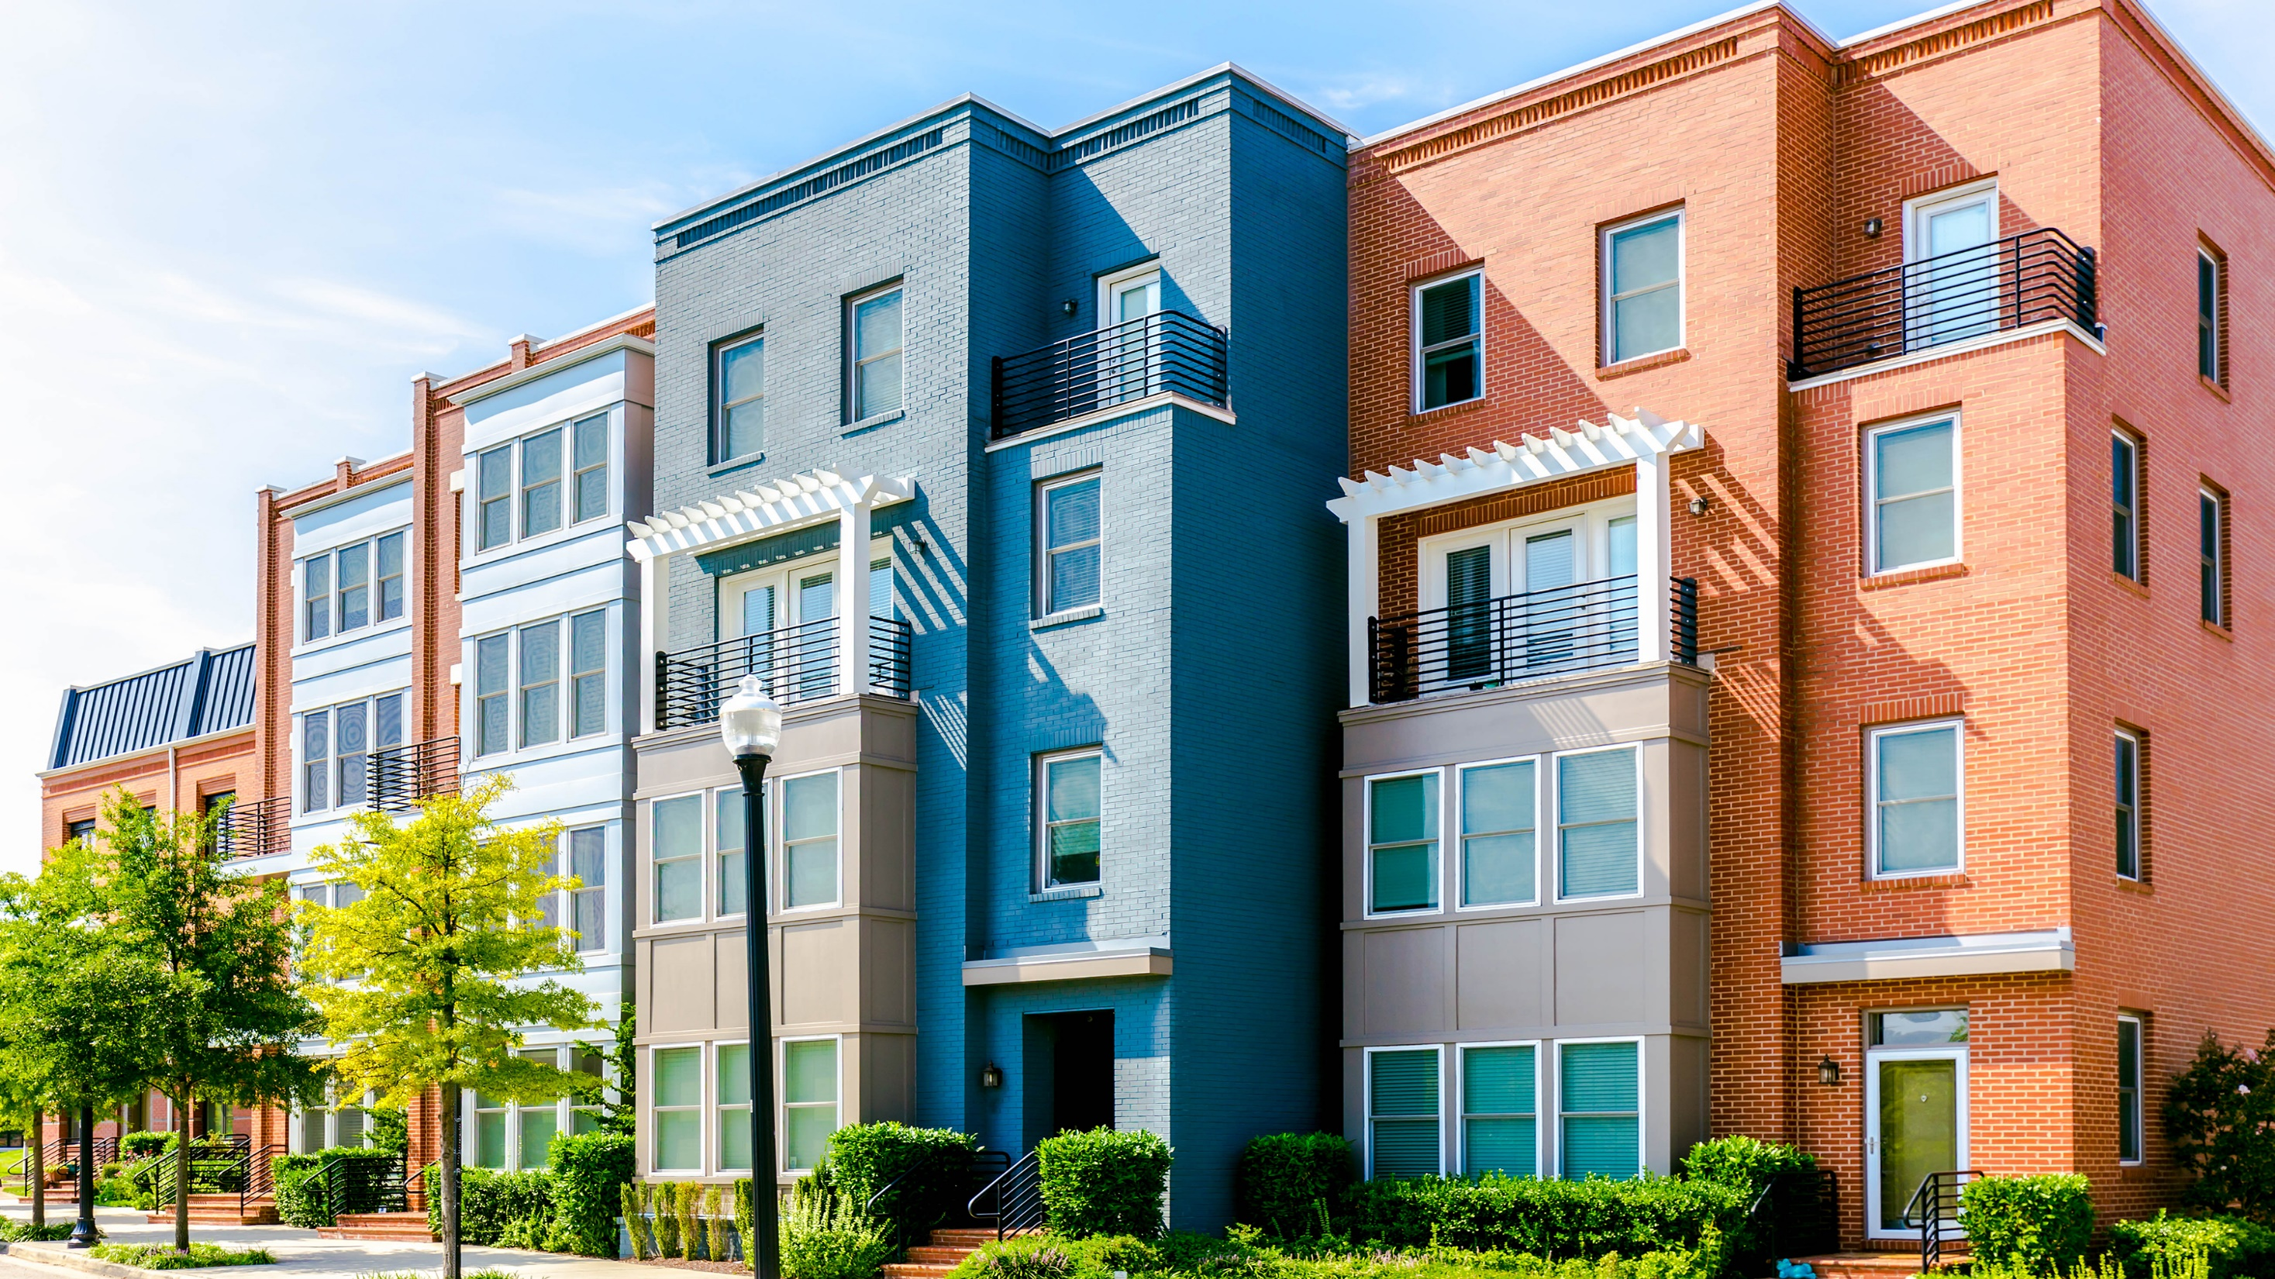
COMPLETED COMPLEXES
2023

Slide 20
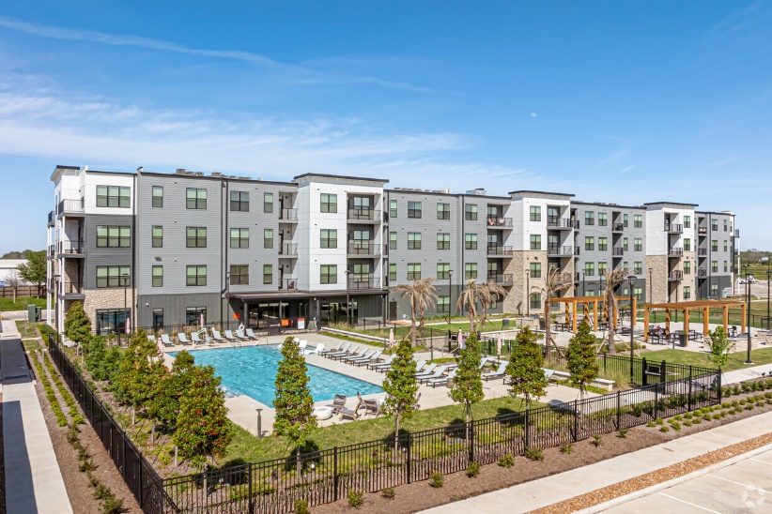
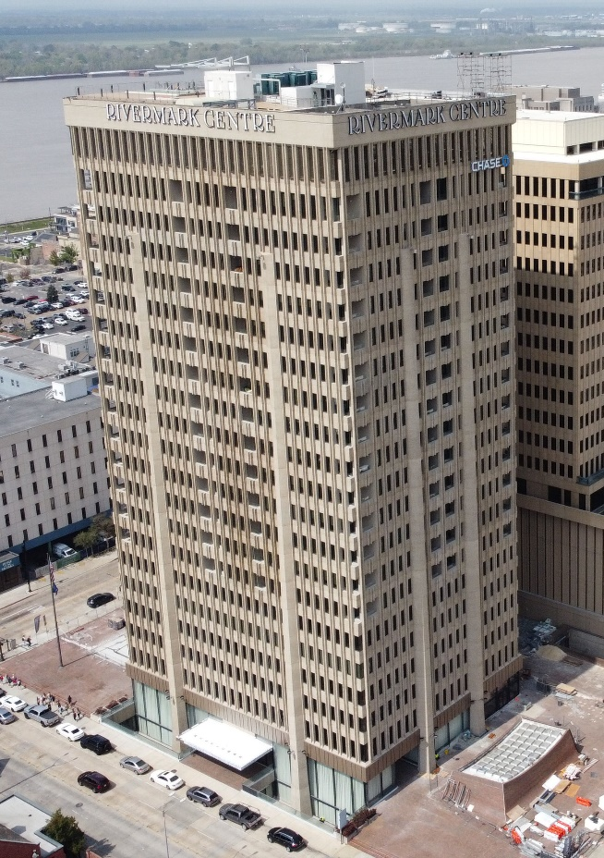
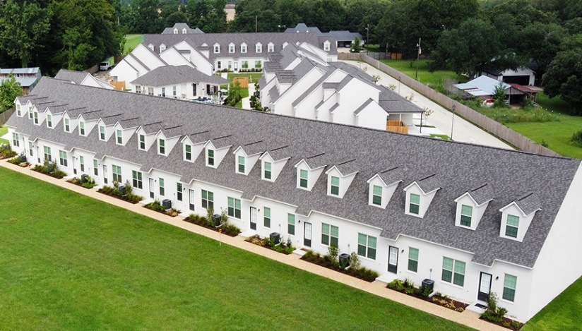
CONVENTIONAL COMPLEXES – COMPLETED IN 2023
Only 3 Conventional Complexes Completed
in 2023
Completed
2019
2020
2021
2022
2023
Bend on Bluebonnet (309 Units)
10231 Bluebonnet Boulevard
1,225 Units
638 Units
581 Units
42 Units
533 Units
The Residences at Rivermark (168 Units)
451 Florida Street
Oak Heritage Townhomes (56 Units)
15276 Heritage Oak Ave, Prairieville

Slide 21
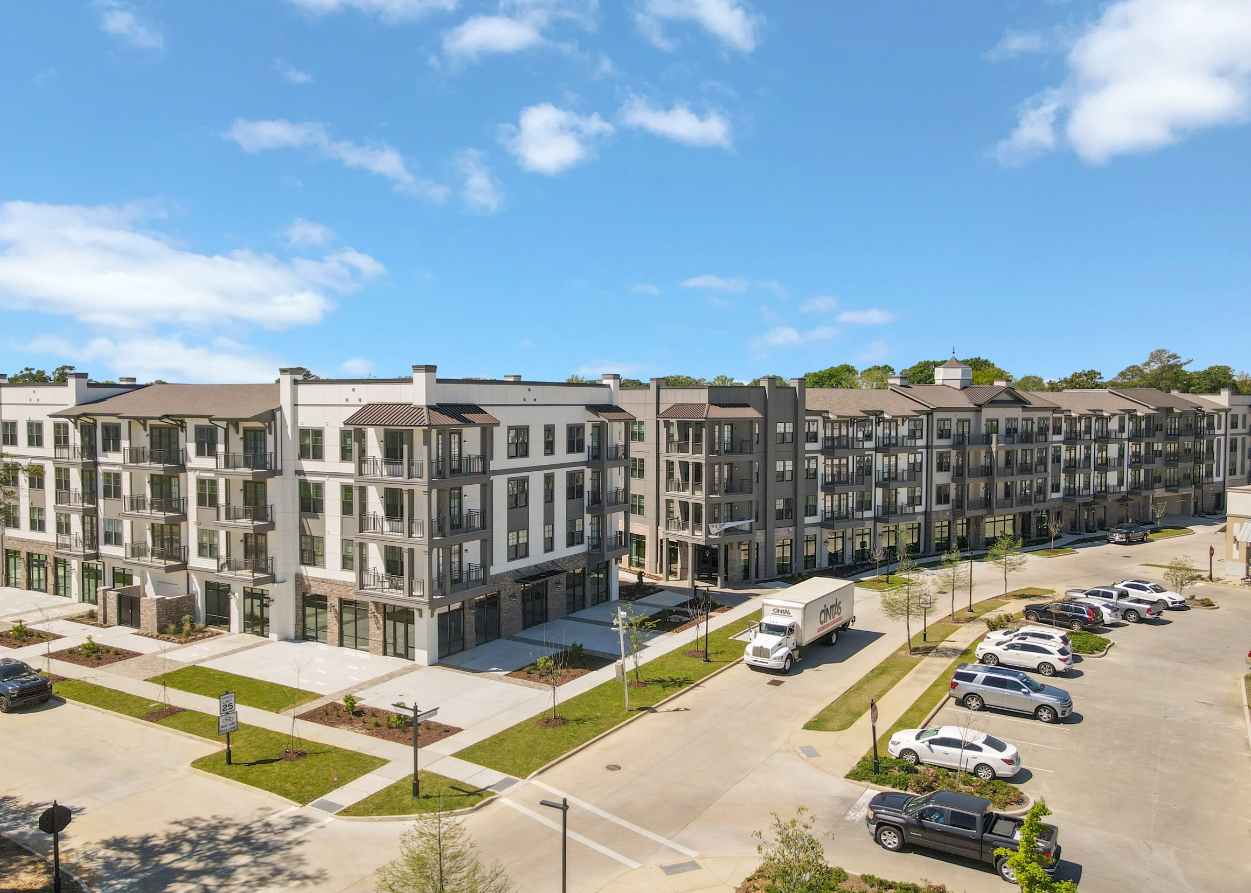

OCCUPIED
VACANT

Slide 22
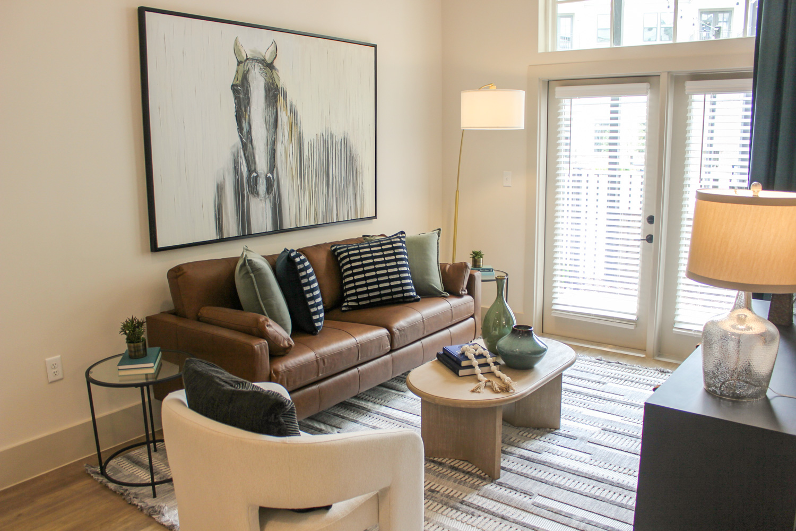
Living Room
OCCUPIED
VACANT

Slide 23
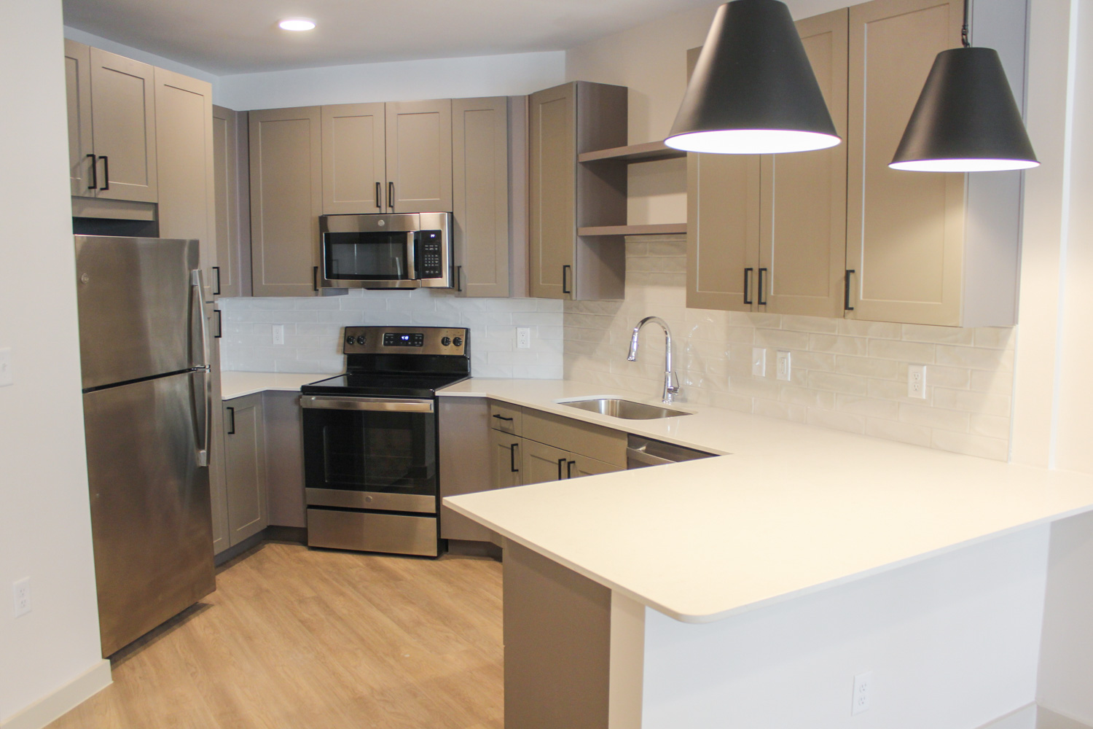
OCCUPIED
VACANT
Kitchen

Slide 24
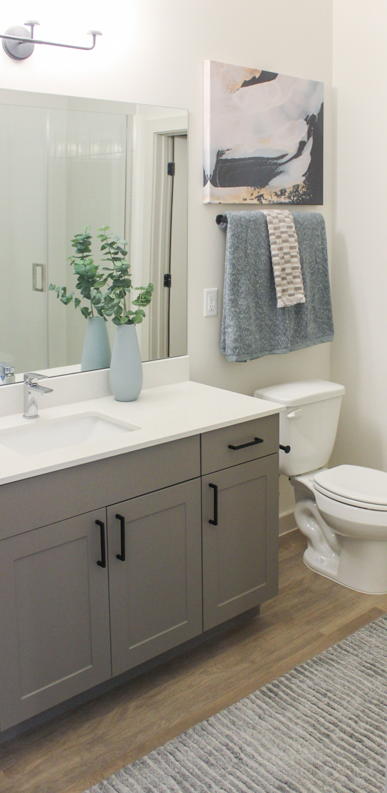
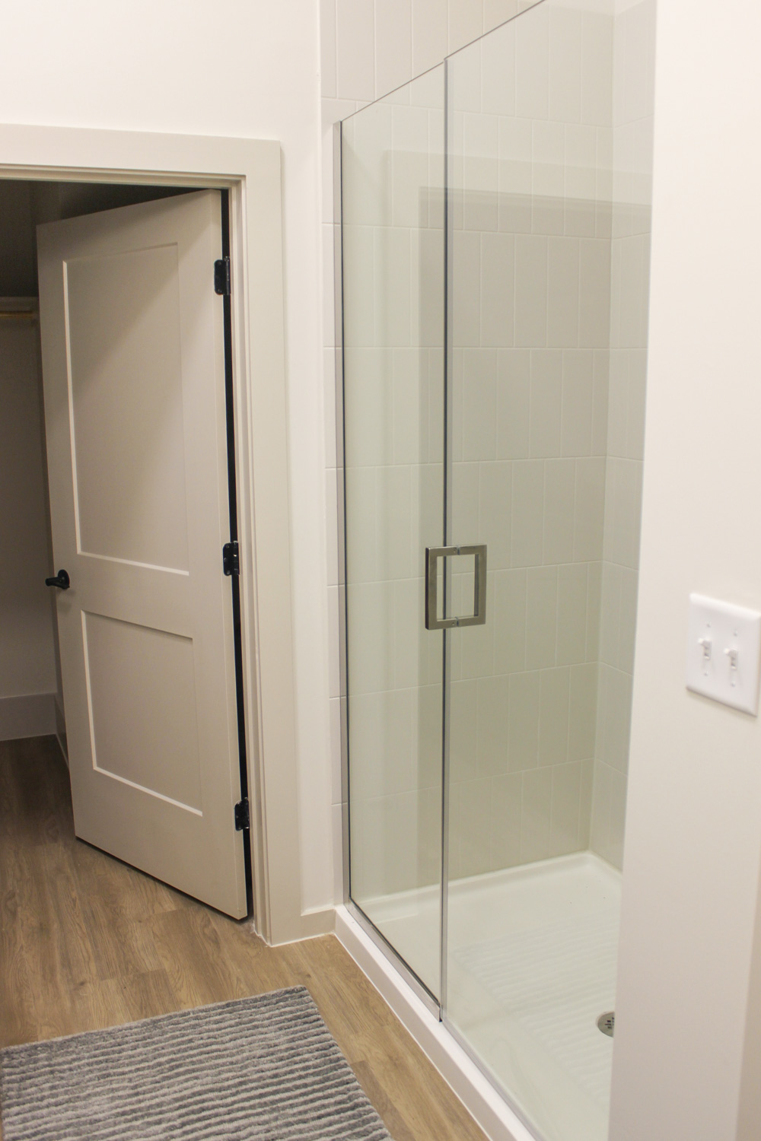
Bathroom
OCCUPIED

Slide 25
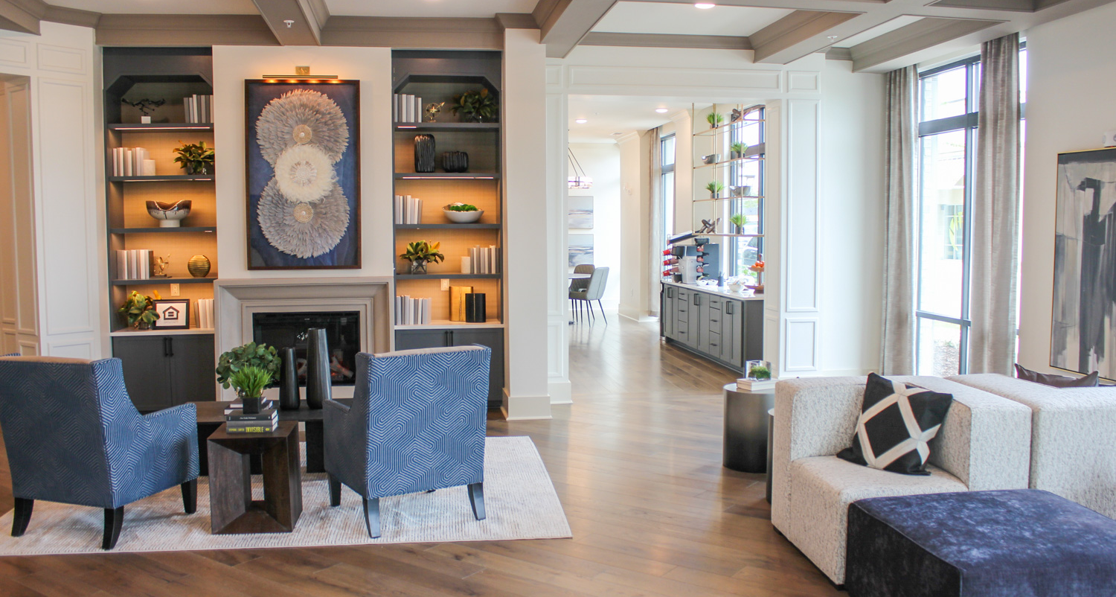
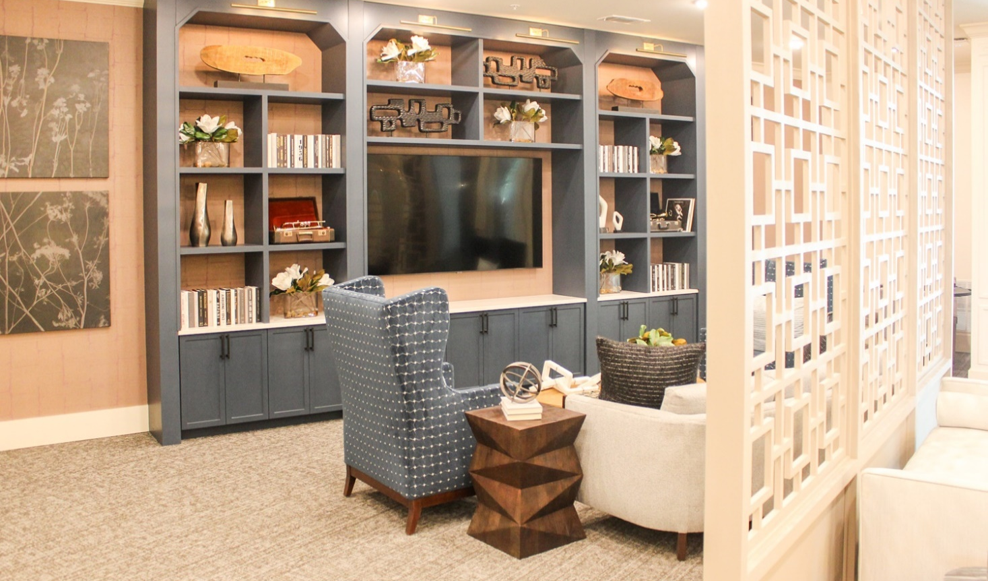
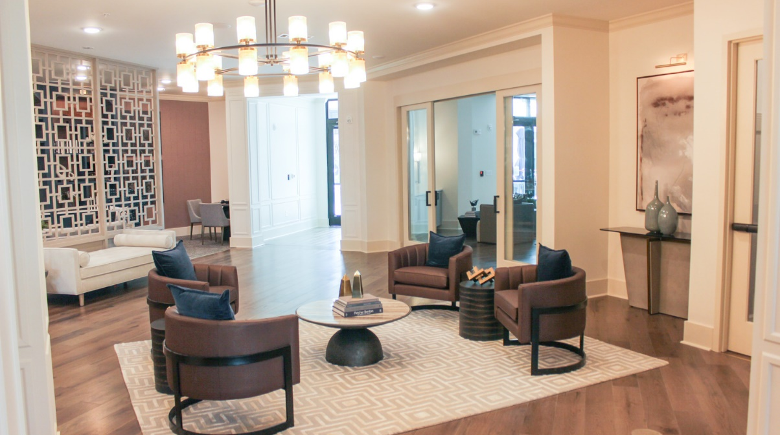

Slide 26
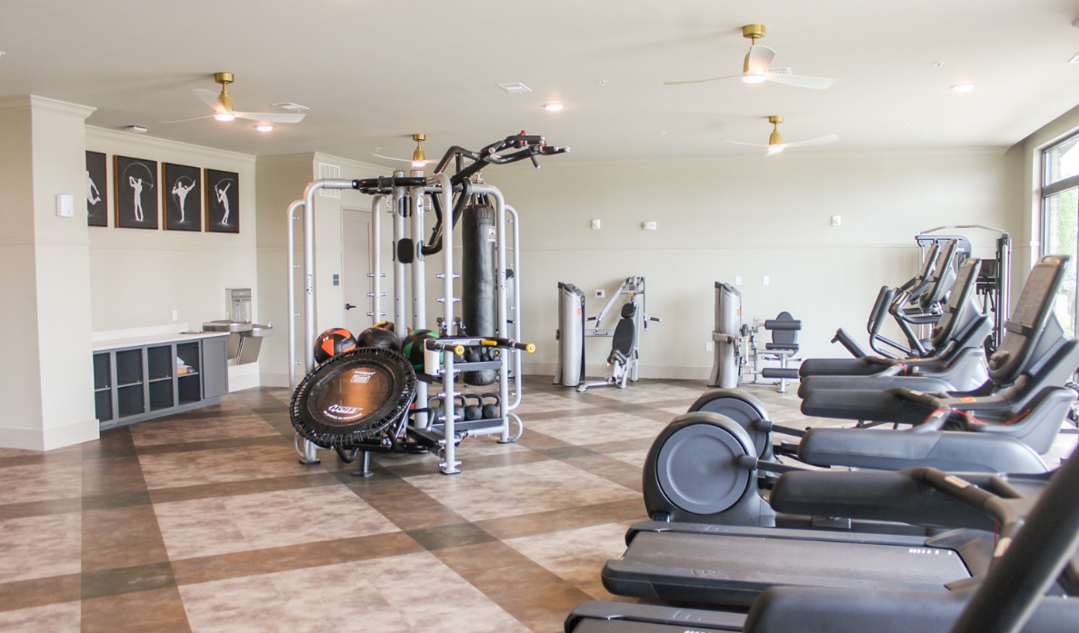
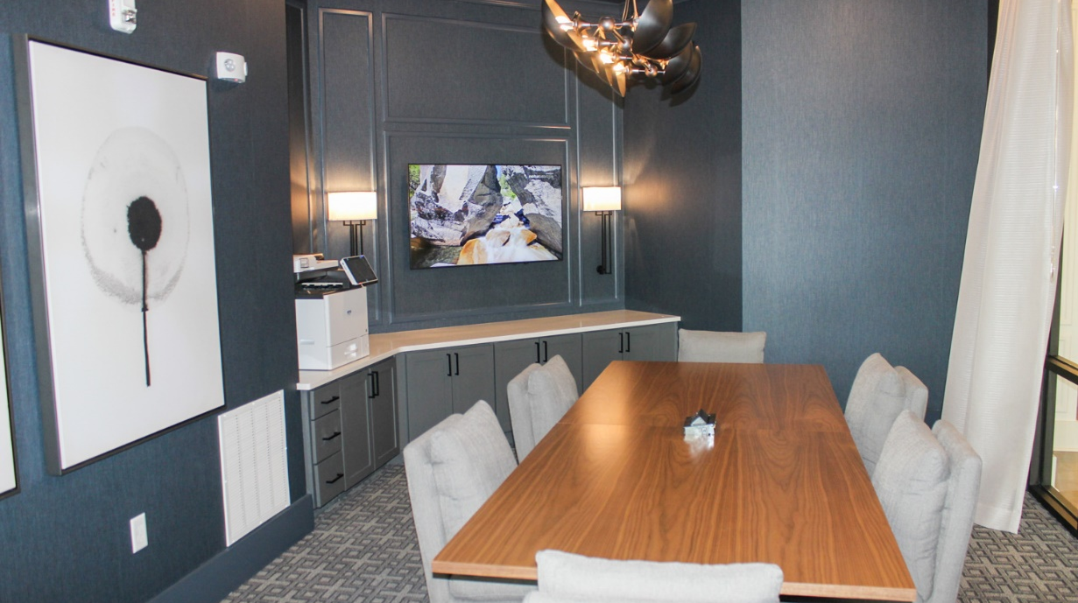
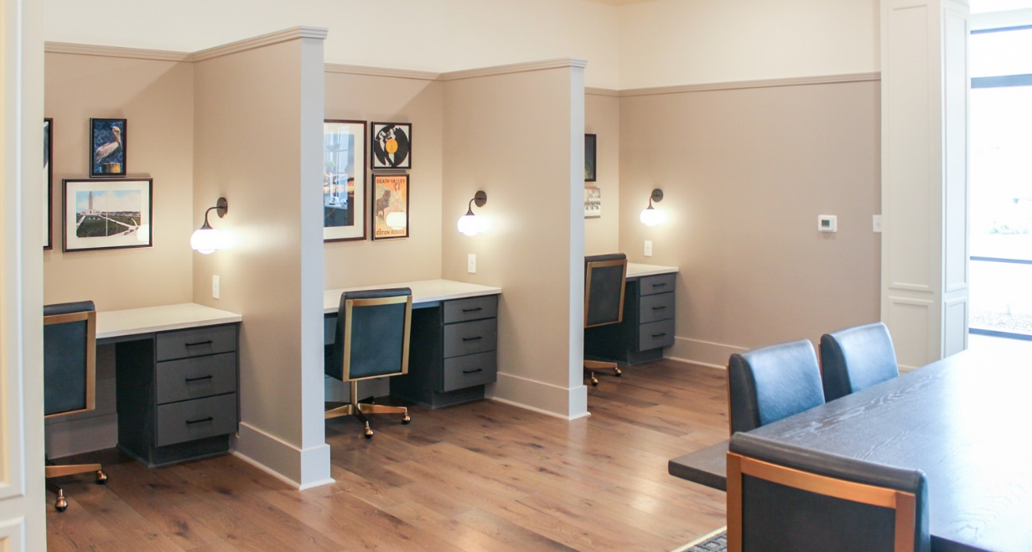

Slide 27
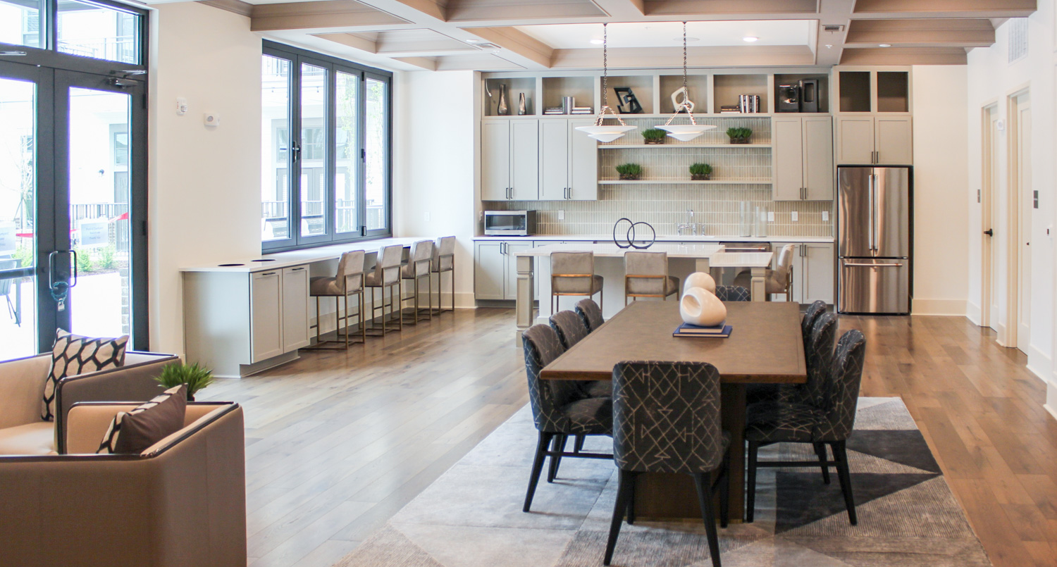
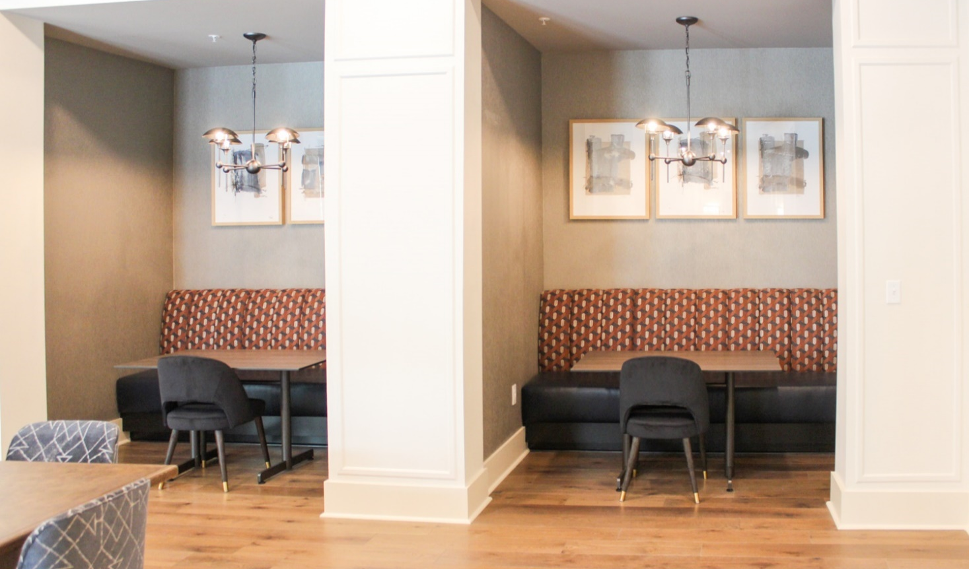
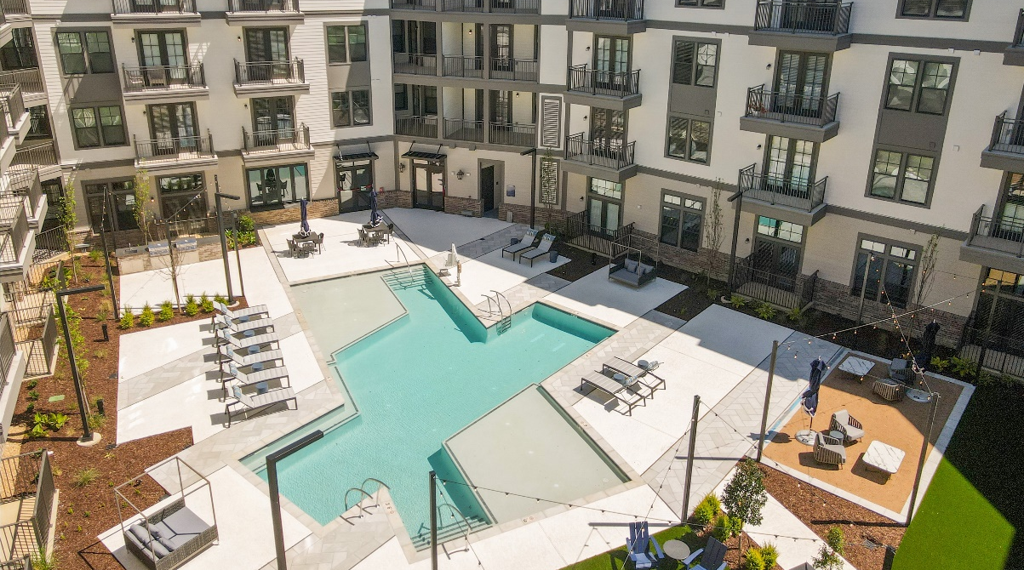

Slide 28
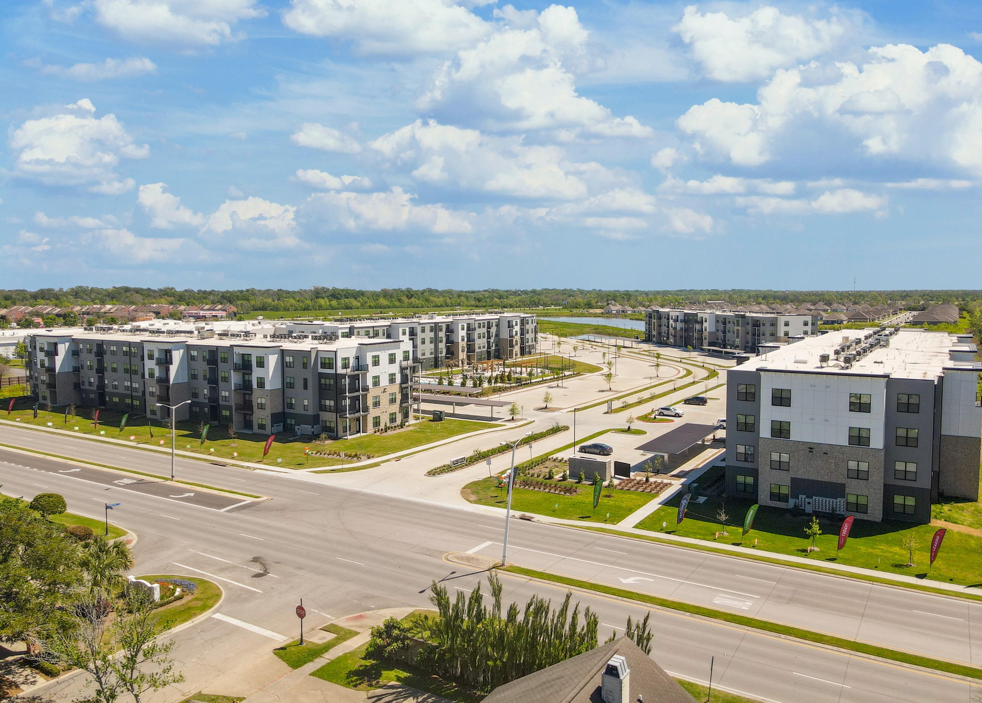

The Bend on Bluebonnet
OCCUPIED
VACANT

Slide 29
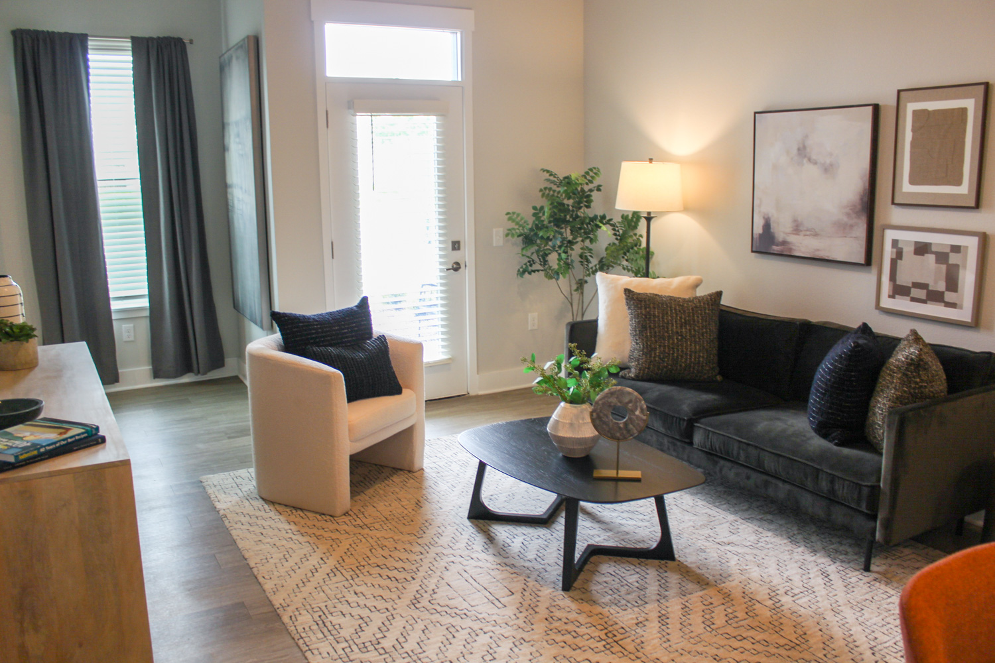
Living Room
OCCUPIED
VACANT

Slide 30
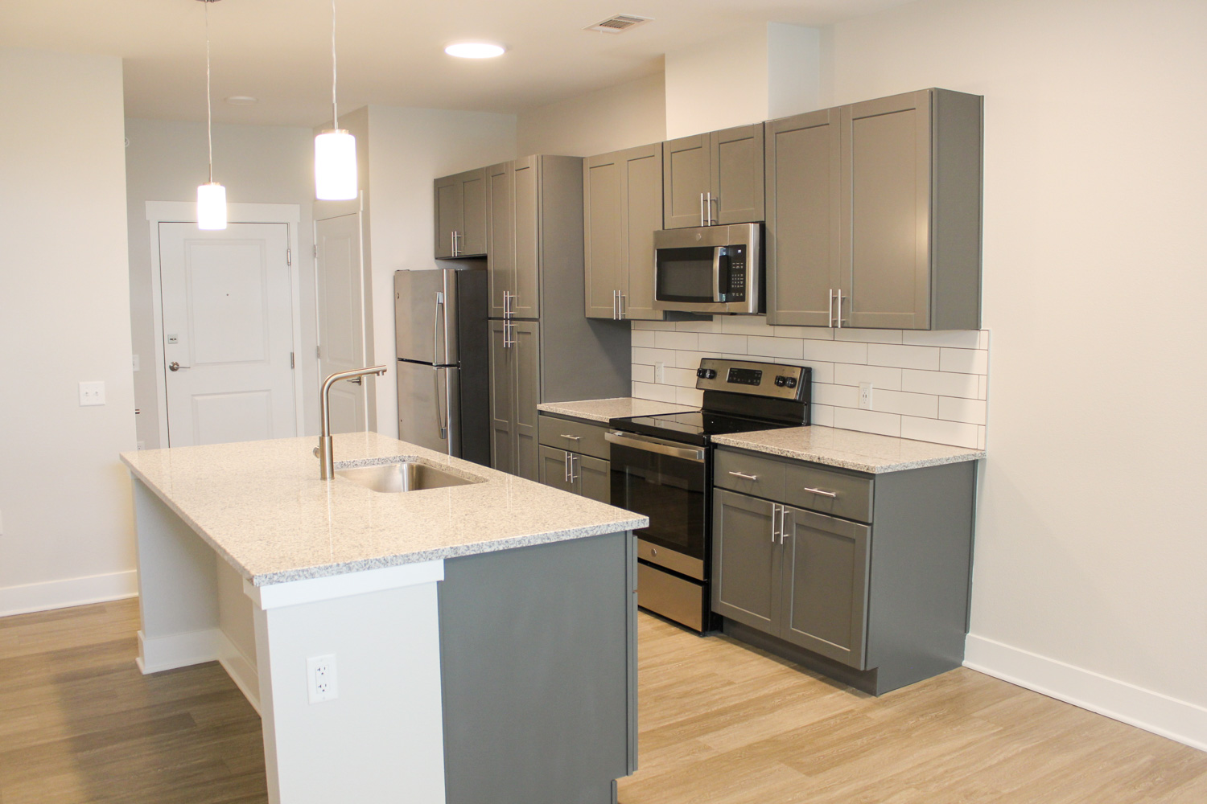
OCCUPIED
VACANT
Kitchen

Slide 31
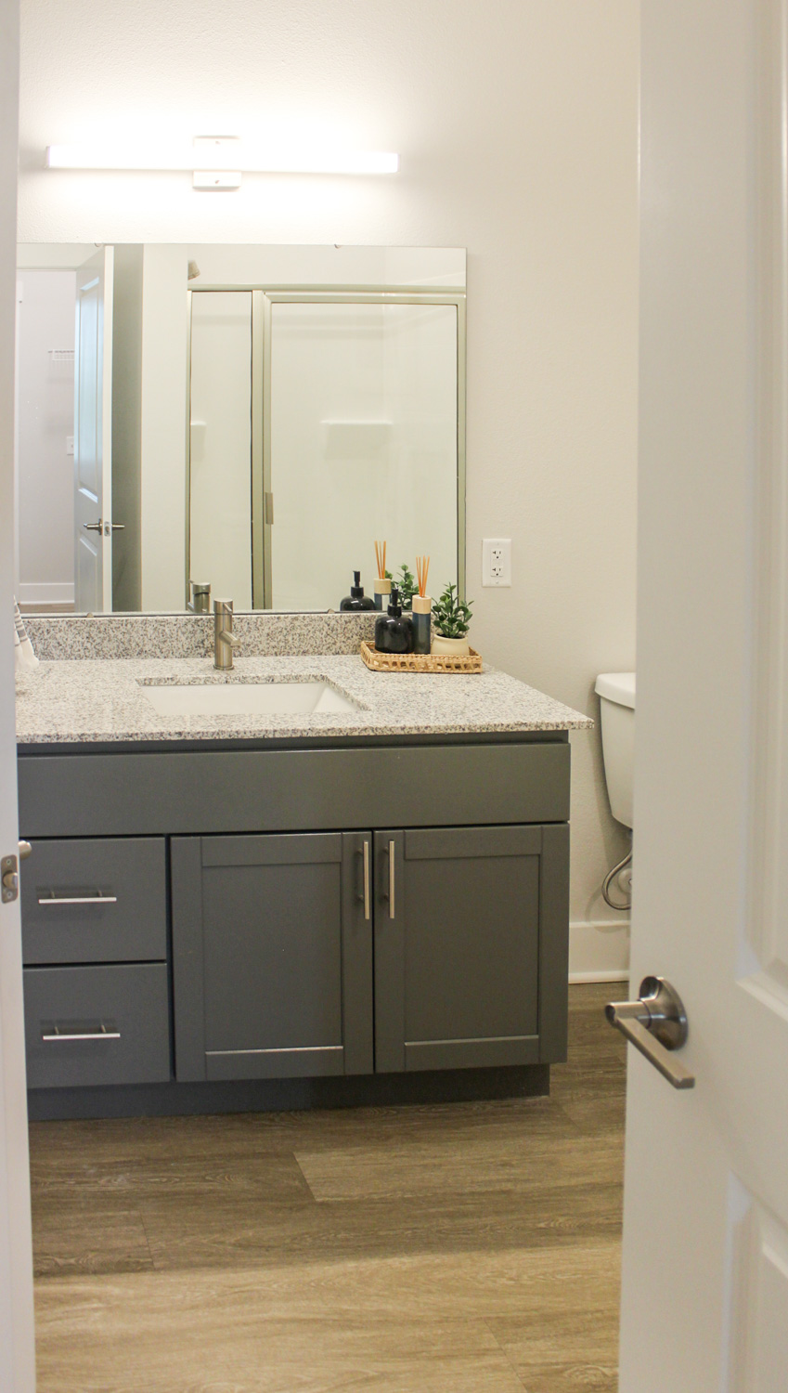
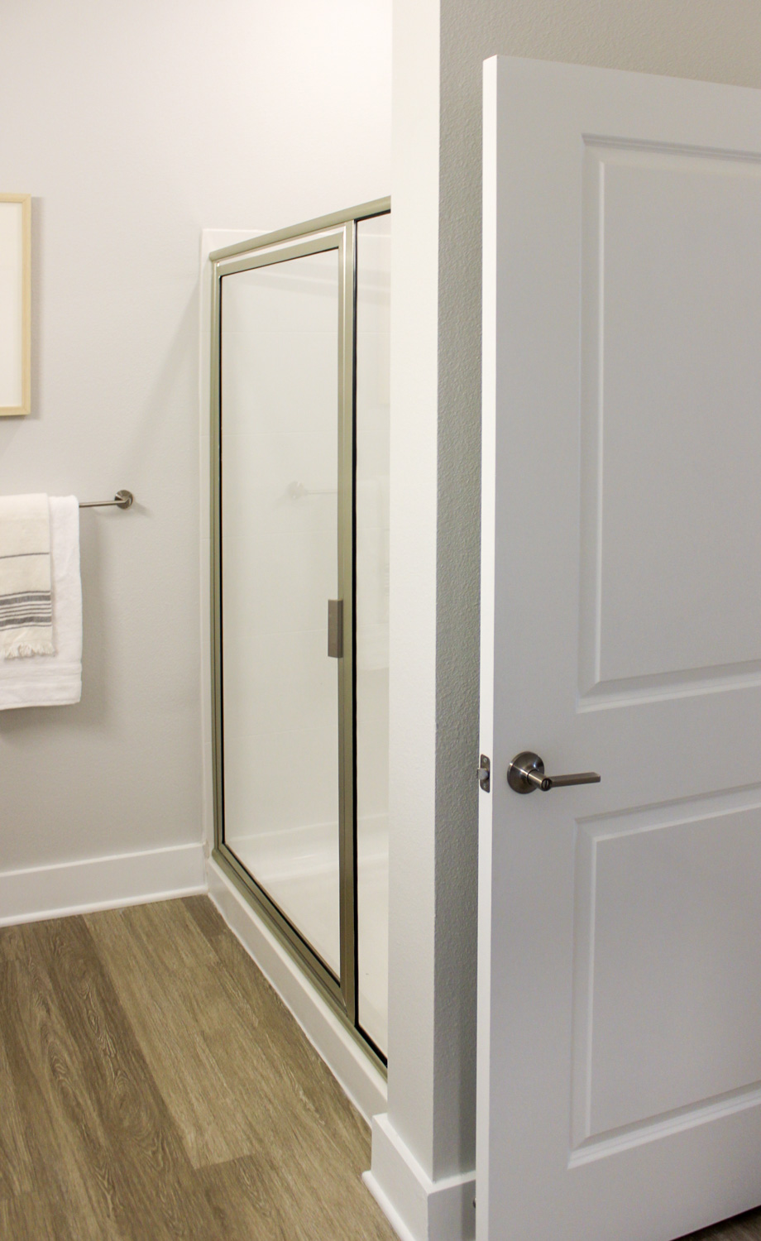
OCCUPIED
Bathroom

Slide 32
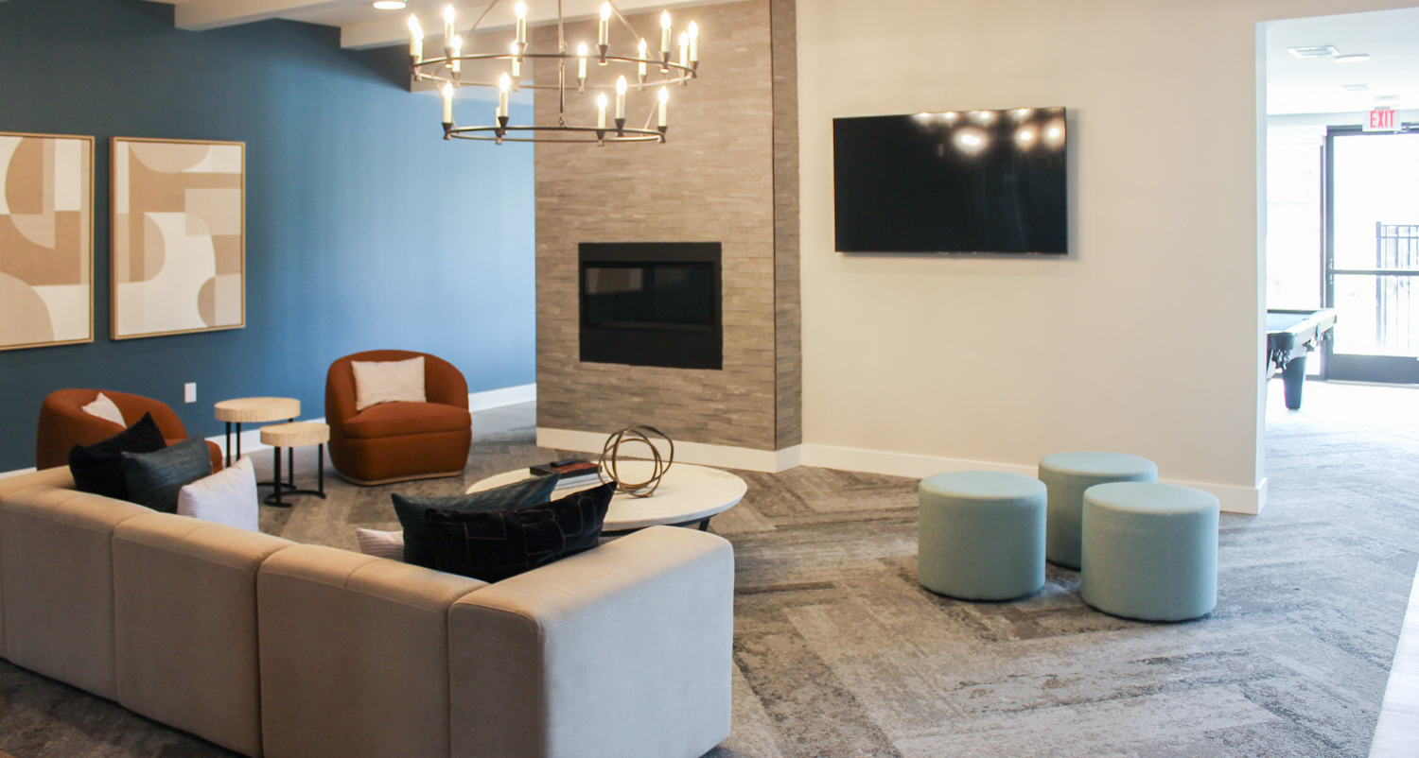
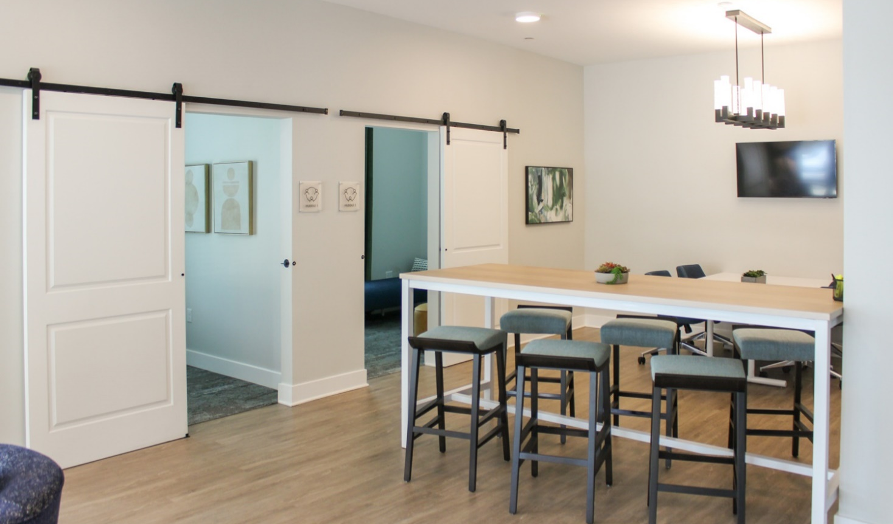
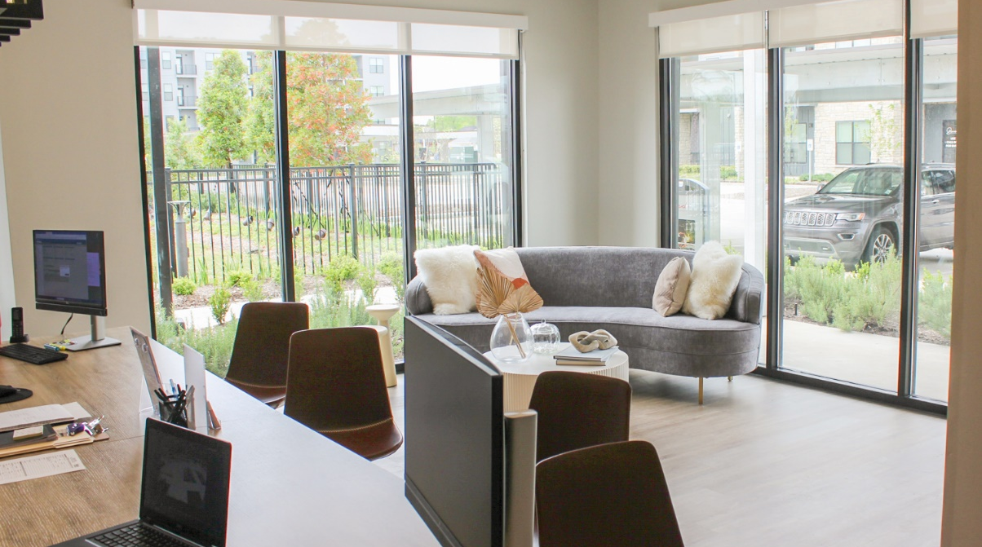

Slide 33
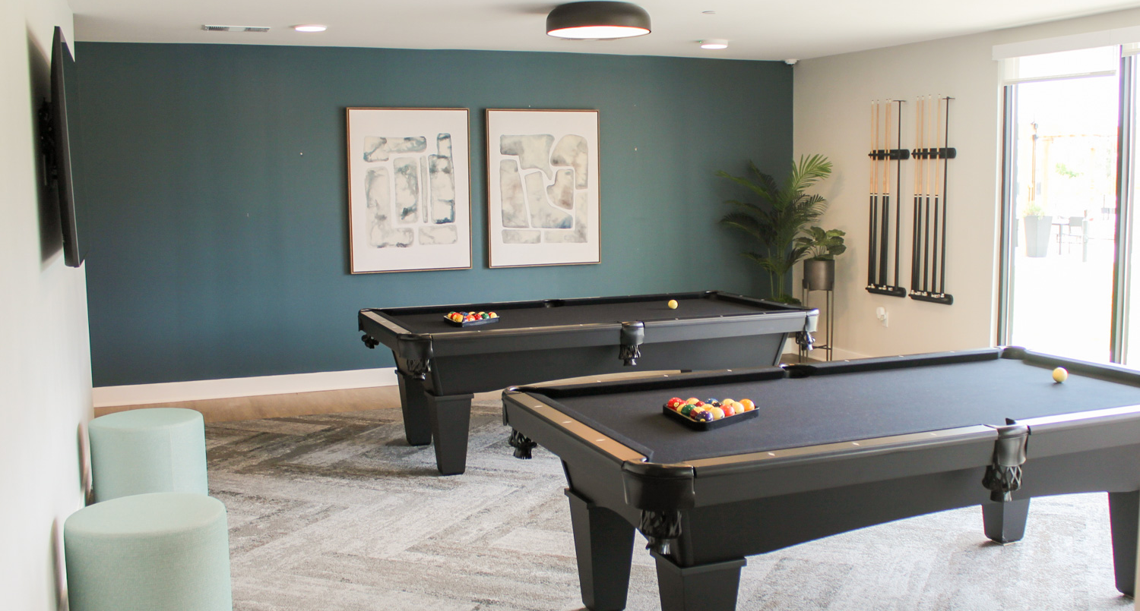
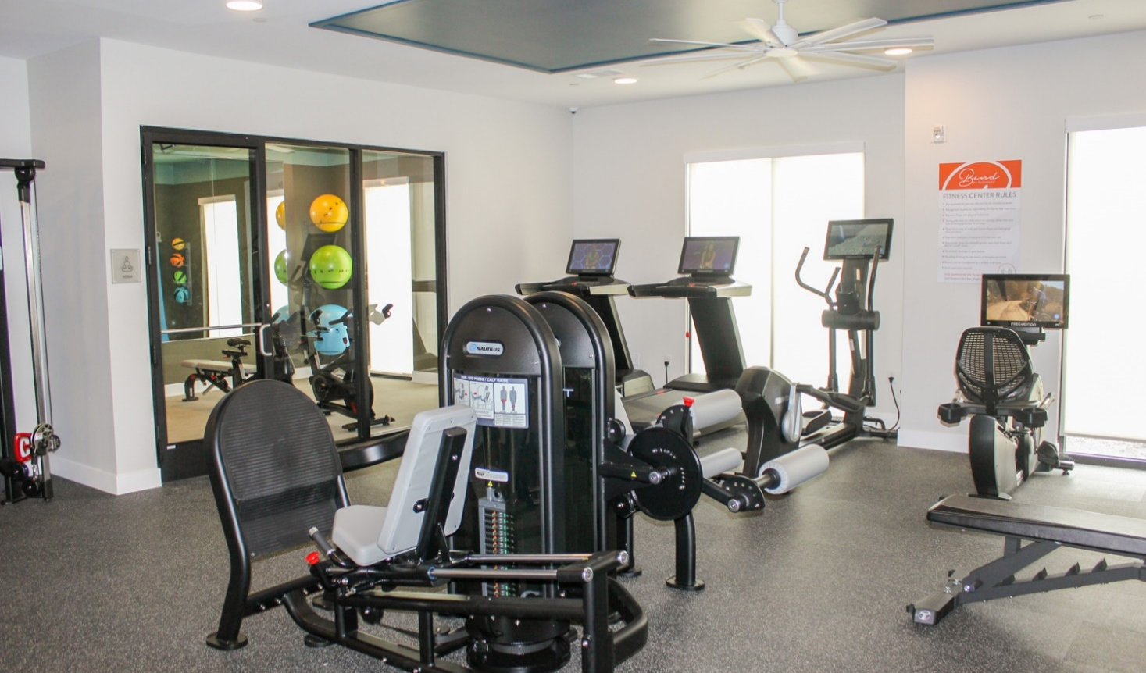
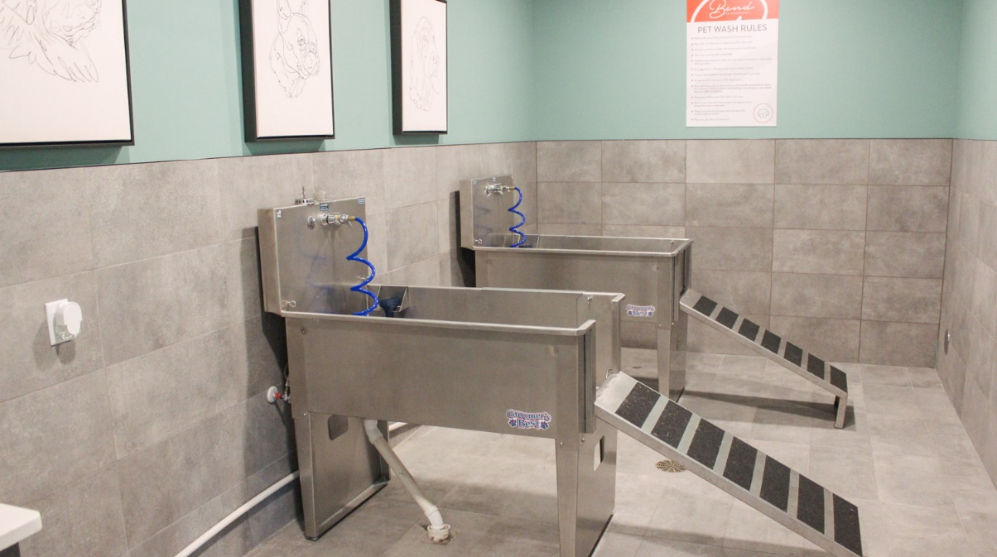

Slide 34
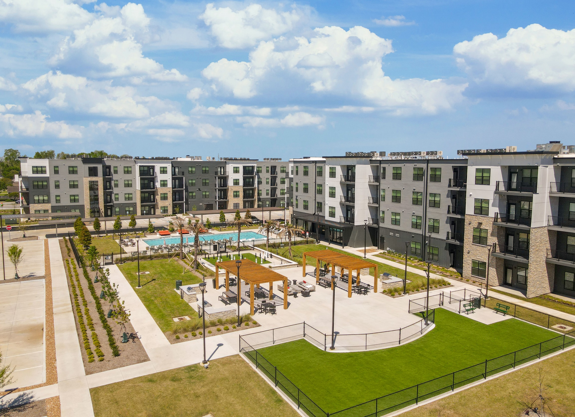
The Bend on Bluebonnet
OCCUPIED
VACANT

Slide 35
AFFORDABLE COMPLEXES – COMPLETED IN 2023
Name | Address | # of Units
Drakes Landing | 800 North Ardenwood Blvd | 216
Lotus Village Seniors | 715 North 16th Street | 116
The Capstone at Scotlandville | 8770 Elm Grove Garden Drive | 84
Hollywood Heights | 4065 Hollywood Street | 45
Hollywood Acres | 3901 Hollywood Street | 45
Motor City | 2040 Gayosa Street | 110
Completed
2019 352 Units
2020 0 Units
2021 42 Units
2022 473 Units
2023 616 Units

Slide 36
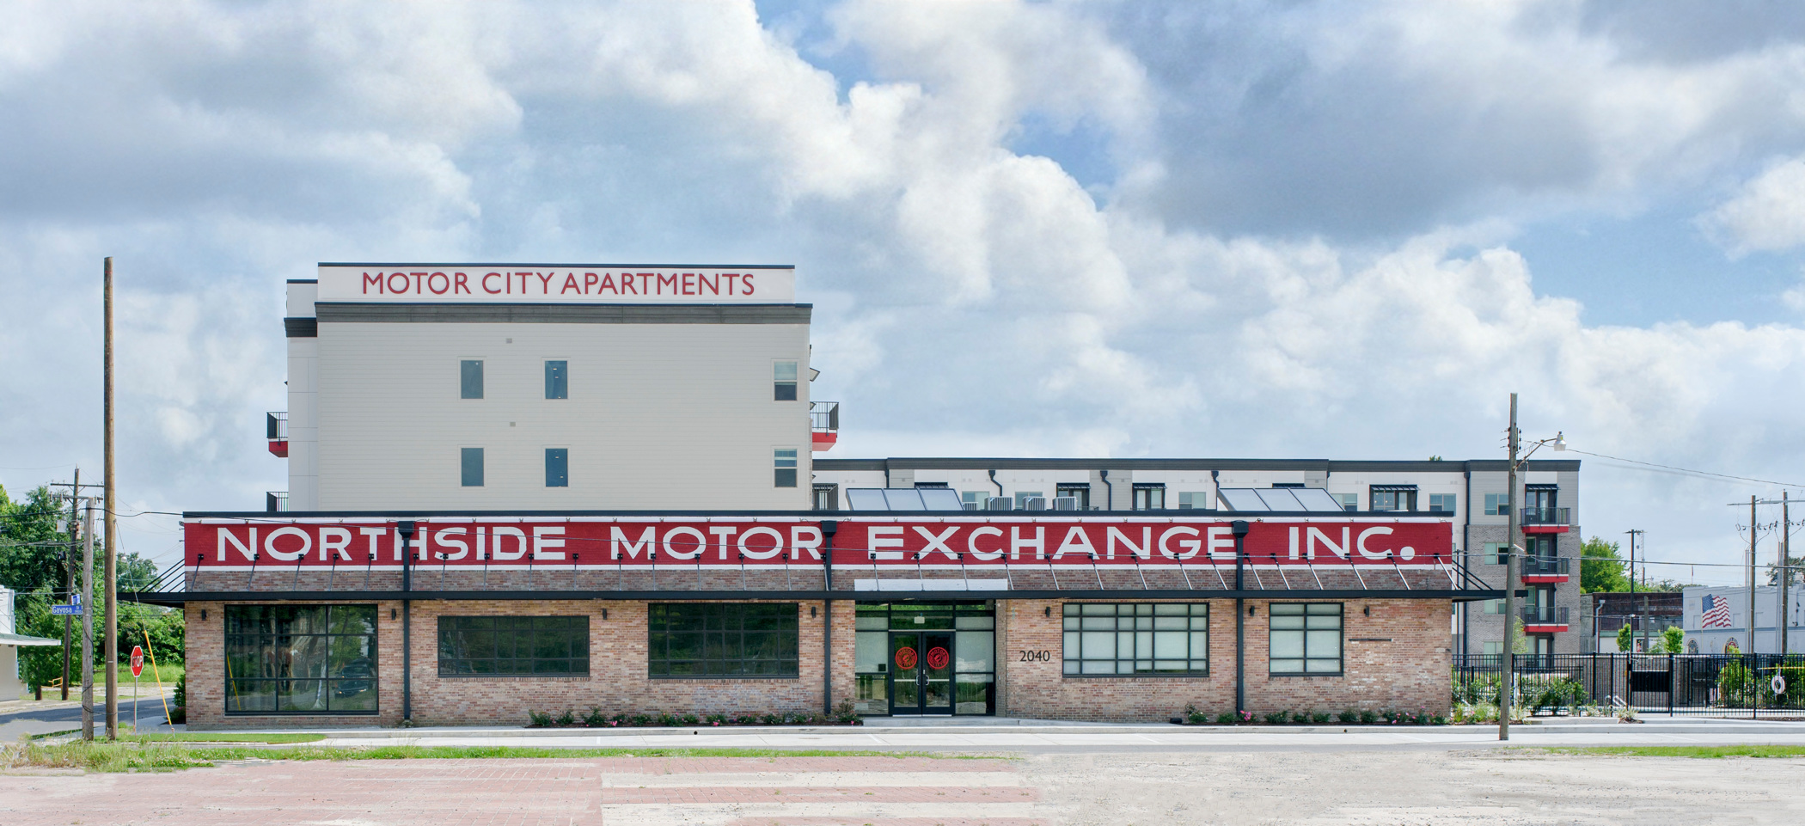

MOTOR
CITY
APARTMENTS

Slide 37
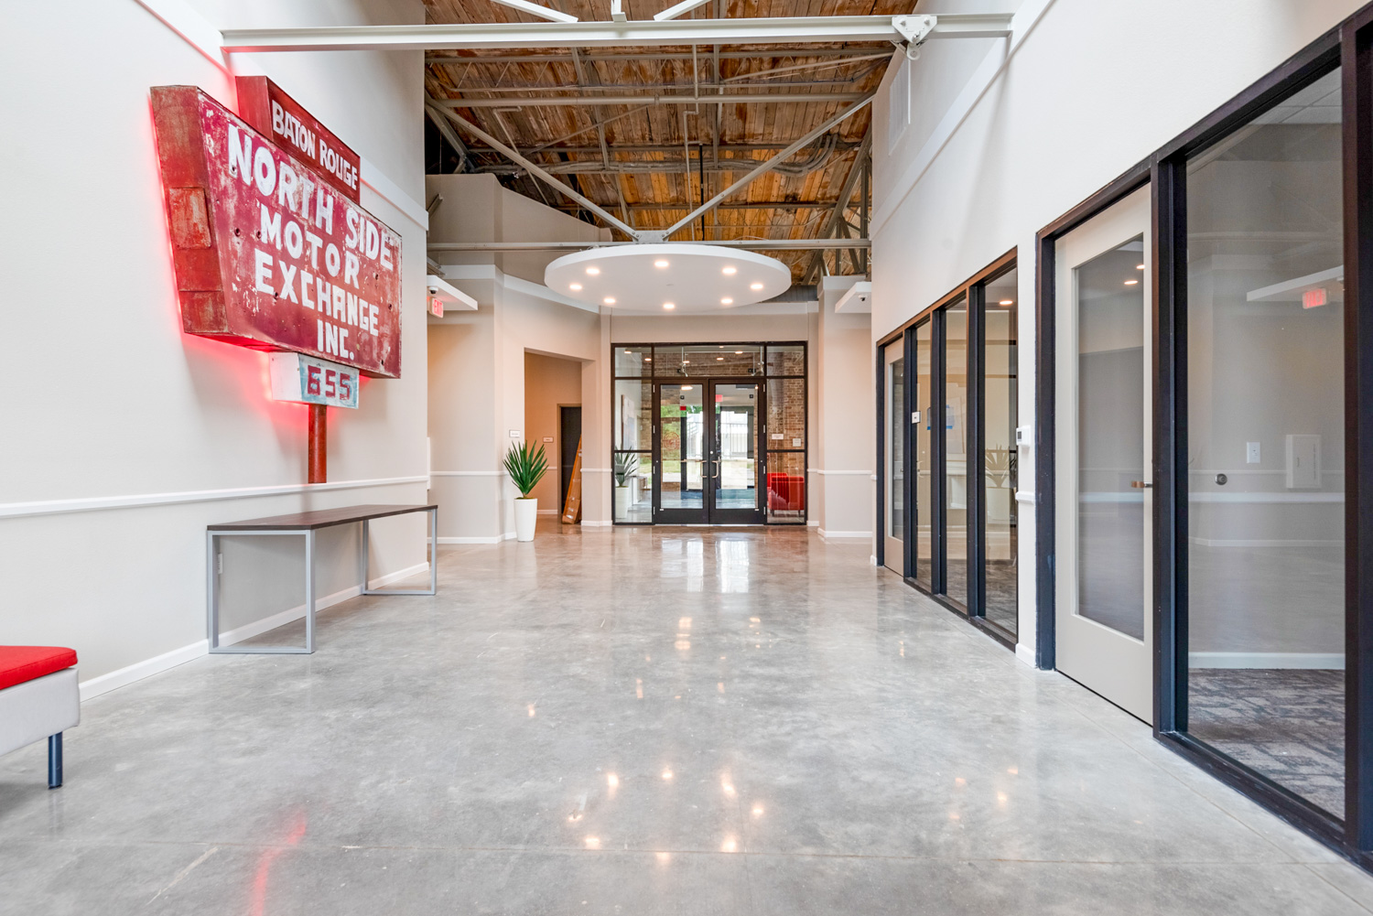
MOTOR CITY
APARTMENTS
BATON ROUGE

Slide 38
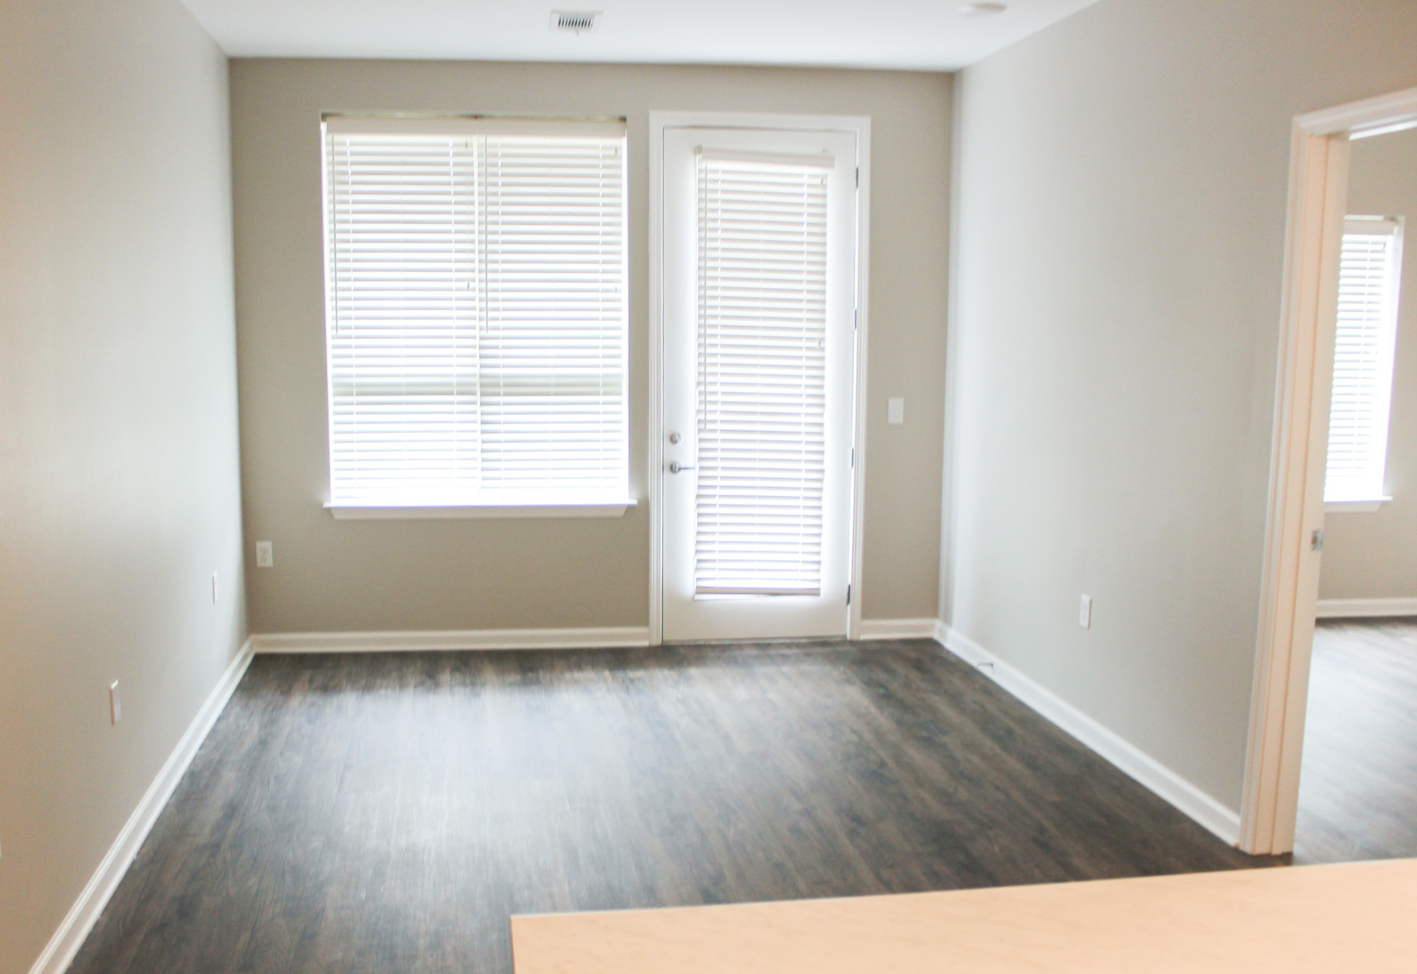
LIVING
ROOM

Slide 39
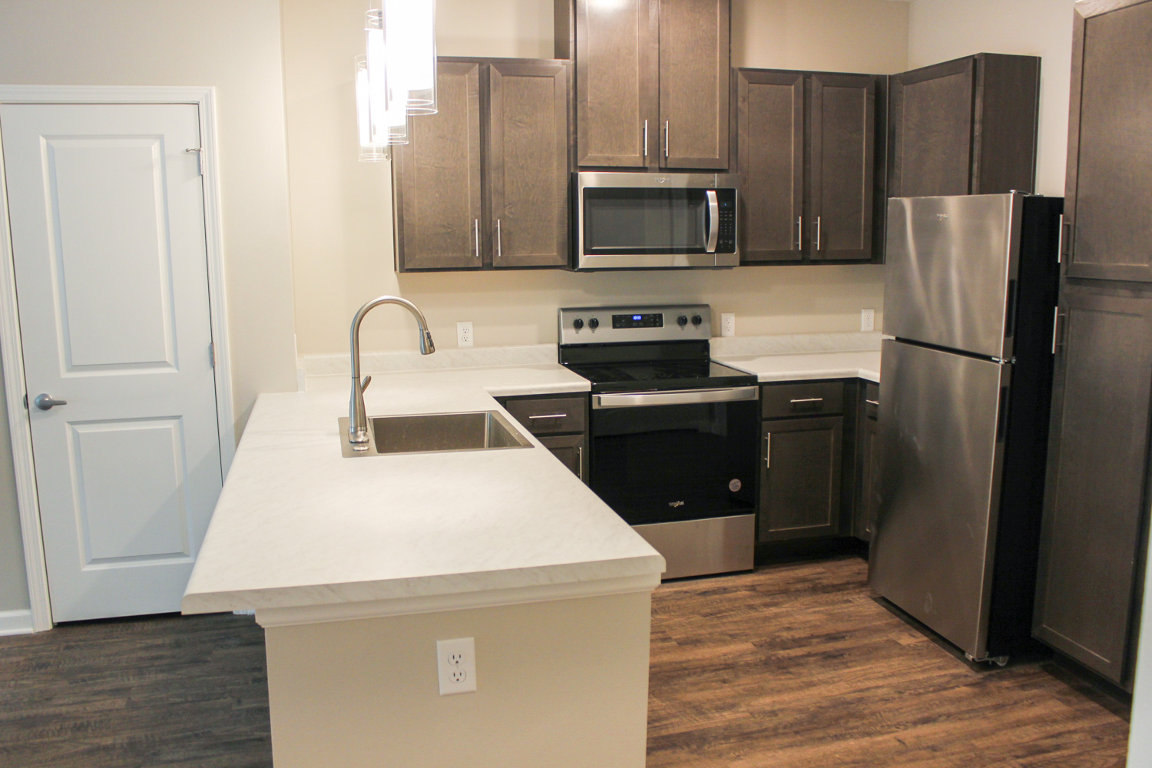
KITCHEN

Slide 40
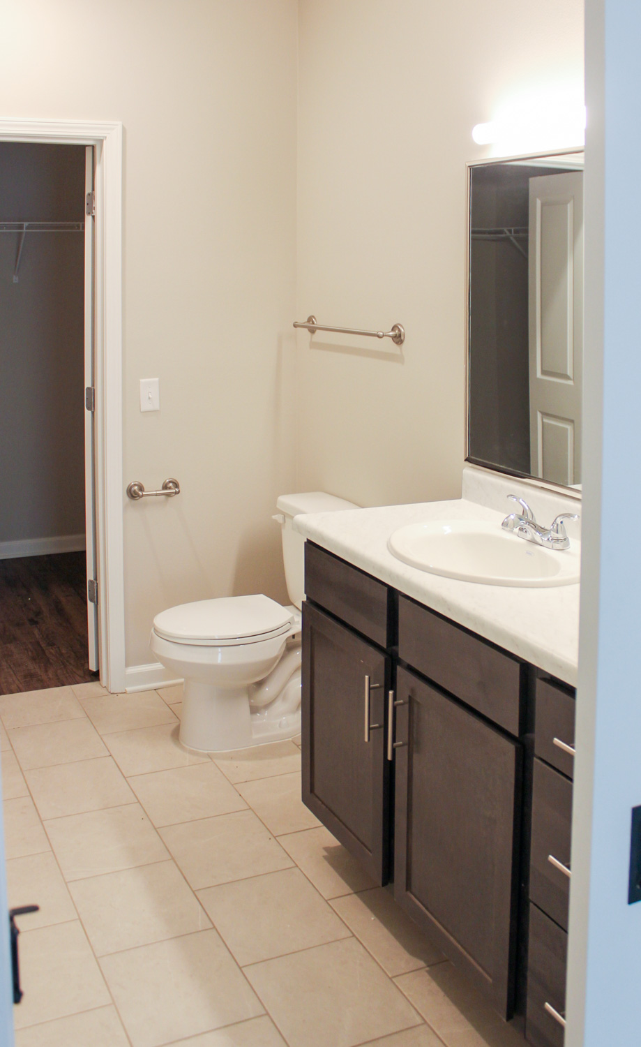
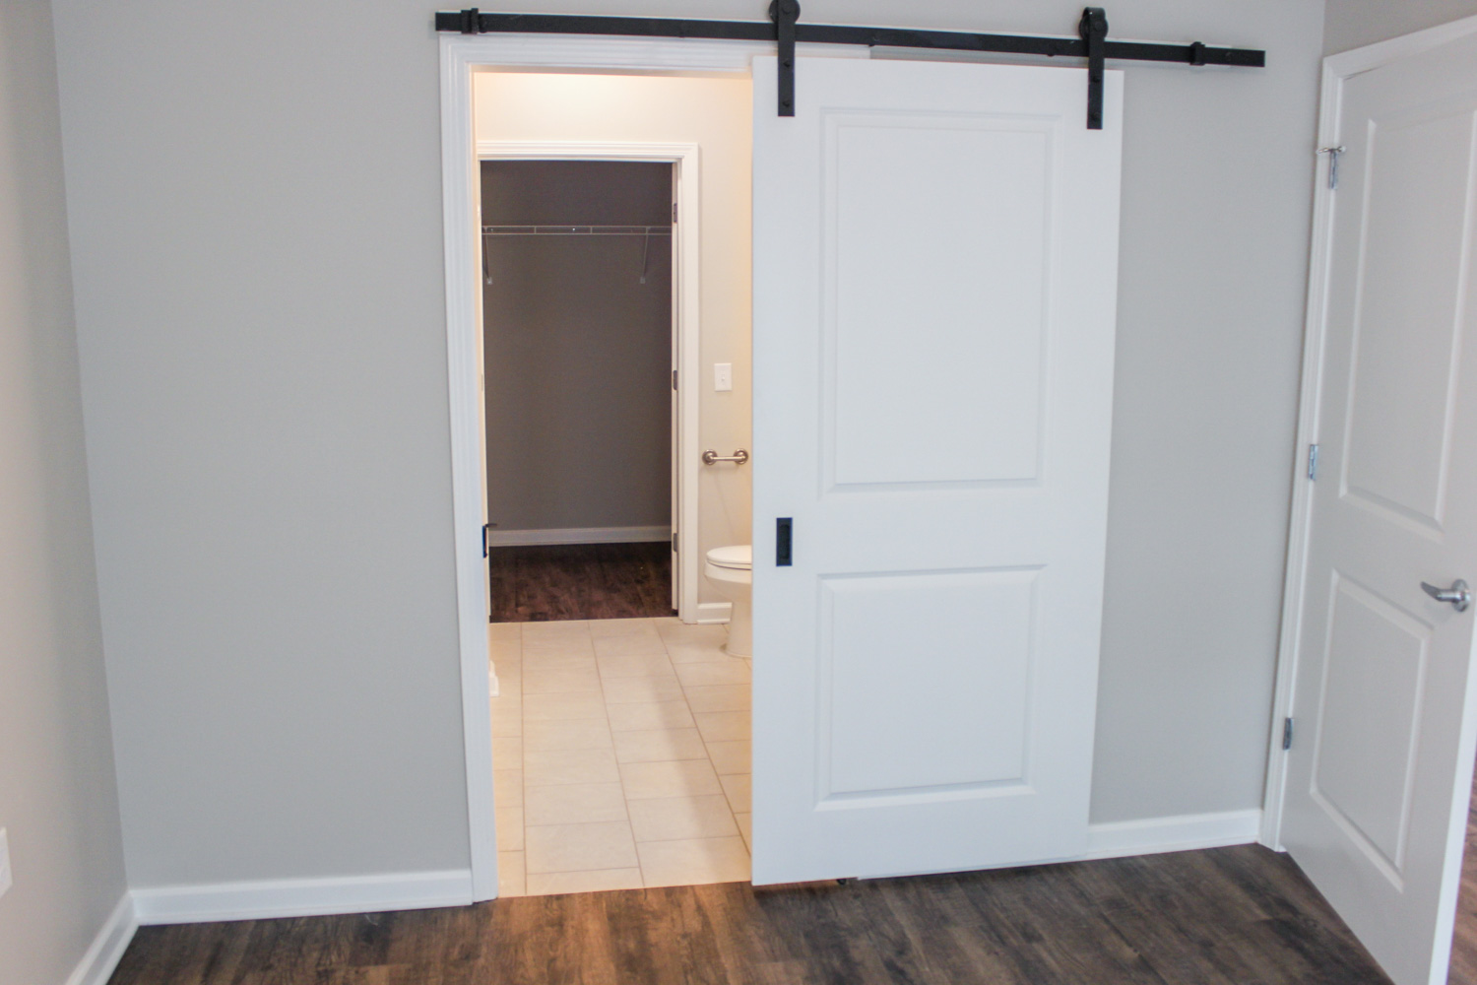
Bathroom

Slide 41
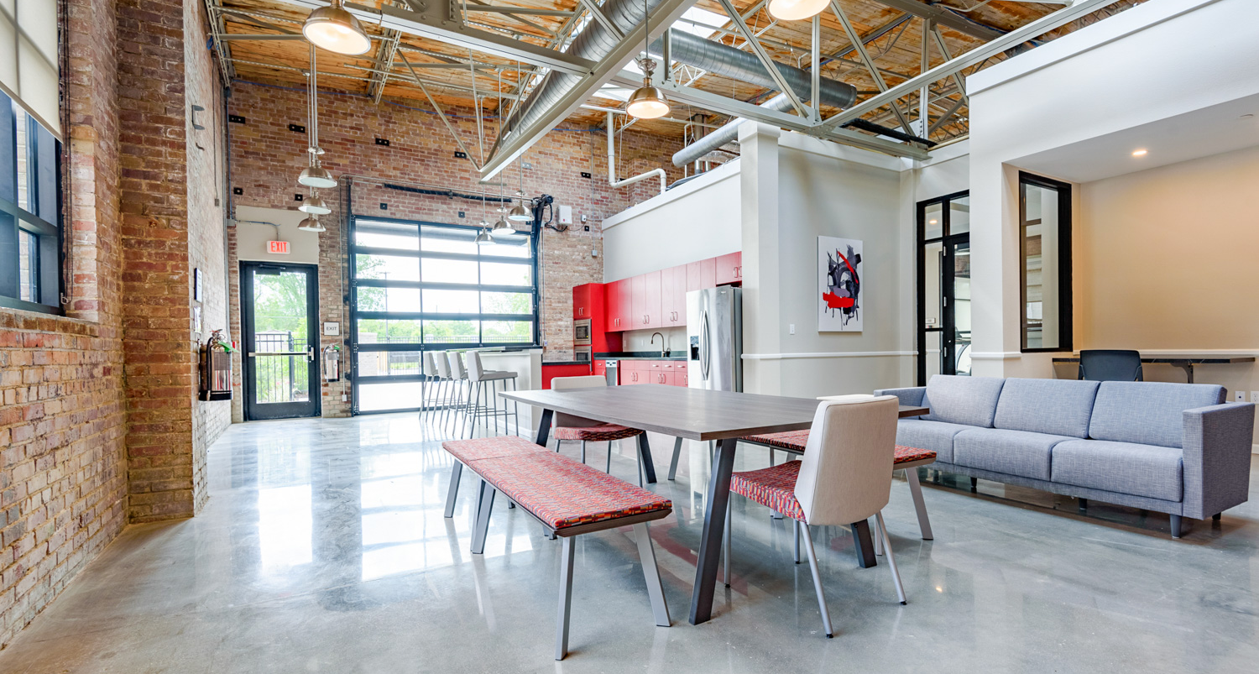
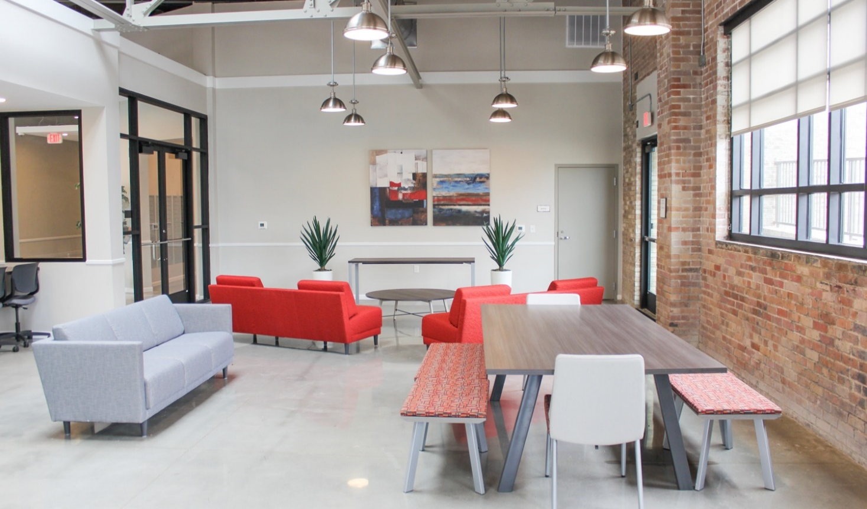
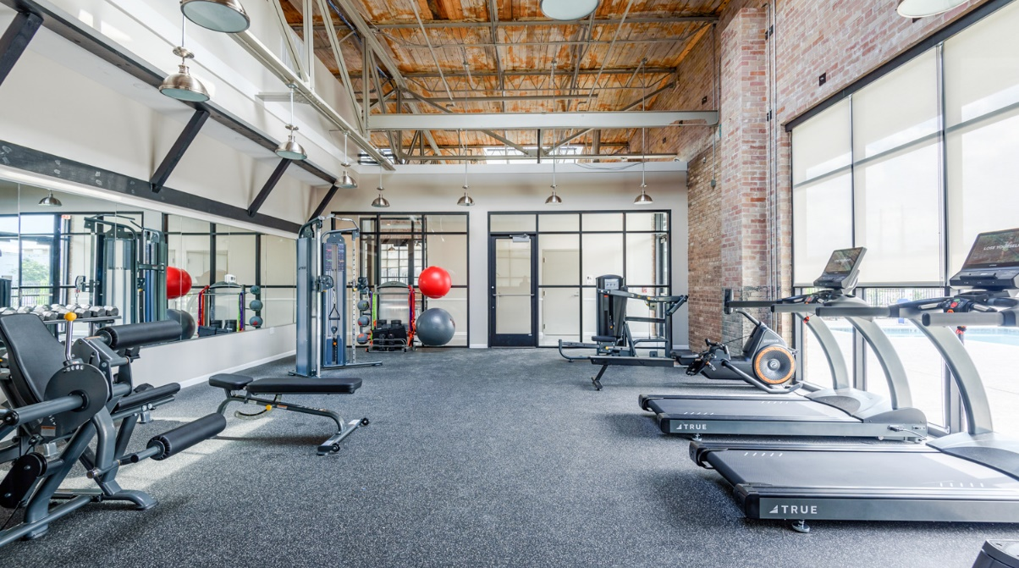

Slide 42
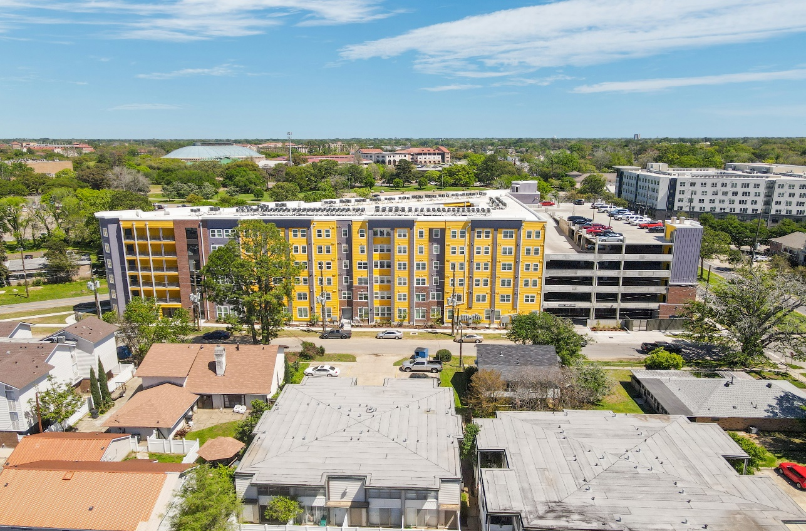
STUDENT COMPLEXES – COMPLETED IN 2023
First Student Complex Completed Since 2018
Completed in 2018 – 805 Units
Completed in 2019 – 0 Units
Completed in 2020 – 0 Units
Completed in 2021 – 0 Units
Completed in 2022 – 0 Units
Completed in 2023 – 132 Units
Flatiron of Baton Rouge
(132 Units – 294 Beds)
300 West Parker Blvd

Slide 43
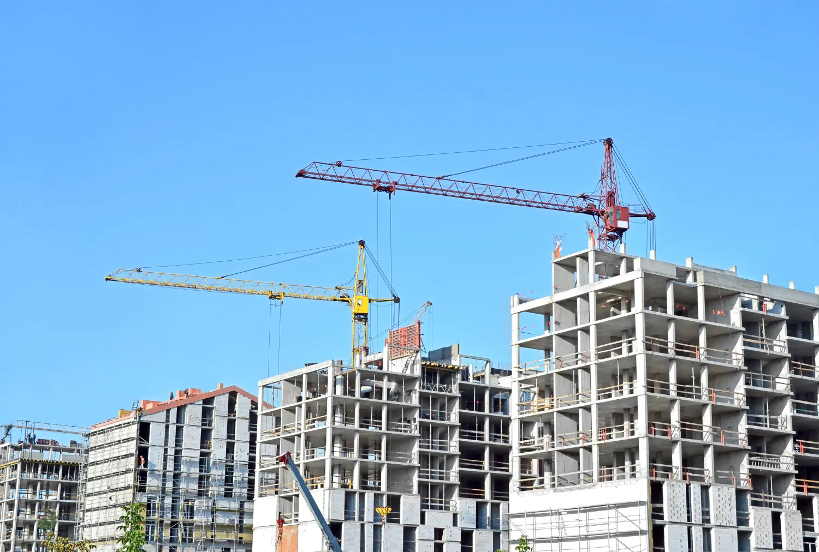
APARTMENTS UNDER CONSTRUCTION 2023-2024

Slide 44
0
COMPLEXES UNDER CONSTRUCTION
Student
2024 - 2025
OCCUPIED
VACANT

Slide 45
Name | Address | # of Units
Waters at Millerville | 13633 Millerville Greens Blvd | 295
Cedar Grove Townhomes | 14810 Old Jefferson Hwy | 148
The Everly at Rouzan | 4850 Rouzan Square Ave | 277
Waters at Bluebonnet | 3445 Bluebonnet Blvd | 324
Heights at Picardy | Picardy Avenue | 232
Mid City Point Apts | 350 South Foster Drive | 100
Waters at Heritage | LA Hwy @ LA Hwy 44 (Gonzales) | 299
Arabella at Dutchtown | 36450 Belle Savanne Ave (Geismar) | 48
Cypress Point SFR | Orice Roth Road (Gonzales) | 111
 | Total Conventional Units | 1,834
COMPLEXES UNDER CONSTRUCTION
Conventional
2024 - 2025
OCCUPIED
VACANT

Slide 46
Name | Address | # of Units
Reserve at Howell Place | 4201 Ford Street | 300
Government Corridor SS | 605 North 33rd Street | 34
Sherwood Oaks | 10950 West Darryl Drive | 280
Cypress River Lofts | Oklahoma Street | 19
Cypress at Ardendale I | North Ardenwood Blvd | 170
Denham Townhomes | LA Highway 16 (Denham) | 102
Reserve at Joor Place | 4663 Joor Road (Central) | 360
 | Total Affordable Units | 1,265
COMPLEXES UNDER CONSTRUCTION
Affordable
2024 - 2025
OCCUPIED
VACANT

Slide 47
AFFORDABLE UNIT CONSTRUCTION
2017 - 2025
OCCUPIED
VACANT
1,265
Affordable Units Under Construction
4,286
Affordable Units Surveyed in 38 Complexes
85%
Occupancy Down from 91% in Last Year’s Survey

Slide 48
NUMBER OF UNITS COMPLETED/PROPOSED 2012-2025
2015 – 2019
7,822 Units Constructed or 1,564 Units/Yr
2024 U.C.
1,265 Affordable
1,834 Market
Average Rent/SF

Slide 49


Baton Rouge and Overall Market
Other Trends in the Multifamily Market
CAP RATES & INTEREST RATES
Cap Rates have been increasing 50 to 75 basis points as Interest Rates increase
SINGLE FAMILY RESIDENTIAL RENTALS
Single-family houses for rent instead of for sale
Blackrock – Vanguard – Kairos Living
FORECLOSURES
Foreclosures are up and are likely to increase over the next year
INSURANCE COSTS ARE STILL HIGH
2023 ---
2024
Increased From $500 - $750/unit to $1,200 - $2,000/unit
Seeing Some Decreases with 2024 Renewals

Slide 50
SUMMARY AND CONCLUSIONS

Slide 51





Market Summary - 2023
RENTS
VACANCY
CONSTRUCTION
SALES
Up 2.5% to an
Average of $1.22/sf
Up 15% from
2021 to 2024
5.57% Matched Sample
Up Slightly from Last 2 Years
Affordable Properties
at 15%
Up from 9% last year
1,281 Units
Completed in 2023;
Most Since 2019
3,099 Units Under Construction
$188.6 Million in Sales in 2023
but
Only $32.6 Million in Non-Student Properties

Slide 52



Multifamily Projections Last Year
RENTS
VACANCY
CONSTRUCTION
SALES
Continue to INCREASE in 2023 - 2024
at Historical
1% to 3% Level
Remain at Current
Overall 5% to 7% Vacancy Levels
Watch Affordable Properties
With Interest Rates Increasing,
Construction of New
Units Will Likely Slow Down
Significant Slowdown of Sales Due to Increasing Interest Rates

Slide 53





Multifamily Projections 2024-2025
RENTS
VACANCY
CONSTRUCTION
SALES
Remain Flat to Increasing Slightly in 2024 - 2025
Remain at Current
5% to 7% Vacancy Levels
Except Affordable Properties
Increase in Construction Over Next 2 Years, but Announcements of New Properties Slowing Down
Increase in Sales from 2023, but Not to Levels Seen in 2021 – 2022
Should Pick Up in Q2-Q4 2024

Slide 54
MULTIFAMILY COMMITTEE MEMBERS
D. Wesley Moore, II, MAI, CCIM
Cook, Moore, Davenport & Associates
Abby McMasters
Cook, Moore, Davenport & Associates
Deane Bryson
Bearing Point Properties
Laura T. White, CPM
NAI Latter & Blum Property Management
Chris Gremillion, CCIM
Multifamily Division of NAI Latter & Blum
Chad Rigby
Stirling Investment Advisors

Slide 55

THANK YOU
Contact Info
Craig Davenport, MAI
Cook, Moore, Davenport & Associates
www.CookMoore. com
cdavenport@cookmoore.com
Contact Info
Mark Segalla
ELIFIN
www.elifinrealty. com
msegalla@elifinrealty.com

