Slide 1


BATON ROUGE
OFFICE MARKET
PRESENTED BY
Branon W. Pesnell, CCIM, SIOR
Marcus & Millichap

Slide 2


OFFICE COMMITTEE MEMBERS
Branon Pesnell, SIOR
Marcus & Millichap
Bill Sanders
Beau Box Commercial
Jonann Stutzman
NAI Latter & Blum
Gary Black
Wampold Companies
W. Foster Murphy
Stirling
Fabian Edwards, JD/DCL
Elifin Realty

Slide 3
EXECUTIVE OVERVIEW
TRENDS IN THE OFFICE SECTOR
National vacancy rate hit an all-time high of 19.7% in Q4 2023
    Prior to 2020 it was around 12%
Hybrid work environment remains strong
    77% of Fortune 100 employees work hybrid
Corporate demand for Return to Office
    Resume Builder revealed 95% of companies said employees will suffer consequences if they don’t return to the office.
Employee pushback
    FlexJobs poll found that 63% of professionals are willing to accept a pay cut for a remote opportunity
Abundance of low-quality office spaces nationwide
    16 percent of them having an occupancy rate of 70 percent or less

Slide 4

National Office Market
Q4 2023
The United States office market continued to soften through the fourth quarter of 2023
Since the beginning of 2020, U.S. net absorption has contracted by 188.6 million SF. By comparison, absorption losses associated with the Great Recession of 2008 totaled about 50 million SF. ¹
Negative net absorption was 71 million SF for 2023 ²
National vacancy rates increased 200 basis points to 19.7% in Q4 2023 ³
Average asking rents are $39.75 driven by higher rates in new construction ⁴
^{1,2} Source – Lee & Associates Office Market Report, Q4 2023
³ Source – Cushman & Wakefield Office Market Report, Q4 2023
⁴ Source – JLL U.S. Office Outlook, Q4 2023

Slide 5
Hybrid Work Model Remains Strong
Renewed focus on efficient use of space
12.7% of full-time employees work from home
28.2% of full-time employees work a hybrid model
59.1% of full-time employees work in-office
By 2025 it is estimated that 32.6 million Americans will work remote
Source: Forbes

Slide 6
Return to Work / Employee Push Back
75% percent of businesses surveyed plan to reduce their office square footage in 2024, nearly 30% more than in 2022, according to a 2023 office space report from workspace platform provider Robin. ¹
However, 88% of the companies surveyed said they are mandating that employees work a certain number of days onsite — up nearly 20% since 2022 — the firm stated. ²
82% percent of the companies surveyed expressed concern about their ability to retain their current office space due to recession or space underutilization, the report said. ³
64% of CEOs believe hybrid schedules will transition back to pre-pandemic levels by 2026 according to a CEO Outlook Study from KPMG ⁴
^{1,2,3} Source – Facilities Dive – 2024 Robin Study
⁴ Source – KPMG Office Market Report, Q4 2023

Slide 7
UTILIZATION
Commercial Office Space
40% of companies nationally are currently utilizing half of their available space or less, with only 28% of businesses using 100% of their offices. ¹
Average weekly attendance requirement for Fortune 100 employees in January 2024 was 2.96 days ²
Average national office utilization rates are less than 50% of pre Covid levels according to Kastle ³
Baton Rouge office space utilization hovers around 60%
¹ Source – Facilities Dive – 2024 Robin Study
²Source – Fortune, Q4 2023
³Source - Kastle

Slide 8
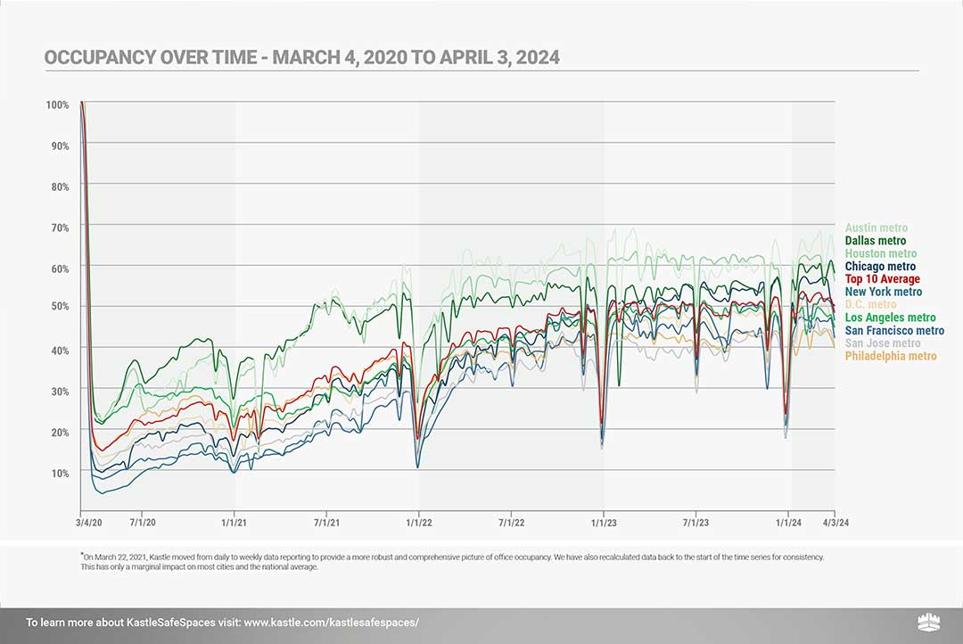
UTILIZATION
Kastle Back to Work Barometer

Slide 9
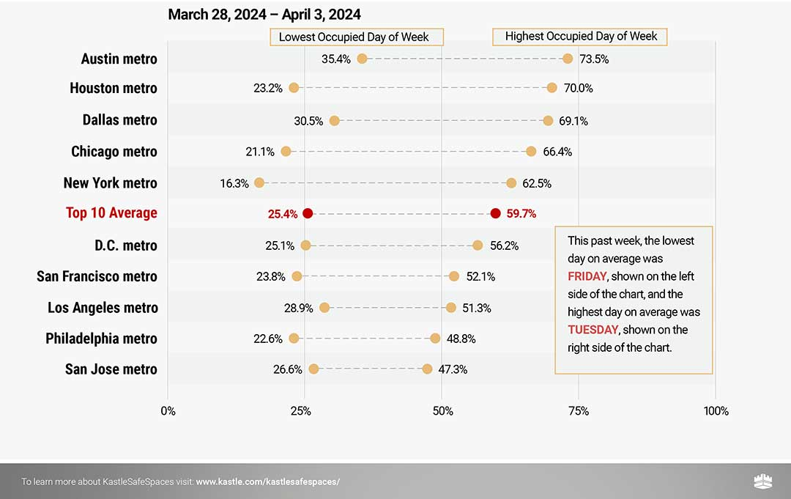
UTILIZATION
Kastle Back to Work Barometer

Slide 10
Office Debt Crisis
Per capita the US Office Market is the most oversupplied office market in the world. ¹
$2.2 Trillion in office building debt is maturing before 2028 ²
Estimated $540 Billion in Commercial Real Estate Debt will come due this year ³
This Trend has already impacted several office buildings in Louisiana
Negative perception of office combined with low space utilization have softened lenders appetite for office product
¹ Source – Brookfield Asset Management
^{2,3} Source – Trepp Office Market Report

Slide 11
The Aging Exodus
Commercial Office Space
Older buildings devoid of significant capital improvements have seen a rise in vacancy since 2020
Buildings constructed after 2015 have seen occupancy gain, while older buildings are seeing occupancy loss
13.1% of leasing volume in 2023 took place in newer buildings
Vacancy rates in newer buildings are more than 5% lower than the rest of the market
Baton Rouge has a high number of aged Class B/C buildings that are becoming difficult to lease
Tenants are seeking “ready to lease” spaces and rejecting dated suites
Suburban garden offices in well-located areas are generating healthy leasing activity and maintain above 95% occupancy

Slide 13
Pulse of the Office Market
What Brokers Reported in 2023 & 2024
Deals are still taking longer to transact
Companies are averaging a 10% - 15% reduction in space when they renew
Tenants are requesting shorter, more flexible lease terms
Garden Office Condo market remained strong
Overall leasing activity remains slow

Slide 14
BATON ROUGE MSA
OFFICE MARKET 2024
3.71 MILLION
SQUARE FEET CLASS A
1.63 MILLION
SQUARE FT. CLASS B/C
Class B/C
OCCUPIED
VACANT
Class A
Condo A/B
1.71 MILLION
SQUARE FT. CONDO

Slide 15
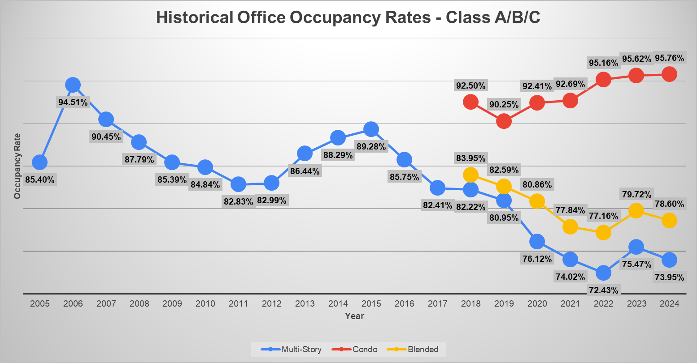

Slide 16
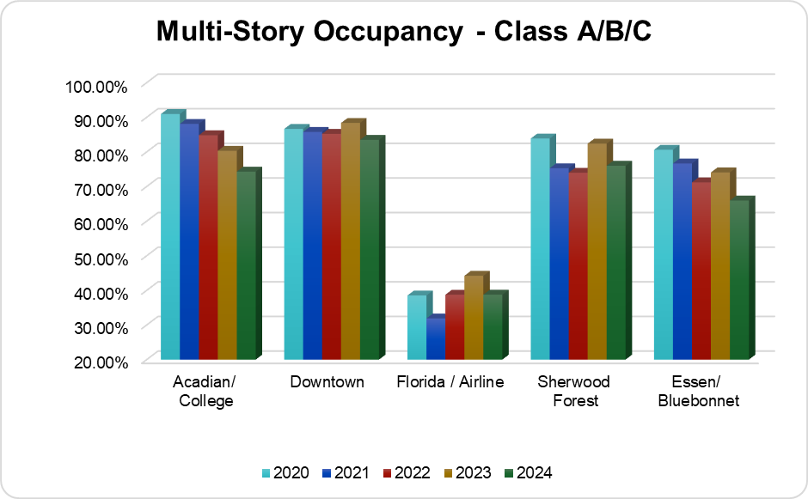
Overall Multi-Story Occupancy
69.12%
*73.95 % w/Original Data Set

Slide 17
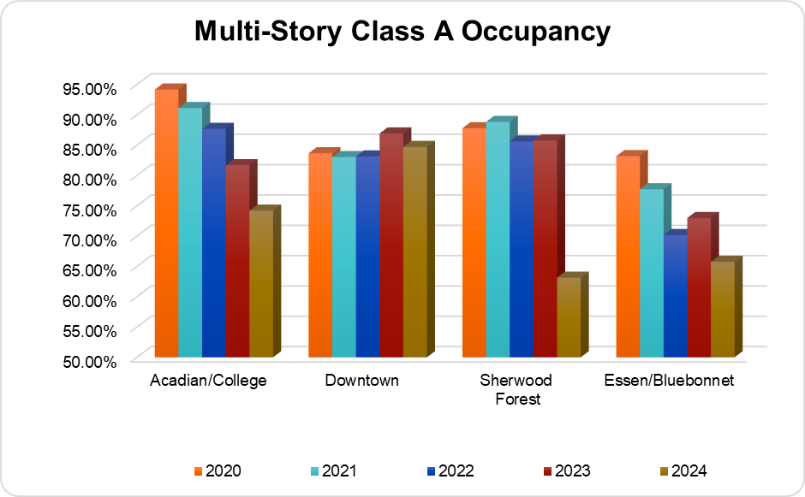
Average Class A Occupancy
73.84%

Slide 18
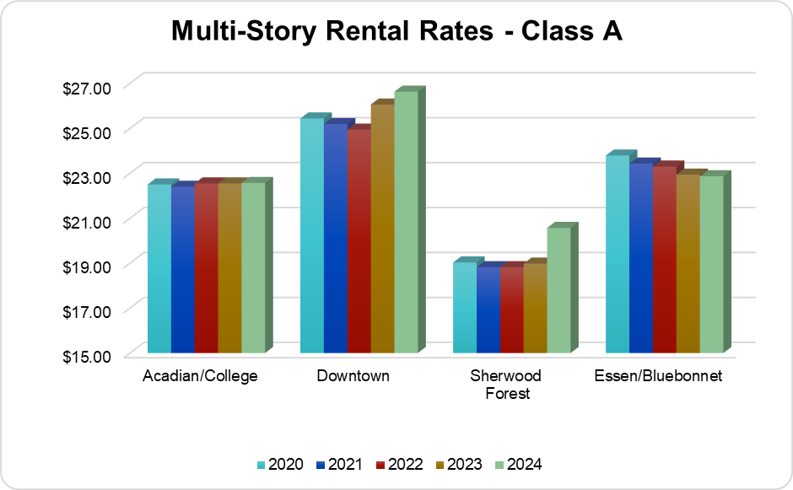
Average Class A Rental Rate
$23.16 PSF

Slide 19
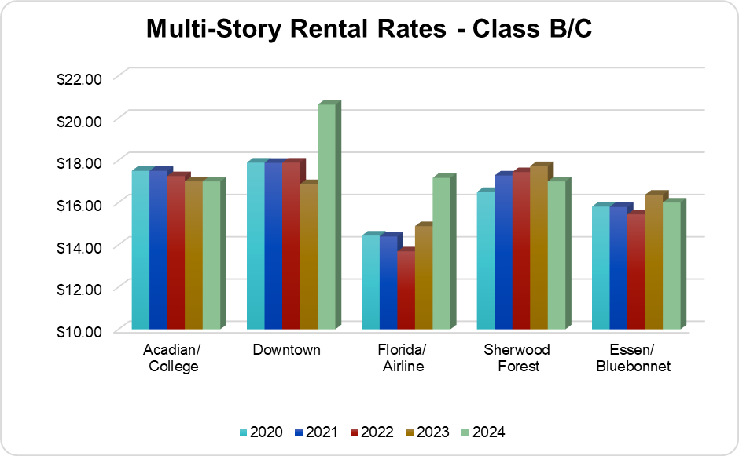
Average Class B/C Rental Rate
$17.56 PSF

Slide 20
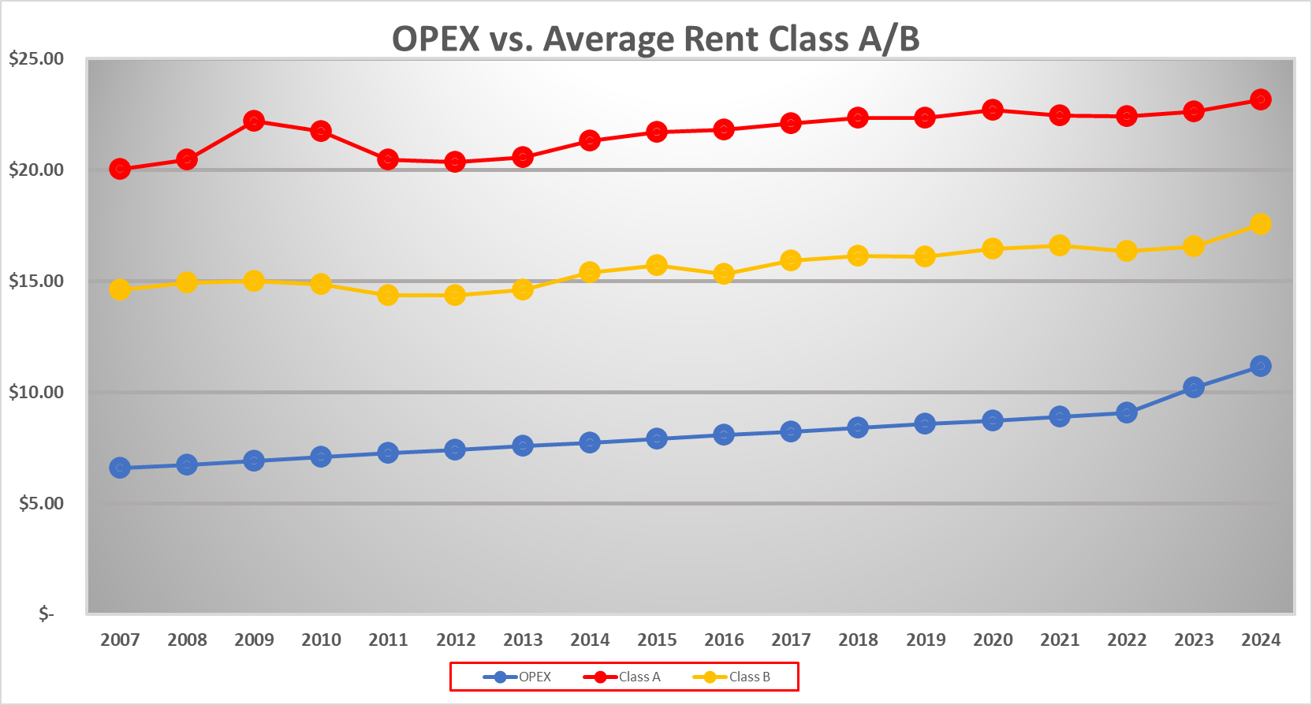

Slide 21
Office Market Forecast
So what does this all mean?
Rents are going to have to rise to counter rising OPEX and TI costs
Development activity will be slow to nonexistent due to high interest rates, slowing demand, and increased construction cost
Market will remain flat with little to no new tenant activity
Buildings with “ready to lease” spaces will see the most activity
Commercial Loans for speculative office will be difficult to obtain
The market will remain favorable for tenants in negotiations
Tenants will demand more flexible lease terms

Slide 22
Office Market Forecast
How Does Baton Rouge Compare
Positives
Office Space utilization is higher than the national average
Landlords are spending money to upgrade aging office product
State government and a strong petrochemical industry insulate the market
Negatives
A large amount of older aged buildings in the marketplace
Small number of new tenants entering the Baton Rouge market

Slide 23

THANK YOU

