Slide 2
A New Strategic Plan

Slide 3
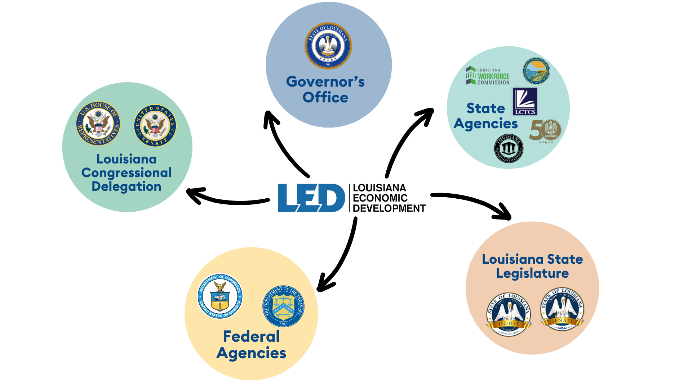
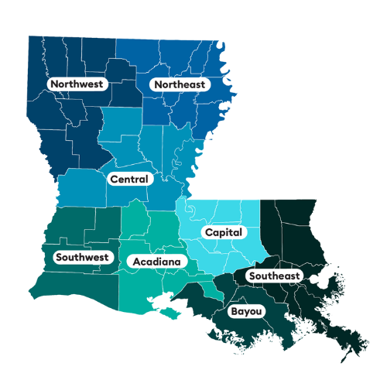
Accomplishing The Mission
All economic development starts locally.
A whole-of-government approach is necessary.

Slide 4
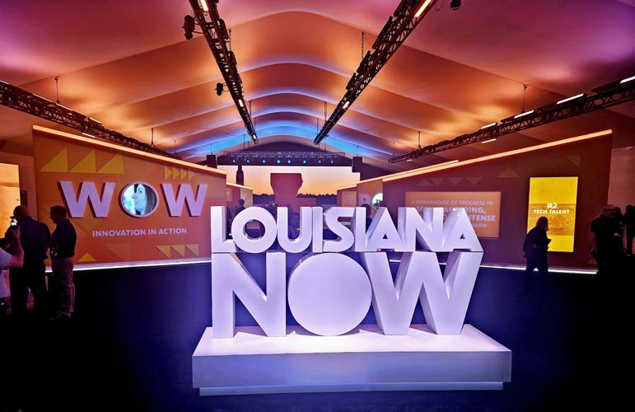
The Louisiana Opportunity
Louisiana Now Pavilion opens up in New Orleans amid Super Bowl week to encourage business in state
LED shared competitive advantages and assets with corporate executives, technology companies, energy leaders and more…
4,000+ Business Leaders
200+ Members of Media

Slide 5
The Louisiana Opportunity
Affordable Energy. Most recent average annual industrial energy rates (EIA) Electricity – 2nd lowest nationally; Natural Gas – 4th lowest nationally
Low Property Tax. Louisiana ranks 11th lowest in the country for property taxes (Tax Foundation)
Infrastructure. Louisiana boasts 6 deep water ports along the Mississippi River and Gulf Coast, as well as 6 Class 1 railroads and 6 interstate highway systems
Ports. 5 of the top 15 ports in the U.S. are in Louisiana
Pipelines. Louisiana has 50,000 miles of pipeline

Slide 6
Nationally Recognized Gains
50th
16th
In National Assessment of Education Progress testing, Louisiana 4th grade reading has improved into the top 20 nationally
2024
2019
LOUISIANA STUDENTS ACHIEVE THEIR HIGHEST NATIONAL RANKINGS ON THE NATION’S REPORT CARD (louisianabelieves.com)​
Notes:
Education. This past January, results from the Nation’s Report Card were released, Louisiana’s performance was highlighted by our 4th grade reading score 16th.

Slide 7
Tax Reform Overview
Key Features:
Reduced Personal Income Tax Rates from 4.25% to 3.0% flat rate
Lowered Corporate Income Tax Rate from 7.5% top rate to 5.5% flat rate
Eliminated Corporate Franchise Tax (formerly $2.75 foe each $1,000)
Allows Permanent Full Expensing for capital investments and R&D

Slide 8
Why this Matters
Nationally Attractive. Low, flat rates and simpler system that are competitive regionally, and nationally
Reduction of bottom-line costs. Repealing corporate franchise tax removes layer of cost for operating
Inducing Growth. Full expensing of capital expenditures allows companies to recoup investments sooner
Improved Perception. “Had all the reforms been in place at time of last index, the state’s overall rank would have improved to 26th, a significant improvement compared to current rank of 40th” (Tax Foundation)
Louisiana moved from #31 to #18 in Economic Competitiveness Index (ALEC)
Notes:
. According to the Tax Foundation, “had all the reforms been in place at the time of the last Index, the state’s overall rank would have improved to 26th, a significant improvement compared to the current rank of 40th… Moreover, the state would have ranked among the top 15 best in four of the five major categories of taxation.”
Source: https://taxfoundation.org/blog/louisiana-tax-reform-2024/

Slide 9
Business Impact of Tax Reform
“Of the 10 states that experienced the largest gains in income taxpayers, 8 of the top 10 states either forgo individual income taxes, have a flat tax, or are moving to a flat income tax.”
– Tax and Interstate Migration 2024 Update, Tax Foundation
No State Income Tax
Flat Income Tax
Graduated Income Tax

Slide 10
Restoration Tax Abatement Program
Provides up-to 10-year abatement of property taxes (ad valorem) on increased value of property from renovations and improvements
Eligibility: existing commercial structures, owner-occupied residences within economic development districts, historic districts, downtown development districts and OZs
Non-eligible: Acquisition cost of structure/land; movable and personal property
Subject to approval of local governing authority and Board of Commerce & Industry
Notes:
This program administered by LED may be of interest
The Restoration Tax Abatement Program provides up to a 10-year abatement of property taxes on renovations and improvements
The most common applicants are generally commercial developers who acquire properties with the goal of restoring them and then renting them out, either to businesses, or as homes.
Business owners applying directly for their own properties and private homeowners are somewhat less common, but definitely not unheard of.
The great majority of projects are located in urban parishes, especially Orleans and Ouachita, but there is nothing that should be stopping applicants in rural areas other than maybe lack of awareness of the program’s existence.
LED Contacts: Travis.Rosenberg@la.gov; joyce.Metoyer@la.gov
Process: $250 fee

Slide 11
LED Site Certification
LED certification is granted after an extensive application process and third-party review
Industrial Sites: 25+ contiguous acres (plant sites, manufacturing, distribution, port sites)
Business Sites: 10-24 acres (light industrial, office, warehouse, or mixed-use sites)
Review includes site inspections, Initial Site Evaluation, due diligence
Benefits include certification of site’s suitability and readiness

Slide 12
Development-Ready Sites Keep Louisiana Competitive
118
ACTIVE SHOVEL-READY CERTIFIED SITES
~25,000
CERTIFIED ACREAGE
Identifying a site early on is critical when a project has a very large land requirement, and heavy or unique infrastructure needs
Certified Sites have undergone due diligence (e.g. environmental, geotechnical protected species, archaeological/cultural)
Certified Sites are available in Louisiana, but are not all development-ready
Development-ready takes a site beyond certification designation, with site work and infrastructure improvements
Notes:
Louisiana Certified Sites - https://www.opportunitylouisiana.gov/why-louisiana/certified-sites

Slide 13
Recent Site Development Investments
“Project schedules are getting delayed or cancelled due to a lack of industrial sites.” – State of Site Selection, Site Selectors Guild

Slide 14
Site Investment and Improvement Fund
LED supported House Bill 433 creates a Site Investment and Infrastructure Improvement Fund
Provides the state with resources to further develop sites and take them from shovel-ready to development-ready.
As filed, initial funding will consist of $150M along with a recurring annual investment up to $50M.
Initial investment alone represents a 1,750% increase from prior state investment.

Slide 15
LED at Work
Since January 2024, LED has announced more than 40 projects spanning the state, accounting for the following:
Capital Expenditure: Nearly $45 Billion
New Jobs: Nearly 5,000
Retained Jobs: 4,400+
Site Selection’s 2024 Governor’s Cup Rankings – Louisiana ranked 10th nationally in projects per capita
Both New Orleans (2nd) and Baton Rouge (7th) ranked in the top ten tier two metros (200,000 -1,000,000) for number of projects.
Business Facilities 2024 Platinum Deal of the Year - Meta AI Datacenter announcement, Richland Parish

Slide 16
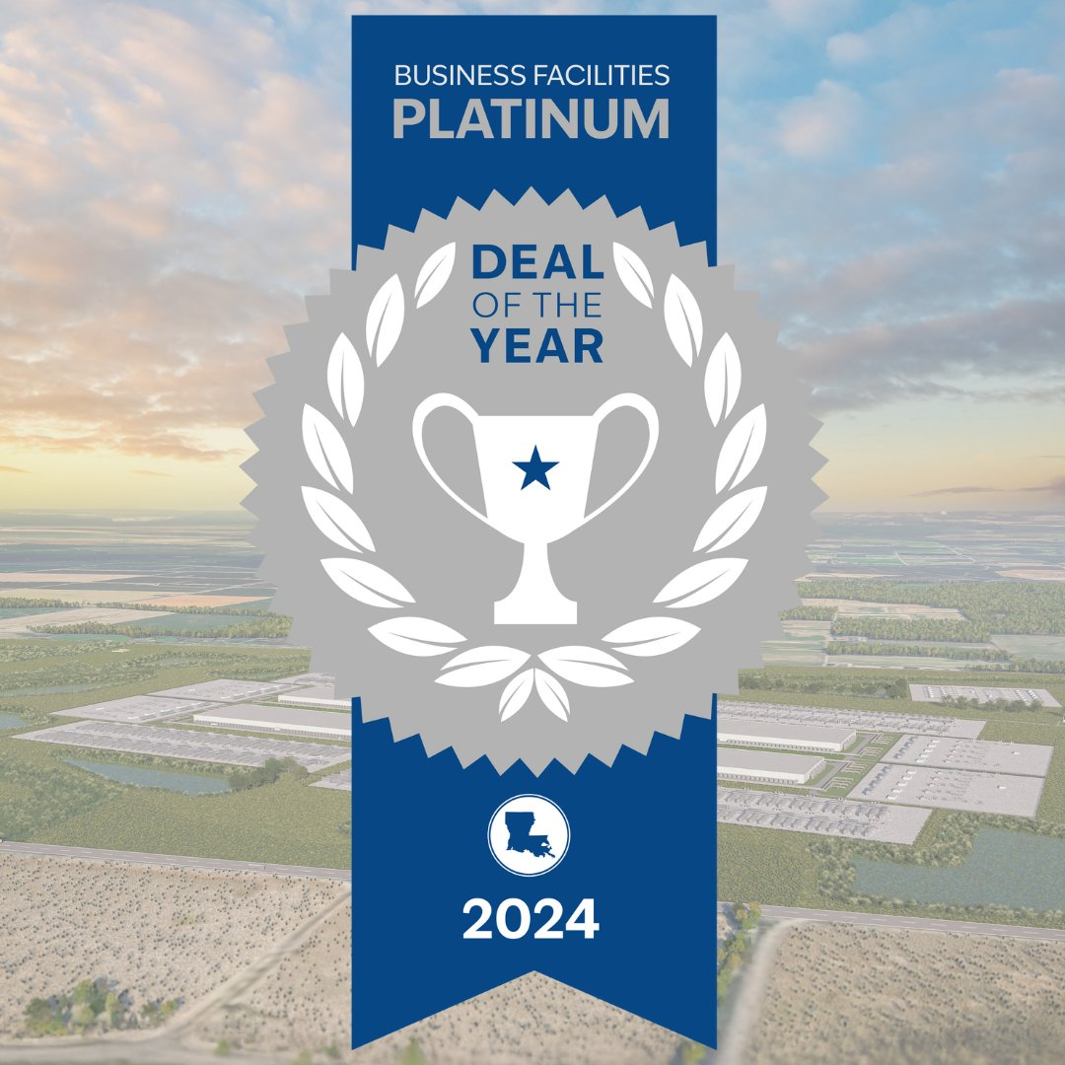
Project Spotlight - META
December 2024, Facebook and Instagram parent company Meta announced a $10 billion artificial intelligence data center in Richland Parish.
This AI data center will be the largest in Meta's global fleet
Will create 500+ direct jobs with an average salary greater than 150% of the parish average.
Community Win: Outside of job creation and investment, Meta is joining the Northeastern, LA community as an active member – committing $200M+ to infrastructure improvements and partnering with local education organizations to expand STEAM education and skills.
LED Involvement:
Located on a Louisiana-owned, certified site
Partnership with LCTCS for workforce upskilling

Slide 17
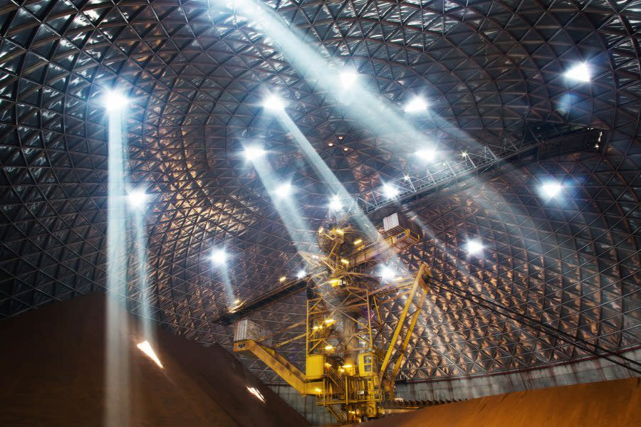
Project Spotlight – Hyundai
March 2025, Hyundai announces its inaugural North American steel facility, establishing its made-in-America supply chain in Donaldsonville, LA.
Will create 1,300+ direct jobs with an average salary of $95,000.
A portion of the RiverPlex MegaPark site was registered as a Louisiana Certified Site - infrastructure improvements will be made to remaining portions of the site, allowing for additional industry expansion.
Our premier workforce development program (LED FastStart) utilized its partnership with LCTCS to develop and implement a tailored curriculum
The Port of South Louisiana was instrumental, providing deep water dock access to Hyundai as well as future industry partners in the region.
Entergy has remained in contact to insure that energy generation and transmission infrastructure is in place and on-pace for continued statewide investment.

Slide 18
Paige Carter
Chief Business Development Officer
Louisiana Economic Development
Ileana Ledet
Chief Economic Competitiveness Officer
Louisiana Economic Development

Slide 19
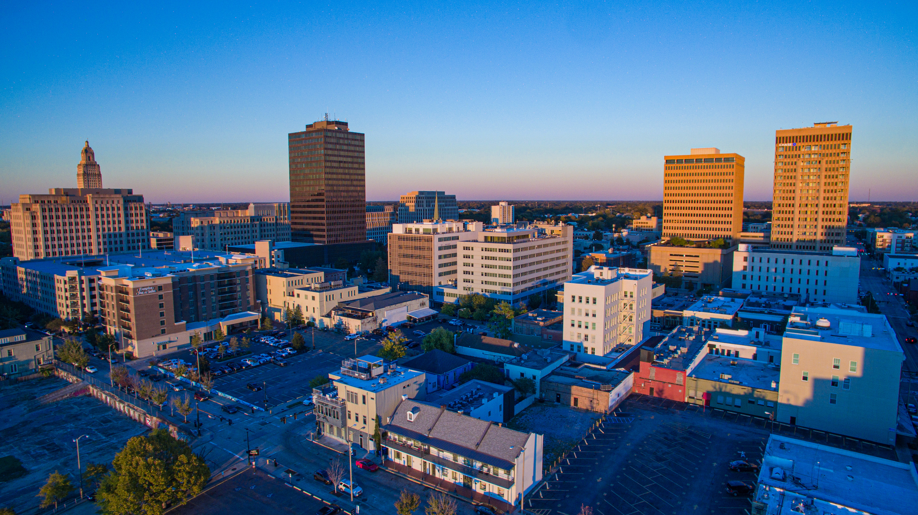
OPPORTUNITYLOUISIANA.COM

